Slide 1
COMBINE HANDWRITTEN AND AUTOMATION TO PRODUCE API DOCS FOR JAVA PROJECTS
Mohammed Nasiruddin

Slide 2
WHAT WE WANTED TO BUILD
We saw a lot of teams using Swagger.
A sample repository showing how to adopt Spring Rest Docs and how it compares to Swagger.
We hope this can serve as a starting point for engaging teams with the tool and advocating for its adaption where appropriate.

Slide 3

WHY? (OR WHAT’S WRONG WITH SWAGGER?)
1. Pollutes application code base with superfluous annotations.
2. Documentation can contradict the application.
3. Limited customisation options for documentation.

Slide 4
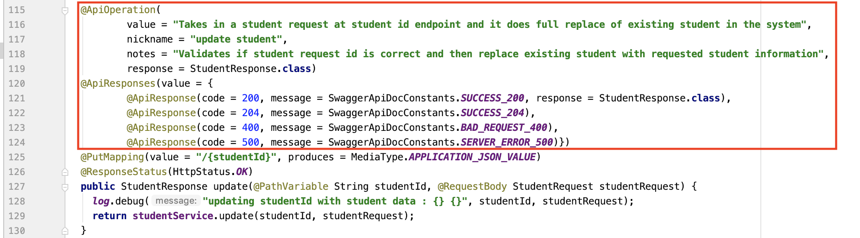

Slide 5
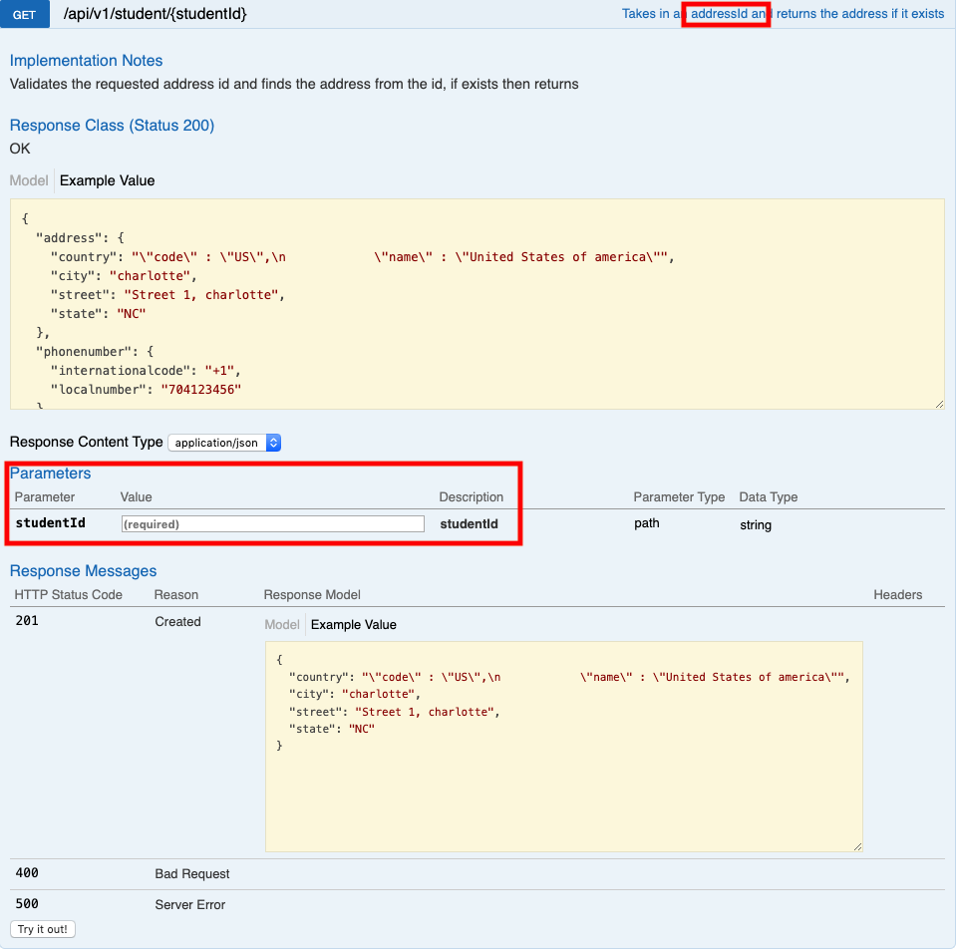

Slide 6
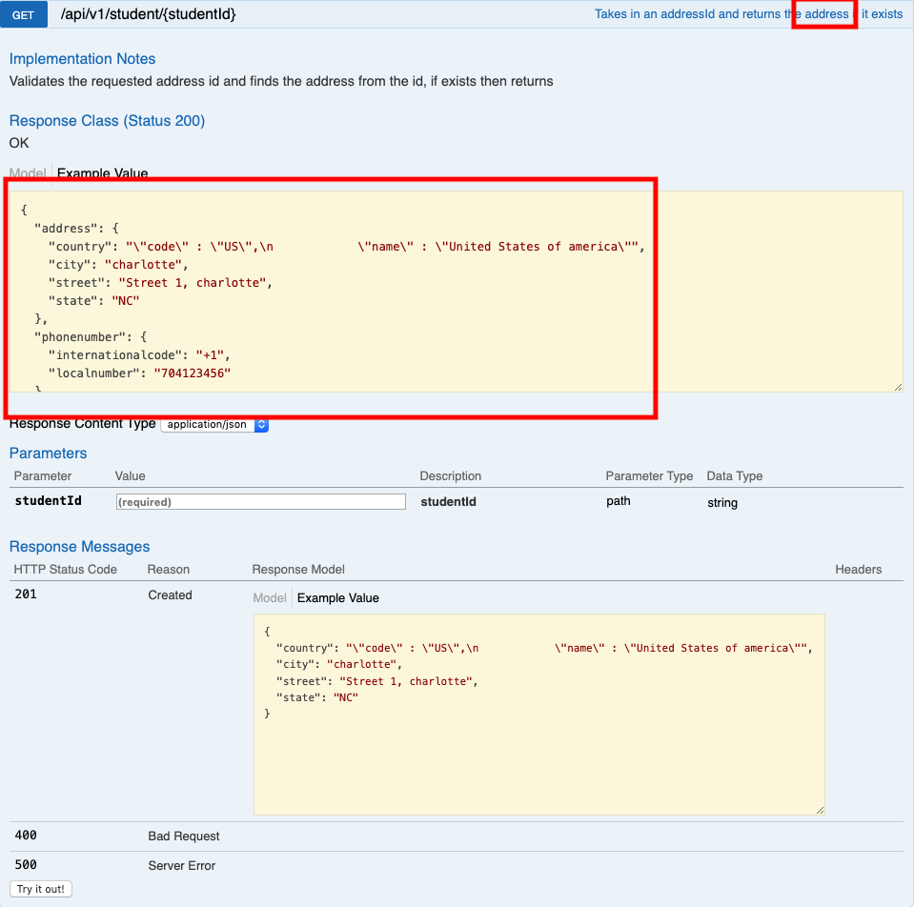

Slide 7
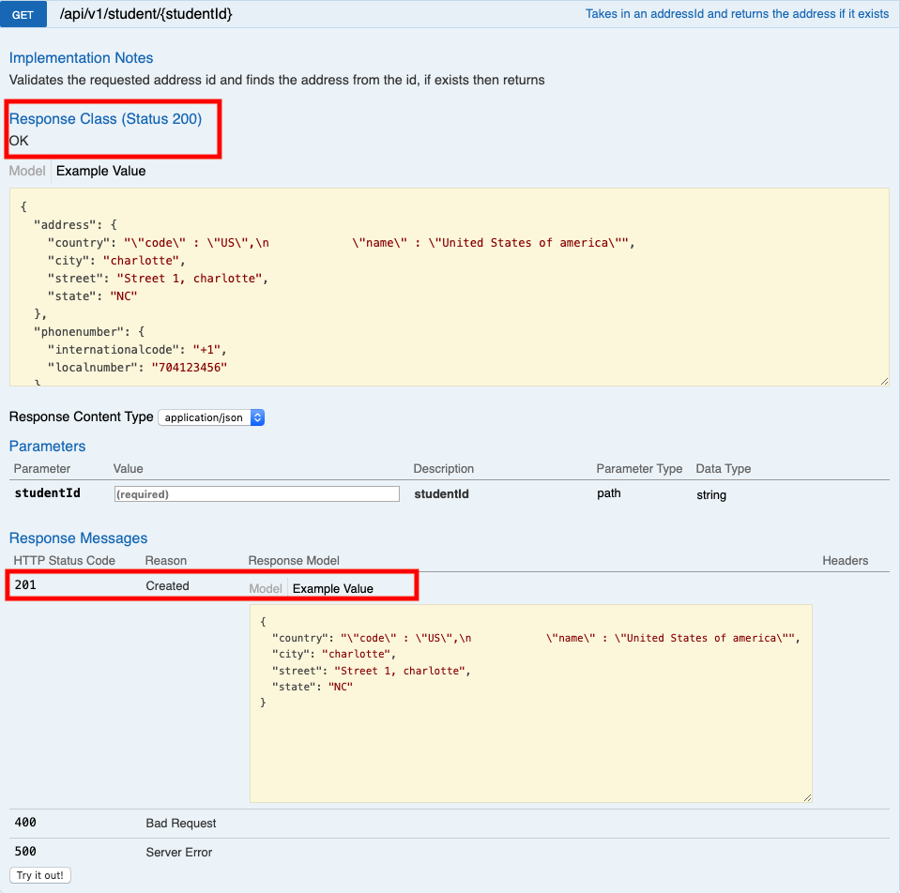

Slide 8

SPRING REST DOCS
1. No code in application.
2. API documentation cannot contradict the application.
3. Supports good development practices like TDD and automation of API docs.
4. Supports powerful customisation with Markdown and CSS

Slide 9
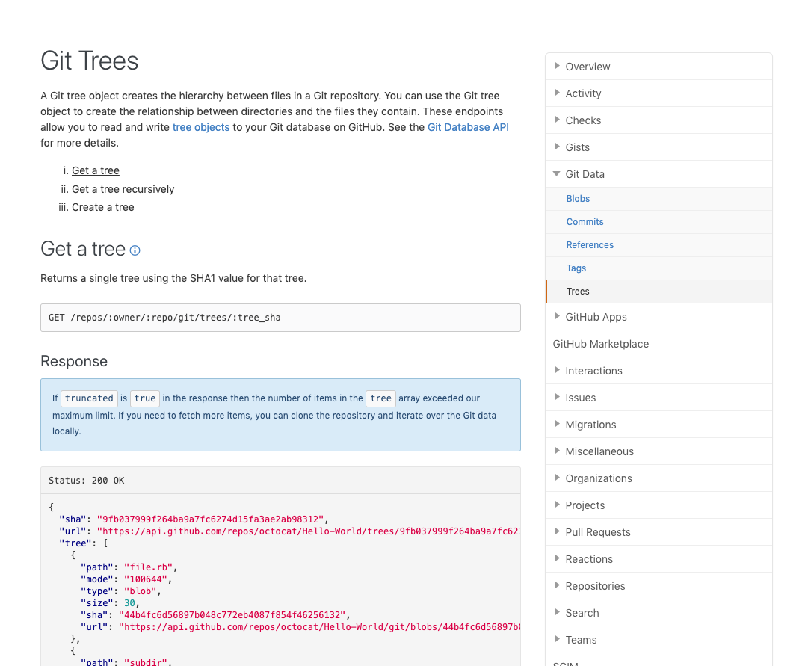
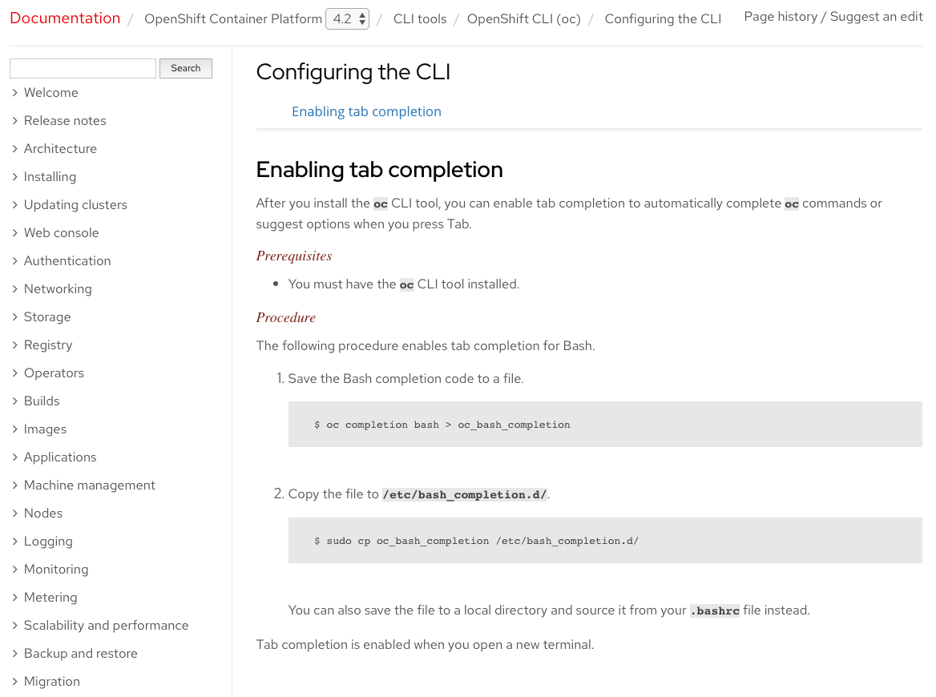

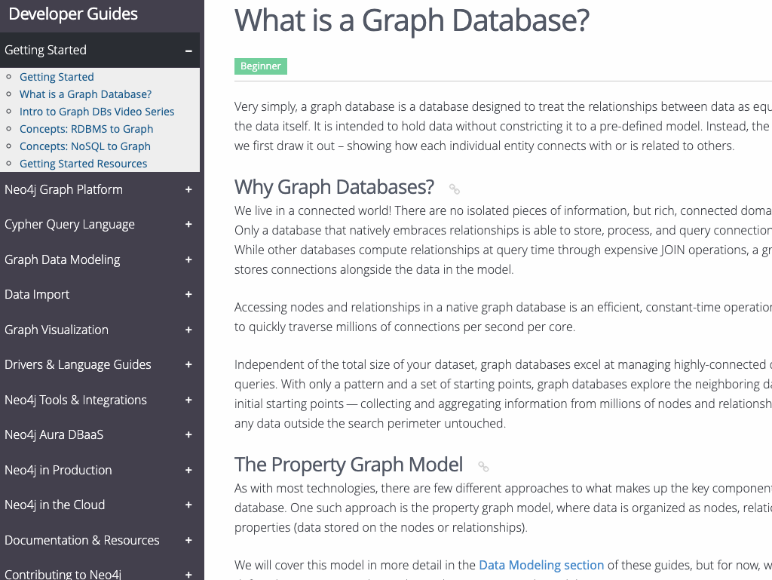
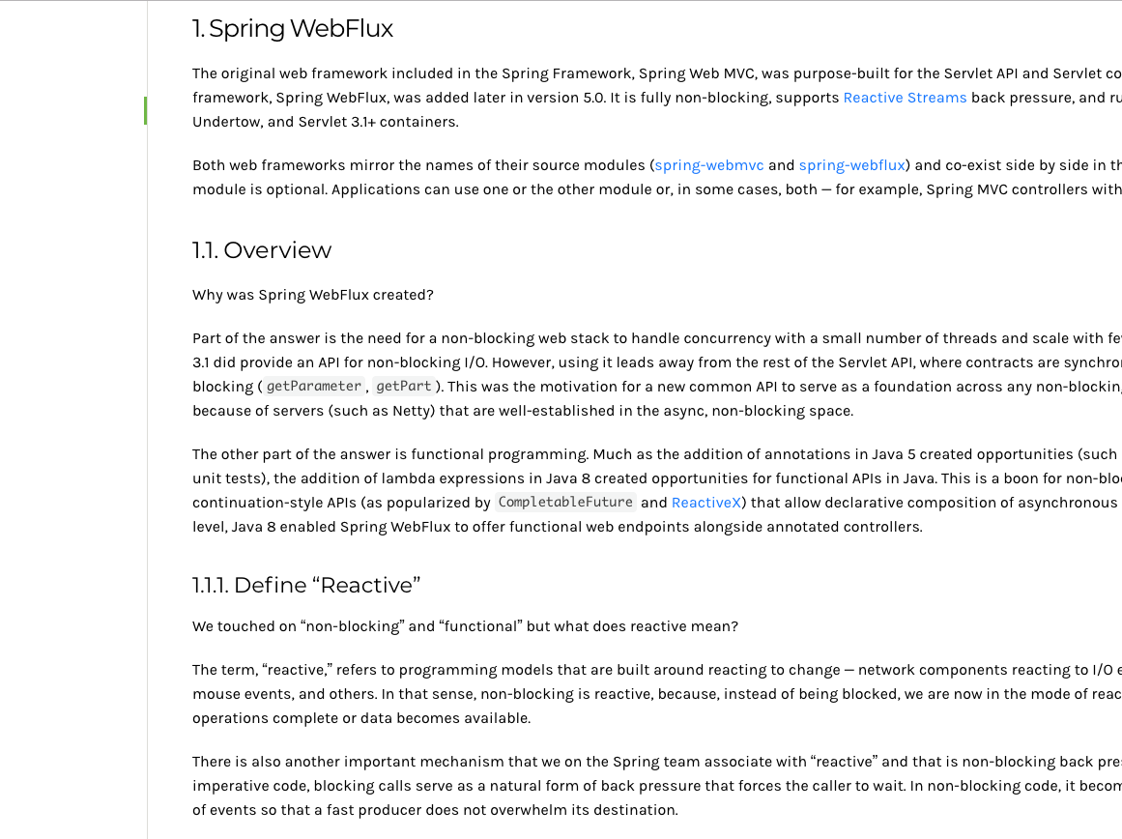



Slide 10
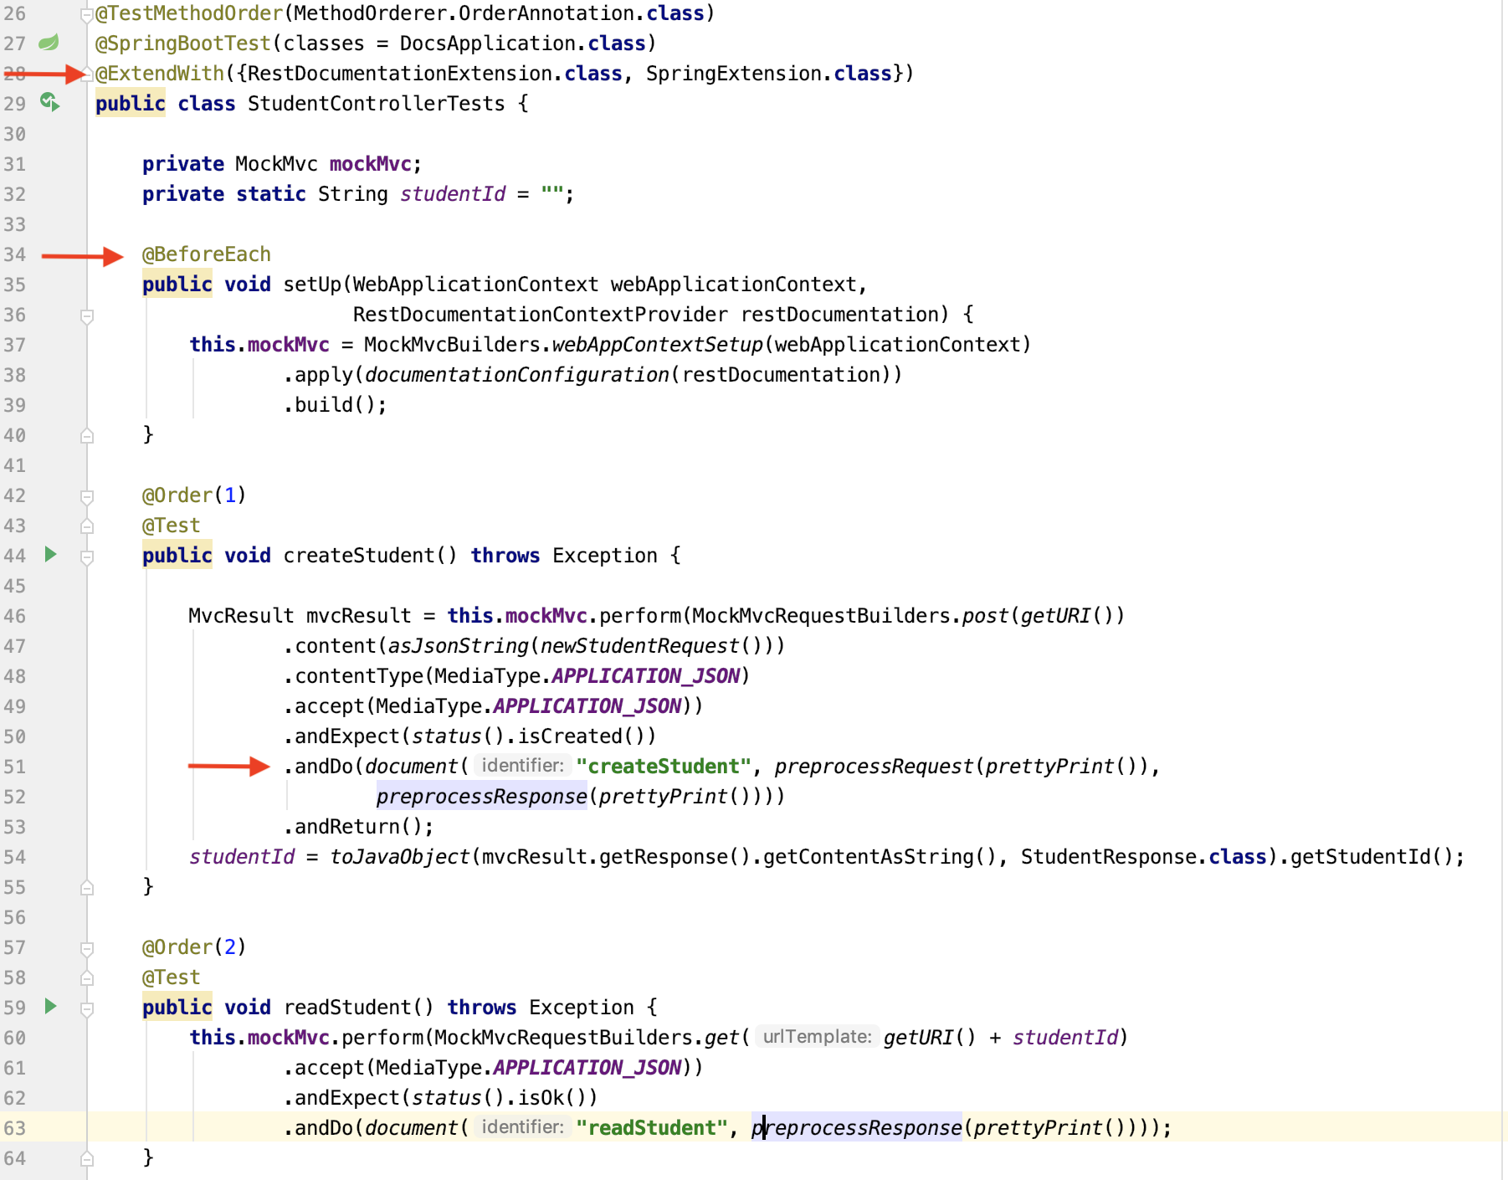

Slide 11
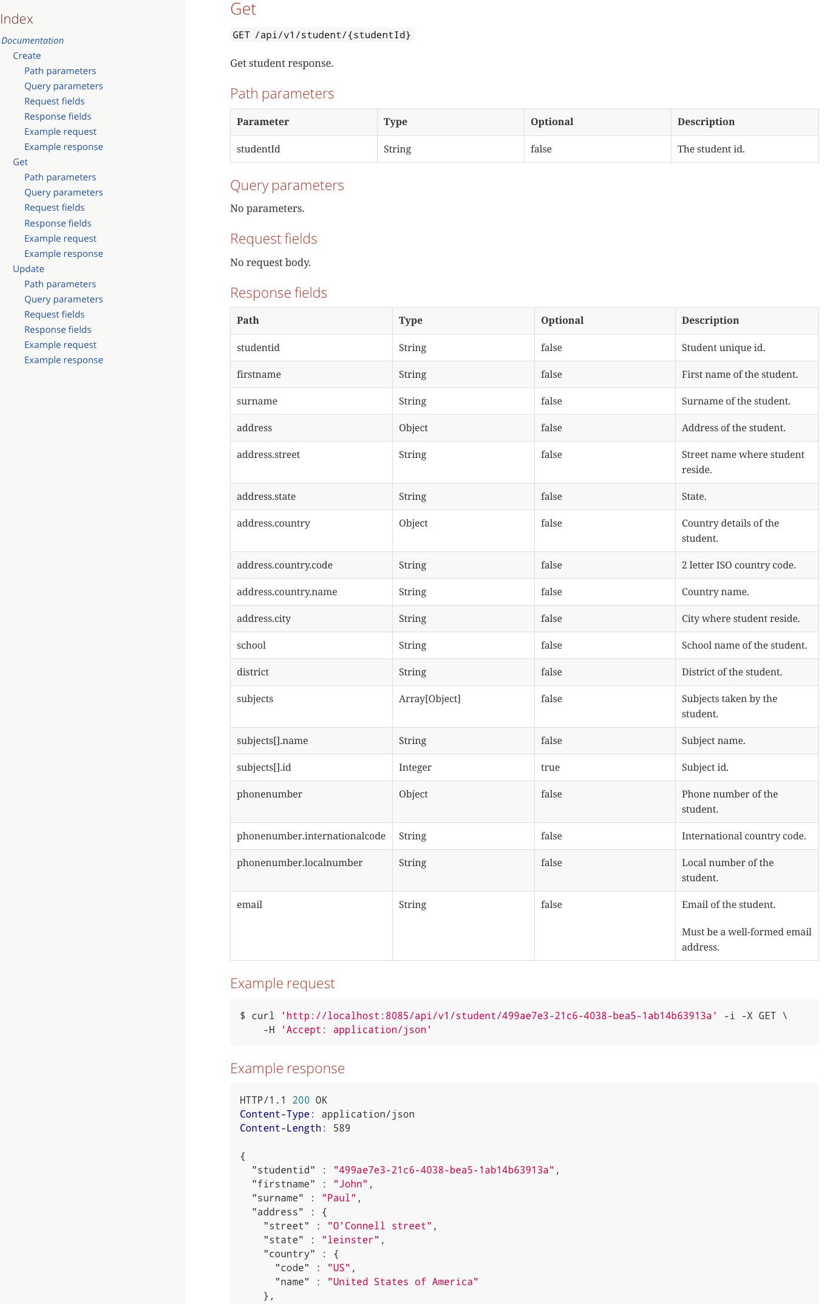

Slide 12
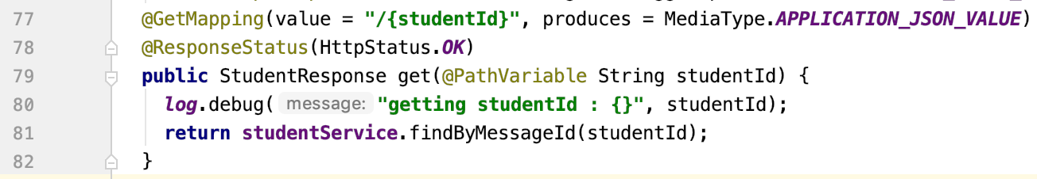

Slide 13
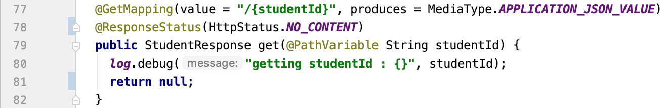

Slide 14
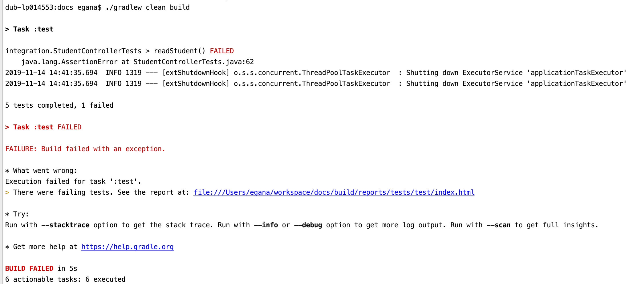

Slide 15


Slide 16
https://scm.eng.hmhco.com/nasiruddinm/spring-rest-docs

