Slide 1

Team Lasso
Team Challenge → Funciones.

Slide 2
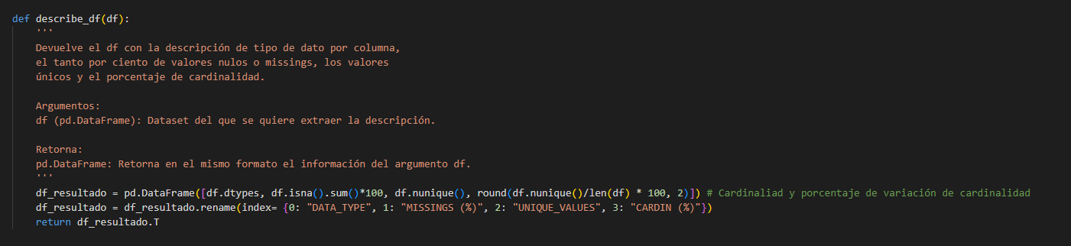
describe_df

Slide 3
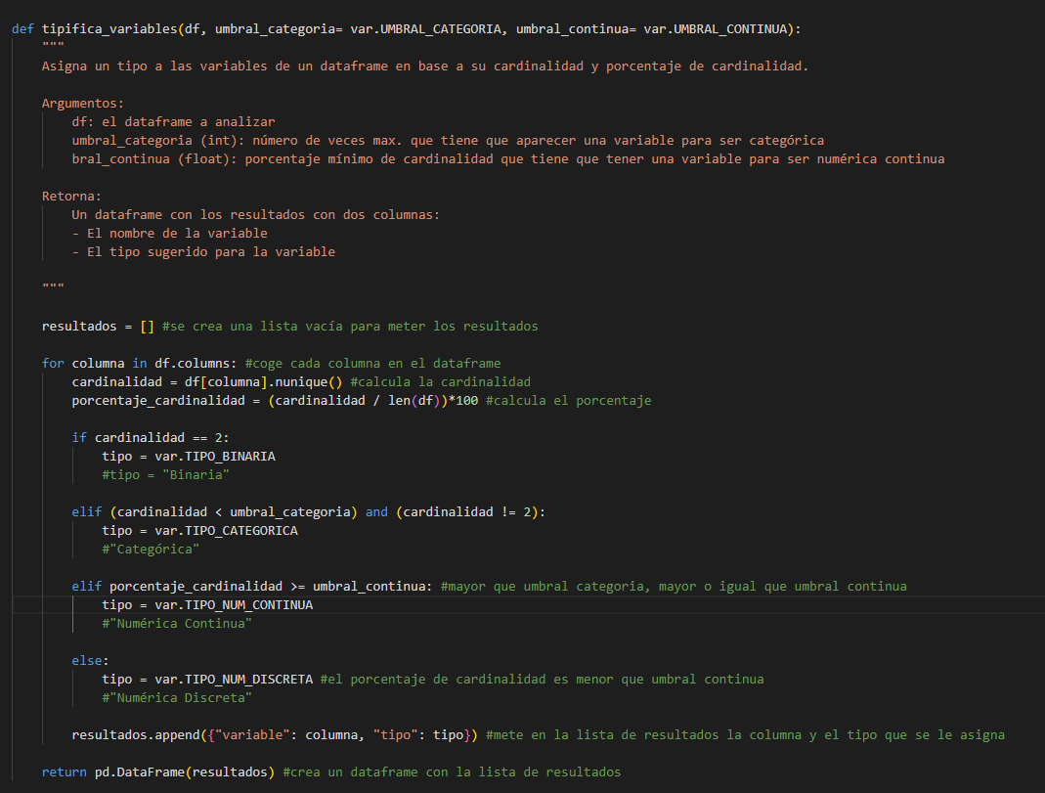
tipifica_variables

Slide 4
get_features_num_regression

Slide 5
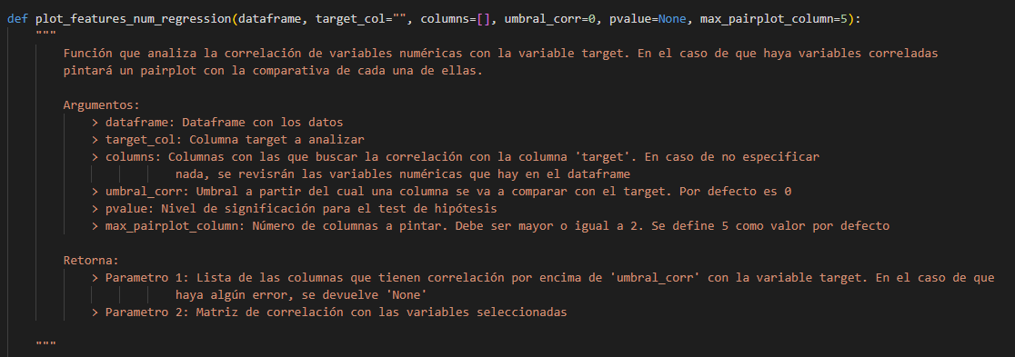
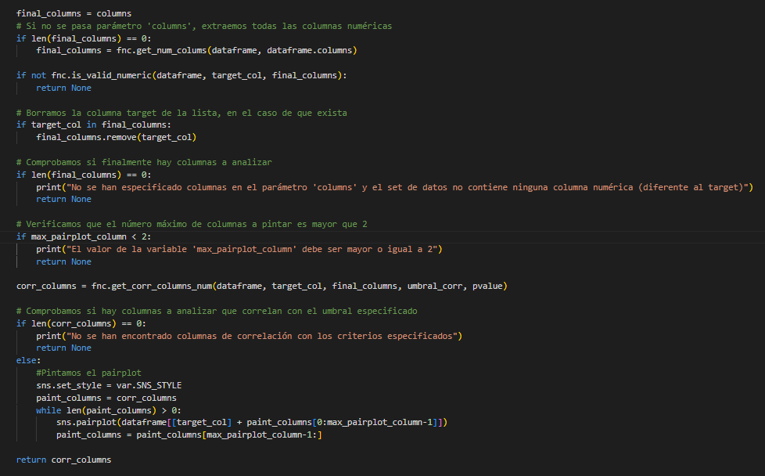
plot_features_num_regression

Slide 6
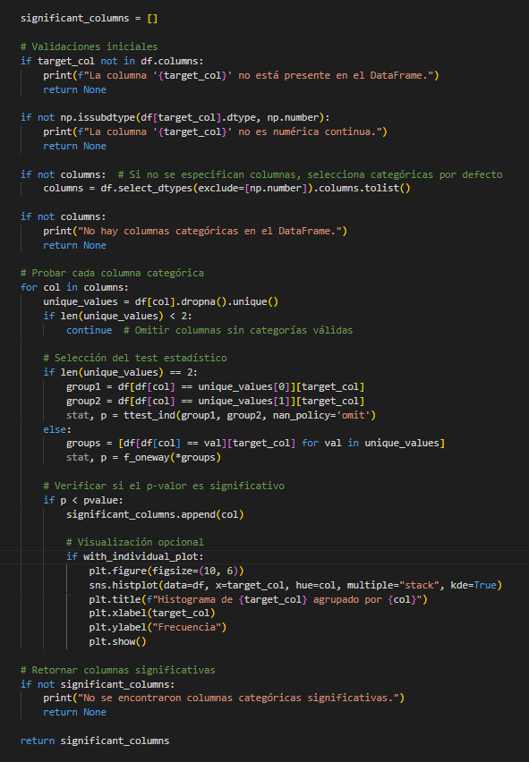
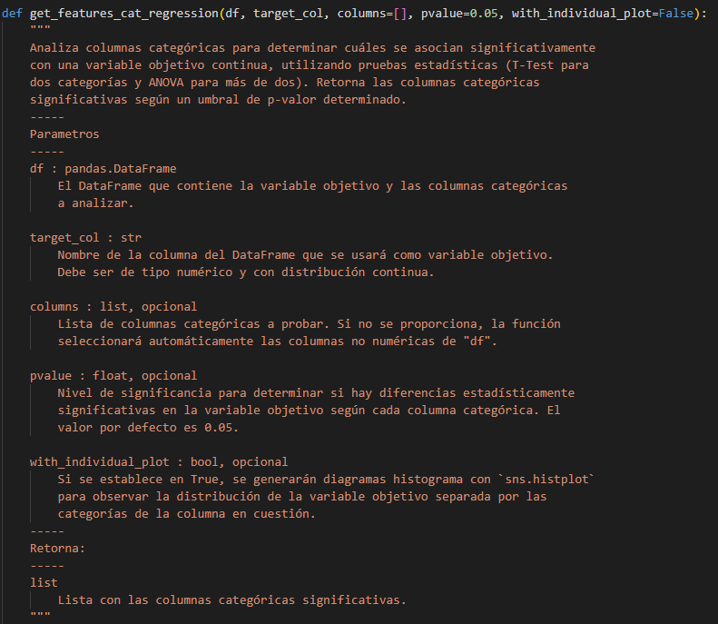
get_features_cat_regression

Slide 7
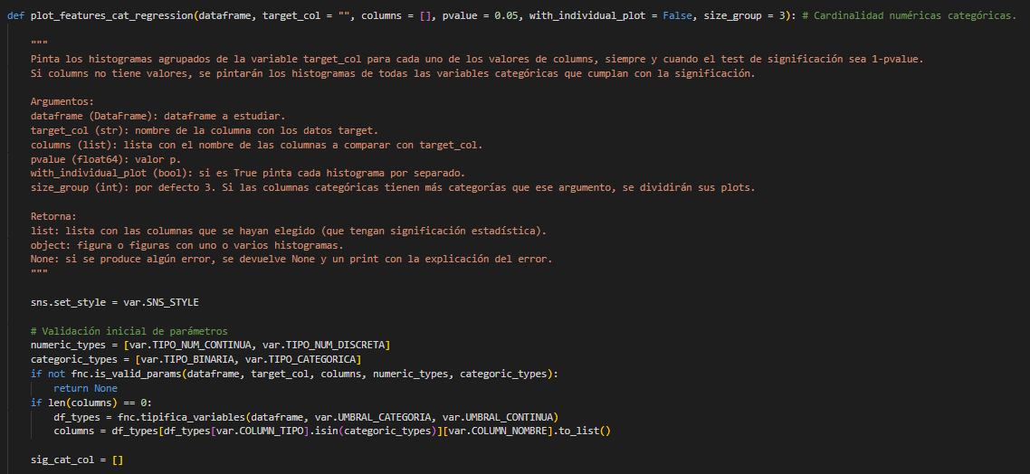
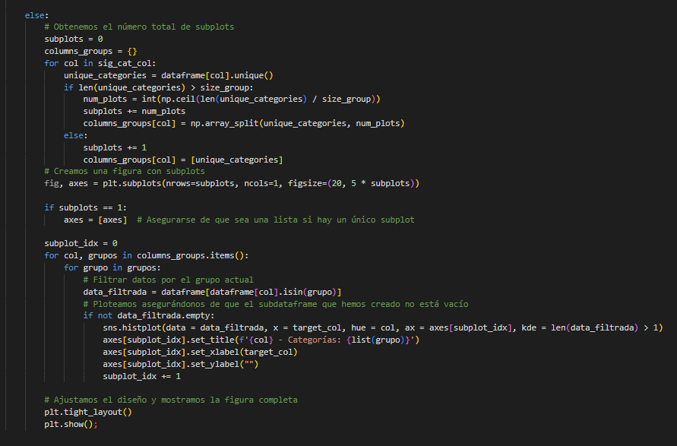
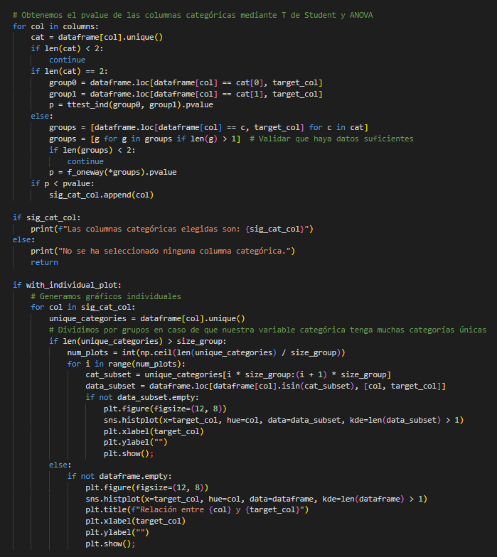
plot_features_cat_regression
3
1
2

Slide 8
Team Lasso
Mariano Puchades
Patricia Diez
Chiara
Justo Barco
Eva Mañas
Antonio Herrera

