Slide 1
Team Lasso

Slide 2
Describe_df

Slide 3
Tipifica_variables

Slide 4
Get_features_num_regression

Slide 5
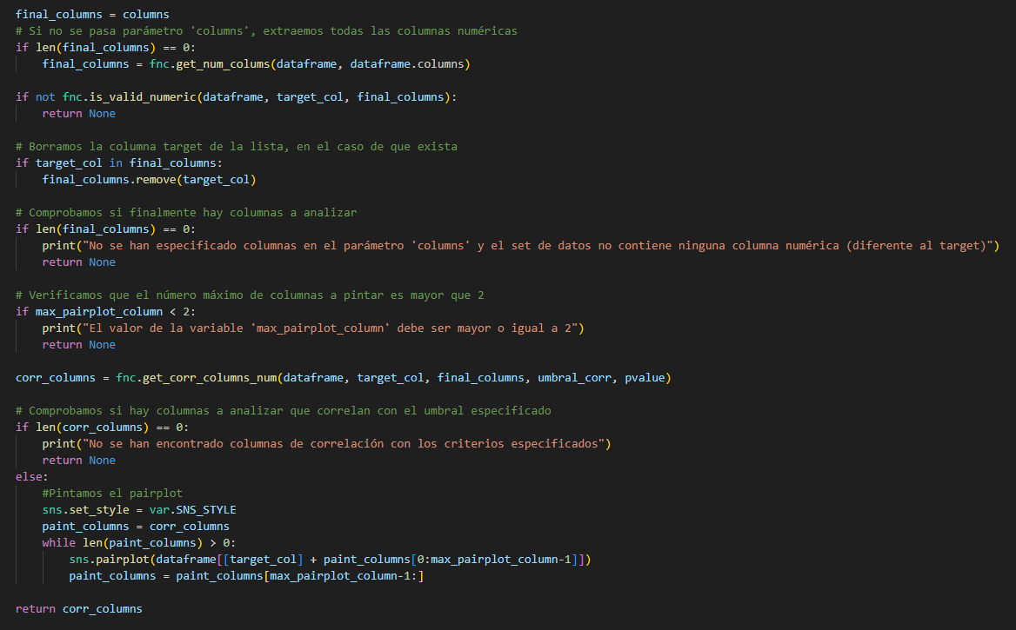
Plot_features_num_regression

Slide 6
Get_features_cat_regression

Slide 7
Plot_features_cat_regression

