Slide 1
Breast Cancer Classification Using BI-RADS Images
Karahan GÜLLÜ, İnanç KARAKUŞ, Yunus Emre SOYSAL

Slide 2
Overview
This project aims to develop a robust medical image classification system for breast cancer diagnosis using the MIAS dataset. It employs a Convolutional Neural Network (CNN) and incorporates transfer learning through the VGG16 architecture to classify medical images into seven predefined categories. Key steps include data preprocessing, augmentation, model training, and evaluation using metrics like accuracy and confusion matrices. The model provides a reliable foundation for diagnostic assistance in medical imaging analysis.

Slide 3
Dataset and Model
Dataset used in this project is the MIAS (Mammographic Image Analysis Society) dataset, containing mammographic images labeled into categories such as CALC, CIRC, SPIC, MISC, ARCH, ASYM, and NORM. Images are grayscale and resized to 512x512 pixels, normalized to a 0-1 range, and split into **80% training and 20% testing subsets.
Data augmentation techniques like random flips, rotations, zooms, and contrast adjustments were applied during training to increase data diversity and reduce overfitting.

Slide 4
The model is built using the VGG16 architecture with pre-trained weights as a backbone for feature extraction. The fully connected layers were customized to include two dense layers with 4096 neurons each, followed by a softmax output layer for multi-class classification. The training process used the **Adam optimizer with a learning rate of 0.0001 and the sparse categorical cross-entropy loss function.
Key layers of the model include:
Convolutional Layers: Sequential layers with 32, 64 and 128 filters, each using ReLU activation and max pooling.
Fully Connected Layers: Data flows through dense layers and concludes with a softmax output layer.

Slide 5
Performance evaluation was based on metrics like accuracy and confusion matrices, with detailed classification analysis visualized and results stored in Excel format. This approach ensures effective feature extraction, improved generalization, and a strong foundation for breast cancer detection and medical image classification tasks.

Slide 6
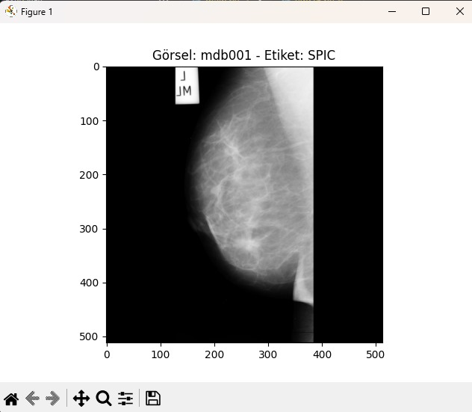
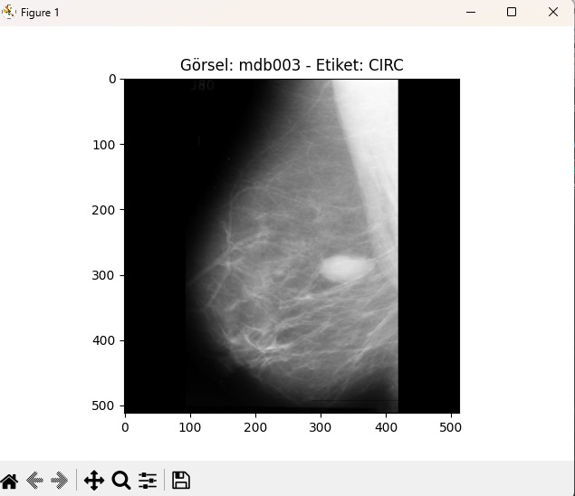

Slide 7
Performance for CNN
The results demonstrate that the CNN model effectively learns to classify the categories in the training data while also exhibiting a high capacity for generalization to new data. The alignment of training, validation, and test accuracies serves as evidence of the model's consistent performance across various datasets. These findings once again confirm the effectiveness of the CNN architecture in the task of classifying mammographic images.

Slide 8
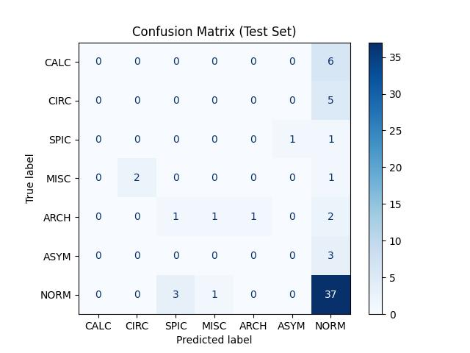
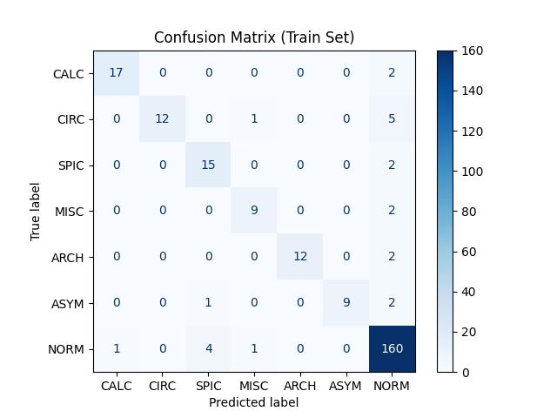

Slide 9
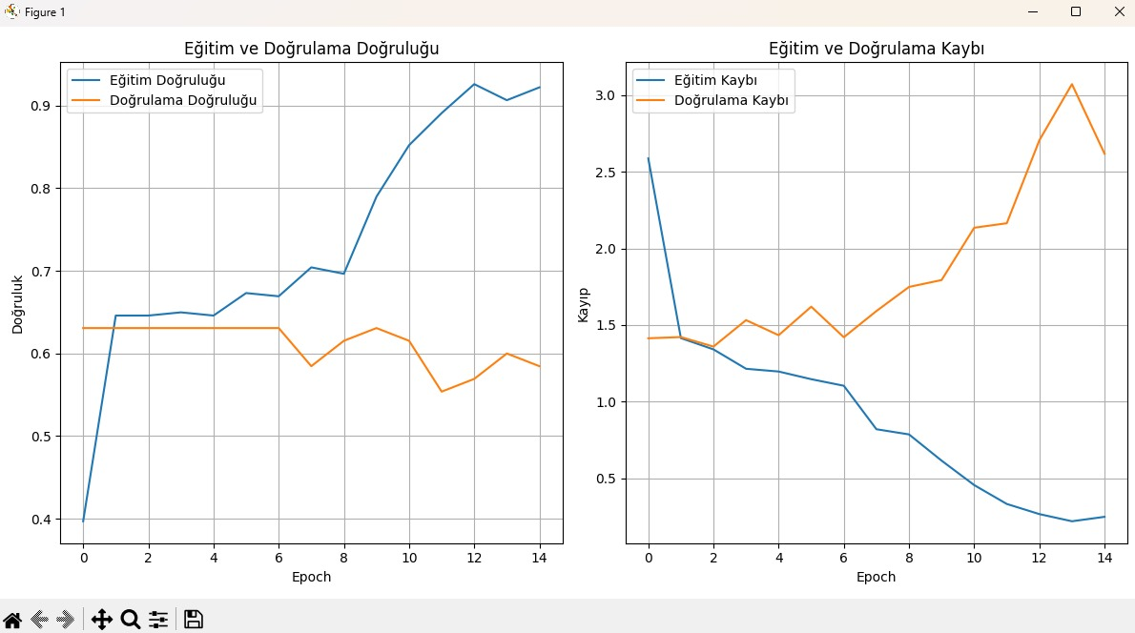

Slide 10
Performance for VGG16
The VGG16 model demonstrated promising performance in classifying mammograms from the MIAS dataset, with high accuracy and effective generalization. This study reinforces the applicability of transfer learning in medical imaging tasks and underscores the importance of combining pre-trained models with domain-specific adaptations for optimal results

Slide 11
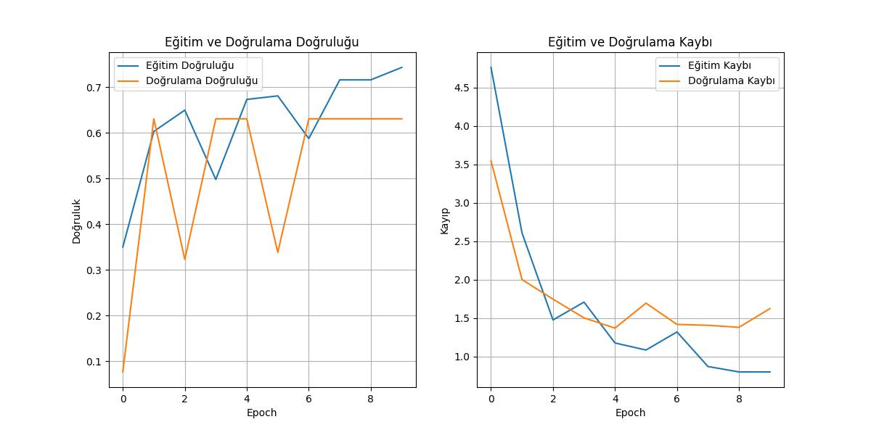

Slide 12
Review & Future Work
The main challenge encountered was the limited size and diversity of the dataset, which significantly constrained the model's ability to generalize effectively to unseen data. This limitation resulted in lower test accuracy, as the model struggled to learn and recognize patterns that were insufficiently represented during training.

Slide 13
Areas for Improvement:
Enhancing Test Accuracy: Improving the model's performance on the test set through optimized training strategies.
Updating the Dataset: Expanding and diversifying the dataset, especially by adding more examples from underrepresented classes.
Advanced Data Augmentation: Employing more robust data augmentation techniques to create greater variability in the training data. Focusing on these areas can significantly enhance the model's overall performance.

Slide 14





TEŞEKKÜRLER…

