Slide 1
Programming in Java (BCAC 0012) Module-2

Slide 2

Module 2 Section 3 Packages and Interfaces

Slide 3
Syllabus
Defining Packages
Importing Packages
User Defined packages and predefined packages
Introduction to Interfaces.

Slide 4
Packages is Java
A java package is a group of similar types of classes, interfaces and sub-packages.
A Package can be defined as a grouping of related types (classes, interfaces, enumerations and annotations ) providing access protection and namespace management.

Slide 5
Packages is Java
Package in java can be categorized in two form, built-in package and user-defined package.
There are many built-in packages such as lang, awt, javax, swing, net, io, util, sql etc.
We can also create our user defined packages.

Slide 6
Advantage of Java Package
1) Java package is used to categorize the classes and interfaces so that they can be easily maintained.
2) Java package provides access protection.
3) Java package removes naming collision.

Slide 7
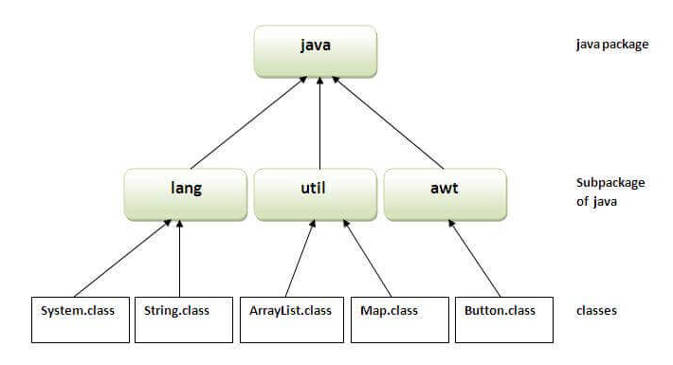
Packages is Java

Slide 8
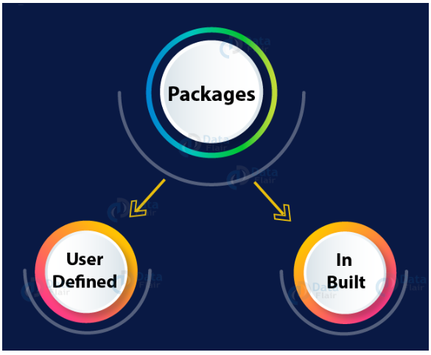
There are two types of Packages in Java-
User Defined packages
predefined packages (In-Built packages)

Slide 9
Predefined packages or Built in packages
Built-in is a part of Java API.
These packages come with JDK and we can directly import and use these packages.
In every java program the java.lang package is already imported and no need to import it.
We have to import all other packages as and when needed.

Slide 10
Predefined packages or Built in packages
Java offers a variety of built in packages.
The six major packages offered by Java API are :
lang – Automatically imported and it contains language support classes.
io – Contains classes for input and output operations.
util – Contains utility classes for implementing data structures.
applet – This package contains classes that create applets.
awt – Contain classes that implement compounds for GUI.
net – This package contains classes that support networking operations.

Slide 11
User Defined Packages : Defining Packages
In Java, the user creates these packages according to their requirements.
While creating a package, you should choose a name for the package and include a package statement along with that name at the top.

Slide 12
User Defined Packages : Defining Packages
Example
package mypack;
public class Simple
{
public static void main(String args[])
{
System.out.println("Welcome to package");
}
}

Slide 13
User Defined Packages : Defining Packages
The package statement should be the first line in the source file.
There can be only one package statement in each source file.
If a package statement is not used then the class, interfaces, enumerations, and annotation types will be placed in the current default package.

Slide 14
User Defined Packages : Defining Packages
How to compile and run the Simple.java program
// Simple.java
package mypack;
public class Simple
{
public static void main(String args[]){
System.out.println("Welcome to package");
}
}

Slide 15
User Defined Packages : Defining Packages
To Compile: javac -d . Simple.java
It will create a directory mypack and store Simple.class file in mypack directory
To Run: java mypack.Simple
The -d switch specifies the destination where to put the generated class file.
If you want to keep the package within the same directory, you will use. (dot) in between –d and Simple.java in the command of compilation.

Slide 16
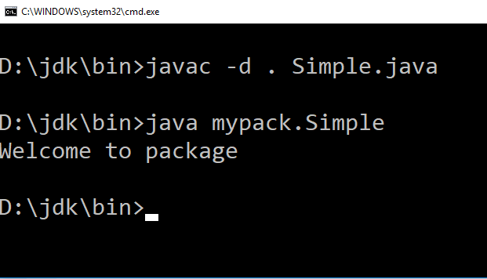
User Defined Packages : Defining Packages
So after creating Simple.java in jdk/bin directory use following command to run it.
To Compile: javac -d . Simple.java
To Run: java mypack.Simple

Slide 17
Importing Packages
We can import classes from one package to another package to use them.
import package.classname; // to import a single class from a package
or import package.*; // to import all classes from that package

Slide 18
Importing Packages
Example
Let we have a class A in package pack
package pack;
public class A
{
public void msg()
{
System.out.println("Hello");
}
}

Slide 19
Importing Packages
To Compile : javac –d . A.java
It will create a folder/package with name pack and store A.class file in that folder
OR
To Compile : javac A.java
Create a folder with name ‘pack’ in ‘BIN’ folder
Copy the A.class file from BIN to BIN\pack\ folder

Slide 20
Importing Packages
// Importing class from a package
//save by B.java
import pack.*;
class B{
public static void main(String args[])
{
A obj = new A();
obj.msg();
}
}

Slide 21
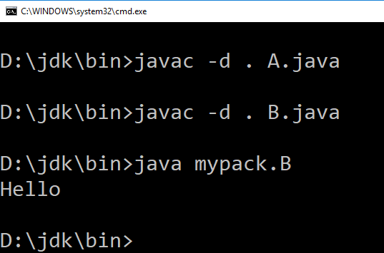
Importing Packages
To Compile : javac B.java
To Run : java B
Output:
Hello

Slide 22
Interfaces in Java
An interface in Java is a blueprint of a class. It has static constants and abstract methods.
The interface in Java is a mechanism to achieve abstraction.
There can be only abstract methods in the Java interface, not method body.
It is used to achieve abstraction and multiple inheritance in Java.
It cannot be instantiated just like the abstract class.

Slide 23
Interfaces in Java
How to declare an interface?
An interface is declared by using the interface keyword.
It provides total abstraction; means all the methods in an interface are declared with the empty body, and all the fields are public, static and final by default.
A class that implements an interface must implement all the methods declared in the interface.

Slide 24
Interfaces in Java
Syntax:
interface <interface_name>
{
// declare constant fields
// declare methods that are abstract by default.
}
Example
interface printable
{
void print();
}

Slide 25
Interfaces in Java
Internal addition by the compiler
The Java compiler adds public and abstract keywords before the interface method.
Moreover, it adds public, static and final keywords before data members.
In other words, Interface fields are public, static and final by default, and the methods are public and abstract.

Slide 26
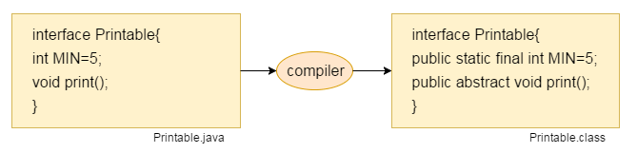
Internal addition by the compiler

Slide 27
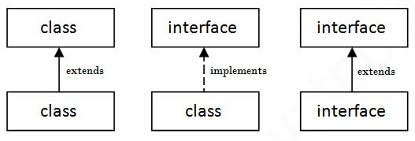
Interfaces in Java
The relationship between classes and interfaces
As shown in the figure given below, a class extends another class, an interface extends another interface, but a class implements an interface.

Slide 28
// Java Interface Example
interface printable
{
void print();
}
class A6 implements printable
{
public void print()
{
System.out.println("Hello");
}
public static void main(String args[])
{
A6 obj = new A6();
obj.print();
}
}

Slide 29
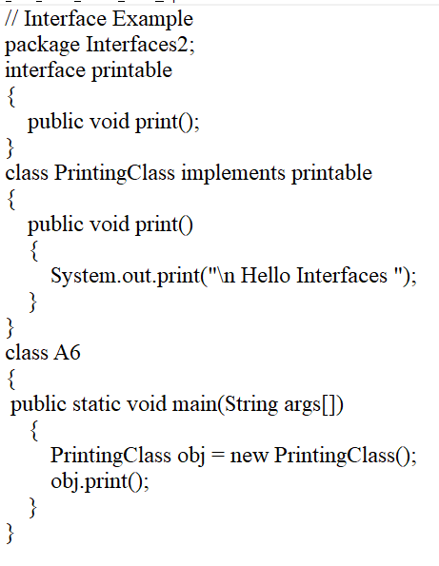

Slide 30
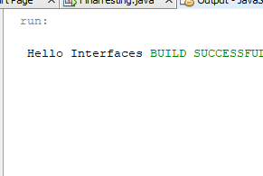

Slide 31
Notes on Interfaces:
Like abstract classes, interfaces cannot be used to create objects
Interface methods do not have a body - the body is provided by the "implement" class
On implementation of an interface, you must override all of its methods
Interface methods are by default abstract and public
Interface attributes are by default public, static and final
An interface cannot contain a constructor

Slide 32
Why And When To Use Interfaces?
1) To achieve security –
Hide certain details and only show the important details of an object (interface).
2) To Achieve Multiple Inheritance –
Java does not support "multiple inheritance" (a class can only inherit from one superclass).
However, it can be achieved with interfaces, because the class can implement multiple interfaces.
Note: To implement multiple interfaces, separate them with a comma (see example below).

Slide 33
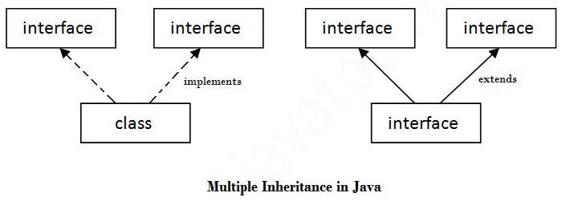
Multiple inheritance in Java by interface
If a class implements multiple interfaces, or an interface extends multiple interfaces, it is known as multiple inheritance.

Slide 34
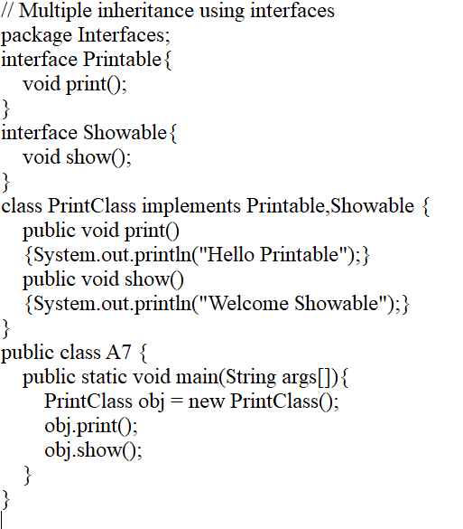

Slide 35
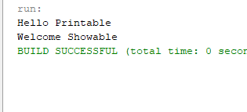

Slide 36
// Multiple inheritance using interfaces
// Multiple inheritance using interfaces
package Interfaces;
interface Printable{
void print();
}
interface Showable{
void show();
}
class PrintClass implements Printable,Showable {
public void print()
{System.out.println("Hello Printable");}
public void show()
{System.out.println("Welcome Showable");}
}
public class A7 {
public static void main(String args[]){
PrintClass obj = new PrintClass();
obj.print();
obj.show();
}
}

Slide 37
Multiple inheritance using interfaces
Multiple inheritance is not supported in the case of class because of ambiguity.
However, it is supported in case of an interface because there is no ambiguity.
It is because implementation of methods of the interface is provided by the implementation class.

Slide 38
Abstract class | Interface
1) Abstract class can have abstract and non-abstract methods. | Interface can have only abstract methods. Since Java 8, it can have default and static methods also.
2) Abstract class doesn't support multiple inheritance. | Interface supports multiple inheritance.
3) Abstract class can have final, non-final, static and non-static variables. | Interface has only static and final variables.
4) Abstract class can provide the implementation of interface. | Interface can't provide the implementation of abstract class.

Slide 39
Abstract class | Interface
5) The abstract keyword is used to declare abstract class. | The interface keyword is used to declare interface.
6) An abstract class can extend another Java class and implement multiple Java interfaces. | An interface can extend another Java interface only.
7) An abstract class can be extended using keyword "extends". | An interface can be implemented using keyword "implements".
8) A Java abstract class can have class members like private, protected, etc. | Members of a Java interface are public by default.

Slide 40
Java 8 Interface Improvement
Since Java 8, interface can have default and static methods

Slide 41
Java 8 Interface Improvement
Since Java 8, we can have method body in interface.
But we need to make it default method.
Eg.
interface Drawable
{
void draw();
default void msg()
{System.out.println("default method");}
}

Slide 42
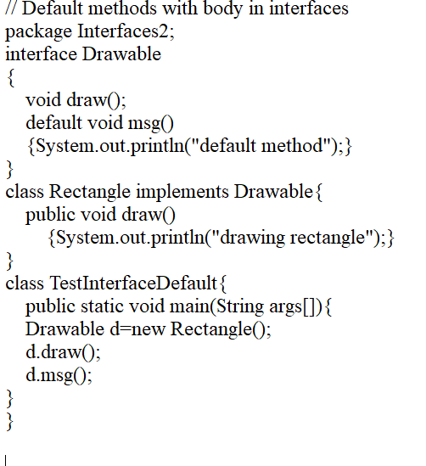

Slide 43
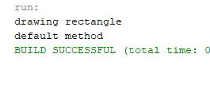

Slide 44
// Multiple inheritance using interfaces
// Multiple inheritance using interfaces
package Interfaces;
interface Printable{
void print();
}
interface Showable{
void show();
}
class PrintClass implements Printable,Showable {
public void print()
{System.out.println("Hello Printable");}
public void show()
{System.out.println("Welcome Showable");}
}
public class A7 {
public static void main(String args[]){
PrintClass obj = new PrintClass();
obj.print();
obj.show();
}
}

Slide 45
Java 8 Static Method in Interface
Since Java 8, we can have static method in interface. Let's see an example:
interface Drawable
{
void draw();
static int cube(int x){return x*x*x;}
}
class Rectangle implements Drawable
{
public void draw(){System.out.println("drawing rectangle");}
}

Slide 46
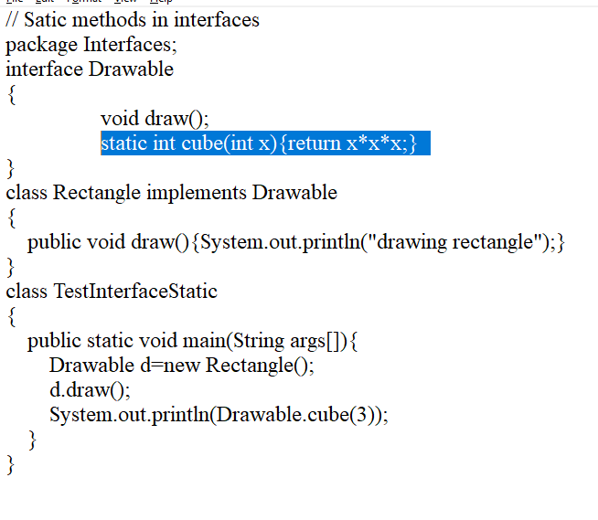

Slide 47
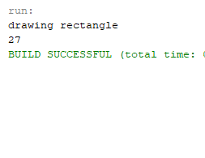

Slide 48
// Satic methods in interfaces
// Satic methods in interfaces
package Interfaces;
interface Drawable{
void draw();
static int cube(int x){return x*x*x;}
}
class Rectangle implements Drawable
{
public void draw(){System.out.println("drawing rectangle");}
}
class TestInterfaceStatic
{
public static void main(String args[]){
Drawable d=new Rectangle();
d.draw();
System.out.println(Drawable.cube(3));
}
}

Slide 49
Example discussed in class
// Multiple Inheritance using interfaces
interface I1
{
public static final int MIN=5;
abstract public void print();
}
interface I2
{
abstract public void display();
}
class C1 implements I1,I2
{
public void print()
{
System.out.print("\n Print of interface I1");
}
public void display()
{
System.out.print("\n Display of interface I2");
}
}
public class InterfaceDemo
{
public static void main()
{
C1 obj = new C1();
obj.print();
obj.display();
}
}

Slide 50
END

