Slide 1
AI-Powered Data Cleaning Pipeline
Topic - Automated Data Cleaning with AI for Faster & Smarter Insights
Team Name – Soul society
Team Members name :–
Shubham Mishra
Sujal Nage
Vedansh Wagh

Slide 2
Problem Statement
Data cleaning consumes 80% of a data scientist’s time (Forbes, 2023), delaying analysis and insights. Manual cleaning is slow, costly, and inconsistent, leading to unreliable predictions and poor business decisions. Dirty data costs U.S. businesses $3.1 trillion annually (IBM).
Industries like finance, healthcare, and e-commerce struggle with missing values, duplicates, and inconsistent formats, causing Inefficiencies, compliance risks, and lost revenue. Without automation, businesses face delays, inflated costs, and flawed models.
Our AI-powered solution automates cleaning, enhances data integrity, and enables smarter, faster decision-making.

Slide 3
Solution (What We’re Building)
Manual data cleaning is slow, error-prone, and costly. Our AI-powered web-based pipeline automates this process by:
Removing duplicates for cleaner datasets.
Detecting anomalies using ML models.
Handling missing values with AI-driven imputation.
Standardizing & normalizing data for consistency.
Key Benefits: Faster, scalable, and customizable cleaning with Google Sheets & API integration.
Tech Stack: HTML, Tailwind,Python, Flask/FastAPI, Sklearn, TensorFlow, JavaScript.
Unlike Excel or SQL scripts, our AI-driven approach is automated, efficient, and cost-effective, ensuring smarter, faster decision-making.

Slide 4
How It Works?
Step 1: Users start by uploading a CSV or JSON file via drag-and-drop or manual selection. A preview allows them to inspect the dataset and set custom cleaning preferences (e.g., handling missing values, duplicate removal).
Step 2: After upload, the AI-powered backend processes the dataset by removing duplicates, detecting anomalies, handling missing values, and standardizing formats.
Step 3: Shows summary of fixes (duplicates removed, missing values handled, etc.)
Step 4: After reviewing the cleaning summary, users can download the cleaned dataset in their preferred format (CSV, JSON, or Excel).

Slide 5
Core AI-Powered Cleaning Steps
Deduplication → Deduplication identifies and removes duplicate records, improving data accuracy and efficiency. Anomaly Detection → Finds outliers using ML models
Missing Value Handling → Missing values arise from human errors, system failures, or incomplete data collection, leading to biased analysis and inaccurate predictions. Proper handling ensures data consistency and reliability.
Encoding & Scaling → Encoding & scaling convert raw data into a machine-readable format, ensuring consistency for analysis.
Smart AI pipeline makes it fully automated!

Slide 6
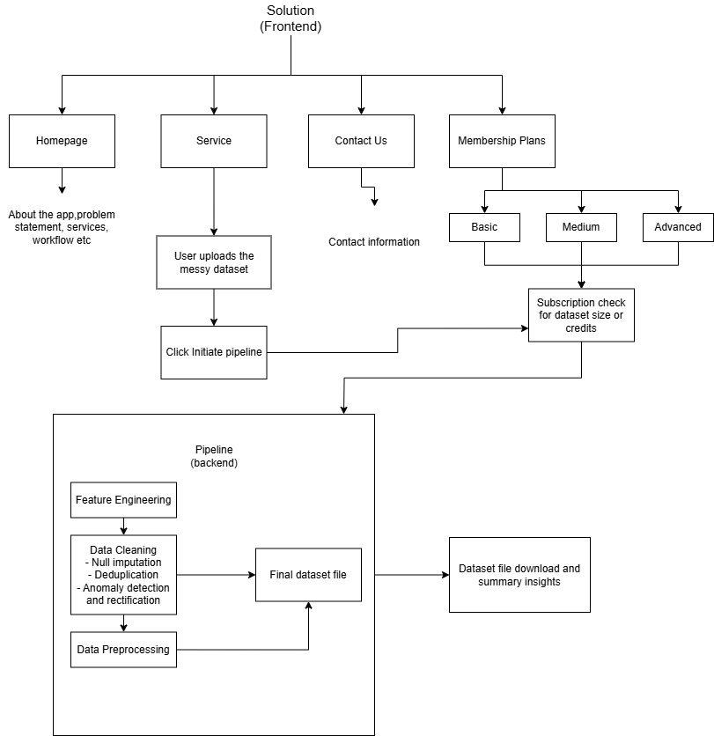
Flowchat

Slide 7
Monetization
Freemium Model:
Process up to 1,000 rows per dataset
Medium API Model:
Process up to 10,000 rows per dataset
Pro API Model:
Process unlimited rows per dataset

Slide 8
Competitive Advantage
No-Code AI Cleaning - Non-tech users can clean data
Faster than Manual Cleaning - ML-powered automation
Hands-Free Data Cleaning - Our AI-driven system eliminates manual effort, automatically handling deduplication, anomaly detection, and missing values. This ensures faster, more accurate, and seamless data processing.
Flexible Subscription Model - Our scalable subscription plans cater to individuals and businesses with free, pay-per-use, and premium options. Enjoy seamless upgrades, transparent pricing, and easy cancellations for a hassle-free experience.

Slide 9
Future Improvements
API Access → Developers can integrate the cleaning pipeline into their applications.
Customizable Workflows → Modify cleaning rules to fit specific project needs.
Scalable Processing → Handle large datasets efficiently.
Seamless Integration → Compatible with databases, cloud storage, and ML pipelines.
Automation-Ready → Set up scheduled cleaning for continuous data refinement.

