Slide 1
Example school Data exercise
ELA and Math trends from Quarterly Diagnostic Assessments for a given school year

Slide 2

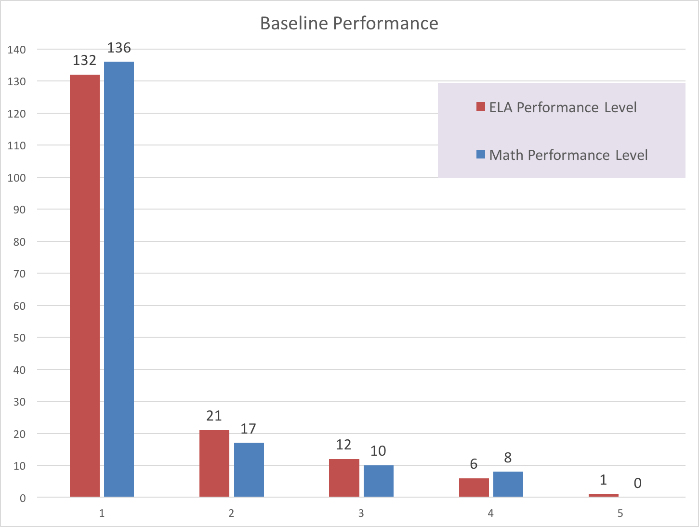
Overview of baseline data
Baseline Data show…
19 of 172 students scoring at or above 3 in ELA (11% proficient)
18 of 171 students scoring at or above 3 on Math (10.5% proficient)
In order to show growth as a school, percent of students scoring proficient should exceed these baseline percentages. Target growth was arbitrarily chosen as 15% for the purpose of this analysis exercise.
Projected proficiency on the end of year test is set at
12.65% for ELA (15% growth)
12.075% for Math (15% growth)

Slide 3
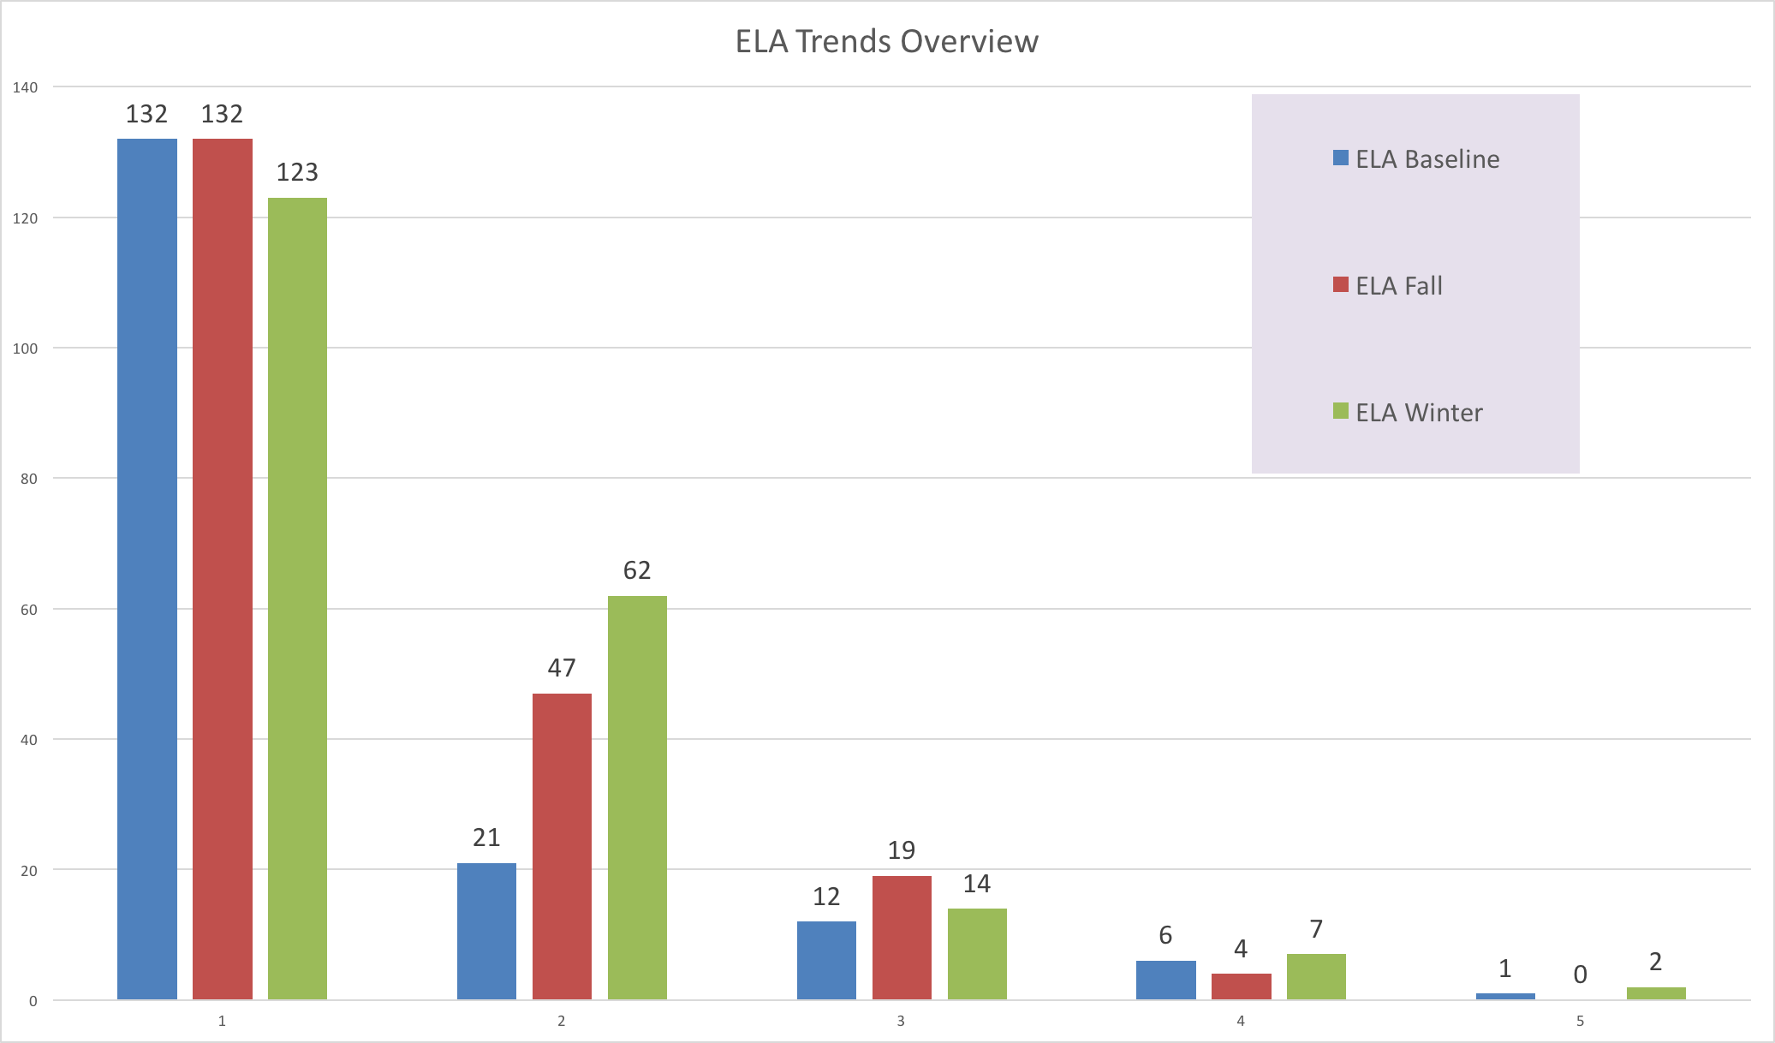
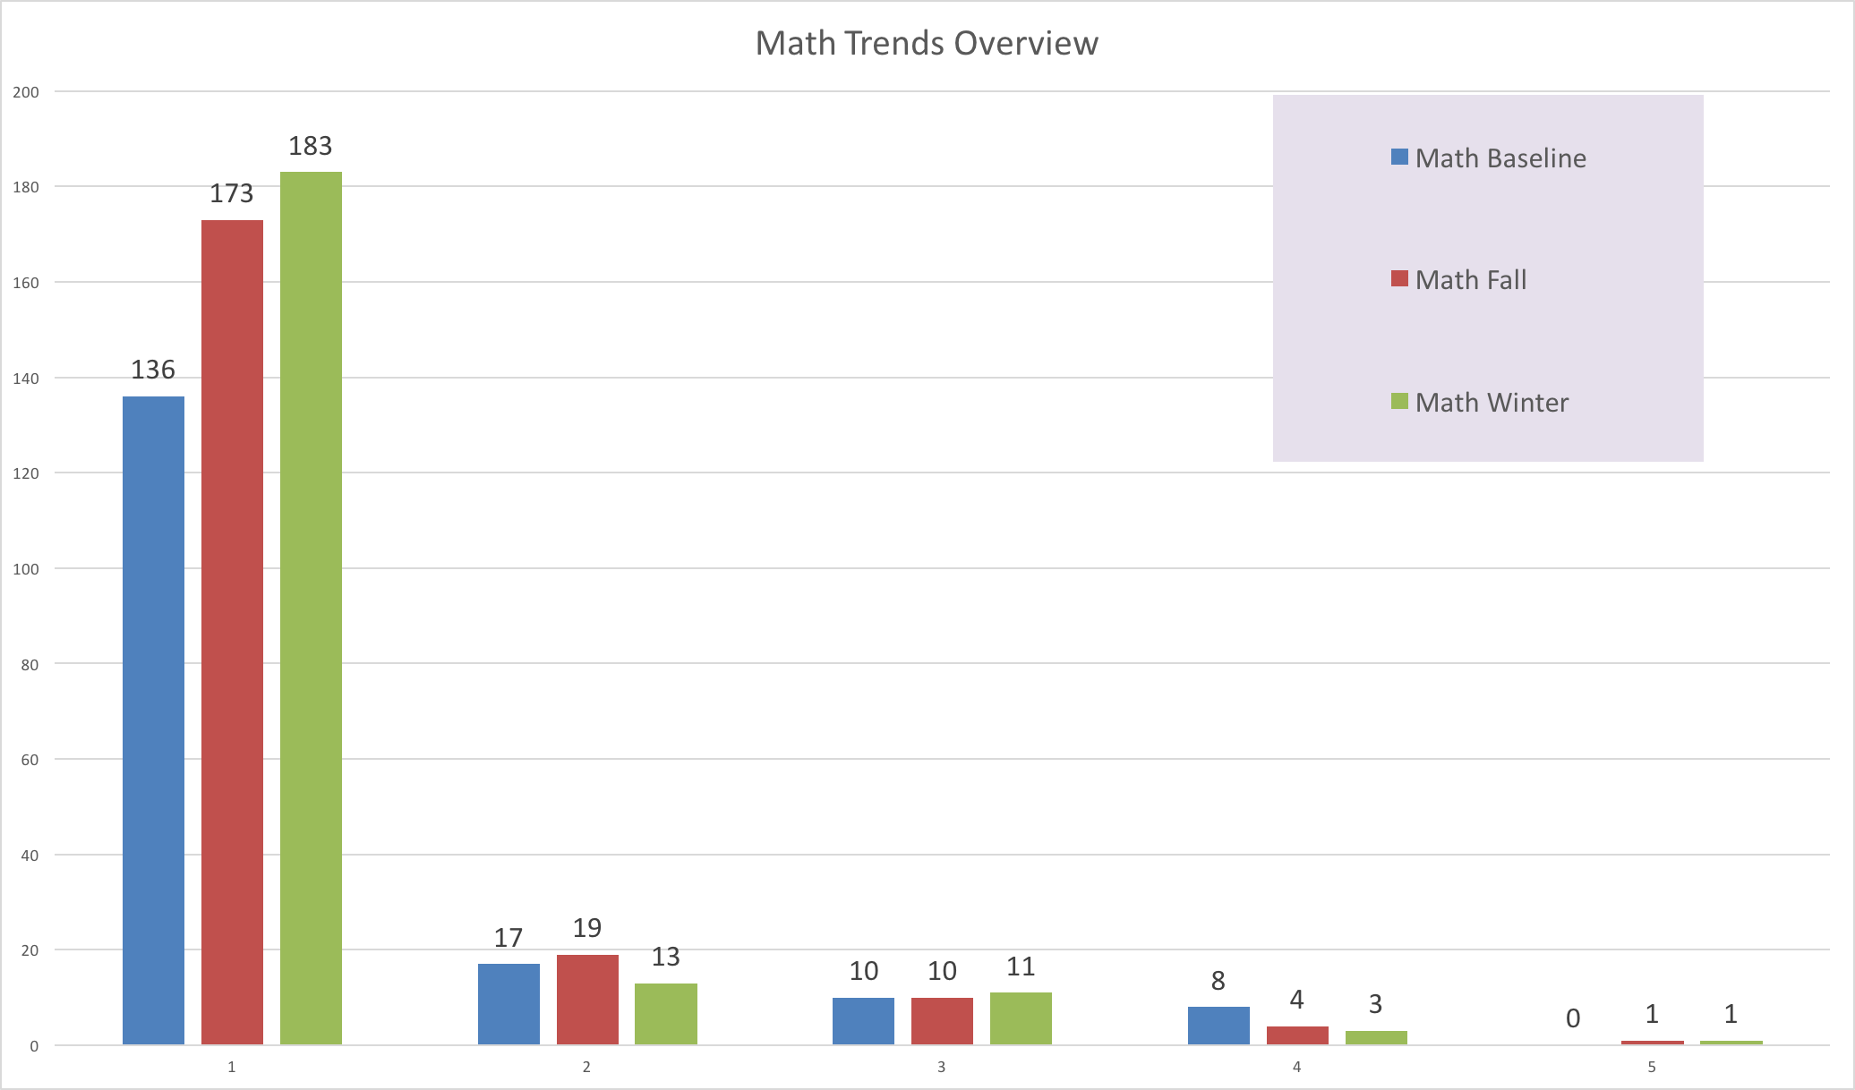
Performance Level Movement: ELA / Math Schoolwide
When we examine the schoolwide performance level movement in ELA, we see that much of the increase in performance level comes from students moving up one level from 1 to 2. These students will need to continue this increase toward levels 3 and above. An additional 1.6% of students need to reach proficiency – from 23 students now to 27 in the spring.
Math scores continue to shift down toward level 1 with each successive assessment window. An additional 5% of students need to reach proficiency in order to meet the schoolwide growth target – from 15 students now to 26 in the spring.

Slide 4
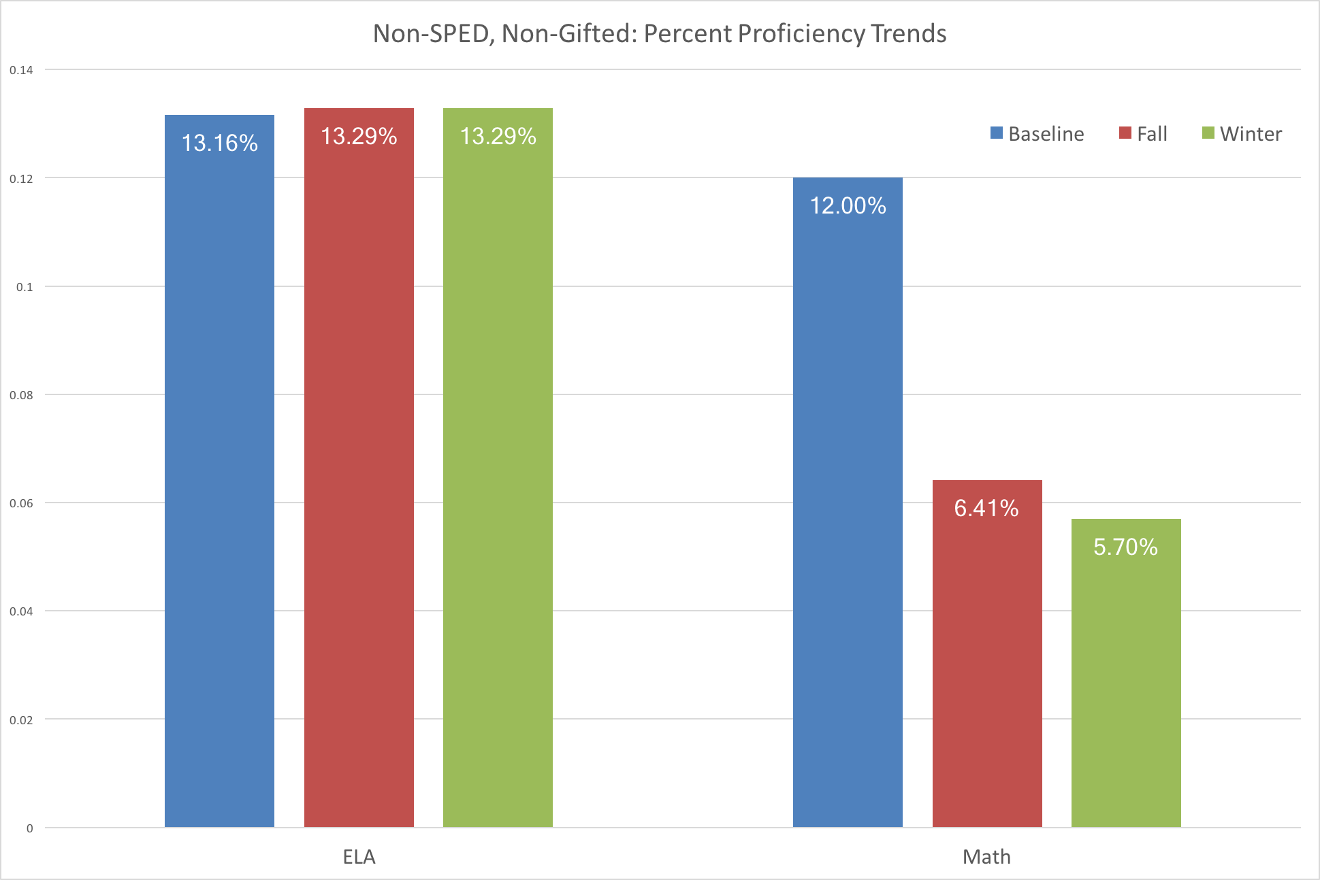
Students without exceptions: Math and ELA Trends
Of the students without SPED or Gifted classifications, all subjects at each assessment interval yielded fewer than 14% of students scoring at or above proficiency.
Based on (arbitrarily chosen for this exercise) 15% growth from baseline, target scores are
15.64% on ELA. This is an additional 2.35% or 4 students – from 21 now to 25 in the spring.
13.8% on Math. This is an additional 8.1% or 13 students – from 9 now to 22 in the spring.

Slide 5
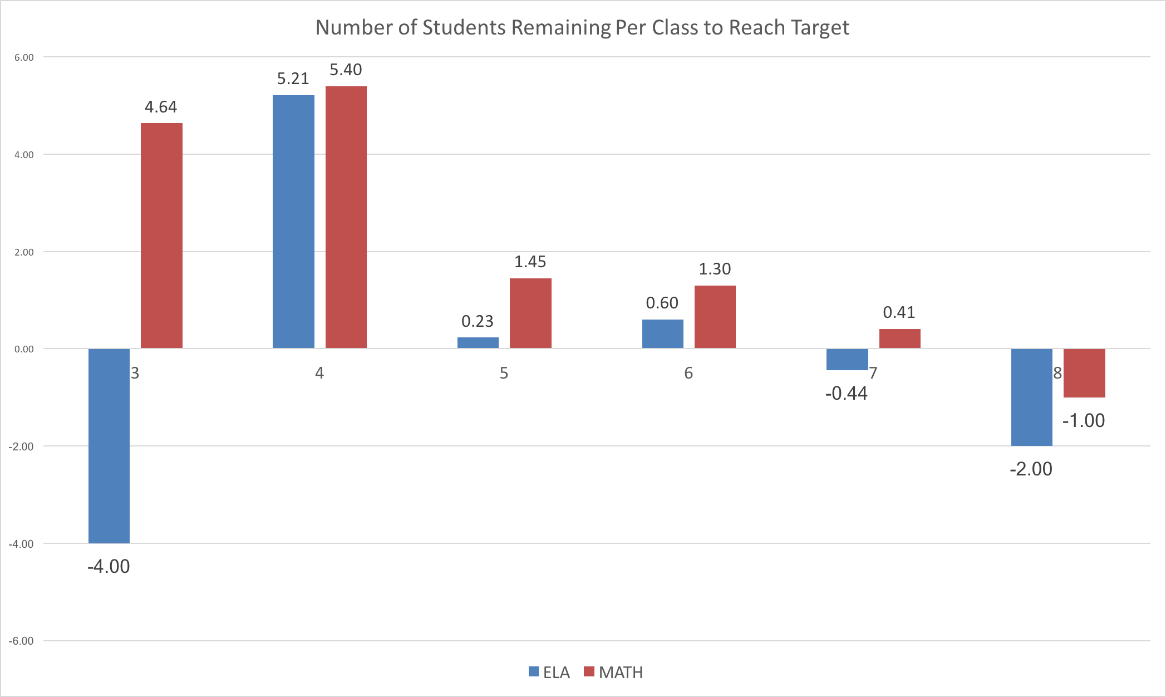
Students without exceptions: targeting needs by Grade level
Of this subgroup, an additional 4 students need to improve on ELA from Winter to Spring schoolwide. The majority of this growth deficit appears to be contributed by the 4th grade, making them the highest need for ELA intervention.
Of this subgroup, an additional 13 students need to improve on Math from Winter to Spring schoolwide. This growth deficit appears to be distributed across the lower grades, with 3rd and 4th grades most in need of math intervention.

Slide 6
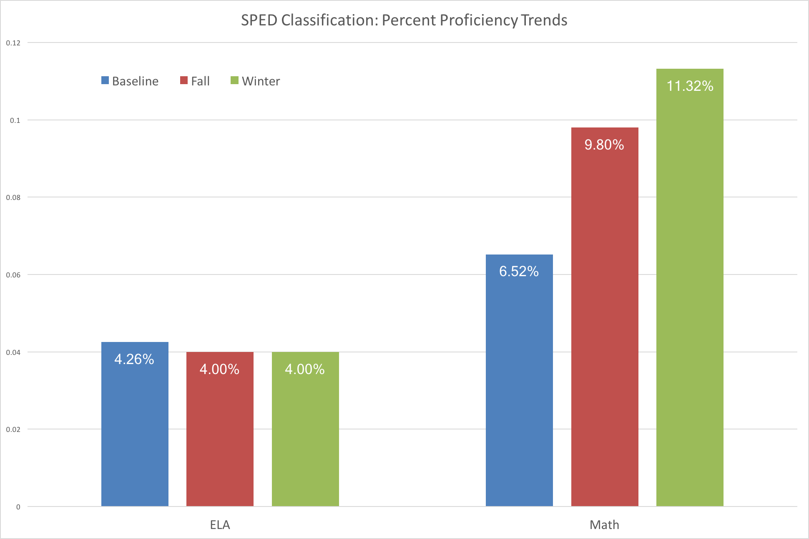
Students with exceptions: Math and ELA Trends
Based on (arbitrarily chosen for this exercise) 15% growth from baseline, target percentages for the SPED subgroup are
4.89% for ELA. Change in percent proficiency for ELA is minimal, however an additional student in SPED scoring proficient at the next testing interval would meet the growth target.
6.5% for Math. Change in percent proficiency for math has already exceeded this target by 3.8%. Any additional students in SPED scoring at or above proficient would add to this growth.

Slide 7
Notes on the Gifted Subgroup:
There are 4 students in the gifted subgroup; no visualization is included for their growth data due to the small sample size.
There is one student in this group, a fifth grader, with data that shows significant need for improvement, even relative to the non-gifted subgroup. Each score at every assessment interval is at level 1, with zero measurable growth.
ELA is at ”Basic” for the other fifth grader with the gifted classification.
All other scores in the gifted subgroup have reached level 3 or above. Further scores with similar performance will meet the growth goal for this subgroup, provided the above concerns are addressed.

