Slide 1
GreenGroceries

Slide 2
We are going to implement a e-commerce store that specifically sells fruits and vegetables in the UK.
customers can buy local produce by issuing orders to farms and then rate said farms
farmers can register their farms and sell their produce on the farms page
couriers deliver orders
The main purpose of this store is to provide local farmers with a modern day approach to selling their produce and compete with the big enterprises that control the fruits and vegetables market and offer subpar quality for very large (and growing) prices. We believe that farmers should be allowed to better provide for their own communities.
The data used to populate the database is taken from: Fruit and Vegetable Prices in UK (2017_2022) | Kaggle. This source provides all the necessary information about many types of fruits and vegetables, such as:
category (fruit, vegetable, cutflower)
subcategory (apple, tomato, etc.)
variety
price per unit
Unit
Data for some test users (couriers, farmers, farms) will be generated through a script (python, SQL)

Slide 3
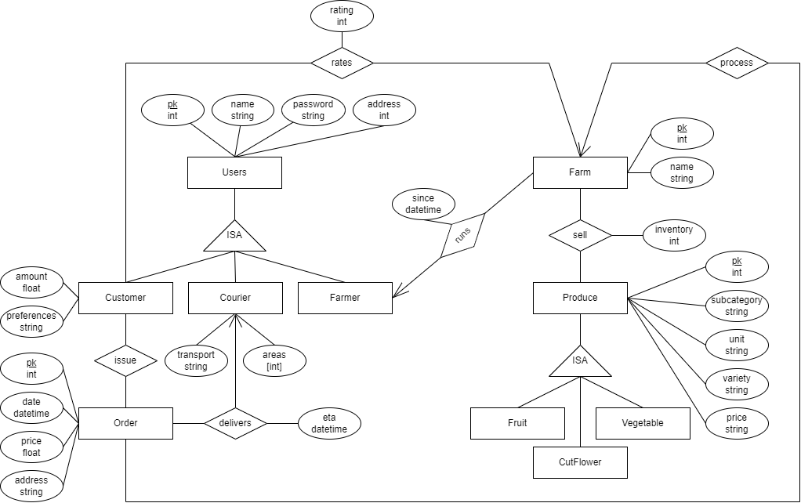
E/R Diagram

