Slide 1
SkiRent
Ski equipment rental and management software
Made by students of Szeged SZC Vasvári Pál Vocational School of Economics and IT
József Miklós Kovács
Gábor Varga

Slide 2
Identifying the problem
Ski rental shops often face difficulties managing bookings, tracking inventory, and providing a smooth customer experience.
Winter sports are not only relevant in winter - people may need ski equipment at any time of the year.
The solution
We created a user-friendly website for customers to book equipment online, and a desktop application for administrators to manage rentals, users, and inventory efficiently.

Slide 3
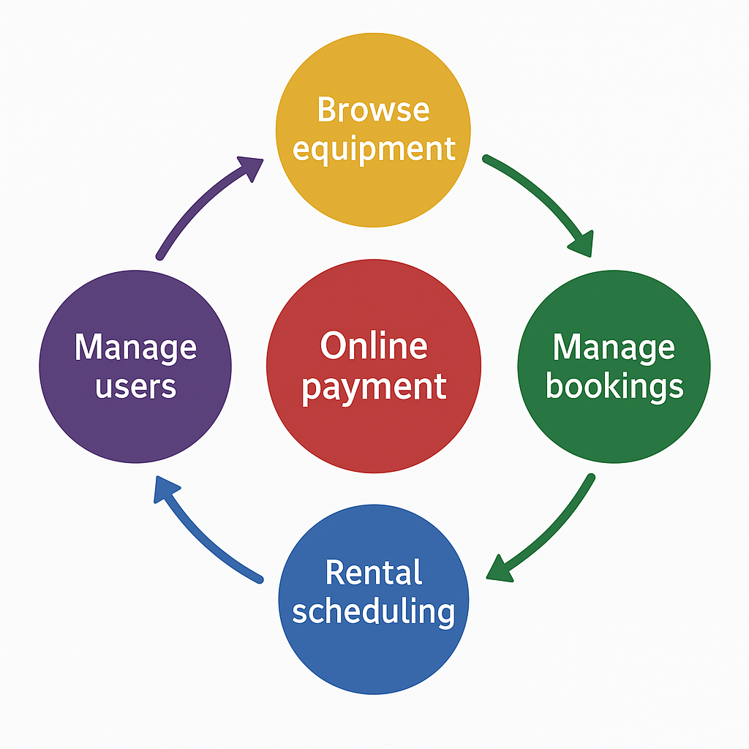
Main functions of the software
• Browse equipment for guest users - with limited features
• Admin management of bookings, users, equipment, and invoices
• Online payment support (demo integration)
• Registered users can view and manage their own bookings and invoices
• Equipment rental can be scheduled in advance through the website

Slide 4


The software
Backend - C#, ASP.NET Core
Swagger
RESTful API
Authentication and authorization
Thin controllers, business logic in services
Result patterns instead of exceptions between controllers and services
Generic repository
Dependency Injection
FluentValidation (shared with desktop app)
Desktop - C#, WPF
Model-View-ViewModel (MVVM) pattern
Dependency Injection
Database - MariaDB (MySQL fork)
Entity Framework Core

Slide 5


The software
Frontend - PHP, JavaScript
Vanilla JavaScript - DOM manipulation, event handling
Fetch API - backend communication
SessionStorage - temporary storage
Cookie-based authentication
Client-side validation
Dynamic content loading
Frontend - Style
CSS style
Bootstrap 5 - Modals and responsive layout and styling
Parallax scrolling

Slide 6
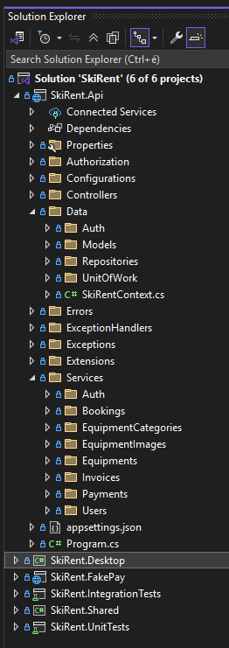
Backend
.NET 8 (LTS)
Cookie and token-based authentication supported
Admin and Customer roles
Invoices and uploaded images are stored in the local filesystem

Slide 7
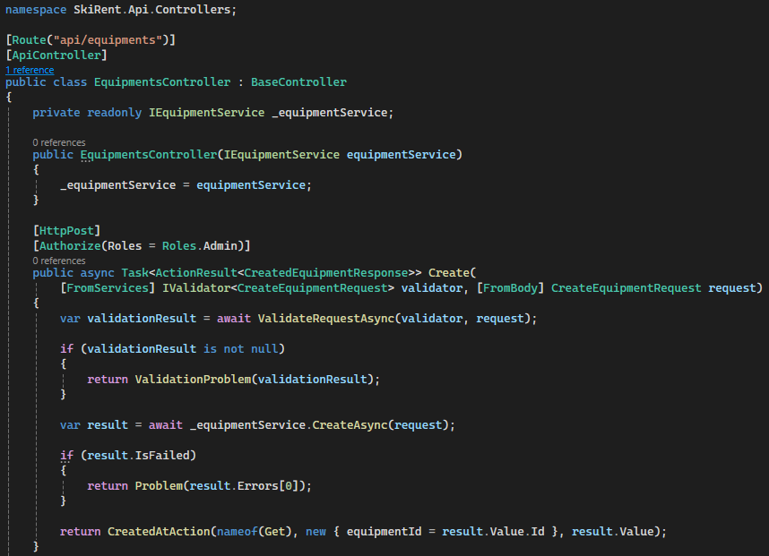
Controllers
Thin controllers:
Maintainability
Testability
Separation of concerns
Reusability
Readability

Slide 8
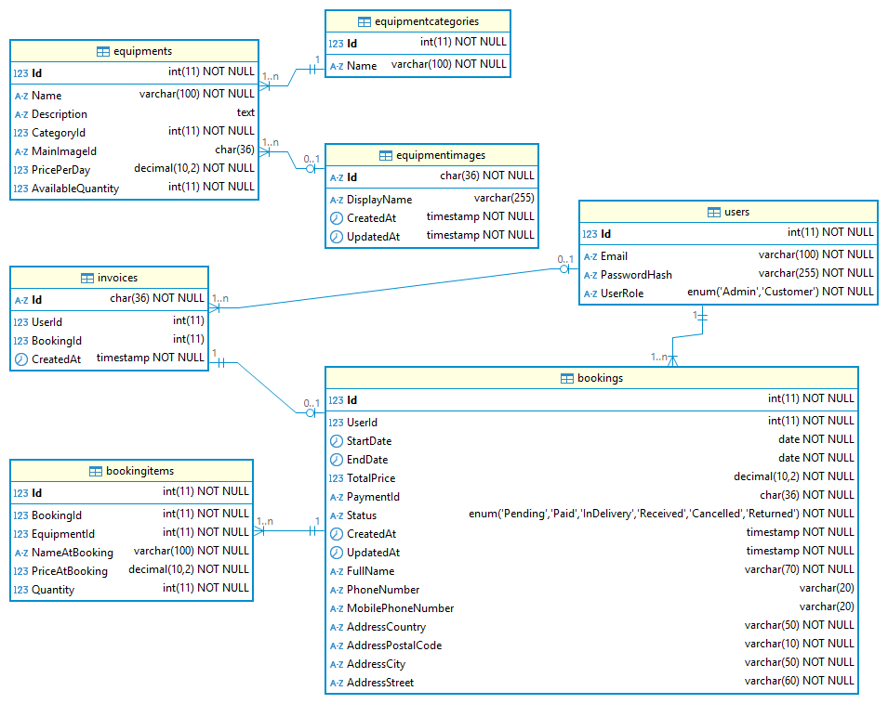
Database
MariaDB (MySQL fork)
Database First
Entity Framework Core
Sample data:
Equipments
Users
Bookings
7 tables

Slide 9
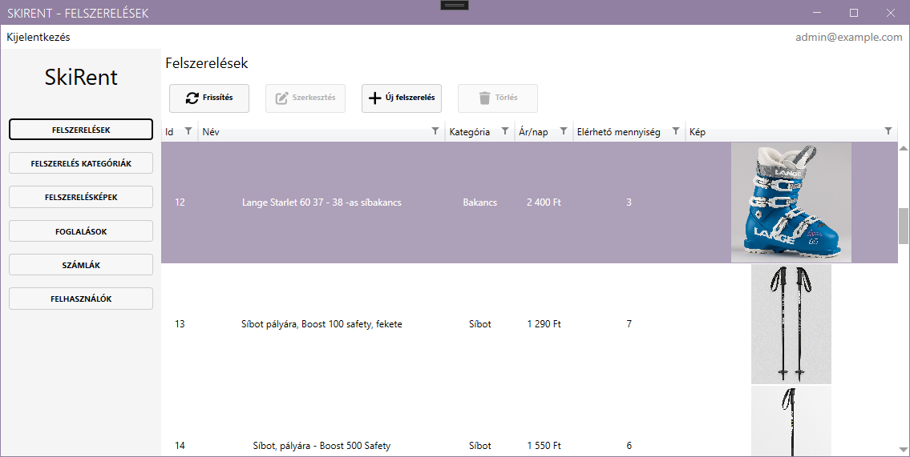
Desktop
.NET 8 (LTS)
Only administrators are allowed to log in
MahApps.Metro (style, icons)
Refit (REST library)
CommunityToolkit.Mvvm

Slide 10
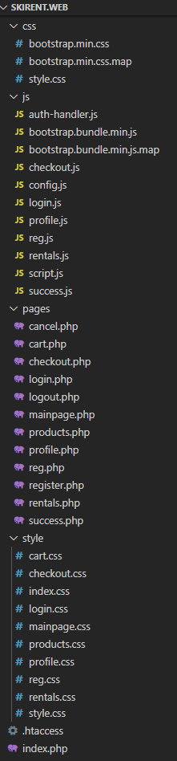
Frontend
Modular structure
Dynamic menu and products display.
Payment process integration (FakePay demo)
Invoice preview and print support
Detailed storage of bookings
Guest user menu
Logged-in user menu

Slide 11
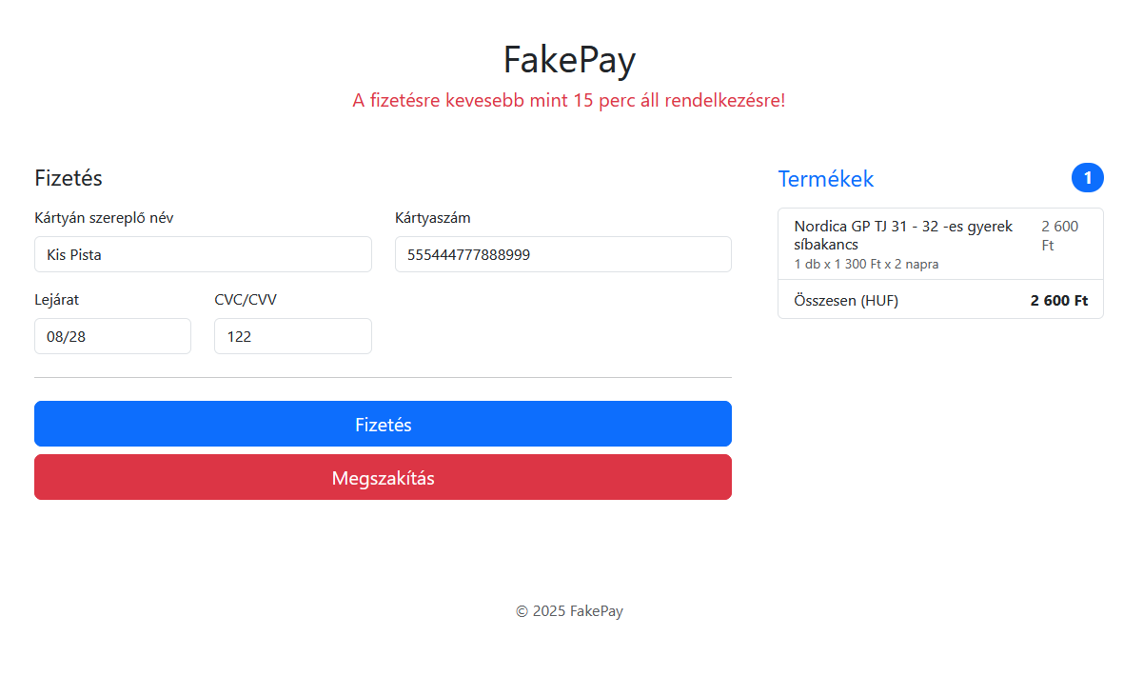
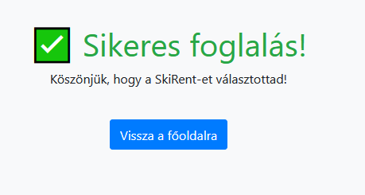
Payment
Redirects the user to the payment gateway
Request card details
Payment
Redirects to success page

Slide 12
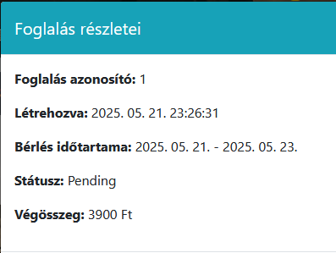
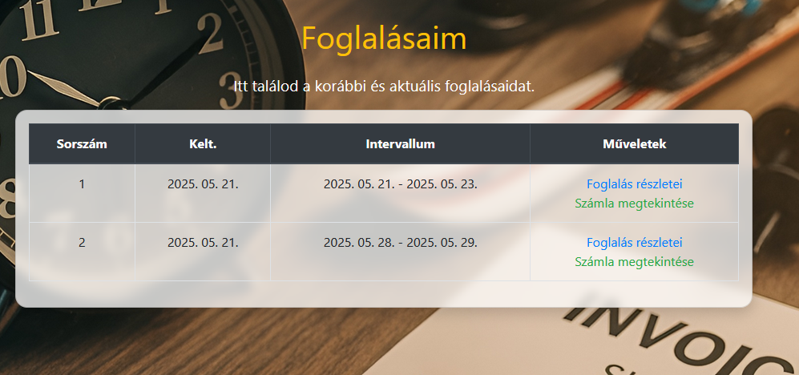
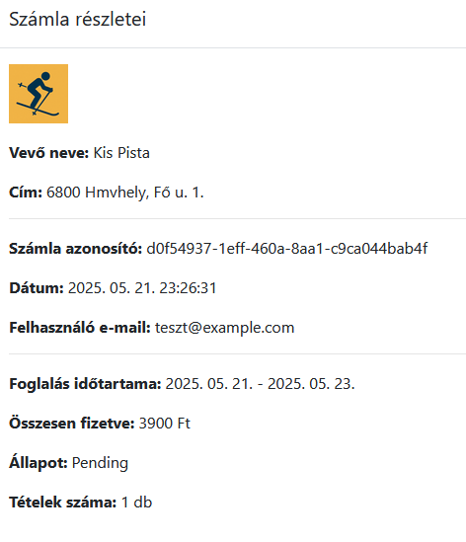

Bookings management
List previous bookings
Booking details, invoice, printing

Slide 13
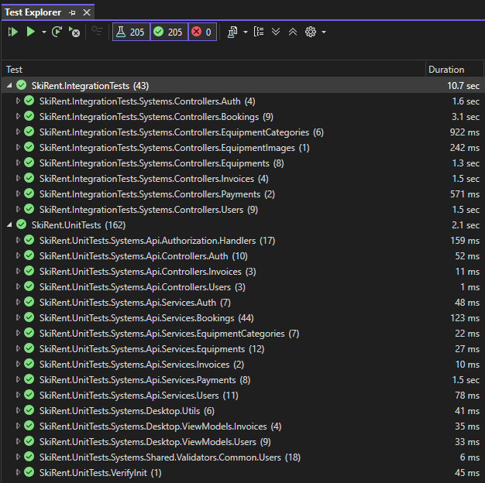
Tests
NUnit
AutoFixture
Unit tests
Integration tests
In Memory database
WebApplicationFactory
NSubstitute
Verify (for PDF content check)
Manual testing for desktop and frontend

Slide 14


Teamwork
GitHub
Discord
We both worked on the specification and the database
Gábor Varga developed the frontend and occasionally extended the backend, when necessary
József Miklós Kovács developed the backend, desktop application, and automated tests

Slide 15

Future ideas
Coupon system
Statistics, visual charts
Users
Bookings
Popular products
One-time sale items
Integration with real payment services like Stripe or SimplePay
Provide English localization for the entire software
Notification and alerts
Filtering and category system on the frontend

Slide 16
Thank you for your attention!
We’re happy to answer any questions
Project: https://github.com/2024e-vp-vizsgaremek/SkiRent
Team Members:
Gábor Varga - bsze3vargab@vasvari.org
József Miklós Kovács - bsze3kovjoz@vasvari.org

