Slide 1
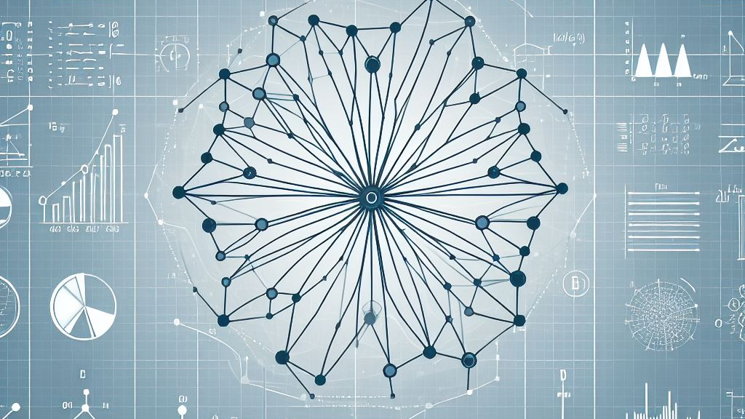
Investigating the Evolution of Fisher Information for Neural Network Dynamics
Marc Sauter

