Slide 1
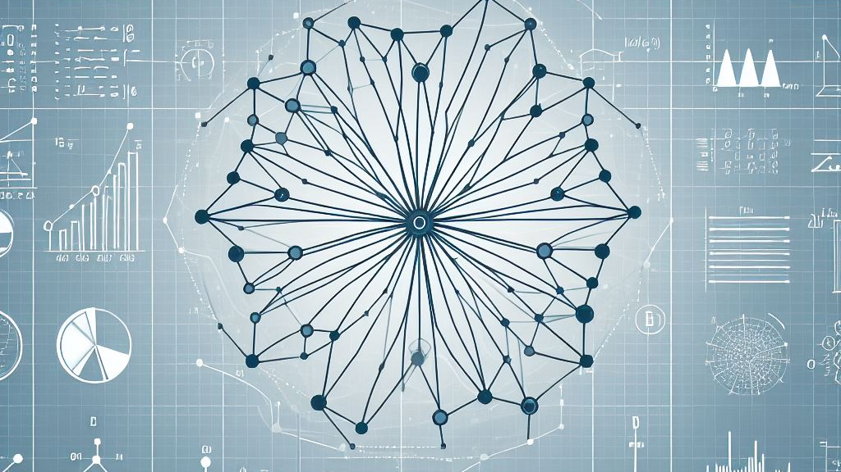
Investigating the Evolution of Fisher Information for Neural Network Dynamics
Marc Sauter

Slide 2
Fisher Information

Slide 3
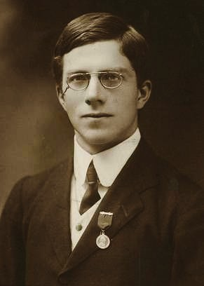
Fisher Information
https://commons.wikimedia.org/w/index.php?curid=42616717

Slide 4
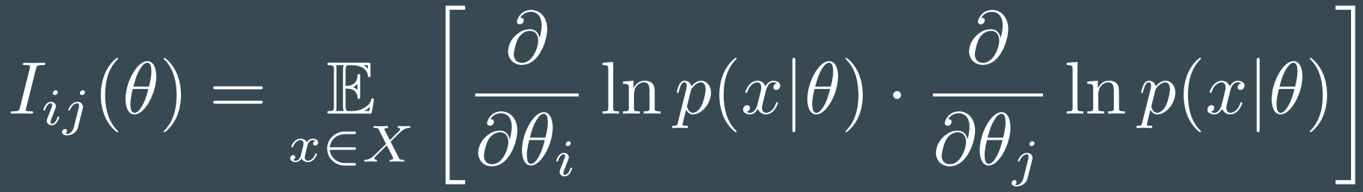
Fisher Information
https://commons.wikimedia.org/w/index.php?curid=42616717

Slide 5

Fisher Information
https://commons.wikimedia.org/w/index.php?curid=42616717

Slide 6

Fisher Information
https://commons.wikimedia.org/w/index.php?curid=42616717

Slide 7
Fisher Information
Probability distribution
Distribution parameters
https://commons.wikimedia.org/w/index.php?curid=42616717

Slide 8
Fisher Information in statistical physics
Gibbs measure
Thermodynamic variables
https://commons.wikimedia.org/w/index.php?curid=42616717

Slide 9
Fisher Information in statistical physics
Gibbs measure
Thermodynamic variables
Components of Fisher Information relate to order parameter derivatives
Prokopenko et al. (2011)
https://commons.wikimedia.org/w/index.php?curid=42616717

Slide 10
Fisher Information for Neural Networks

Slide 11
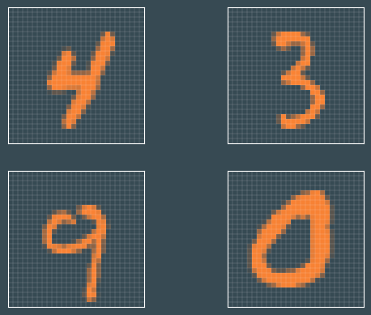
Fisher Information for Neural Networks
Dataset

Slide 12
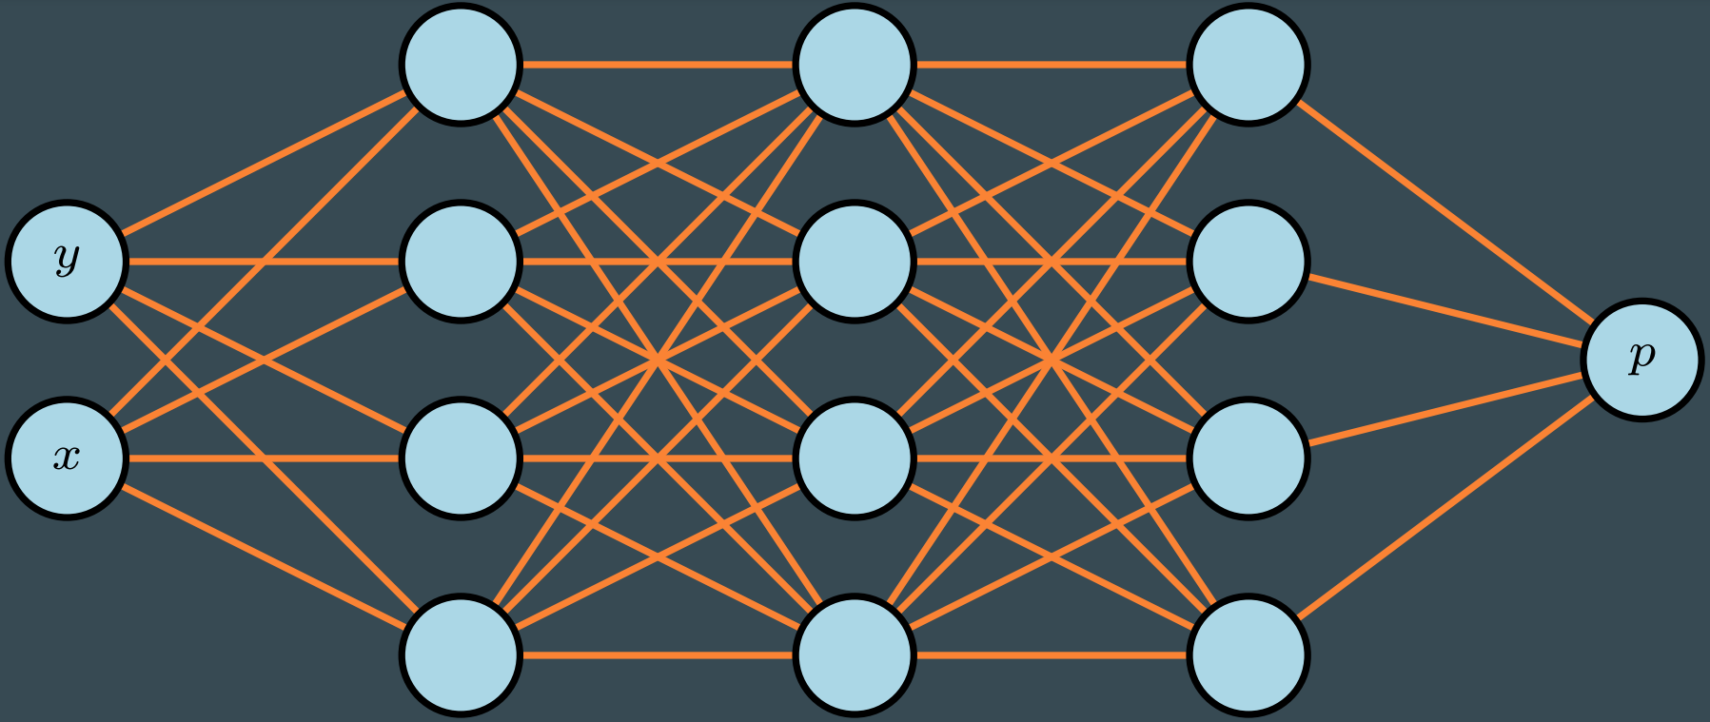
Fisher Information for Neural Networks
Dataset
Network

Slide 13
Fisher Information for Neural Networks
Dataset
Network
Introduce Loss function

Slide 14
Fisher Information for Neural Networks
Dataset
Network
Introduce Loss function
Training becomes minimization Problem

Slide 15

Fisher Information for Neural Networks

Slide 16
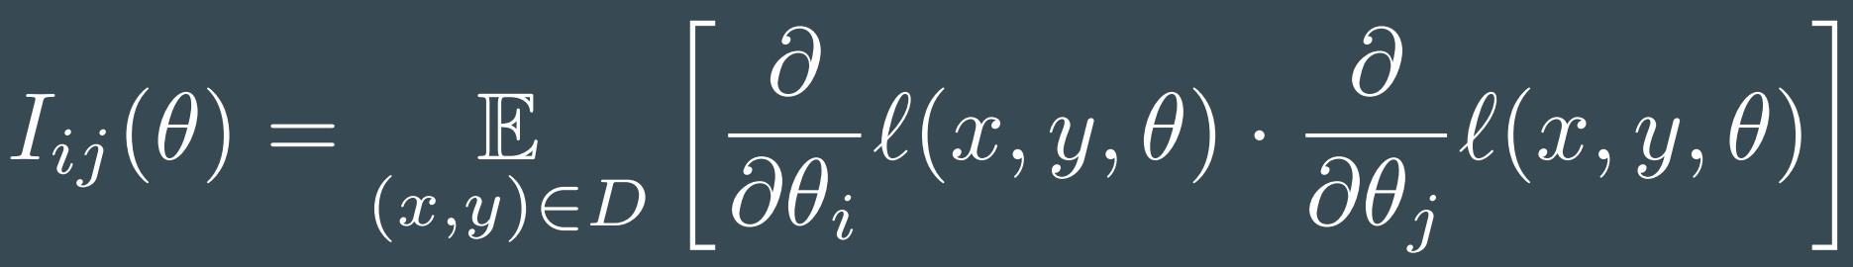
Fisher Information for Neural Networks

Slide 17
Fisher Information for Neural Networks
Established concept
Holds geometrical information
Has been utilized in optimization algorithms 30 years ago

Slide 18
Fisher Information for Neural Networks
Established concept
Holds geometrical information
Has been utilized in optimization algorithms 30 years ago

Slide 19



Analyzing the loss influence

Slide 20
Analyzing the loss influence

Slide 21
Experimental use

Slide 22
Experimental use

Slide 23
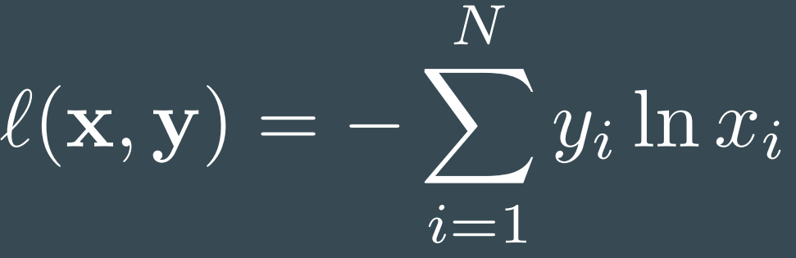
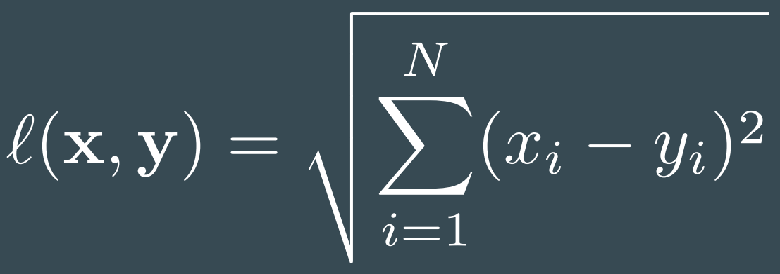
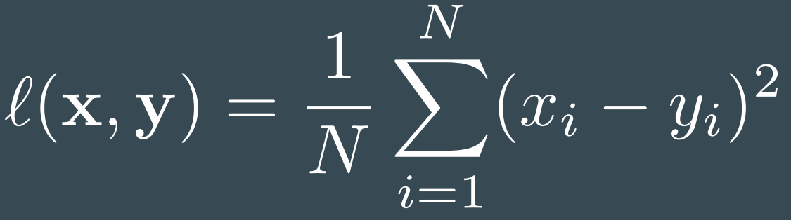
Experimental use
Cross Entropy | Lp norm of order 2 | Mean Squared Error

Slide 24
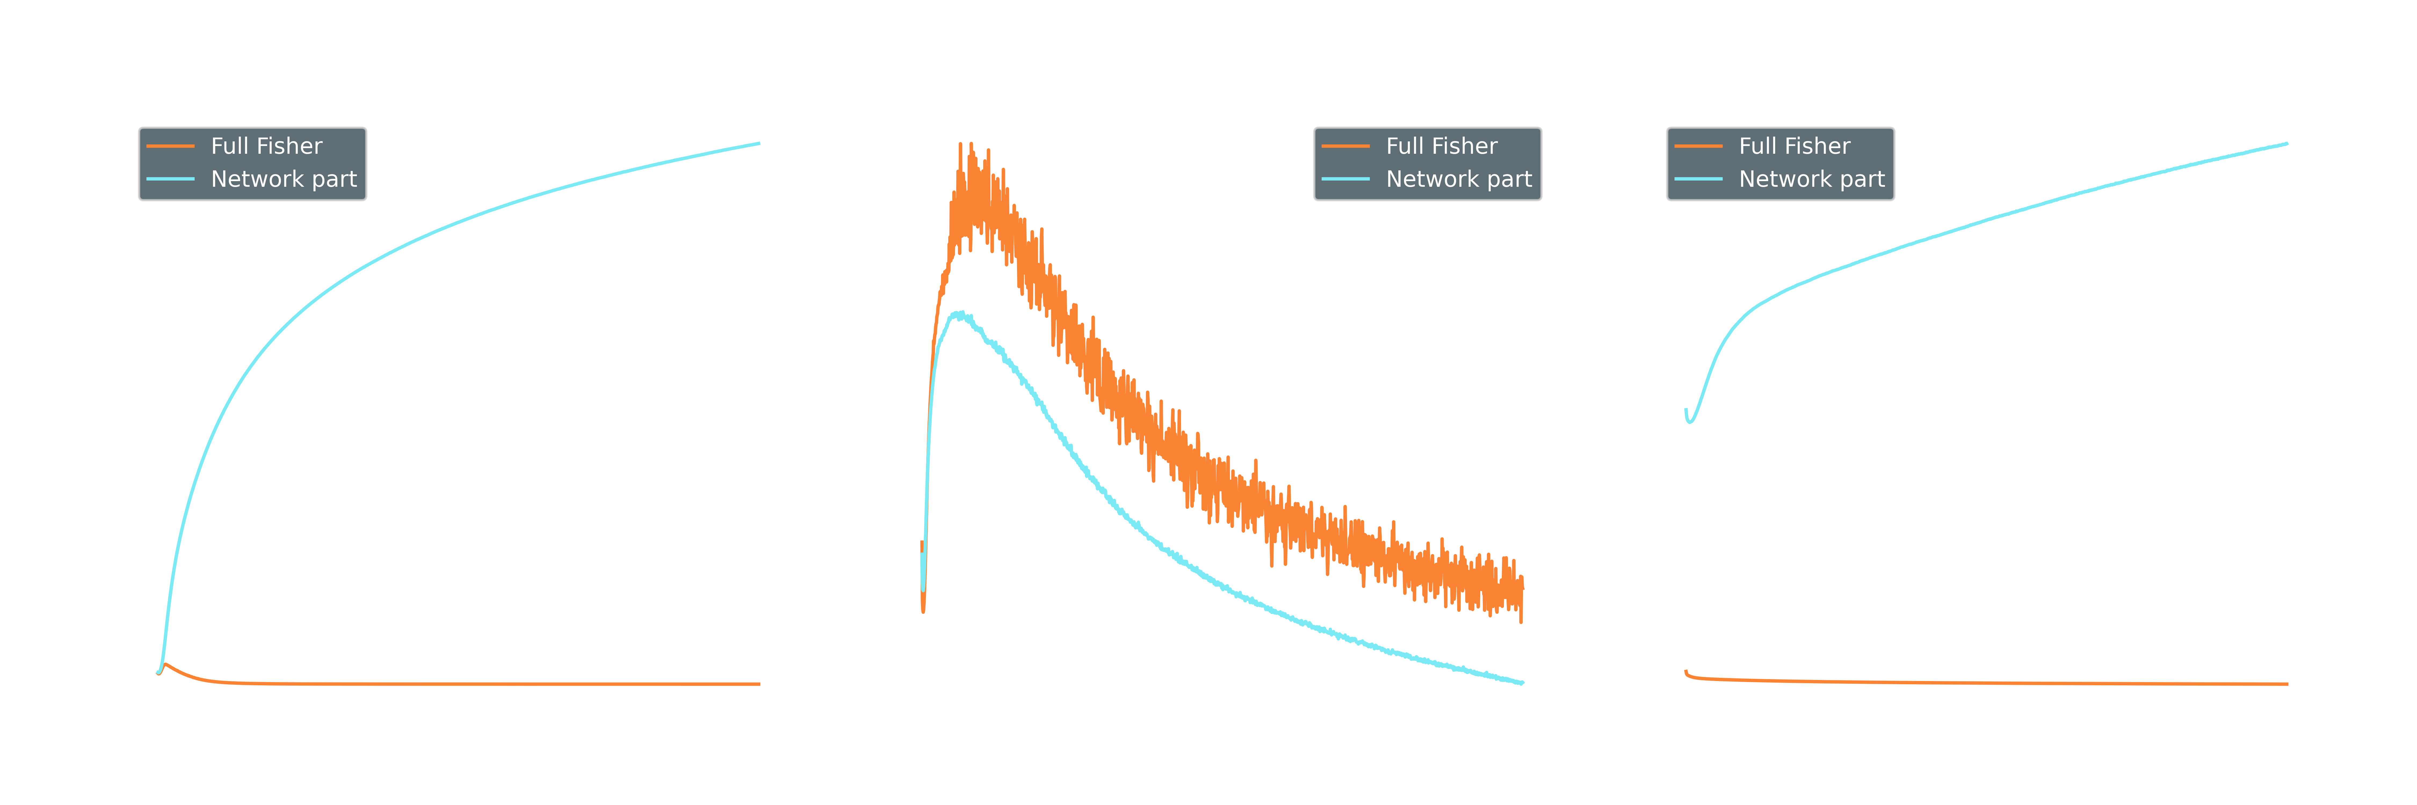
Experimental use

Slide 25
Experimental use

Slide 26
Experimental use

Slide 27
Experimental use

Slide 28
Experimental use

Slide 29
Experimental use

Slide 30
Experimental use

Slide 31
Experimental use

Slide 32
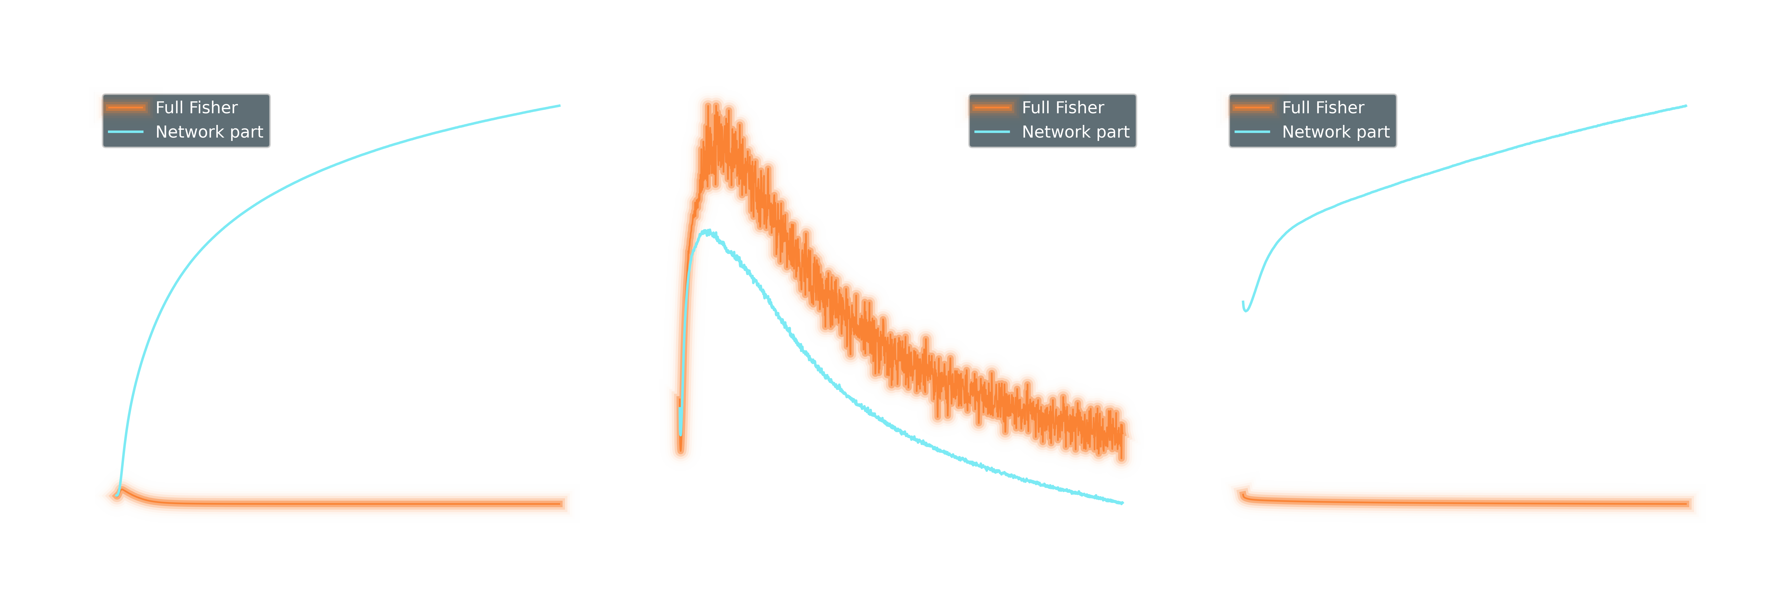
Experimental use

Slide 33
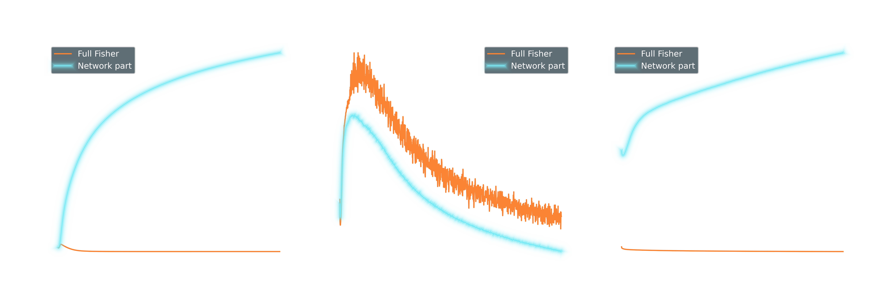
Experimental use

Slide 34
Experimental use

Slide 35
Experimental use

Slide 36
Experimental use

Slide 37
Experimental use

Slide 38
Experimental use

Slide 39
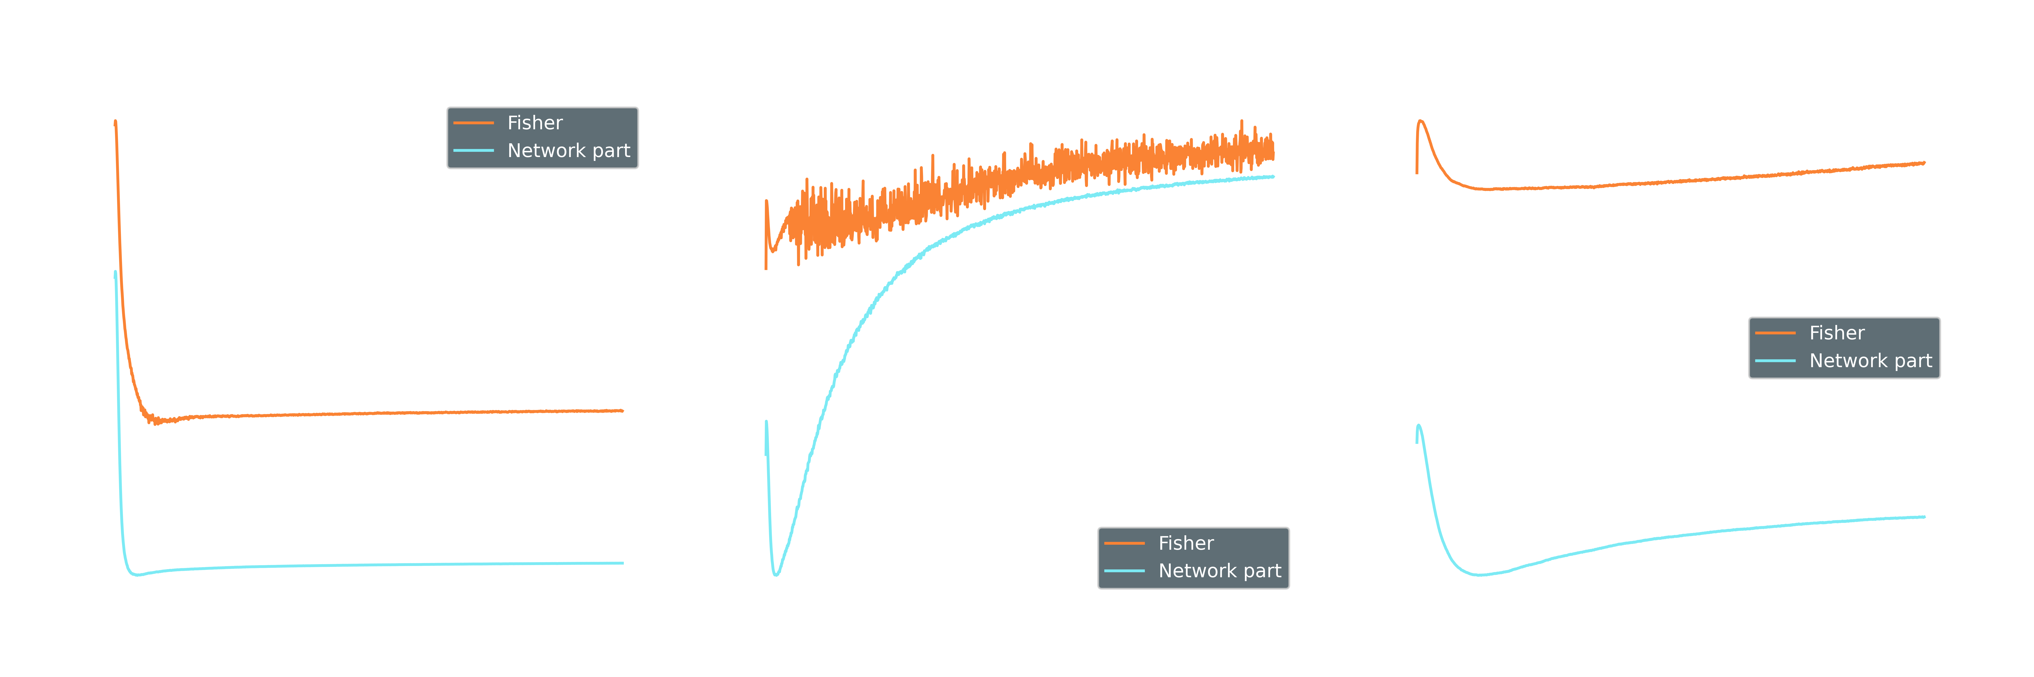
Experimental use

Slide 40
Experimental use

Slide 41
Experimental use

Slide 42
Experimental use

Slide 43
Experimental use

Slide 44
Summary and Outlook

Slide 45
Summary and Outlook
New application of Fisher information

Slide 46
Summary and Outlook
?
New application of Fisher information
New possible insights

