Slide 1

My dpg talk plans

Slide 2
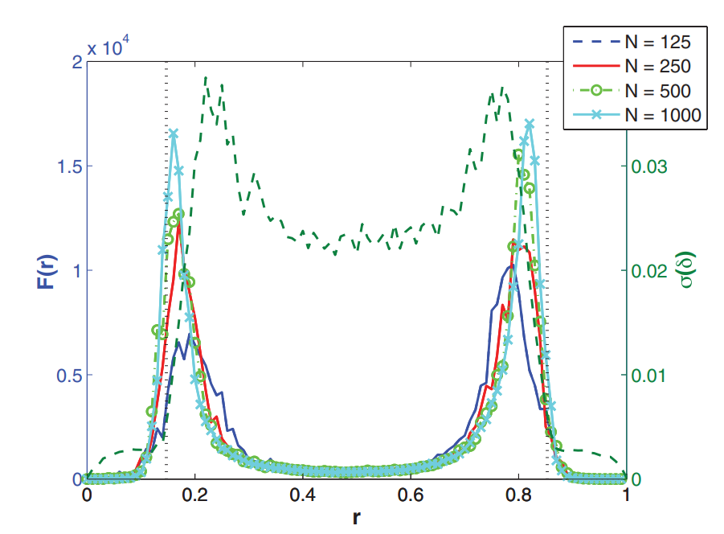
Introduce our group
People trying to understand ML using physics
Fisher as a method of finding phase transitions
Quickly brush over to motivate Fisher
Cross over to NNs
Introduce ML Notation
Explain metric nature
Emphasize computation issues

Slide 3
Introduce our group
People trying to understand ML using physics
Fisher as a method of finding phase transitions
Quickly brush over to motivate Fisher
Now apply Fisher to NNs
Introduce ML Notation
Explain metric nature
Mention Relation to NTK
Prokopenko et al. 2011
Introduce NTK
Short introduction like in Bachelors Defence

Slide 4
Introduce our group
People trying to understand ML using physics
Fisher as a method of finding phase transitions
Quickly brush over to motivate Fisher
Now apply Fisher to NNs
Introduce ML Notation
Explain metric nature
Mention Relation to NTK
Introduce NTK
Short introduction like in Bachelors Defence
Interpreting Fisher using NTK
Show relation between Eigenvalues of Fisher and „Loss NTK“
Discuss new Interpretation possibilities

Slide 5
Introduce our group
People trying to understand ML using physics
Fisher as a method of finding phase transitions
Quickly brush over to motivate Fisher
Now apply Fisher to NNs
Introduce ML Notation
Explain metric nature
Mention Relation to NTK
Introduce NTK
Short introduction like in Bachelors Defence
Interpreting Fisher using NTK
Show relation between Eigenvalues of Fisher and „Loss NTK“
Discuss new Interpretation possibilities

Slide 6
Introduce our group
People trying to understand ML using physics
Fisher as a method of finding phase transitions
Quickly brush over to motivate Fisher
Now apply Fisher to NNs
Introduce ML Notation
Explain metric nature
Mention Relation to NTK
Introduce NTK
Short introduction like in Bachelors Defence
Interpreting Fisher using NTK
Show relation between Eigenvalues of Fisher and „Loss NTK“
Discuss new Interpretation possibilities

