Slide 1

7COM1079-2022 Student Group No: Names of Student Attendees (all group should attend to get feedback):
1
Group Id: A147 Name of Student Presenting: Haroon
Data Analysis – Tutorial Presentation for Feedback Date:

Slide 2
7COM1079-2022 Student Group ID: A147
We are using the dataset DS115 Flight_data.csv to answer our Research question, “ Is there a correlation between price & duration for domestic flights in India?”
2
The dataset has 389 rows
The dependent variable is Price
The independent variable is Duration
FlightName | FlightCode | DepartingCity | DepartingTime | ArrivingCity | ArrivingTime | Duration | Price
Air India | AI 621 | Mumbai | 03:55:00 | Bengaluru | 05:50 | 115 | 2307
AirAsia | I5 670 | Mumbai | 19:55:00 | Bengaluru | 21:45 | 110 | 2773
AirAsia | I5 2992 | Mumbai | 23:55:00 | Bengaluru | 01:45 + 1 DAY | 110 | 2773
IndiGo | 6E 5388 | Mumbai | 21:30:00 | Bengaluru | 23:15 | 105 | 2839
Akasa Air | QP 1103 | Mumbai | 00:45:00 | Bengaluru | 02:20 | 95 | 3005
Akasa Air | QP 1103 | Mumbai | 00:45:00 | Bengaluru | 02:20 | 95 | 3005
Akasa Air | QP 1103 | Mumbai | 00:45:00 | Bengaluru | 02:20 | 95 | 3005
Akasa Air | QP 1341 | Mumbai | 20:00:00 | Bengaluru | 21:35 | 95 | 3005
Akasa Air | QP 1341 | Mumbai | 20:00:00 | Bengaluru | 21:35 | 95 | 3005
Akasa Air | QP 1139 | Mumbai | 18:05:00 | Bengaluru | 19:40 | 95 | 3053
IndiGo | 6E 6953 | Mumbai | 00:50:00 | Bengaluru | 02:40 | 110 | 3219
Akasa Air | QP 1306 | Mumbai | 19:00:00 | Bengaluru | 20:35 | 95 | 3283
Notes:
2

Slide 3
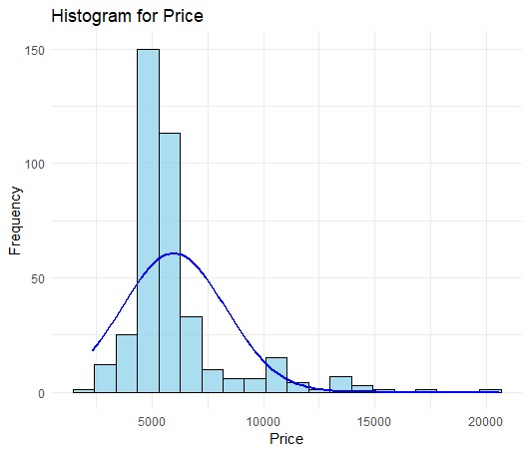
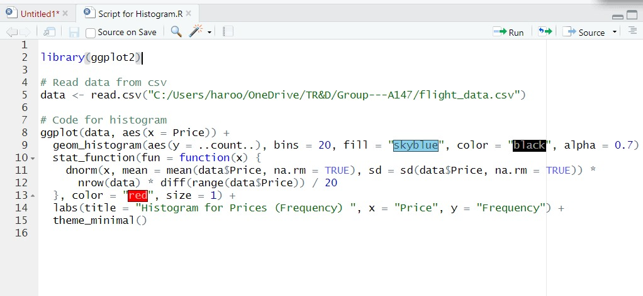
Here is a Histogram showing the frequencies of our dependent variable to include the normal curve overlay.
Our RQ asks about Correlation
The normal curve overlay does not follow the shape of the underlying data, so for our analysis we use the non-parametric test for correlation that does not assume normality: Spearman’s Rho
3
Notes:
3

Slide 4
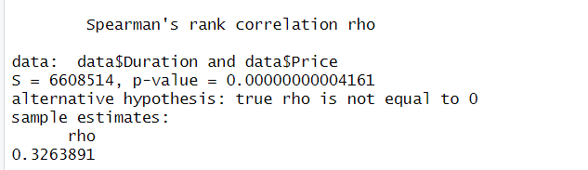
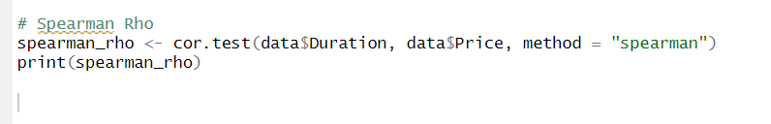
R Script and Results of Spearman’s Rho - The Analysis
PRE 7COM1079-2022 Student Group No: ?????
4
The values of the test statistic
The snippet of the R code for Spearman test
Notes:
4

Slide 5
R Script and Results of Spearman’s Rho - The Analysis (contd..)
The p-value is 0.00000000004161 < 0.05
The result is significant as it shows that p-value is less than 0.05
As the p-value is significant we can reject the null hypothesis.
To answer our RQ - the Spearman test result shows that There is a correlation between price and duration for domestic flights in India.

