Slide 1







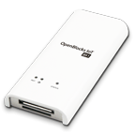


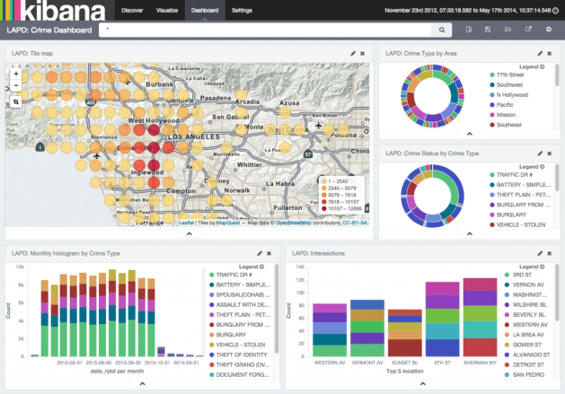
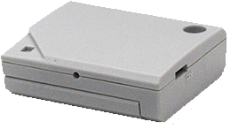
AWS IoT
Amazon Elasticsearch Service
AWS Lambda
jawsdays2016/sensor0
jawsdays20160312handson
SORACOM Air
Topic
Rule
jawsdays20160312_to_es
Kibana
3G
OpenBlocks IoT BX1
Wi-Fi
Serial
BLE
Control PC
Fujitsu Component Limited FWM8BLZ02
Icons made by http://www.freepik.com from http://www.flaticon.com is licensed by http://creativecommons.org/licenses/by/3.0 <CC 3.0 BY>

Slide 2
AWS IoT
Amazon Elasticsearch Service
AWS Lambda
jawsdays2016/sensor0
jawsdays20160312handson
SORACOM Air
Topic
Rule
jawsdays20160312_to_es
Kibana
3G
OpenBlocks IoT BX1
Wi-Fi
Serial
BLE
Control PC
Fujitsu Component Limited FWM8BLZ02
Icons made by http://www.freepik.com from http://www.flaticon.com is licensed by http://creativecommons.org/licenses/by/3.0 <CC 3.0 BY>

Slide 3
AWS IoT
Amazon Elasticsearch Service
AWS Lambda
jawsdays2016/sensor0
jawsdays20160312handson
SORACOM Air
Topic
Rule
jawsdays20160312_to_es
Kibana
3G
OpenBlocks IoT BX1
Wi-Fi
Serial
BLE
Control PC
Fujitsu Component Limited FWM8BLZ02
Icons made by http://www.freepik.com from http://www.flaticon.com is licensed by http://creativecommons.org/licenses/by/3.0 <CC 3.0 BY>

Slide 4
AWS IoT
Amazon Elasticsearch Service
AWS Lambda
jawsdays2016/sensor0
jawsdays20160312handson
SORACOM Air
Topic
Rule
jawsdays20160312_to_es
Kibana
3G
OpenBlocks IoT BX1
Wi-Fi
Serial
BLE
Control PC
Fujitsu Component Limited FWM8BLZ02
Icons made by http://www.freepik.com from http://www.flaticon.com is licensed by http://creativecommons.org/licenses/by/3.0 <CC 3.0 BY>

Slide 5
AWS IoT
Amazon Elasticsearch Service
AWS Lambda
jawsdays2016/sensor0
jawsdays20160312handson
SORACOM Air
Topic
Rule
jawsdays20160312_to_es
Kibana
3G
OpenBlocks IoT BX1
Wi-Fi
Serial
BLE
Control PC
Fujitsu Component Limited FWM8BLZ02
Icons made by http://www.freepik.com from http://www.flaticon.com is licensed by http://creativecommons.org/licenses/by/3.0 <CC 3.0 BY>

Slide 6
AWS IoT
Amazon Elasticsearch Service
AWS Lambda
jawsdays2016/sensor0
jawsdays20160312handson
SORACOM Air
Topic
Rule
jawsdays20160312_to_es
Kibana
3G
OpenBlocks IoT BX1
Wi-Fi
Serial
BLE
Control PC
Fujitsu Component Limited FWM8BLZ02
Icons made by http://www.freepik.com from http://www.flaticon.com is licensed by http://creativecommons.org/licenses/by/3.0 <CC 3.0 BY>

Slide 7
AWS IoT
Amazon Elasticsearch Service
AWS Lambda
jawsdays2016/sensor0
jawsdays20160312handson
SORACOM Air
Topic
Rule
jawsdays20160312_to_es
Kibana
3G
OpenBlocks IoT BX1
Wi-Fi
Serial
BLE
Control PC
Fujitsu Component Limited FWM8BLZ02
Icons made by http://www.freepik.com from http://www.flaticon.com is licensed by http://creativecommons.org/licenses/by/3.0 <CC 3.0 BY>

