Slide 1

A Connected Health System for Spain
Building a federated European Health Data Space
across the 17 regions of Spain
Better care for every citizen. Better research for every region.
Introduction for the Spanish Ministry of Health
May 2026

Slide 2
The challenge today
Spain's strength is regional autonomy. The cost is fragmentation.
Patients
Doctors
Researchers
A citizen who lives in Madrid and falls ill in Seville cannot share their medical history easily with the local doctor.
=> Primary use of data
Hospitals in different regions cannot see what care a patient already received elsewhere — tests get repeated, time is lost.
Studying a rare disease across Spain means asking 17 separate regions for permission, data, and approvals
=> Secondary use of data.
European Health Data Space · A federated approach for Spain

Slide 3
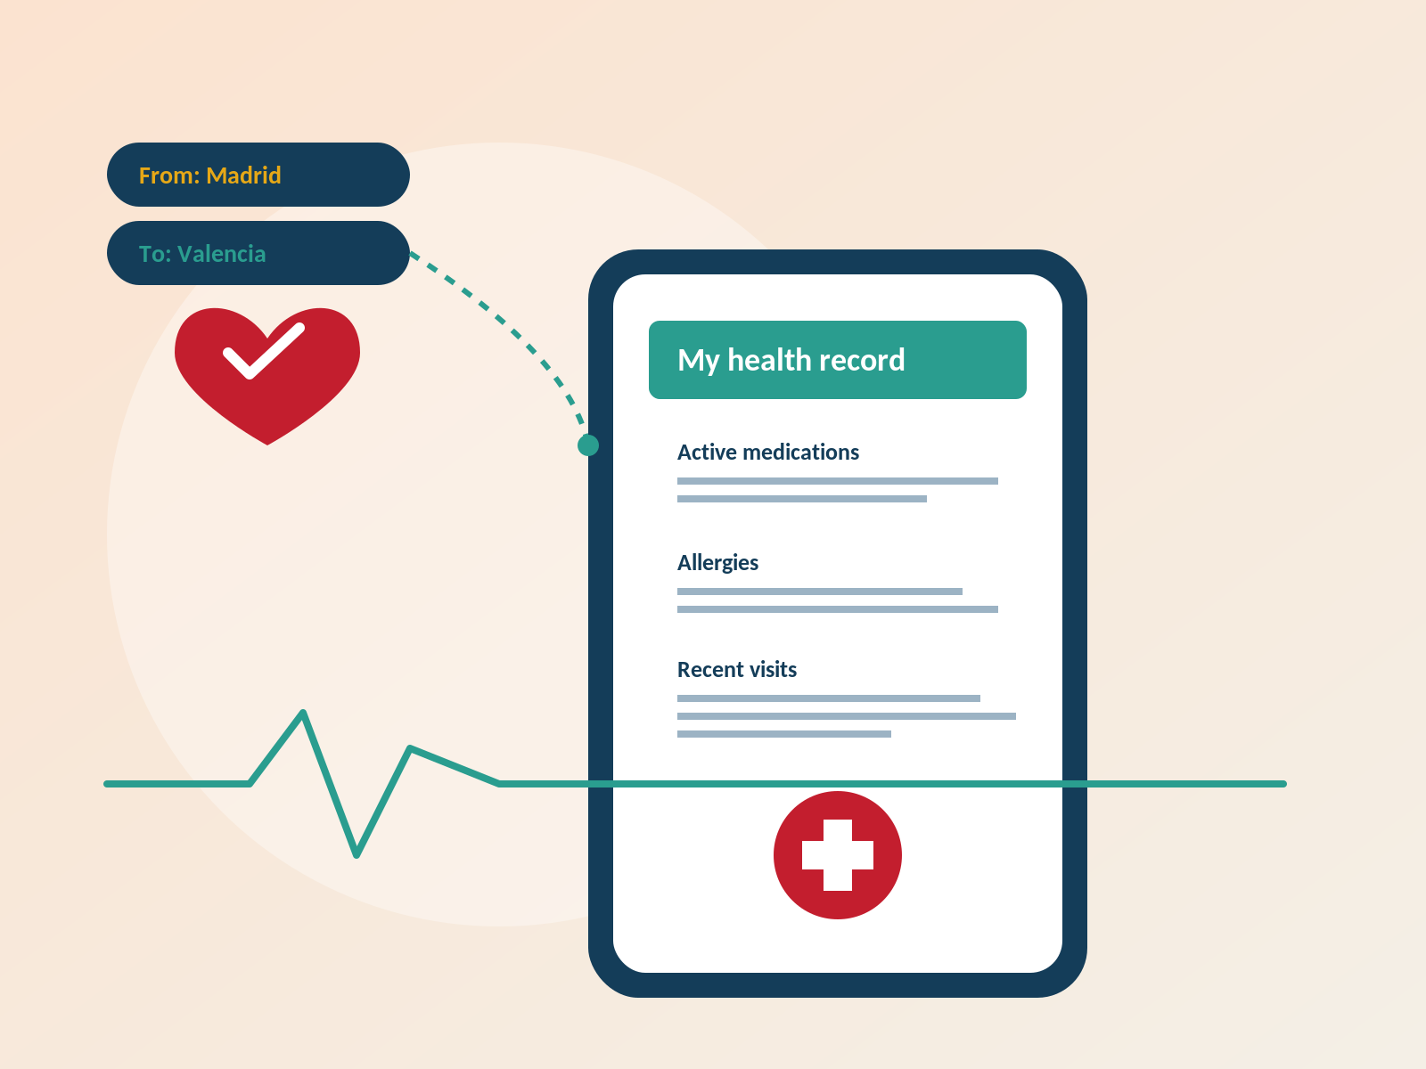
The patient — when care does not follow the citizen
Primary use of data. Continuous, safe care across all 17 regions of Spain.
Today's pain
Records do not travel.
A Madrid resident on holiday in Valencia has to recite their history at the desk.
Tests get repeated.
Lab results from one region cannot be seen by a hospital in another.
Allergies and prescriptions are blind spots.
In an emergency, doctors guess instead of read.
No single view of consent.
The citizen does not know who has accessed what, or how to revoke it.
What EHDS gives the patient
One record that follows them across regions and borders.
Always-visible consent and an access diary they control.
Right to view, correct, erase, and export their data.
European Health Data Space · A federated approach for Spain

Slide 4
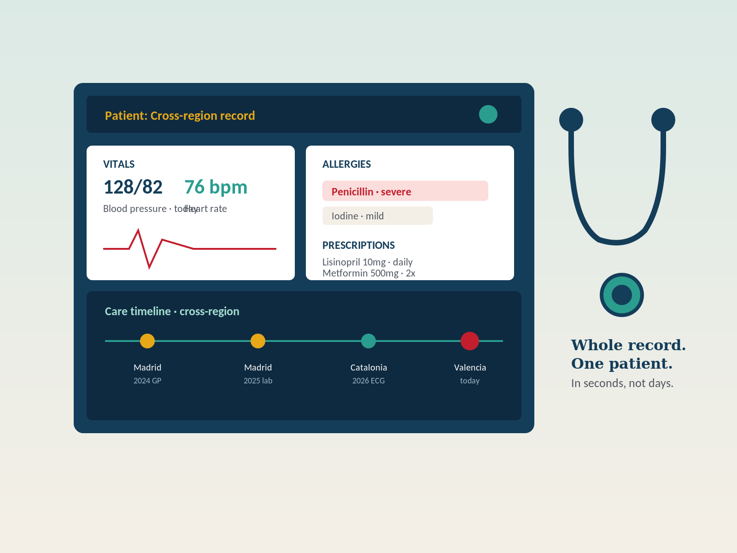
The doctor and hospital — data holders, not data prisons
Hospitals keep the records. They become safer when records can travel under the right rules.
Today's pain
Each hospital is an island.
Strong systems internally; nothing speaks to the next region.
Doctors face cognitive load.
Re-asking history wastes 15 minutes of every consult.
Liability without information.
Treating without the full picture is a clinical and legal risk.
Integration costs are repeated 17 times.
Every region builds its own bridge, often twice.
What EHDS gives the data holder
Common rules and shared connectors — build once, reuse 17 times.
Clear lawful basis and audit trail for every cross-region access.
Less duplicated tests, fewer repeated questions, safer care.
European Health Data Space · A federated approach for Spain

Slide 5
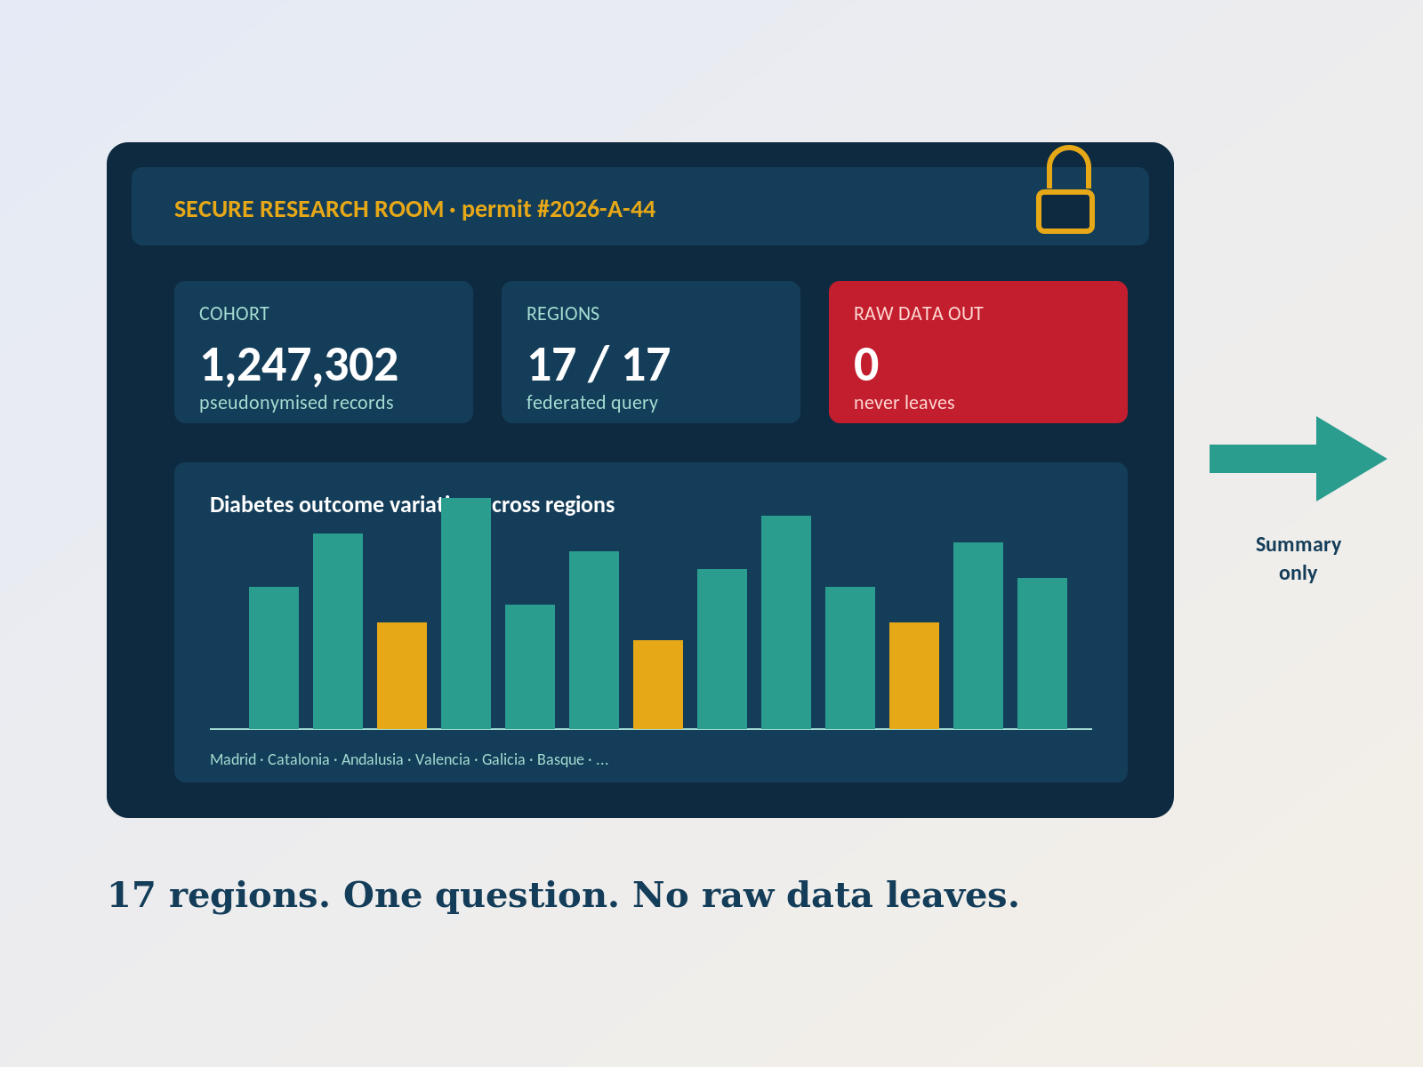
The researcher: 17 regions, 17 doors
Secondary use of data. Discovering Spain-wide patterns without ever exposing a single citizen.
Today's pain
Asking 17 regions takes 17 negotiations.
A study of diabetes outcomes across Spain stalls before it begins.
No common catalogue.
Researchers do not know what data exists and at what quality.
Re-identification fear blocks sharing.
Privacy concerns prevent even safe research.
Findings arrive years late.
By the time we know what works, the policy window has closed.
What EHDS gives the researcher
One application, one approval — federated query across 17 regions.
Pseudonymous data inside a secure room; only summaries leave.
A public catalogue with quality labels and clear lawful basis.
European Health Data Space · A federated approach for Spain

Slide 6
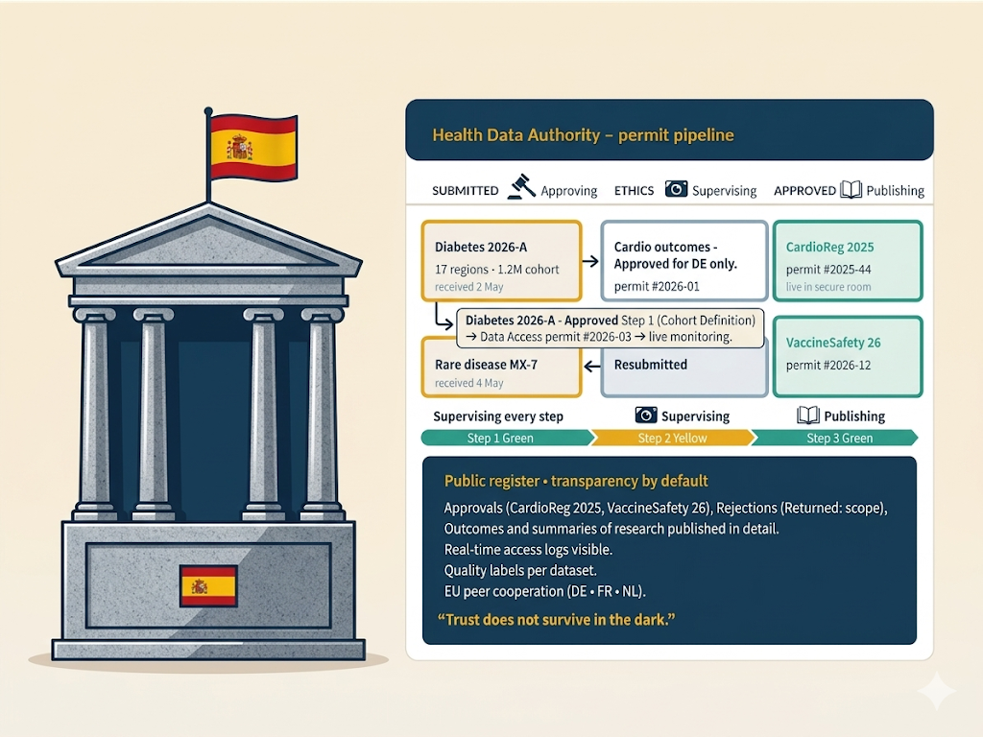
The regulator: keeping trust visible
Health Data Authority. Approving every secondary use, supervising every step, publishing every outcome.
Today's pain
No single point of accountability.
Citizens do not know who decides who can access what.
Slow, manual approvals.
Each request is hand-evaluated with no shared evidence base.
Limited cross-border peer cooperation.
EU-level cooperation requires Spanish counterparts ready to engage.
Penalties exist but are invisible.
Without a public register, sanctions do not deter misuse.
What EHDS gives the regulator
A clear remit: gatekeeper for every secondary use.
A standard process for approval, ethics, and supervision.
A public register that makes oversight legible to citizens and the EU.
European Health Data Space · A federated approach for Spain

Slide 7






17 autonomous regions, one Spain, one EHDS
Each region keeps its data and its rules. The federation lets care and research cross the lines.
+ Aragón · Asturias · Balearic Islands · Canary Islands · Cantabria · Castile-La Mancha · Castile and León · Extremadura · La Rioja · Murcia · Navarre
European Health Data Space · A federated approach for Spain

Slide 8
Two ways data helps people
Both are equally important. Both follow strict rules.
1. For your care
2. For better health policy
Doctors see what they need to treat you.
Researchers learn from millions of records.
• Your medical record follows you across hospitals and regions.
• Emergency doctors can see allergies and prescriptions in seconds.
• Less repeated tests, less lost paperwork, faster care.
• You decide what is shared and you can withdraw consent.
• Hospitals and regions share patterns, never names.
• Researchers spot diseases earlier and find better treatments.
• The Ministry sees what is working in different regions.
• Every research request is approved and supervised.
European Health Data Space · A federated approach for Spain

Slide 9
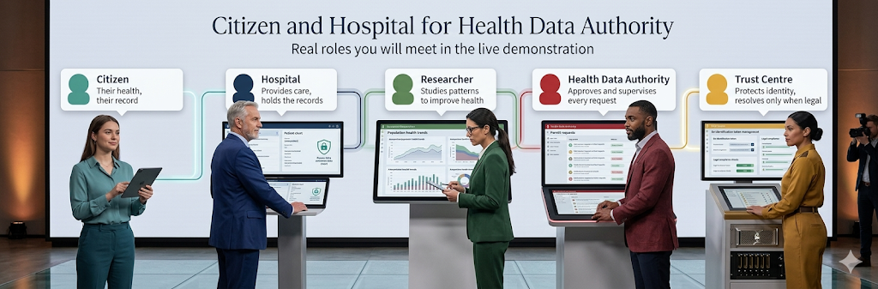
The five roles in the system
Real roles you will meet in the live demonstration.
European Health Data Space · A federated approach for Spain

Slide 10
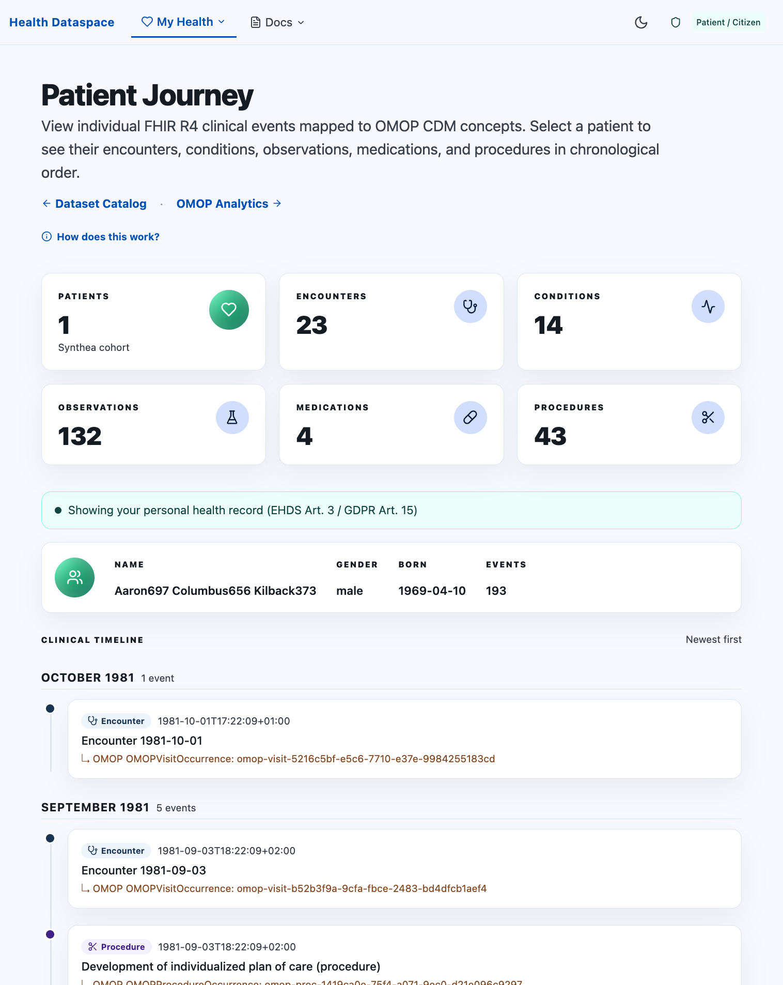
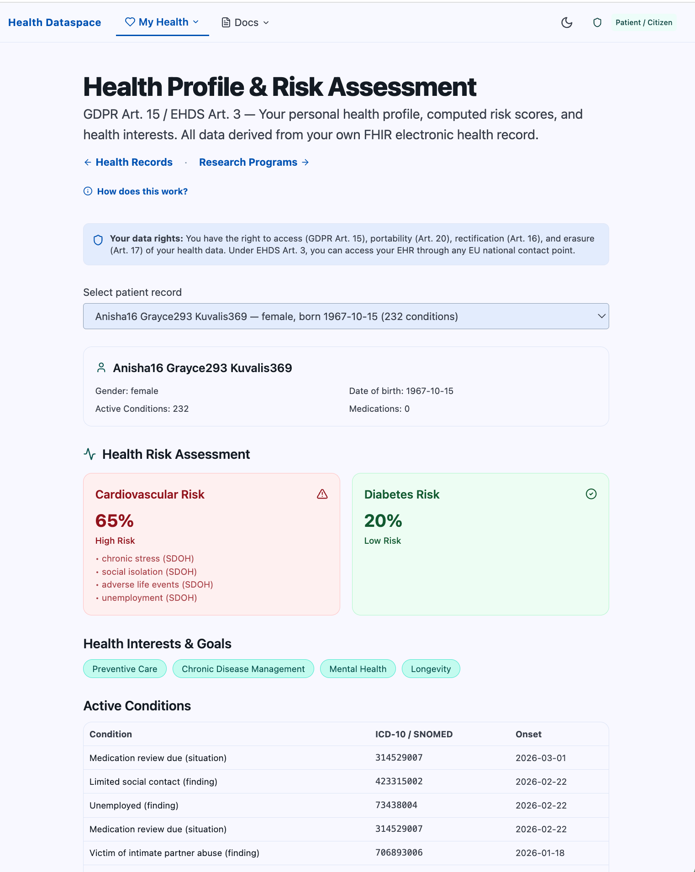
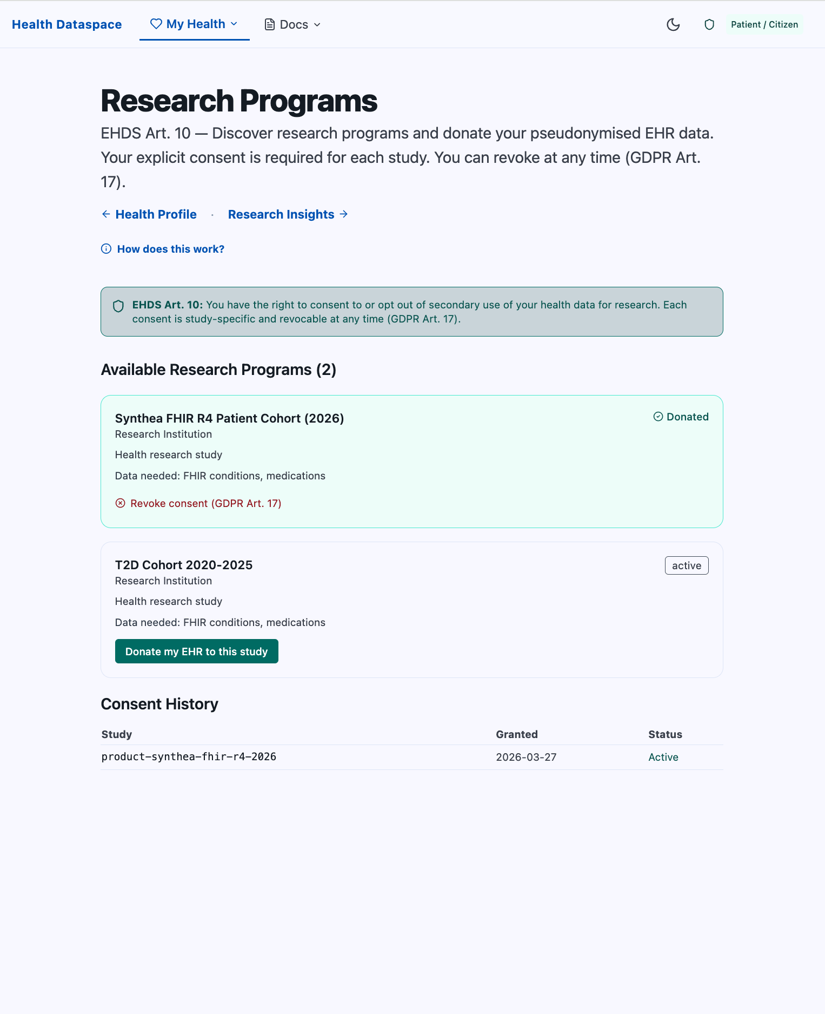
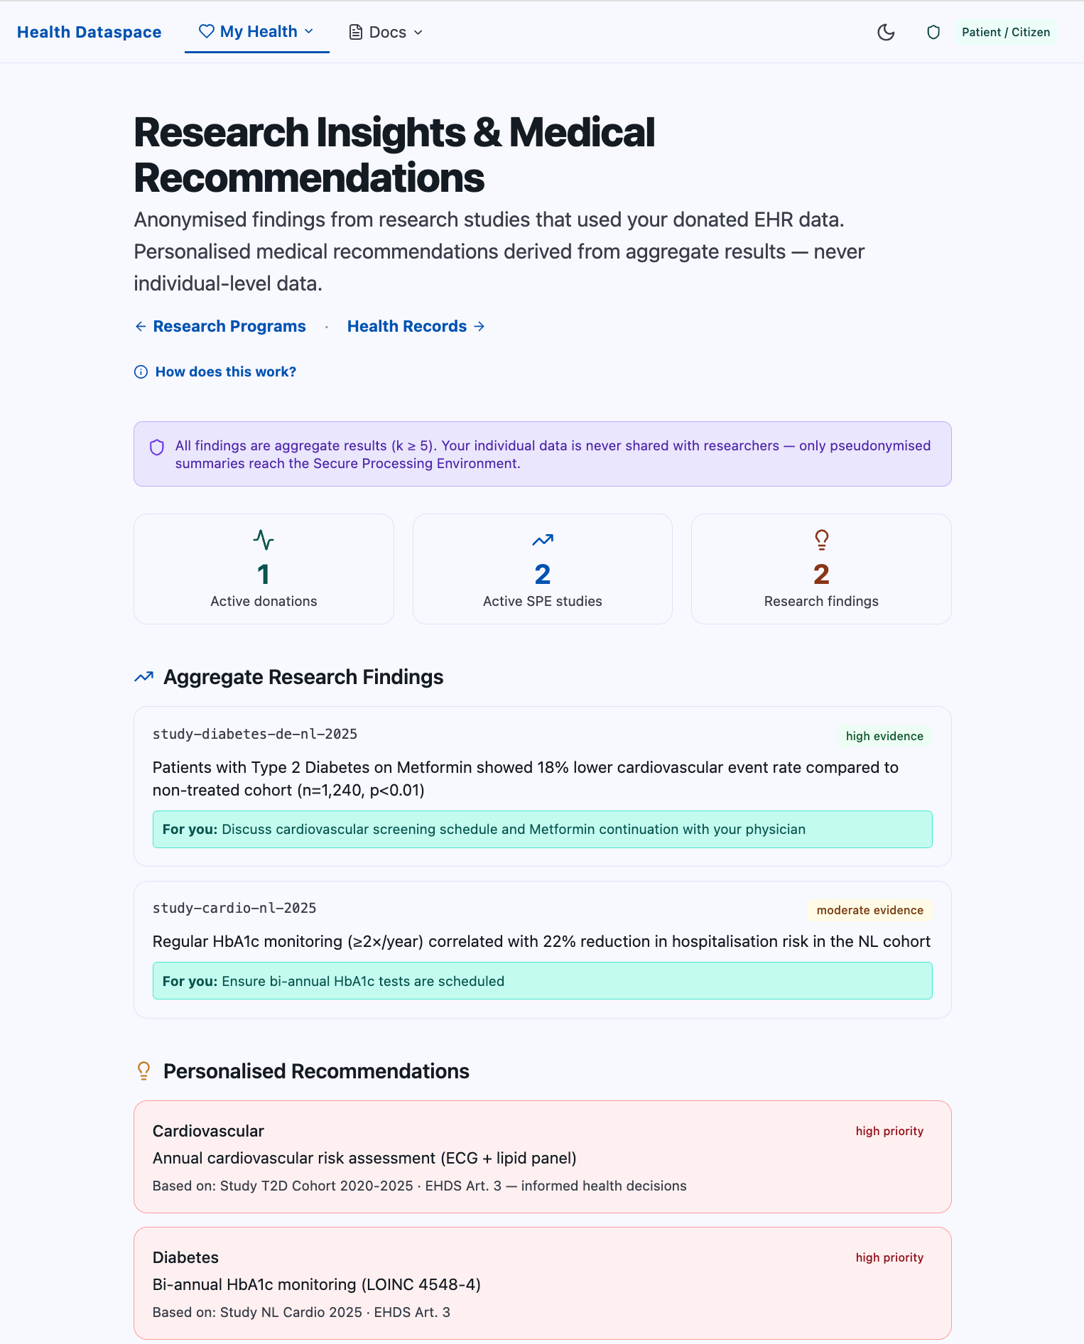
The Patient User Journey
What I have built as a Longevity Enthusiast with a known risk.
My Electronic Health Record
Know My Health Risks
Know the Research Programs that fit my risks
I want to discuss with my doctor the result of the study
European Health Data Space · A federated approach for Spain

Slide 11
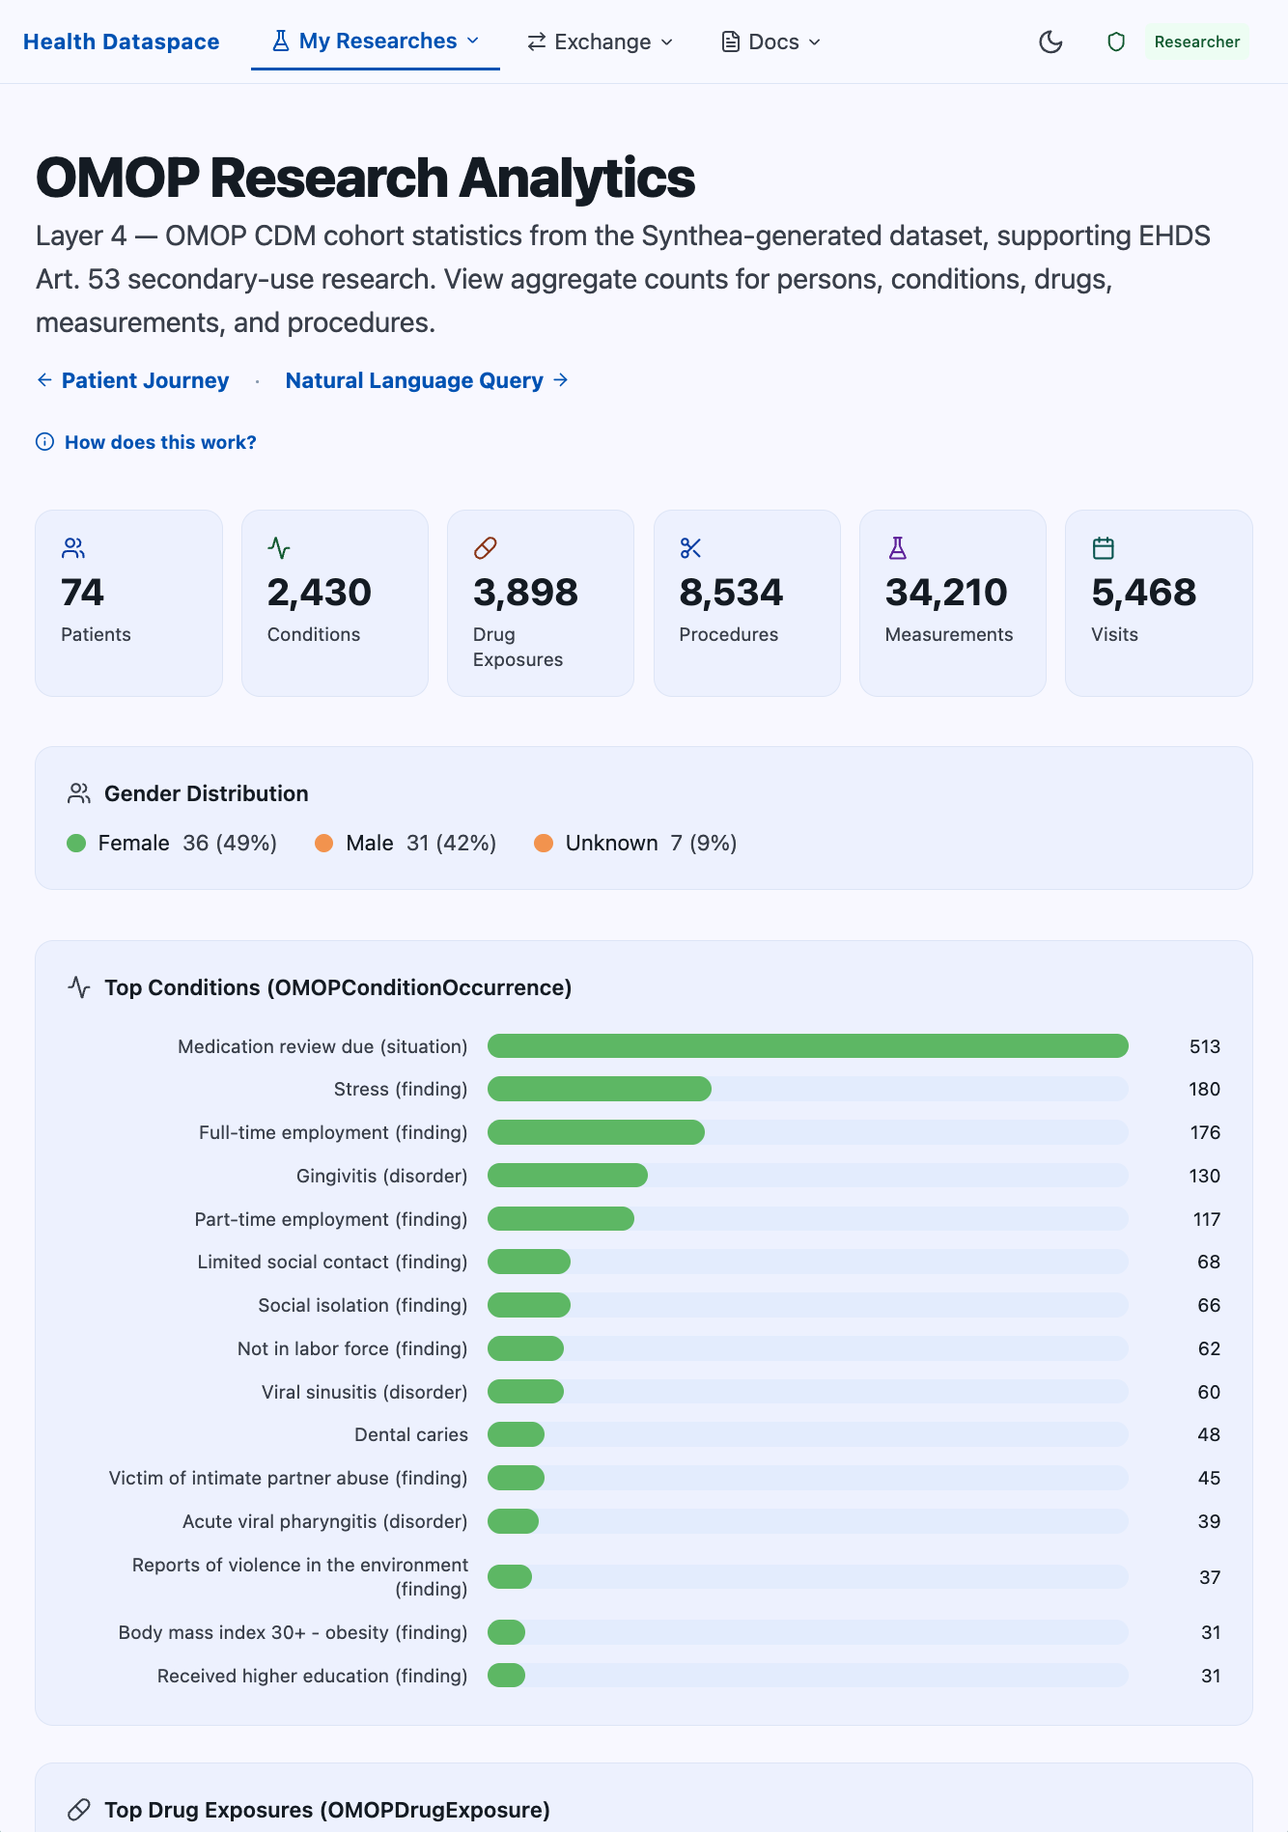
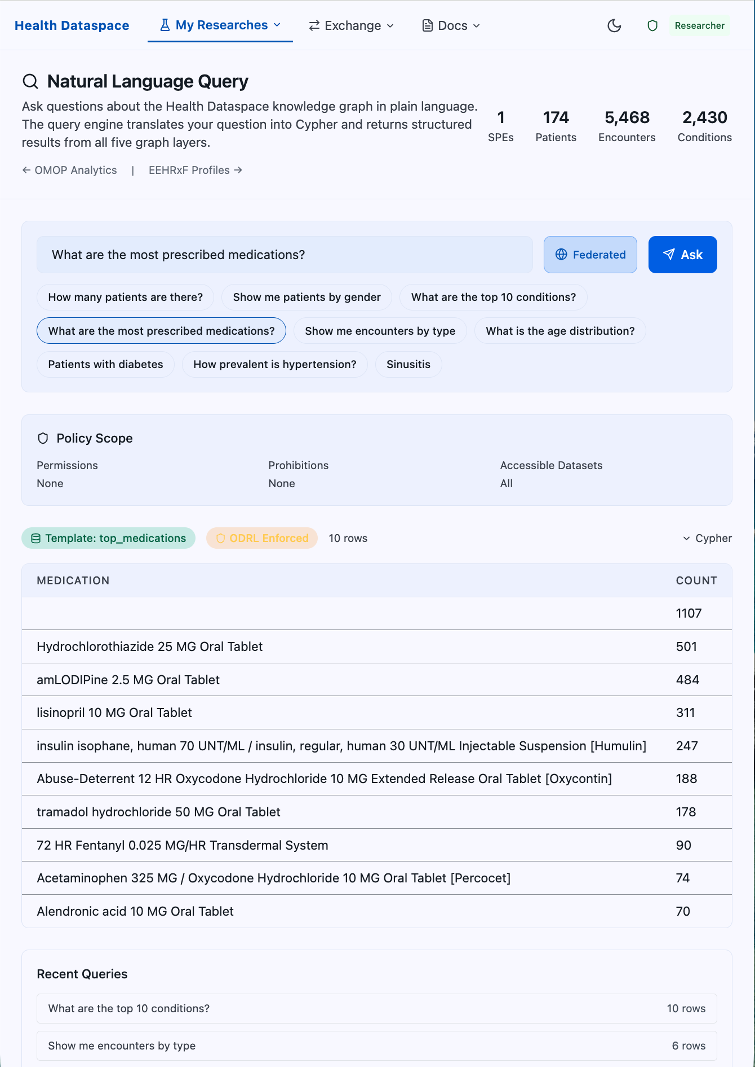
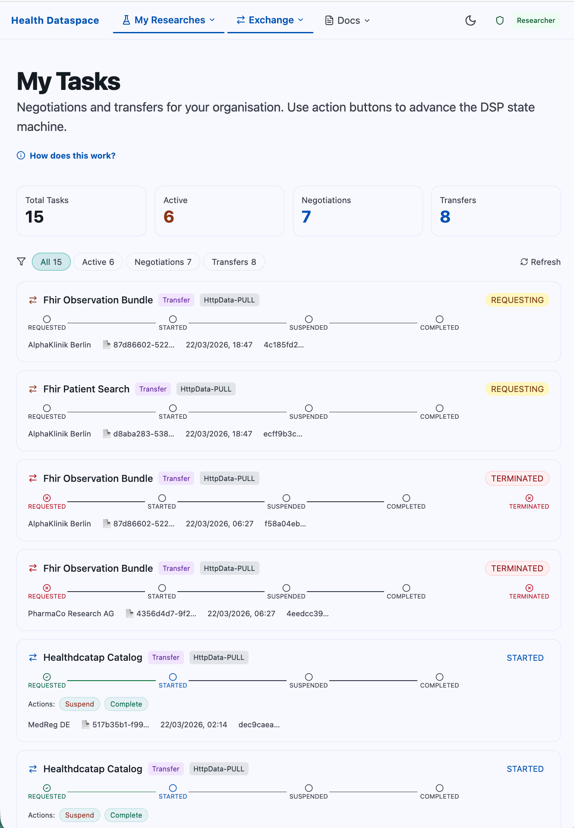
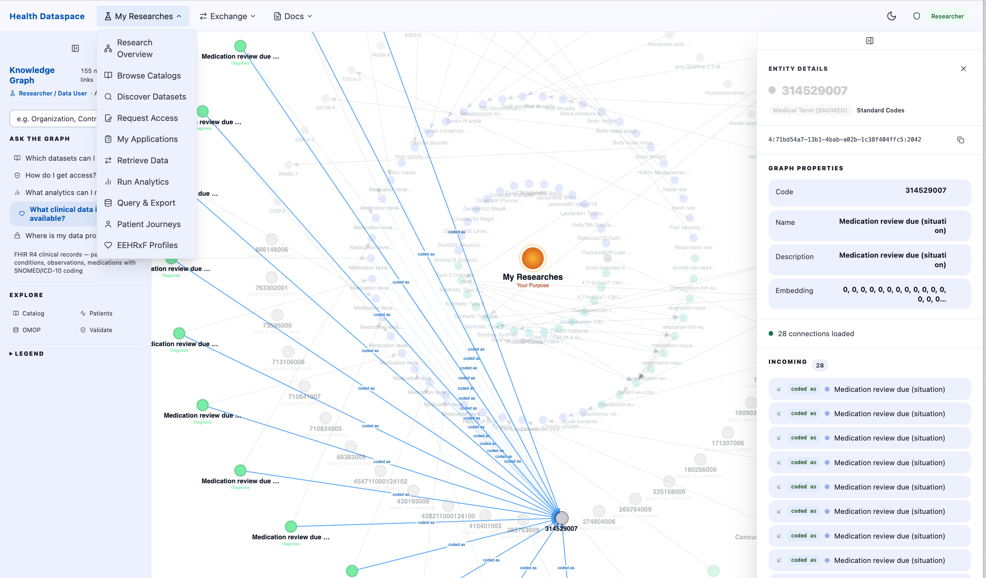
How it works for research
A researcher studies how diabetes treatment differs across regions.
1
Discover
2
Approve
3
Protect
4
Analyse
5
Publish
Researcher submits a clear question and a study plan.
Health Data Authority checks purpose, ethics, scope.
Trust Centre replaces names with safe pseudonyms.
Researcher works inside a secure room. Data never leaves.
Only summary results come out. No individual is identifiable.
European Health Data Space · A federated approach for Spain

Slide 12
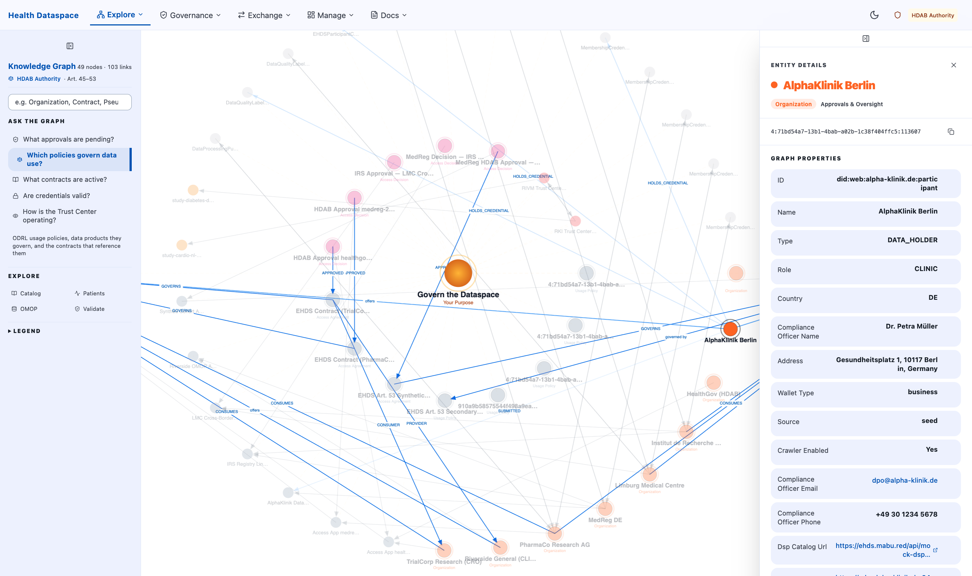
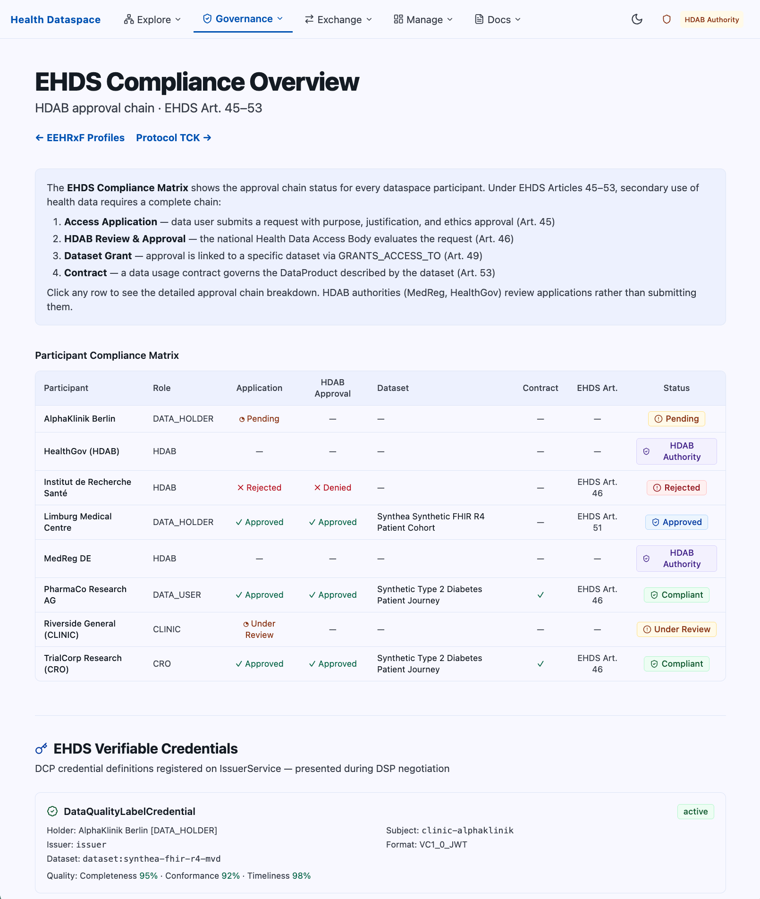
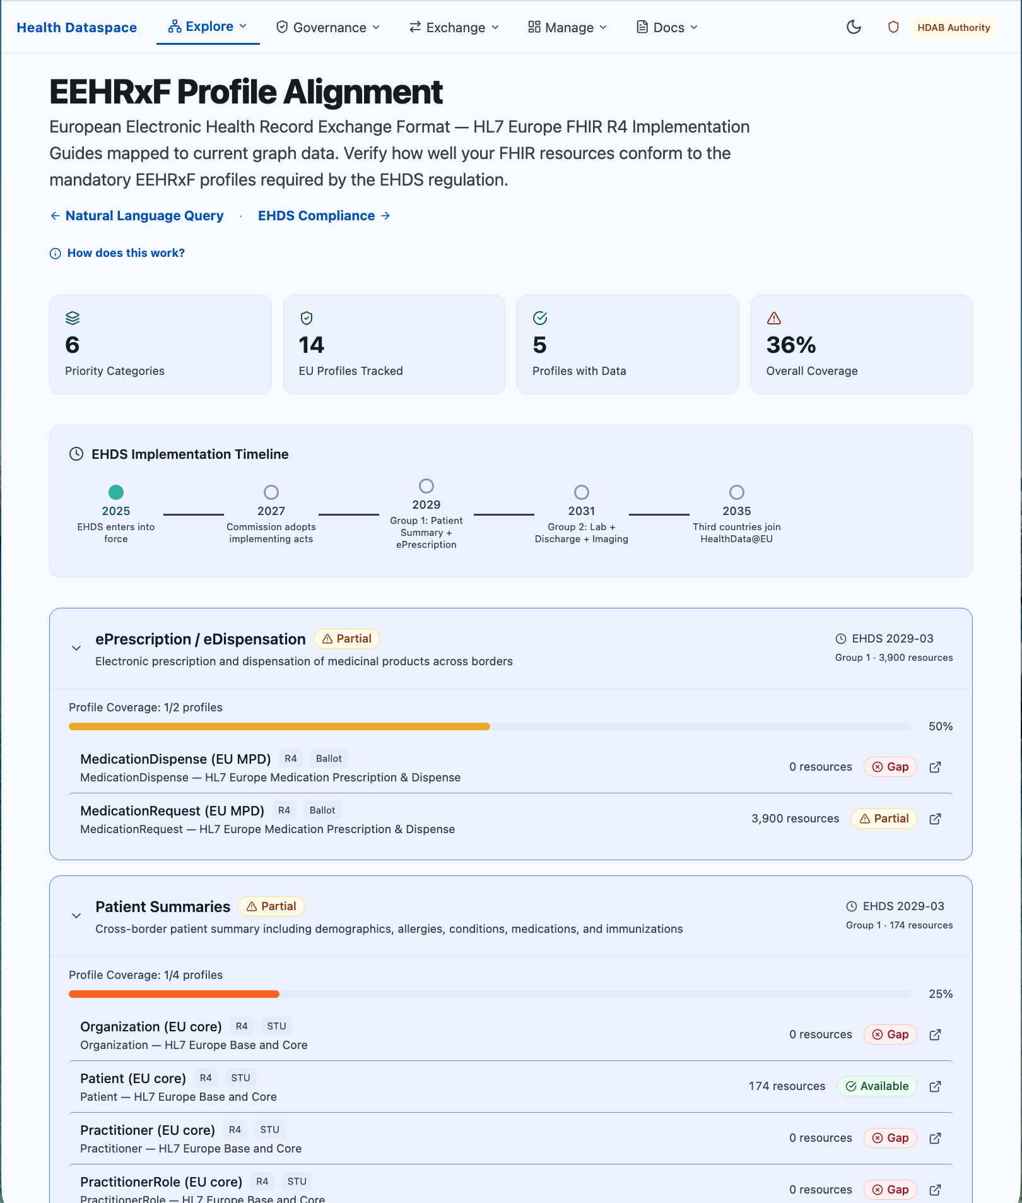
The Role Of Health Data Authority
The Ministry's data office is the trusted gatekeeper for every secondary use.
Approve research requests
Transparent register
Enforce the rules
Run the secure room
Cooperate across borders
Maintain the catalogue
Reviews each application: purpose, lawful basis, proportionality, ethics.
Every approval, every rejection, every research outcome is public.
Suspends or revokes permits and applies penalties for misuse.
Operates the protected environment where researchers analyse the data.
Works with peer authorities in Germany, France, and the wider Union.
Publishes a public list of available datasets with quality labels.
European Health Data Space · A federated approach for Spain

Slide 13
Trust by design
Citizens stay in control. Every step is visible.
Citizen consent
Pseudonyms by default
The citizen always see what may be shared, with whom, and for how long. Consent can be withdrawn at any time.
Identifiers are replaced with safe codes before any researcher sees the data. The link can be re-made only when the law requires it.
A complete diary
Right to ask, change, erase
Every access — who, when, what, why — is recorded. The citizen can read their own access diary.
Citizens can request their record, ask for corrections, and ask for erasure under European data protection law.
European Health Data Space · A federated approach for Spain

Slide 14
Why integration is the key
Without integration, EHDS is a policy. With it, EHDS is care.
1
Identity
2
Standards
3
Consent
4
Governance
One citizen identity (Cl@ve / eIDAS) recognised everywhere.
HL7 FHIR, IPS, SNOMED CT, LOINC — same words for the same things.
Consent travels with the request, not with the user's memory.
Lawful basis, audit, oversight — automated, not improvised.
The hard part is not storing the data. The hard part is making 17 systems agree on what 'a patient', 'a consent', and 'a result' mean — and proving it to a citizen.
That is integration. That is what we build.
A common language
A trusted gateway
A repeatable playbook
Shared profiles for medications, allergies, labs, imaging, and care episodes.
Single integration hub; federated, observable, and EU-ready out of the box.
Templates for each region's onboarding — legal, technical, operational.
European Health Data Space · A federated approach for Spain

Slide 15
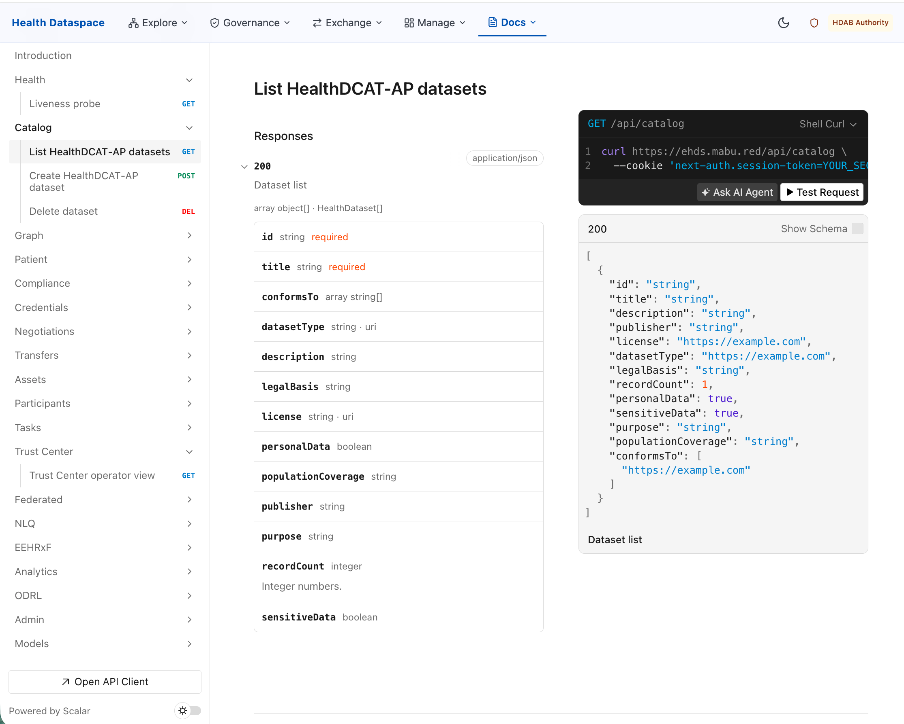
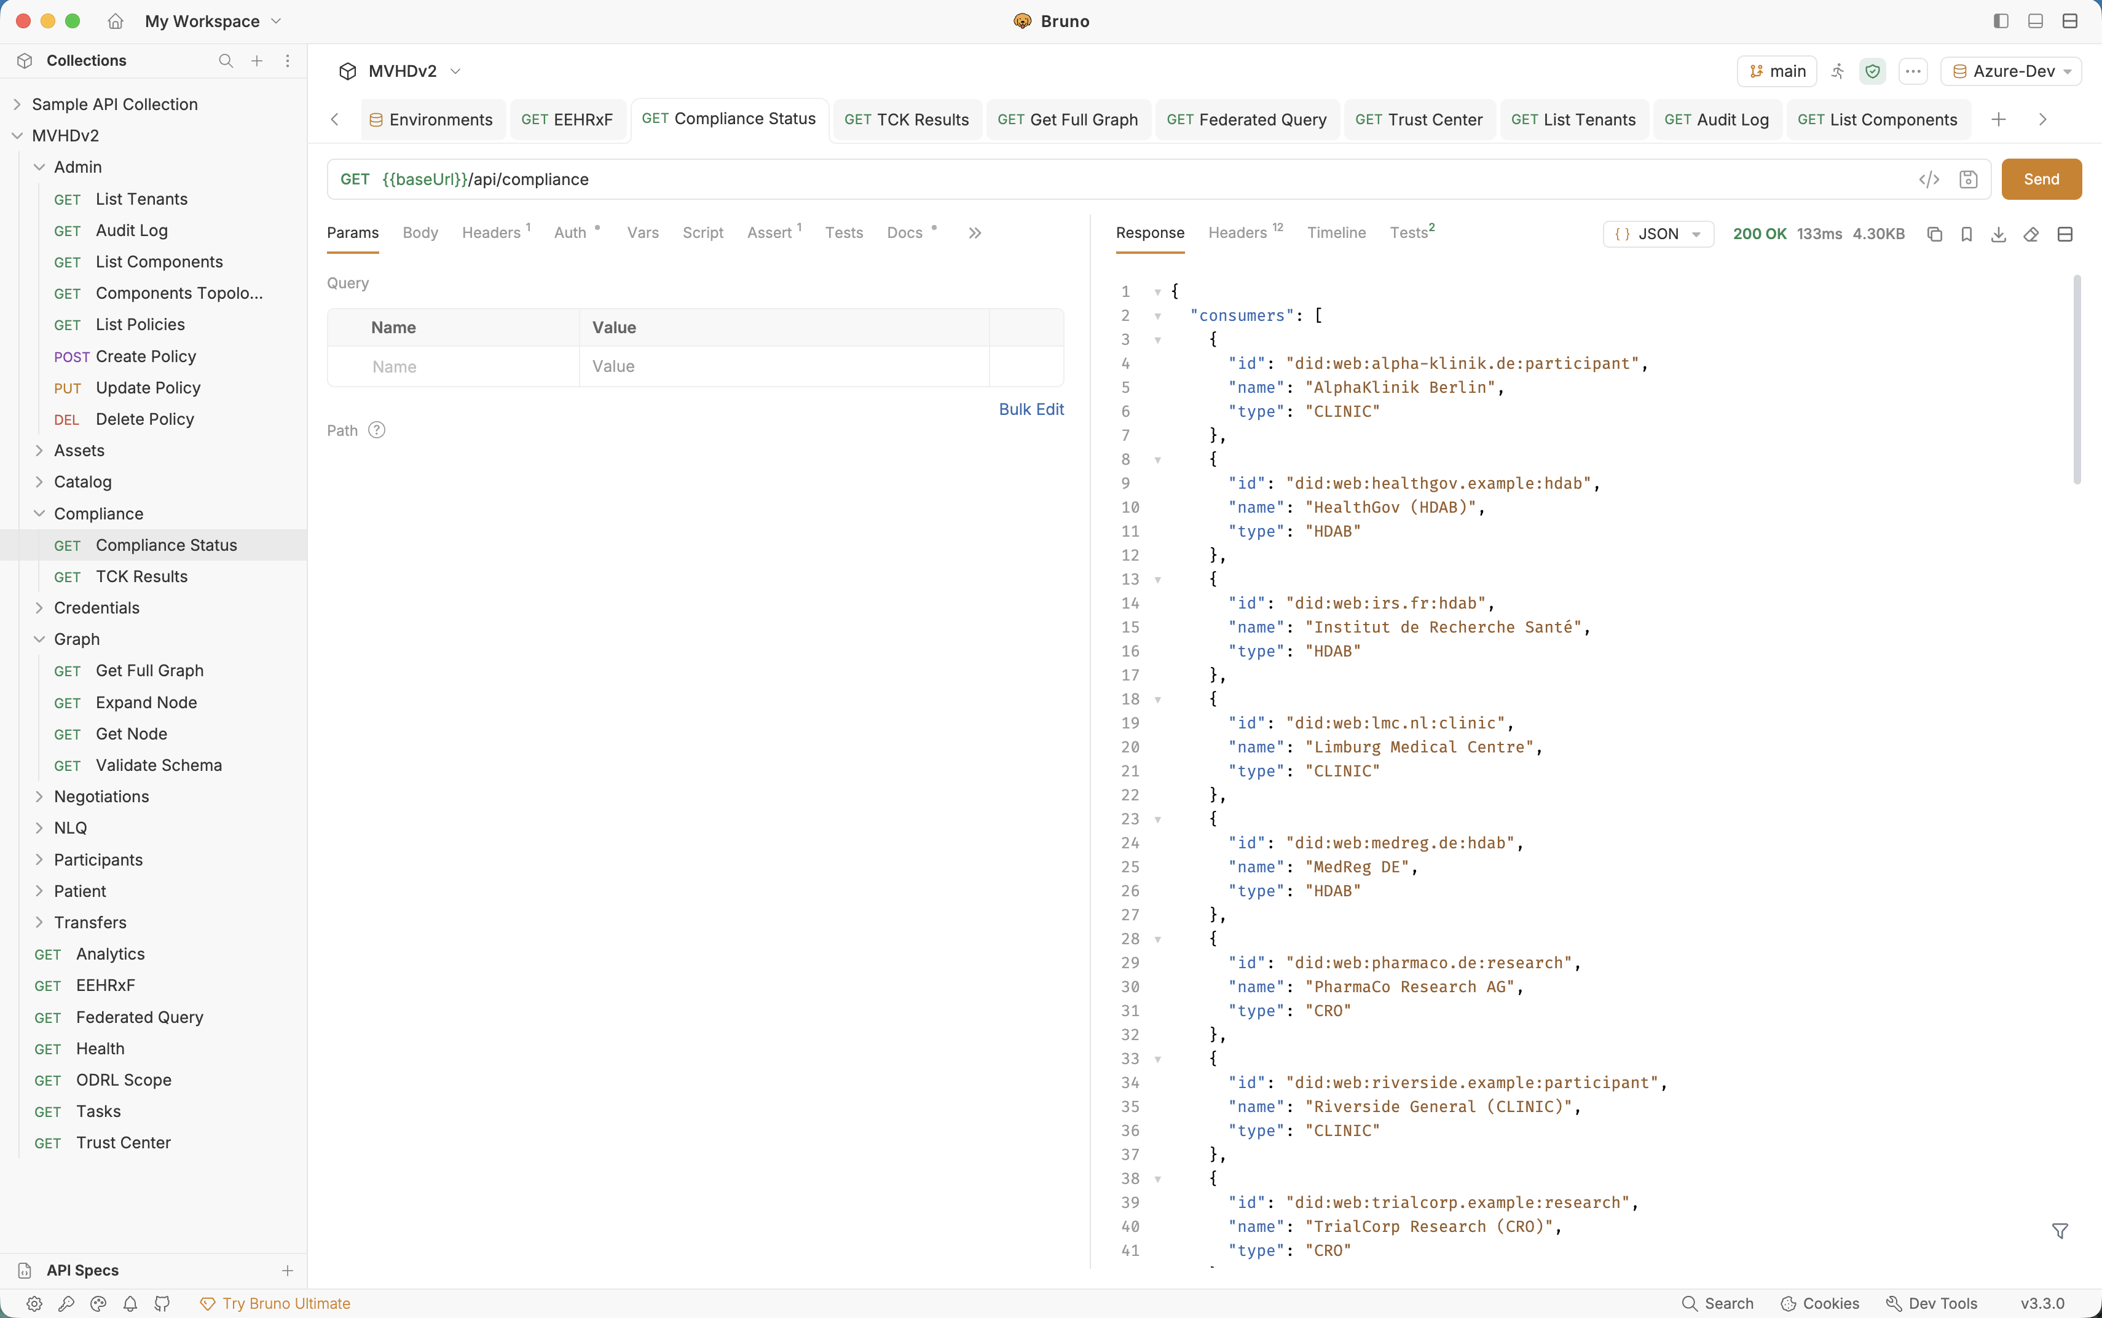
Why integration is the key
Without integration, EHDS is a policy. With it, EHDS Integration Hub is care.
Integration Tests on Web with Scalar
Integration Tests on Web with Bruno Collection

Slide 16
A roadmap for Spain
Three phases. Each one delivers value on its own.
Phase 1
Foundation
Establish the Health Data Authority. Agree common rules with the regions. Set up the secure room.
Phase 2
Connect three pioneer regions
Madrid, Catalonia, Andalusia. Citizens experience care that follows them. First research approvals issued.
Phase 3
Federate all 17 regions and join Europe
Every region connected. Cross-border with Germany, France, the wider Union. Spain becomes a leader in trusted health data.
European Health Data Space · A federated approach for Spain

Slide 17
What EHDS will bring for Spain
Outcomes — for citizens, for the system, for science, for Europe.
For citizens
For the system
For science
For Europe
Better care
Real efficiency
Faster discovery
Spain in the lead
1 record
≈ €1.2B
1 application
DE · FR · NL
follows you everywhere
potential annual savings (avoided duplication)
to study all 17 regions
peers ready to federate
0 repeats
17 → 1
Pseudonymised
MyHealth@EU
of tests already done
integration build, reused everywhere
by design — no raw data leaves
active gateway
100%
EU-ready
Public catalogue
Trust
of accesses logged for you
from day one
of datasets and approvals
as a Spanish export
Each outcome is measurable. Each is delivered region by region. Each is published in the public register.
European Health Data Space · A federated approach for Spain

Slide 18
Who operates the Health Data Space?
Catena-X answered this question. Two thirds of the answer is already law in EHDS.
Rules and governance
Reference implementation
Operation
Catena-X: the Association writes the standards, the certification framework, the rulebook.
EHDS: already law. The EHDS Board, the stakeholder forum, the steering groups, and Commission implementing acts.
Verdict: statutory. Not open to design.
Catena-X: Eclipse Tractus-X. Open source, vendor neutral, with an integration sandbox.
EHDS: nothing equivalent exists. Every access body is at risk of commissioning its own.
Verdict: the biggest gap in Europe today.
Catena-X: an operating company. Cofinity-X registers participants, issues identities, runs the core services, answers the phone.
EHDS: undefined below the access body.
Verdict: this is the opening.
Catena-X did not become a working dataspace when the standards were published. It became one when somebody was made accountable for running it.
European Health Data Space · A federated approach for Spain

Slide 19
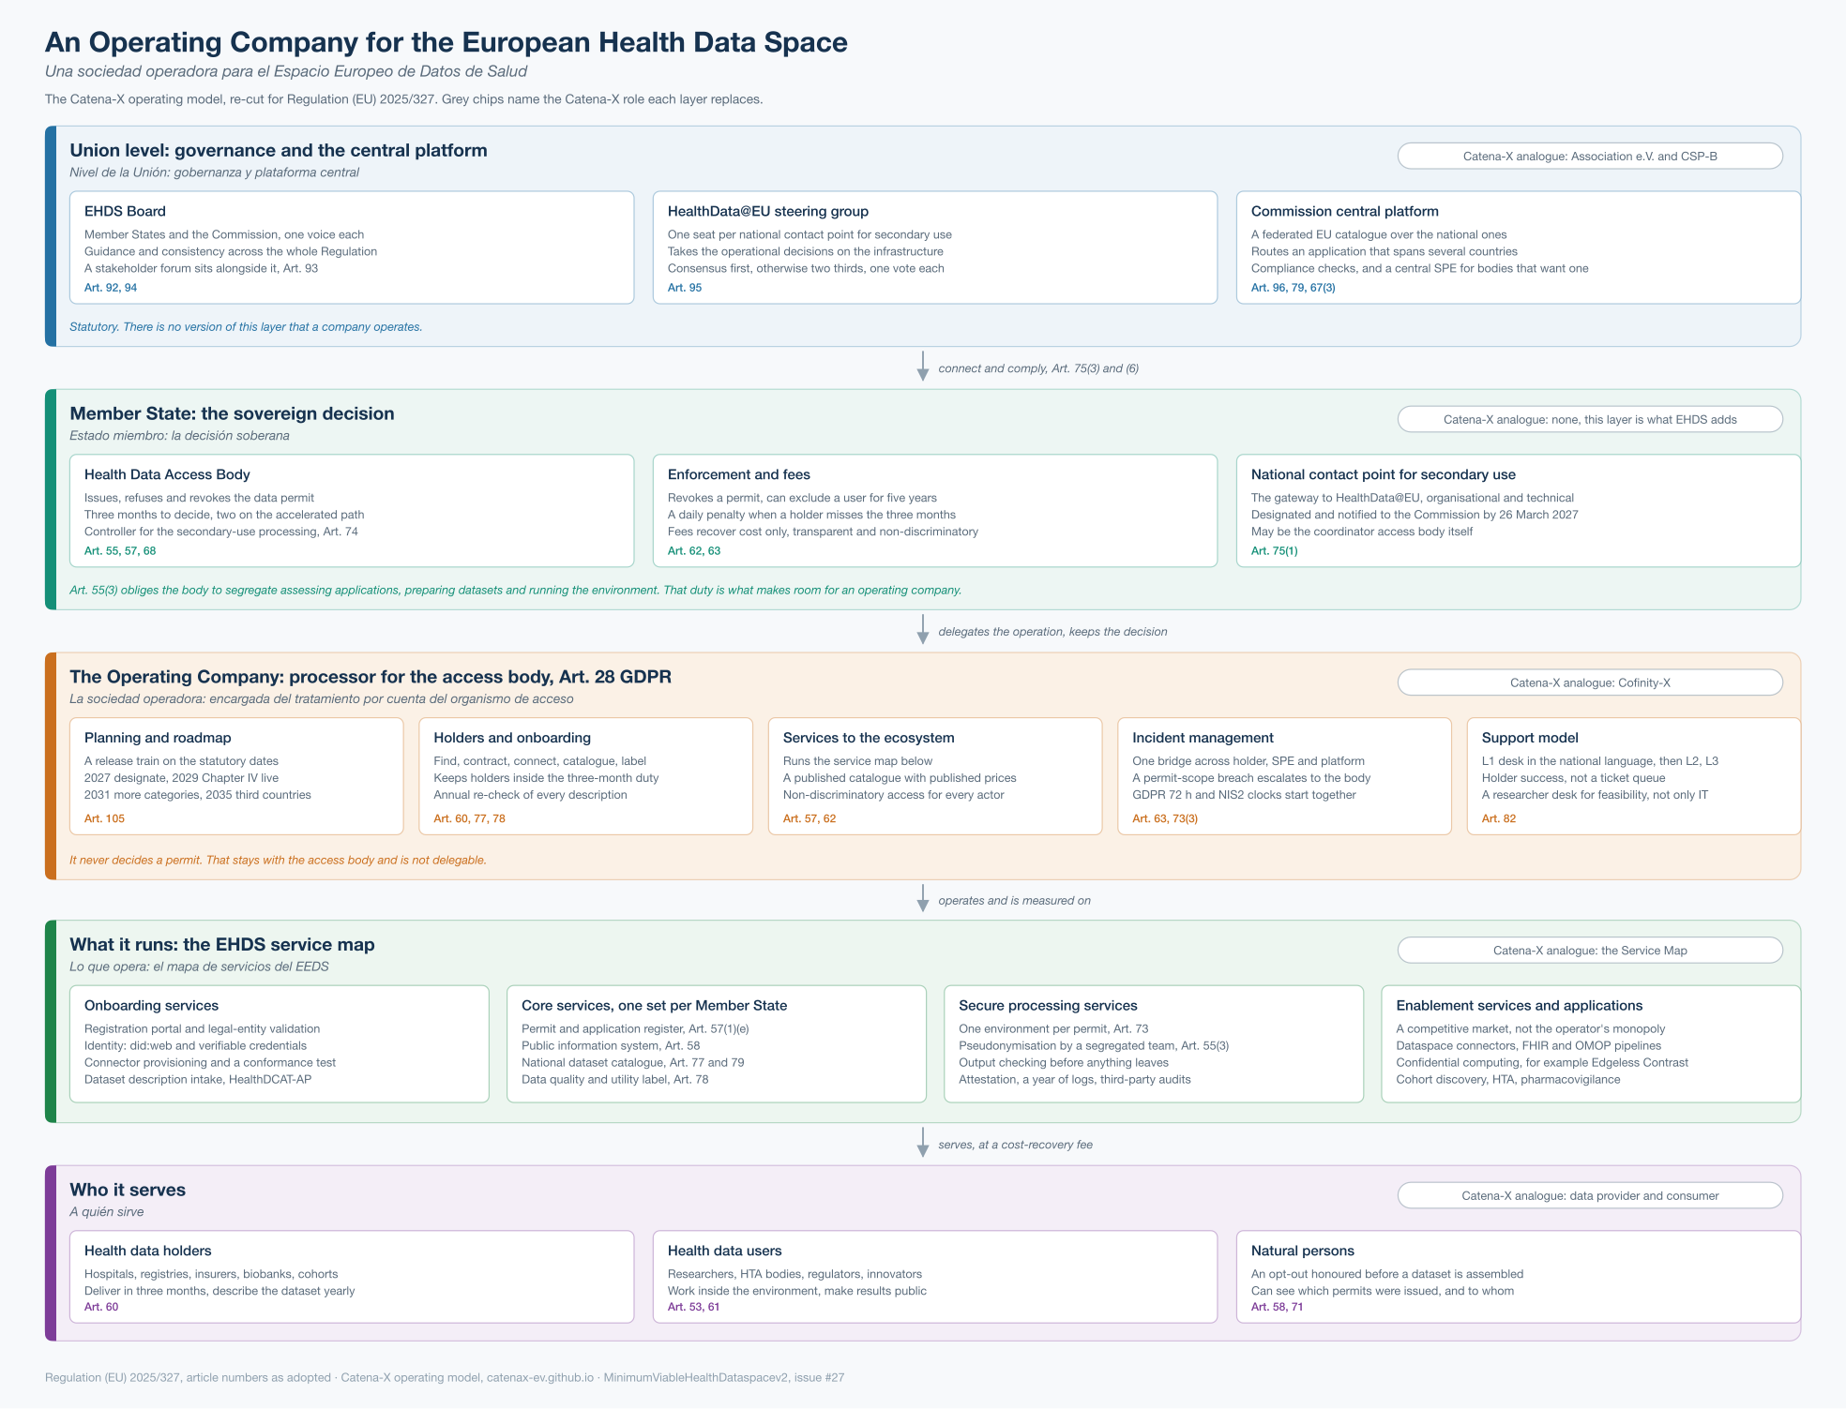
The operating model on one page
The Catena-X operating model, re-cut for Regulation (EU) 2025/327.
Closed by law
The Union layer is the Commission's: the federated EU catalogue, cross-border routing, compliance checks, a central environment. Art. 96.
Open by design
Below the access body nothing is specified. That is where an operating company sits, as processor under Art. 28 GDPR.
Never delegated
Issuing a permit, enforcement and fees stay with the access body. Art. 68, Art. 63, Art. 62.
European Health Data Space · A federated approach for Spain

Slide 20
What the access body keeps, and what an operator runs
The line is drawn by the access body's own conflict-of-interest duty, not by convenience.
Stays with the Health Data Access Body
Can be operated on its behalf
• Issuing, refusing and revoking a data permit Art. 68
• Enforcement, up to five years' exclusion Art. 63
• Setting fees, and settling a disagreement Art. 62
• Controllership for the secondary use Art. 74
• Supervising holders and users Art. 57(1)(a)
These are sovereign acts of a public body. No contract moves them.
• Onboarding holders, and the identities they use
• The national catalogue and the quality label Art. 77, 78
• Receiving and preparing data, pseudonymisation Art. 57(1)(b)
• Running the secure processing environment Art. 73
• Incident coordination and the support desk
As a processor under Art. 28 GDPR, on documented instructions.
Art. 55(3) obliges the access body to segregate assessing applications, preparing datasets and running the environment. Read the other way round, that is a list of exactly what can be industrialised.
European Health Data Space · A federated approach for Spain

Slide 21
The five things an operating company does
Each one looks different under EHDS than under Catena-X, and the difference is the regulation.
Planning and roadmap
Data holders
Services
Incidents
Support
A release train against dates nobody gets to choose.
Two supported versions, a published deprecation window, a sandbox with synthetic data.
Art. 105
Identify, register, validate, contract, connect, describe, label, sustain.
The last two have no Catena-X counterpart, and are the ones ministries underestimate.
Art. 60, 77, 78
A published service map, published prices, non-discriminatory access.
Onboarding, core, secure processing, and a competitive market above them.
Art. 57, 62
One record and one timeline across every party involved.
A permit-scope breach is escalated to the access body, never quietly fixed.
Art. 63, 73(3)
L1 in Spanish, L2 per service, L3 with the suppliers.
Plus holder success and a researcher feasibility desk, neither of which is a ticket queue.
Art. 82
Holders owe the data within three months, with a penalty for every day late. The body owes a decision in three. Descriptions are re-verified yearly. The clocks are the job.
European Health Data Space · A federated approach for Spain

Slide 22
The dates are not negotiable
Counting procurement, March 2029 is about two release years away.
Designate, and tell the Commission
Mar 2027
The Regulation applies. Health data access bodies and the national contact point for secondary use are designated and notified. Art. 55(6), Art. 75(1)
Chapter IV goes live in full
Mar 2029
Permits, data holders' duties, secure processing environments, HealthData@EU. Everything in today's demonstration becomes an obligation.
The wider data categories
Mar 2031
Art. 51(1)(b), (f), (g), (m) and (p) join the scope, and Chapter III reaches EHR systems already in service.
Third countries join HealthData@EU
Mar 2035
Art. 75(5). Only then does the infrastructure open beyond the Union, under Commission compliance checks.
European Health Data Space · A federated approach for Spain

Slide 23
Cost recovery, not a platform business
Art. 62 caps the business model. Better said now than discovered in year two.
What Art. 62 fixes
Which forms survive it
• Fees proportionate to the cost of making data available
• They must not restrict competition
• Transparent and non-discriminatory, without exception
• Reduced rates for public bodies, universities, small firms
• Part of the fee passes through to the data holder
• If the parties disagree, the access body sets the price
• An in-house entity of the ministry or the access body
• A public-private joint venture, which is what Cofinity-X is
• A competitively tendered concession, for a fixed term
The commercial upside is not the operating company. It is the layer above it: connectors, pipelines, secure-environment technology, analytics applications.
Keeping the operator out of the application market is exactly what keeps that market open. Saying so plainly makes the proposition more credible, not less.
European Health Data Space · A federated approach for Spain

Slide 24
The conversation we want to start
Working together with the Ministry and the regions.
Questions for the Ministry
What we bring to the table
• Which regions would be the first three to connect?
• How will the Health Data Authority be staffed and funded?
• Which existing public health programmes benefit most quickly?
• How should citizens be informed and consulted?
• Which European partners should Spain federate with first?
• A working live demonstration with realistic data.
• Experience federating data across European regions.
• Templates for the legal, organisational, and operational setup.
• A roadmap aligned with the European timetable.
• A team that has done this before, ready to support each region.
European Health Data Space · A federated approach for Spain

Slide 25
Thank you
Better care for every citizen. Better research for every region.
Live demonstration available on request
Walk through the five roles, the patient journey, and the research approval process — end to end.
Sopra Steria · European Health Data Space practice

