Slide 1

A Connected Health System for Spain
Seventeen regional datasets, one research resource
secondary use of health data under the EHDS
Researchers
Data holders
The regulator
Studying a rare disease across Spain means asking 17 separate regions for permission and for data.
Hospitals and registries hold the data with no way to publish what they hold, or to deliver it on a deadline.
Every approval is bespoke, and nobody outside can see which permits were issued, or why.
Art. 67: one application
Art. 60: three months to deliver
Art. 68: one permit, published
Spain's strength is regional autonomy. The cost is fragmentation.
European Health Data Space · A federated approach for Spain
Secondary use, Chapter IV of Regulation (EU) 2025/327 · data.europa.eu/eli/reg/2025/327/oj

Slide 2
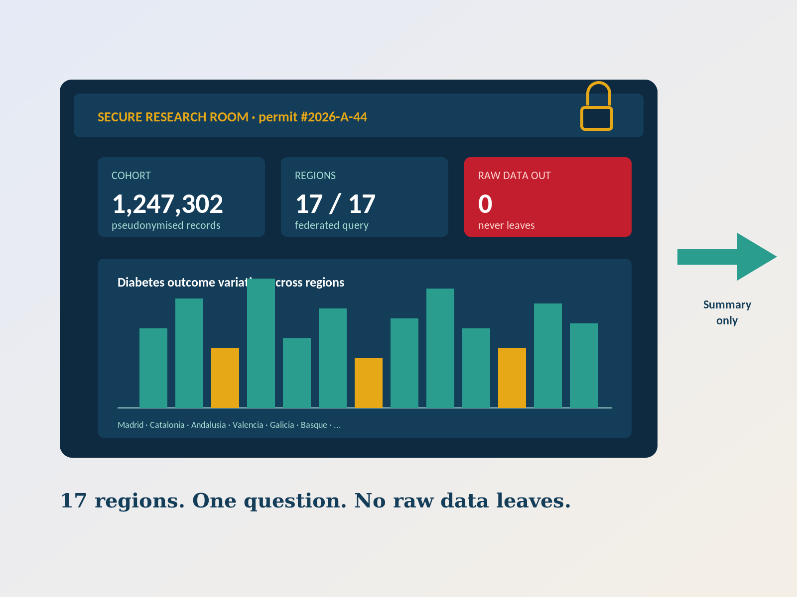
One question, asked once
What the Regulation requires for secondary use, and what it puts in place to make it work.
What EHDS puts in place
• One application, however many regions Art. 67
• A permit decision in three months Art. 68(4)
• Holders deliver within three months Art. 60(2)
• Analysis inside a secure environment Art. 73
• Only results leave, never the rows Art. 73(2)
• Every permit published, with reasons Art. 57(1)(j)
And the price is fixed by law
Fees recover cost only, transparent and non-discriminatory, with reduced rates for public bodies and university researchers. Art. 62.
European Health Data Space · A federated approach for Spain
Reg. (EU) 2025/327, Art. 57, 60, 62, 67, 68, 73

Slide 3
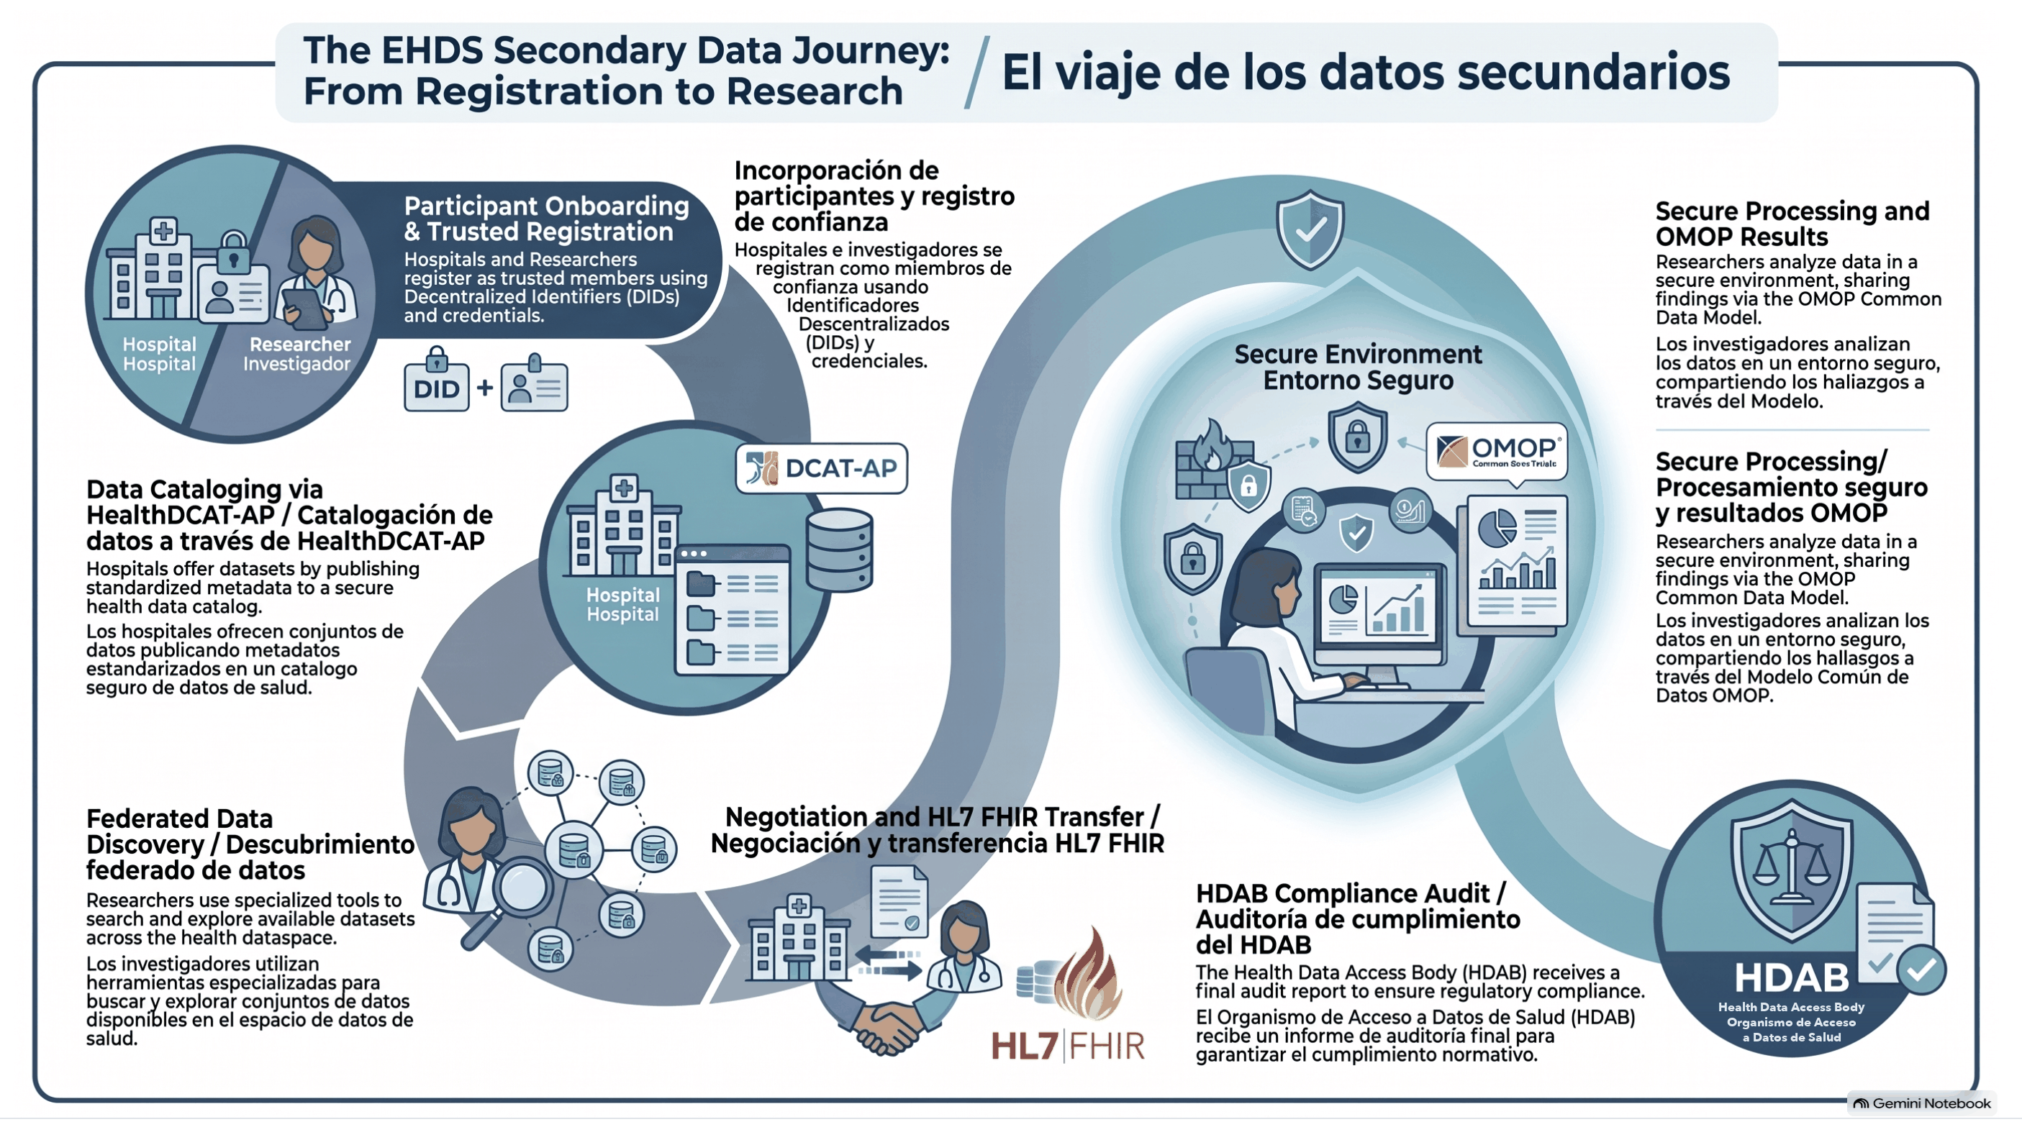
What the demonstration shows
The whole journey, from registration to an audited result. Synthetic data, real protocols.
European Health Data Space · A federated approach for Spain
Live: ehds.mabu.red · Mirror: ma3u.github.io/MinimumViableHealthDataspacev2 · issue #27

Slide 4
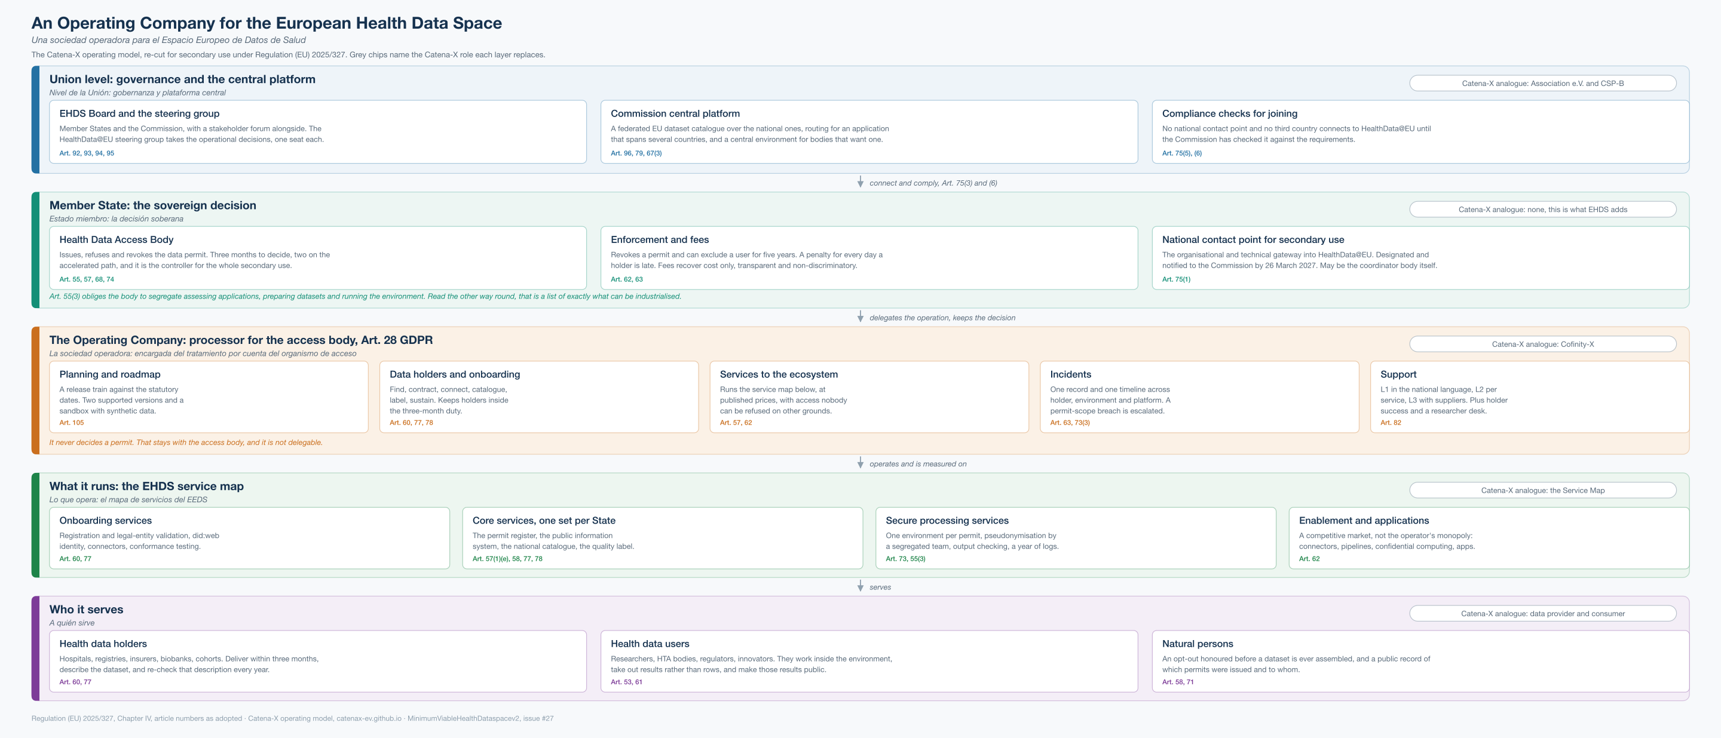
A proposed operating model for the EHDS
The Catena-X operating model, re-cut for Regulation (EU) 2025/327. Two of the three layers are already law.
European Health Data Space · A federated approach for Spain
catenax-ev.github.io/docs/operating-model · data.europa.eu/eli/reg/2025/327/oj · cofinity-x.com

Slide 5
The conversation we want to start
Working together with the Ministry and the regions.
Questions for the Ministry
What we bring to the table
• One access body, or several with a coordinator? Art. 55(1)
• Is the national contact point that same body, or separate? Art. 75(1)
• Does the March 2027 designation have an owner and a budget line?
• Who holds the inventory of the Art. 51 data categories?
• In-house entity, joint venture, or tendered concession, and by when?
• A working live demonstration with realistic data.
• Experience federating data across European regions.
• Templates for the legal, organisational and operational setup.
• A roadmap aligned with the European timetable.
• A team that has done this before, ready to support each region.
The access body and the national contact point must be designated by March 2027, and Chapter IV applies in full from March 2029. Counting procurement, that is about two release years away.
European Health Data Space · A federated approach for Spain
Reg. (EU) 2025/327, Art. 55(6), 75(1), 105 · Paper: docs/ehds-operating-company.md

