Slide 1

twobreath
A STORY · IN PLATO'S WORDS
Once we were one.
"Zeus split us. Ever since, every soul has been searching for the other half."
— Aristophanes, in Plato's Symposium
01 · ONCE WE WERE ONE
LIFE SUMMIT BERLIN · STARTUP DAY 01 / 08

Slide 2
twobreath
CHAPTER ONE · THE PROBLEM
Then modernity split us again.
15%
shorter lifespan · loneliness (Holt-Lunstad)
↑
paired breathing lifts vagal tone (polyvagal)
Same bed. Different timers. Calm, Headspace, Insight Timer — the breakthrough wellness apps of the last decade optimized the individual. The bond — the thing that actually keeps two people alive — was forgotten.
0
mainstream apps ship a paired-breath ritual
02 · THE PROBLEM
LIFE SUMMIT BERLIN · STARTUP DAY 02 / 08

Slide 3
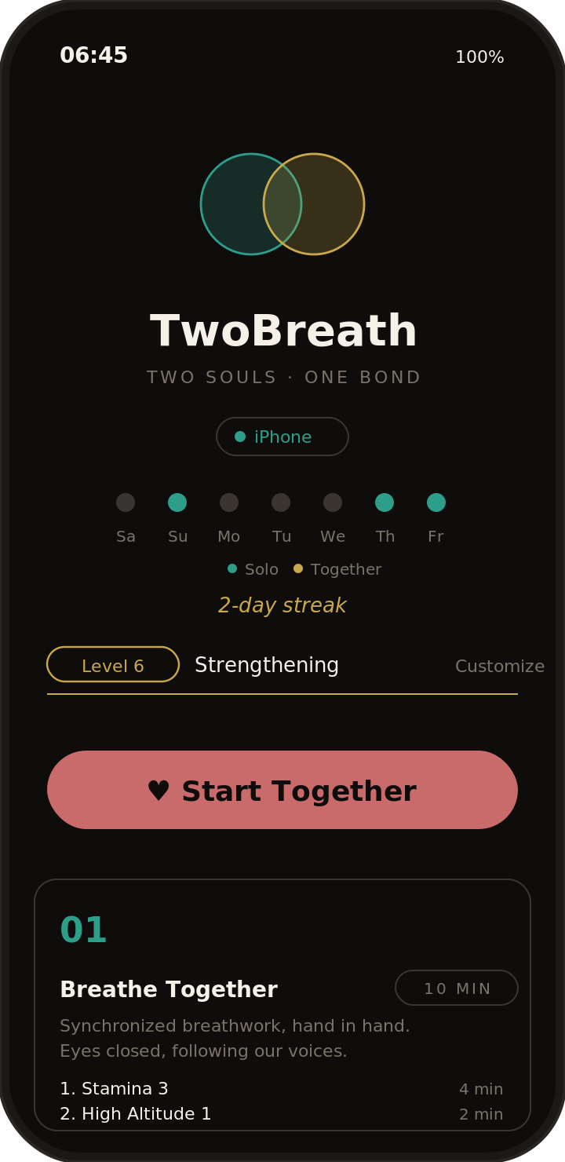
twobreath
CHAPTER TWO · THE THREAD
A two-minute thread, every morning.
01
Two phones.
One for each partner. Shared ritual. Local pairing — no cloud accounts.
02
One breath.
Voice-guided in our own voices · EN / DE / JA. Inhale together. Exhale together.
03
Daily by design.
Streaks · Apple Health · Apple Watch. The thread shows up on your wrist.
03 · THE THREAD · IPHONE + APPLE WATCH
LIFE SUMMIT BERLIN · STARTUP DAY 03 / 08

Slide 4
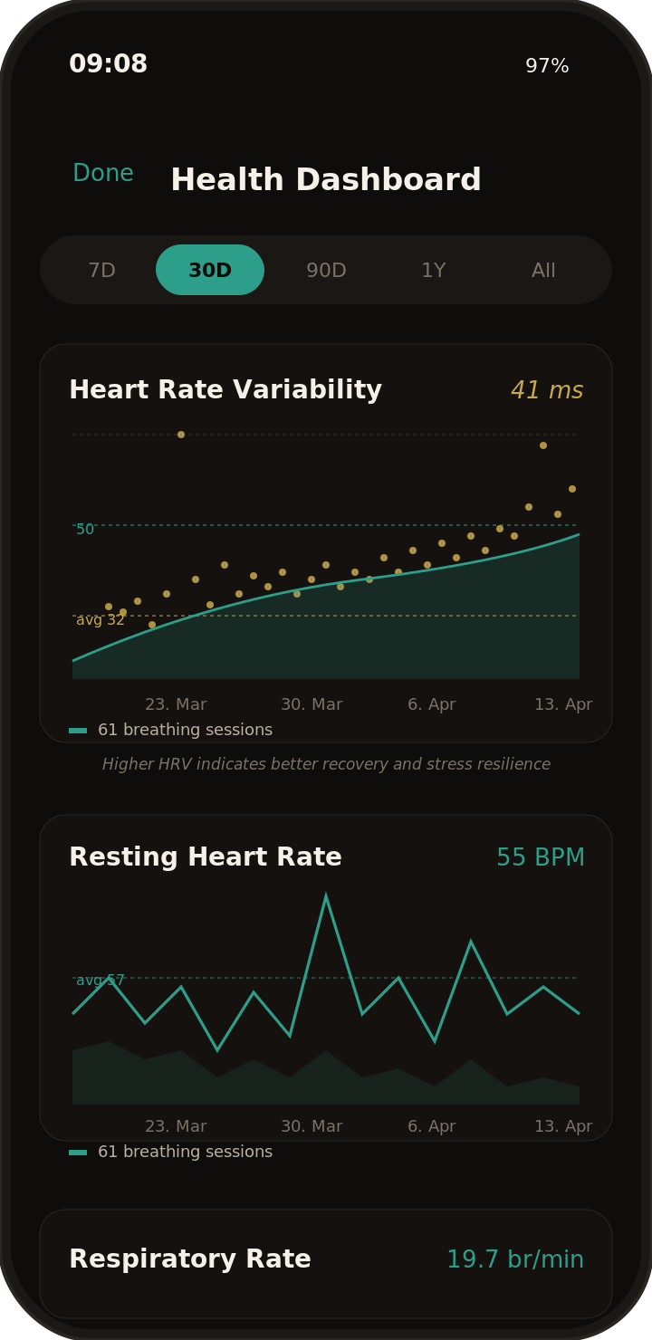
twobreath
CHAPTER THREE · THE PRACTICE
Eight years a day.
Every morning. Berlin → Tokyo → Lisbon. Through three years of distance, two children, and one pandemic.
We didn't research the user. We are the user. The data on the right is ours.
04 · EIGHT YEARS A DAY
LIFE SUMMIT BERLIN · STARTUP DAY 04 / 08

Slide 5
twobreath
CHAPTER FOUR · THE EVIDENCE
What science already knows.
01
Paired breathing trains the vagus nerve.
Polyvagal science (Porges) — synchronized slow breathing co-regulates two nervous systems. HRV up. Cortisol down. Measurable in two minutes.
02
Strong bonds add years to life.
Holt-Lunstad meta-analysis — chronic loneliness shortens lifespan ~15%. Strong daily connection rivals diet and exercise as a longevity factor.
03
Wellness is a $80B market — for individuals.
Growing ~15% per year (Statista, McKinsey). Couples paired-breath rituals = a category that does not yet exist. The evidence has been waiting for the product.
05 · THE EVIDENCE
LIFE SUMMIT BERLIN · STARTUP DAY 05 / 08

Slide 6
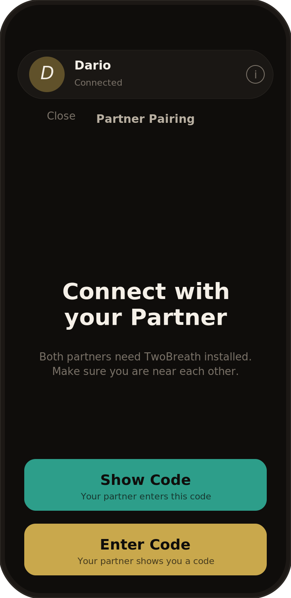
twobreath
CHAPTER FIVE · TRUST BY DESIGN
One phone for the breath. Two phones for the data.
PAIRED
Local pairing code · no cloud account required to start the ritual.
PRIVATE
HealthKit on-device. Each partner's HRV stays on their own iPhone.
PORTABLE
Works on Apple Watch · the breath shows up on the wrist, no phone needed.
LAUNCHING JULY 1, 2026
06 · TRUST BY DESIGN
LIFE SUMMIT BERLIN · STARTUP DAY 06 / 08

Slide 7
twobreath
CHAPTER SIX · WHAT WE'RE ASKING FOR
We're not raising capital. We're recruiting partners.
DiGA
INSURERS
Digitale Gesundheitsanwendung
Health insurer pilots
Prescription-grade reimbursement by German statutory health insurers. Couples co-regulation as covered care.
TK, Barmer, AOK Plus — bonded couples lower healthcare costs. Pilot integration with Apple Health outcomes.
CLINICS
COMMUNITY
Longevity & retreat partners
Breath educators · therapists
Lanserhof-style centers, couples retreats, fertility clinics. TwoBreath as the take-home daily ritual.
Wim Hof / Buteyko / tantra teachers · couples coaches. Co-create the awareness movement around the bond.
07 · PARTNERSHIPS · NOT CAPITAL
LIFE SUMMIT BERLIN · STARTUP DAY 07 / 08

Slide 8
twobreath
THE INVITATION
Will you breathe with us?
We don't need money to launch. We need partners who believe the bond is the next wellness category.
M
Matthias
Dario
D
CTO
CMO · COO
twobreath.com · matthias@twobreath.com · launching July 1, 2026
08 · WILL YOU BREATHE WITH US?
LIFE SUMMIT BERLIN · STARTUP DAY 08 / 08

