Slide 1


Our STORY
One Breath Two Souls
01 · ONCE WE WERE ONE
LIFE SUMMIT BERLIN · STARTUP DAY 01 / 08

Slide 2
twobreath
Our Story
We build a ritual every morning …
15%
shorter lifespan · loneliness (Holt-Lunstad)
↑
paired breathing lifts vagal tone (polyvagal)
open the window, welcome the day, and start breathing together, hand in hand. Synchronizing our breath, our hearts, our souls.The bond, the thing that actually keeps two people alive was forgotten.
0
mainstream apps ship a paired-breath ritual
02 · THE PROBLEM
LIFE SUMMIT BERLIN · STARTUP DAY 02 / 08

Slide 3
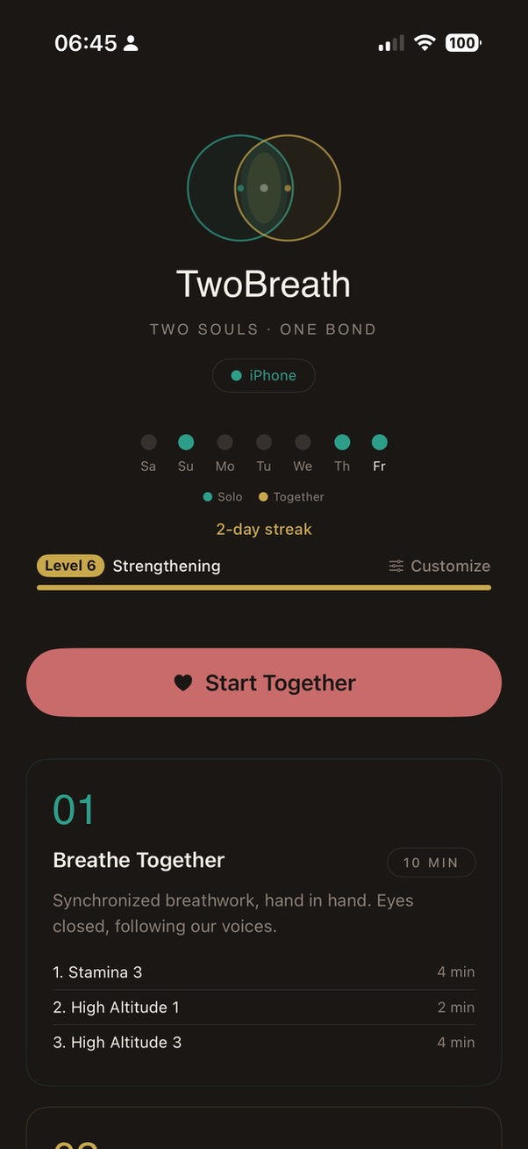
twobreath
THE THREAD
No App Subscriptions
So we build our own
01
Two phones.
One for each partner. Shared ritual. Local pairing – keep data local.
02
One breath.
Voice-guided in our own voices · Inhale together. Exhale together.
03
Daily by design.
Streaks · Apple Health · Apple Watch. The thread shows up on your wrist.
03 · THE THREAD · IPHONE + APPLE WATCH
LIFE SUMMIT BERLIN · STARTUP DAY 03 / 08

Slide 4
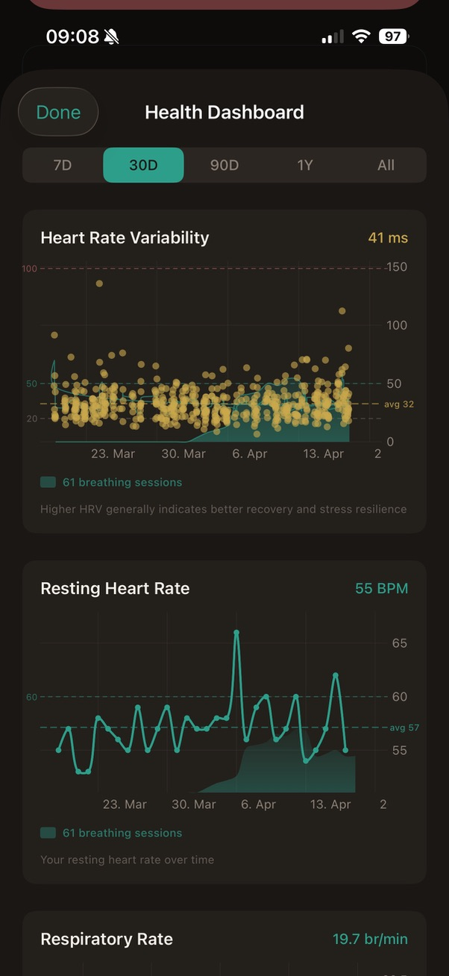
twobreath
Our PRACTICE
Eight years a day.
We identified leading markets and optimize our app. Berlin → Tokyo → California. Backed by science.
We didn't research the user. We are the user. The data on the right is ours.
04 · EIGHT YEARS A DAY
LIFE SUMMIT BERLIN · STARTUP DAY 04 / 08

Slide 5
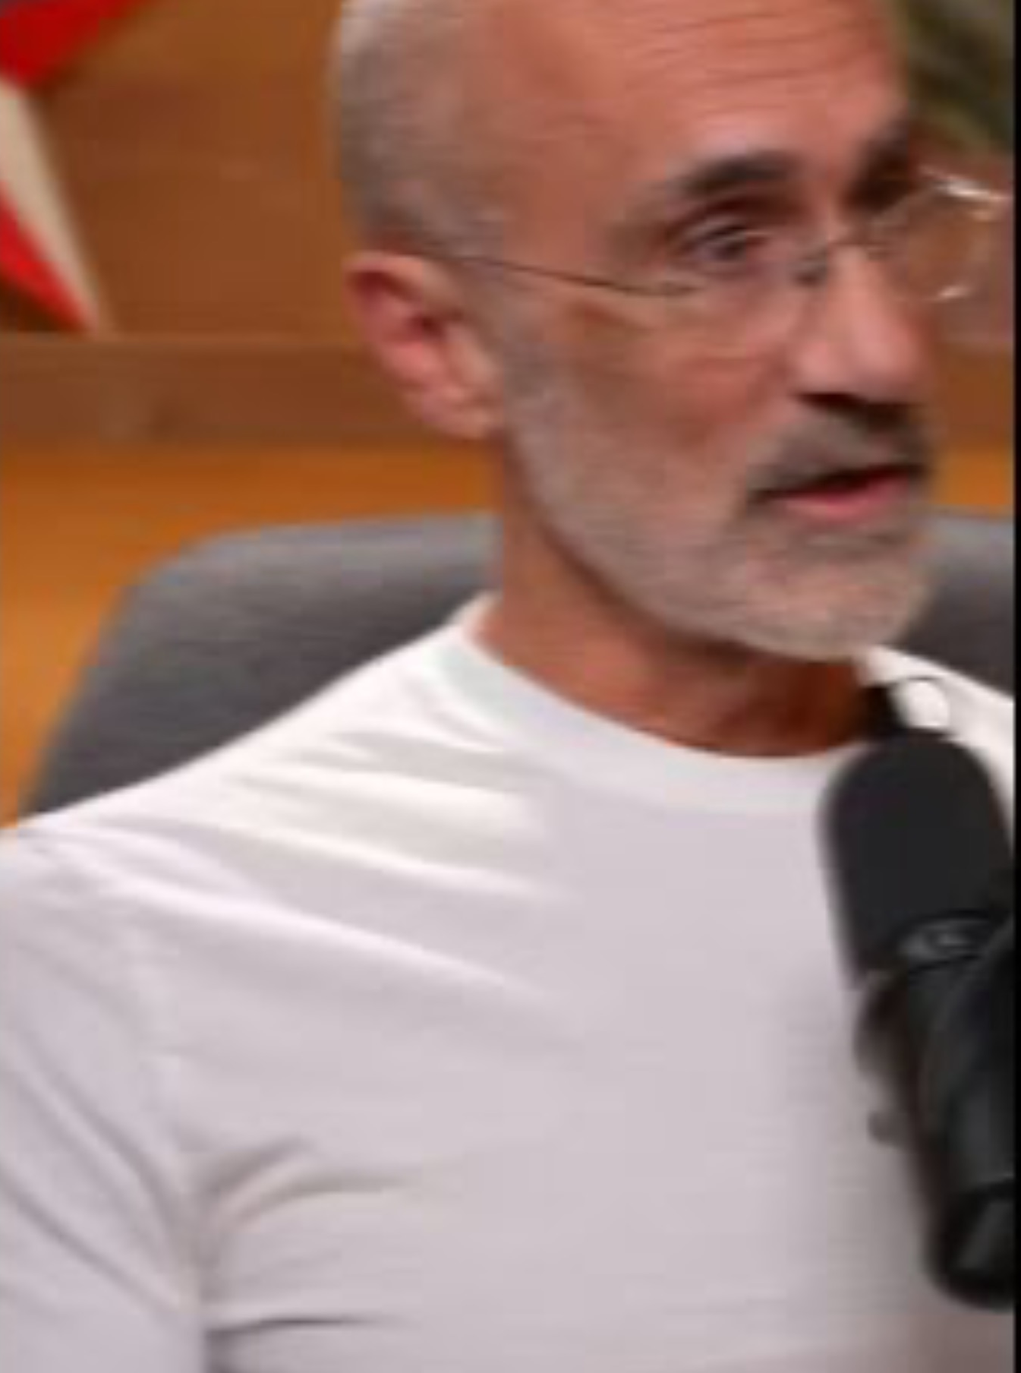
twobreath
THE EVIDENCE
What science already knows.
01
Paired breathing trains the vagus nerve.
synchronized slow breathing co-regulates two nervous systems. HRV up. Cortisol down. Measurable in two minutes.
02
Strong bonds add years to life.
chronic loneliness shortens lifespan ~15%. Strong daily connection rivals diet and exercise as a longevity factor.
03
Wellness is a $80B market for individuals.
Growing ~15% per year. Couples paired-breath rituals = a category that does not yet exist.
05 · THE EVIDENCE
LIFE SUMMIT BERLIN · STARTUP DAY 05 / 08

Slide 6
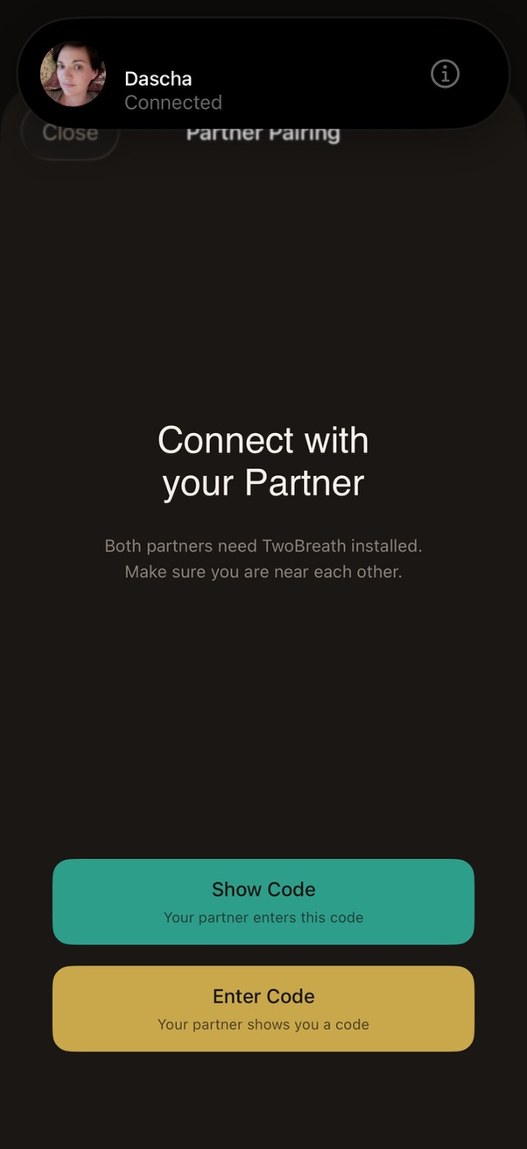
twobreath
TRUST BY DESIGN
One phone for the breath. My phone for my data.
PAIRED
Local pairing code · no cloud account required to start the ritual.
PRIVATE
HealthKit on-device. Each partner’s VO2Max and HRV stays on our own iPhone.
PORTABLE
Works on Apple Watch · the breath shows up on the wrist, no phone needed.
On TESTFLIGHT - LAUNCHING JULY 1, 2026
06 · TRUST BY DESIGN
LIFE SUMMIT BERLIN · STARTUP DAY 06 / 08

Slide 7
twobreath
WHAT WE'RE ASKING FOR
We're not raising capital. We're recruiting partners.
DiGA
INSURERS
Digitale Gesundheitsanwendung
Health insurer pilots
Prescription-grade reimbursement by German statutory health insurers. Couples co-regulation as covered care.
TK, Barmer, AOK Plus: bonded couples lower healthcare costs. Pilot integration with Apple Health outcomes.
CLINICS
COMMUNITY
Longevity & retreat partners
Breath educators · therapists
Lanserhof-style centers, couples retreats, fertility clinics. TwoBreath as the take-home daily ritual.
Wim Hof / Buteyko / tantra teachers · couples coaches, therapeuts. Co-create the awareness movement around the bond.
07 · PARTNERSHIPS · NOT CAPITAL
LIFE SUMMIT BERLIN · STARTUP DAY 07 / 08

Slide 8
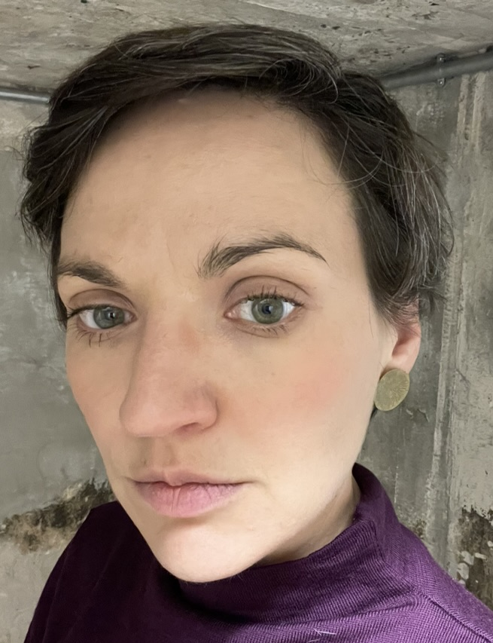
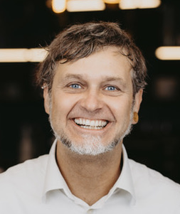
twobreath
THE INVITATION
Will you breathe with us?
We looking for partners who believe the bond is the next wellness category.
Matthias
Daria
Builder
Marketing
twobreath.com · info@twobreath.com · launching July 1, 2026
08 · WILL YOU BREATHE WITH US?
LIFE SUMMIT BERLIN · STARTUP DAY 08 / 08

