Slide 1


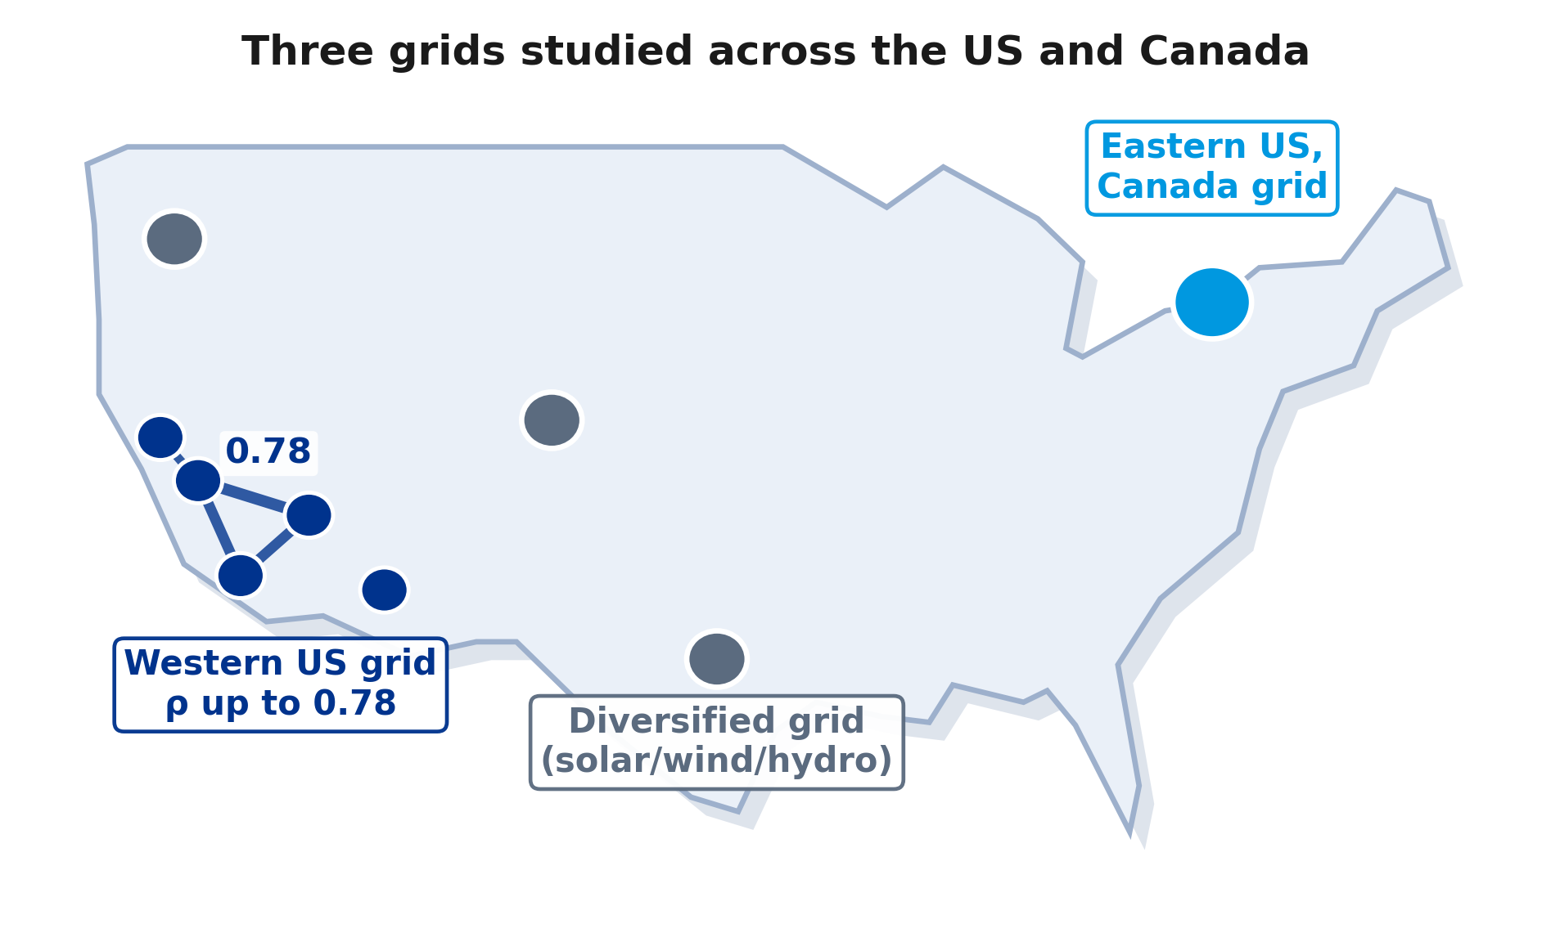
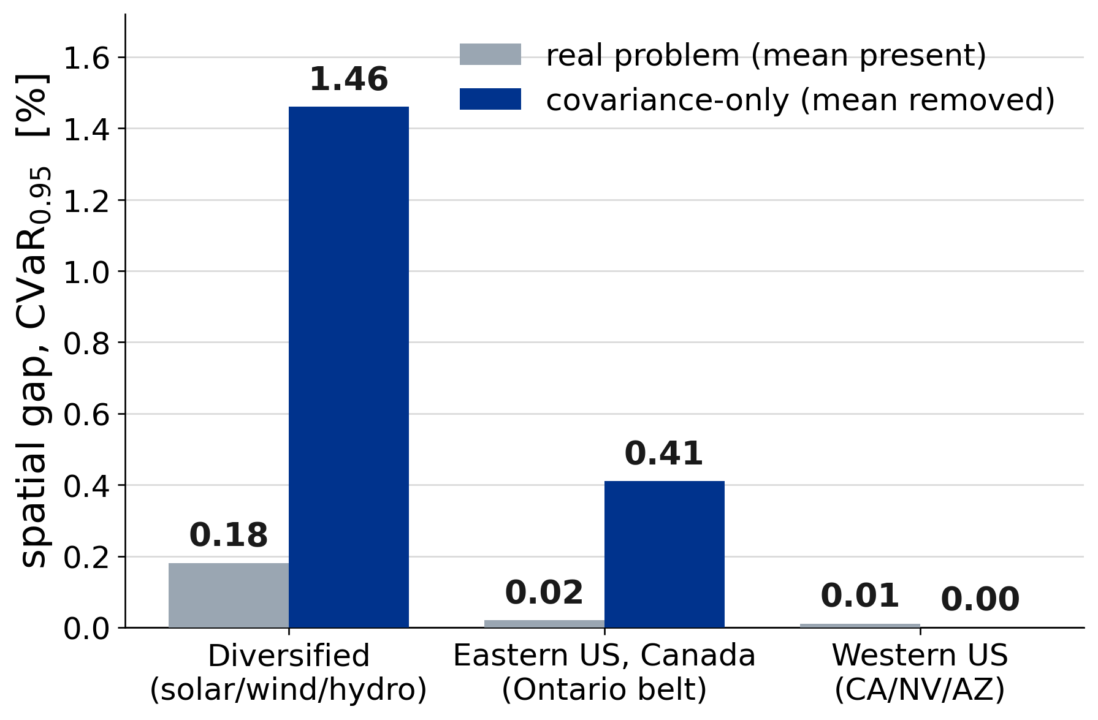
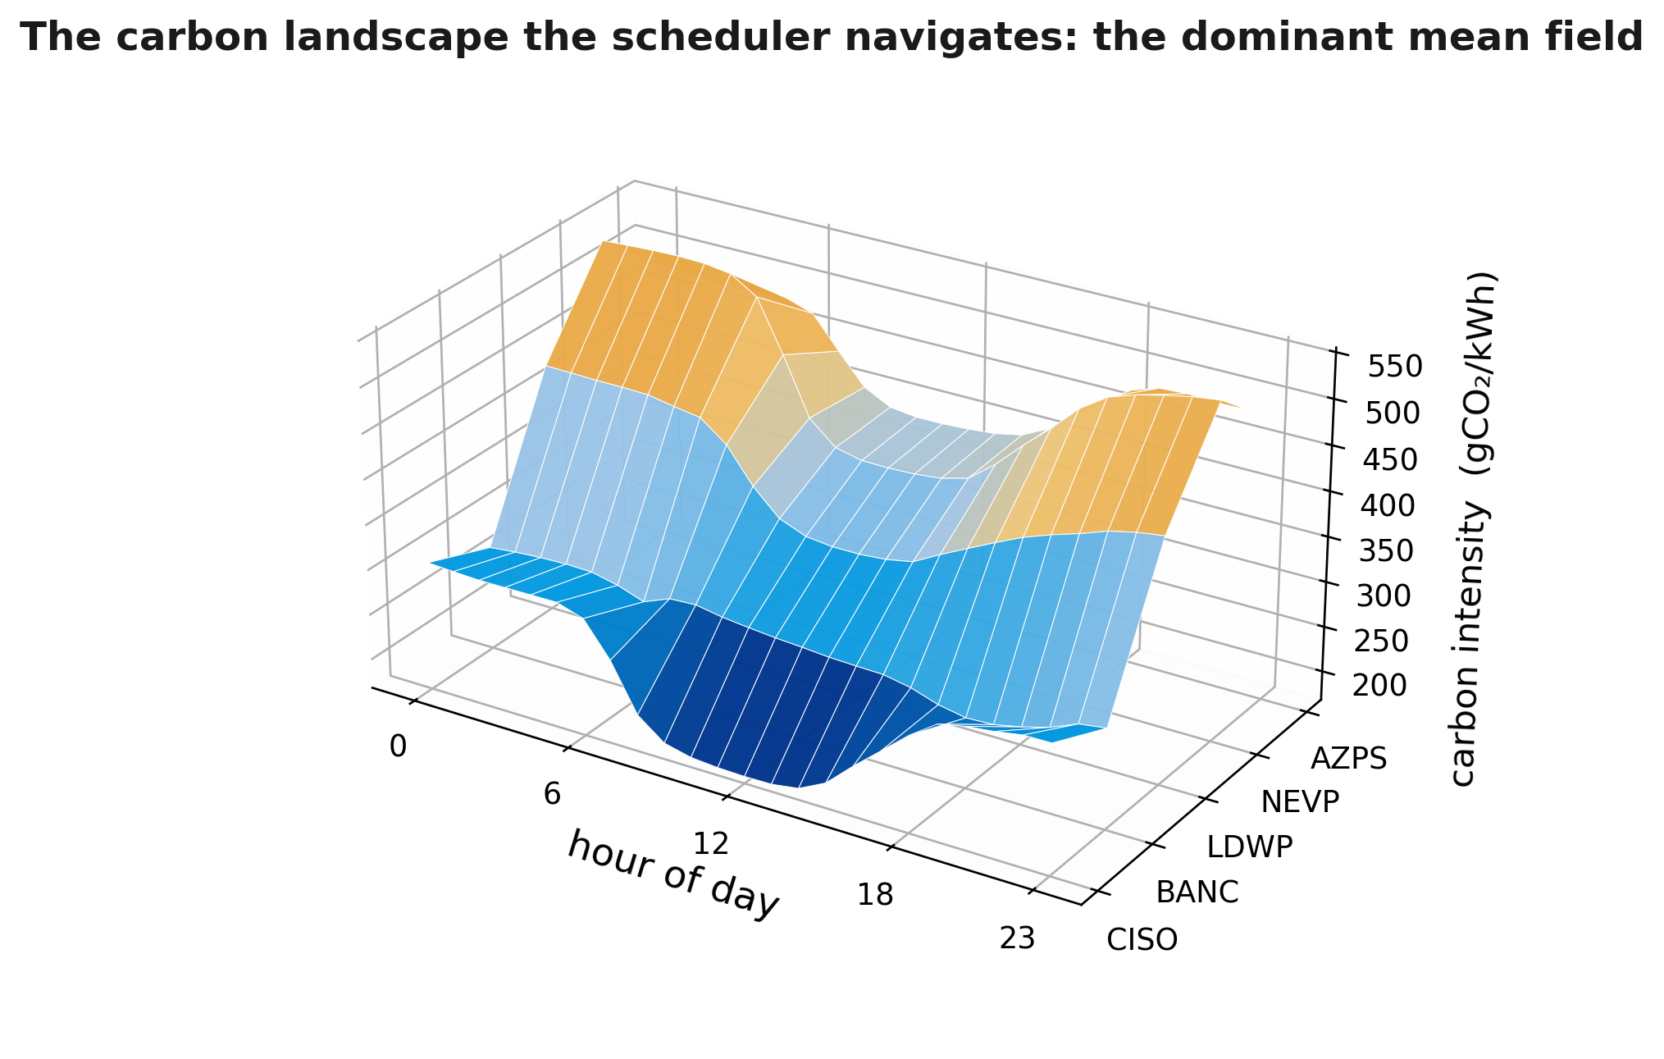
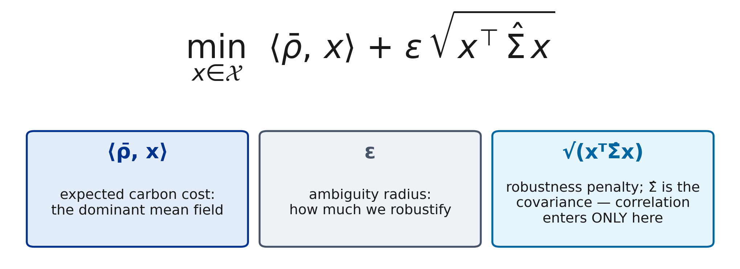
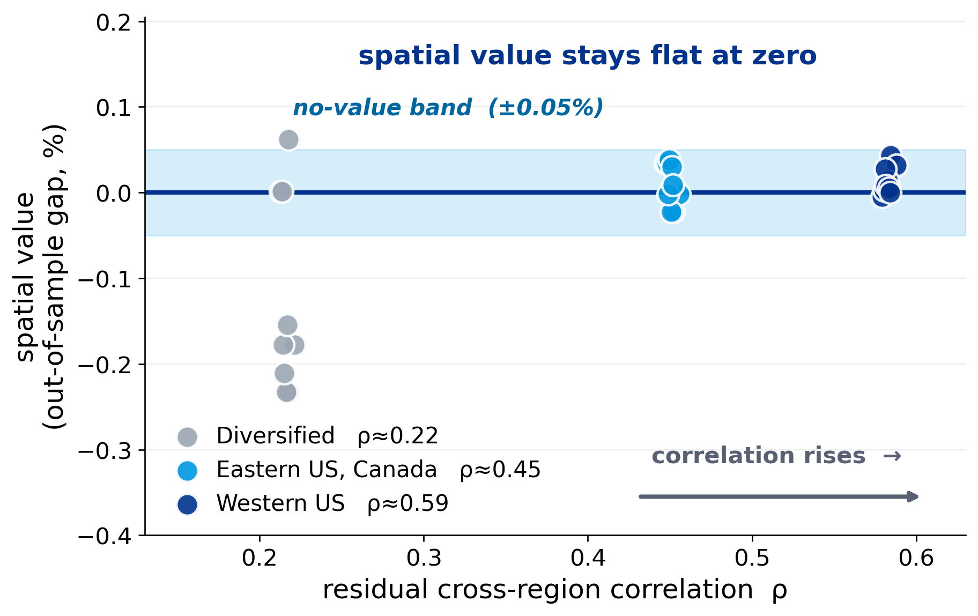
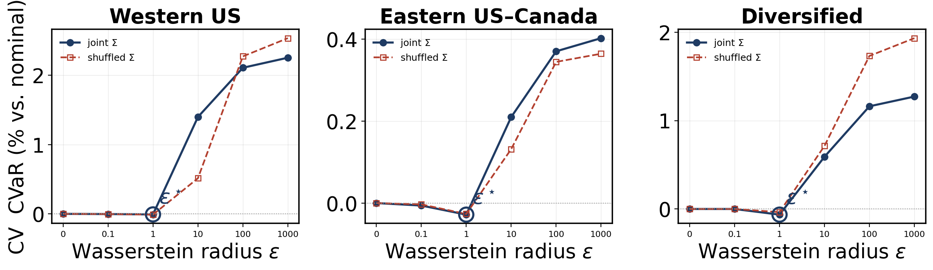
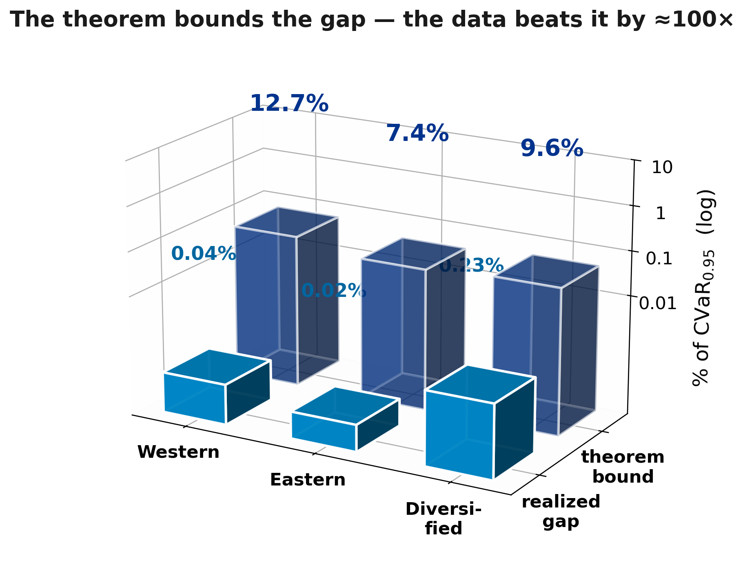
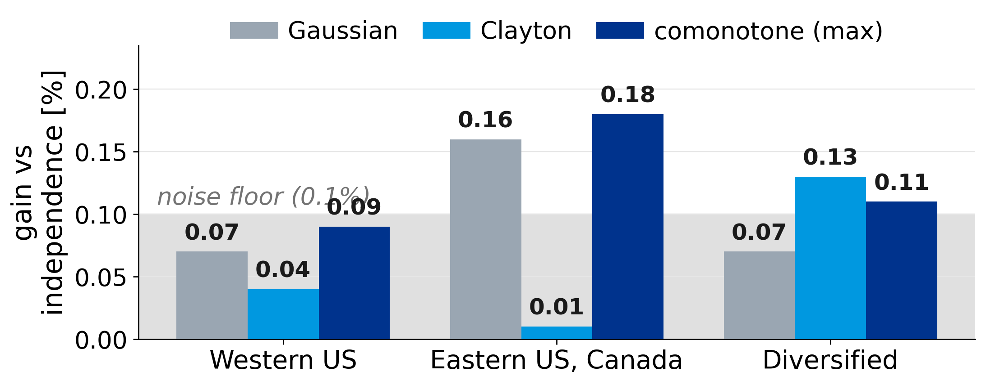
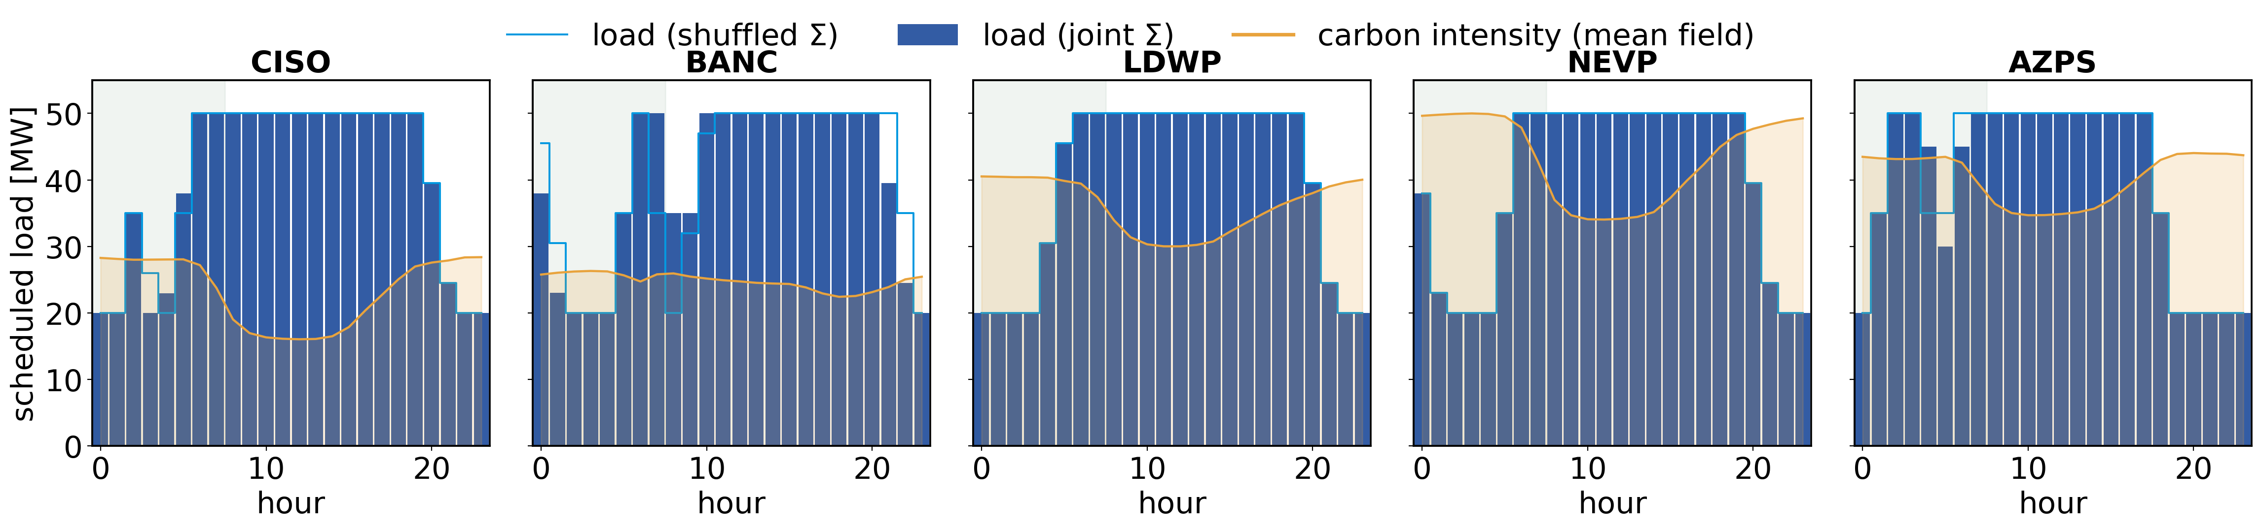
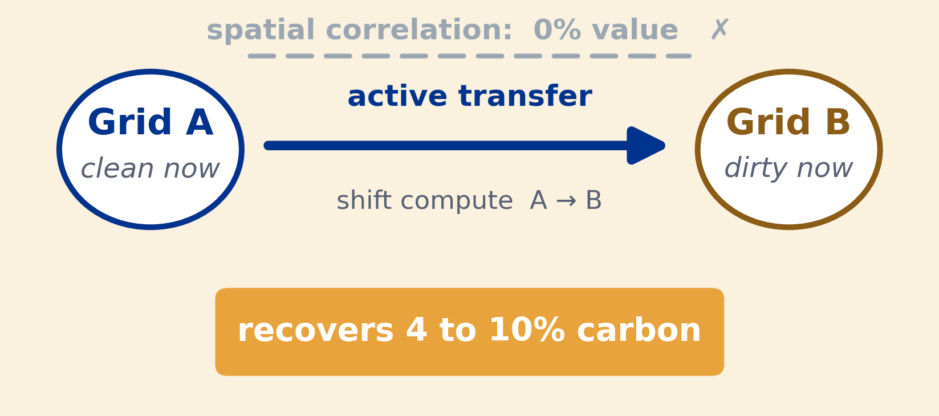

The Price of Sophistication: When Do Spatial and
Robust Models Pay in Carbon-Aware Scheduling?
DATA & TOOLS
Electricity Maps
Real-time grid carbon, 2021 to 2025
A day-ahead migration scheduler and a complexity-value decision rule
Solved with CVXPY · CLARABEL · HiGHS
Marco Ortiz Togashi Supervisor: Prof. Bissan Ghaddar IE University, Master in Business Analytics & Data Science
Day-ahead
forecast
Migration
scheduler
Price each
modeling layer
Decision
rule
Active inter-region migration cuts worst-case emissions 4.0 to 9.9%; added sophistication (joint covariance, robustness) does not pay until a severity real grids never reach.
~0%
M* = 3
0 / 17
4-10%
value added by joint
covariance and copulas
severity where robustness
finally starts to pay
real grids that reach the
robustness threshold
worst-case (CVaR) emissions cut
by active inter-region migration
THE SCREEN
THE PRICE
THE LIMIT
THE LEVER
BACKGROUND
STEP 01 THE PREMISE
STEP 02 THE SCREEN
STEP 03 THE MECHANISM
The promise
The spatial signal is real, but does it pay?
Does passive sophistication pay? No.
Why does it add nothing? The mean field holds it.
Modern compute is flexible: training and batch jobs shift in time and across data-center sites, so deferring work to cleaner hours and regions lowers operational carbon. Across 2021 to 2025 neighbouring grids move strongly together, so spatial structure looks like free signal a robust scheduler could turn into savings. Question: can measured spatial correlation actually lower out-of-sample carbon?
Across 2021 to 2025, de-seasonalized carbon intensity in neighbouring zones moves together. Residual cross-region correlation reaches 0.78 in the Western US and 0.73 in the Eastern interconnection. If spatial structure can ever sharpen a robust schedule, this is the regime where it should.
We re-fit the scheduler on the full joint covariance and on a block-diagonal version that erases every cross-region term, then compare out-of-sample CVaR of carbon cost. Across grids and horizons the gap stays at zero.
Mean ablation isolates the cause. Hold the covariance fixed and flatten the mean field, and the same spatial structure now pays +1.46%. The signal is real but masked by a dominant mean, not absent.
DATA & SETUP
What goes in
Electricity Maps hourly carbon intensity, 2021 to 2025 (43,824 obs/zone); train 2021 to 2024, single locked 2025 test. Three US and Canadian grids spanning weak to strong residual correlation (up to 0.78). Facility: R zones × 24 h, 50 MW cap, 80% utilization, 15 MW/h ramp, deferral window 0 to 7 h, inflexible fraction 30 to 75%.
METHOD
How it is built
A Mahalanobis Wasserstein DRO, a second-order cone program in CVXPY (Clarabel/HiGHS), minimizing CVaR of carbon cost (Rockafellar and Uryasev 2000):
Three grids span the US and Canada; the Western US zones form a tightly correlated graph (up to 0.78).
Real problem versus covariance-only: about zero unless the mean field is removed.
The dominant mean carbon field: the schedule follows this terrain; the spatial covariance is a thin ripple on top (≤1.46%).
Cross-region value enters only through the off-diagonal blocks of Σ; the pre-registered shuffled-marginals test zeroes exactly those blocks. We add copula and tail checks, mean ablations, and walk-forward validation to 2025.
Cross-validation picks ε* = 1: the optimizer truly robustifies, so the null is real.
RIGOR
But value does not follow: out-of-sample spatial value stays at zero as correlation rises from 0.2 to 0.6.
The mean-dominance theorem caps the gap a-priori at 7 to 13% of CVaR; the realized gap never exceeds 0.23%, about 100x below its own bound.
Why you can trust a null
WE EXPECTED
WE FOUND
THE NULL SURVIVES EVERY CHECK
194
unit tests, CI on every push
Correlation sharpens the schedule
Spatial value stays ~0%
Gaussian, Clayton, even the comonotone (maximal) copula: every gain sits at the noise floor.
✓
Ledoit-Wolf covariance shrinkage
Copulas capture the dependence
Even the maximal copula adds nothing
THE VERDICT across every estimator and test, the out-of-sample spatial value is statistically indistinguishable from zero.
✓
Residualization of the mean field
27
cells where TOST confirms a null effect
✓
Benjamini-Hochberg over 144 cells
The signal is simply absent
Real, but masked: +1.46%
✓
Walk-forward validation to 2024
✓
Ramp and utilization sweeps
1
mean-dominance theorem bounding the gap
✓
The full CVaR tail range, 0.80 to 0.99
THE RESULT, SEEN DIRECTLY
Each panel is one Western US grid. Bars: scheduled load. Line: carbon intensity. Joint and shuffled plans overlap.
THE PAYOFF
The value is in physically moving compute toward whichever grid is clean right now. An active inter-region transfer channel cuts 4 to 10 percent of carbon, deterministically. The sophisticated layers (joint covariance, copulas, distributional robustness) add nothing until grid emergencies hit 3x severity, which real grids never reach. Deploy the simple migration scheduler; price robustness only if your grid faces genuine extremes.
RECOMMENDATION Deploy the deterministic migration scheduler; skip joint-covariance and copula modeling; price robustness only past a severity real grids never reach.
REPOSITORY
DATA · THESIS
Marco Ortiz Togashi · marco.ortiztogashi@student.ie.edu | Supervisor: Prof. Bissan Ghaddar | IE University, MS in Business Analytics & Data Science | Carbon data: Electricity Maps (academic licence).
References: Hall et al. 2024 (carbon-aware DRO); Mohajerin Esfahani and Kuhn 2018 (Wasserstein DRO); Rockafellar and Uryasev 2000 (CVaR).

