Slide 1

The Price of Sophistication
When does a fancier model actually pay in carbon-aware
data-center scheduling?
We built a real scheduler, then put a price on three upgrades. One pays. Two do not.
Marco Ortiz Togashi · IE University · MSc Business Analytics & Data Science
Supervisor: Prof. Bissan Ghaddar · Viva · 7 July 2026

Slide 2
THE CASE IN ONE SLIDE
One operator, three decisions
2
Move work between regions?
Model how regions co-move?
Plan for worse than forecast?
Yes. Worst-day emissions fall 4.0 to 9.9%, roughly $1.7M a year (gross). No statistics needed. This is the lever.
No. It adds under 0.4%, worth about $37k gross and not reliable. Skip it, and we show why.
Only if carbon can spike to triple. Real grids peak near 1.4 times, far below that, so on observed data, skip it.
The contribution: a rule that tells you when a dependence model can ever pay, and a fair way to put a price on any modelling layer.
The operator is a stand-in for the real study: three grids, 17 US and Canada zones. We priced all three upgrades on a year of real data it never saw, under a pre-committed test. 202 tests, every number archived.
The Price of Sophistication · carbon-aware data-center scheduling
M. Ortiz Togashi · 2

Slide 3
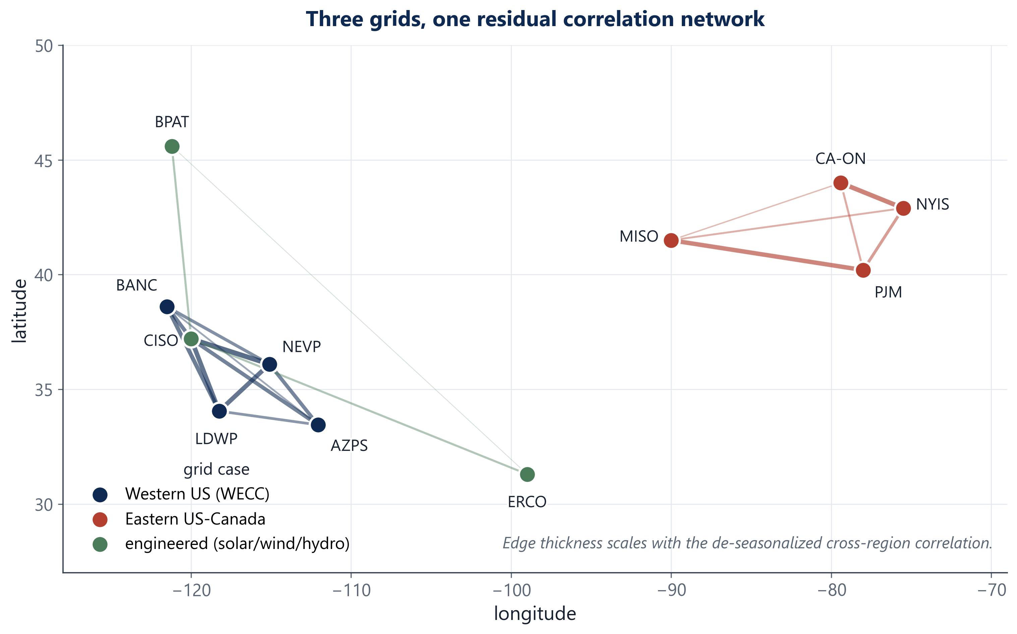
THE SETUP · MEET THE OPERATOR
Electricity is not equally clean all day, everywhere
3
You run compute across regions
● You run a fleet of data centers across the US and Canada, with a carbon promise to keep. Every evening you choose where tomorrow's flexible work runs.
● The work can wait. Training and batch jobs can start a few hours later, or run in a cleaner region, and nobody notices.
● The grid will not wait. Clean power comes and goes by the hour and by region. So you send the work to the cleanest hour and place.
The question is not whether to do this. It is how fancy the model needs to be.
Carbon intensity differs across regions, and it keeps moving.
The Price of Sophistication · carbon-aware data-center scheduling
M. Ortiz Togashi · 3

Slide 4
THE CATCH
Nobody had priced the upgrades one at a time
4
Savings were never separated
No fair baseline
The closest work stops at one region
Papers change many things at once and report one big saving. Nobody can say which part earned what.
Richer models get compared against weaker setups under different rules. The model and the setup are mixed together.
Hall et al. 2024 builds robust carbon scheduling for a single region. Whether links across regions pay was an open question.
Our fix: one scheduler, the same rules for everyone, add one layer at a time, and price each layer on data it has never seen.
RQ1 moving work between regions. Does it pay, and how much?
RQ2 modelling how regions move together. Does that add anything?
RQ3 planning for a worse day than the forecast. When is that worth it?
The Price of Sophistication · carbon-aware data-center scheduling
M. Ortiz Togashi · 4

Slide 5
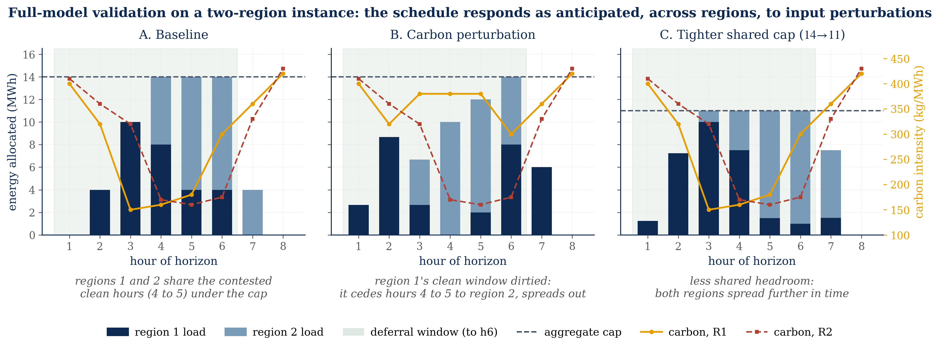
HOW WE TESTED IT
A day-ahead scheduler, scored on its worst days
5
Forecast, plan, execute, score
● Every evening: forecast tomorrow's carbon per region, plan where and when the work runs, execute, score. Repeat for a full held-out year (2025).
● The fair-test rule: every version of the scheduler runs under identical constraints. Only the brain changes, so any difference is the brain's doing.
● The baseline is the same scheduler with the transfer channel switched off (Φ = 0). Like for like.
● The score: CVaR, the average of the worst 5% of days.
The constraints: a capacity ceiling, ramp limits, a work deadline, and a thermal (PUE) limit, plus the transfer budget Φ. The full model is written out on the last backup slide.
Check: on small problems the scheduler finds the exact best answer.
The Price of Sophistication · carbon-aware data-center scheduling
M. Ortiz Togashi · 5

Slide 6
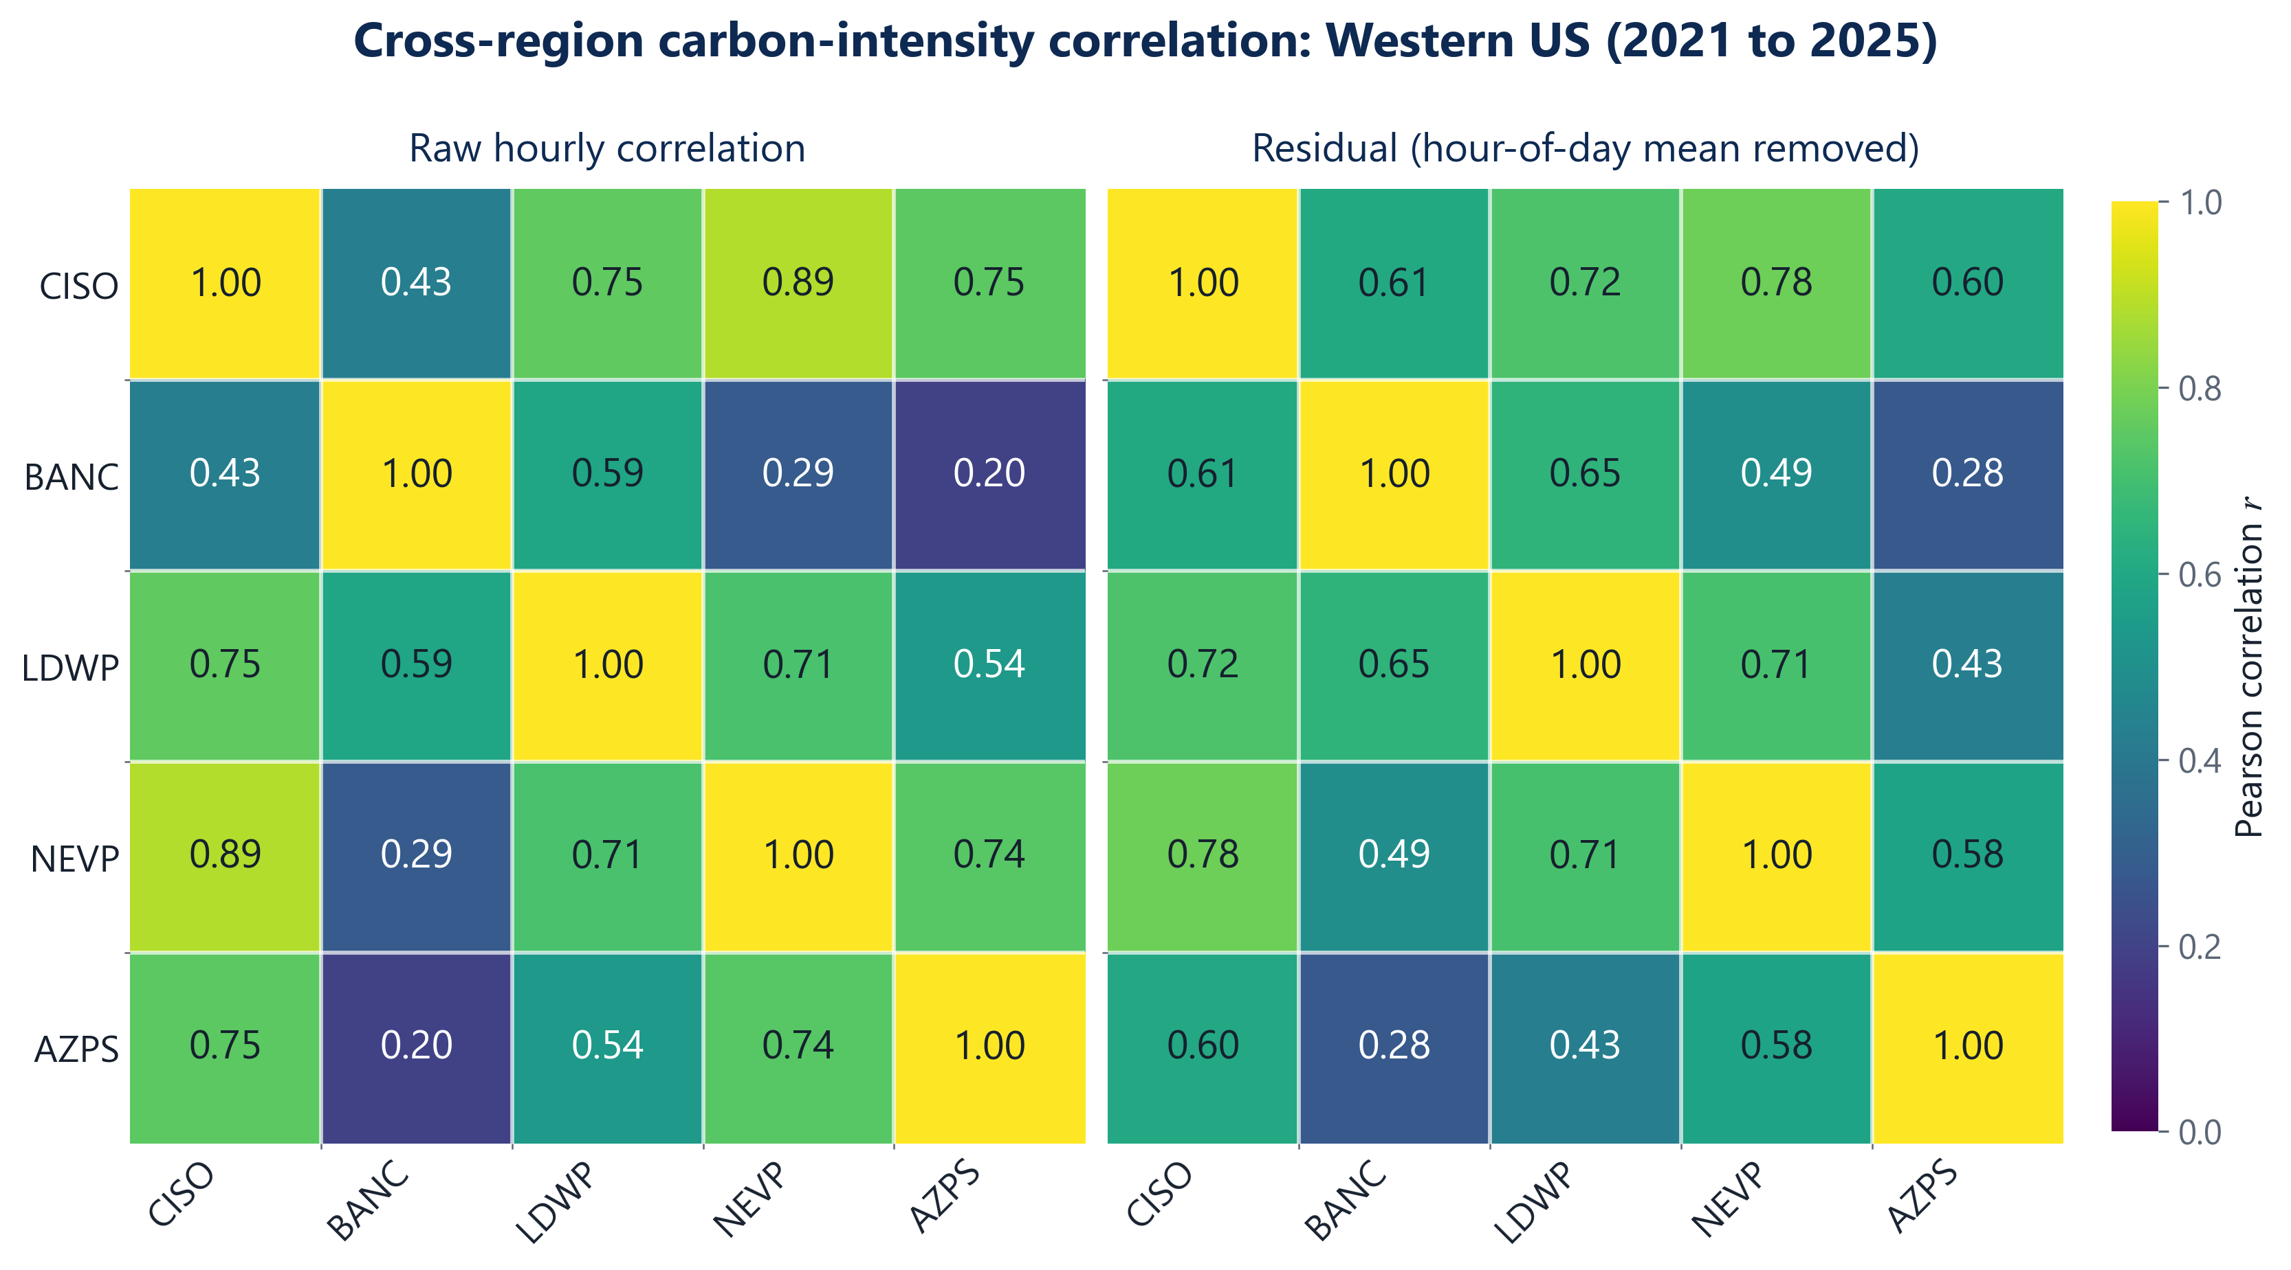
HOW WE TESTED IT
Real data, and grids picked to work against us
6
If the layer can pay anywhere, it is here
● Real hourly carbon data (Electricity Maps), 2021 to 2025, 17 zones across the US and Canada. Trained up to 2024, tested once on 2025.
● US West: regions strongly linked, all moving together.
● Eastern US and Canada belt: middle of the road.
● A built portfolio of solar, wind and hydro zones: barely linked, on purpose. The best possible case for the co-movement layer.
● Iberia and France: checked early, set aside as too weak a test. The robust machinery does not engage there, so a zero from it would prove nothing.
The links are real, up to 0.78 out of 1 on the US West, close to a perfect match. Value is the question.
The Price of Sophistication · carbon-aware data-center scheduling
M. Ortiz Togashi · 6

Slide 7
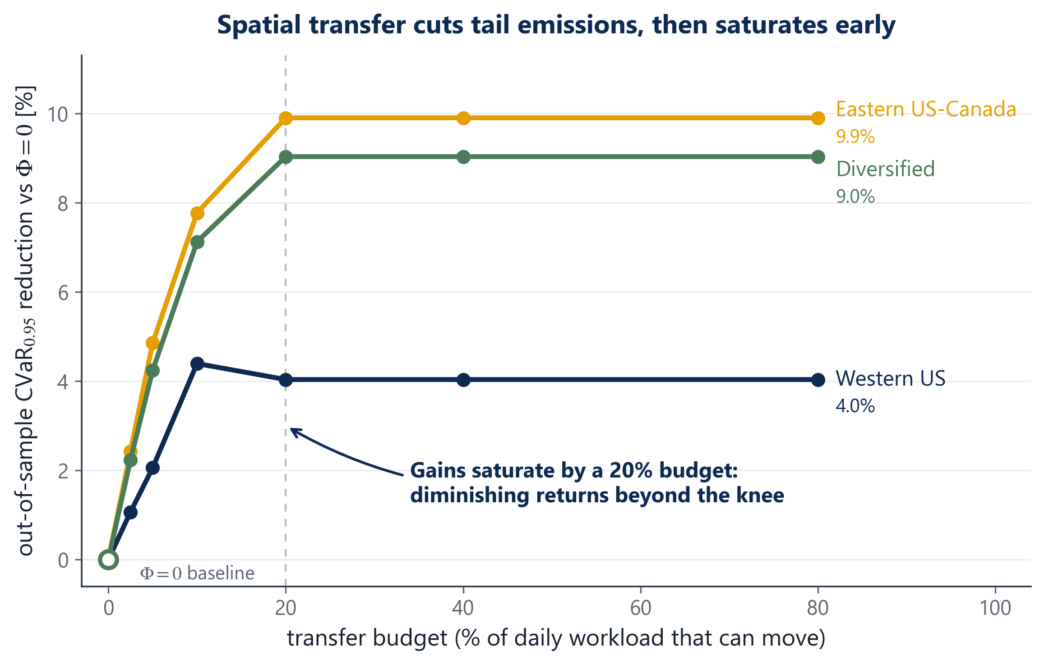
DECISION 1 · MOVE THE WORK?
Let the work chase the clean region. It pays.
7
4.0 to 9.9%
cut in worst-day emissions, against the same scheduler with transfer switched off
● Per grid: Western 4.0%, Eastern 9.9%, Diversified 9.0%. On the Eastern fleet, roughly $1.7M a year, before the cost of moving work.
● Savings flatten out near a 20% transfer budget. A modest channel captures nearly all the value.
● And it needs no statistics at all. This is the lever.
The Price of Sophistication · carbon-aware data-center scheduling
M. Ortiz Togashi · 7

Slide 8
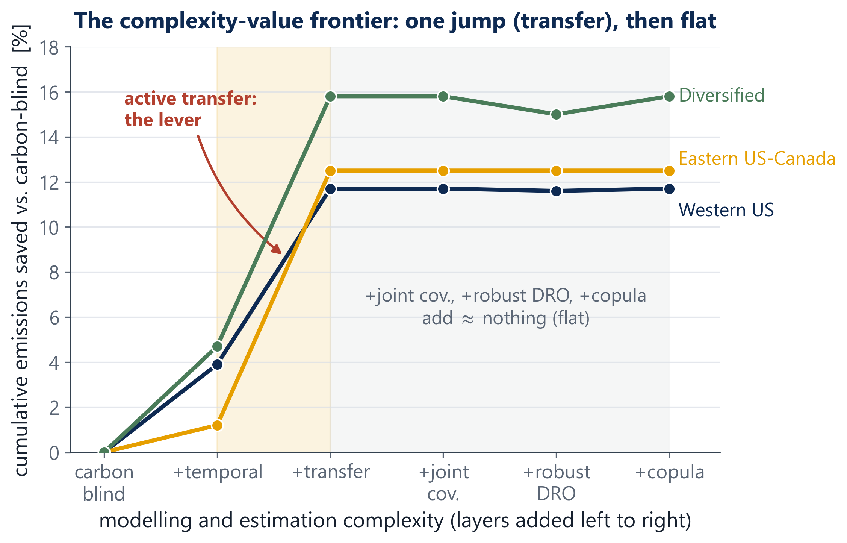
THE VERDICT SO FAR
One jump, then flat
8
The whole thesis in one image
● Every model we built, on one line: value against complexity. Same rules, same test year.
● Transfer is the single jump. Everything after it adds almost no height.
● The rest of this talk explains why the line goes flat, and when it would not.
y-axis: savings vs a carbon-blind scheduler; the 4.0 to 9.9% headline is CVaR vs Φ = 0 (archived: complexity_frontier_2026-07-05.csv).
The Price of Sophistication · carbon-aware data-center scheduling
M. Ortiz Togashi · 8

Slide 9
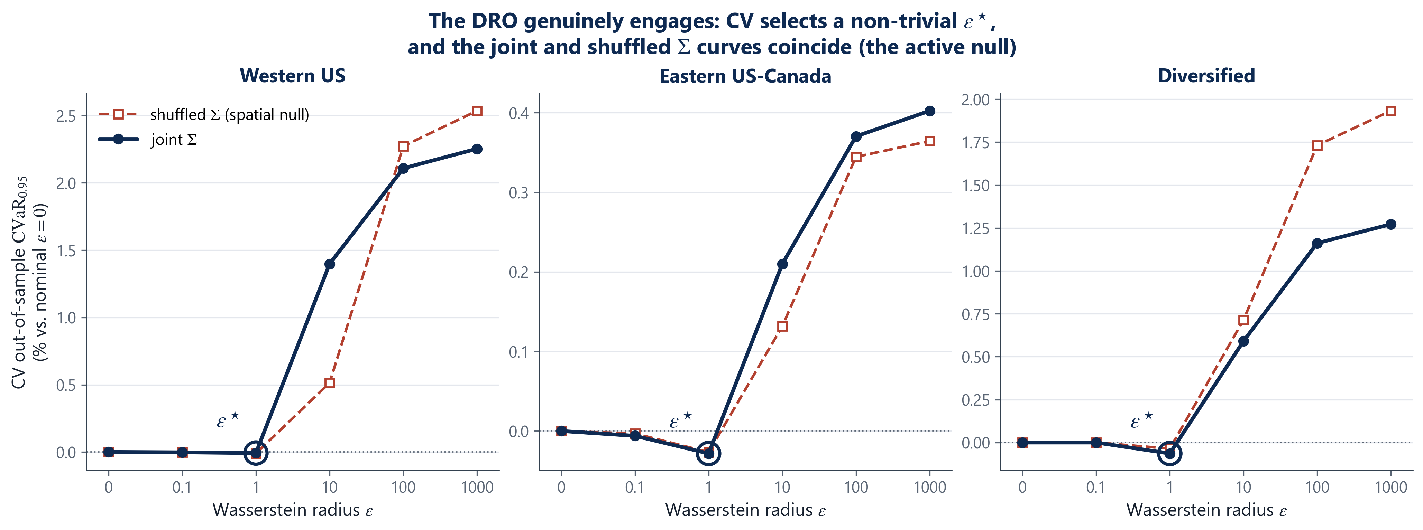
DECISION 2 · MODEL THE LINKS?
Knowing how regions move together adds nothing
9
The test, fixed in advance: fit the schedule with the real links between regions, then with the links destroyed. Across 144 pre-committed cells the gap never leaves a plus or minus 0.4% band, and its sign flips.
An active zero: the machinery was on and engaged, so this is a real zero, not a switched-off one. Skip this layer.
The Price of Sophistication · carbon-aware data-center scheduling
M. Ortiz Togashi · 9

Slide 10
THE TWIST: A REAL SIGNAL THAT STILL DOES NOT PAY
A wave and a ripple: the signal was there all along
10
The signal is real, but the wave hides it
● Carbon follows a big daily wave, driven by sun and demand. It is large, shared, and easy to predict.
● The links between regions live in a small ripple on top, 2 to 4 times smaller than the wave. The schedule barely reacts to it.
● The proof the test works: flatten the wave artificially, and the same layer suddenly pays +1.46%. Far above the 0.4% bar.
● So the signal is real, just too small and shaky to bank. It loses to the wave.
The wave-and-ripple rule
A dependence layer can only move the schedule when the ripple rivals the wave.
On every grid we measured, the wave is 2 to 4 times bigger. So the layer cannot pay there.
This is the part that travels: a simple check anyone can run on their own grid, before spending anything.
The Price of Sophistication · carbon-aware data-center scheduling
M. Ortiz Togashi · 10

Slide 11
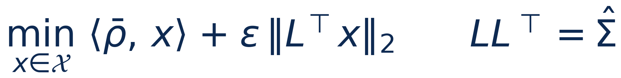
DECISION 3 · BUY INSURANCE?
Forecasts miss, so the plan should expect worse
11
Hedging the forecast
● Planning a day ahead means planning under forecast error.
● The robust plan does not trust one forecast. It draws a ball of plausible tomorrows around it and plans against the worst one inside.
● Like packing for weather a bit worse than predicted.
● More caution buys protection on bad days, and costs a small premium every day. Insurance, in one dial.
The first term carries the saving. The second term prices the caution. So the real question: how bad must the bad day be before the insurance pays for itself?
The Price of Sophistication · carbon-aware data-center scheduling
M. Ortiz Togashi · 11

Slide 12
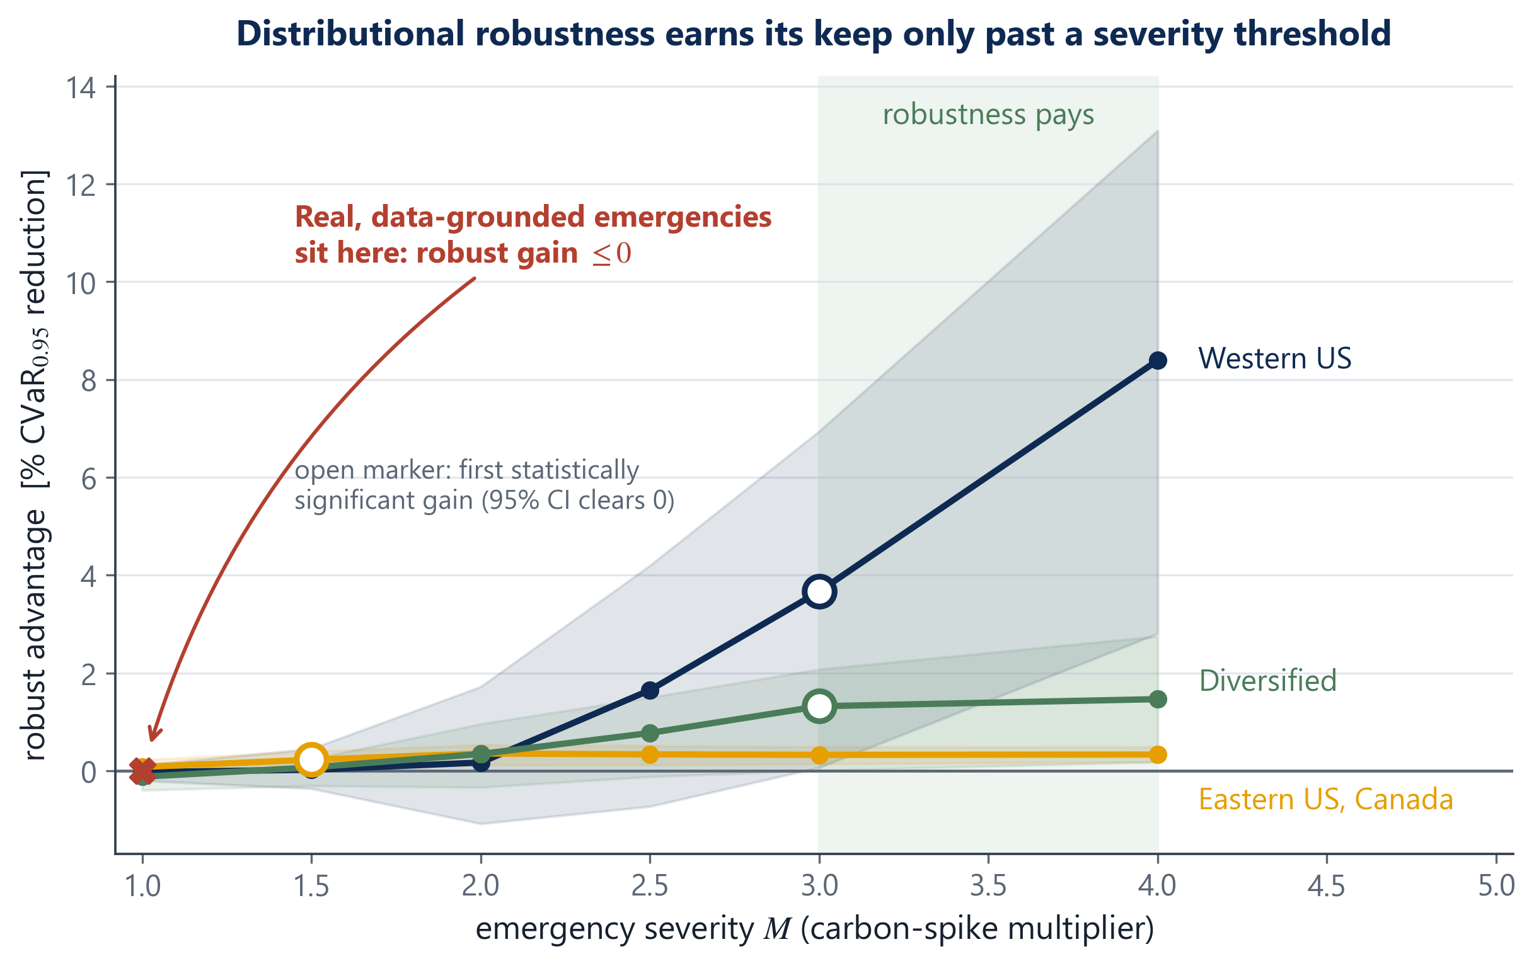
DECISION 3 · BUY INSURANCE?
Insurance pays past a tripling. Observed grids fall far short.
12
● We injected emergencies into the test year and turned the severity up step by step. The robust plan starts to win past M = 3: carbon spiking to triple.
● Reality check, 17 zones, 5 years: the median worst spike is about 1.43 times. Even Winter Storm Uri reached only 1.28 times.
● One caveat, stated up front: this holds for single-region emergencies. For storms that hit every region at once, there is nowhere clean to move the work anyway.
● So robustness is an option you price, not a free win.
The Price of Sophistication · carbon-aware data-center scheduling
M. Ortiz Togashi · 12

Slide 13
THE PLAYBOOK
A decision rule the operator can use tomorrow
13
Layer 1 · Always
Layer 2 · The lever
Schedule per region, day ahead. Riding the daily carbon wave is the free baseline everyone should run.
Add transfer between regions: 4.0 to 9.9% off worst-day emissions. A modest channel near a 20% budget captures nearly all of it.
Layer 3 · Skip
Layer 4 · Conditional
The co-movement models. Covariance and copulas add under 0.4%, below the noise, while the daily wave dominates.
Buy robustness only if you expect emergencies past a tripling. Real grids have not come close.
The Price of Sophistication · carbon-aware data-center scheduling
M. Ortiz Togashi · 13

Slide 14
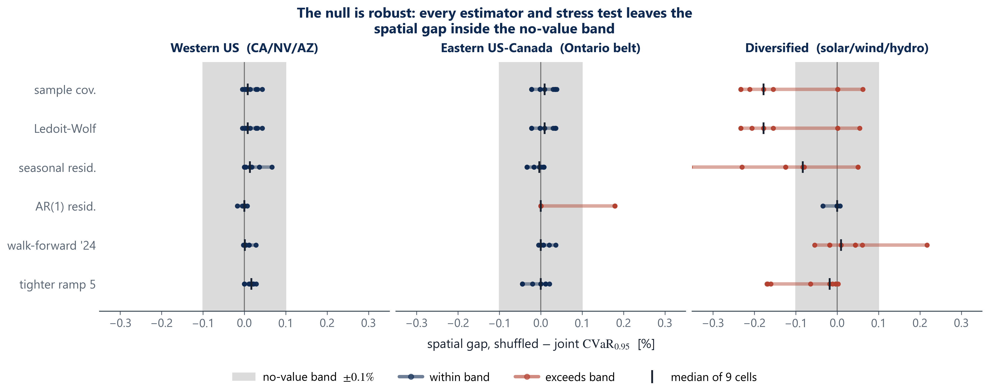
WHY YOU CAN TRUST A NO
Built so that a zero is a result, not an excuse
14
Locked first. The pass-or-fail rule went into version control before we read 2025. An equivalence test, built to prove smallness rather than just miss it, rules out any effect above 0.4%, and holds down to a 0.31% bar. A correction for testing many cells, a resampling check that keeps nearby days together, and re-runs on 2022 to 2024 all give the same zero. The +1.46% positive control proves the test can fire.
The gap stays inside the 0.4% band under every check, and the test had the power to catch any real gap down to 0.015 to 0.11%. Every number is archived.
The Price of Sophistication · carbon-aware data-center scheduling
M. Ortiz Togashi · 14

Slide 15
WHY YOU CAN TRUST A NO
202 tests: the thesis's claims run as code
15
70
Models against known answers. every scheduler is solved on small test problems where we know the exact best answer, and must match it
59
Covariance and dependence tools. the estimators, the link-destroying shuffle, the correlation and tail measures
25
The shared rulebook. capacity, ramp and budget constraints. The fair-test rule, enforced in code
16
Data pipelines. loading the carbon data (13 tests need the licensed files, so the automatic test runner runs 189) and the weather data (3)
11
The thesis's math, run as tests. key claims from the thesis are checked by code on every push. If a claim breaks, the build goes red
21
Frozen numbers and guards. the headline numbers are re-checked against their archived files, so nothing can drift quietly
Why so many? Because the weak point of finding nothing is: you did not look hard enough. The tests are how we prove we looked.
The Price of Sophistication · carbon-aware data-center scheduling
M. Ortiz Togashi · 15

Slide 16
THE CONTRIBUTION
What this thesis adds
16
1. A rule for when the dependence layer can pay
It can only pay when the ripple rivals the wave. We show how to split the score into the big daily wave and the small leftover ripple, give a limit you can check before touching any data, and back it with a measurement that has a working positive control. Carbon grids are not in that regime, and that is a rule about a whole class of problems, not one number.
2. A fair way to price a modelling layer
Lock the pass-or-fail rule first. Keep everything else identical. Compare against a like-for-like baseline and an economic bar. The field added this layer by default. We put a price on it.
Plus: the measured 4.0 to 9.9% transfer saving, the priced robustness rule, and a pipeline anyone can re-run. 202 tests, archived numbers, free solvers.
The Price of Sophistication · carbon-aware data-center scheduling
M. Ortiz Togashi · 16

Slide 17
WHERE IT COULD BREAK
Stated plainly
17
● One workload shape: jobs that can split across hours and sites, with ramp limits. A very different cost shape could change the answer.
● One main test year. Re-runs on 2022 to 2024 agree, but the truly independent evidence is a handful of yearly reads, not 362 days. A longer evaluation is the named next step.
● A pattern, not a law: the rule holds where the daily wave dominates. That is every grid we measured, but we hand you the check, not a theorem.
● The crossover is characterized, not observed: no real grid in our data ever crossed it. It is reported at the pre-committed caution and tail level, not tuned to a number, and we say exactly where that line is.
The Price of Sophistication · carbon-aware data-center scheduling
M. Ortiz Togashi · 17

Slide 18
The rule in one line
Fancier is not safer. It is a bill, and it pays only when the ripple rivals the wave.
● Always schedule with the daily wave.
● Add the transfer channel. That is the lever: 4.0 to 9.9%.
● Skip the co-movement models: under 0.4%, below the noise.
● Buy robustness only past a tripling. Real grids are not there.
Thank you. Questions welcome.
Every number on these slides traces to an archived file in the repository (docs/deck_provenance.md).
M. Ortiz Togashi · 18

Slide 19
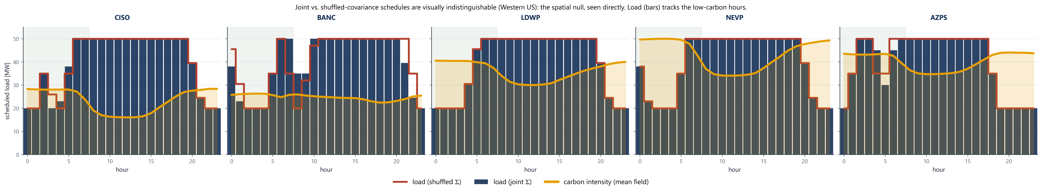
BACKUP · RQ2
The test in detail: destroy the links, keep everything else
19
Keep each region, cut the links. Fit the schedule on the real links between regions. Then refit on a copy where each region keeps its own exact daily pattern, but every cross-region link is destroyed. Score both on the held-out worst days. The rule, fixed in advance: if spatial structure matters, the real-links schedule must win. It does not.
Western US, joint (filled) vs shuffled (outline) schedules. They overlap almost everywhere.
The Price of Sophistication · carbon-aware data-center scheduling
M. Ortiz Togashi · 19

Slide 20
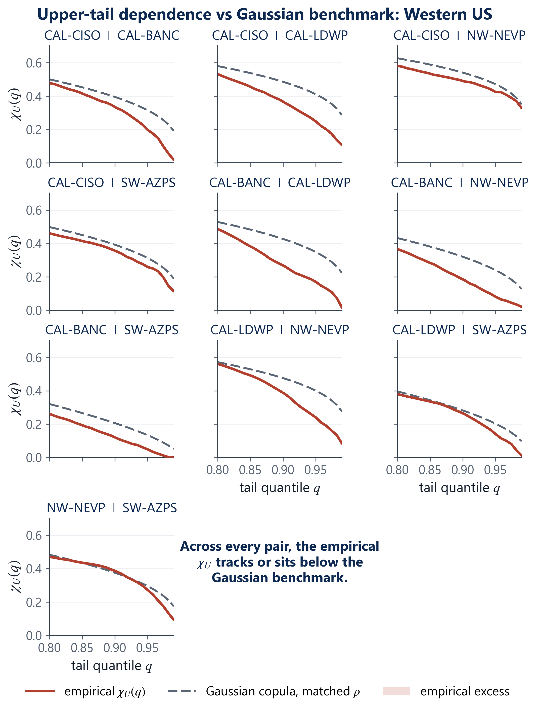
BACKUP · RQ2
The leftover dependence has the wrong shape
20
Clean together, dirty apart
● Regions hit their clean extremes together far more than their dirty ones. CISO/LDWP: 0.48 clean vs 0.25 dirty. BANC/LDWP: 0.40 vs 0.17.
● A simple co-movement model is symmetric: it treats clean-together and dirty-together as the same size. Real grids do not, so it cannot capture this shape.
● And the structure sits in the clean tail, which a risk-averse scheduler ignores anyway.
● Archived: tail_dependence_2026-07-05.csv (residual series).
The Price of Sophistication · carbon-aware data-center scheduling
M. Ortiz Togashi · 20

Slide 21
BACKUP · STATISTICS
144 cells, 198 rows: the anatomy of the test
21
144
+ 54
= 198
pre-committed null-family cells
positive-control cells (wave flattened)
rows in bh_correction.csv
● 144 = 4 grid-runs x 9 regime cells x 4 covariance estimators. The multiple-testing correction applies to this family.
● Biggest gap among the 144: 0.355%, inside the 0.4% band. And the test had the power to catch any real gap down to 0.015 to 0.11% (80% power, TOST at alpha 0.05), an order of magnitude below the bar.
● The 54 extra rows are the instrument check: flatten the wave and the test fires at +1.46%, well above the bar, by design.
● The claim is a conjunction: every cell must rule out a material effect, so it is only as strong as its hardest case, the Diversified grid, which still clears the bar comfortably (z = 3.7). Conservative without extra correction.
The Price of Sophistication · carbon-aware data-center scheduling
M. Ortiz Togashi · 21

Slide 22
BACKUP · STATISTICS
Why 0.4%? An economics bar, and it only cuts one way
22
The bar, defended
● 0.4% is the smallest saving that covers building and running a covariance layer. And that layer can itself hurt: up to 0.233% on the Diversified grid.
● It was not tuned to get the result: the conclusion keeps holding for any bar down to 0.31%.
● Push the bar to 0.1% and only one cell flips: Diversified at minus 0.233%, and it flips to clearly negative. A tighter bar makes skipping the layer stronger, not weaker.
● Scale: on the Eastern facility the covariance channel is worth about $37k a year, and not reliably positive. The transfer lever is worth about $1.7M.
The Price of Sophistication · carbon-aware data-center scheduling
M. Ortiz Togashi · 22

Slide 23
BACKUP · RQ3
Why BPAT's 5.12x does not break the crossover
23
A big ratio on a tiny base is not risk
● BPAT is a hydro zone with near-zero baseline carbon. A 5.12x jump on a tiny base is a small change in grams. It barely moves the portfolio.
● What the schedule's risk actually feels is the portfolio-level worst day: Western 1.34x, Eastern 1.29x, Diversified 1.89x. All well under the tripling.
● Context: CA-ON 2.57x, US-SW-PNM 1.90x, median of the 17 zones 1.43x, Winter Storm Uri 1.28x. (carbon_ceiling_2026-06-24.csv)
● And the decisive check: draw emergencies from each region's own real worst days, and the robust plan still does not pay.
The Price of Sophistication · carbon-aware data-center scheduling
M. Ortiz Togashi · 23

Slide 24
BACKUP · THE FULL MODEL
The scheduler, written out
24
The problem is a second-order cone program:
Subject to (the feasible set):
● Ceiling: 0 ≤ x ≤ capacity. A site cannot exceed its installed power.
● Work and flexible split: each region serves its daily work. A fixed fraction is inflexible (pinned shape); the rest is free to move.
● Ramp: hour-to-hour change ≤ 15 MW. Power cannot jump, so the greedy cheapest-hour schedule is infeasible.
● Deadline: at least 20% of flexible work done in the morning window. You cannot defer everything to the cheap hour.
● Thermal (PUE): hotter hours cost more cooling, so less usable compute. This is why weather enters the model.
● Transfer (Part 3): work can move between regions up to a budget Φ, and flows conserve work. Φ = 0 is the honest baseline.
x is the schedule (power per region, per hour), ρ̄ is forecast carbon, ε is how cautious, Σ is how the regions co-vary.
At ε = 0 it is a plain linear program on the forecast. The cone term is the only place covariance can act, which is exactly what Decision 2 prices.
Calibrated on training data to bind loosely, so the schedule still moves 25 to 30% and covariance gets its best shot.
The Price of Sophistication · carbon-aware data-center scheduling
M. Ortiz Togashi · 24

Slide 25
BACKUP · FUTURE WORK
The null is a sharpened mandate, not a dead end
25
1. Settle the crossover
2. Make the null model-free
Build a calibrated outage model from grid-operator data, not the carbon tail, with a pre-committed evaluation and affine recourse. Does real emergency risk ever reach the 3x the robust plan needs?
A copula-ambiguity Wasserstein DRO (Fan-Ji-Lejeune) on a fitted vine, robustifying the dependence structure itself. Mean-dominance predicts it still will not pay, but this closes the last objection.
3. Transfer, online and multistage
4. A general screening rule
Forecasts arrive in sequence, with demand and transmission themselves uncertain, and the ambiguity ball centred on a learned forecast. This is where the online loss on the Diversified grid could flip.
Turn mean-dominance into a condition for when cross-region dependence can ever help a robust allocation. Carbon-aware scheduling is one instance of a wider class.
Plus broader external validity: a longer multi-year rolling evaluation, grids with different generation mixes (hydro-thermal with seasonal storage), and hard-deadline objectives. Every direction is named in the thesis Future Work section.
The Price of Sophistication · carbon-aware data-center scheduling
M. Ortiz Togashi · 25

