Slide 1

The Price of Sophistication
A Pre-Committed Falsification Test for When Spatial
and Robust Modelling Pay in Carbon-Aware Scheduling
A working day-ahead migration scheduler, and a decision rule for when each modelling layer earns its complexity
Marco Ortiz Togashi · IE University · MSc Business Analytics & Data Science
Supervisor: Prof. Bissan Ghaddar

Slide 2
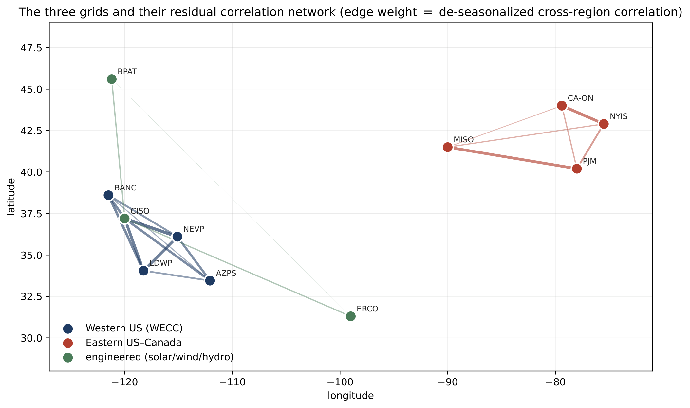
Flexible compute meets a varying grid
2
The opportunity
● Compute is unusually flexible: batch and AI-training jobs can shift in time and across sites.
● Carbon intensity of electricity varies sharply by hour and by region, driven by wind, solar, hydro, and demand.
● So an operator can ship work to cleaner hours and cleaner regions, cutting emissions at almost no cost.
● The open question is not whether to schedule, but which modelling layers actually pay for their complexity.
Carbon intensity is spatially structured, and it moves.
The Price of Sophistication: carbon-aware data-center scheduling
M. Ortiz Togashi · 2

Slide 3
Which layers earn their complexity?
3
Sophistication is not free
● Each layer (inter-region transfer, spatial covariance, distributional robustness, richer copulas) adds estimation and compute cost.
● The literature has assumed this sophistication pays, rather than measuring it.
● We build a working day-ahead scheduler and price each layer directly, out of sample.
RQ1: how much does the transfer lever save? RQ2: does passive covariance or a copula add anything? RQ3: when does robustness pay?
The Price of Sophistication: carbon-aware data-center scheduling
M. Ortiz Togashi · 3

Slide 4
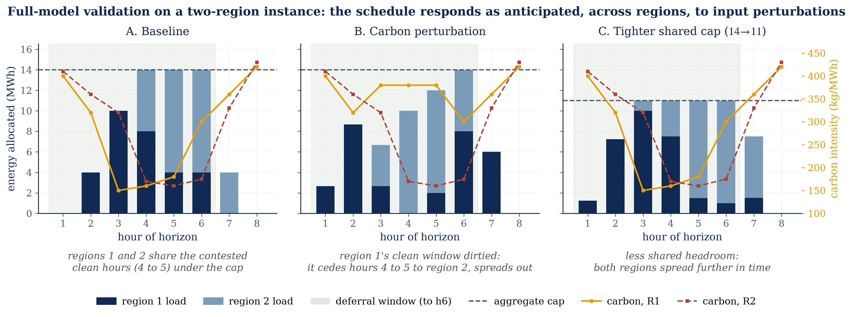
The day-ahead scheduler
4
Forecast, optimize, roll
● Forecast tomorrow's per-region carbon intensity from history.
● Optimize a migration schedule: move splittable compute across regions under ramp limits and a transfer budget Phi.
● Roll forward day by day; score out-of-sample CVaR(0.95) of daily emissions.
● Honest baseline: carbon-aware scheduling with no inter-region transfer (Phi=0), on the same feasible set.
The scheduler matches the exact optimum on small instances.
The Price of Sophistication: carbon-aware data-center scheduling
M. Ortiz Togashi · 4

Slide 5
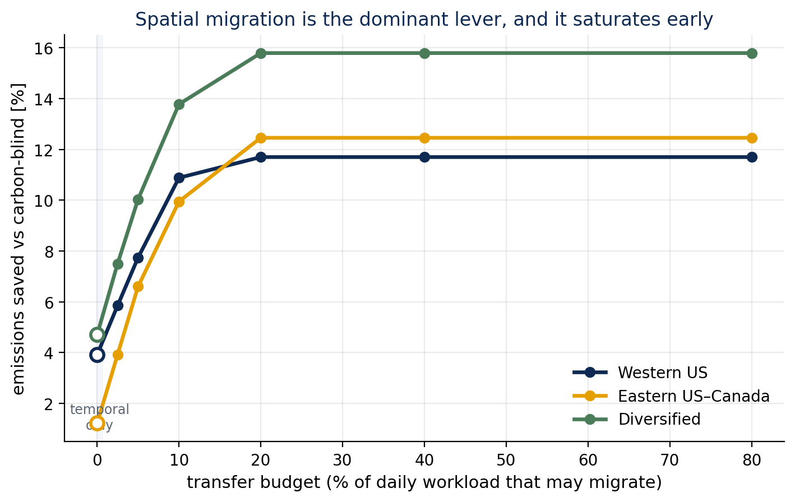
RQ1: the transfer lever pays
5
The lever, and it works
● Active migration cuts out-of-sample CVaR(0.95) by 4.0 to 9.9% over Phi=0.
● Per grid: Western 4.0%, Eastern 9.9%, Diversified 9.0%.
● The lever is the spatial mean: at each hour one region is cleanest, and migration ships work there.
● Deterministic: captured with no dependence model at all.
The Price of Sophistication: carbon-aware data-center scheduling
M. Ortiz Togashi · 5

Slide 6
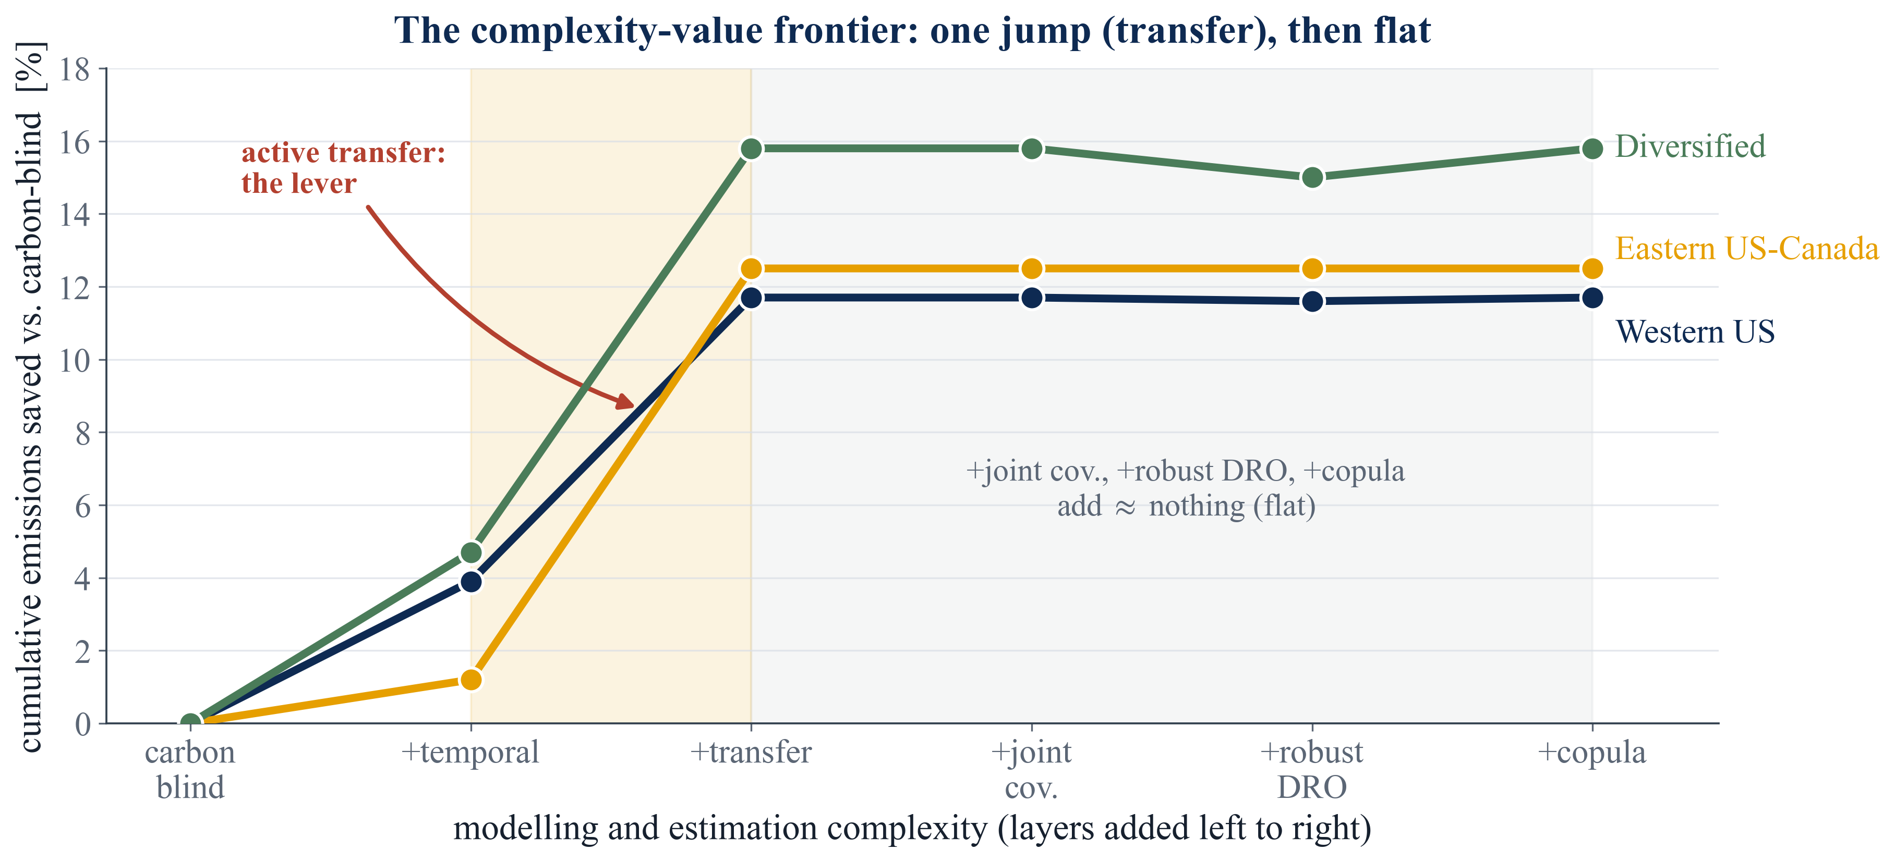
Where the value lives
6
The frontier
● Every model class on one complexity-value frontier.
● Deterministic transfer dominates the frontier.
● Passive covariance and copula layers add no height.
● Robust transfer pays only in the tail, conditional on severity.
The Price of Sophistication: carbon-aware data-center scheduling
M. Ortiz Togashi · 6

Slide 7
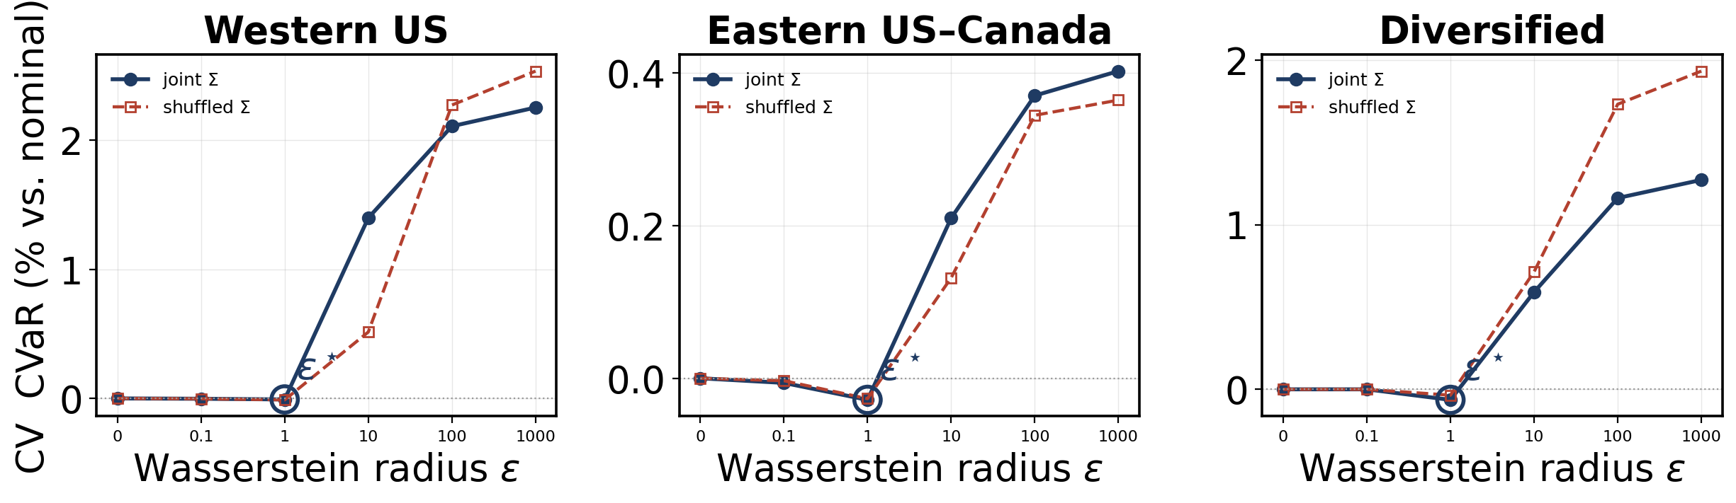
RQ2: passive sophistication adds nothing
7
A strong, active null
● The spatial covariance gap stays below 0.4% of CVaR, and its sign is not stable.
● The DRO is genuinely engaged (CV selects a non-trivial radius), so this is an active null, not a switched-off one.
● Design justification: a simple per-region model is enough.
The Price of Sophistication: carbon-aware data-center scheduling
M. Ortiz Togashi · 7

Slide 8
Why covariance cannot add value
8
The mechanism
● The mean-leveling test: flatten the mean field and the covariance suddenly pays, up to +1.46%.
● So the cross-region signal is real, but masked by the within-day mean carbon field.
● Residual dependence is also non-elliptical and upper-tail independent, invisible to a covariance ball.
● We checked richer dependence models (Gaussian, Clayton, comonotone): they add nothing.
Mean-dominance bound
Carbon intensity is driven overwhelmingly by the time-of-day mean (solar, demand): shared, predictable, and large.
The cross-region covariance is a second-order wrinkle on a first-order wave, so it cannot move the optimal schedule. CVaR's translation invariance makes the dependence model second-order to the mean.
The Price of Sophistication: carbon-aware data-center scheduling
M. Ortiz Togashi · 8

Slide 9

RQ3: why robustify at all
9
Hedging day-ahead forecast error
● Scheduling against tomorrow's carbon means scheduling under forecast error.
● We hedge that error with a data-driven Wasserstein DRO: a daily, rolling ambiguity set around the empirical distribution.
● It reduces to a second-order cone program, solved exactly and fast.
● This is a price-of-robustness question: it buys tail reduction at a mean premium.
The mean term carries the saving; the cone term epsilon times the norm of L-transpose x prices the hedge. The value of the stochastic solution is near zero under nominal carbon.
The Price of Sophistication: carbon-aware data-center scheduling
M. Ortiz Togashi · 9

Slide 10
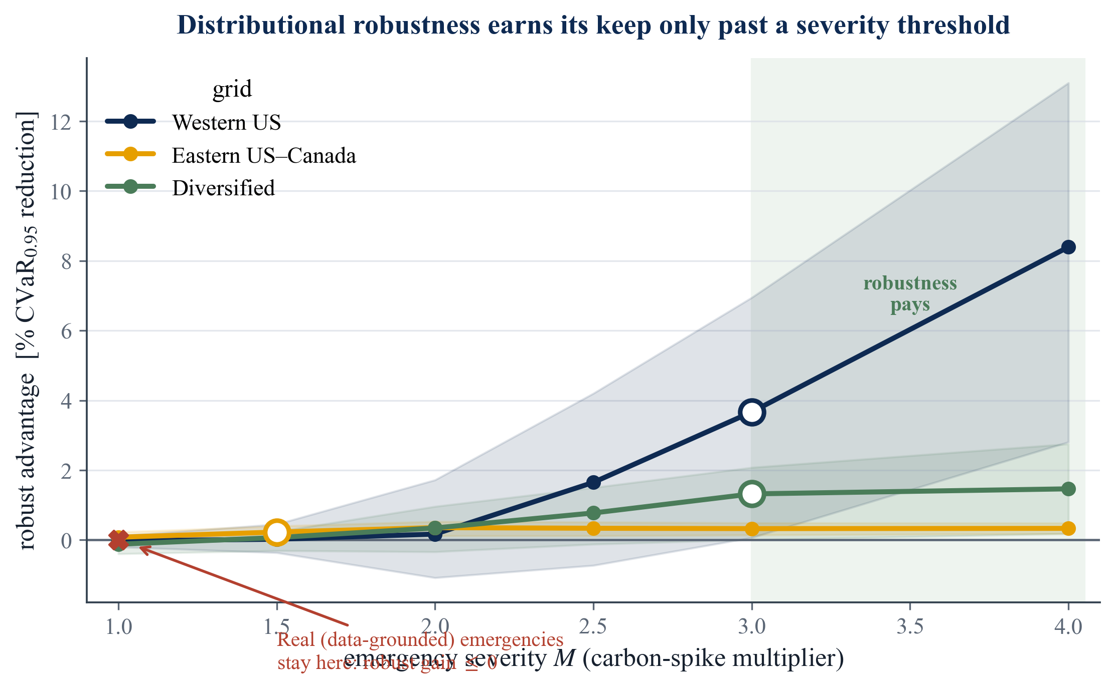
The price-of-robustness crossover
10
M* near 3, real grids stay below
● Robust beats risk-neutral only past an emergency severity M* near 3.
● Real grids, tested across 17 zones, lie at joint-grid M = 1.29–1.89.
● So robustness does not activate on observed data; even Winter Storm Uri reached only 1.3x.
● On real data, deterministic transfer is unambiguously dominant.
The Price of Sophistication: carbon-aware data-center scheduling
M. Ortiz Togashi · 10

Slide 11
The decision rule
11
Layer 1: always
Layer 2: the lever
Schedule per-region, day-ahead. Temporal shifting captures the diurnal carbon cycle.
Add inter-region transfer if migration bandwidth exists: a 4.0 to 9.9% CVaR reduction over Phi=0. This is where the value is.
Layer 3: skip
Layer 4: conditional
Spatial covariance and copulas. They add below 0.4% of CVaR: not worth the complexity.
Robustify only if you expect emergencies past M* near 3. Real grids do not reach it.
The Price of Sophistication: carbon-aware data-center scheduling
M. Ortiz Togashi · 11

Slide 12
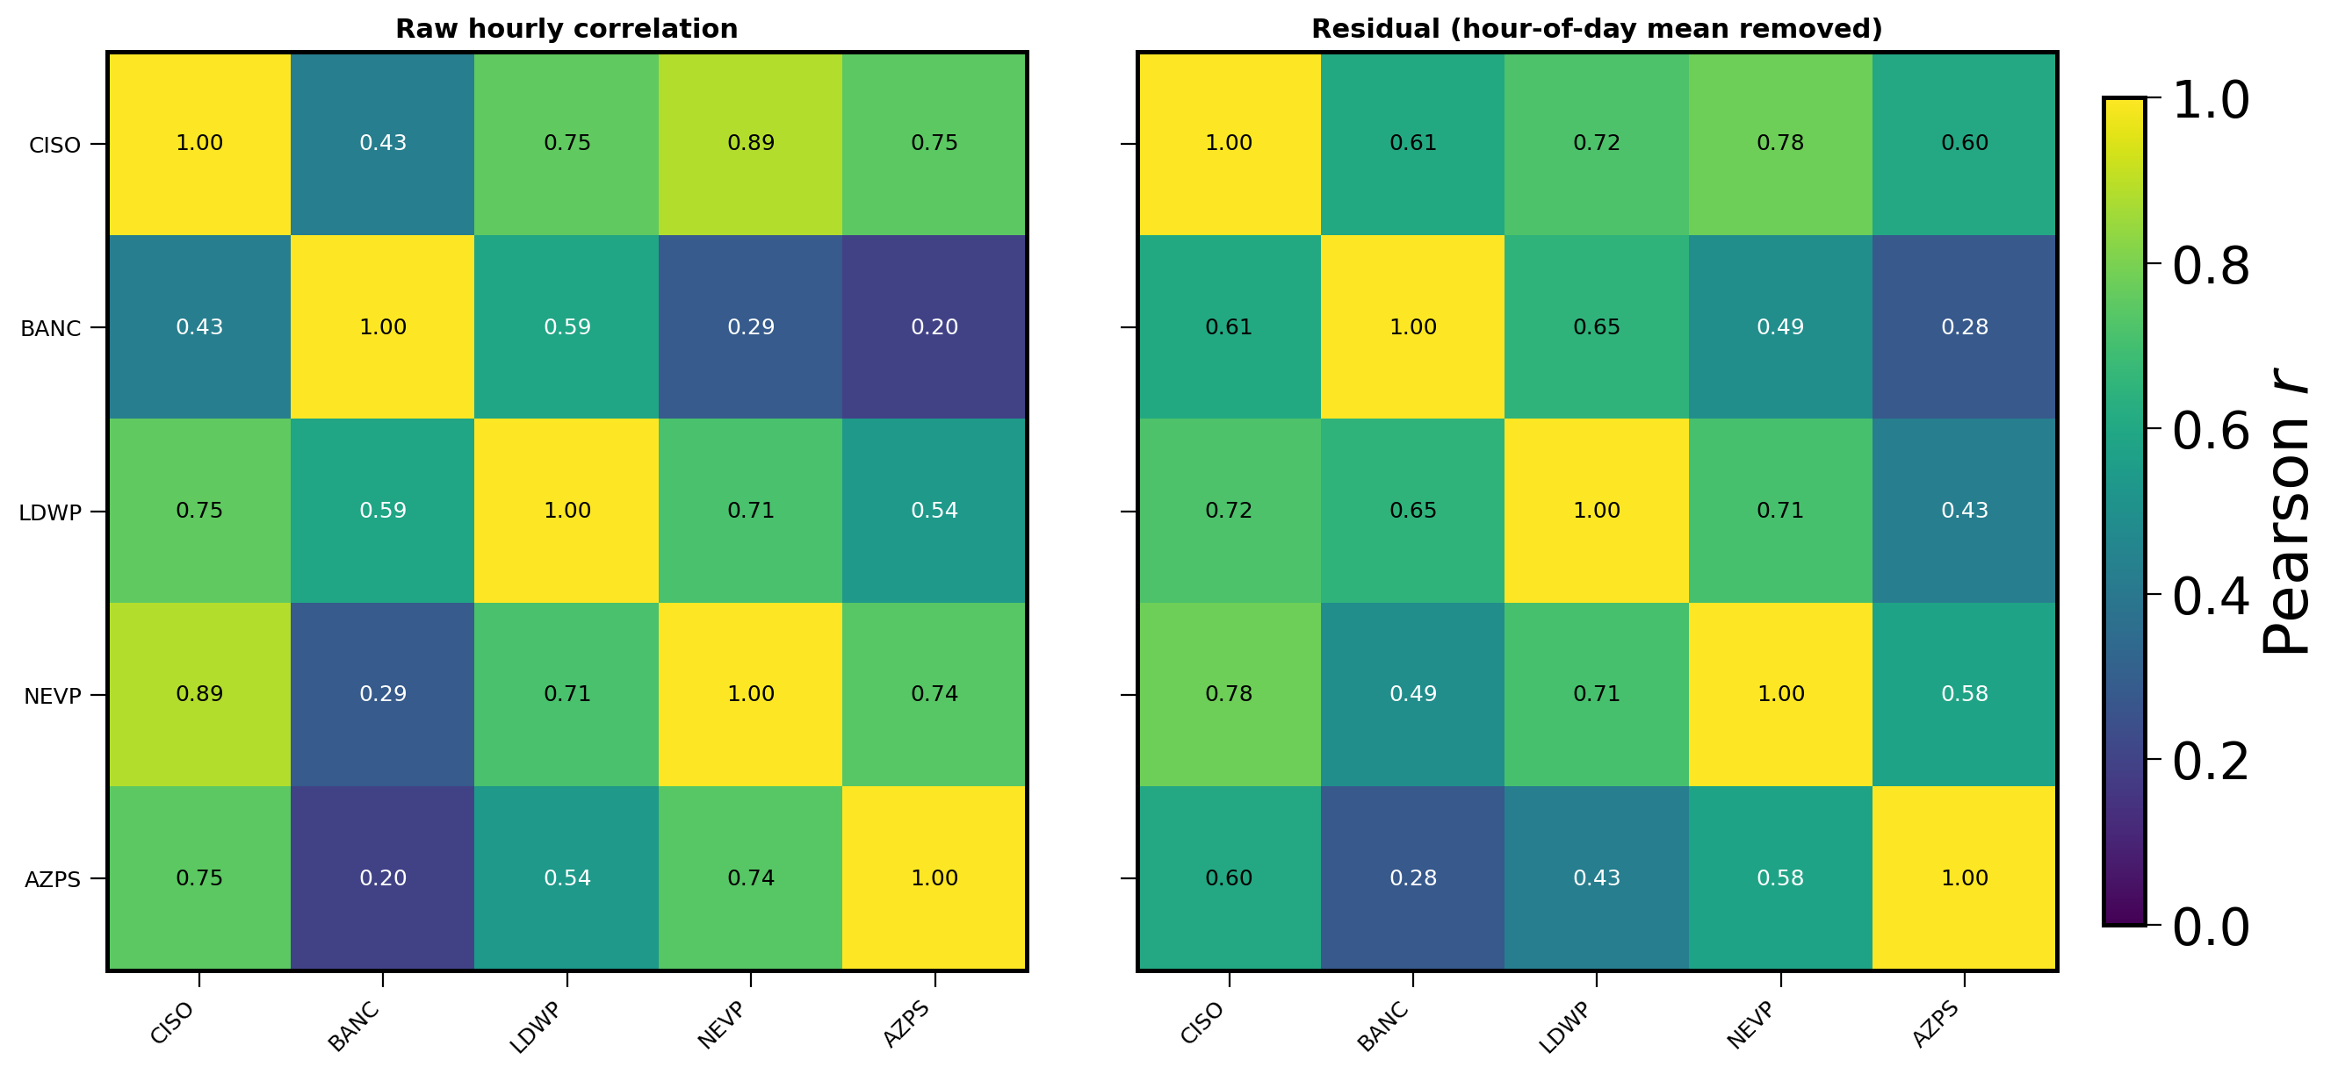
Data: three grids across the spectrum
12
Real Electricity Maps carbon intensity
● US West: a strongly, uniformly correlated grid (common-mode).
● Eastern Interconnection belt: an Ontario-anchored mid-correlation set.
● Engineered solar / wind / hydro portfolio: low, heterogeneous correlation.
● Iberia-France: an independent low-correlation external-validity anchor.
Correlation is real, up to 0.78 on the US West.
The Price of Sophistication: carbon-aware data-center scheduling
M. Ortiz Togashi · 12

Slide 13
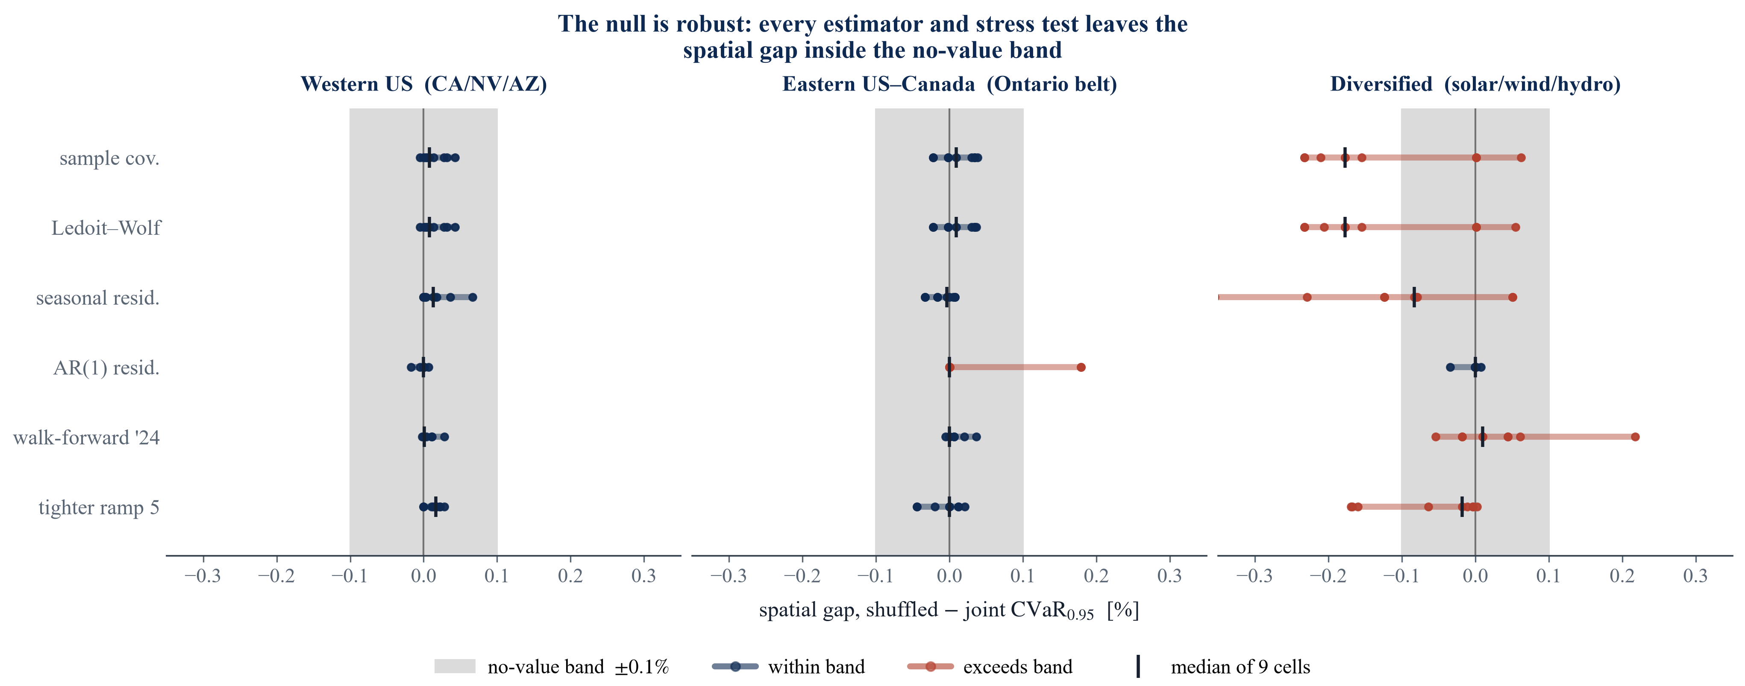
Validation and reproducibility
13
A pre-committed battery
● The null survives Ledoit-Wolf shrinkage, residualization, and Benjamini-Hochberg correction across cells.
● Walk-forward out-of-sample validation and a per-cell equivalence test.
● 202 tests (189 in public CI); bootstrap confidence intervals on every gap.
● Pre-committed, version-controlled, with archived summary tables for every reported number.
The Price of Sophistication: carbon-aware data-center scheduling
M. Ortiz Togashi · 13

Slide 14
Limitations, stated honestly
14
Where the claims could be pushed
● One canonical workload (splittable load, ramp limits); a sharply different cost geometry could re-weight the covariance term.
● Primary read is a single held-out year; walk-forward reproduces it, but multi-year evaluation would strengthen external validity.
● Results generalize to grids where the diurnal mean dominates residual covariance: an empirical regularity, not a universal law.
● The crossover is characterized, not observed: a grid with severe emergencies past M* near 3 would activate the robust layer.
The Price of Sophistication: carbon-aware data-center scheduling
M. Ortiz Togashi · 14

Slide 15
Conclusions and contributions
15
What this thesis delivers
● A working day-ahead migration scheduler with honest savings: a 4.0 to 9.9% CVaR reduction over the Phi=0 baseline, the dominant lever.
● A screening rule: passive covariance and copulas add nothing, with a mean-dominance bound that says why.
● A price-of-robustness decision rule with a tested, data-grounded bound (joint-grid M = 1.29–1.89, below M* near 3).
● A reproducible, pre-committed pipeline under 202 tests.
The Price of Sophistication: carbon-aware data-center scheduling
M. Ortiz Togashi · 15

Slide 16
The takeaway, and thank you
The rule in one line
● Always schedule per-region.
● Add inter-region transfer: this is the lever, 4.0 to 9.9% over Phi=0.
● Skip covariance and copulas: they add nothing.
● Robustify only if you expect emergencies past M* near 3.
Thank you. Questions welcome.

Slide 17
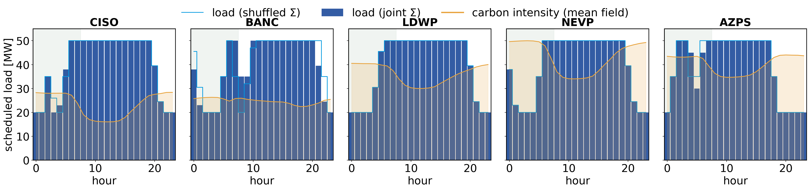
Backup: the falsification test
17
Shuffled marginals
● Fit the schedule to the full joint covariance.
● Refit to a block-diagonal covariance: identical marginals, cross-region structure destroyed (shuffled).
● Score both on out-of-sample CVaR(0.95) of daily emissions.
● Pre-committed: if spatial structure matters, the joint schedule must win. It does not.
Joint vs shuffled schedules, side by side.
The Price of Sophistication: carbon-aware data-center scheduling
M. Ortiz Togashi · 17

Slide 18
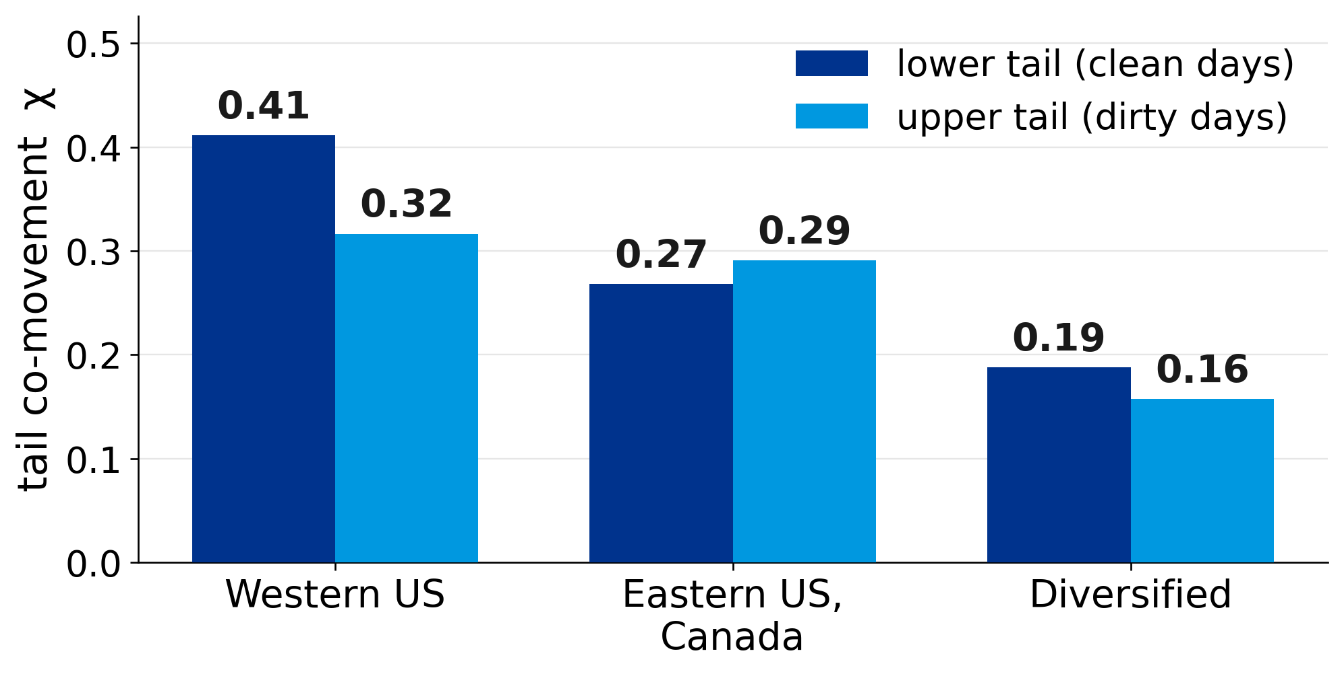
Backup: non-elliptical tail dependence
18
Structural reason covariance fails
● Residual dependence is non-elliptical: regions go clean together more than dirty together (chi_L > chi_U).
● A covariance ball forces chi_L = chi_U by construction.
● So an elliptical ambiguity set is blind to the only structure left, and it sits in the clean tail a risk-averse scheduler ignores.
The Price of Sophistication: carbon-aware data-center scheduling
M. Ortiz Togashi · 18

