Slide 1

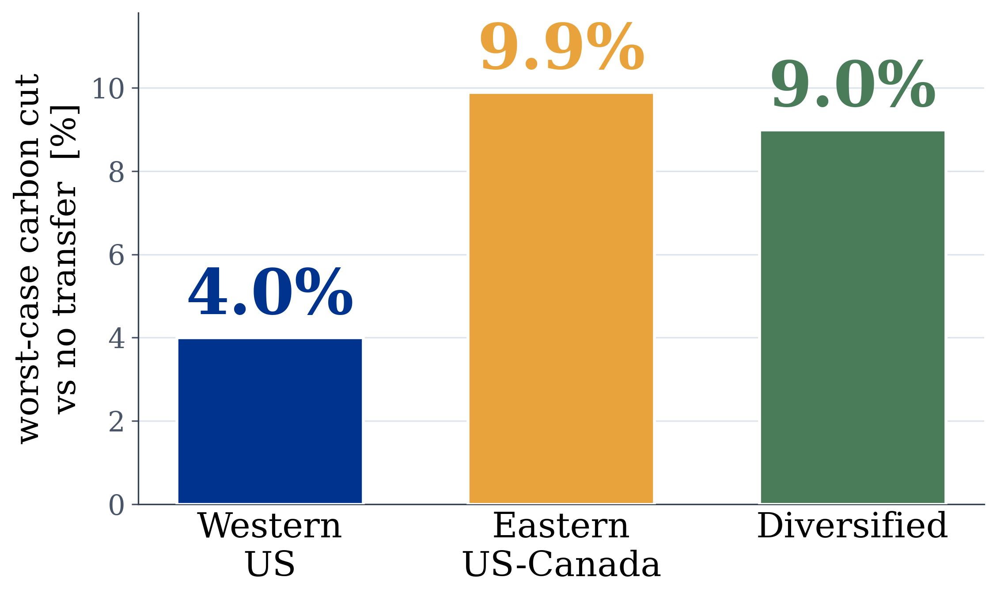

The Price of Sophistication
Marco Ortiz Togashi
Supervisor: Prof. Bissan Ghaddar · IE University
When does extra modelling actually pay in carbon-aware data-center scheduling?
Just move the compute to the cleanest grid.
That alone cuts worst-case carbon 4 to 10% (18,000 to 46,000 tonnes CO2 a year).
Modelling how the grids correlate, on top of that, adds nothing.
Out-of-sample worst-case carbon cut by active transfer, on three real grids.
about 0%
M* = 3
0 of 17
extra benefit from correlation
and copula models, so keep it simple
how extreme an emergency must be
before robustness is worth it
real grids that ever get that
extreme, so robustness stays on the shelf
THE BOTTOM LINE
Ship the simple migration scheduler now. Skip the joint-covariance and copula modelling. Turn robustness on only if conditions get worse than any real grid has seen.
code · data · thesis

