Slide 1


NNDPI
nnDPI: A Novel Deep Packet Inspection Technique Using Word Embedding, Convolutional and Recurrent Neural Networks.
https://github.com/ma7555/nnDPI

Slide 2

Agenda
Introduction
Related Work
Dataset
The Four Tags
Prepossessing
Training Environment
Results
Proposed Solution
Comparison
Conclusion

Slide 3
Introduction
Deep Packet Inspection inspects the packets sent over a network, and usually acts by:
Blocking
Re-routing
Logging
Classifying traffic
Used for prioritizing packets, throttling down the rate of data connections for certain traffic types and DDOS attacks early detection.

Slide 4
Related Work
Rule Based Approaches
Machine Learning Approaches
Deep Learning Approaches
Port-Based Classifiers
Trained on Features Extracted
Trained on Raw Packet Data

Slide 5
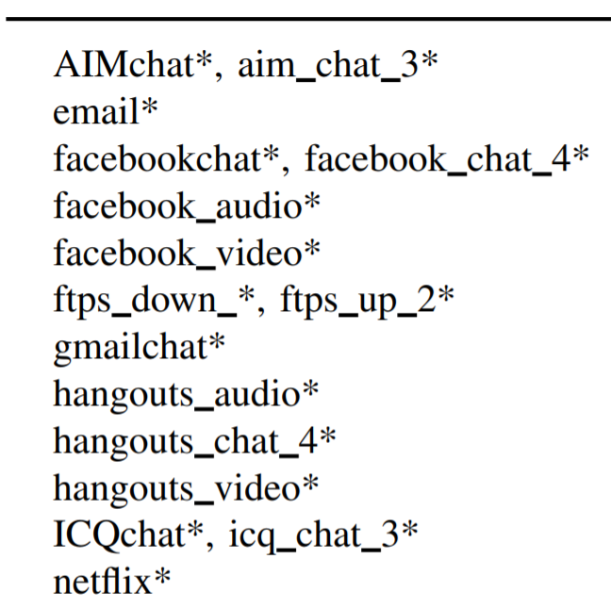
Dataset
We used “ISCX VPN-nonVPN” traffic dataset which consists of pcap and pcapng files captured for different applications.
Each file name represents the type of traffic and application used.
Notes:
Gerard Drapper Gil, Arash Habibi Lashkari, Mohammad Mamun, Ali A. Ghorbani, "Characterization of Encrypted and VPN Traffic Using Time-Related Features", In Proceedings of the 2nd International Conference on Information Systems Security and Privacy(ICISSP 2016) , pages 407-414, Rome, Italy.

Slide 6
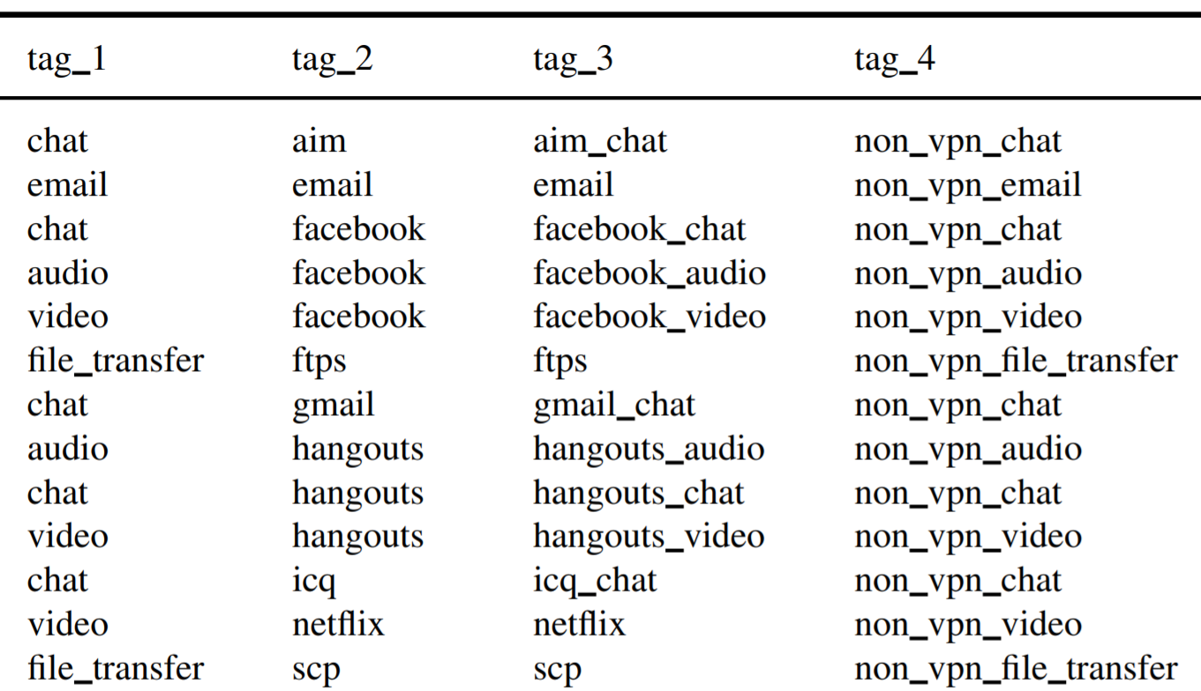
The Four Tags
tag_1
Type of traffic.
tag_2
Application name.
tag_3
Type of traffic inside each application.
tag_4
Type of traffic and whether it used VPN or not.

Slide 7
Prepossessing
Filtering packets
Masking Information
Fixed Packet Length
Integer representation of every byte

Slide 8
Preprocessing – Filtering Packets and Masking Information
Discard packets unrelated to the application identification like:
TCP 3-Way handshake packets.
Packets not having a TCP/UDP header
Packets related to DNS, ARP, etc..
Ethernet Layer: Header is completely removed.
Network Layer: Source and Destination IP addresses are masked with zeros in all packets.

Slide 9
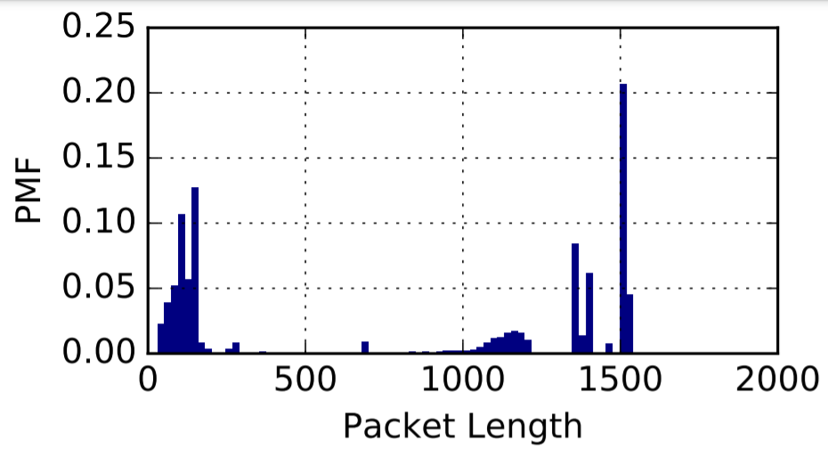
Preprocessing - Fixing packet length & Integer Representation
Since TCP header is larger than UDP headers (20 vs 8 bytes), we zero-pad UDP header with extra 12 bytes to make them equal in size.
Maximum payload size of the packets to be 1480 bytes as 96% of packets payload have less than or equal this value.
Payloads > 1480 were trimmed to exactly 1480
Payloads < 1480 were zero.
In total, every packet had 1500 (1480 payload +20 header bytes)
Every byte was then converted to an integer representation to be later used as a word-like token in the word embedding layer.

Slide 10
Proposed Solution
We proposed a solution using a neural network with a mix of word embeddings, 1D convolutions and recurrent neural network.
Embedding layer: Treat every integer representation of a byte inside the packet as a token. In the context of neural networks, embeddings are low-dimensional, trained continuous vector representations of discrete variables.
1D Convolutions: To figure out n-sized (where n is the filter size) sequence importance between bytes inside every packet. This layer will learn to find relationship between certain byte sequences and targets.
Batch Normalization: Normalizes every batch.
Max Pooling: To pick only the strongest features, downsizing the features count by disregarding irrelevant ones.
Bidirectional GRU: In a bidirectional RNN, we consider 2 separate sequences. One from right to left and the other in the reverse order. After downsizing features, this layer will learn sequences even further from each other in both directions.
Dense: One FC layer has been added before the output softmax layers.

Slide 11
Model architecture
Embedding Layer
Block 1
Block 2
Block 3
Dense
Block 4
Classification Head
Batch Normalization
Batch Normalization
Conv 1D
Max Pooling
Conv 1D
Batch Normalization
Max Pooling
Conv 1D
Batch Normalization
Max Pooling
Conv 1D
Batch Normalization
Max Pooling
Dense – tag_1
Dense – tag_2
Dense – tag_3
Dense – tag_4

Slide 12
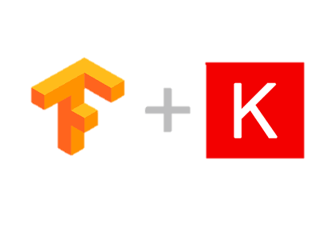
Training Environment
Trained on Keras Tensorflow V2.1 on a Dual RTX 2080 workstation
~800K trainable parameters.
As the dataset is unbalanced, the classes have been weighted and all samples have been used without down sampling.
Adam was used as an optimizer, with starting learning rate of 0.001
Reduce learning rate on plateau by a factor of 0.5 after 2 epochs patience.
Batch size was set to 3072
Training for 70 epochs with early stopping.

Slide 13
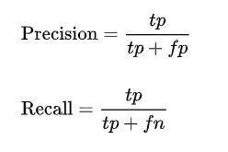
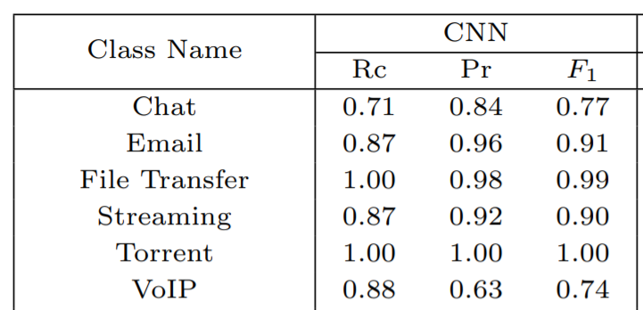
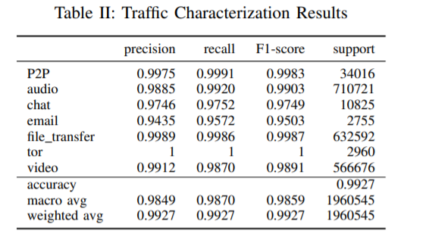
Comparisons: Traffic Characterization
Deep Packet
nnDPI

Slide 14
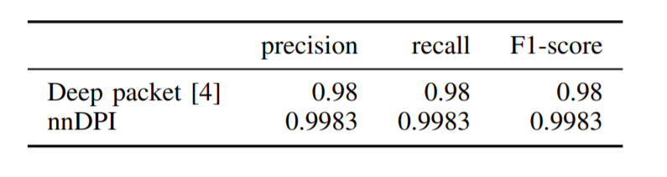
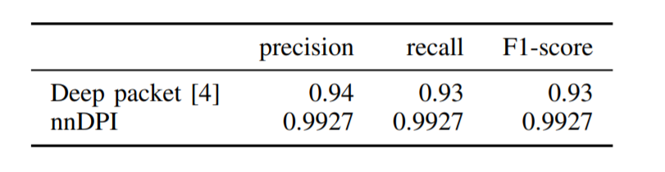
Comparisons with Deep Packet
Application Identification Comparison Results
Traffic Characterization Comparison Results

Slide 15
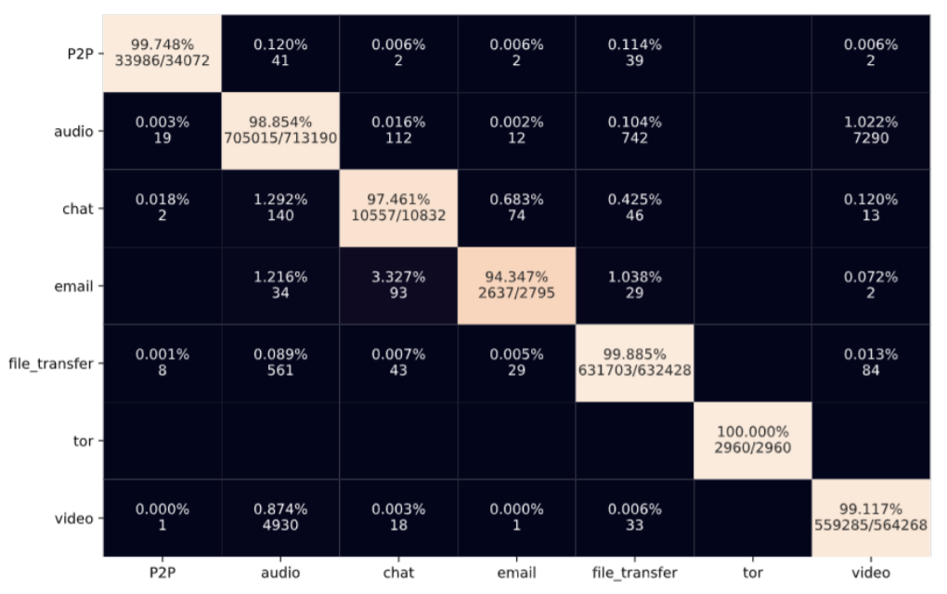
RESULTS: TRAFFIC CHARACTERIZATION CONFUSION MATRIX

Slide 16
Results
Task | Metric | Value
Traffic Characterization | Weighted Average Accuracy | 0.9927
Application Identification | Weighted Average Accuracy | 0.9983
Per Application Classification | Weighted Average Accuracy | 0.9920
VPN/Non-VPN Traffic Characterization | Weighted Average Accuracy | 0.9926

Slide 17
Conclusion
State of the art performance over the ISCX VPN-nonVPN outperforming Deep Packet by Mohammad Lotfollahi et al (JUL 2018).
Added two new tags (3 & 4) for further work and benchmarking papers.

Slide 18
Thank You!

