Slide 1
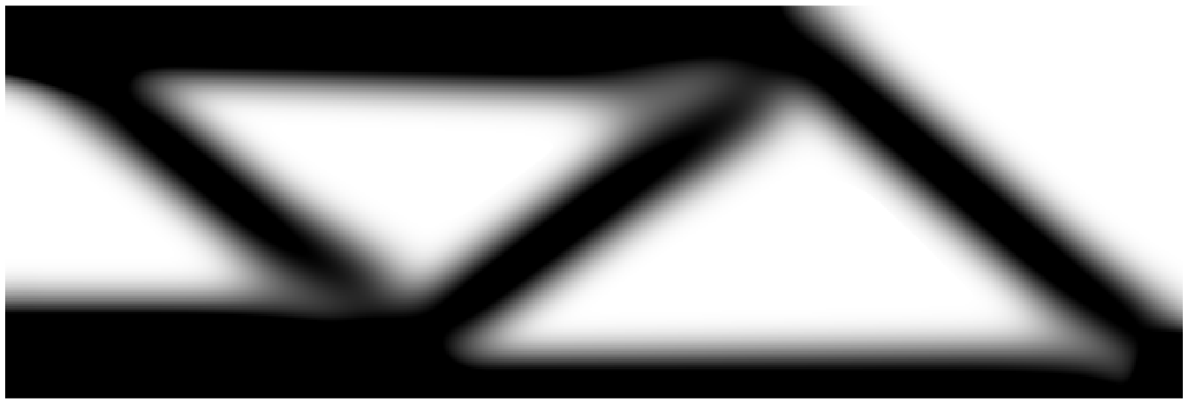
Multiresolution topology optimization
Computational-efficiency assessment for the half MBB beam
Lukas Campaert · Tiebert Lefebure
Structural Optimization · B-KUL-H0T88A · Prof. M. Schevenels
Faculty of Engineering Science · Academic Year 2025-2026
Notes:
PRESENTER: Lukas | Target ~25 s
[Pacing: the whole talk targets about 12 minutes, roughly 6 minutes per presenter. Speak at a measured pace and do not rush the figures; the per-slide targets below sum to about 12 minutes.]
Greeting. Our examination assignment is on multiresolution topology optimization, MTOP. In topology optimization the question is where to put material to make a structure as stiff as possible; here the question is whether we can answer that question faster. We assessed MTOP on the half MBB beam and compared it head-to-head with the classical approach. The image is our optimized beam.

Slide 2
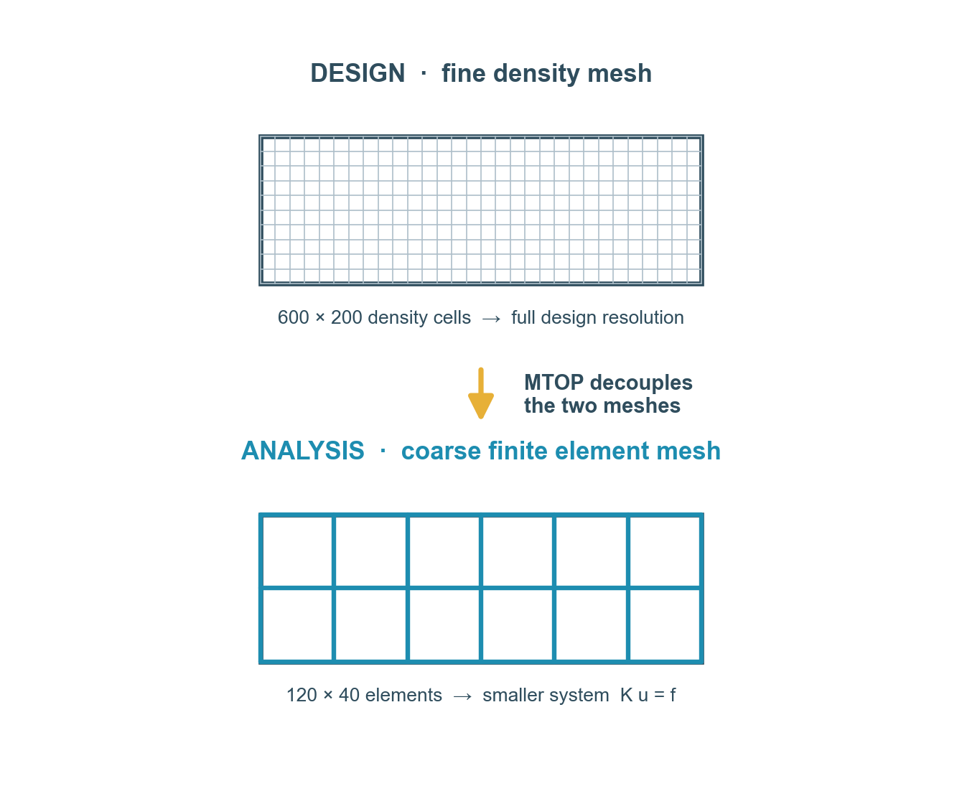
Problem statement and research question
Minimum-compliance topology optimization of the half MBB beam
MTOP (Nguyen et al., 2010): describe the design on a fine density mesh, solve the equilibrium on a coarser mesh
A smaller system K u = f should lower the computation time
The original paper reports no computation times or speedup factors
Research question: how large is the speedup, and is the optimized design preserved?
2
Structural Optimization (B-KUL-H0T88A)
Notes:
PRESENTER: Lukas | Target ~50 s
Topology optimization distributes a fixed amount of material so the structure is as stiff as possible. The cost is dominated by repeatedly solving the finite element system K u = f: every optimization iteration needs a fresh solve, and a run takes on the order of a hundred iterations, so that solve cost is paid over and over.
MTOP, introduced by Nguyen and co-workers in 2010, splits the problem: the design is still described on a fine mesh, but the equilibrium equations are solved on a coarse mesh, which should be much cheaper.
The catch: the original paper never reported computation times. So our research question is exactly that - how large is the speedup, and does the optimized design stay the same?

Slide 3
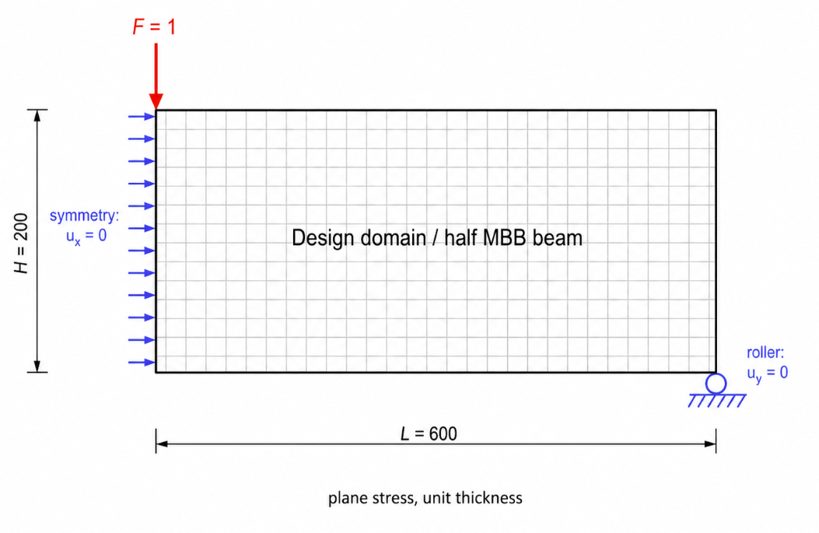
The structural model: half MBB beam
Half MBB beam, plane stress, bilinear Q4 elements
Unit point load at the upper-left corner
Symmetry support on the left edge, roller at the lower-right corner
Volume fraction 0.5, SIMP penalization power 3
Cone filter radius of 24 density cells
These settings are fixed for every experiment
3
Structural Optimization (B-KUL-H0T88A)
Notes:
PRESENTER: Lukas | Target ~45 s
Our test structure is the half MBB beam from the Chapter 9 lecture code. A unit point load at the top-left corner, a symmetry condition on the left edge, and a roller at the bottom-right. Plane stress, bilinear quad elements.
The optimization targets a volume fraction of one half, SIMP penalization three, and a cone filter of radius 24 density cells. Important: these settings are identical for every experiment, so any difference we see is genuinely due to MTOP, not to a change of parameters. That is what makes the comparison a fair one.

Slide 4
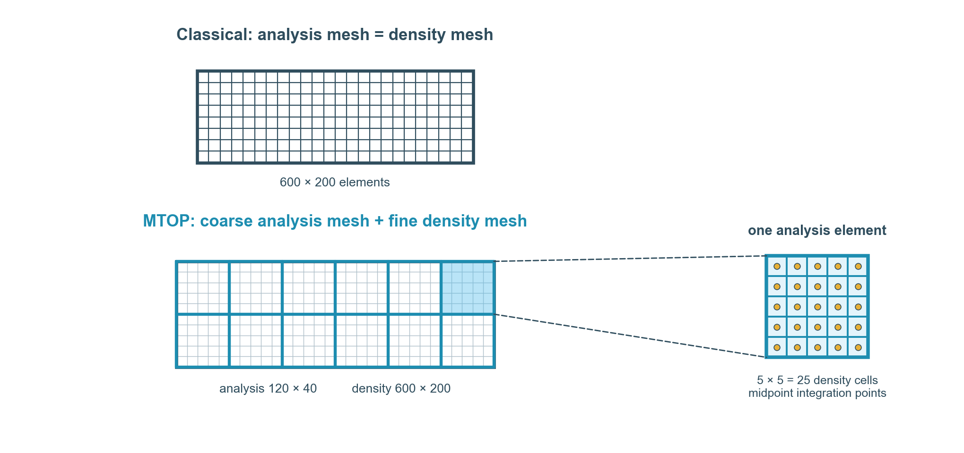
The MTOP idea: decouple analysis from design
Classical: analysis mesh = density mesh (600 × 200)
MTOP: coarse 120 × 40 analysis mesh, 5 × 5 density cells per element
Same 600 × 200 design resolution, far fewer equations
Element stiffness by midpoint quadrature; 25 sub-cell templates precomputed once per run
Free degrees of freedom: 241,000 → 9,900
4
Structural Optimization (B-KUL-H0T88A)
Notes:
PRESENTER: Lukas | Target ~75 s
This is the heart of MTOP. In the classical approach the analysis mesh and the design mesh are the same, 600 by 200.
In MTOP we keep the 600 by 200 design resolution, but we analyze on a coarse 120 by 40 mesh, with 5 by 5 density cells inside each finite element - that is the zoom on the right. Each element's stiffness is integrated with one midpoint sample per density cell, so 25 small stiffness templates, which are precomputed once per run.
One point worth stressing: the displacement field is still only piecewise-bilinear on the coarse mesh. The fine density mesh refines how we describe the material, not how we resolve the displacements - that is the approximation MTOP makes, and it is exactly why we always re-check the final design on the fine mesh.
The payoff is the number of equations: the free degrees of freedom drop from about 241,000 to about 9,900. That factor is the speedup we are chasing.

Slide 5
Optimization problem and experiment matrix
Design variables: the density of each density cell
Objective: minimize compliance (maximize stiffness)
Constraint: material volume fraction at most 0.5
SIMP material interpolation, penalization power 3
Cone filter, radius 24 cells (sensitivity or density)
Seven experiments: OC versus MMA, three filter / projection choices
Case | Approach | Optimizer | Filter / projection
1 | Classical | OC | Sensitivity filter
2 | MTOP | OC | Sensitivity filter
3 | Classical | OC | Density filter
4 | MTOP | OC | Density filter
5 | MTOP | MMA | Sensitivity filter
6 | MTOP | MMA | Density filter
7 | MTOP | MMA | Heaviside η = 0.3 / 0.5 / 0.7
5
Structural Optimization (B-KUL-H0T88A)
Notes:
PRESENTER: Lukas | Target ~55 s
Quickly, the optimization problem. The design variables are the cell densities, the objective is to minimize compliance, and the constraint is the volume fraction of one half. SIMP with penalization three, and a cone filter of radius 24, used either as a sensitivity filter or a density filter.
On the optimizer: OC is a simple, fast update tailored to this kind of problem; MMA is a general-purpose gradient optimizer. We need MMA in step 4 because the Heaviside projection makes the problem too non-linear for the OC heuristic.
We ran the seven experiments in the table: optimality criteria for steps 1 to 3, then MMA for step 4 with sensitivity filtering, density filtering, and Heaviside projection at three thresholds. Every MTOP run has a classical counterpart for comparison.

Slide 6
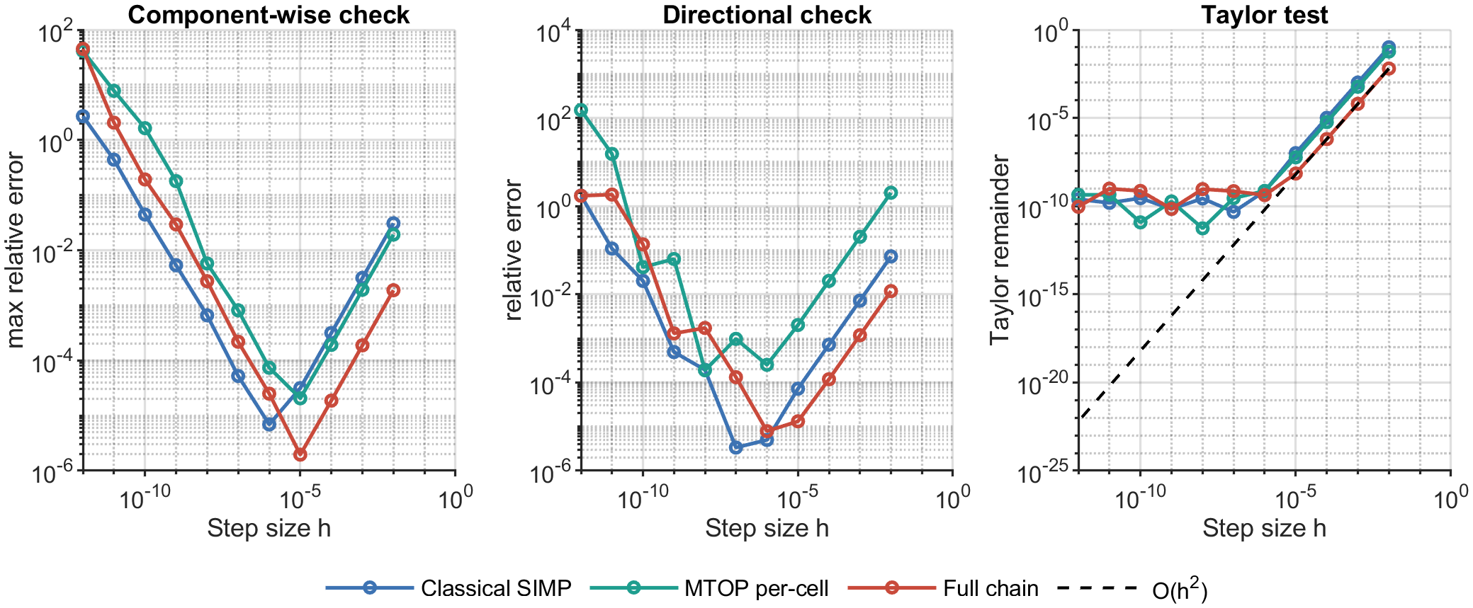
Verifying the implementation
Verified three derivative chains with three finite-difference strategies
Taylor remainder slope ≈ 2.00 confirms the analytical sensitivities
6
Structural Optimization (B-KUL-H0T88A)
Notes:
PRESENTER: Lukas | Target ~45 s
Before trusting any result we verified the sensitivities - the gradients the optimizer relies on. We checked three derivative chains: the classical SIMP gradient, the MTOP per-cell gradient, and the full Heaviside chain, each with three finite-difference strategies.
The strongest is the Taylor remainder test, the right-hand panel: it should decay quadratically with the step size, and the fitted slope is essentially 2.00 for all three chains, with errors down to ten to the minus six. The component-wise check also pins any indexing or chain-rule error to a single variable, which is how we caught bugs during development. So the analytical gradients are correct.

Slide 7
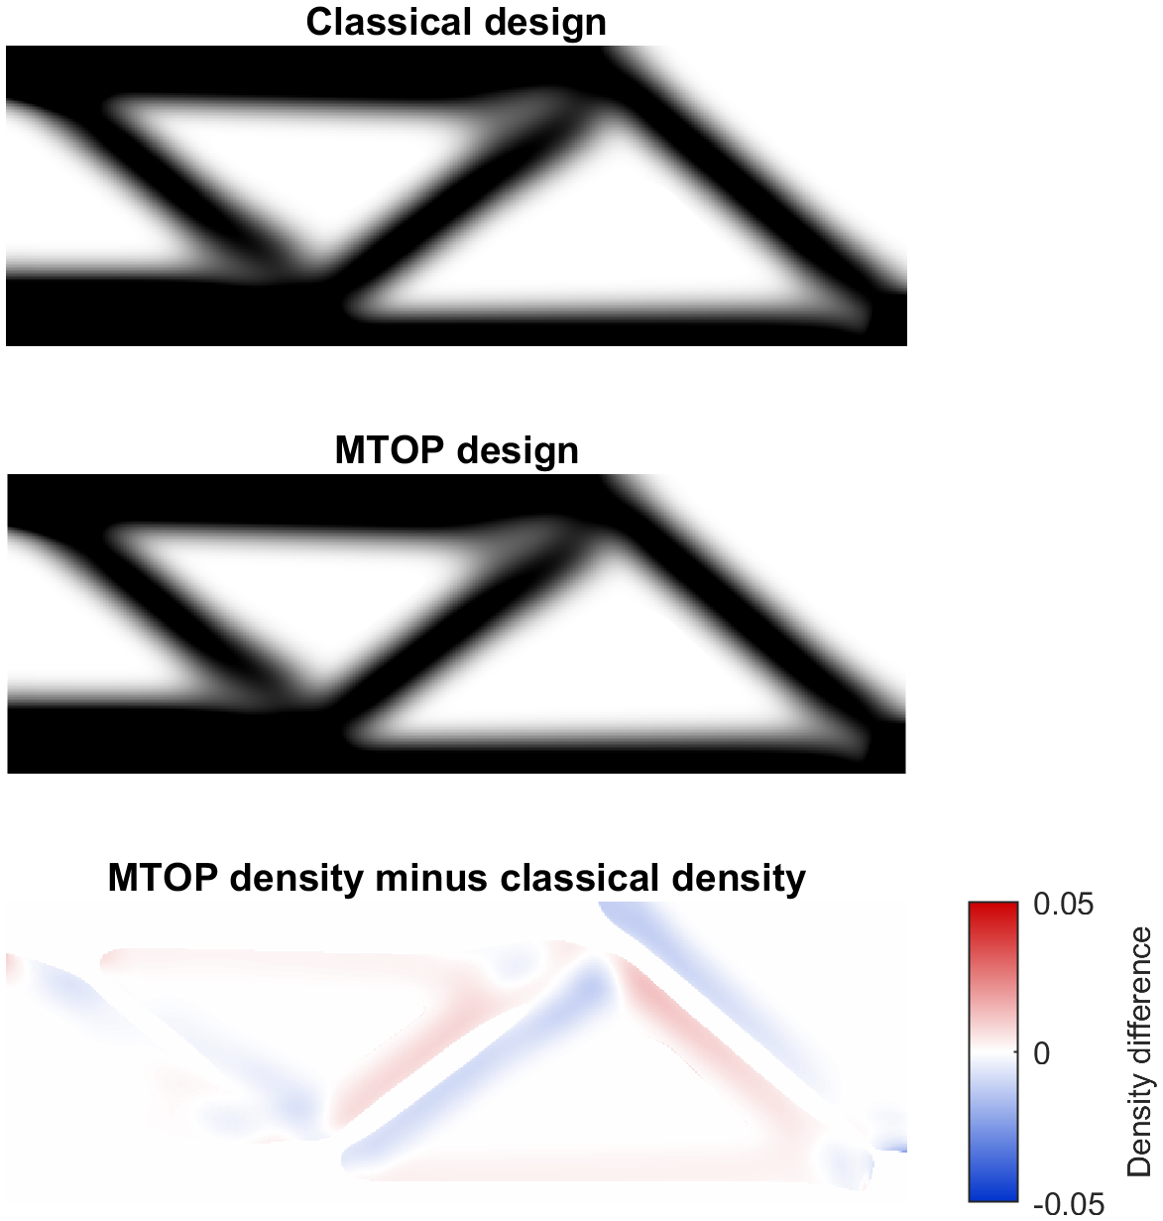
Steps 1 and 2: MTOP reproduces the classical design
Optimality criteria with sensitivity filtering
Same truss load path: top chord, bottom chord, triangulated web
Fine-mesh compliance: classical 224.6, MTOP 224.7 (+0.045 %)
Difference is a tiny boundary-level redistribution (RMS 0.003)
MTOP does not change the optimized design
7
Structural Optimization (B-KUL-H0T88A)
Notes:
PRESENTER: Lukas | Target ~50 s
Now the results. Steps 1 and 2: optimality criteria with sensitivity filtering. On the right, the classical design on top, the MTOP design in the middle, and their difference at the bottom.
The two layouts are the same truss. Physically: a top chord in compression near the load, a bottom chord in tension near the support, and a triangulated web carrying the shear toward the support. The difference plot is almost empty, just small boundary shifts, an RMS of three thousandths. Re-evaluated on the same fine mesh the compliances differ by 0.045 percent.
So MTOP does not change the design. I will hand over to Tiebert for how much faster it is.

Slide 8
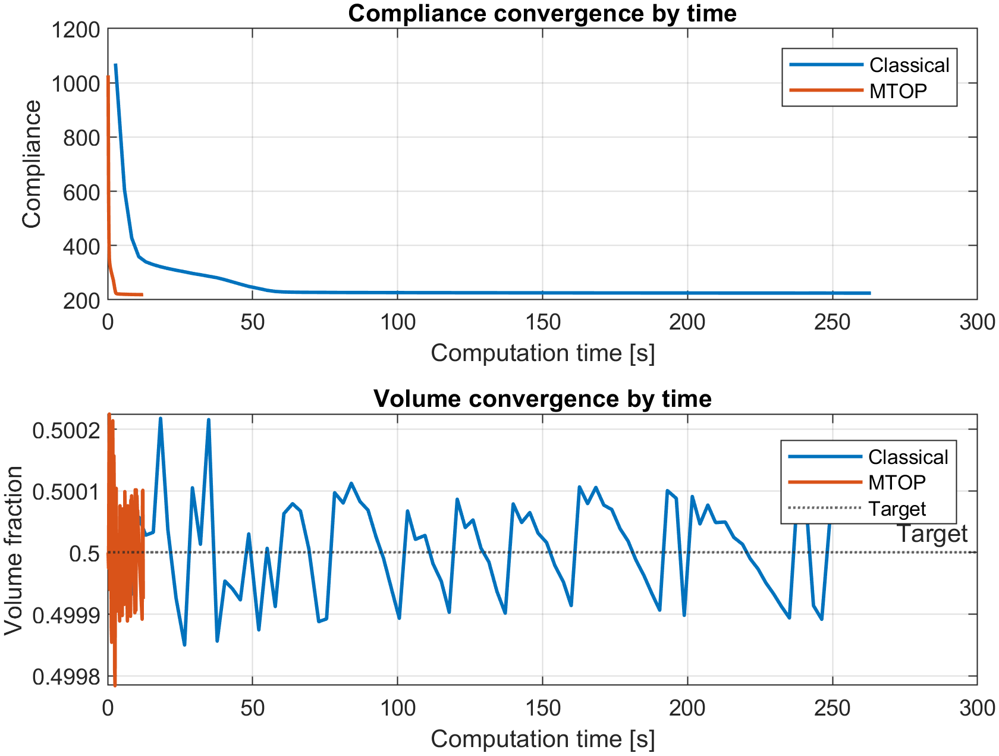
Steps 1 and 2: MTOP is 21× faster
Same convergence path: 94 versus 95 iterations
Wall-clock time: 263 s → 12 s
Speedup factor of 21 at matched compliance
The MTOP curve collapses against the time axis
Same design, same iterations, far less time
8
Structural Optimization (B-KUL-H0T88A)
Notes:
PRESENTER: Tiebert (takes over from Lukas) | Target ~45 s
Thanks. So the designs are identical, but the timing is not. This plot is compliance against wall-clock time - classical in blue, MTOP in orange.
It is worth stressing the iteration counts, 94 and 95: MTOP is not converging differently or cutting corners, it follows the same optimization path. But the classical run takes 263 seconds and the MTOP run takes 12 - a factor of 21. You can see the orange curve squeezed against the time axis.
Same design, same iteration count, each iteration simply cheaper: 21 times faster overall.

Slide 9
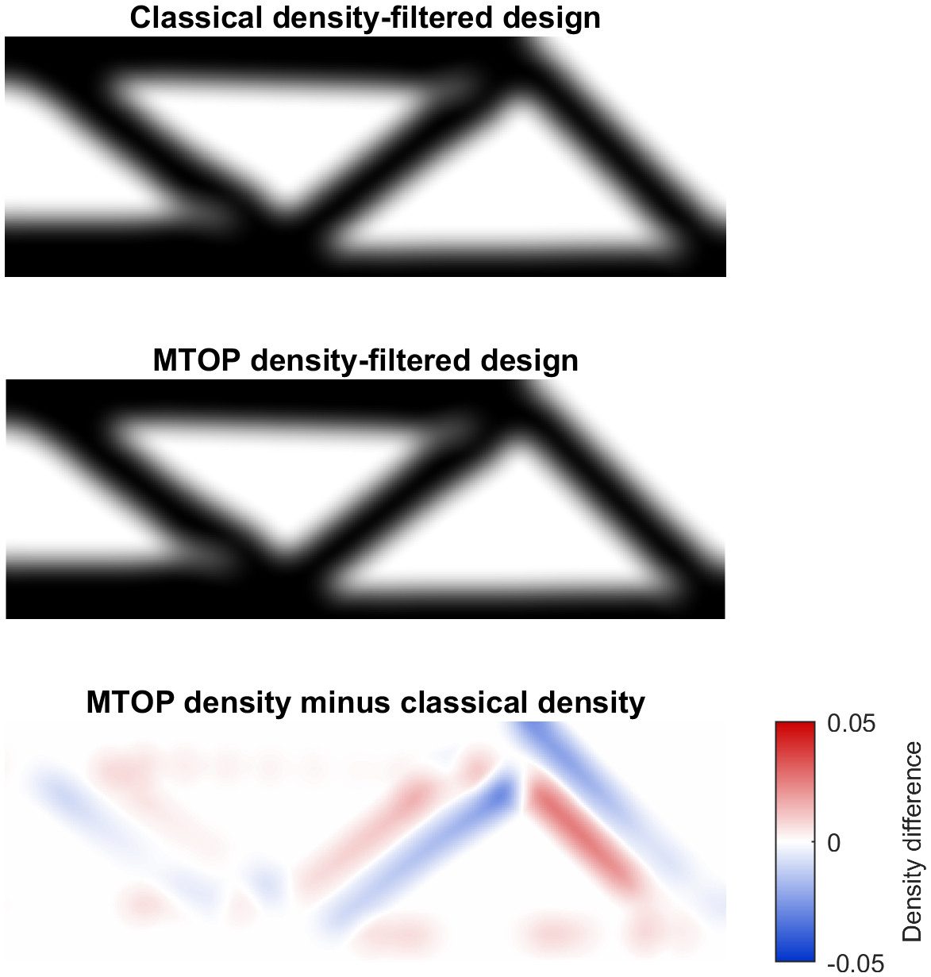
Step 3: density filtering
Same comparison with a density filter instead of a sensitivity filter
Designs again almost identical: 0.04 % compliance difference
Speedup drops to 5×: density-filter work still runs on the fine mesh
OC plus density filter never meets the design-change tolerance
Stopped instead on a compliance plateau
9
Structural Optimization (B-KUL-H0T88A)
Notes:
PRESENTER: Tiebert | Target ~50 s
Step 3 repeats the comparison with a density filter instead of a sensitivity filter. The designs are again almost identical, 0.04 percent in compliance.
But the speedup drops from 21 to about 5. The density filter adds a chain-rule convolution and a volume check that still run on the full 600 by 200 density mesh, so they do not shrink with the analysis mesh.
There is also a convergence subtlety. With a density filter the OC update never quite meets the design-change tolerance. The reason: OC rescales each variable on its own, while the filter spreads every change over a neighbourhood, so the two fight at the member boundaries. The compliance settles, but the design keeps oscillating, so we stop on a compliance plateau instead.

Slide 10
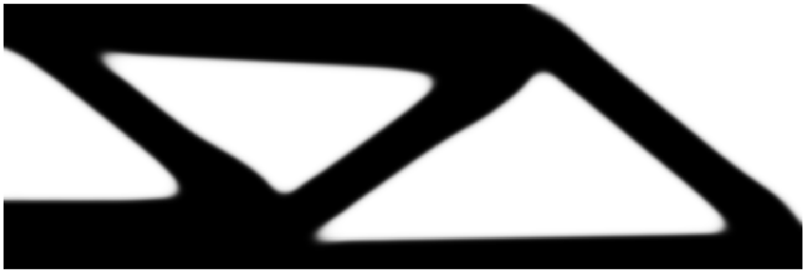
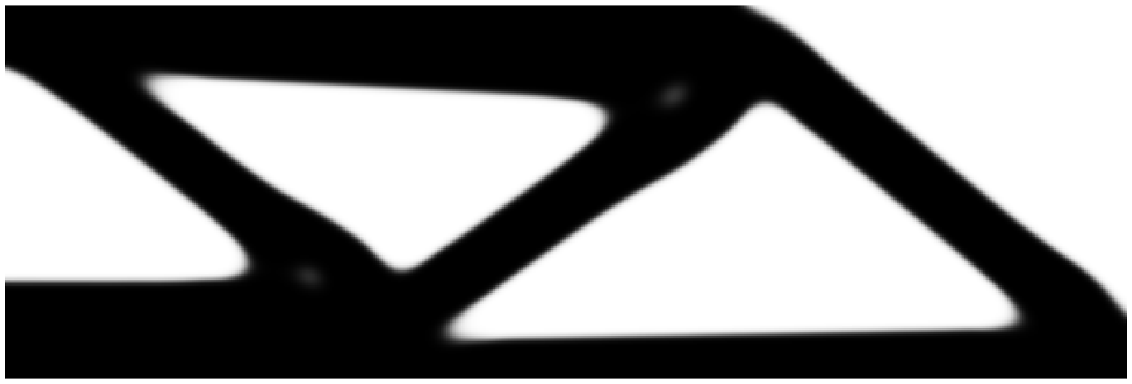
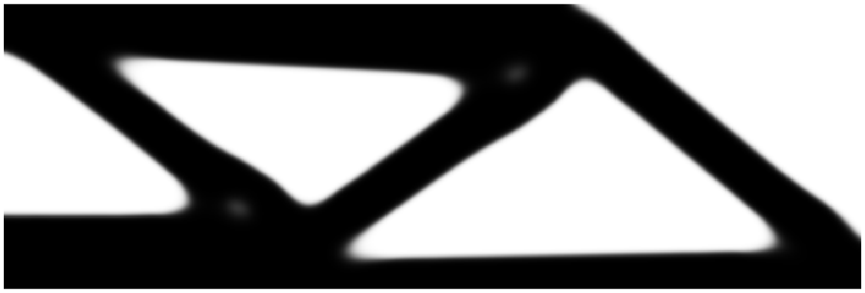
Step 4: MMA and Heaviside projection
OC update replaced by the method of moving asymptotes (MMA)
MMA alone: design close to OC; density-filter convergence issue remains
Heaviside projection pushes the design towards black-and-white
Near-binary layout: ~17 % lower compliance than the gray design
All three thresholds agree within 0.7 %; 0.5 is best
η = 0.3
η = 0.5 (best)
η = 0.7
10
Structural Optimization (B-KUL-H0T88A)
Notes:
PRESENTER: Tiebert | Target ~65 s
Step 4 swaps the optimality-criteria update for MMA, the method of moving asymptotes. MMA on its own gives a design close to the OC result, and it does not by itself fix the density-filter convergence issue.
The real benefit comes with Heaviside projection, which pushes the gray material towards either solid or void. One implementation detail: we ramp the projection sharpness, beta, gradually - doubling it every fifty iterations from one up to sixteen - so the optimizer is never hit with a sharp threshold all at once. That continuation is what keeps the projected runs stable.
On the right are the three projected designs, for thresholds 0.3, 0.5 and 0.7: all near black-and-white, all the same load path. The projected compliance is about 17 percent below the gray density-filtered design, and the three thresholds differ by less than 0.7 percent, with 0.5 marginally the best.

Slide 11
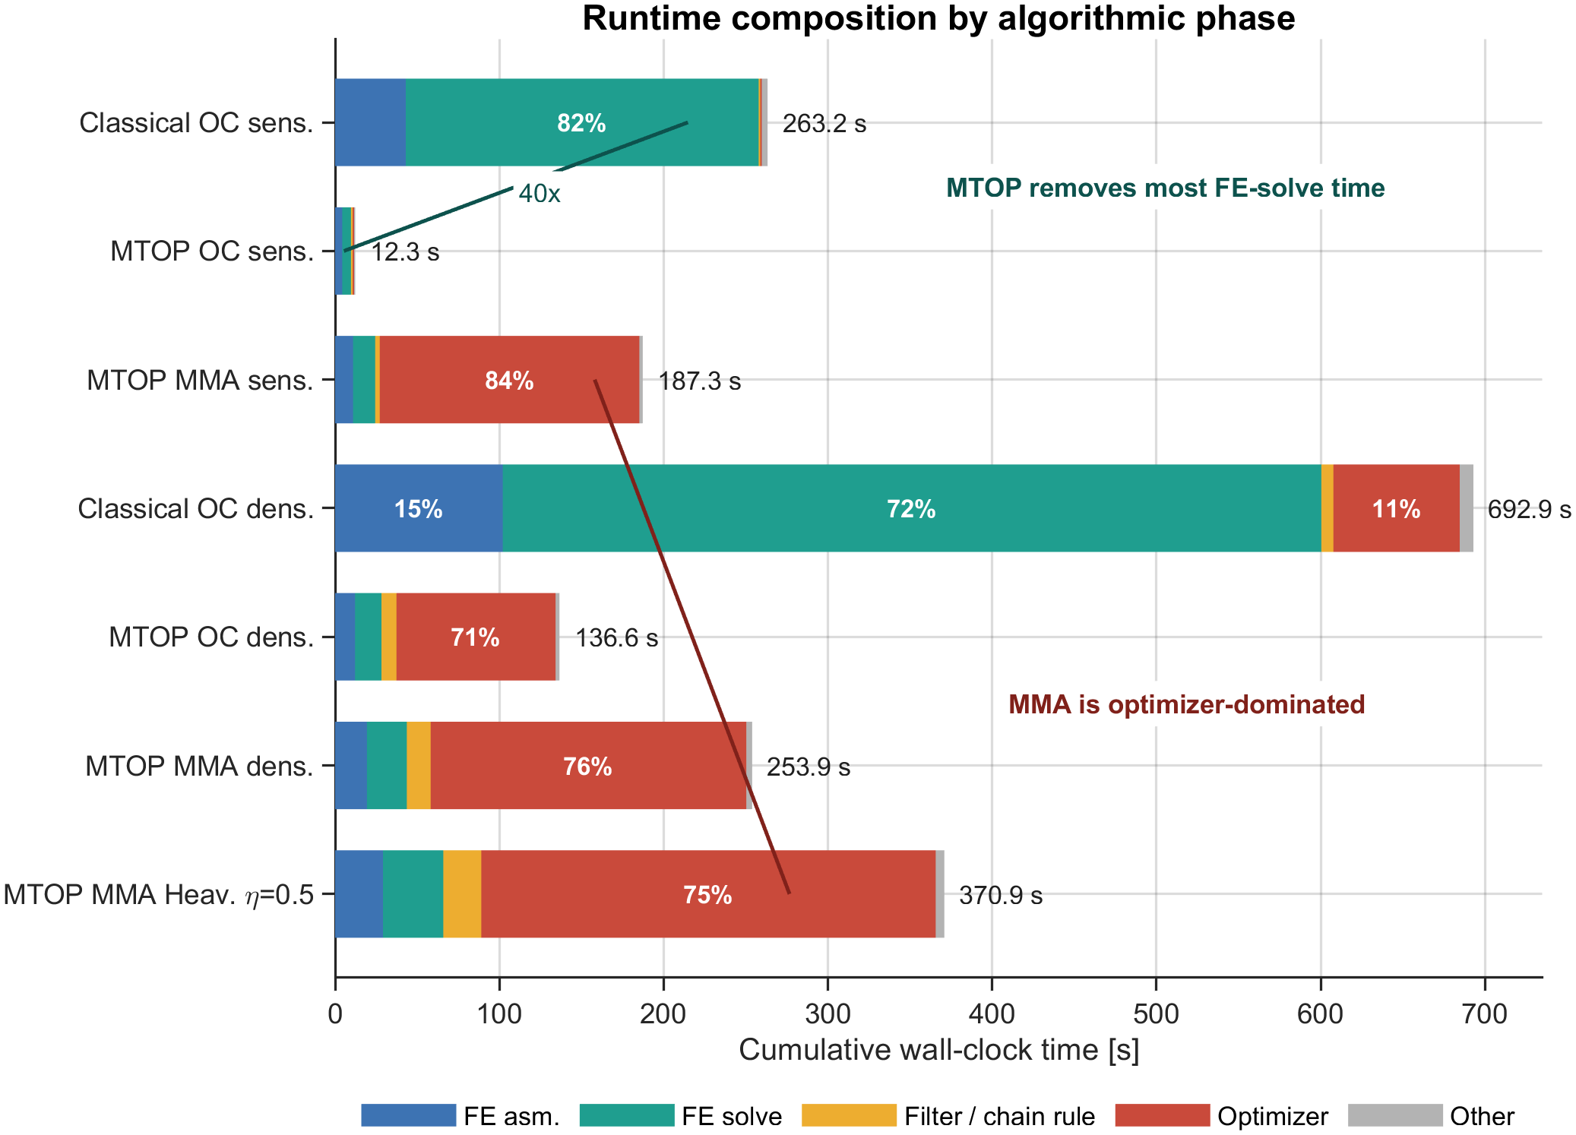
Where does the speedup come from?
Classical OC: 82 % of the time is the finite element solve
MTOP shrinks that solve by about 40×
Filtering, assembly and the optimizer still act on the full density mesh, so they cap the speedup
MMA runs become dominated by the optimizer subproblem
11
Structural Optimization (B-KUL-H0T88A)
Notes:
PRESENTER: Tiebert | Target ~55 s
So where does the speedup actually come from? This chart breaks each run into algorithmic phases.
For the classical OC run, the green block - the finite element solve - is 82 percent of the time. MTOP shrinks exactly that block. To put numbers on it: the FE solve alone drops from about 215 seconds to about 5, a 40-fold gain, but the total only goes from 263 to 12, a 21-fold gain.
The difference is the rest of the work - filtering, assembly, the optimizer update - which still acts on the full density mesh and does not shrink. For the MMA runs the red optimizer block dominates, so there the equilibrium solve is no longer the bottleneck at all.

Slide 12

What MTOP really buys you
A plain coarse model reaches within 0.6 % of the fine design
For this 2D case with a large filter, a coarse model already captures the load path
But that coarse design is grayer and fixed at the coarse resolution
MTOP keeps the full 600 × 200 design while paying only the coarse solve
Coarse-resolution baseline: 120 × 40 analysis = density mesh
12
Structural Optimization (B-KUL-H0T88A)
Notes:
PRESENTER: Tiebert | Target ~50 s
One honest qualification. We also ran a plain coarse model, 120 by 40 for both the analysis and the design. Re-analyzed on the fine mesh, it lands within 0.6 percent of the full design.
So for this 2D beam, with a fairly large filter, even a crude model already finds the load path. But the comparison is not entirely fair to that coarse model: it is also grayer, with more intermediate material, so part of its apparently low compliance is just material that SIMP has not fully penalized.
MTOP's real value is that it keeps the full 600-by-200 design description, and a genuinely black-and-white one, while only paying for the coarse solve.

Slide 13
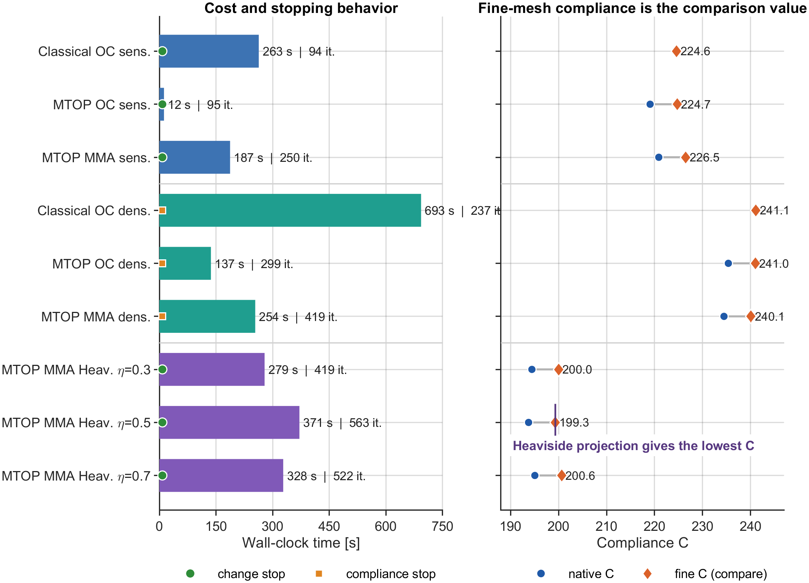
Conclusions
MTOP reproduces the classical MBB design to within 0.05 % compliance
Sensitivity filtering: 21× faster; density filtering: 5× faster
The speedup comes from the cheaper coarse equilibrium solve
OC plus density filtering converges only in the compliance sense
Heaviside projection gives the lowest, near-binary compliance (threshold 0.5)
13
Structural Optimization (B-KUL-H0T88A)
Notes:
PRESENTER: Tiebert | Target ~50 s
To conclude. MTOP reproduces the classical MBB design to within 0.05 percent compliance. It is 21 times faster with sensitivity filtering and 5 times faster with density filtering.
The speedup comes from the cheaper coarse equilibrium solve, and is capped by the operations that still run on the fine mesh. OC with density filtering converges only in the compliance sense. And Heaviside projection gives the lowest, near-binary compliance, best at threshold 0.5. The chart on the right summarizes all nine runs - cost on the left, compliance on the right.
If we had to compress it to one sentence: MTOP buys the speed of a coarse analysis without giving up the resolution of a fine design.

Slide 14
Use of GenAI
We used ChatGPT for
Language editing of text we wrote ourselves
Post-processing and plotting scripts
One supporting theory figure (the MMA sketch)
We kept the work in our control
MTOP method and MATLAB solver implemented by us
All sensitivities verified with finite differences
Every result reproduced and understood ourselves
14
Structural Optimization (B-KUL-H0T88A)
Notes:
PRESENTER: Tiebert | Target ~25 s
A brief word on GenAI. We used ChatGPT as a support tool: to language-edit text we had written ourselves, for post-processing and plotting scripts, and for one supporting theory figure, the MMA sketch.
We did not use it for the method or the results. The MTOP implementation is ours, every sensitivity was verified independently with finite differences, and every number in this talk we reproduced and understand. The full transparency table is in the report.

Slide 15
Future work and outlook
Where MTOP pays off most
3D problems: the equilibrium solve dominates far more, so the speedup is larger
Smaller filter radii and finer features, which a plain coarse model cannot resolve
Cases that need the fine design description, not only the overall load path
Open issues and limitations
Density filtering needs a convergence criterion beyond the design-change tolerance
Filtering, assembly and the optimizer still scale with the fine mesh and cap the speedup
With MMA the optimizer subproblem, not the FE solve, is the bottleneck
Thank you for your attention. Questions?
15
Structural Optimization (B-KUL-H0T88A)
Notes:
PRESENTER: Tiebert | Target ~40 s
To close, a brief outlook. Our headline numbers are for a 2D beam, where a plain coarse model already came within 0.6 percent, so the 2D benefit was modest. MTOP pays off most where the equilibrium solve genuinely dominates the cost: in 3D, with much larger systems, and where the design has fine features a coarse model cannot resolve, so keeping the fine density description is worth it. In 3D in particular the speedup we measured here would only grow, since the solve is an even larger share of the cost.
Three open issues from this study: density filtering needs a better convergence criterion than the design-change tolerance; the filtering, assembly and optimizer steps still scale with the fine mesh and cap the speedup below the 40 times of the solve itself; and with MMA the optimizer subproblem, not the FE solve, becomes the bottleneck.
Thank you - we are happy to take questions.

Slide 16
Appendix
Backup slides for the discussion

Slide 17
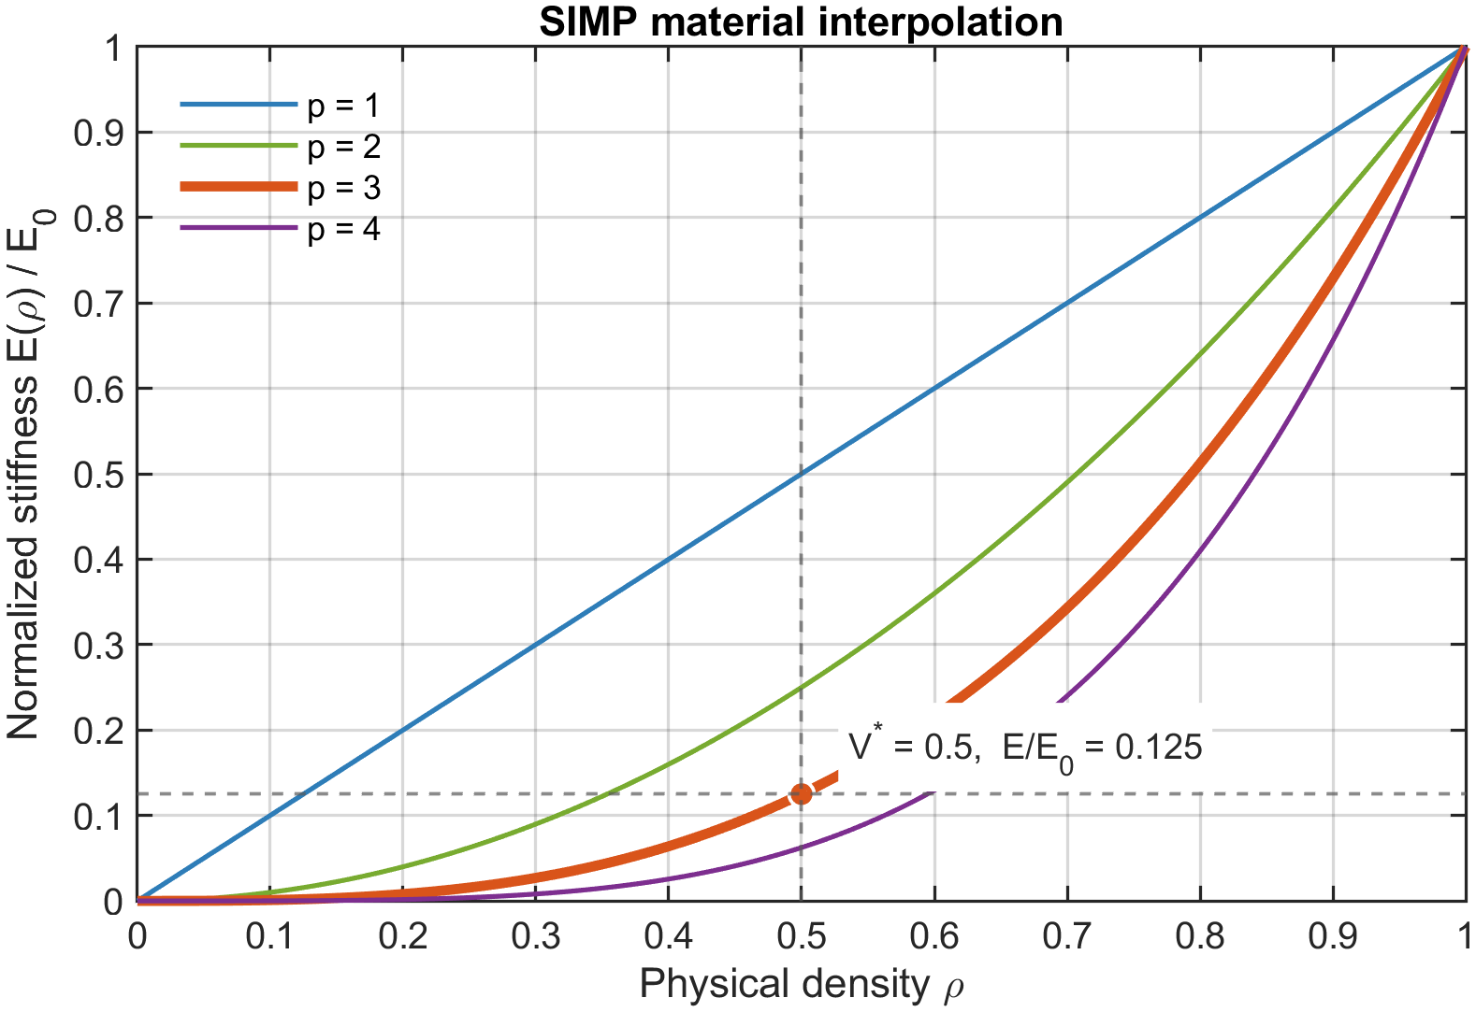
Appendix: problem formulation and SIMP
Minimum-compliance problem
minimize C(x) = f^T u(ρ)
subject to K(ρ) u = f
and mean density ≤ V* = 0.5
design variable x in [0,1] per density cell
SIMP material law
E(ρ) = E_min + ρ^p (E0 - E_min), p = 3
at ρ = 0.5 this gives E / E0 = 0.125
Cone filter, radius r = 24 density cells
density filter: ρ_i = Σ H_ij x_j / Σ H_ij
sensitivity filter: smooths ∂C/∂x_i (a heuristic)
17
Structural Optimization (B-KUL-H0T88A)
Notes:
Backup slide. Use for questions on the optimization formulation, SIMP penalization, or the two filters.

Slide 18
Appendix: MTOP element and sensitivities
Element stiffness, midpoint quadrature
K_e = Σ_k [ E_min + ρ_ek^p (E0 - E_min) ] I_k
I_k = A_k · B^T(ξ_k) D0 B(ξ_k), A_k = 1/25
the 25 templates I_k depend on geometry only
and are precomputed once per run
Compliance sensitivity (self-adjoint)
∂C/∂ρ = - u^T (∂K/∂ρ) u (no extra solve)
classical: ∂C/∂ρ_e = -p (E0-E_min) ρ_e^(p-1) u_e^T K0 u_e
MTOP cell: ∂C/∂ρ_ek = -p (E0-E_min) ρ_ek^(p-1) u_e^T I_k u_e
18
Structural Optimization (B-KUL-H0T88A)
Notes:
Backup slide. Use for questions on the MTOP element, the 25 sub-cell templates, midpoint quadrature, and the per-cell sensitivity.

Slide 19
Appendix: sensitivity verification
Derivative chain | Best component-wise error | Best directional error | Taylor slope
Classical SIMP | 6.9e-6 | 3.4e-6 | 2.000
MTOP per-cell | 2.1e-5 | 1.9e-4 | 2.000
Full Heaviside chain | 2.0e-6 | 7.9e-6 | 1.999
Three finite-difference strategies on three derivative chains.
The Taylor-remainder slope of about 2 confirms the analytical gradients.
19
Structural Optimization (B-KUL-H0T88A)
Notes:
Backup slide. Use for questions on how the sensitivities were verified and how accurate they are.

Slide 20
Appendix: all nine experiments
Run | C (fine mesh) | Iterations | Time (s) | Stopping criterion
Classical OC, sensitivity filter | 224.6 | 94 | 263 | design change
MTOP OC, sensitivity filter | 224.7 | 95 | 12 | design change
Classical OC, density filter | 241.1 | 237 | 693 | compliance plateau
MTOP OC, density filter | 241.0 | 299 | 137 | compliance plateau
MTOP MMA, sensitivity filter | 226.5 | 250 | 187 | design change
MTOP MMA, density filter | 240.1 | 419 | 254 | compliance plateau
MTOP MMA, Heaviside η = 0.3 | 200.0 | 419 | 279 | design change
MTOP MMA, Heaviside η = 0.5 | 199.3 | 563 | 371 | design change
MTOP MMA, Heaviside η = 0.7 | 200.6 | 522 | 328 | design change
20
Structural Optimization (B-KUL-H0T88A)
Notes:
Backup slide. The full results table for any question on a specific run, its compliance, cost, or stopping criterion.

Slide 21
Appendix: native vs fine-mesh compliance
Model | Analysis | Density | Native C | Fine-mesh C
Classical fine | 600 × 200 | 600 × 200 | 224.60 | 224.60
MTOP | 120 × 40 | 600 × 200 | 219.07 | 224.70
Classical coarse-resolution | 120 × 40 | 120 × 40 | 219.11 | 226.04
Why two compliance values?
Native C uses each run's own analysis model. A coarser displacement mesh is stiffer, so MTOP's native C is lower.
Fine-mesh C re-analyzes every design on the common 600 × 200 model: this is the value used for all comparisons.
The coarse-resolution baseline reaches 226.04 but is locked to 120 × 40 and is grayer; MTOP keeps the full design.
21
Structural Optimization (B-KUL-H0T88A)
Notes:
Backup slide. Use for questions on why native and fine-mesh compliance differ, and on the coarse-resolution baseline.

Slide 22
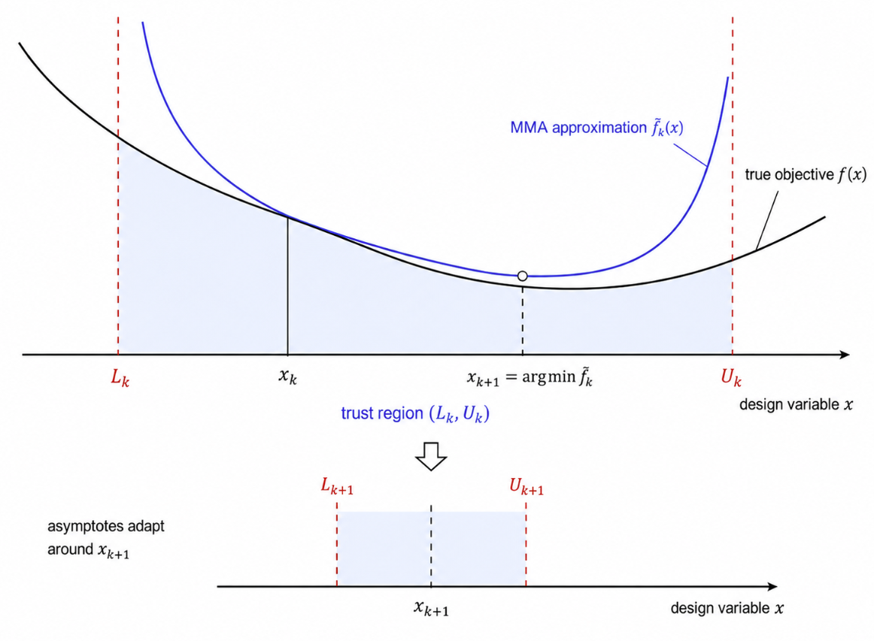
Appendix: the OC and MMA updates
Optimality criteria (OC)
x_i ← x_i · ( B_i / λ )^(1/2)
then clip to move limit m = 0.2 and to [0,1]
B_i = - (∂C/∂x_i) / (∂V/∂x_i)
optimality criterion: B_i = λ at all interior cells
λ from bisection so the volume constraint is active
MMA, method of moving asymptotes
a separable convex subproblem each iteration
asymptotes L_k, U_k act as an adaptive trust region
general-purpose: handles the Heaviside projection
22
Structural Optimization (B-KUL-H0T88A)
Notes:
Backup slide. Use for questions on the OC update rule, the Lagrange-multiplier bisection, or how MMA works.

Slide 23
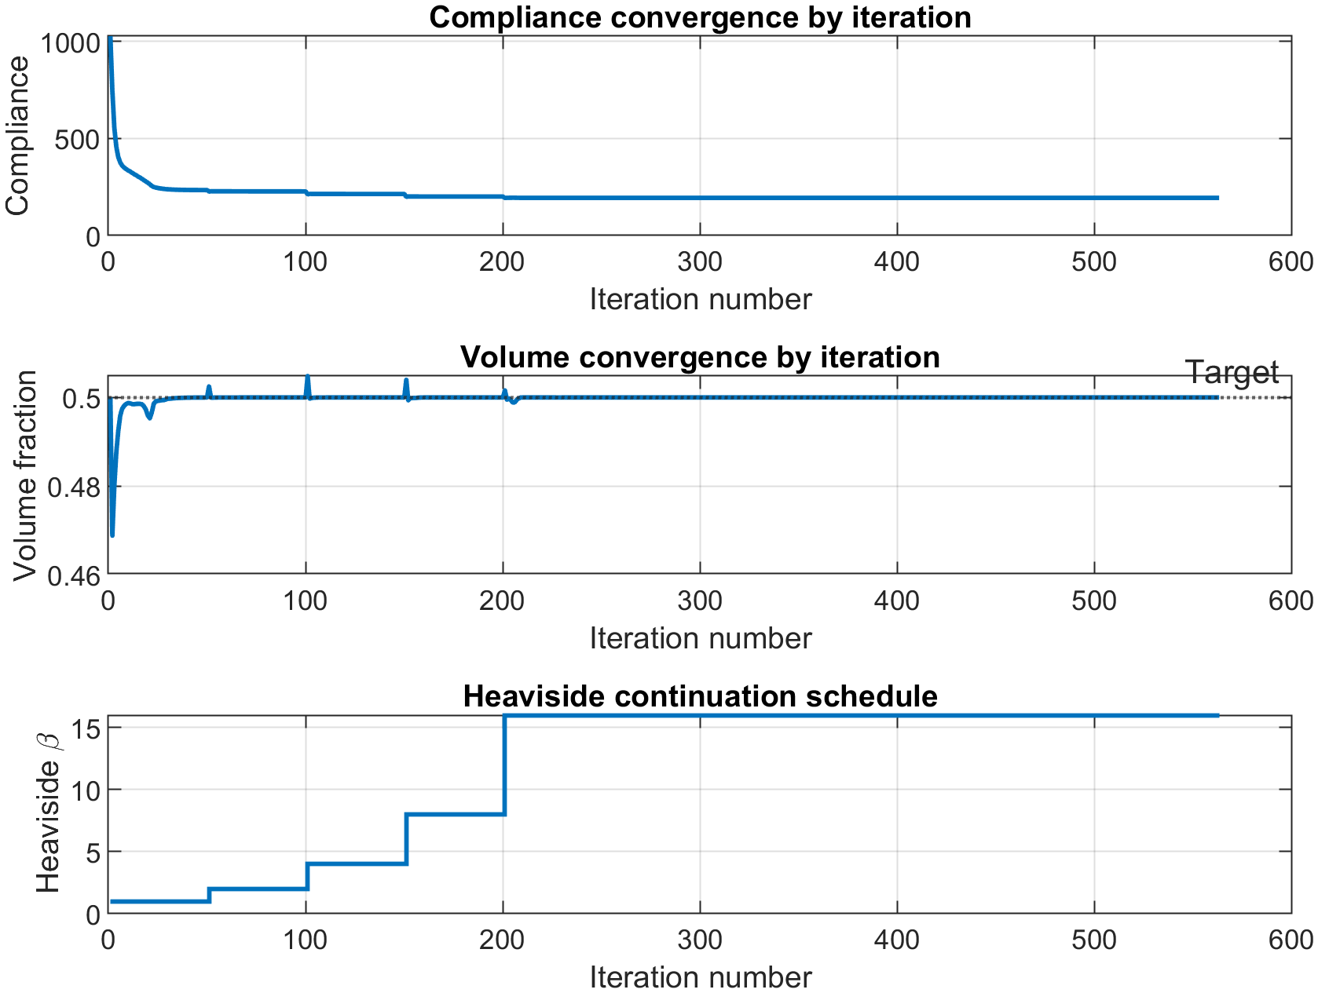
Appendix: Heaviside projection
Smooth Heaviside projection
projects the filtered density d toward 0 or 1:
ρ = [ tanh(βη) + tanh(β(d - η)) ]
/ [ tanh(βη) + tanh(β(1 - η)) ]
η : threshold β : projection sharpness
Continuation in β
β doubled from 1 to 16, every 50 iterations
solve the smooth problem first, then sharpen
this avoids poor local minima at high β
23
Structural Optimization (B-KUL-H0T88A)
Notes:
Backup slide. Use for questions on the Heaviside projection, the threshold eta, and the beta-continuation strategy. The figure shows compliance, volume and beta versus iteration for eta = 0.5.

