Slide 1








Intro to Open Source – CSCI 2963-01
Group Members:
Adeet Phanse
Alvin Leung
Jacob Arriola
Matt Bu

Slide 2
About Pokémon Snowdown
Pokémon Snowdown is a Pokémon battle simulator where you can fight your opponents, team up and play strategy to take down OP computer bots, and even edit your Pokémon with a fully-functional editor for hours of endless fun!
The game features a single player mode, a two player mode and a no player mode where you can watch the computer battle itself.

Slide 3
Tools we used
OCaml
JSON
Python

Slide 4
What we did
Expanded the tournament game variant as it felt lackluster compared to the other created game modes
Expanded the unlockable Pokémon field to include the full list
Added our own unique NPC’s to the game
Added documentation on how to install and play the game so that more people could play it

Slide 5
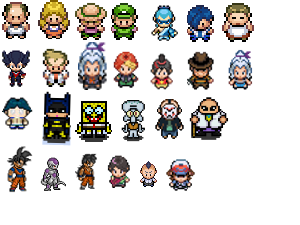
NPCS We added

Slide 6

NPC Portraits we added

Slide 7
Problems we Faced
Trying to learn OCaml and change parts of the game, such as the logic units, was very hard
We face time constraints we could not add the items/moves as we had planned

