Slide 1
Xilinx Design Constraints
Artix-7
Vivado 2014.2 Version

Slide 2
Objectives
After completing this module, you will be able to:
Assign pin locations using the I/O Planner
Describe static timing paths
Create real and virtual clocks
Create appropriate input and output delays
Use virtual clocks for input and output delays
Use the Constraints Wizard

Slide 3
Outline
Pin Constraints
Timing Constraints
Period
Input Delay
Output Delay
Virtual Clocks
Constraints Wizard
Summary

Slide 4
Pin and Clock Planning
Pin and clock planning often happens early in the project
Decisions here can have significant effects throughout the design
Excessive clock skew
Poor I/O timing
Timing-hazardous clock domain crossing
Less flexible design placement
Fewer clocking resource choices
Poor logic placement
Excessive routing delays
Reduced device utilization
Pin and clock planning should be considered together
Choices made for clock pins affect clocking timing and resources choices
Choices made for data pins affect clock pin placement decisions

Slide 5
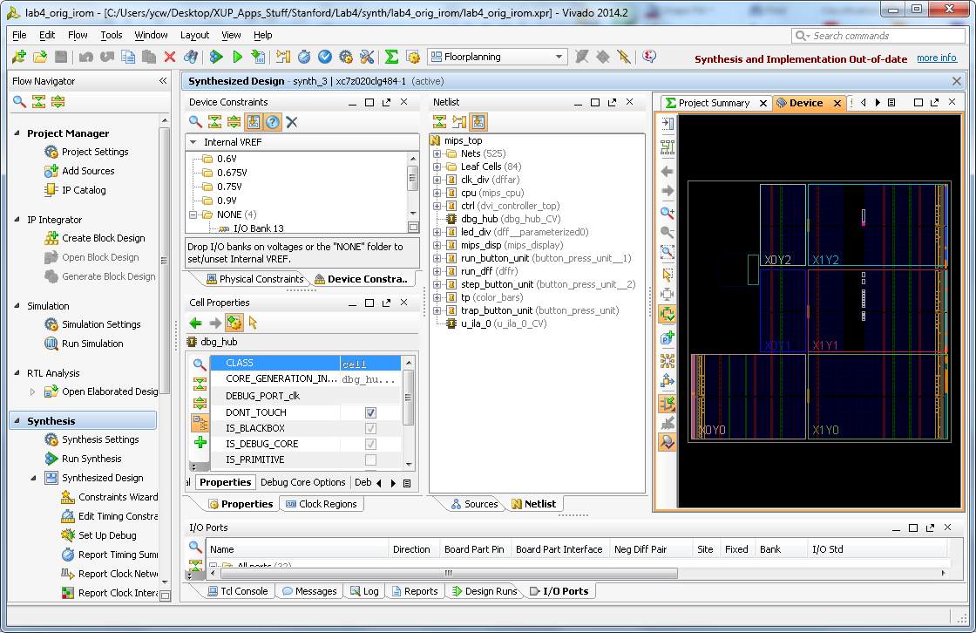
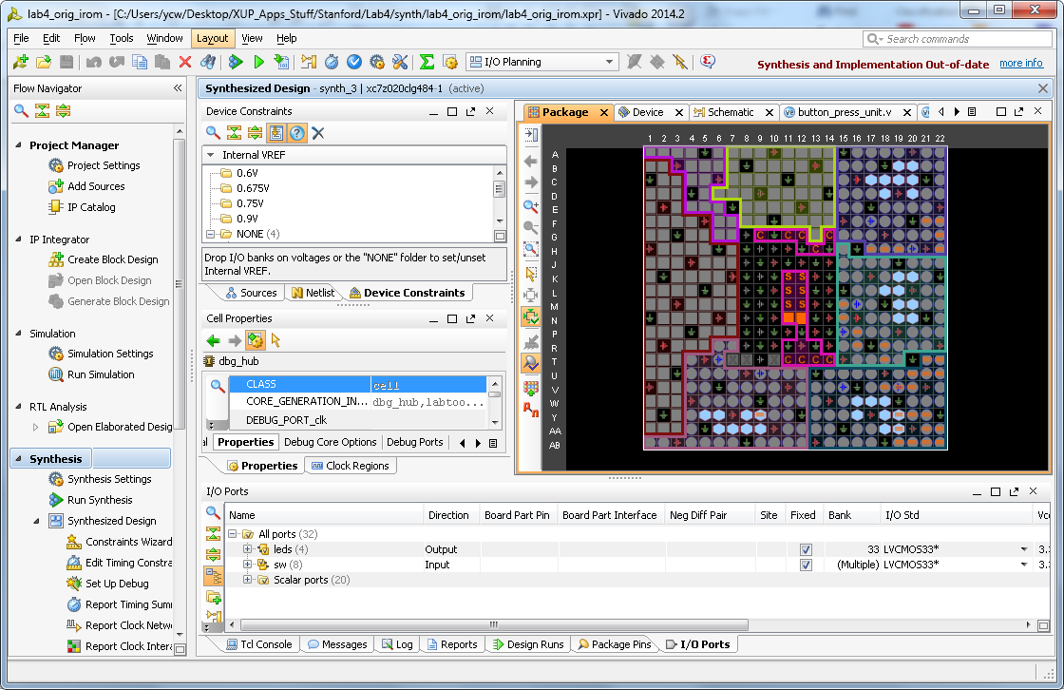
Design View Layouts
Several default view layouts available
Toolbar pull-down (I/O Planning, Clock Planning, Floorplanning, etc)
Designs load with "Design Analysis" view by default
Use "I/O Planning" for easy access to I/O planning functions
Adds Package view, clock resources, I/O ports, package pins

Slide 6
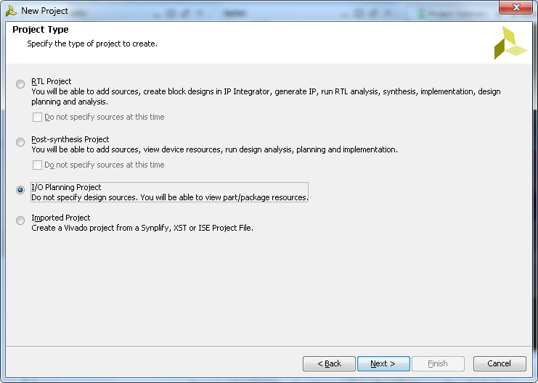
I/O Planning Project
When creating a new project from the Getting Started page you have the option to create an I/O planning project without RTL
This allows testing of pin assignments
I/O banking rules
Avoid ground bounce
The I/O Planner performs error checking for your pinout
However, it is recommended that you have RTL associated
Error checking is better
Notes:
The New Project Wizard presents four project types of choices. Choosing an I/O planning project when there is not a netlist or RTL allows you to build a prototype pinout and test it. However, it is preferred that you have RTL associated with your project when you start to make your pin assignments. This is because the error checking is more thorough when you have RTL.
I/O pin planning projects always open in the I/O Planning view.
An XDC file is a user constraints file and is designed to store your pin assignments and pin attributes. It can also be used to store your design’s timing constraints. The Vivado IDE software also allows you to modify your design’s timing constraints.

Slide 7
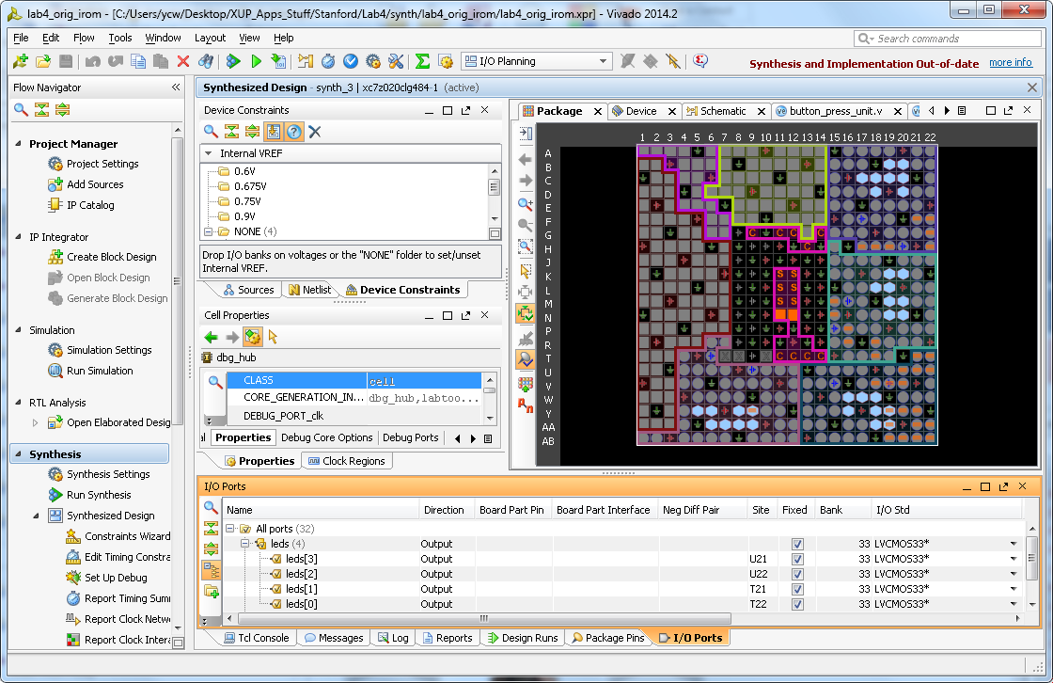
Launching I/O Planner with RTL
This flow is used if you already have a RTL project created
Synthesize the design
Open synthesized design by clicking Open Synthesized Design
This allows you to enter the I/O and Design Planner
Alternatively, open the I/O Planner by selecting the I/O Planning view from the drop-down box on the horizontal toolbar after synthesis
Notes:
If you already have logic associated with your project, you will not be using the Create an I/O Planning Project option from the New Project Wizard. Instead, you will simply open an existing project and open the I/O Planner this way.

Slide 8
I/O Planner
I/O Planner performs error checking on the design pin layout
This requires rules-based I/O assignments
DRC provides guidance for pin assignments connecting to dedicated FPGA logic (microprocessor, MGT, or differential pairs, for example)
Noise analysis (to avoid ground bounce)
Verify I/O banking rules
Semi or fully automatic pin assignment capabilities
Xilinx recommends that you place timing-critical ports before allowing automatic pin assignment of the remaining pins
Supports grouping-related pins to simplify I/O interface management

Slide 9
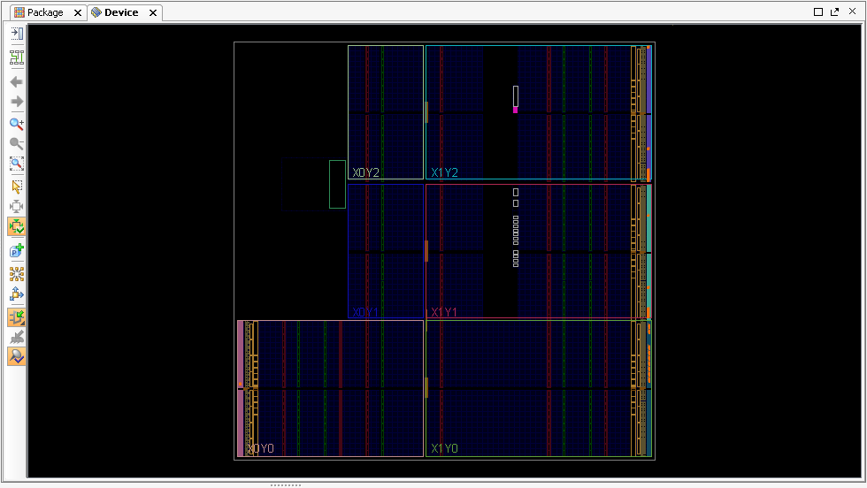
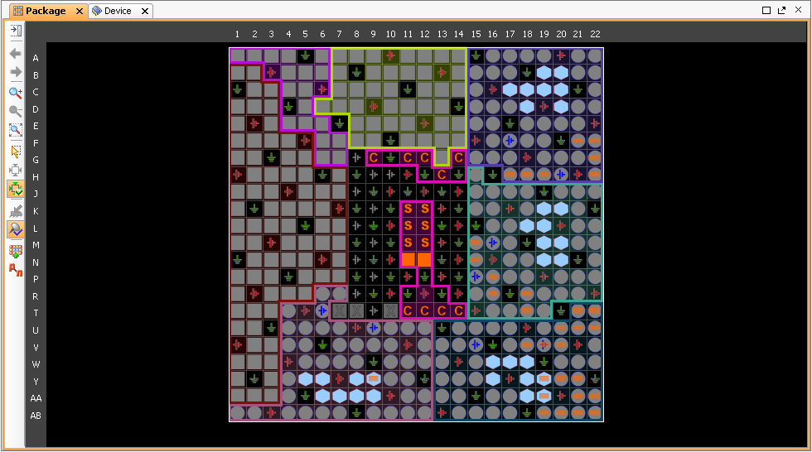
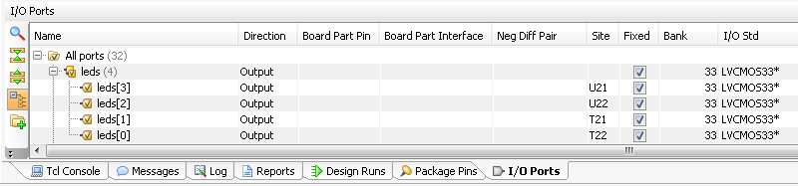
I/O Planner Layout View
I/O Planner allows you to view both the Die and Package views so that you can understand the I/O bank relationship with your logic
Package and Device views
Graphically displays package pins, die pads, and I/O banks
I/O ports can be assigned within either of these two views
Package Pins view
Displays I/O package specifications and assignment status
Allows you to see the Trace delays, pin type, voltage standard, and differential pair partners
Can display pins as a group, in an I/O bank, or as a list
As you drag across the display, icons show pin and I/O bank placement status
Notes:
As pins or banks are selected, the corresponding pins or banks become highlighted in the other views. This makes it easy to see that the pins assigned in each bank meet the I/O banking rules and are grouped appropriately.
Clock pins are shown as gray hexagons, clock-capable pins are shown as blue hexagons, power pins are shown as red squares, and ground pins are shown as green squares. These views also allow you to manually assign I/O-related objects, such as BUFRs, BUFGs, IODELAYCTRLs, or MGTs.
When pins are displayed as a list they can be easily sorted. This allows you to see them organized by attributes such as prohibited pins.
As you drag across the package view, yellow icons indicate assigned pins, gray icons indicate unassigned pins, and both displayed indicates partially assigned I/O banks.

Slide 10
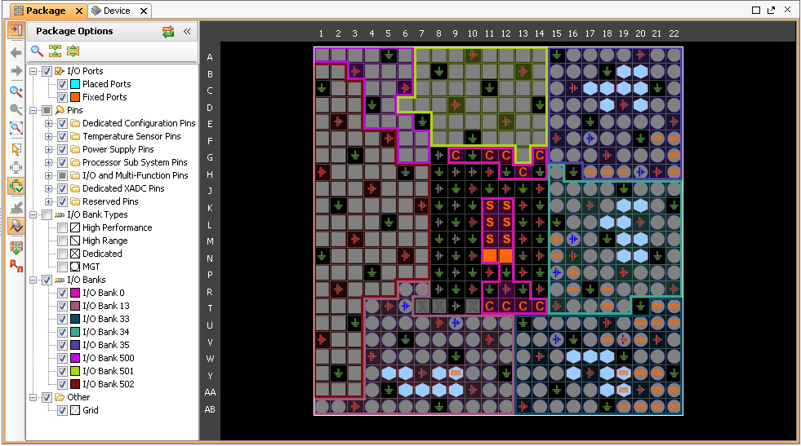

Package View
The colored areas between the pins display the I/O banks
Show differential pairs
Clock-capable pins ( ), VCC ( ), GND ( ), no connection ( )
Notes:
In the package view:
Clock-capable pins display as hexagon pins
VCC and GND pins show as red and green square pins
The colored areas between the pins display the I/O banks
The Package View Layers option allows you to turn on/off pins of a certain type.
Moving and holding the cursor over the display will show the pin information.
Ports and I/O buffers can be dragged into the Package view or Device view for assignment

Slide 11
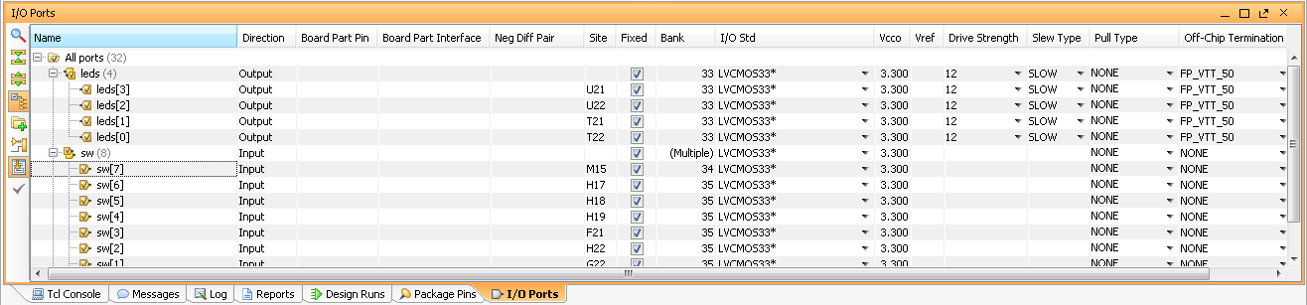
I/O Ports View
Displays all I/O ports defined in the project
Groups buses into expandable folders
Can be displayed as groups of buses and interfaces or as a list
Most I/O port assignment is initiated from this view
Icons indicate I/O port direction and status

Slide 12
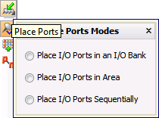
Interactively Placing I/O Ports
Place by selecting the I/O ports, buses, or interfaces and clicking the Place Ports button in the Device or Package view
Place I/O Ports in an I/O Bank – Place I/O ports in selected I/O banks
Place I/O Ports in Area – Draw a rectangle around the desire pins or pads
Place I/O Ports Sequentially – Select a pin or pad for each I/O port individually
The placement mode remains active until all selected I/O ports are placed or until the ESC key is pressed
Assignment direction is dictated by the first selected I/O pin or I/O pad
Notes:
Ports are displayed on the cursor. You can place by clicking the specific desired location. You cannot drag-and-drop pins. Dragging-and-dropping I/O ports will default to placing I/O ports in an available I/O bank.
The assignment order of the placement is determined by the order displayed in the I/O Ports view.
You can also sort to change bus direction.

Slide 13
set_property command
Use set_property command
set_property PACKAGE_PIN T22 [get_ports led_pins[0]]
set_property IOSTANDARD LVCMOS33 [get_ports led_pins[0]]

Slide 14
Outline
Pin Constraints
Timing Constraints
Period
Input Delay
Output Delay
Virtual Clocks
Constraints Wizard
Summary

Slide 15
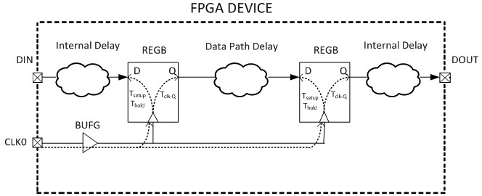
Static Timing Paths and I/O
Static timing paths start at clocked elements and end at clocked elements
Paths from internal flip-flop to internal flip-flop are constrained by clock
Inputs and outputs of the FPGA are not start-points/end-points of static timing paths
By default, any logic between a primary I/O and an internal clocked element are not part of a complete static timing path
Without additional commands, no setup/hold checks are done on logic associated with I/O

Slide 16
Outline
Pin Constraints
Timing Constraints
Period
Input Delay
Output Delay
Virtual Clocks
Constraints Wizard
Summary

Slide 17
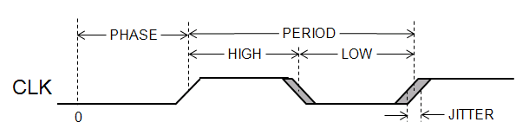
Clocks
Clocks are periodic signals
Clocks have certain attributes
Period
Nominal time from rising edge of the clock to the next rising edge of the clock
Duty cycle
Ratio of the high time to the low time of the clock
Jitter
Variation of the period from its nominal value
Phase
Position of the rising edge

Slide 18
Clocks as Objects
In XDC clocks are primary objects
Clocks have properties
NAME is the name of the clock
Will be user assigned or auto generated depending on the clock
PERIOD is the period of the clock
WAVEFORM describes the position of the edges of the clock
IS_GENERATED, IS_VIRTUAL are flags that describe how the clock was created
SOURCE_PINS are the pins/ports/nets which the clock is attached to

Slide 19

Creating Clocks
Clocks are created with the create_clock Tcl command
create_clock -name <name> –period <period> <objects>
<period> is the period of the clock
<name> is the user assigned name for the clock
<objects> are the list of pins, ports, or nets to which to attach the clock
If <objects> is not present (or is a null list), the clock will not be attached to any objects, and will be a virtual clock
create_clock –name my_clock –period 5.0

Slide 20
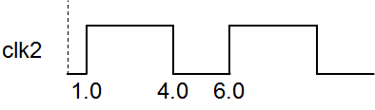
Clock Waveform
Clocks can be created with edges at different positions
Allows for the description of clocks with phase offsets and clocks with different duty cycles
Uses the –waveform <edges> option
<edges> is a list of numbers representing the times of successive edges
The first number is the time of the first rising edge
Default is 0.00 for the rising edge and PERIOD/2 for the falling edge
create_clock –name clk2 –period 5.0 –waveform {1.0 4.0}
Notes:
As with all Tcl commands, variables and expressions can be used for any options. Therefore, to define the above clock using an offset and duty cycle could be done as follows:
set period 5.0
set offset 1.0
set duty_cycle 0.6
create_clock -name clk2 -period $period -waveform "$offset [expr $offset + $period * $duty_cycle]"
Note the use of the “” to enclose the list, rather than {}. Inside {} variables are not expanded and embedded commands are not processed.

Slide 21
Setting Jitter
The Vivado Design Suite timing engine allows for two sources of jitter
System Jitter: Jitter introduced by the clocking network inside the FPGA
A single value for all clocks in the system
Set with the set_system_jitter command
set_system_jitter <value>
<value> is the jitter in time units (nanoseconds)
Input Jitter: Jitter that exists on the input clock
Set independently for each clock source
Set with the set_input_jitter command
set_input_jitter <clock_name> <value>
<clock_name> is the name of a clock (not the clock object)
<value> is the jitter in time units
Both sources of jitter will be combined appropriately in STA calculations
Notes:
The set_input_jitter command takes a clock name as an option. In this command (and a few others) the actual name of the clock is used, rather than the object itself. Thus, you can use:
set_input_jitter clk_pin_p 0.2
For this command, the get_clocks is assumed. However, it is still legal to use it; the following command is equivalent:
set_input_jitter [get_clocks clk_pin_p] 0.2

Slide 22
Clock Latency
The latency of the clock can be controlled with the set_clock_latency Tcl command
set_clock_latency –source <latency> <objects>
<latency> is the latency to apply
<objects> is the list of clocks, ports or pins to which to apply the latency
The latency is an additional clock delay that is added between the clock object and the pin, port, or net to which the clock is attached
If the set_clock_latency specifies a clock object, the latency is added to all destinations of the clock
If the set_clock_latency specifies a port or pin, it applies to all clocks that go through that port or pin
If the port or pin has more than one clock associated with it, the –clock <clocks> option can be used to specify which clocks to apply the latency to

Slide 23
Options of the set_clock_latency Command
The set_clock_latency command has several options
-rise: The specified latency applies only to the rising edge of the clock
-fall: The specified latency applies only to the falling edge of the clock
-min: Specifies the latency to apply when the shortest path is used
-max: Specifies the latency to apply when the longest path is used
If the –min/-max are not specified, the latency applies to both min and max
If the –rise/-fall are not specified the latency applies to both rise and fall

Slide 24
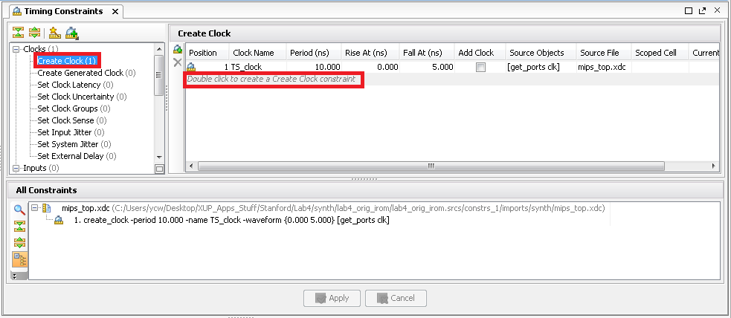
Creating Clocks using the GUI
The Timing Constraint window can be opened using the menu Window > Timing Constraints
A clock can be created by double clicking on the Create Clock, or a new row in the Create Clock table
Alternatively can be set via the Constraints Wizard
Covered later in this presentation

Slide 25
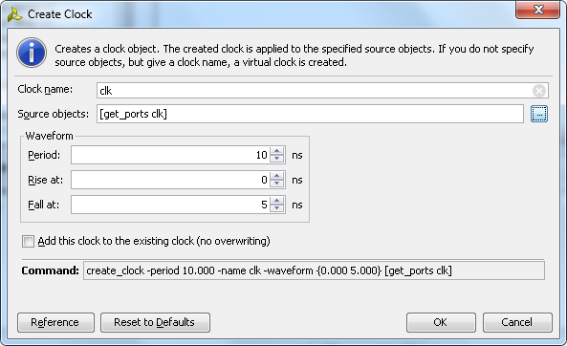
The Create Clock Wizard
Name of clock to be created
Objects to which attach clock
Period and edges of the clock
Tcl command to create clock

Slide 26
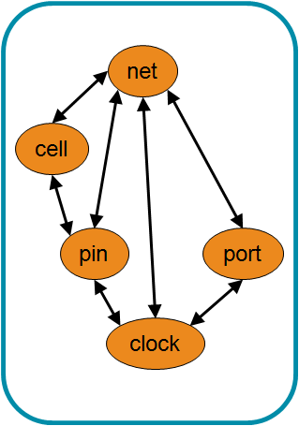
Handling Clock Objects
Clocks can be attached to pins, ports, and nets
Specify the list of pins, ports, or nets which are to be attached to the clock when the clock is created
Once created, clock objects can be gotten using the get_clocks command
get_clocks <name>
Returns list of clocks that match <name>
<name> may include wildcards
Has similar options as the other get_* commands
-regexp
-filter <expression>
-of_objects <object>

Slide 27
Outline
Pin Constraints
Timing Constraints
Period
Input Delay
Output Delay
Virtual Clocks
Constraints Wizard
Summary

Slide 28
Synchronous Input Interfaces
Most interfaces to an FPGA use synchronous communication
FPGA and the device driving the FPGA have some shared timing reference
This is usually a common clock or a related clock
Complete static timing path through an input
Starts at a clocked element in the driving device
Referenced to a clock provided to the driving device
Ends at a clocked element in the FPGA
Referenced to the clock that propagates to the destination clocked element in the FPGA
Propagates through the elements between them
CLK > Q of the external device
Board propagation time
Port of the FPGA
Combinatorial elements in the FPGA before the destination clocked element

Slide 29
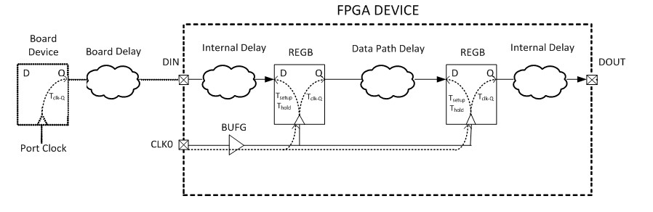
Completing the Static Timing Input Path
To complete the static timing path, you need to describe the external elements to the Vivado static timing engine
What clock is used by the external device
Delay between the external device’s clock and the arrival at the input port of the FPGA
Includes the CLK > Q time of the external device and the board delay

Slide 30
set_input_delay Command
set_input_delay command supplies the information required to complete the static timing path
set_input_delay –clock <clock_name> <delay> <objects>
<clock_name> is the name of the clock used by the external device
Can be a real or virtual clock
Can be the name of a clock; does not need to be a clock object
Can use a clock object if desired
<objects> is the list of objects to which to attach the set_input_delay
Usually a set of input and/or inout ports
Usually uses the get_ports command or the all_inputs command
<delay> is the delay from <clock_name> to the attached <objects>
Includes the external device and board delay
Notes:
The all_inputs command (which returns a list of ports that are inputs or inouts) is convenient for applying input delays to all the input ports of the design. When this is done, the tool will usually issue a warning because the clock port is also an input port, and a set_input_delay cannot be specified on a port that has a clock attached to it. As will be indicated by the warning, the set_input_delay will not be applied to the clock port, but will be applied to all other inputs.

Slide 31
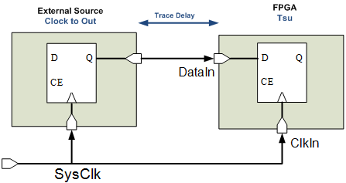
Using a Common Clock
A set_input_delay can be related to an already existing clock
Can be the clock attached to the FPGA clock pin
Value used for the set_input_delay is the sum of
Clock to out of the external source
Trace delay on the board
create_clock –name SysClk –period 10 [get_ports ClkIn]
set_input_delay –clock SysClk 4 [get_ports DataIn]

Slide 32
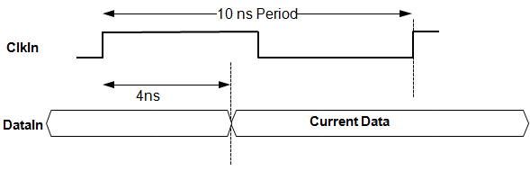
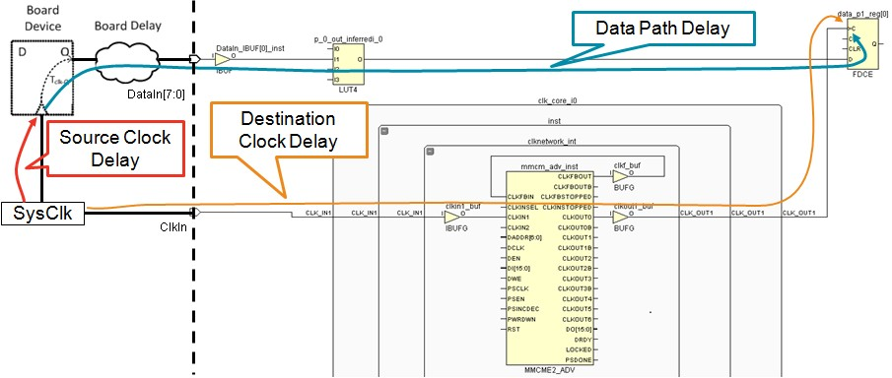
set_input_delay example
create_clock –name SysClk –period 10 [get_ports ClkIn] set_input_delay –clock SysClk 4 [get_ports DataIn]

Slide 33
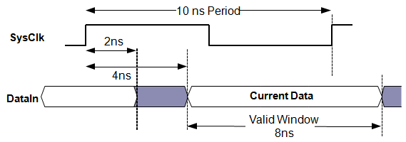
Minimum and Maximum Delays
By default, each input port can have one maximum delay and one minimum delay
Maximum delay is used for the setup check
Minimum delay is used for the hold check
Without the –max or –min option, the value supplied is used for both
create_clock –name SysClk –period 10 [get_ports ClkIn]
set_input_delay –clock SysClk 4 [get_ports DataIn]
set_input_delay –clock SysClk –min 2 [get_ports DataIn]
Notes:
Using the set_input_delay without the –max or –min option sets both the max and min to the same value. The subsequent command with the –min option overrides the min value

Slide 34
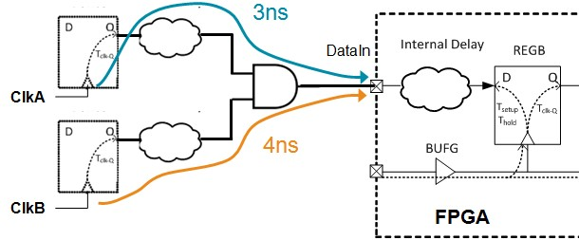
Multiple Input Delays on the Same Port
An input can have multiple set_input_delay commands associated with it
Use the –add_delay option
Results in multiple static timing paths to check
set_input_delay –clock ClkA 3 [get_ports DataIn]
set_input_delay –clock ClkB 4 [get_ports DataIn] –add_delay
Notes:
set_input_delay is a command that is executed in order. Without the –add_delay option, the second set_input_delay would override the first one.
Note: the two input delays define two different startpoints with their own propagation delays. The path from each start-point to the end-points in the FPGA are separate static timing paths and are each timed by the tools.

Slide 35
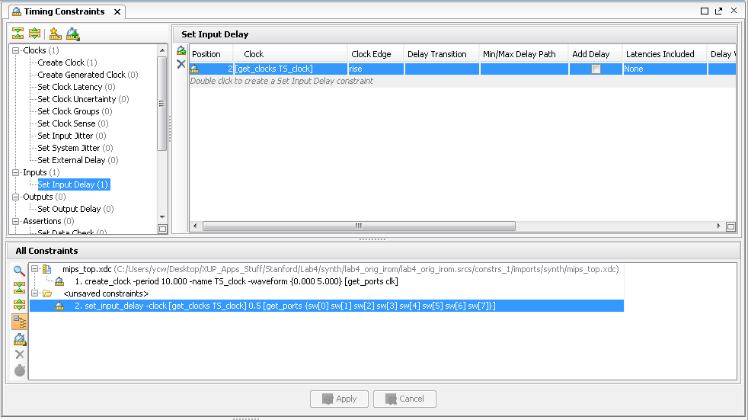
Creating Input Delays Using the GUI
Timing Constraint window can be opened by selecting Window > Timing Constraints
Clock can be created by double-clicking Set Input Delay, or a new row in the Set Input Delay table
Alternatively can be set via the Constraints Wizard
More details to follow in this presentation

Slide 36
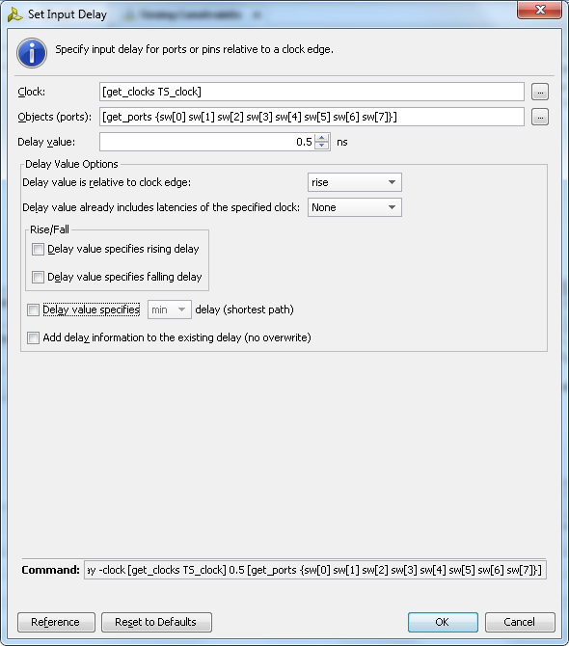
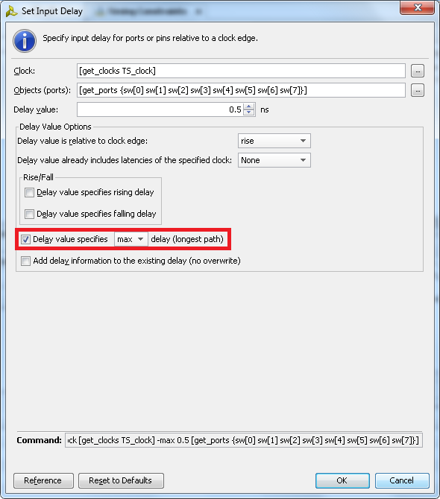
Set Input Delay Wizard
Separate constraint is required for the maximum and minimum
Wizard retains its options between invocations, making it easy to specify the minimum after the maximum has been specified

Slide 37
Outline
Pin Constraints
Timing Constraints
Period
Input Delay
Output Delay
Virtual Clocks
Constraints Wizard
Summary

Slide 38
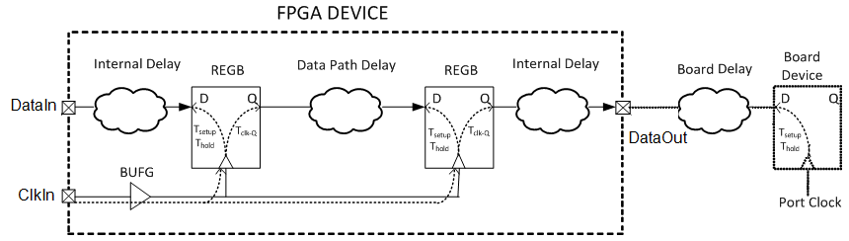
Completing the Static Timing Output Path
To complete the static timing path, you need to describe the external elements to the Vivado Design Suite static timing engine
What clock is used by the external device
Delay between the output port of the FPGA and the external device’s clock
Includes the required time of the external device and the board delay

Slide 39
set_output_delay Command
set_output_delay command supplies the information required to complete the static timing path
set_output_delay –clock <clock_name> <delay> <objects>
<clock_name> is the name of the clock used by the external device
Can be a real or virtual clock
Can be the name of a clock; does not need to be a clock object
Can use a clock object if desired
<objects> is the list of objects to which to attach the set_output_delay
Usually a set of output and/or inout ports
Usually uses the get_ports command or the all_outputs command
<delay> is the delay from the attached <objects> to the external device’s clock
Includes the external device's requirements and board delay

Slide 40
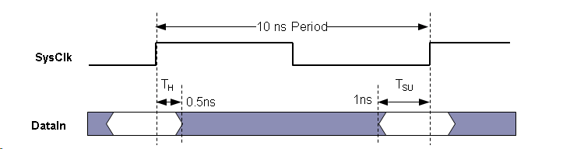
External Setup and Hold Requirements
External devices need a setup and hold time around the clock
set_output_delay –max specifies the required setup time
set_output_delay –min specifies the negative of the required hold time
create_clock –name SysClk –period 10 [get_ports ClkIn]
set_output_delay –clock SysClk 1 [get_ports DataIn]
set_output_delay –clock SysClk –min -0.5 [get_ports DataIn]
Notes:
The set_output_delay values should take into account the board propagation delay.
set_output_delay –max should be the required setup time of the external device plus the longest board delay.
set_output_delay –min should be negative of the required hold time of the external device plus the shortest board delay.

Slide 41
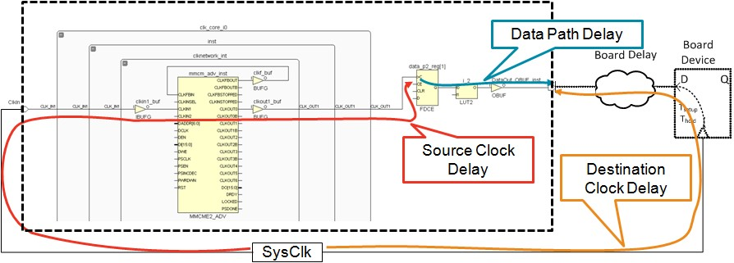
Complete Output Static Timing Path
Output static timing path is segmented slightly differently
Data path delay ends at the port of the FPGA
Destination clock path traces back through the board device to the port of the FPGA

Slide 42
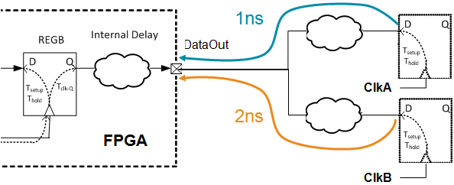
Multiple Output Delays on the Same Port
An output can have multiple set_output_delay commands associated with it
Use the –add_delay option
Results in multiple static timing paths to check
set_output_delay –clock ClkA 1 [get_ports DataOut]
set_output_delay –clock ClkB 2 [get_ports DataOut] –add_delay

Slide 43
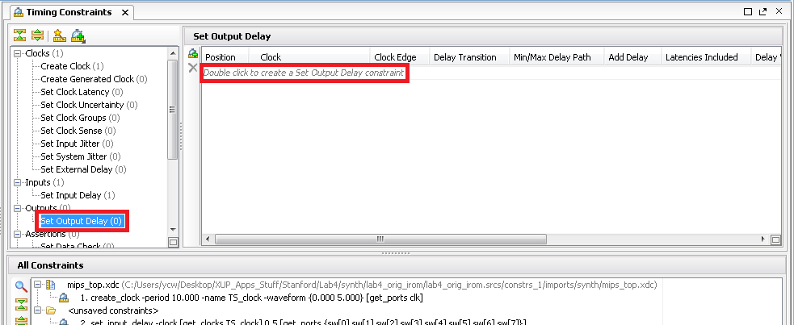
Creating Output Delays Using the GUI
Timing Constraint window can be opened by selecting Window > Timing Constraints
Clock can be created by double-clicking Set Output Delay, or a new row in the Set Output Delay table
Alternatively can be set via Constraints Wizard
To be covered later in this presentation

Slide 44
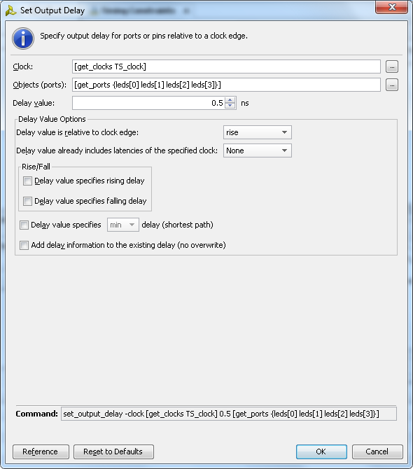
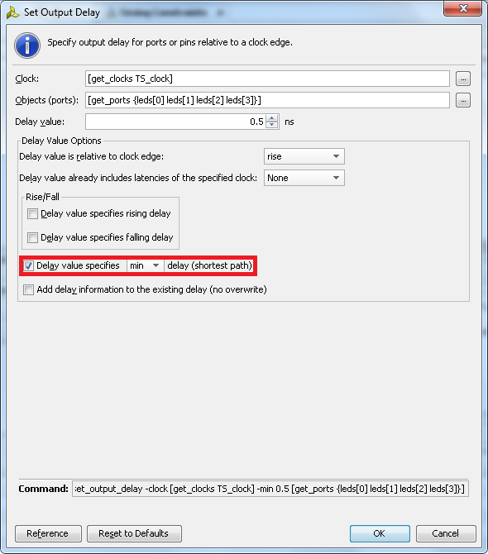
Set Output Delay Wizard
Separate constraint is required for the maximum and minimum
Wizard retains its options between invocations, making it easy to specify the minimum after the maximum has been specified

Slide 45
Outline
Pin Constraints
Timing Constraints
Period
Input Delay
Output Delay
Virtual Clocks
Constraints Wizard
Summary

Slide 46
Clocks for Input and Output Delay
Clock specified by the set_input_delay and set_output_delay can be any clock from the clock database
Manually created clock attached to a clock input port of the FPGA
Derived clock generated inside the FPGA
This is legal, but rarely useful
Sometimes the proper clock to use does not already exist
Virtual clocks can be created solely for the purpose of specifying input and output delays

Slide 47
Reasons for Virtual Clocks
There are many reasons for using virtual clocks for clocking I/O
Device external to the FPGA uses a different clock than the FPGA
Runs at a different frequency
Maybe a multiple/division of the FPGA clock
Maybe the frequency of an internal FPGA clock generated by an MMCM/PLL
Has a different delay path on the board
Maybe has a clock buffer chip on the board
XDC provides powerful mechanisms for describing clocks
Remember, all clocks in XDC are related by default

Slide 48
Creating Virtual Clocks
Virtual clocks are created with create_clock
Created clock is not attached to any design objects
create_clock -name <name> –period <period>
<period> is the period of the clock
<name> is the user assigned name for the clock
Can use the –waveform option
Can specify jitter with the set_input_jitter command
Can set clock latency with the set_clock_latency –source command
Virtual clocks are placed in the design database and can be accessed like other clocks
Can be seen via the report_clocks command
Can be accessed by the get_clocks command

Slide 49
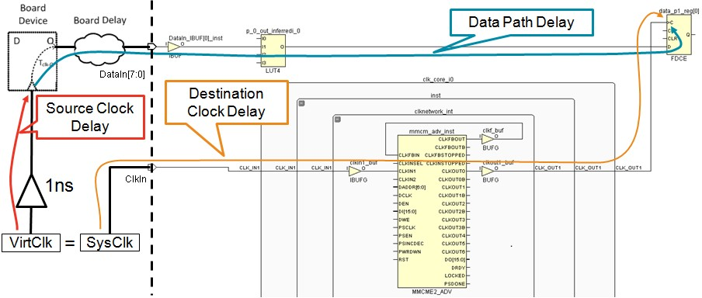
Input Static Timing Path with External Buffer
create_clock –name SysClk –period 10 [get_ports ClkIn]
create_clock –name VirtClk –period 10
set_clock_latency –source 1 [get_clocks VirtClk]
set_input_delay –clock VirtClk 4 [get_ports DataIn]

Slide 50
Outline
Pin Constraints
Timing Constraints
Period
Input Delay
Output Delay
Virtual Clocks
Constraints Wizard
Summary

Slide 51
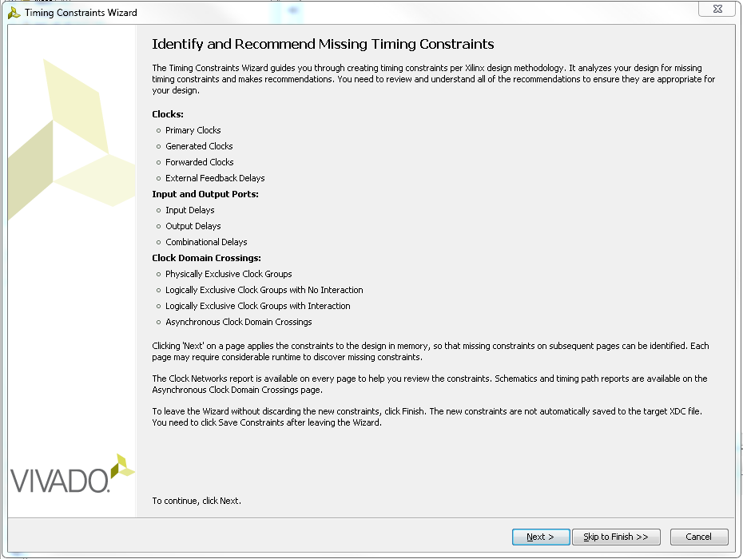

The Constraints Wizard
Can only be launched after either Synthesis or Implementation
Allows Vivado to identify and suggest timing constraints
Writes the constraints into the XDC file via the Timing Constraints Editor
Not mandatory but HIGHLY recommended
User flexibility
The user has the choice to ignore the selected constraints
The wizard can be launched even if timing constraints have already been entered into the XDC file

Slide 52
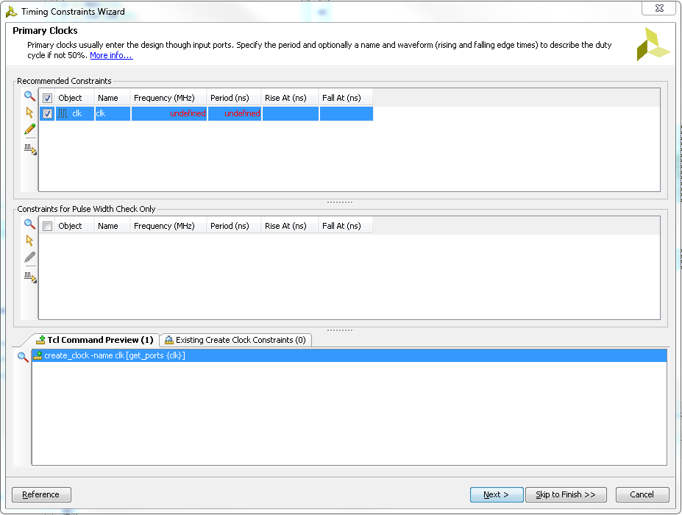

The Constraints Wizard, Primary Clock
Defines the input clock waveform
Object
Name
Frequency (MHz)
Period (ns)
Rise At (ns)
Fall At (ns)
The resultant Tcl command can be previewed at the bottom of the wizard

Slide 53
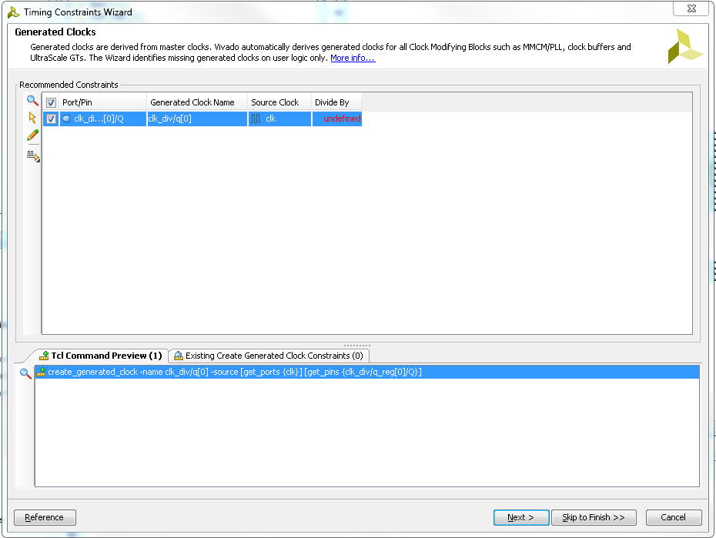
The Constraints Wizard, Generated Clocks
Vivado analyzes design to locate clocks derived from the master clock
Covers derived clocks from a main clock source
MMCM/PLL
Clock buffers
GTs (UltraScale)

Slide 54
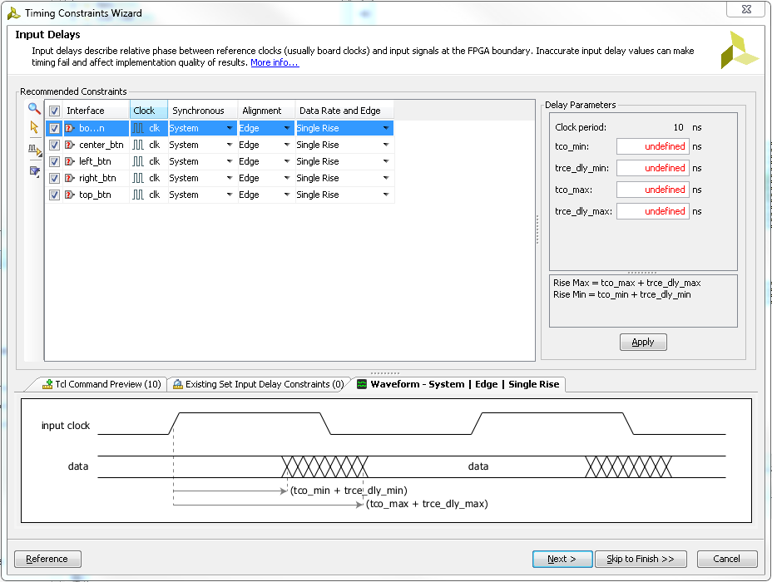
The Constraints Wizard, Input Delays
Another way to specify Input Delays
Identifies input signals/interfaces going into the FPGA
Defines delay parameters
tco_min
trce_dly_min
tco_max
trce_dly_max

Slide 55
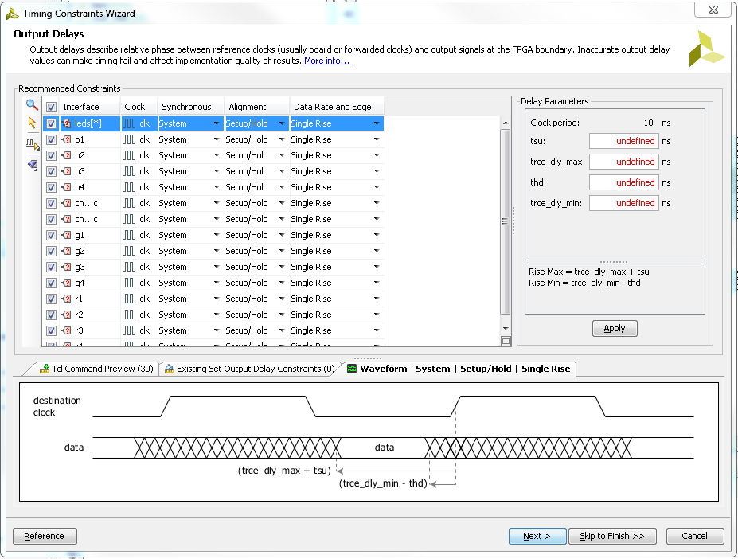
The Constraints Wizard, Output Delays
Another way to specify Output Delays
Identifies output signals/interfaces from the FPGA
Defines delay parameters
tsu
trce_dly_min
thd
trce_dly_max

Slide 56
The Constraints Wizard: Other Constraints
Forwarded Clocks
The Forwarded Clocks constraint covers clock reference for output signals associated with “downstream” devices clocked by an FPGA output pin
External Feedback Delays
Pertinent if the MMCM/PLL feedback loops used in the design is routed out of the FPGA and back into the device via input and output ports
Combinatorial Delay
Cover paths that traverse the FPGA without being captured by any sequential elements
Physically Exclusive Clock Groups
Define clocks that do not exist in the design at the same time
Logically Exclusive Clock Groups with No Interaction
Define logically exclusive clocks that do not have paths between each other outside of shared sections (such as clock trees)
Logically Exclusive Clock Groups with Interaction
Define logically exclusive clocks that have paths between each other, only clocks limited to the shared clock tree sections are logically exclusive
Asynchronous Clock Domain Crossings
Define paths that transfer data between two clocks without a known phase relationship

Slide 57
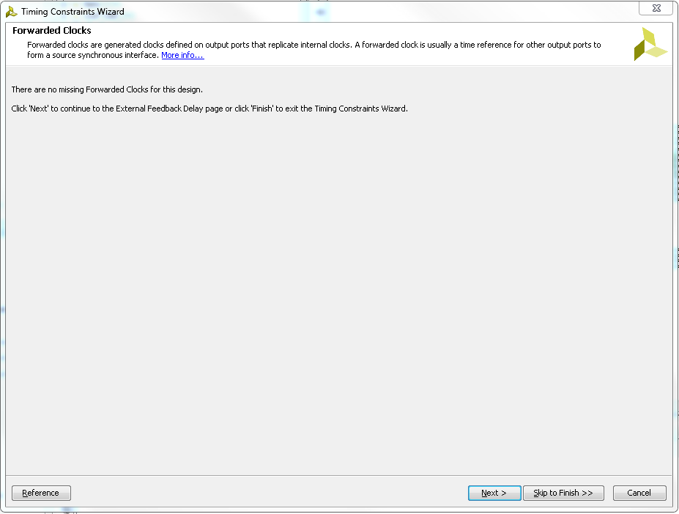
The Constraints Wizard: Non-Applicable Constraints
Constraints that are not applicable to the design do not have any options shown in the wizard (blank grey screen)

Slide 58
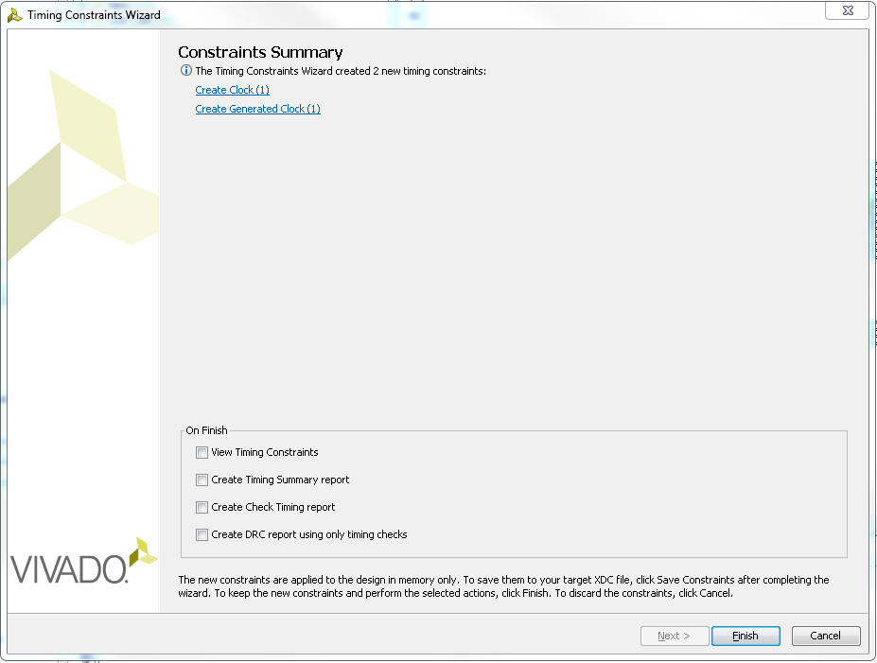
The Constraints Wizard: Constraints Summary
The final screen of the wizard summarizes all the constraints selected for insertion into the XDC file
Generated constraints are not immediately applied to the target XDC
On Finish options allow for follow-up operations
View Timing Constraints
Create Timing Summary Report
Create Check Timing Report
Create DRC report using only timing checks

Slide 59
Outline
Pin Constraints
Timing Constraints
Period
Input Delay
Output Delay
Virtual Clocks
Summary

Slide 60
Summary
The I/O Planner view in the Vivado IDE provides an easy-to-use interface for assigning pin locations
Use I/O Planning project for pin planning early in the design analysis
DRC checking
SSO analysis
Verify I/O banking rules
Static timing paths start at clocked elements and end at clocked elements
Static timing paths are analyzed for setup and hold violations at both fastest and slowest process corners
Clocks are objects
Clocks can be created with the create_clock command

Slide 61
Summary
set_input_delay and set_output_delay commands provide the details to complete the static timing path
set_input_delay specifies the clock of the driving component and the delay to the port
set_output_delay specifies the clock of the receiving component and the delay to the port
–max is the required setup time
–min is the negative of the required hold time
Port can have one –min and one –max by default
Additional delays can be specified with the –add_delay option
I/O delays can be specified with respect to virtual clocks
The Constraints Wizard is a powerful tool for creating constraints pertinent to the design

