Slide 1
2021牛客暑期多校训练营 第 7 场
出题人：Isonan, LJC00118, wlzhouzhuan, zx2003

Slide 2

xay loves connected graphs

Slide 3
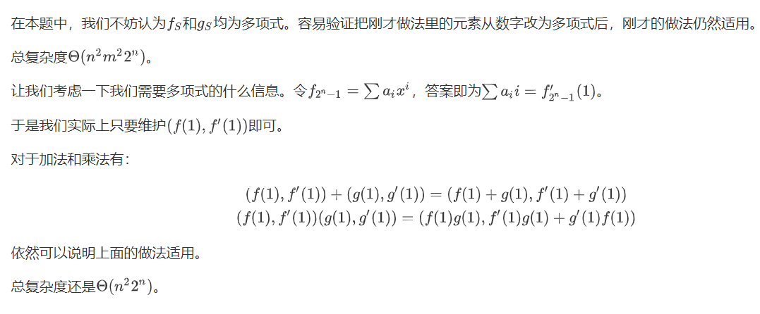
xay loves connected graphs

Slide 4
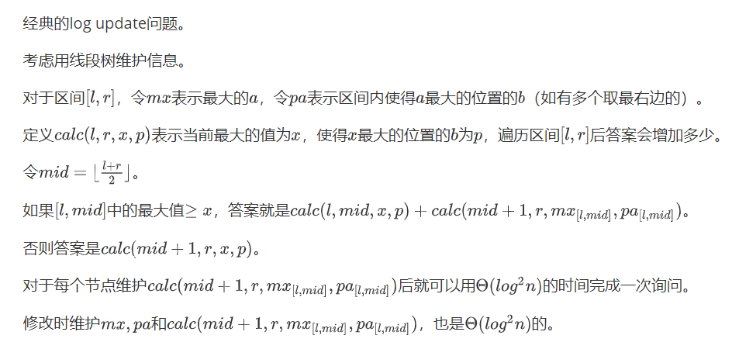
xay loves monotonicity

Slide 5

xay loves jumping

Slide 6
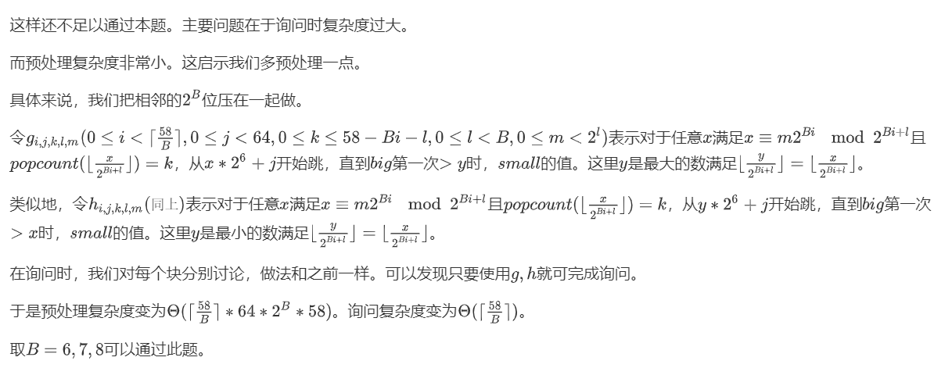
xay loves jumping

Slide 7
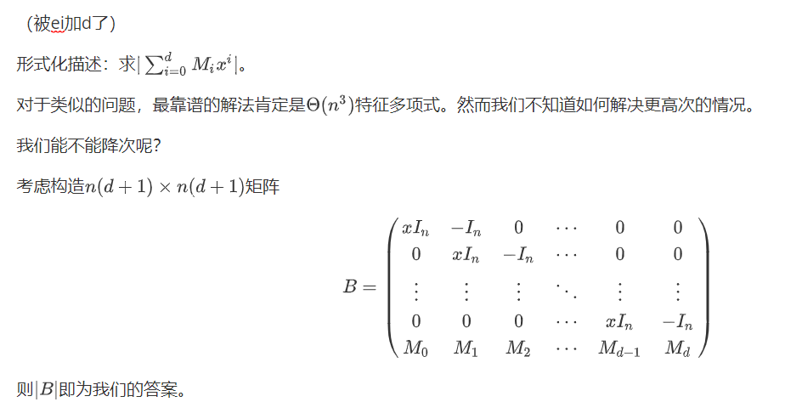

xay loves matrices

Slide 8
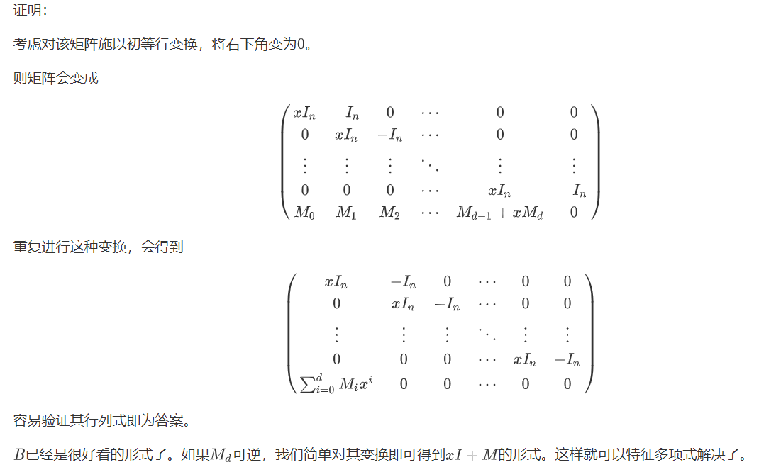





xay loves matrices

Slide 9
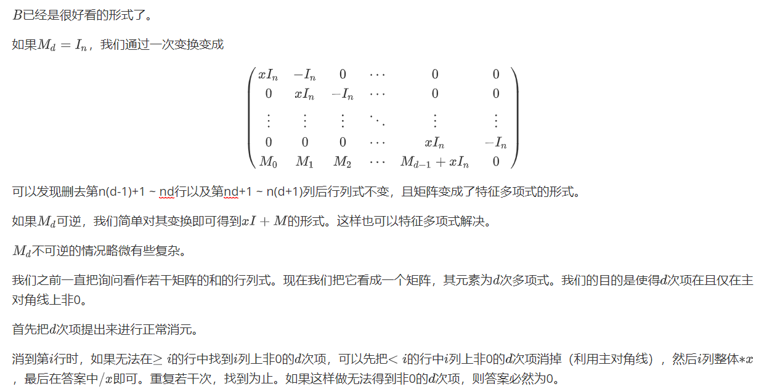












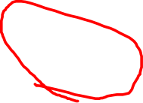




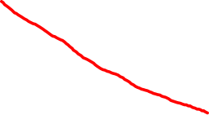
xay loves matrices

Slide 10


xay loves or

Slide 11

xay loves floyd

Slide 12


xay loves floyd

Slide 13
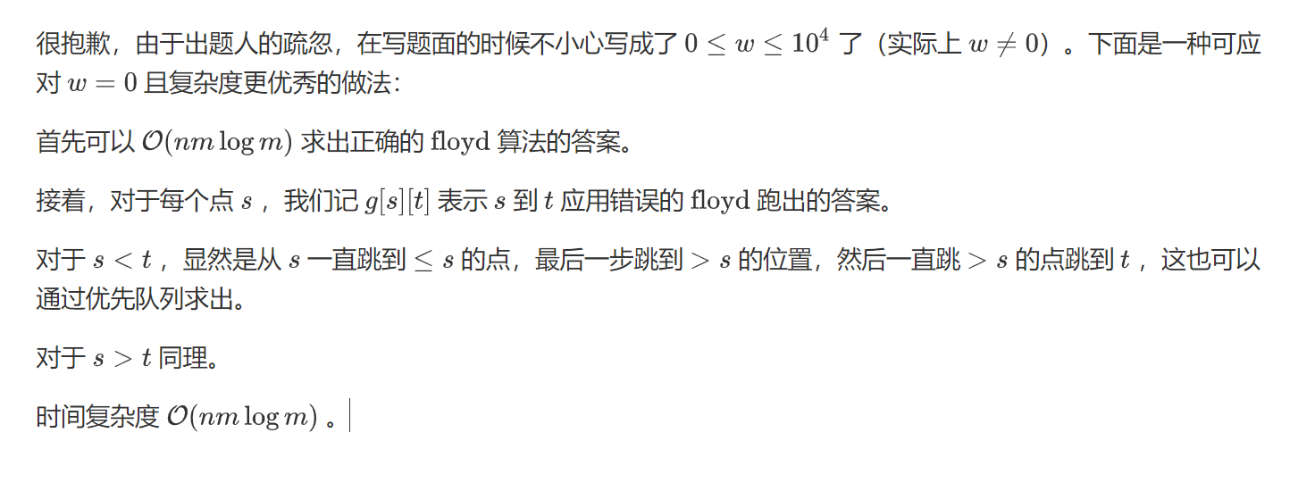
xay loves floyd

Slide 14



xay loves sequence

Slide 15





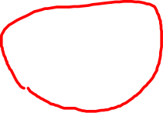








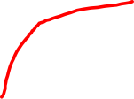
xay loves KDT

Slide 16


xay loves KDT

Slide 17






xay loves nim

Slide 18


















xay loves trees

Slide 19

xay loves trees

Slide 20

xay loves count

