Slide 1
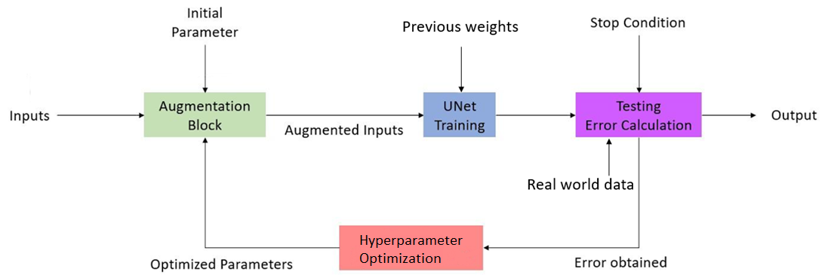

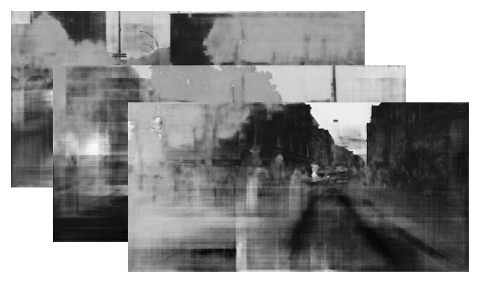
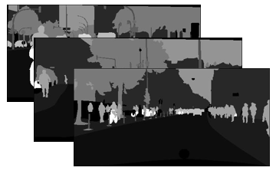
New
Weights
0.73
aug = [0.15, 0.17, 0.0986, 0.004, 0.1506]
params = [0.8335, 0.1369, 0.0256, None, None]
0.73

