Slide 1
Assembly Variables
Unlike HLL like C or Java, assembly cannot use variables
  Why not? Keep Hardware Simple
Assembly Operands are registers
  limited number of special locations built directly into the hardware
  operations can only be performed on these!
Benefit: Since registers are directly in hardware, they are very fast
Drawback: Since registers are in hardware, there are a predetermined number of them
  Solution: MIPS code must be very carefully put together to efficiently use registers
32 registers in MIPS
  Why 32? Smaller is faster
Each MIPS register is 32 bits wide
  Groups of 32 bits called a word in MIPS

Slide 2
C, Java variables vs. registers
Registers are numbered from 0 to 31
Each register can be referred to by number or name
Number references:
  $0, $1, $2, … $30, $31
  In C (and most High Level Languages) variables declared first and given a type
  Example:
  int fahr, celsius;
  char a, b, c, d, e;
Each variable can ONLY represent a value of the type it was declared as (cannot mix and match int and char variables).
In Assembly Language, the registers have no type; operation determines how register contents are treated

Slide 3
Comments in Assembly
The way to make your code more readable: comments!
Hash (#) is used for MIPS comments
  anything from hash mark to end of line is a comment and will be ignored
Note: Different from C.
  C comments have format
  /* comment */
  so they can span many lines

Slide 4
Assembly Instructions
In assembly language, each statement (called an Instruction), executes exactly one of a short list of simple commands
Unlike in C (and most other High Level Languages), each line of assembly code contains at most 1 instruction
Instructions are related to operations (=, +, -, *, /) in C or Java

Slide 5
MIPS arithmetic instructions
All instructions have 3 operands
Operand order is fixed (destination first)
Example:
C code: a = b + c
MIPS ‘code’: add a, b, c
“The natural number of operands for an operation like addition is three…requiring every instruction to have exactly three operands, no more and no less, conforms to the philosophy of keeping the hardware simple”

Slide 6
MIPS Addition and Subtraction (1/4)
Syntax of Instructions:
  1 2,3,4
  where:
  1) operation by name
  2) operand getting result (“destination”)
  3) 1st operand for operation (“source1”)
  4) 2nd operand for operation (“source2”)
Syntax is rigid:
  1 operator, 3 operands
  Why? Keep Hardware simple via regularity

Slide 7
Addition and Subtraction of Integers (2/4)
Addition in Assembly
  Example: add $s0,$s1,$s2 (in MIPS)
  Equivalent to: a = b + c (in C)
  where MIPS registers $s0,$s1,$s2 are associated with C variables a, b, c
Subtraction in Assembly
  Example: sub $s3,$s4,$s5 (in MIPS)
  Equivalent to: d = e - f (in C)
  where MIPS registers $s3,$s4,$s5 are associated with C variables d, e, f

Slide 8
An Example
Design Principle: simplicity favors regularity.
Of course this complicates some things...
C code: a = b + c + d;
MIPS code: add a, b, c
add a, a, d
Operands must be registers, only 32 registers provided
Each register contains 32 bits
Design Principle: smaller is faster.

Slide 9
Addition and Subtraction of Integers (3/4)
How do the following C statement?
a = b + c + d - e;
Break into multiple instructions
  add $t0, $s1, $s2 # temp = b + c
  add $t0, $t0, $s3 # temp = temp + d
  sub $s0, $t0, $s4 # a = temp - e
Notice: A single line of C may break up into several lines of MIPS.
Notice: Everything after the hash mark on each line is ignored (comments)

Slide 10
Addition and Subtraction of Integers (4/4)
How do we do this?
f = (g + h) - (i + j);
Use intermediate temporary register
  add $t0,$s1,$s2 # temp = g + h
  add $t1,$s3,$s4 # temp = i + j
  sub $s0,$t0,$t1 # f=(g+h)-(i+j)

Slide 11
Register Zero
One particular immediate, the number zero (0), appears very often in code.
So we define register zero ($0 or $zero) to always have the value 0; eg
  add $s0,$s1,$zero (in MIPS)
  f = g (in C)
  where MIPS registers $s0,$s1 are associated with C variables f, g
defined in hardware, so an instruction
  add $zero,$zero,$s0
will not do anything!

Slide 12
Immediates
Immediates are numerical constants.
They appear often in code, so there are special instructions for them.
Add Immediate:
  addi $s0,$s1,10 (in MIPS)
  f = g + 10 (in C)
  where MIPS registers $s0,$s1 are associated with C variables f, g
Syntax similar to add instruction, except that last argument is a number instead of a register.

Slide 13
Immediates
There is no Subtract Immediate in MIPS: Why?
Limit types of operations that can be done to absolute minimum
  if an operation can be decomposed into a simpler operation, don’t include it
  addi …, -X = subi …, X => so no subi
addi $s0,$s1,-10 (in MIPS)
  f = g - 10 (in C)
  where MIPS registers $s0,$s1 are associated with C variables f, g

Slide 14
Memory Organization
Bytes are nice, but most data items use larger "words„
For MIPS, a word is 32 bits or 4 bytes.
2³² bytes with byte addresses from 0 to 2³²-1
2³⁰ words with byte addresses 0, 4, 8, ... 2³²-4
Words are aligned
i.e., what are the least 2 significant bits of a word address?
An access to an objects of size s bytes at byte address A is aligned if A mod s = 0.
0
32 bits of data
4
32 bits of data
8
32 bits of data
Registers hold 32 bits of data
12
32 bits of data
...

Slide 15
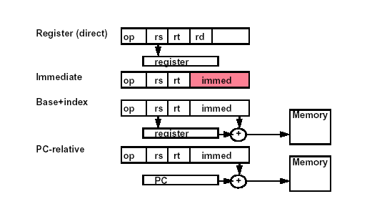
MIPS Addressing Modes

Slide 16
Load and Store
Load and store instructions
Example:
C code: A[12] = h + A[8];
MIPS code: lw $t0, 32($s3)
add $t0, $s2, $t0
sw $t0, 48($s3)
Can refer to registers by name (e.g., $s2, $t2) instead of number
Store word has destination last
Remember arithmetic operands are registers, not memory!
Can’t write: add 48($s3), $s2, 32($s3)

Slide 17
An Example
MIPS
— loading words but addressing bytes
— arithmetic on registers only
Instruction Meaning
add $s1, $s2, $s3 $s1 = $s2 + $s3
sub $s1, $s2, $s3 $s1 = $s2 – $s3
lw $s1, 100($s2) $s1 = memory[$s2+100]
sw $s1, 100($s2) Memory[$s2+100] = $s1

Slide 18

An Example
swap(int v[], int k);
{ int temp;
temp = v[k]
v[k] = v[k+1];
v[k+1] = temp;
}
swap:
muli $2, $5, 4
add $2, $4, $2
lw $15, 0($2)
lw $16, 4($2)
sw $16, 0($2)
sw $15, 4($2)
jr $31

Slide 19
Machine Language
Instructions, like registers and words of data, are also 32 bits long
  Example: add $t1, $s1, $s2
  registers have numbers, $t1=8, $s1=17, $s2=18
Instruction Format:
000000 10001 10010 01000 00000 100000
op rs rt rd shamt funct

Slide 20
Machine Language
Consider the load-word and store-word instructions,
  What would the regularity principle have us do?
  New principle: Good design demands a compromise
Introduce a new type of instruction format
  I-type for data transfer instructions
  other format was R-type for register
Example: lw $t0, 32($s2)
35 18 9 32
op rs rt 16 bit number

Slide 21
Control Instructions
Decision making instructions
  alter the control flow,
  i.e., change the "next" instruction to be executed
MIPS conditional branch instructions:
bne $t0, $t1, Label
beq $t0, $t1, Label
Example: if (i==j) h = i + j;
bne $s0, $s1, Label
add $s3, $s0, $s1
Label: ....

Slide 22
Control Instructions
MIPS unconditional branch instructions:
j label
Example:
if (i!=j) beq $s4, $s5, Lab1
h=i+j; add $s3, $s4, $s5
else j Lab2
h=i-j; Lab1: sub $s3, $s4, $s5
Lab2: ...
Can you build a simple for loop?

Slide 23
Remainder
Instruction Meaning
add $s1,$s2,$s3 $s1 = $s2 + $s3
sub $s1,$s2,$s3 $s1 = $s2 – $s3
lw $s1,100($s2) $s1 = Memory[$s2+100]
sw $s1,100($s2) Memory[$s2+100] = $s1
bne $s4,$s5,L Next instr.is at Label if $s4 ≠ $s5
beq $s4,$s5,L Next instr.is at Label if $s4 = $s5
j Label Next instr.is at Label
Formats:
op rs rt rd shamt funct
op rs rt 16 bit address
op 26 bit address

Slide 24
Control Flow
We have: beq, bne, what about Branch-if-then-else?
New instruction:
if $s1 < $s2 then
$t0 = 1
slt $t0, $s1, $s2 else
$t0 = 0
Can use this instruction to build "blt $s1, $s2, Label"
— can now build general control structures
Note that the assembler needs a register to do this,
— there are policy of use conventions for registers

Slide 25
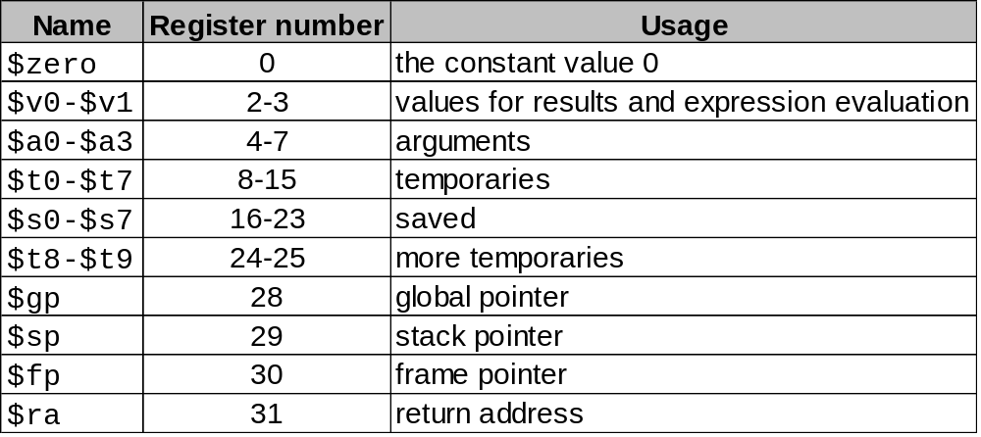
Use Conventions
Register 1 ($at) reserved for assembler, 26-27 for operating system

Slide 26
Constants
Small constants are used quite frequently (50% of operands)
e.g., A = A + 5;
B = B + 1;
C = C - 18;
Solutions? Why not?
  put 'typical constants' in memory and load them.
  create hard-wired registers (like $zero) for constants like one.
MIPS Instructions:
addi $29, $29, 4
slti $8, $18, 10
andi $29, $29, 6
ori $29, $29, 4
Design Principle: Make the common case fast. Which format?

Slide 27
How about larger constants?
We'd like to be able to load a 32 bit constant into a register
Must use two instructions, new "load upper immediate" instruction
lui $t0, 1010101010101010
Then must get the lower order bits right, i.e.,
ori $t0, $t0, 1010101010101010
filled with zeros
1010101010101010
0000000000000000
1010101010101010
0000000000000000
1010101010101010
1010101010101010
1010101010101010

Slide 28
Assembly Language vs. Machine Language
Assembly provides convenient symbolic representation
  much easier than writing down numbers
  e.g., destination first
Machine language is the underlying reality
  e.g., destination is no longer first
Assembly can provide 'pseudoinstructions'
  e.g., “move $t0, $t1” exists only in Assembly
  would be implemented using “add $t0,$t1,$zero”
When considering performance you should count real instructions

Slide 29
Overview of MIPS
simple instructions all 32 bits wide
very structured, no unnecessary baggage
only three instruction formats
rely on compiler to achieve performance
— what are the compiler's goals?
help compiler where we can
op rs rt rd shamt funct
R
I
J
op rs rt 16 bit address
op 26 bit address

Slide 30
Addresses in Branches and Jumps
Instructions:
  bne $t4,$t5,Label Next instruction is at Label if $t4 ≠$t5
  beq $t4,$t5,Label Next instruction is at Label if $t4 =$t5
  j Label Next instruction is at Label
Formats:
Addresses are not 32 bits
op rs rt 16 bit address
I
J
op 26 bit address

Slide 31
Addresses in Branches
Instructions:
  bne $t4,$t5,Label Next instruction is at Label if $t4≠$t5
  beq $t4,$t5,Label Next instruction is at Label if $t4=$t5
Formats:
Could specify a register (like lw and sw) and add it to address
  use Instruction Address Register (PC = program counter)
  most branches are local (principle of locality)
Jump instructions just use high order bits of PC
  address boundaries of 256 MB
op rs rt 16 bit address

