Slide 1

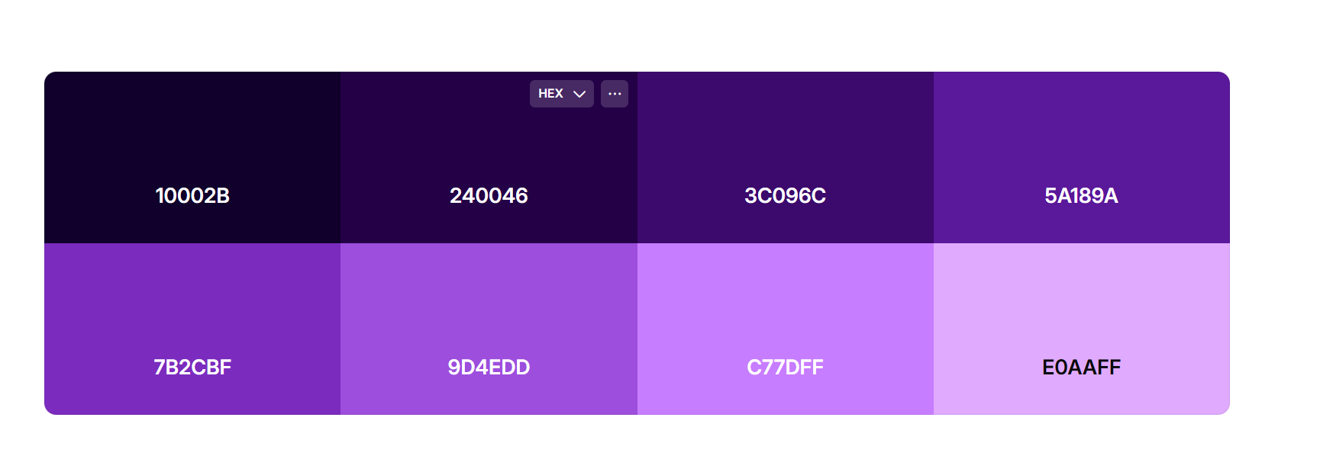

Slide 2
Healthcare Analytics Dashboard
Monitoring patient admissions, billing, and clinical insights.

Slide 3
Healthcare Analytics Dashboard
Monitoring patient admissions, billing, and clinical insights.

