Slide 1
Collaborative Translation Efforts (CTE） Trial Report
Feb, 2019

Slide 2
Vision of CTE (Tentative, TBD)
More productive translation in “Open Source” way;
with more Openness,more Collaboration,
and much more Fun!

Slide 3
Contents
Challenges in translation (especially in OSS resources)
Aim and approach
Trial
1st Trial : By single person.
2nd Trial : with 2 persons collaboration
Thought so far
Knowledge and feeling
Next steps

Slide 4
Challenges in translation (especially of OSS resources)
Question of “Quality”: Dilemma b/w OSS expertise and translation skills
The OSS related translation strongly requires OSS expertise such as technology and its culture. It tends to be hard even for professional translators
Meanwhile, if you have good enough undestanding about OSS, translation quality may not be good enough
Question of “Quantity”: Unscalable prcess
There exist bottlnecks for each process as in; Choose ,Prepare,Translate,Review,and Release
Choose
Prepare
Tlans-rate
Review
Release

Slide 5
Major bottlenecks though traslation procecess
Management, Visualize
C
B
Project A
We focus on these processes here
Choose
Prepare
Translate
Review
Release
1. Single main translator must translate all
->It takes time depending on time and skill available for the translator
->Besides , quality also depends on his/her skil
and the quality affects review prcess quality
2. Sequential reviews
-> Review is done one by one sequentially and
it takes time
-> Besides, you often have to do “review of
review” it also takes time
-> e-mail base communications also take time
(and need your brain/emotional power)
3. Release
-> Workload is concentrated on
a few people who have
DTP or documention skills ,
This suspends or delays
pubulishing.

Slide 6
Aim and approach
Aim: Focusing on “Question of Quantity” (1 and 2 in the previous page), create virtuous cycle to “Question of Quality”
To be “prolific”, above all
Invigorate peer review, make it more fun
The more collaborators gather, the more prolific (and scalable)
Approach: Automation of Translation prcess and Review in realtime using tools
Tool 1: Google Machine Translation -> Shorten the time in Translation prcess, and Focus on Review process
Tool 2: Hackmd -> Simultaneous, realtime review (Edit markdown contents )
Toolrea 3: Slack -> Simultaneous, realtime review (Communication)
Evaluation indicators：
1. Progress rate | 2. Efficiency
Words /day | Minuites/(person*word)
Bigger, better | Smaller,better

Slide 7
Aim and approach (Cont’d)
Current processes
Reviewer A
Reviewer B
Reviewer C
Main Translator
Preparation
Translation
Sequencial Review
Re-lease
Weeks/Months
Weeks/Months
CTE approach
Reviewer A, B, C
Preparation
(None in some case )
Translation
（Machine)
Simultaneous Review
(Realtime)
Re-lease
(GOTO Next Project)
Seconds/Minuites
Weeks

Slide 8
Trials: Basic policy
Measure and record time in your activity
-> This is an important factor for evaluation indicators -> NOT necessary to be so accurate
Online cross reviews should be done periodically , in short time
-> Eliminate the time you think hard on your own.
-> Do not disucss for long time. Let’s make reviews more casual -> Abstract and manage ToDo list
Online review should be done via Chat tool -> Chat is more casual for many. We need more collaborators!
Above all, make it fun!
-> Enjoy original contents (Author’s idea, thought )
-> Enjoy interaction ( Off topic is also important sometime)
-> Enjoy progress (We are coming to the goal!)

Slide 9
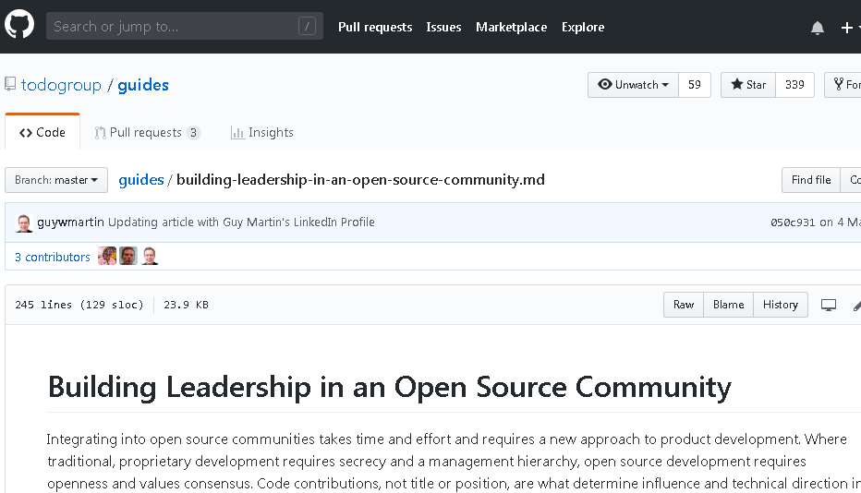
1st Trial (by 1 person)
Objective : Measure and evaluate how much single person takes
Target Resource：
TODO Group ”Building Leadership in an Open Source Community”
Approx.3600 words (24,000 letters)
# of person：1 (Taniguchi)
Started: 28th Oct, 2018

Slide 10
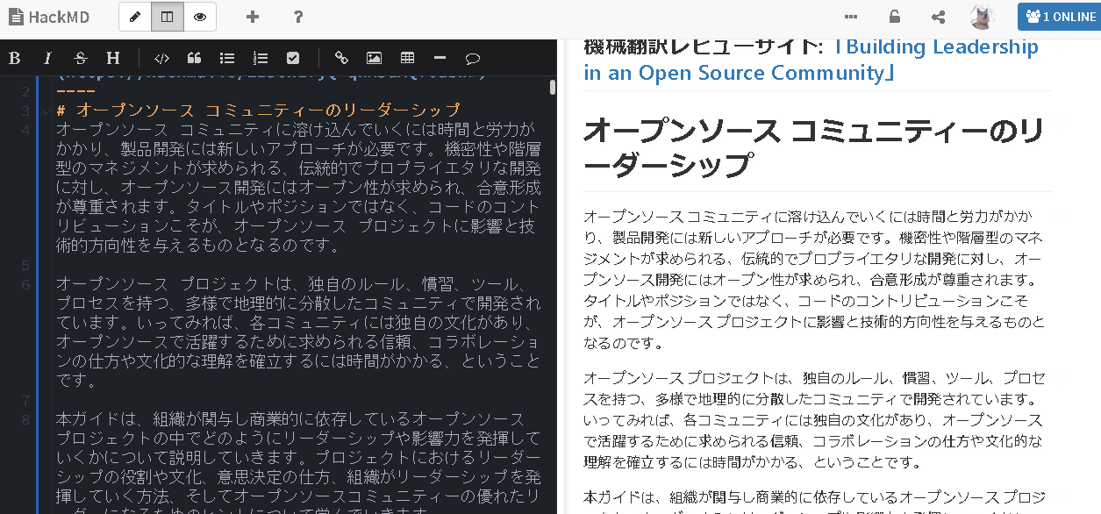
1st Trial (by 1 person): Work in progress
Edit pane(markdown)
*Paste machine translation output here at first
View pane

Slide 11
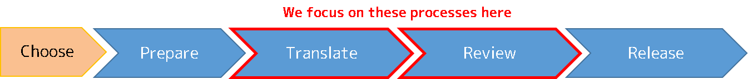
1st Trial (by 1 person): Result
Outout: “オープンソース コミュニティのリーダーシップ” https://hackmd.io/aibsz3_JTqStRbyTdVO7rA
Duration: 32days (28th Oct, 2018- 26th Nov, 2018)
Translation：Google Machine Translation -> 30 min. (manual work a little)
Review -> 870 min. (14.5h)
Review (correction by tool) -> 30 min.
Release (Image linking ) -> 30 min.
Sum 960 min. (16h)
Evaluation:
1. Progress rate ：112.5 words/day (3600 words/ 32days）
2. Efficiency (Translation + Review) ：0.26 min/(person*word) (930min/1 person/3600 words＝0.26)
Note: Evalutation scores become worse because review must be done more than 1 person essentially

Slide 12
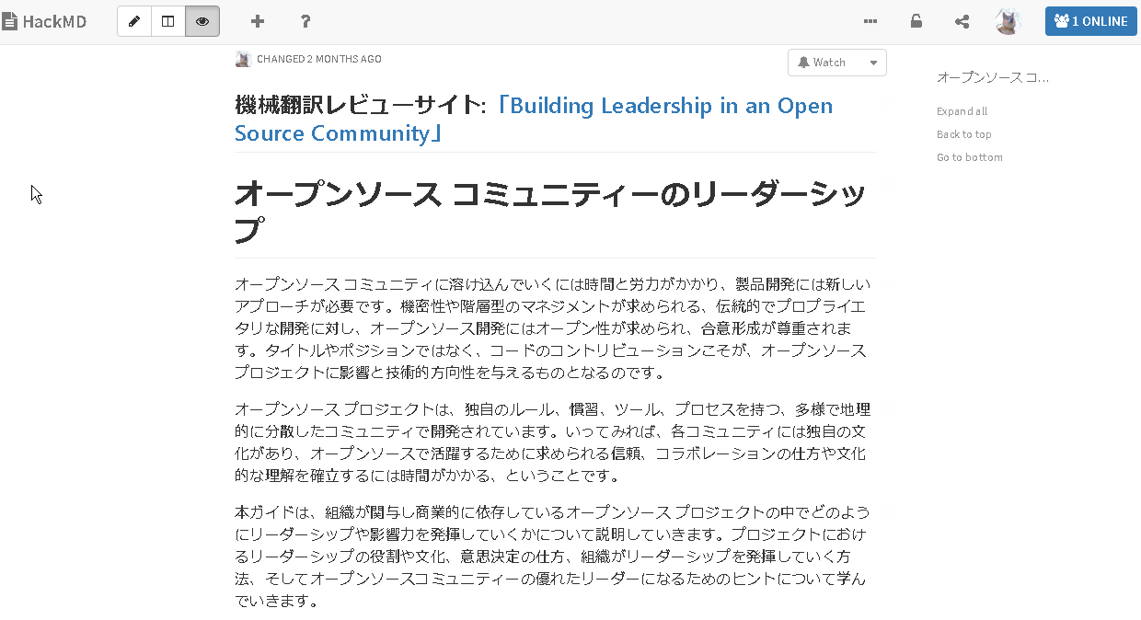
1st Trial (by 1 person): Result(Outcome)
https://hackmd.io/zgthoZZcTl-s3JXAg1pgkw?view

Slide 13
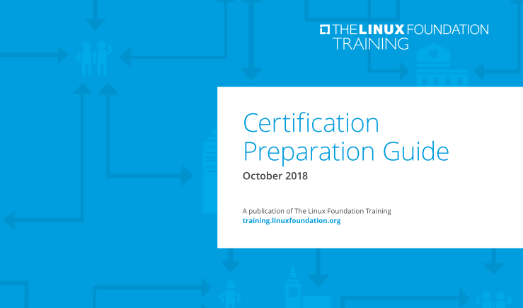
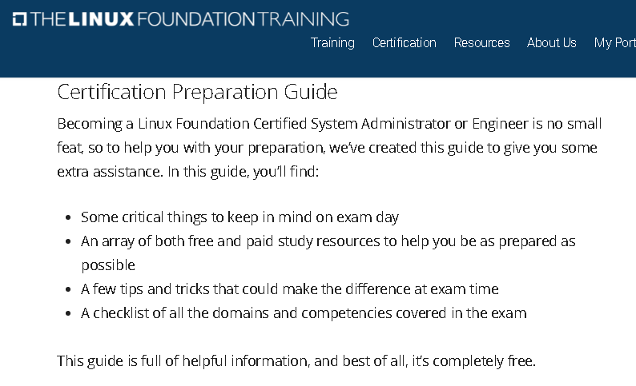
2nd Trial (2 persons)
Obejective: Evaluate effectiveness by 2 collaborators
Target resources:
LF「 Certification Preparation Guide 」
(１) DL site with introduction (104 words, 591letters)
(２) PDF Slide (w/ 21 slides, 4,212 words, 27,799 lettes）
# of person:２(Mieko-san and Taniguchi) ※Besides that, Inou-san from NEC Solution Innovator joined and did technical check as an engineer
Started : 27th Dec 2018
DL site
PDF slide

Slide 14
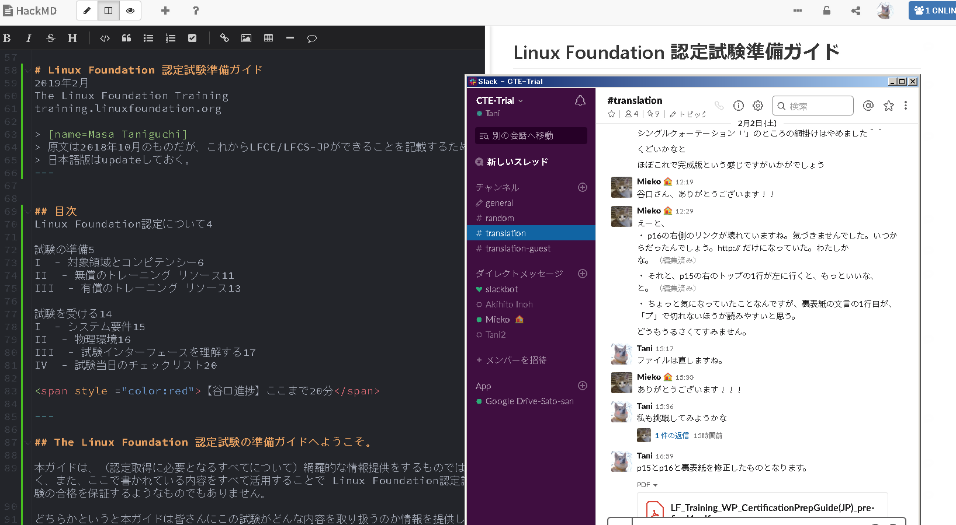
2nd Trial ( 2 persons) Work in progres
Realtime multi-user editing on Hackmd
Chat on Slack

Slide 15
2nd Trial (2 person): Result
Output: “Linux Foundation 認定試験ガイド” (１) DL site https://hackmd.io/LCiwQGyfQKysQBVQDj61kw (２) PDF Slide https://github.com/maabou512/CertPrepGuide
Duratiom：
(１) Half a day (27th Dec 2018 - 27th Dec 2018)
Translation: Google Machine Translation -> 5 min.
Review -> 45 min.
Sum 50 min.
（２）32 days (28th Dec, 2018 – 28th Jan, 2019( Incl. Release process by InDesign DTP)
Translation: Google Machine Tranlsation -> 30 min. (mainly Copy and Paste)
Review ( Self review) -> 1140 min. (19h：609min for Taniguchi), 540 min for Mieko-san）
Review ( Online cross-review) -> 550 min.（5 times)
Release (DTP by InDesign) -> 420 min.
Sum 2140 min. (35h)
# of ToDo in online review: approx. 20 (closed all)

Slide 16
2nd Trial (2 persons) :Result(cont’d)
Evaluation
(1) DL site
Progress rate : 240 words / day (104 words/0.5 day)
Efficiency (Translation + Review) : 0.24 min /(person*word) (50 min/2 persons /104 words=0.24)
(2) PDF Slide
Progress rate ：131 words / day (4,212 words/32days* ）
Efficiency (Translation + Review) ：0.20 min. / (person*word) (1,720 min/2 persons/4,212 words＝0.20 * ）
* Note: Acutually , above scores includes “Release” activity , so scores must be (much) better

Slide 17
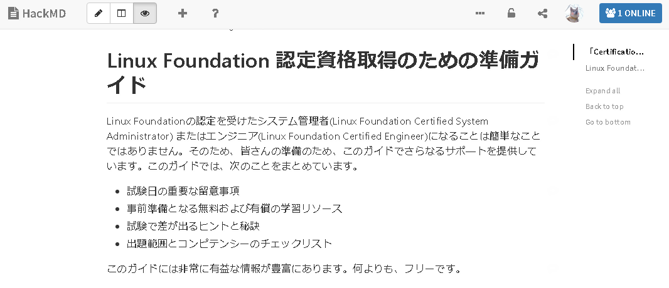


2nd Trial: Result (Outcome)
DL site introduction
PDF Slide (Prep Guide)

Slide 18
Trials Round-up
 | 1st Trial | 2nd Trial (1) | 2nd Trial (2)
# of Person | 1人 | 2人 | 2人
Words | 3,600 | 104 | 4,212
Translation time [min.] (Machine Translation | 30 | ５ | 30
Review time [min.] | 960 | 45 | 1690
Result 1. Progress rate [words/day](bigger better) | 113^{*1} | 240^{*2} | 131^{*2}
Result 2. Efficiency [min./(person*word)] (smaller better) | 0.26^{*1} | 0.24^{*2} | 0.20^{*2}
Special notes | - | - | Abstracted approx.20 ToDos (All closed)
*１: Evalutation scores become worse because review must be done more than 1 person essentially
*２: Acutually , above scores includes “Release” activity , so scores must be (much) better

Slide 19
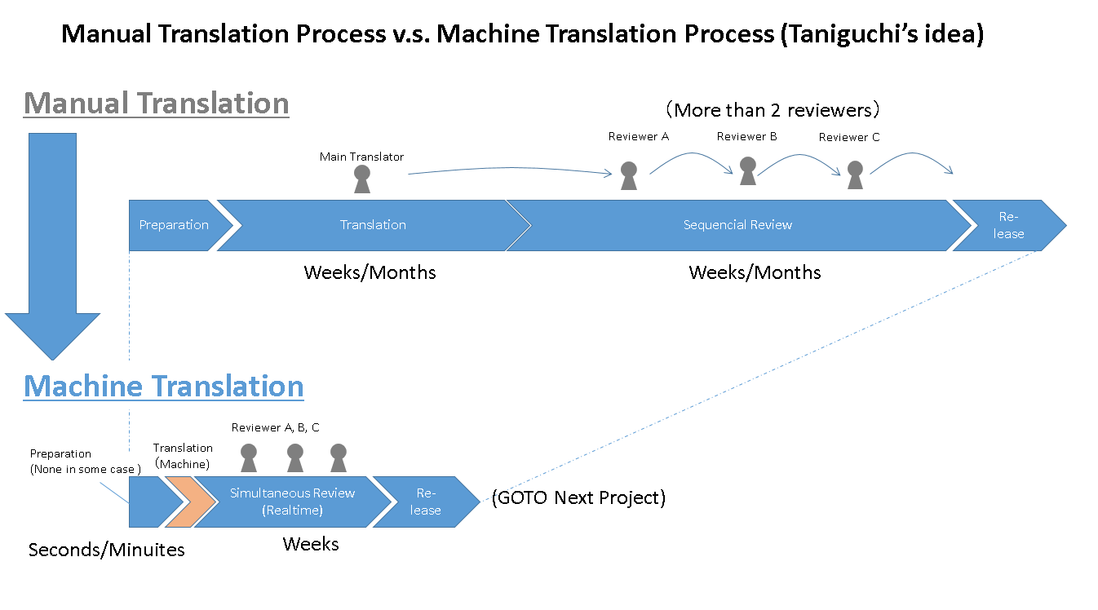
Thoughts (so far)
This approach ( Machine Translation + Realtime cross review) has possibility about;
Shorter leadtime (Observed 1 -> 2 person)
More efficiency (ditto)
And Quality improvement ( More issues and ToDos can be abstracted and tackled on accurately)
So, it can be exected that the more we collaborate, the better translation in terms of quickness, efficiency, and quality.
The diagram we intended in P7 (see right) is not comparable directly, but it can be effective indirectly.

Slide 20
Knowledge and Comments
[About processes]
Ease of review. We don’t need to take “who translate this?” in consideration. Machines did it, you don’t care of who did.
Review process can be broken down like below (just idea basis)
Choose
Prepare
Translate
Review
Release
Contents review ( Self and cross review)
TODO management
Output definition
(File format, etc)
Assign
Define
Words
Cosmetic
issues

Slide 21
Knowledge and Comments
[Google machine translation]
Very interesting tlanslation experience. ( e.g . Same original sentences not always to be translated into same translation/It does mistake, but not like human )
Basically , Quality is very low, 99% of its output must be modified ultimately.
Characteristics of Machine Translation
1. Context is not understood semantically, so sometimes it can be even unreadable
2. Subjects are mistaken or missing sometimes
3. “De-Aru” and “ Desu-Masu” style often mixd
4. Very weak about “metaphor”
5. Expressions are not coherent though a material
6. Errors human beings never do

Slide 22
Next steps ( Incl. Issues)
Improve processes -> 3rd Trial ? What if 3 – 4 persons?
Shorten leadtime (Plan in advance and book members’ schedules)
More efficient（Automate progress measurement, etc.)
Quality improvement (Create Check list, and so on)
And above all , much more fun!
Improve tools
Hackmd -> Enhance evaluation indicator (Work time measurement) , Chat addon, Response improvement (Cloning Tokyo region), etc.
Slack etc. -> Function for ease of ToDo mgmt.
Indesign -> Realtime design check (not supported so far)
How to improve Machine Translation’s quality?
We “teach” good translation in OSS domain.
Can we have so-called “Reinforcement Learning” process?

Slide 23
Other Resources
「 Collaborative Translation Effort（CTE）2nd Trial Spec (Japanese)」
https://hackmd.io/xhHAQBZcTmmgEGRNgrzNhQ
→Motivation and background about this trial and how to do it

