Slide 1

Presentation
By
Somalla Suresh [B.Tech & M.tech IIT Kharagpur]
Head of IIC, KG Reddy College, HYD
sureshsomalla@gmail.com, 8967224533

Slide 2
AIM:
To control the GUN CONTROLLER [TPD K1] of T-72 Tank through Telecommunication.

Slide 3
STEP 1: Examining the GUN CONTROLLER and drawing 2D sketches of the GUN CONTROLLER

Slide 4
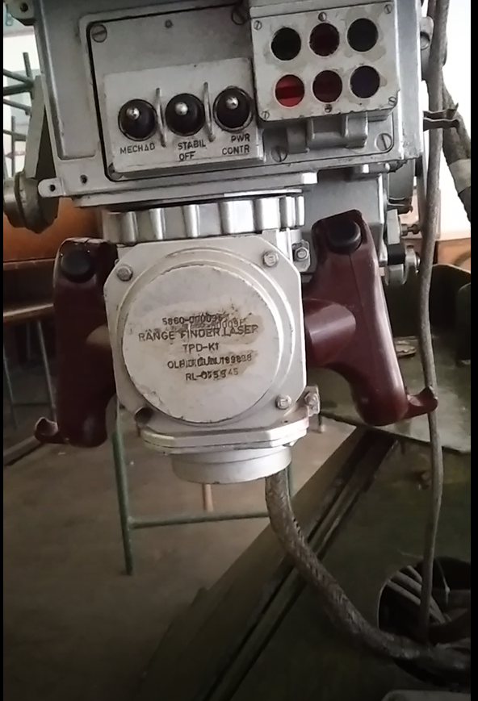
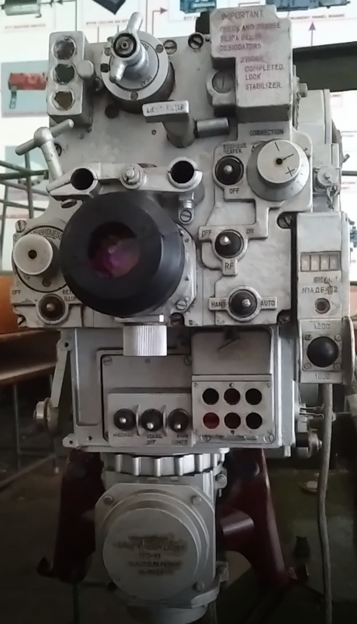
Gun controller
Actual photo

Slide 5
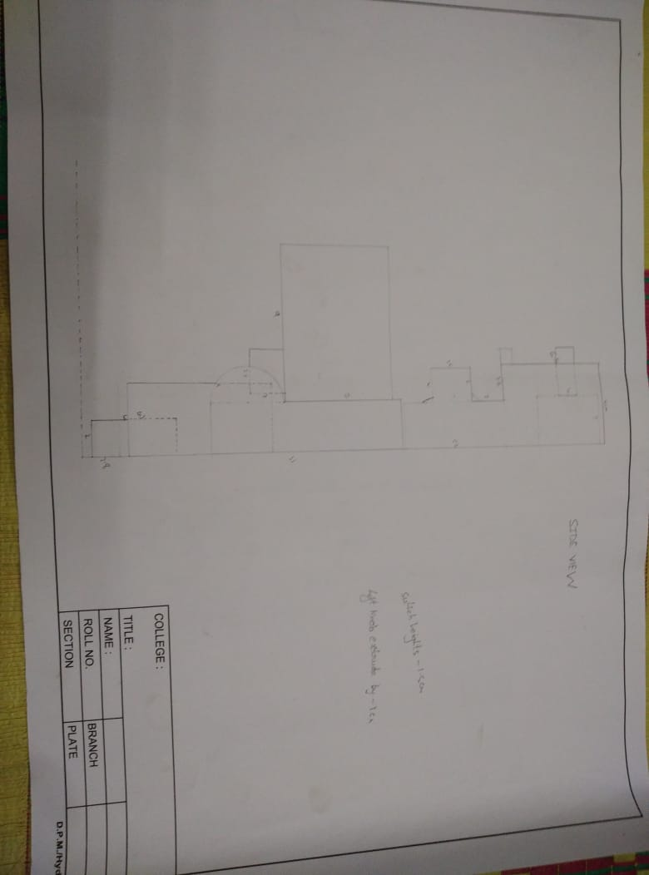
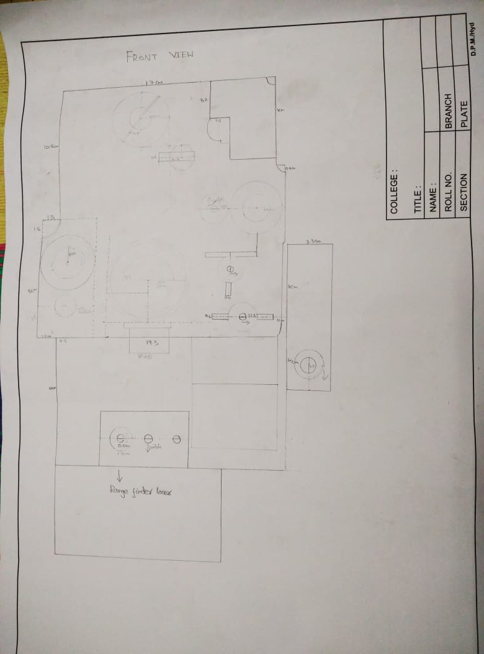
2D -Drawings

Slide 6
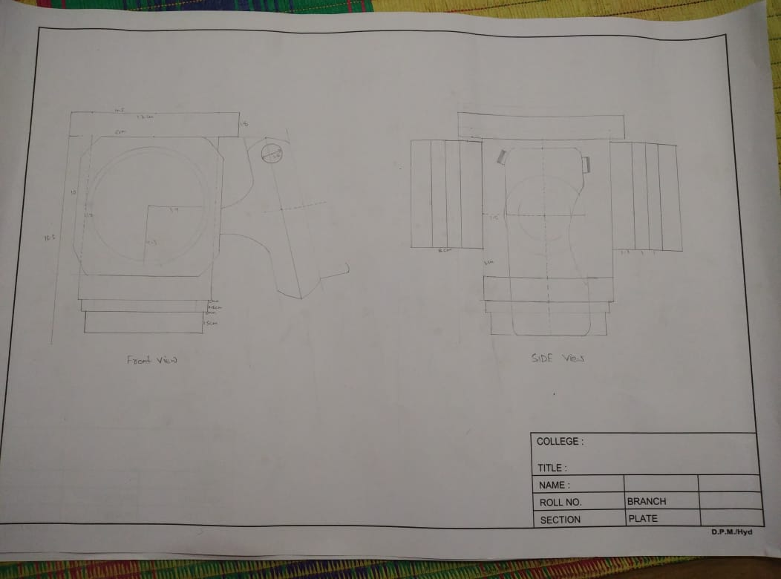
2D-Drawing
Control Handle

Slide 7
STEP 2:
CONVERSION OF 2D IMAGE INTO 3D MODEL USING
SOLIDWORKS(3D DESIGNING SOFTWARE)

Slide 8
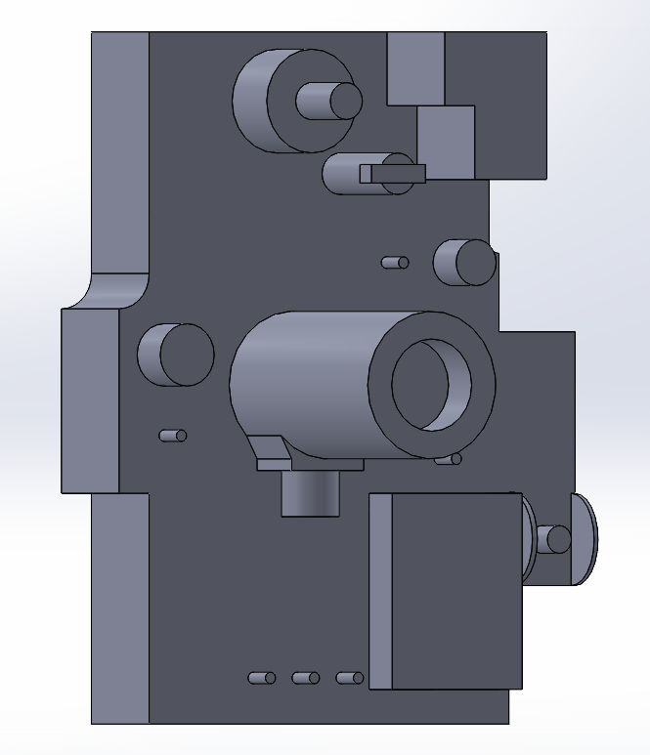
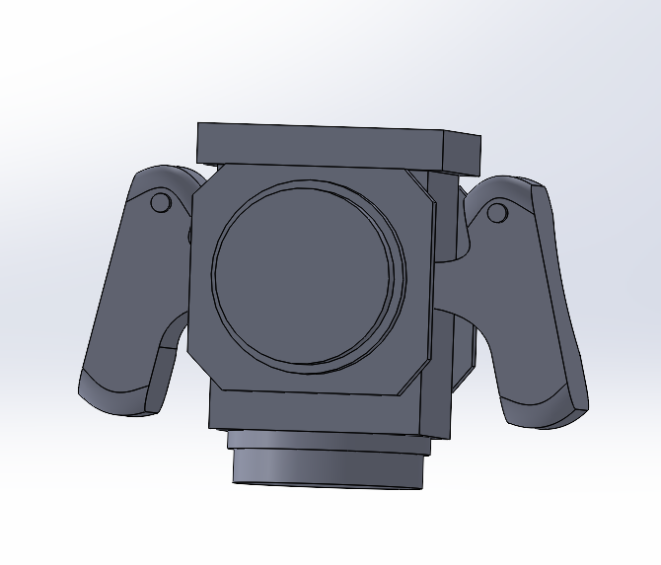
3D VIEW

Slide 9
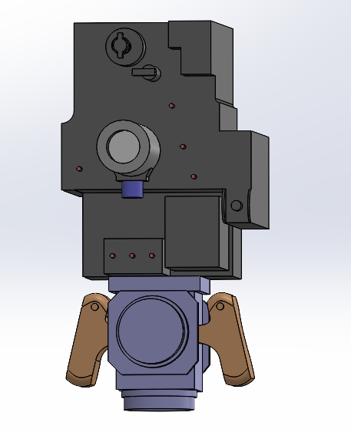
3D GUN CONTROLLER:
LENS
SWITCH
KNOB
CONTROL HANDLE

Slide 10
IDEA:
GUN CONTROLLER mainly consists of 7 switches and 3 knobs to be controlled and one control handle.
Our solution is to control the SWITCHES with the PUSHPULL SOLENOIDs and the KNOBS with the MOTORS which run through the received signals from the transmitter.
(From a farther distance, the transmitter sends the signals based on the soldiers operation of the GUN CONTROLLER )

Slide 11
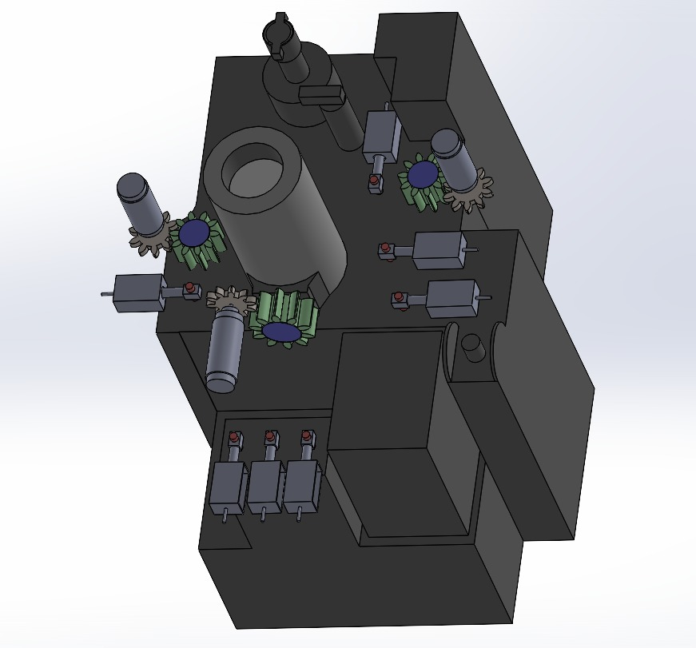
3D View
MOTOR
GEARS
(movement tranmitters)
PUSHPULL SOLENOID

Slide 12
Mechanical Design:
The MOTORS and PUSHPULL SOLENOIDS, which control the KNOBS and SWITCHES respectively, are to be held intact with the GUN CONTROLLER.
Therefore, a PANEL is designed to hold the motors and pushpull solenoids with the GUN CONTROLLER.

Slide 13
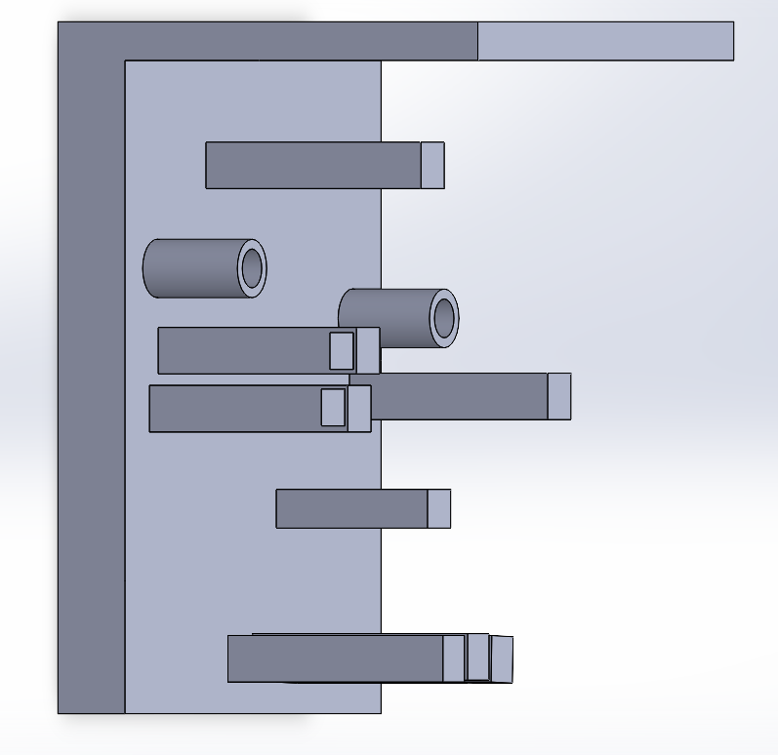
3D VIEW of PANEL

Slide 14
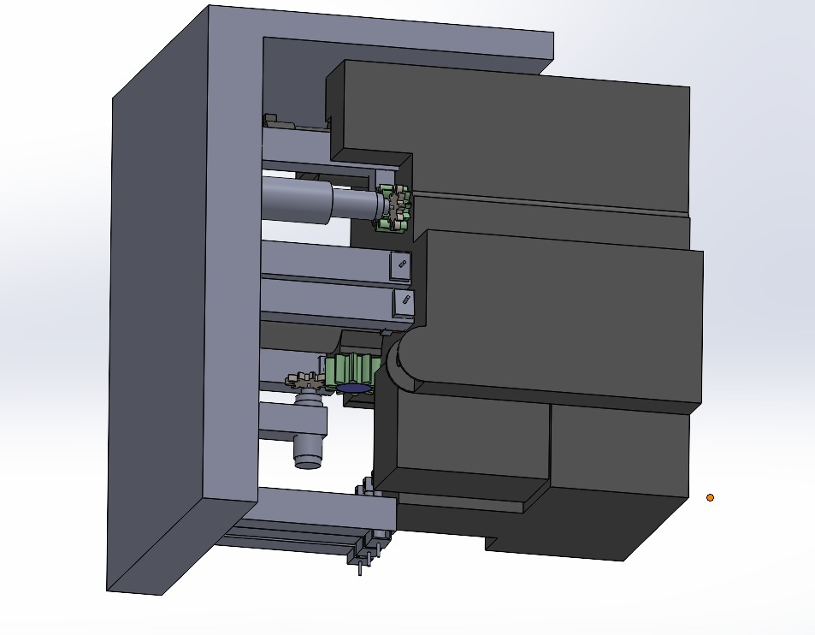
3D view with PANEL:
.

Slide 15
List of parts
Spur/helical gears
DC-motors
Push pull solenoid switches
Rod end ball joint
Acrylic panel
3D printer for prototyping

Slide 16
Electronics Part
Simulations and Prototype Testing:
KiCAD Software for developing the electronic circuit and simulations
For prototyping low range antennas will be use

Slide 17
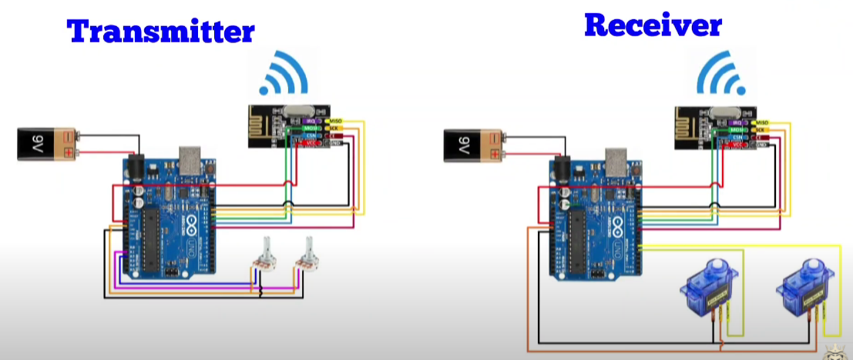
CIRCUIT (Representation):
SOLDIER’S OPERATION UNIT:
T-72 TANKER
LONG DISTANCE

Slide 18
Thank You

