Slide 1

Imagine you’re 15 years old, autistic, and someone asks you, 'What did you do this weekend?’
A simple question that isn’t simple at all for autistic youth because they might struggle with:
Finding the right words
Knowing what to say
Managing speech clarity under pressure
That's the problem ConvoBridge solves."
Notes:
Image source: Microsoft 365 content library
Many organizations struggle with fragmented communication across teams and platforms. This results in delays, misunderstandings, and decreased productivity. The Convobridge project aims to address these challenges by providing a unified solution to streamline and enhance internal collaboration.

Slide 2
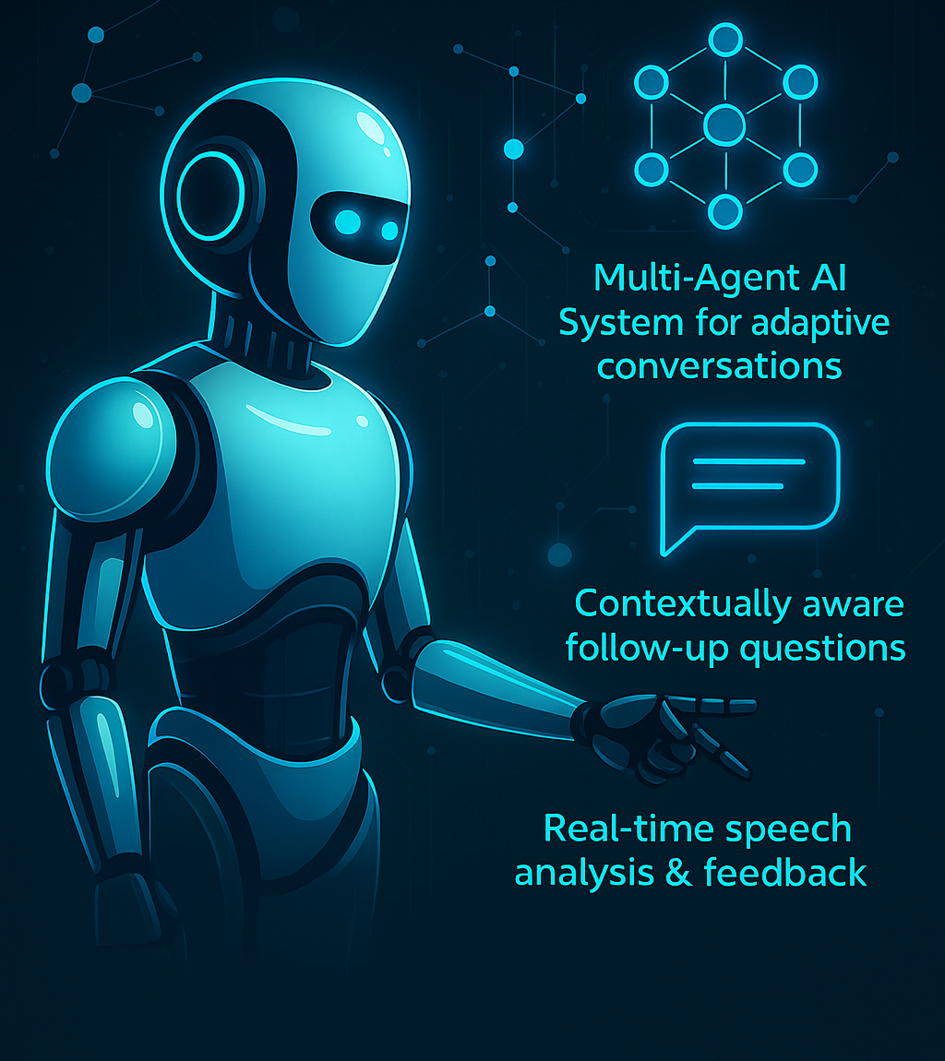
ConvoBridge
AI-Powered Conversation Practice System for Autistic Youth
By Madhavi Nithianandam
Notes:
Image source: Microsoft 365 content library
Many organizations struggle with fragmented communication across teams and platforms. This results in delays, misunderstandings, and decreased productivity. The Convobridge project aims to address these challenges by providing a unified solution to streamline and enhance internal collaboration.

Slide 3
ConvoBridge
The Solution
ConvoBridge is a safe space where teens practice real conversations –
choosing topics,
learning responses, and
building vocabulary.
All Powered by LLMs and multi-agent orchestration.
Notes:
Image source: Microsoft 365 content library
Many organizations struggle with fragmented communication across teams and platforms. This results in delays, misunderstandings, and decreased productivity. The Convobridge project aims to address these challenges by providing a unified solution to streamline and enhance internal collaboration.

Slide 4
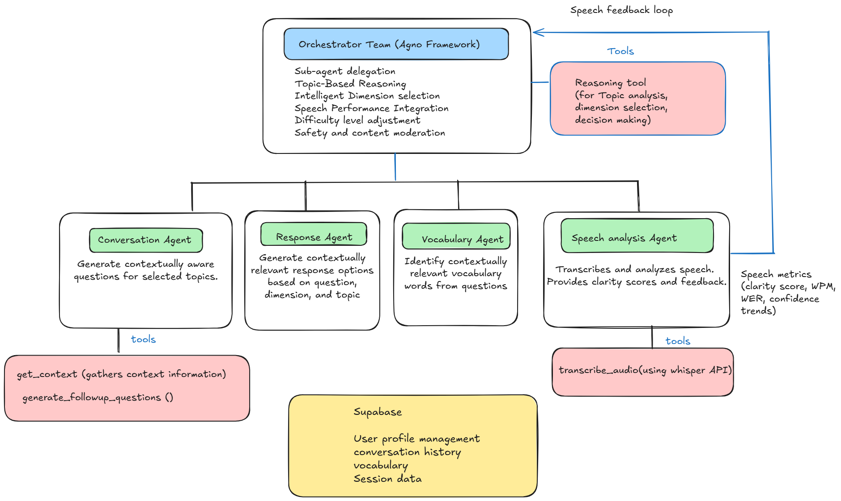
ConvoBridge
Multi-agent architecture
Notes:
Orchestrator reasons, makes decisions and delegates to sub-agents
It does things like topic analysis , deciding the conversation dimension for next turn and adjusting the sentence difficulty

