Slide 1








Smart Room
t
Educational practice
Bekarys Magauiya
SE-2017
2020-2021

Slide 2


Introduction
All automation systems are made to simplify life and this project is no exception. Also should be noted that with the help of this system it is possible to reduce energy consumption. In this project, the main goal is to make part of an automated system for a smart room.
Smart room
Lightning system
Temperature control system

Slide 3
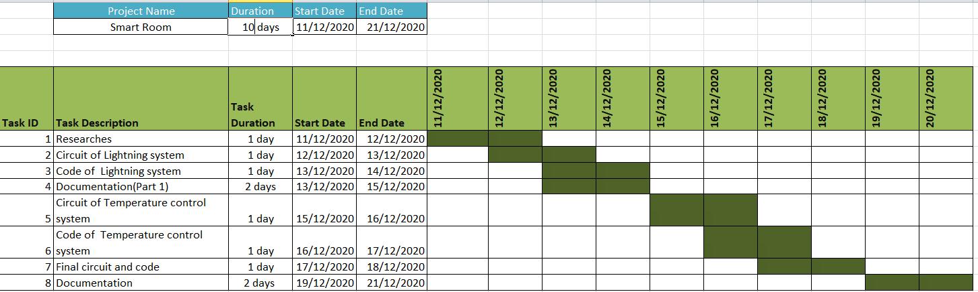
Gantt Chart

Slide 4
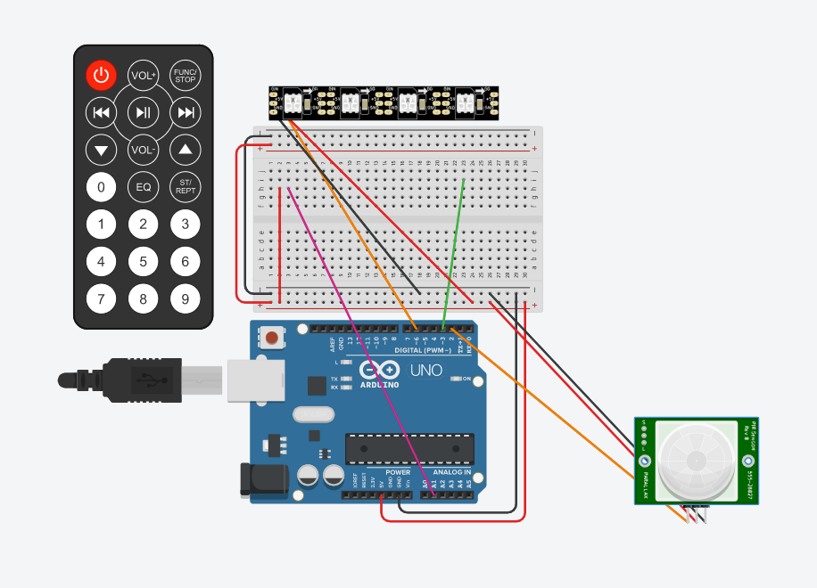
Lightning system
This system is based on the work of the "IR motion" sensor. Room lighting occurs by using addressable RGB LED strip.
When the IR motion sensor receives a signal and it sends to the microcontroller and the microcontroller turns on the LED. In this project, I choose by default colour yellow
It is possible in the program level to change the colour of the light using the hexadecimal code of colours.

Slide 5
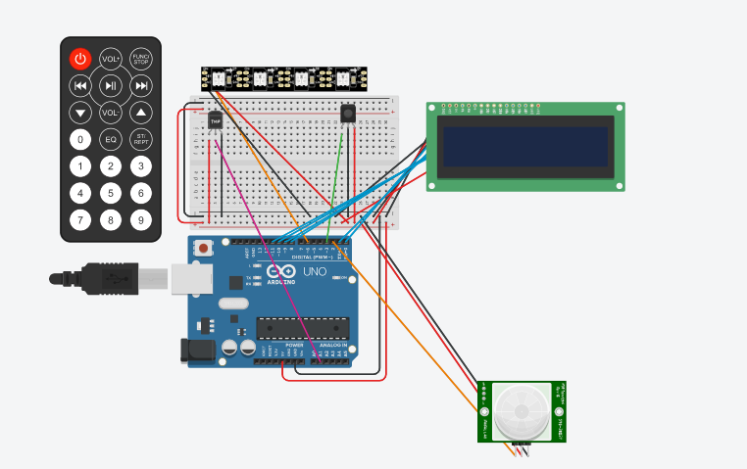
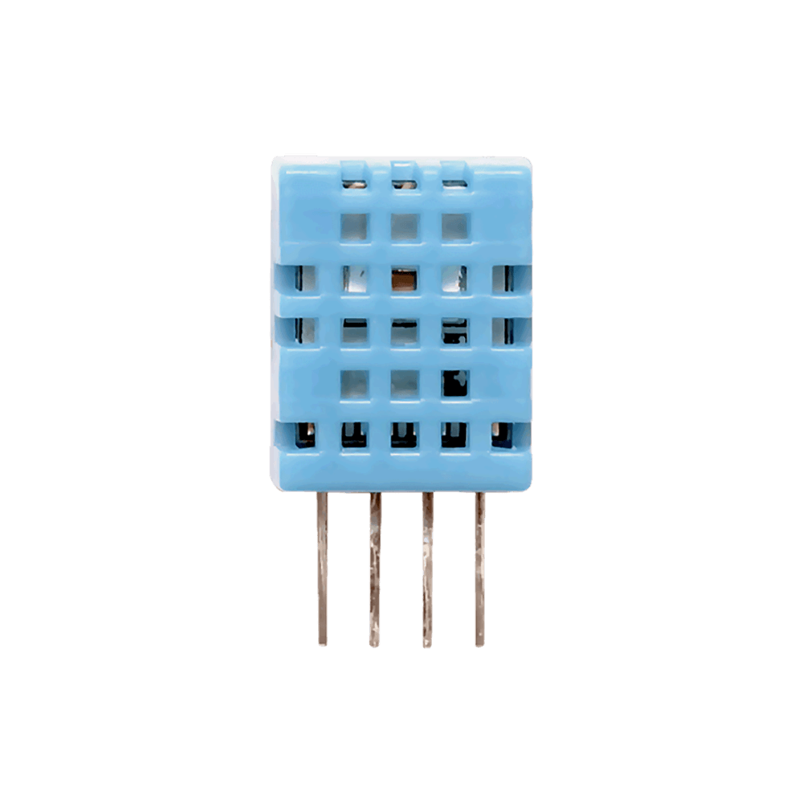
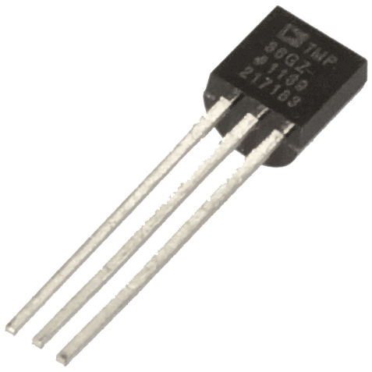
Temperature control system
The temperature control system is created to monitor the temperature inside the room. To create this system, an LCD display and a temperature sensor "TMP36" were used. A 16x2 LCD display was used in the project.
VS
If the temperature is below 20
If the temperature is above 20

Slide 6
Корм в mini гранулах для молоди и мелких рыб «Mini Granules» (100 мл)
Conclusion

Slide 7
Thanks for your attention

