Slide 1


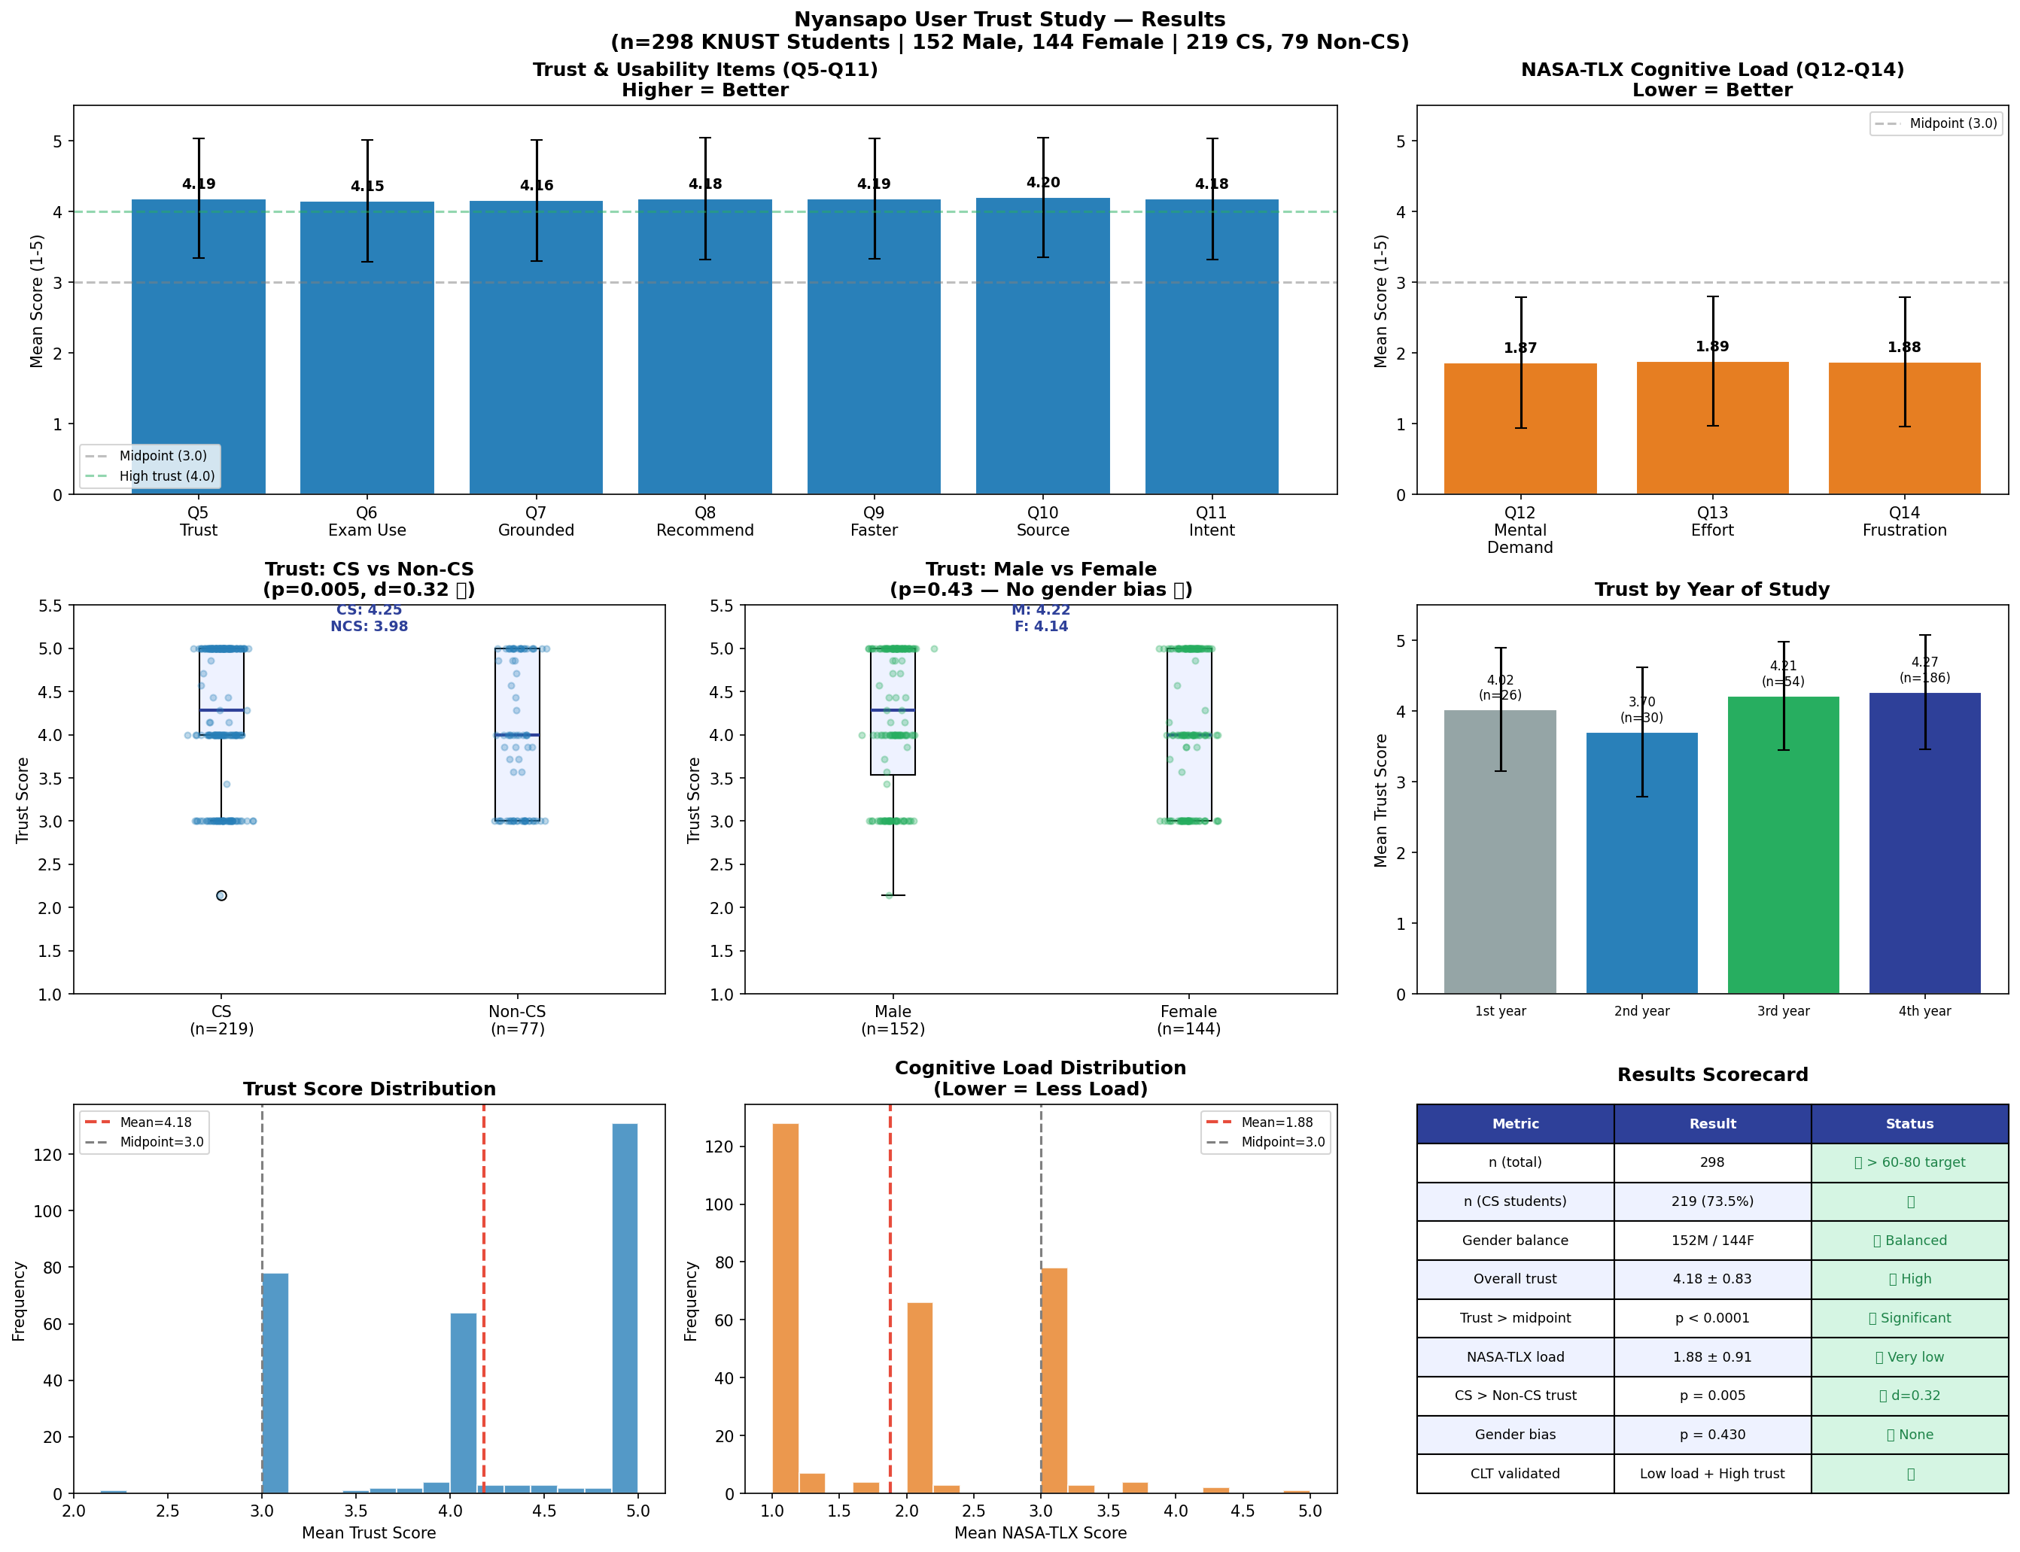
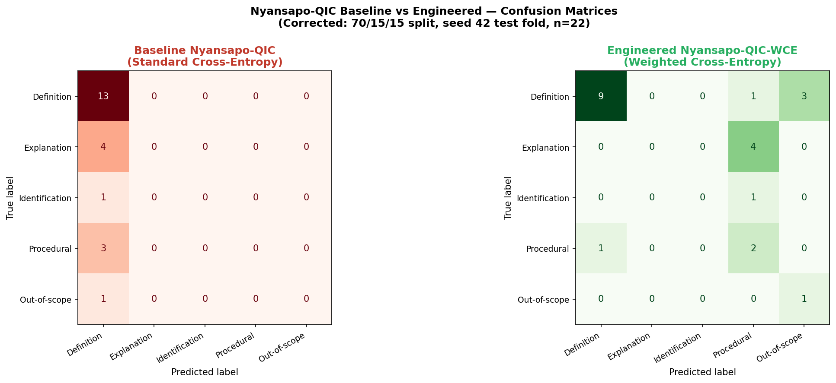
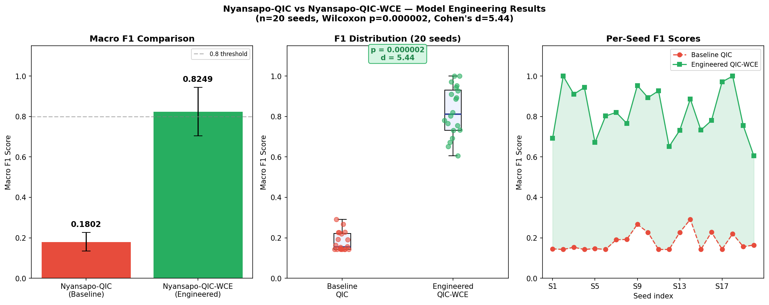
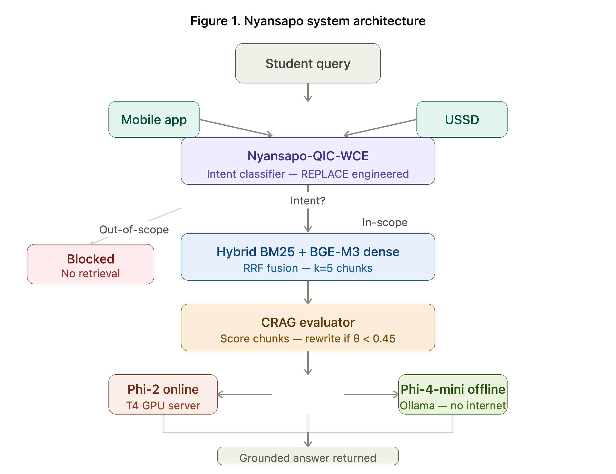

Nyansapo
NYANSAPO
A Cost-Weighted Intent-Classified Corrective RAG System for Hallucination Reduction in a Ghanaian University Environment
CORRECTIVE-RAG TUTORING SYSTEM
Agyei Michael Addai · Akyen Abban Maxwell · Ajuitey Prince Awonaab · Anorchie Michelle Frimpomaah · Opoku Kwaku Kelvin
Supervisor: Dr. Eric Opoku Osei | Department of Computer Science, KNUST, Ghana
TARGET: Computers & Education: AI (Elsevier, Q1)
github.com/maagyei04/Nyansapo-RAG-Research
USSD 384714# · No Internet Needed
1
Abstract
5
Key Results
6
User Trust Study
Standard LLMs deployed for student support in Ghanaian universities hallucinate — generating plausible but factually wrong answers. Nyansapo is a Corrective RAG tutor grounded in 12,311 KNUST lecture-content chunks, built around a cost-weighted intent classifier (Nyansapo-QIC-WCE) that intercepts out-of-scope queries before retrieval. It runs online (Phi-2) or fully offline (Phi-4-mini, 3.60s latency) and is reachable by mobile app, USSD (384714#), and web.
0.621
p = 0.000002
QIC-WCE Macro F1
Wilcoxon significance
vs. 0.198 baseline
Cohen's d = 2.175
3.60s
4.18 / 5.0
2
Problem Statement
Offline mean latency
Student trust score
LLMs hallucinate — plausible but false academic content
Naive RAG still hallucinates when retrieval quality is poor
No prior CRAG deployment in sub-Saharan African universities
Bandwidth-constrained campuses need offline-capable AI
Out-of-scope queries waste compute and risk hallucination
2.93× faster than online
n = 298, p < 0.0001
METRIC
RESULT
Fig. 9 — Trust study, n=298 KNUST students: high trust, very low cognitive load, no gender bias.
Improvement over baseline
+214.6%
NOVELTY — THREE WAYS TO REACH NYANSAPO
CRAG vs BM25 ROUGE-L
p = 0.000001, d = 0.396
📱
☎
🌐
Online latency (Colab T4 GPU)
10.55 s
Mobile App
USSD
Web App
Objectives
Cognitive load (NASA-TLX)
1.88 / 5.0 — very low
React Native
384714# — any phone
Browser access
3
Gender bias in trust
None (p = 0.430)
Engineer Nyansapo-QIC-WCE — replace standard cross-entropy with weighted cross-entropy for class imbalance and misrouting cost
Evaluate CRAG against Naive RAG, BM25-only, and a Vanilla LLM on 200 gold QA pairs
Measure online vs. offline latency; validate user trust with n=298 KNUST students
CRAG fairness across topics
8 / 8 CS topic areas
7
Conclusion
Nyansapo-QIC-WCE significantly beats the cross-entropy baseline (p=0.000002, d=2.175)
Hybrid RRF retrieval significantly beats BM25-only on ROUGE-L and BERTScore
Offline mode (3.60s) is 2.93× faster than online — and free
High trust (4.18/5) with very low cognitive load (1.88/5) validates the CLT framework
First RAG+USSD deployment in Ghanaian higher education
Multi-interface access (app, USSD, web) ensures equitable device access
Future work: Twi/multilingual queries, federated RAG, live USSD rollout
4
Methodology
Intent classifier: TF-IDF (d=500) + 2-layer feedforward network, weighted cross-entropy loss, 5 classes, 20 seeds, 70/15/15 split. RAG: hybrid BM25 + BGE-M3 dense retrieval, RRF fusion (k=5), CRAG evaluator (θ=0.45), Phi-2 online / Phi-4-mini offline. Knowledge base: 12,311 chunks from KNUST lecture slides & IDL transcripts. 200 gold QA pairs (Wilcoxon, Bonferroni α=0.0167).
Fig. 7 — Confusion matrices: standard cross-entropy baseline collapses to one class; QIC-WCE recovers across all five intents.
8
References
1. Yan et al. (2024). Corrective Retrieval Augmented Generation. arXiv:2401.15884
2. Lewis et al. (2020). RAG for Knowledge-Intensive NLP Tasks. NeurIPS
3. Ji et al. (2023). Survey of Hallucination in NLG. ACM Comp. Surveys
4. Chen et al. (2024). BGE M3-Embedding. arXiv:2402.03216
5. Sweller (2020). Cognitive Load Theory. ETRD
Fig. 5 — Macro-F1 across 20 seeds: engineered classifier (green) dominates the baseline (red) on every seed.
SCAN FOR CODE & PAPER
github.com/maagyei04/
Nyansapo-RAG-Research
Fig. 1 — Nyansapo architecture: dual-interface intake, hybrid retrieval, CRAG evaluation, online/offline generation.
DATASET & SCOPE
12,311
200
5
3
lecture chunks
gold QA pairs
intent classes
access interfaces
GitHub: github.com/maagyei04/Nyansapo-RAG-Research | Supervisor: Dr. Eric Opoku Osei | Dept. of Computer Science, KNUST, Ghana
Contact — Email: maagyei04@gmail.com | Phone: +233 54 119 0955 | Submitted: September 2026

