Slide 1

MENACHART HACKATHON 2026
مثبّت
زعما صحيحة؟
مثبّت
منصة التحقق الأولى بالعربي
AI-Powered Verification Suite for MENA — Arabic-First. Live Today.
ZvenDenLabs

Slide 2
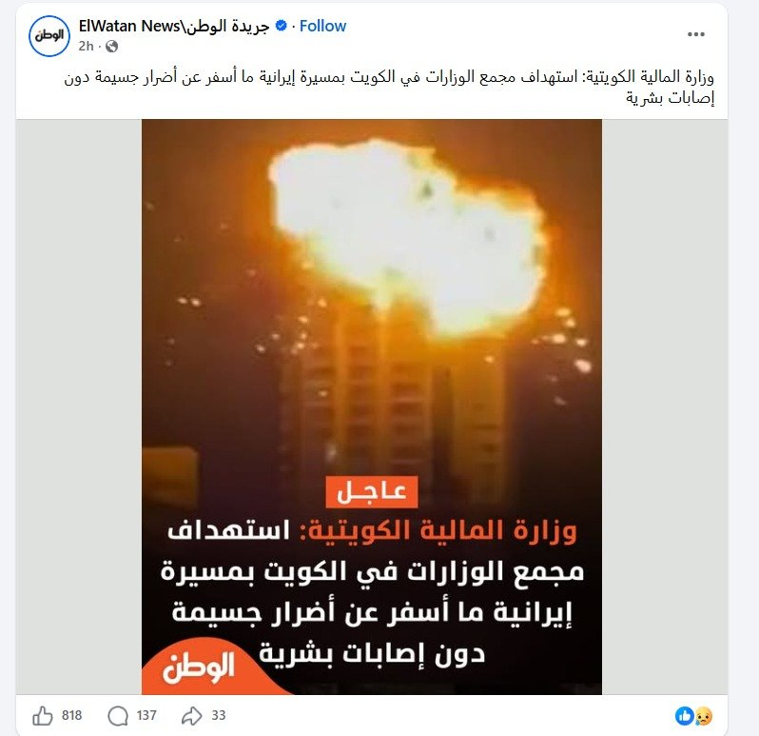
THE PROBLEM
المعلومة الكاذبة تنتشر
٦ مرات أسرع من الحقيقة
MIT Study, 2018
صور مزوّرة أو مولودة بالذكاء الاصطناعي
AI-generated images spread as real news
أخبار ملفّقة بدون مصادر موثوقة
Unverified claims circulate on WhatsApp daily
لا أداة عربية حقيقية للتحقق في الوقت الفعلي
No real-time Arabic fact-checking tool exists

Slide 3
THE GAP
كل الأدوات الموجودة فاشلة هنا
Existing fact-checkers weren't built for MENA
 | Snopes / AFP | مثبّت
Language | English only | Arabic, Derja, French
Speed | Hours / Days | Seconds
Access | You find them | WhatsApp — where you already are
MENA sources | None | Mosaique, TAP, Nawaat, Reuters AR
Dialect support | None | Tunisian Derja native
Cost to user | Free but irrelevant | Free (tools) / Premium (agent)

Slide 4



THE SOLUTION
مثبّت
4 Tools. 1 Platform. Arabic-First. Live Today.
Arabic-First
WhatsApp Native
Real-Time Agent
Derja, MSA, French
— whatever you send
No app. No login.
Where the news already is.
Thinks, searches, gives
a verdict with evidence.
Built with AI agents for research, development & orchestration — powered by Claude Sonnet, Gemini, Groq / LLaMA

Slide 5




THE PLATFORM
٤ أدوات — ٣ محاور — منصة واحدة
FREE
FREE
FREE
PREMIUM
كاشف الصور والفيديو
محقق التطابق
كاشف النص
مثبّت Agent
AI Media Detector
Consistency Checker
AI Text Detector
Fact-Checker Agent
Detects AI-generated images & videos
Checks if image matches its caption
Detects AI-generated or manipulated text
Real-time web search → verdict with sources
Google Gemini
Groq / Llama 4 Scout
Groq / LLaMA 3.3 70B
Claude Sonnet
Axis 1: Content Authenticity
Axis 2: Contextual Consistency
Axis 3: Source Credibility
Axis 3: Source Credibility + Fact-Check

Slide 6
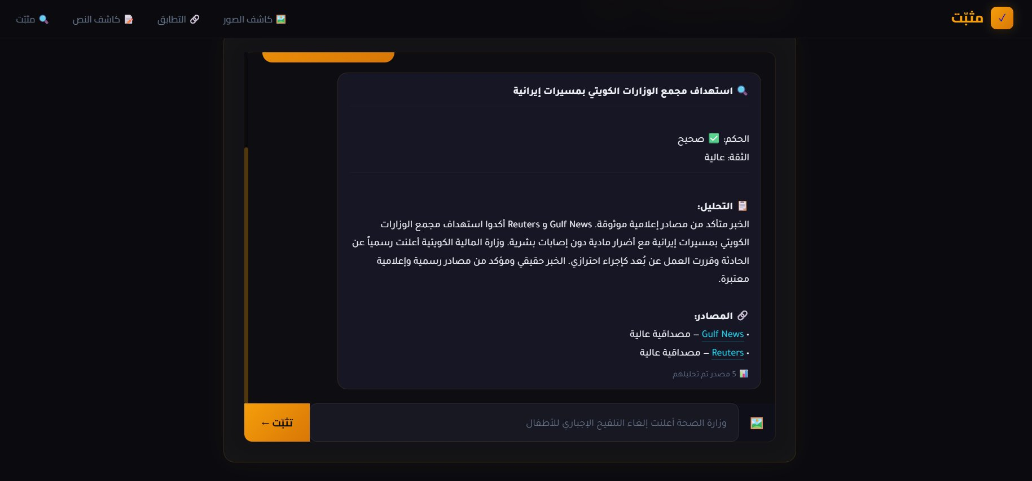
LIVE DEMO
مثبّت في العمل — وقت حقيقي
Claim submitted → Web searched → 5 sources analyzed → Verdict in seconds. Not a prototype. Live today.

Slide 7



USE CASES
من يستعمل مثبّت؟
The Everyday Citizen
المواطن العادي
Sees a viral post → sends it to مثبّت on WhatsApp → gets a verdict before sharing
Journalists & Newsrooms
الصحفيين والجرايد
Verify claims before publishing — saves hours of manual fact-checking per article
Government & Institutions
الحكومة والمؤسسات
A national fact-checking hotline — public service like emergency lines 190 / 198

Slide 8
BUSINESS MODEL
مين يدفع؟
FREEMIUM — Tools 1-3
PREMIUM — مثبّت Agent
3 Detection Tools
• No login required
• 5 checks/day per IP
• Funded via B2G grants
& institutional partnerships
B2G — Government
5,000–20,000 DT/month
HAICA, Ministry of Communication
B2B — Newsrooms
99 DT/seat — 399 DT/team
Mosaique FM, Shems FM, Inkyfada

Slide 9

TRACTION & ROADMAP
أين نحنا الآن — وين رايحين
مثبّت Agent live on WhatsApp — tested and working
Phase 1
Now
Phase 2
6 months
Phase 3
12 months
3 specialized detection tools built and deployed
All 3 problem axes fully covered
Tunisia launch
3 newsroom pilots
HAICA pilot
MENA expansion
Morocco, Algeria, Egypt
Partner: Misbar, Fatabyyano
API platform
Browser extension
Full pipeline agent
Arabic-first, Tunisian Derja-native output
Built with AI agents for research, dev & orchestration

Slide 10
مثبّت
THE ASK
نحتاجوا دعمكم
Infrastructure Support
Hosting & API cost coverage to scale beyond hackathon
Government Introductions
HAICA, Ministry of Communication — for the pilot program
Media Partnerships
Mosaique FM, Shems FM, Inkyfada — verify before you publish
التقنية جاهزة. هاذا مش prototype. هاذا شغال دروك.

