Slide 1
Style Transfer of Audio Effects
Mahya Khazaei

Slide 2
AGENDA
What is Style Transfer of Audio Effects?​
What is Differentiable Signal Processing?
​Implementation details
Results
​Summary​

Slide 3
What is Style Transfer of Audio Effects?​
Style transfer of audio effects is a process of imposing the audio effects and production style from one recording to another by example with the goal of simplifying the audio production process. This is achieved through a framework that uses a deep neural network to analyze an input recording and a style reference recording, and predict the control parameters of audio effects used to render the output.

Slide 4
samples
You can see some sensible examples in this link :
https://csteinmetz1.github.io/DeepAFx-ST/
But how can it be possible?

Slide 5













Style transfer models

Slide 6

Supervised - Paralleled data

Slide 7






Unsupervised - Unparalleled data

Slide 8
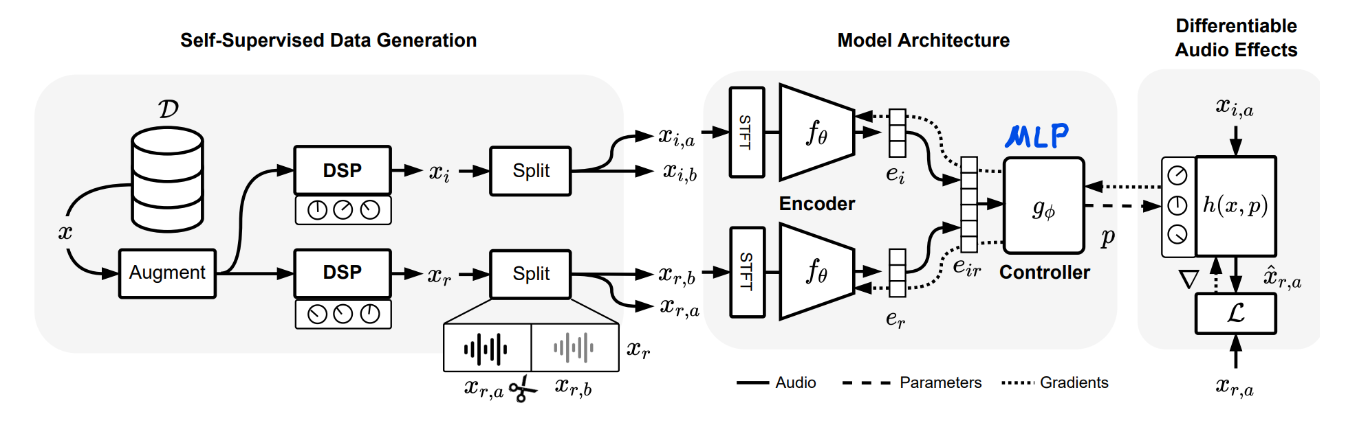
The self-supervised training process

Slide 9
Differentiable Audio Effects
manually implemented automatic differentiation effects (AD)
neural proxy effects (NP)
full neural proxy hybrids (NP-FH)
half neural proxy hybrids (NP-HH)
numerical gradient approximations (SPSA)

Slide 10
Implementation steps
Small and simple dataset (speech only)
Create DSP filters
Make proxy out of DSP filters
Design Neural Network Architecture
Train and fine tune
Inference
Try Unseen filters

Slide 11
Implementation steps
PL : Python
Framework: PyTorch
Encoders : CNN
Controller : MLP
Loss Function : mean absolute error (MAE) + frequency domain loss : multi-resolution short-time Fourier transform loss (MR-STFT)
Activation function: ReLu and Sigmoid

Slide 12

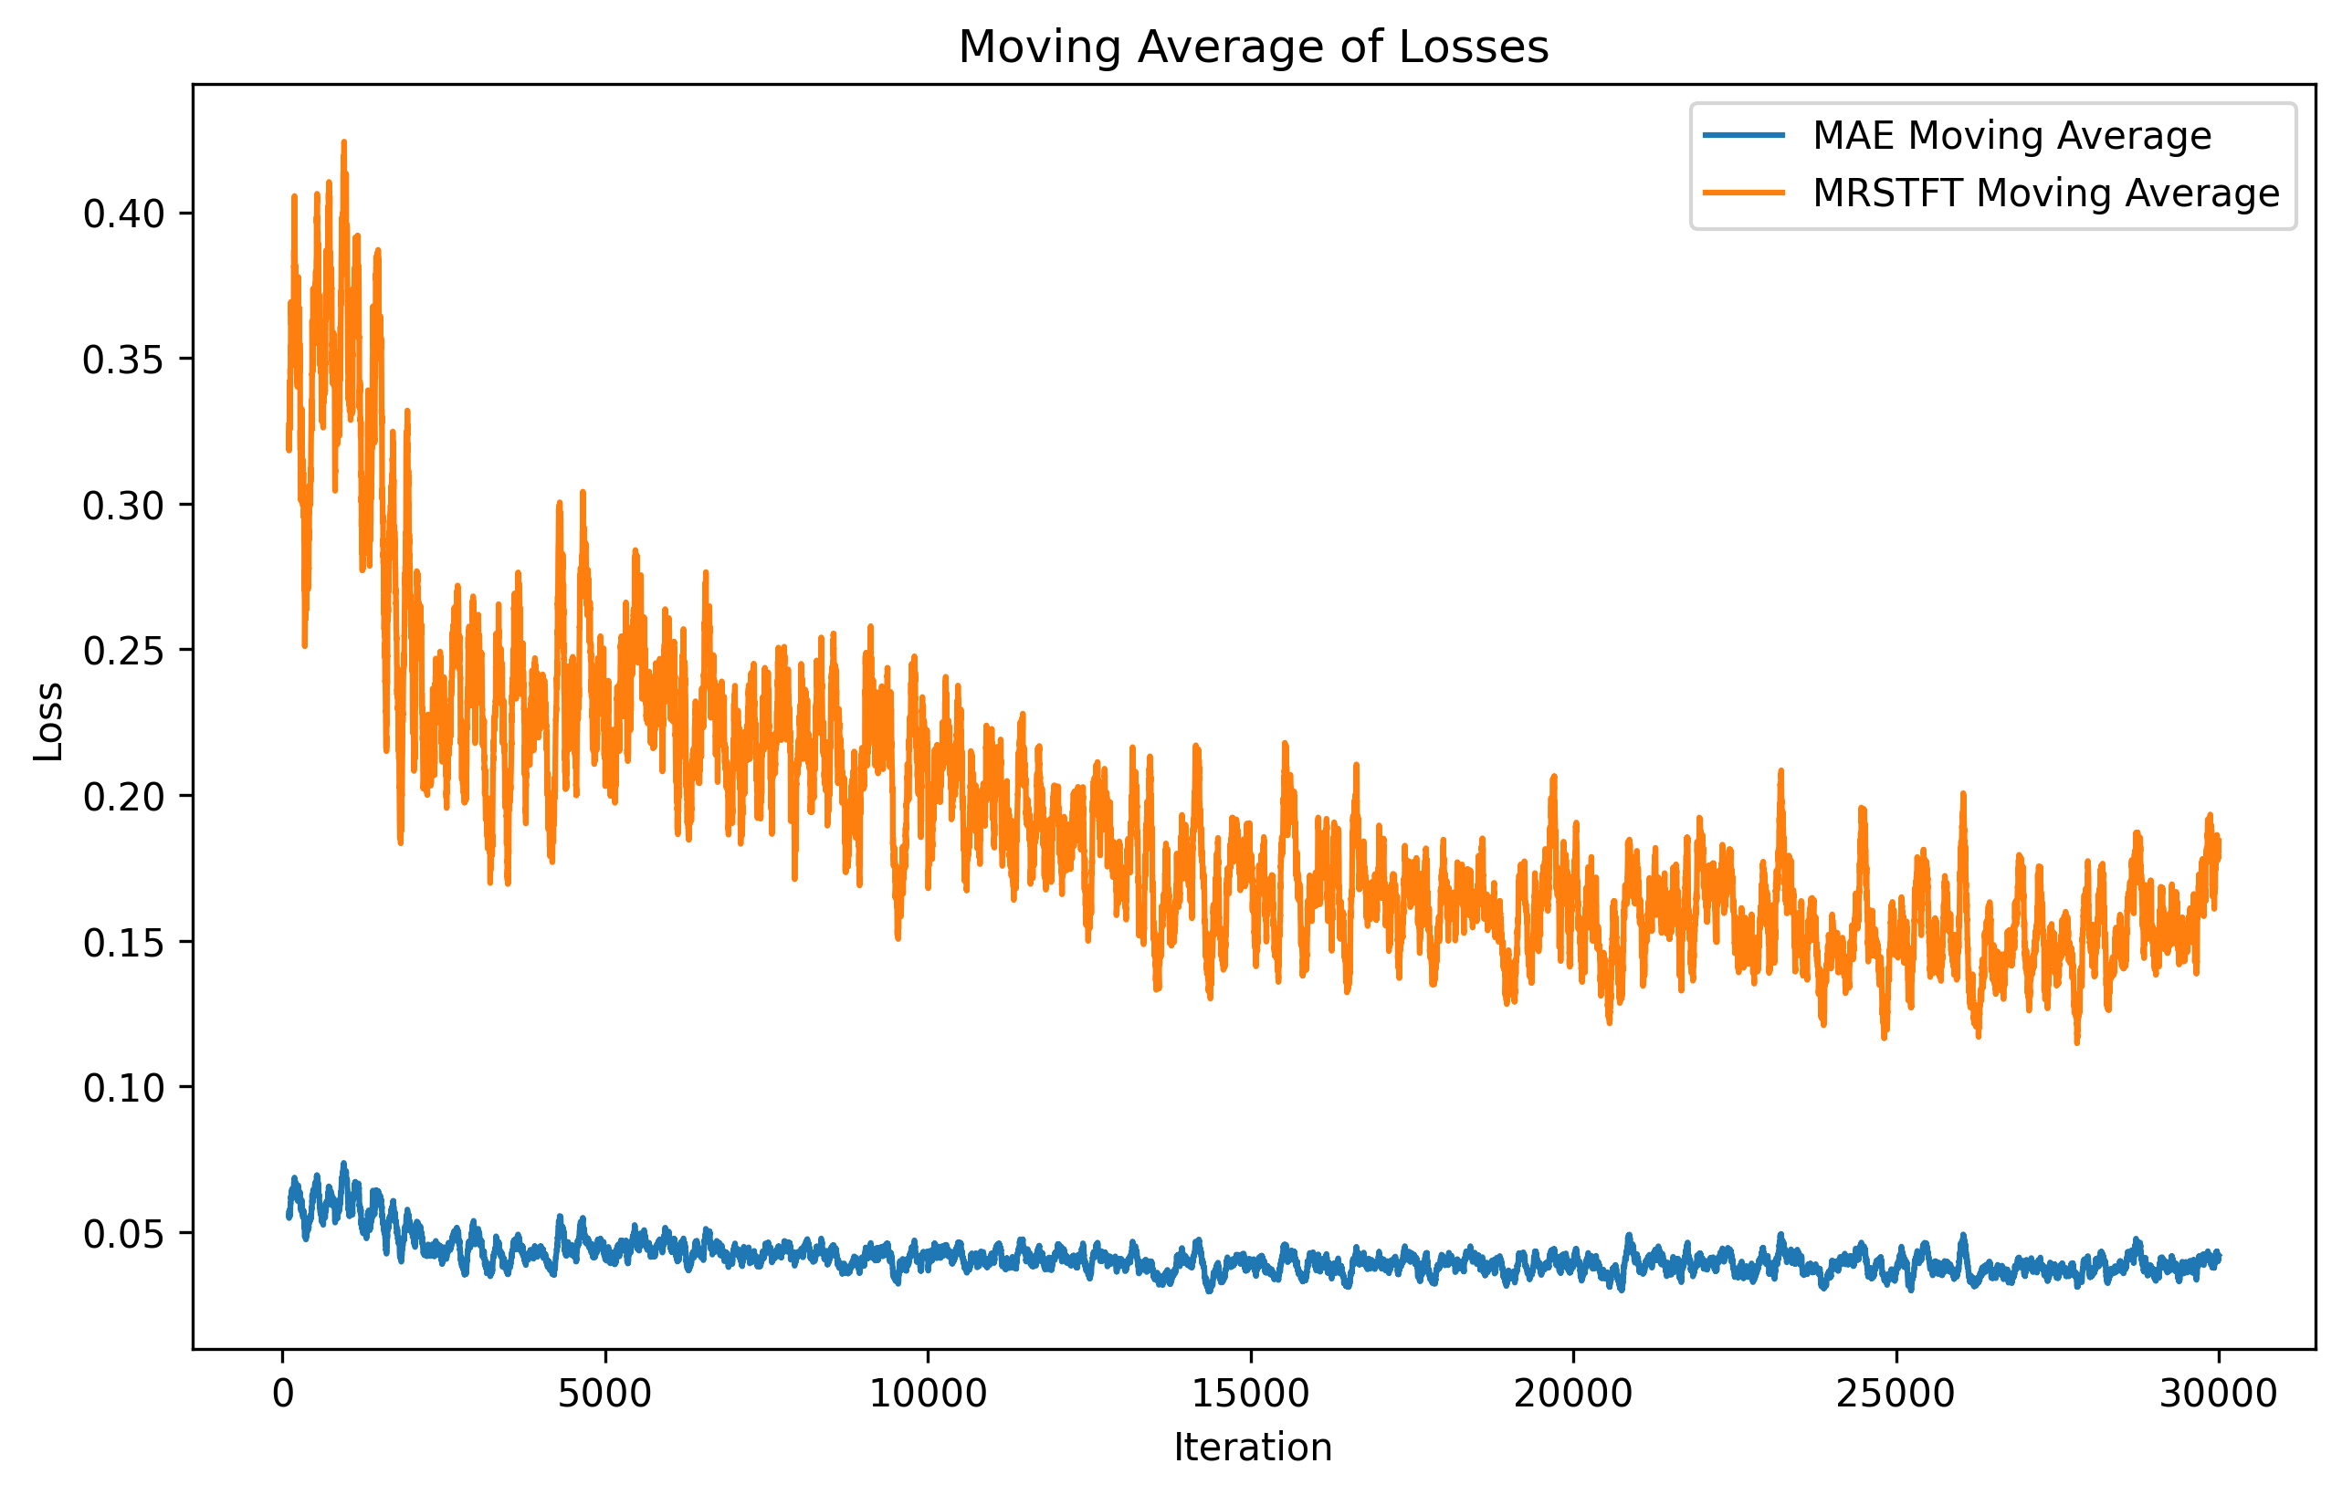
Equalizer Proxy
Original
EQ bands
20-100
100-200
Filtered
200-300
300-400
400-500
500-12000
Proxied
Validation loss:
MAE = 0.037633
MRSTFT =0.145704

Slide 13
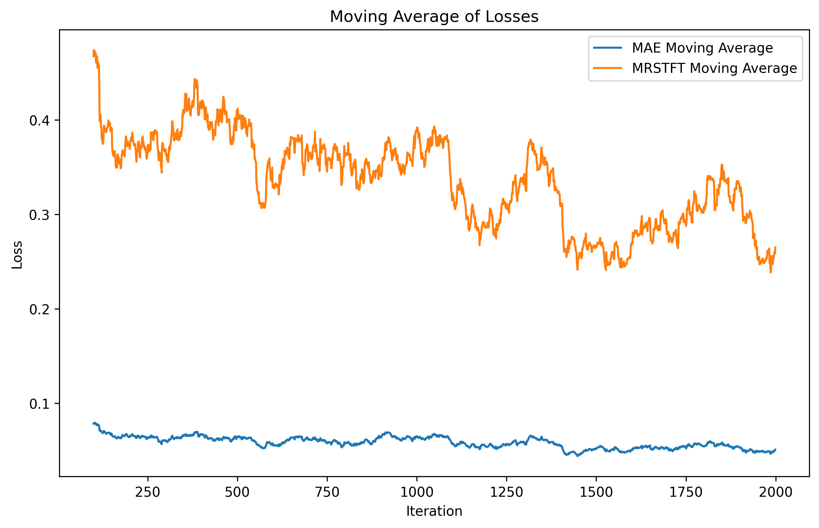
Style transfer: EQ + compressor
full neural proxy hybrids (NP-FH)

Slide 14
Validation
How far this model can regenerate different filters?
Filters | MAE | MRSTFT
EQ + comp | 0.053905062 | 0.270354189
reverb | 0.068662373 | 0.45525916
distortion | 10798.12553 | 79496.91031

Slide 15
Future works
- More Complex Architecture
- Add other filters like reverb and distortion to pipeline of training and measure their influence on performance
- Expand dataset: quantity and Music
SUMMARY
It was an application of style transfer on audio effects.
With well tuned model, people can mimic the character of other’s voice or songs with out lots of trial and errors.
Despite other AI methods, this architecture help experts to understand under the hood by providing meaningful parameters.

Slide 16
THANK YOU
Mahya Khazaei
maahhi@uvic.ca
github.com/maahhi/filterstyletransfer

