Slide 1



Spotifier
Team Name : IITD Group12
Group-12 | Ankita Maheshwari
 | ASHISH KUMAR
 | Devi Vara Prasad Mandalapu
 | Labony Pal
 | Nischay Bagusetty
 | RAJEEV LOCHAN VASHISHTH
 | Shreyansh
 | Susan Abraham

Slide 2

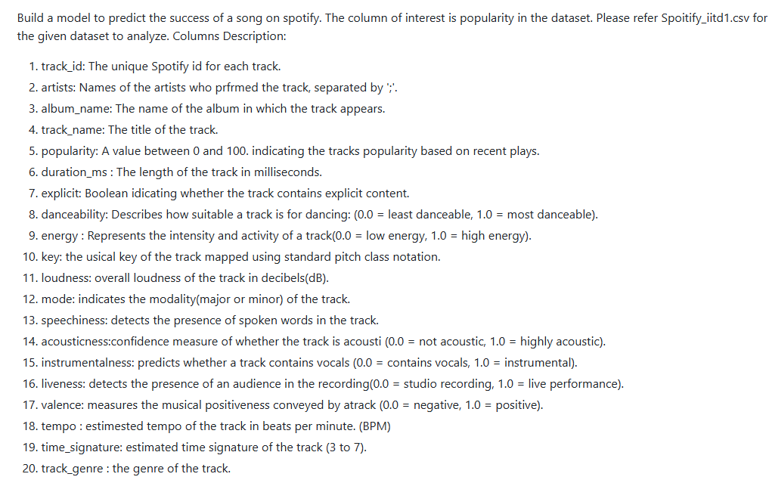
Problem Statement
Proposed Solution
🎯 Objective: Build ML models to predict song popularity on Spotify
📊 Enhanced Implementation:
• EDA, 5 Different Regression Algorithms and MLP (NN) model Implemented
• Comprehensive Model Comparison & Evaluation
• Interactive Multi-Model Web Application using streamlit
• Feature Importance & Cross-Validation Performance Analysis
🎵 Target Variable: Popularity score (0-100) based on recent plays

Slide 3
Regression Models Implemented
1. 📈 Linear Regression
• Basic linear relationship assumption
• Fast training and prediction
• Baseline model for comparison
2. 🔄 Ridge Regression (L2 Regularization)
• Prevents overfitting with penalty term
• Handles multicollinearity better
• Shrinks coefficients towards zero
3. 🎯 Lasso Regression (L1 Regularization)
• Automatic feature selection capability
• Sparse solutions (some coefficients = 0)
• Good for high-dimensional data
4. 🌳 Random Forest Regressor ⭐ WINNER
• Ensemble of 100 decision trees
• Captures non-linear relationships
• Handles feature interactions naturally
5. 🚀 XGBoost Regressor
• Gradient boosting algorithm
• Advanced ensemble method
• Often wins ML competitions
6. MLP Regressor
• Deep Neural network
• Hidden layers

Slide 4
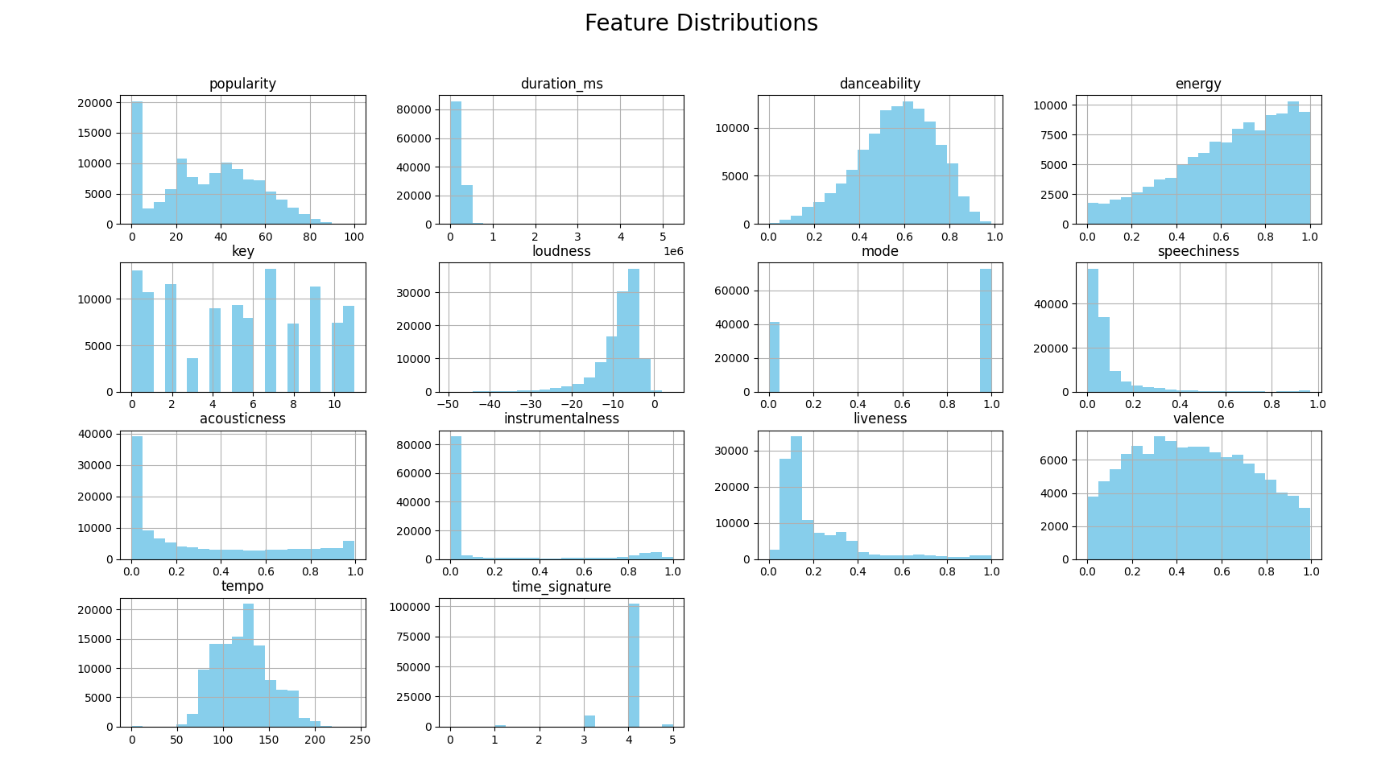

Slide 5
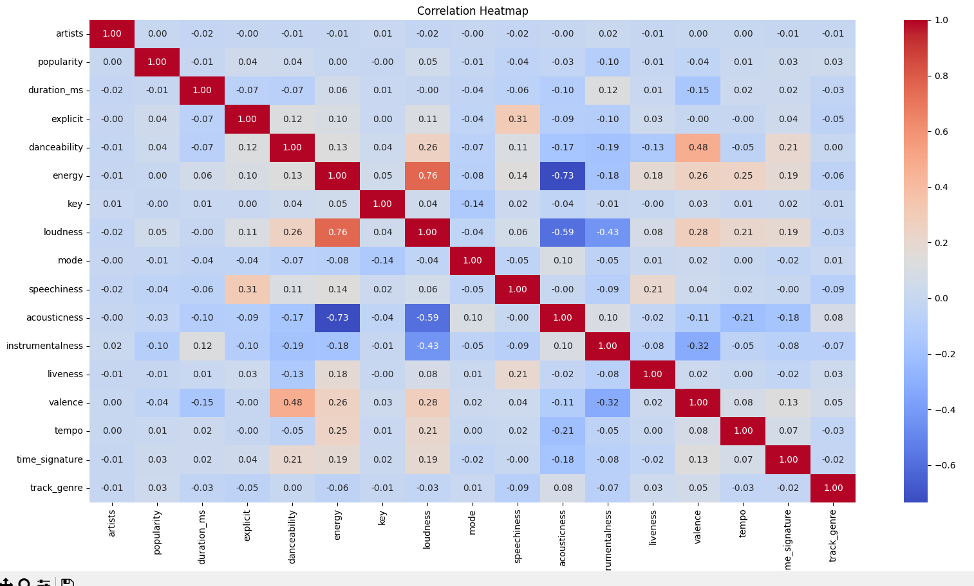
1

Slide 6
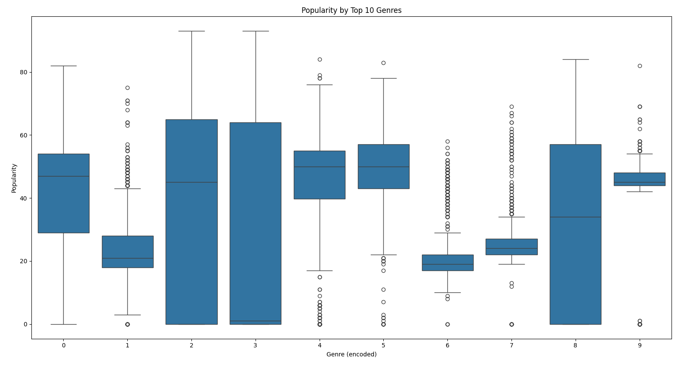
1

Slide 7
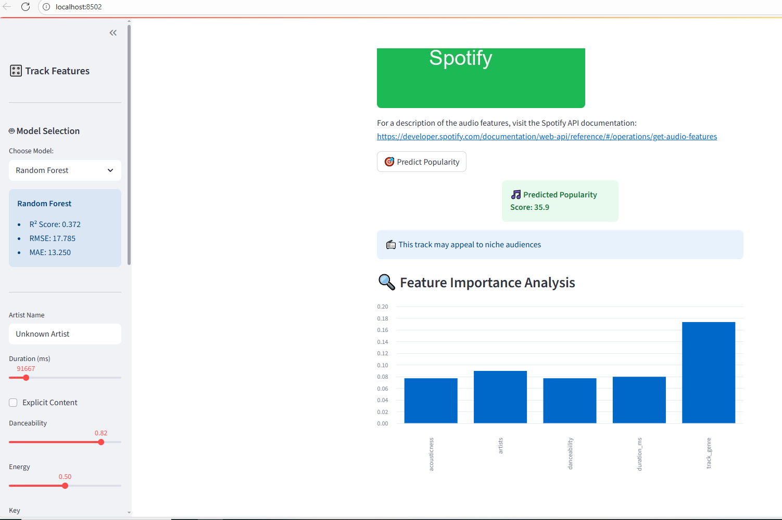

Slide 8
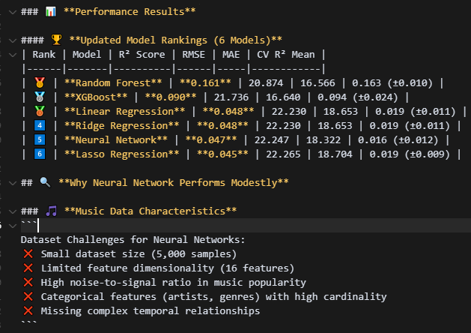
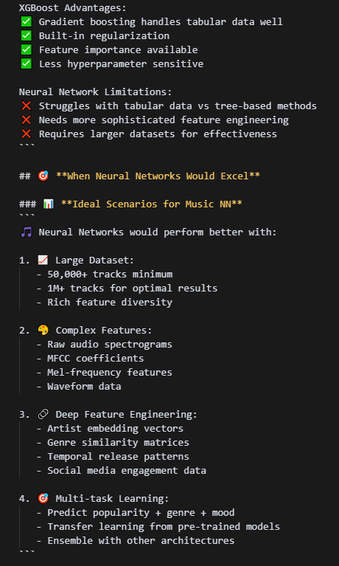
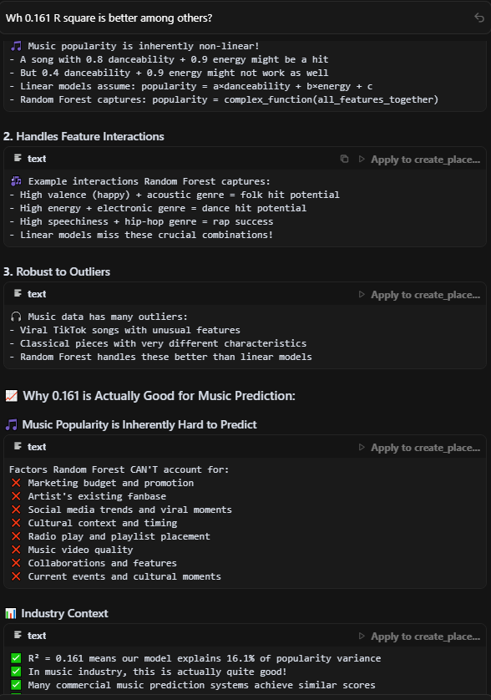
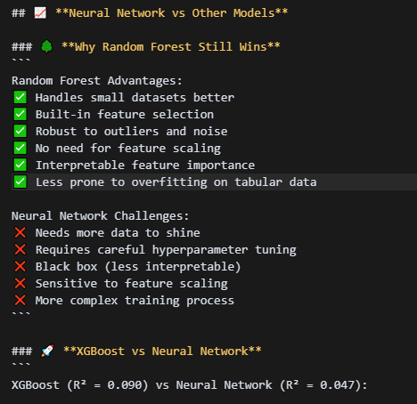
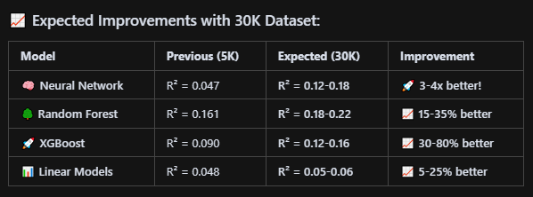

Slide 9
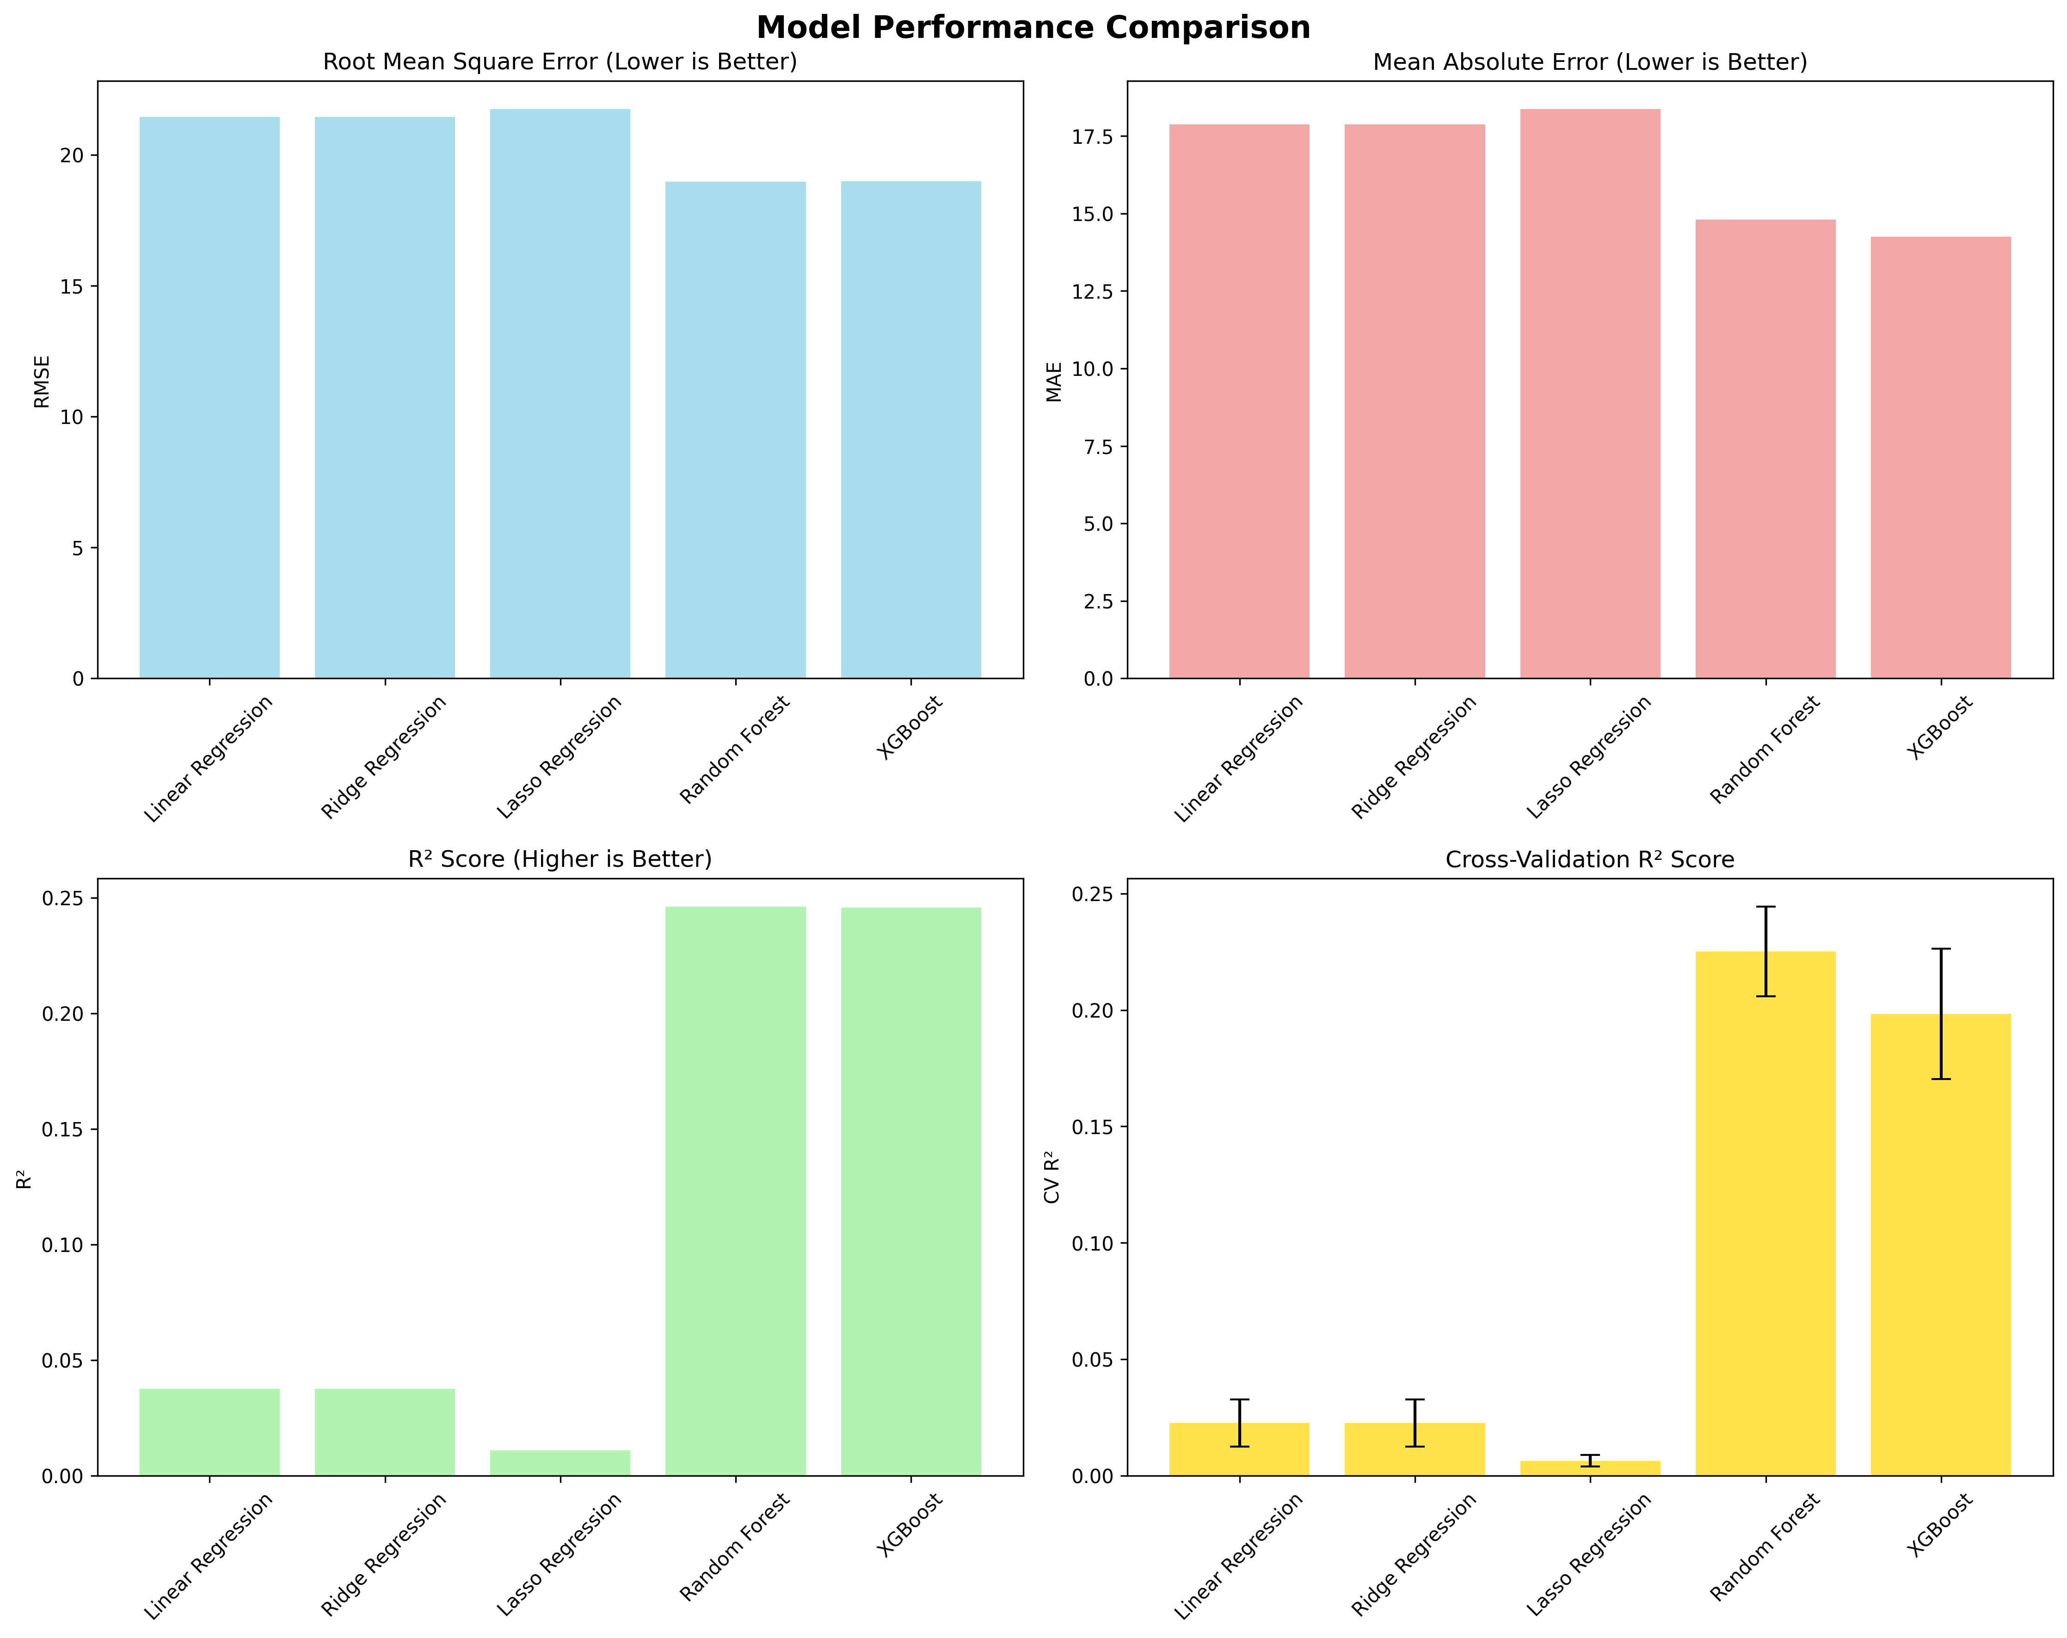
The Random Forest Regressor emerged as the best performer with an R² score of 0.161, significantly outperforming the linear models and showing the importance of capturing non-linear relationships in music popularity prediction.

Slide 10
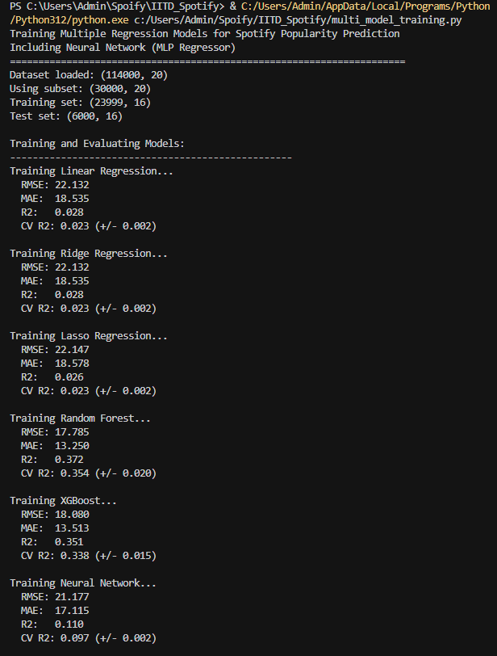
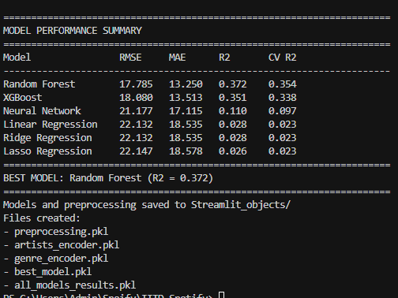

Slide 11
1
Thank You!

