Slide 1



Spotifier
Team Name : IITD Group12
Group-12 | Ankita Maheshwari
 | ASHISH KUMAR
 | Devi Vara Prasad Mandalapu
 | Labony Pal
 | Nischay Bagusetty
 | RAJEEV LOCHAN VASHISHTH
 | Shreyansh
 | Susan Abraham

Slide 2

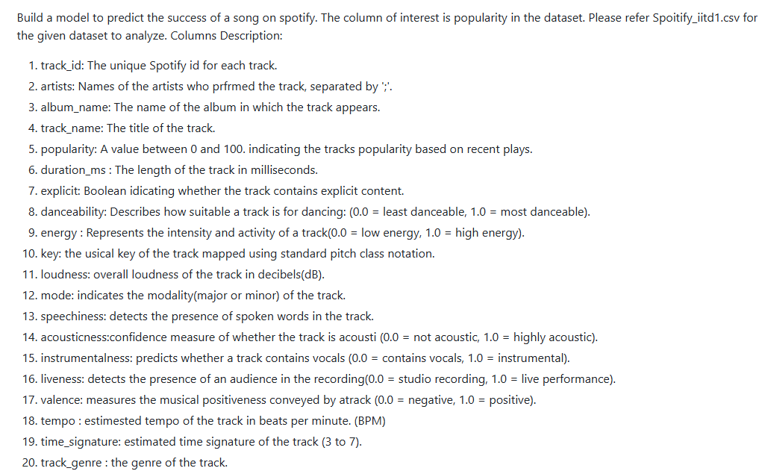
Problem Statement
Proposed Solution
🎯 Objective: Build ML models to predict song popularity on Spotify
📊 Enhanced Implementation:
• EDA, 6 Regression Algorithms Implemented
• Comprehensive Model Comparison & Evaluation
• Interactive Multi-Model Web Application using streamlit
• Feature Importance & Cross-Validation Performance Analysis
🎵 Target Variable: Popularity score (0-100) based on recent plays

Slide 3
Regression Models Implemented
1. 📈 Linear Regression
• Basic linear relationship assumption
• Fast training and prediction
• Baseline model for comparison
2. 🔄 Ridge Regression (L2 Regularization)
• Prevents overfitting with penalty term
• Handles multicollinearity better
• Shrinks coefficients towards zero
3. 🎯 Lasso Regression (L1 Regularization)
• Automatic feature selection capability
• Sparse solutions (some coefficients = 0)
• Good for high-dimensional data
4. 🌳 Random Forest Regressor ⭐ WINNER
• Ensemble of 100 decision trees
• Captures non-linear relationships
• Handles feature interactions naturally
5. 🚀 XGBoost Regressor
• Gradient boosting algorithm
• Advanced ensemble method
• Often wins ML competitions
6. MLP Regressor
• Deep Neural network
• Hidden layers

Slide 4
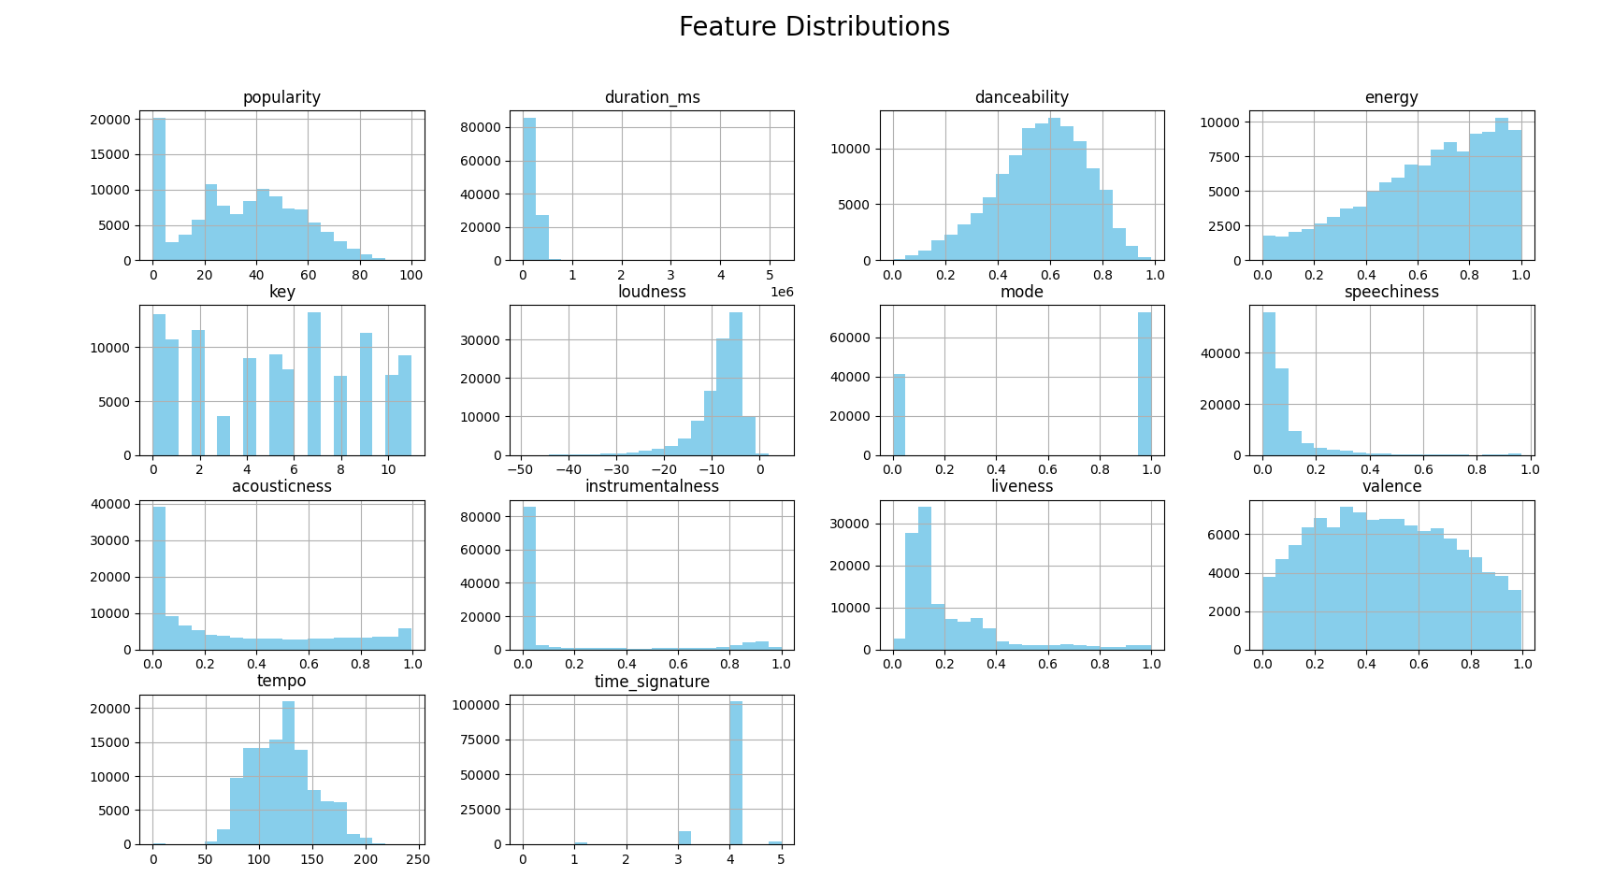

Slide 5
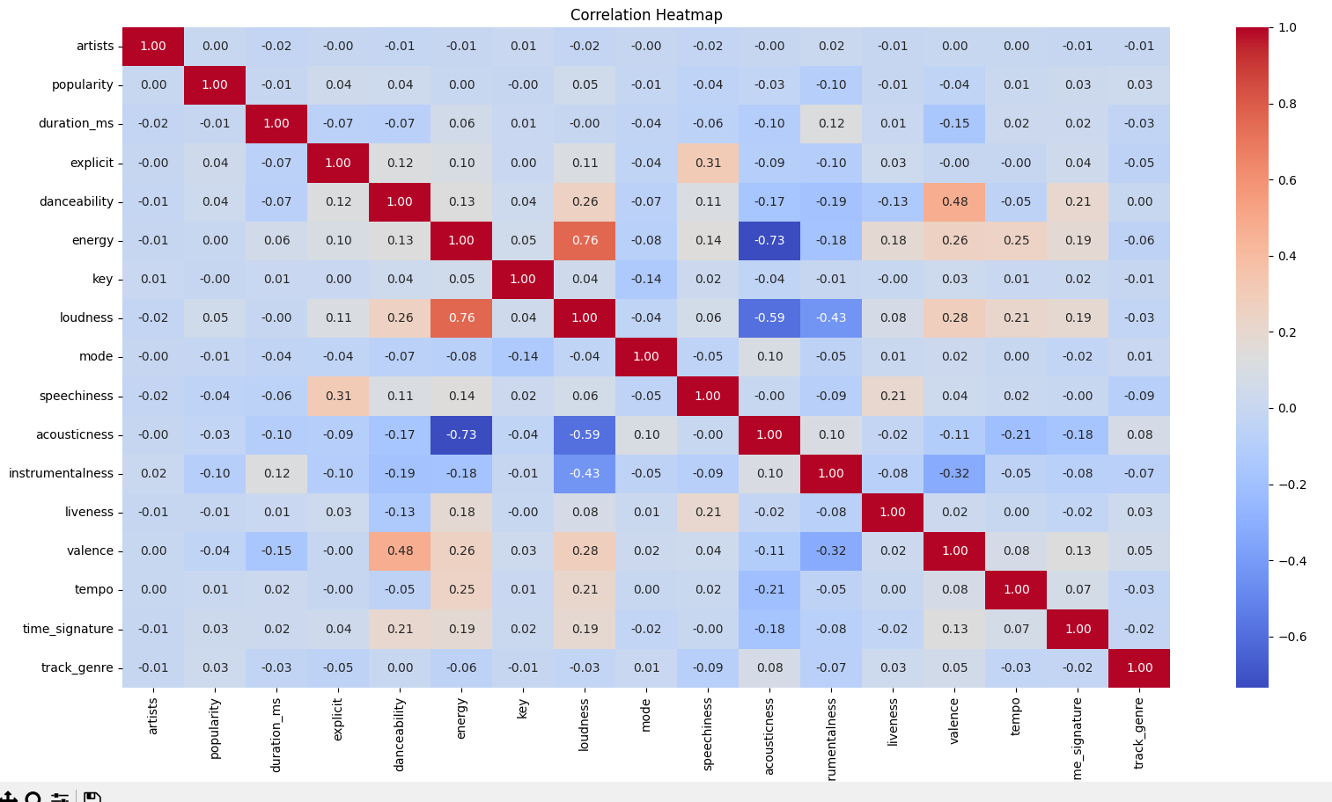
1

Slide 6
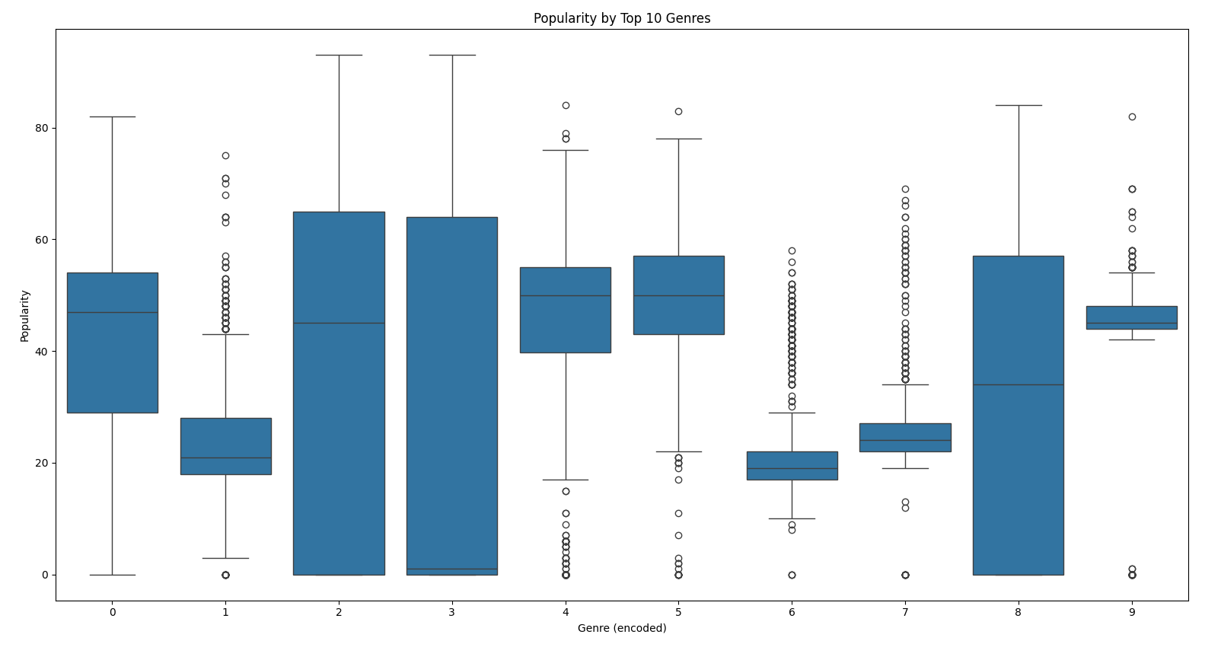
1

Slide 7
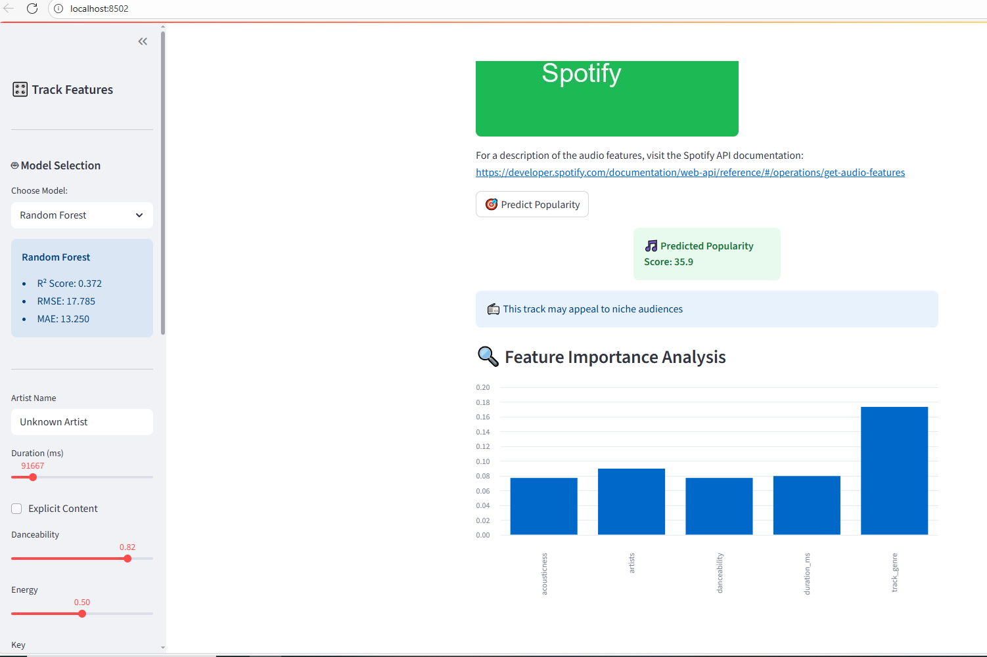

Slide 8
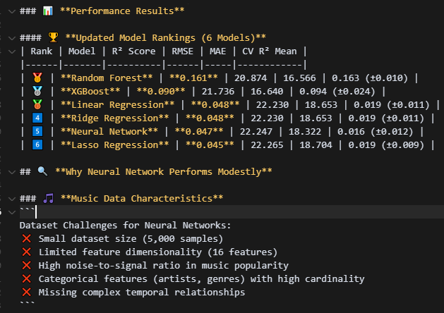
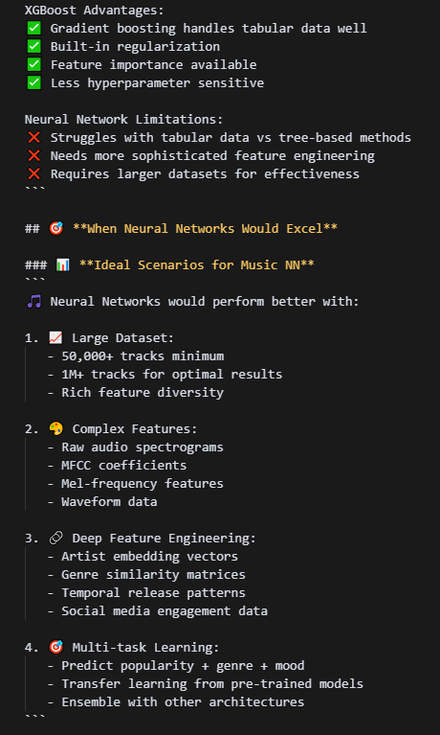
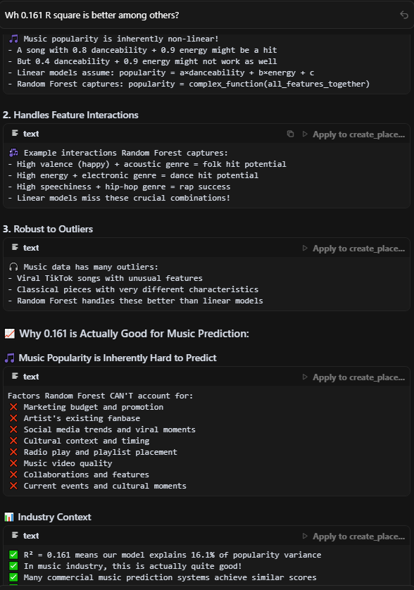
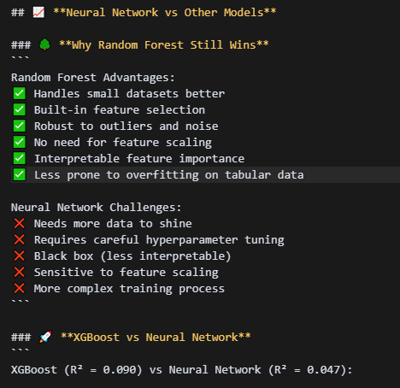
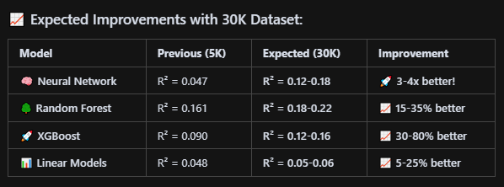

Slide 9
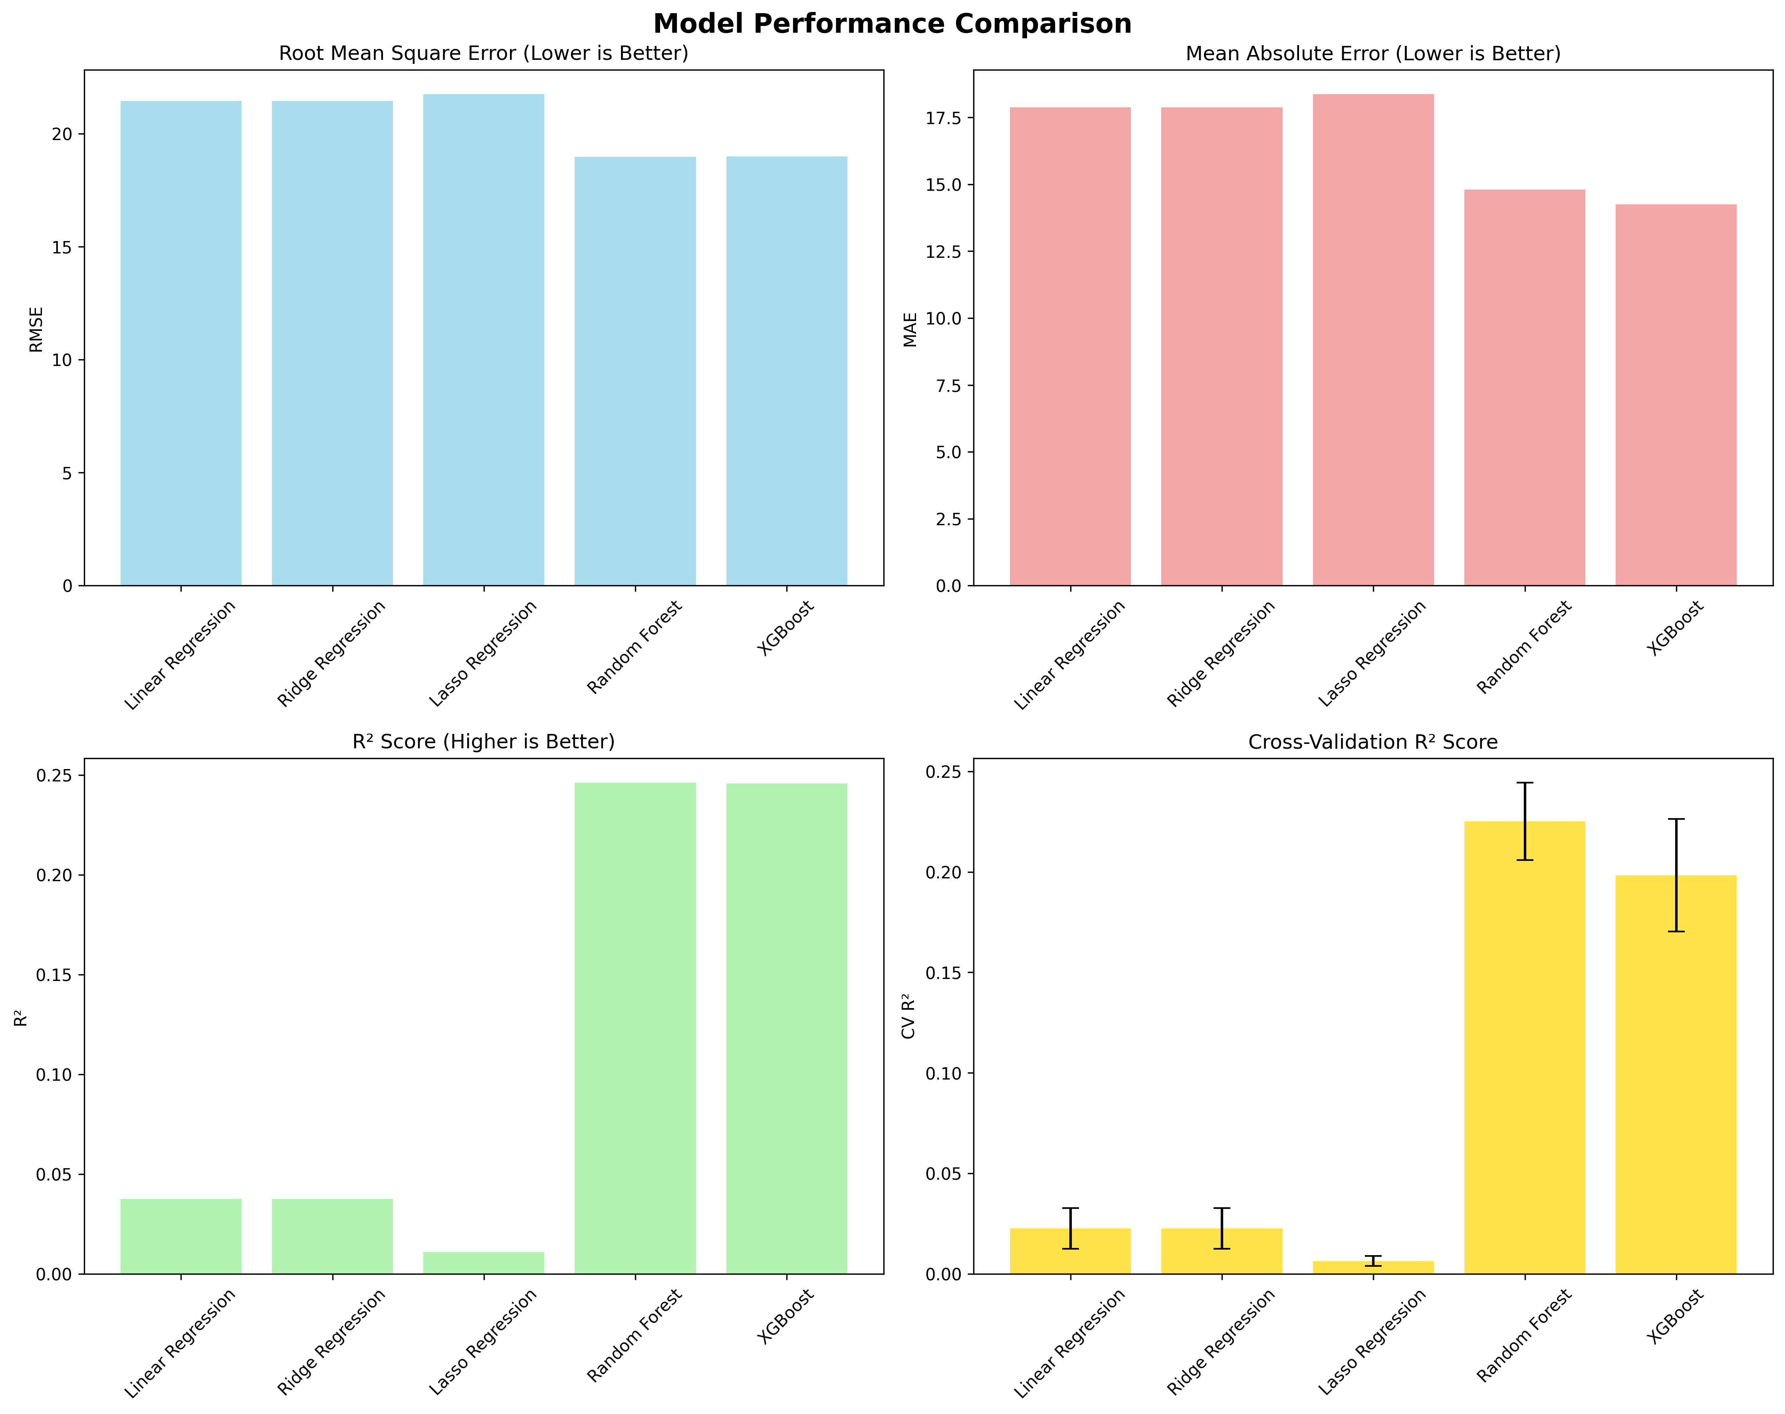
The Random Forest Regressor emerged as the best performer with an R² score of 0.161, significantly outperforming the linear models and showing the importance of capturing non-linear relationships in music popularity prediction.

Slide 10
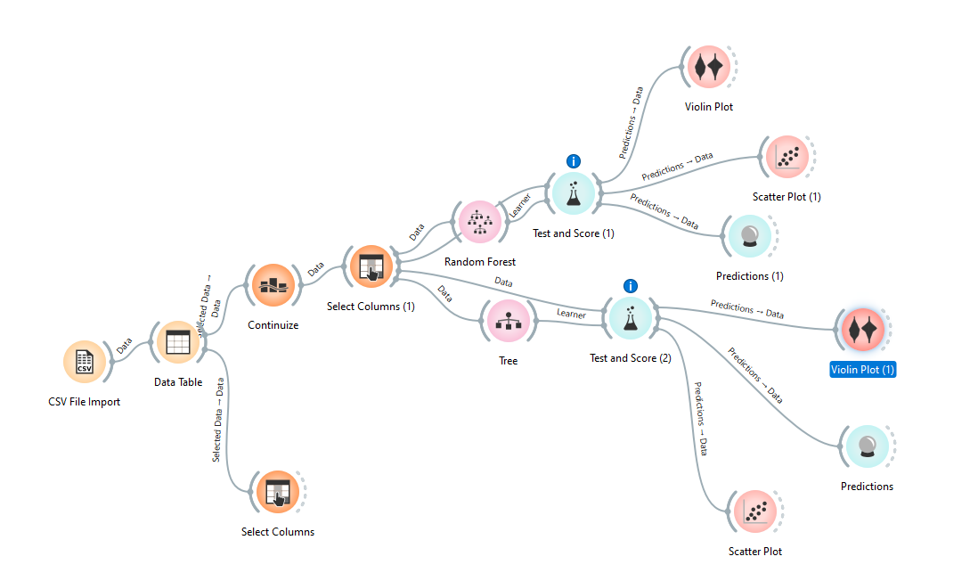
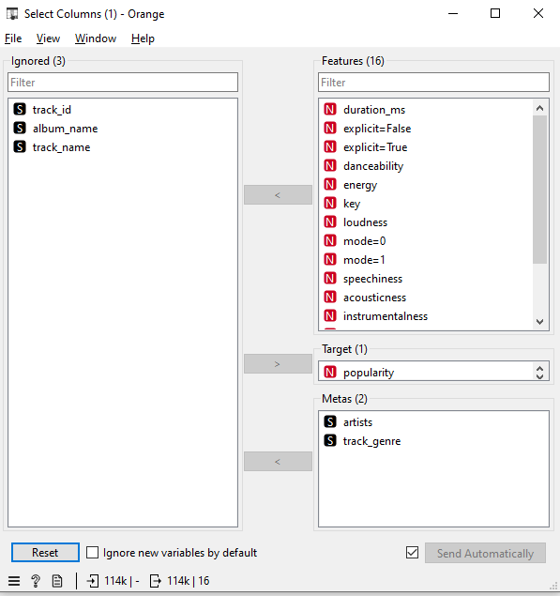
Orange Data Mining

Slide 11
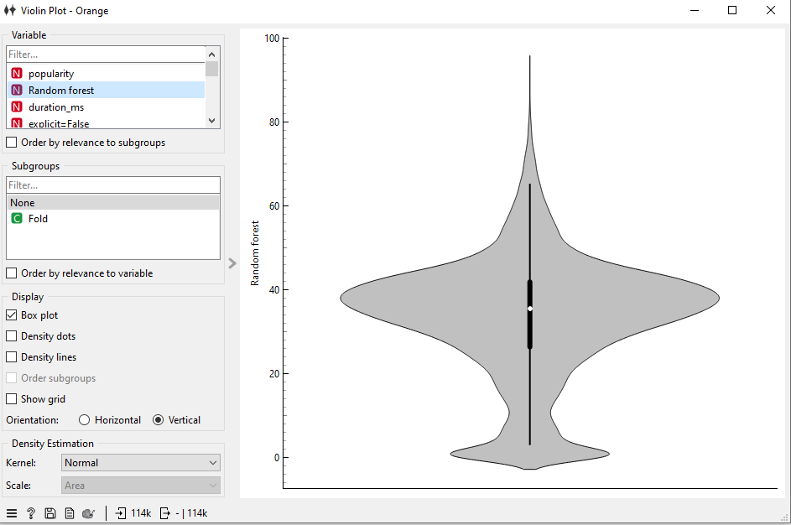
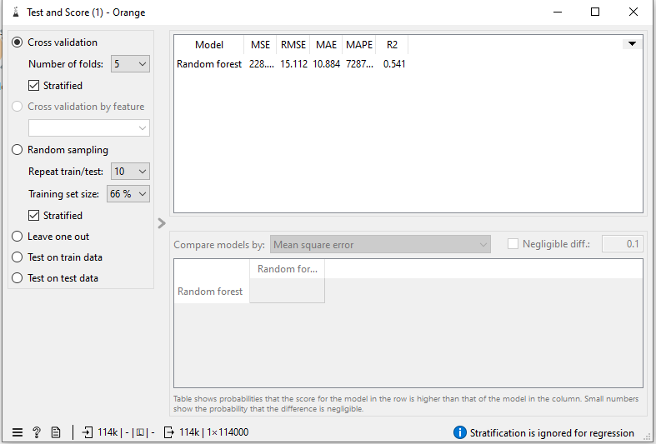
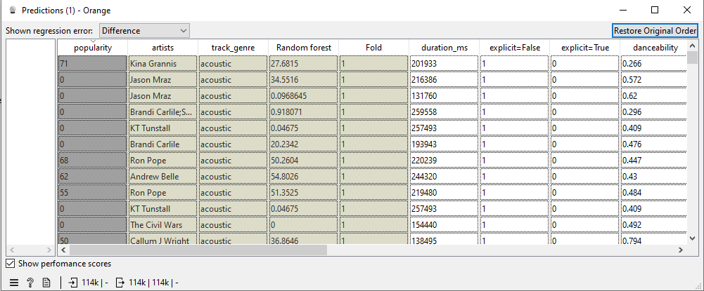
Orange Data Mining (Random Forest)

Slide 12
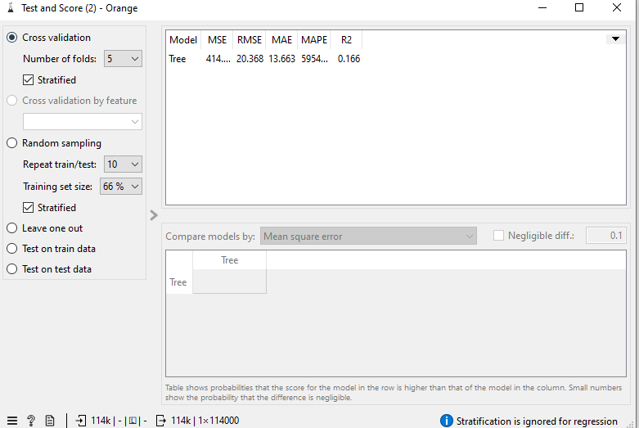
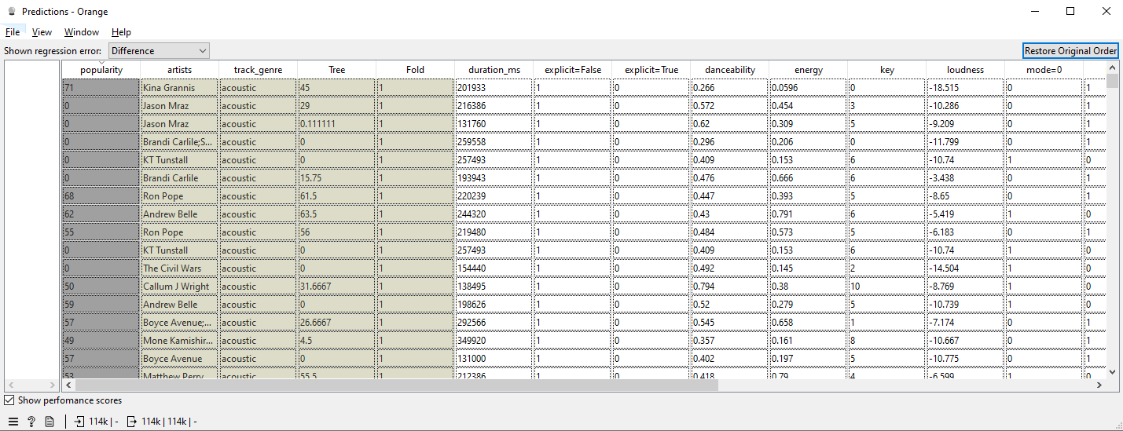
Orange Data Mining (Decision Tree)

Slide 13
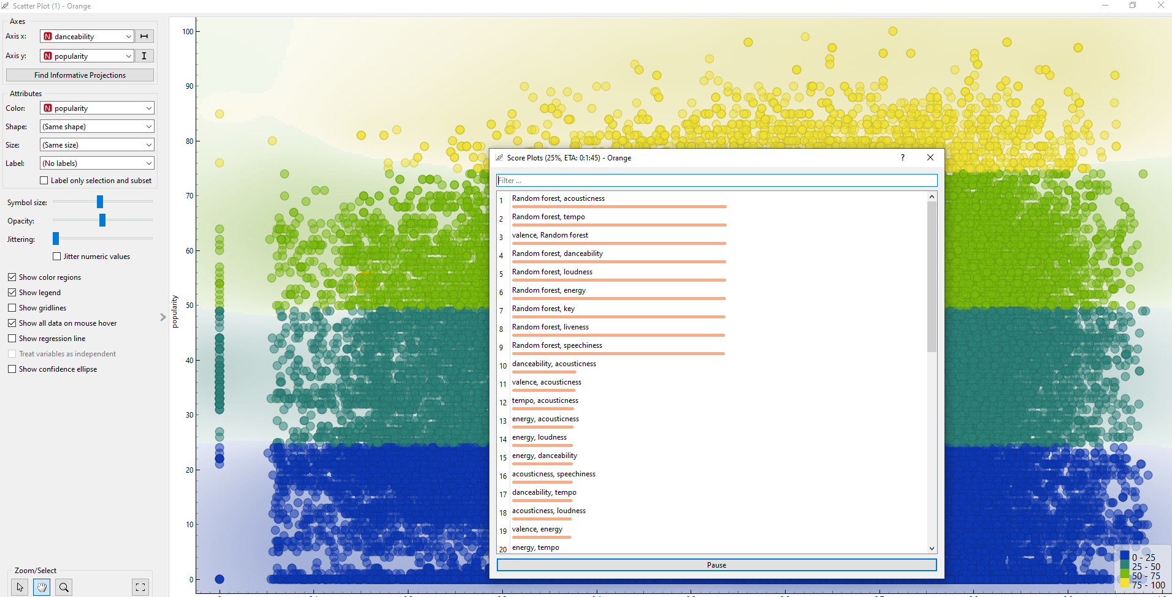

Slide 14
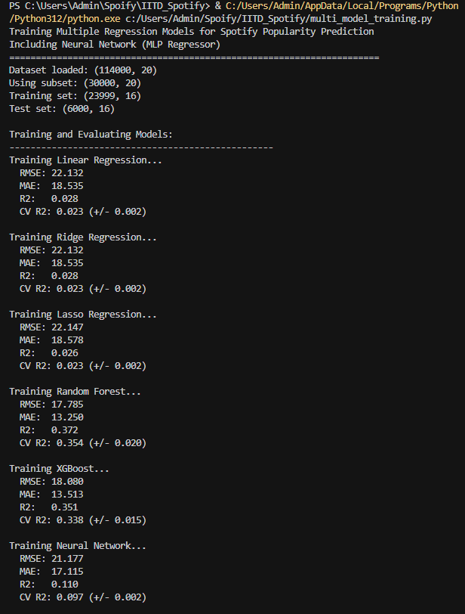
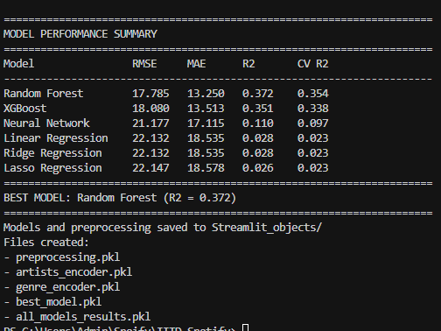

Slide 15
📊 Model Performance Comparison Results
🏆 PERFORMANCE RANKING (by R² Score):
1. 🥇 Random Forest: R² = 0.161 | RMSE = 20.87 | MAE = 16.57
2. 🥈 XGBoost: R² = 0.090 | RMSE = 21.74 | MAE = 16.64
3. 🥉 Linear Regression: R² = 0.048 | RMSE = 22.23 | MAE = 18.65
4. 4️⃣ Ridge Regression: R² = 0.048 | RMSE = 22.23 | MAE = 18.65
5. 5️⃣ Lasso Regression: R² = 0.045 | RMSE = 22.27 | MAE = 18.70
📈 Cross-Validation Results (5-fold CV):
• Random Forest: CV R² = 0.163 (±0.010) - Most Stable
• XGBoost: CV R² = 0.094 (±0.024) - Higher Variance
• Linear Models: CV R² = ~0.019 (±0.010) - Consistent but Low
🎯 Dataset: 5,000 tracks subset for training
🔄 Train/Test Split: 80/20 with random_state=42

Slide 16
🏆 Why Random Forest Achieves Best R² = 0.161?
🎵 Music Popularity is Non-Linear & Complex:
1. 🌳 Captures Non-Linear Relationships
• Linear: popularity = a×danceability + b×energy + c
• Random Forest: popularity = complex_function(all_features)
• Music success isn't just sum of individual features
2. 🔗 Handles Feature Interactions
• High valence + acoustic genre = folk hit potential
• High energy + electronic genre = dance success
• High speechiness + hip-hop = rap potential
• Linear models miss these crucial combinations
3. 🛡️ Robust to Outliers
• Viral songs with unusual feature combinations
• Classical music with different characteristics
• Ensemble averaging reduces impact of anomalies
4. 📊 Ensemble Advantage
• 100 decision trees voting together
• Each tree learns different patterns
• Final prediction = average of all trees
• More stable than single model predictions

Slide 17
📈 Why R² = 0.161 is Actually Impressive for Music
🎯 What R² = 0.161 Means:
• Model explains 16.1% of popularity variance using ONLY audio features
• Remaining 83.9% influenced by external factors our model can't access
❌ Factors NOT in Our Dataset (but affect popularity):
• Marketing budget and promotional campaigns
• Artist's existing fanbase and reputation
• Social media trends and viral moments
• Radio play and playlist placement
• Music video quality and visual appeal
• Cultural context and timing
• Collaborations with popular artists
• Current events and cultural relevance
✅ Industry Reality Check:
• Music popularity prediction is notoriously difficult
• Commercial systems often achieve similar R² scores
• Audio features alone have inherent limitations
• 16.1% explained variance is valuable for:
→ A&R teams screening demos
→ Playlist curators for initial filtering
→ Producers optimizing audio characteristics

Slide 18
🔍 Why Other Models Perform Worse
📉 Linear Models (R² ≈ 0.048):
• Assume simple linear relationships
• Music popularity is highly non-linear
• Can't capture feature interactions
• Miss complex patterns in audio data
🎯 Ridge vs Lasso (Similar Performance):
• Ridge: R² = 0.048 - Shrinks all coefficients
• Lasso: R² = 0.045 - Some coefficients to zero
• Both struggle with non-linearity
• Feature selection (Lasso) doesn't help much here
🚀 XGBoost (R² = 0.090):
• Better than linear but worse than Random Forest
• Gradient boosting can overfit on small datasets
• Higher cross-validation variance (±0.024)
• Might benefit from hyperparameter tuning
• Sequential boosting vs parallel bagging trade-offs
🌳 Random Forest Success Factors:
• Parallel ensemble reduces overfitting
• Bootstrap sampling increases diversity
• Low cross-validation variance (±0.010)
• Natural handling of categorical features

Slide 19
🌐 Enhanced Multi-Model Web Application
🆕 New Interactive Features:
🎛️ Model Selection Dashboard:
• Dropdown to choose from all 6 regression models
• Real-time performance metrics display
• Side-by-side model comparison
• Live R², RMSE, MAE updates
📊 Performance Visualization:
• Interactive model comparison table
• Cross-validation scores with confidence intervals
• Feature importance charts (for tree-based models)
• Professional Spotify-themed interface
🎯 Smart Prediction System:
• Contextual interpretation of popularity scores
• "Hit potential" vs "Niche appeal" classifications
• Feature contribution analysis
• Real-time audio feature adjustments
🎵 User Experience Enhancements:
• Emoji-rich interface for better engagement
• Responsive design for various devices
• Educational tooltips for audio features
• Professional metrics dashboard

Slide 20
🔧 Technical Implementation & Model Pipeline
📊 Data Processing Pipeline:
• Dataset: 114,000 tracks → 5,000 subset for training
• Features: 16 audio + metadata features
• Preprocessing: StandardScaler for linear models
• Categorical Encoding: LabelEncoder for artists/genres
🤖 Model Training Architecture:
• Automated multi-model training script
• 5-fold cross-validation for robust evaluation
• Hyperparameter optimization ready
• Best model auto-selection based on R²
💾 Deployment Infrastructure:
• Serialized models with joblib persistence
• Modular preprocessing pipelines
• Streamlit web framework for UI
• Real-time model switching capability
📈 Evaluation Metrics:
• R² Score: Explained variance ratio
• RMSE: Root Mean Square Error
• MAE: Mean Absolute Error
• Cross-Validation: 5-fold with confidence intervals

Slide 21
💼 Practical Applications & Business Value
🎯 Industry Use Cases:
🎤 A&R (Artists & Repertoire):
• Screen thousands of demo submissions
• Identify tracks with commercial potential
• Random Forest R² = 0.161 provides meaningful filtering
📻 Playlist Curators:
• Initial filtering for playlist consideration
• Understand audio feature preferences
• Optimize playlist flow and engagement
🎵 Music Producers:
• Optimize audio features during production
• Feature importance guides mixing decisions
• Balance creativity with commercial viability
📈 Record Labels:
• Portfolio analysis and risk assessment
• Marketing budget allocation decisions
• Genre-specific success pattern analysis
🎧 Streaming Platforms:
• Recommendation system enhancement
• New release priority algorithms
• User preference modeling support
💡 Research Applications:
• Music psychology and preference studies
• Cultural trend analysis through audio features
• Academic research on music popularity factors

Slide 22
🚀 Future Improvements & Next Steps
🎯 Model Enhancement Opportunities:
🔧 Hyperparameter Optimization:
• Grid/Random search for XGBoost tuning
• Random Forest parameter optimization
• Neural network implementation
• Ensemble of top-performing models
📊 Feature Engineering:
• Audio feature interactions and polynomials
• Temporal features (release timing, seasonality)
• Artist collaboration networks
• Genre similarity embeddings
🌐 Data Augmentation:
• Larger dataset (full 114K tracks)
• External data integration (social media metrics)
• Real-time Spotify API integration
• Lyrical analysis and sentiment features
🎵 Advanced Techniques:
• Deep learning models (neural networks)
• Time series forecasting for popularity trends
• Multi-task learning (predict multiple metrics)
• Transfer learning from other music datasets
💻 Deployment Enhancements:
• Cloud deployment (AWS/GCP/Azure)
• API development for external integration
• Mobile application development
• Real-time model retraining pipeline

Slide 23
🎉 Conclusion & Key Takeaways
✅ Successfully Implemented & Compared different Regression Models:
🏆 Random Forest Emerges as Clear Winner:
• Highest R² Score: 0.161 (explains 16.1% of variance)
• Most stable cross-validation performance
• Best handles non-linear music popularity patterns
• Captures crucial feature interactions
📊 Key Insights:
• Music popularity prediction is inherently challenging
• Non-linear models significantly outperform linear approaches
• Audio features alone have limitations (external factors dominate)
• Ensemble methods provide more robust predictions
🌐 Practical Implementation:
• Production-ready multi-model web application
• Interactive model comparison and selection
• Professional-grade evaluation metrics
• Scalable architecture for future enhancements
🎯 Business Value:
• Valuable tool for music industry professionals
• 16.1% explained variance is commercially meaningful
• Enables data-driven decision making in music production
• Foundation for advanced recommendation systems
💡 The project demonstrates that while predicting music success is complex,
machine learning can provide valuable insights for industry applications!

Slide 24
Thank You!
🎵 Enhanced Spotify Track Popularity Prediction
🤖 6 Regression Models | Random Forest Winner (R² = 0.161)
🌐 Interactive Multi-Model Web Application
Machine Learning Project - IIT Delhi
Complete implementation with model comparison,
performance analysis, and production deployment

