Slide 1
Salon Management System
Appointments, point of sale, inventory, staff, finance and reports in one tested application
Project status and acceptance summary
Notes:
All seven build phases are complete. This deck summarises what was built, what was verified, and what still depends on the salon.

Slide 2
One system for the whole salon
Front desk
Sales
Stock
Customers, appointments, calendar, double-booking prevention
POS, split payments, receipts, refunds, cash drawer
Products, suppliers, purchase orders, immutable stock ledger
Team
Loyalty
Finance
Attendance, leave, commissions with documented rules
Points, memberships, promotions and coupons
Expenses with approval, profit summary, 18 reports
Laravel 13 · PHP 8.3 · MySQL 8 · Blade and Bootstrap 5

Slide 3
Built and verified in seven phases
1
2
3
4
5
6
7
Foundation
Core salon
POS and finance
Inventory
HR and CRM
Reporting
Hardening
Each phase ended with its own tests and a pushed commit. Phase 7 added the integrity checker, backup and restore, security sweep, performance review and the acceptance report.

Slide 4
Money and stock stay correct
Exact arithmetic
Never counted twice
Money in integer cents, DECIMAL columns, largest-remainder allocation. Payments, refunds and invoice lines cannot be edited.
Idempotency keys on checkout, payments, refunds, stock, points and commissions.
Immutable ledgers
Concurrency-safe
Stock, loyalty points and audit log are append-only; balances are re-checked against them.
Row locks, READ COMMITTED isolation and automatic deadlock retry.

Slide 5
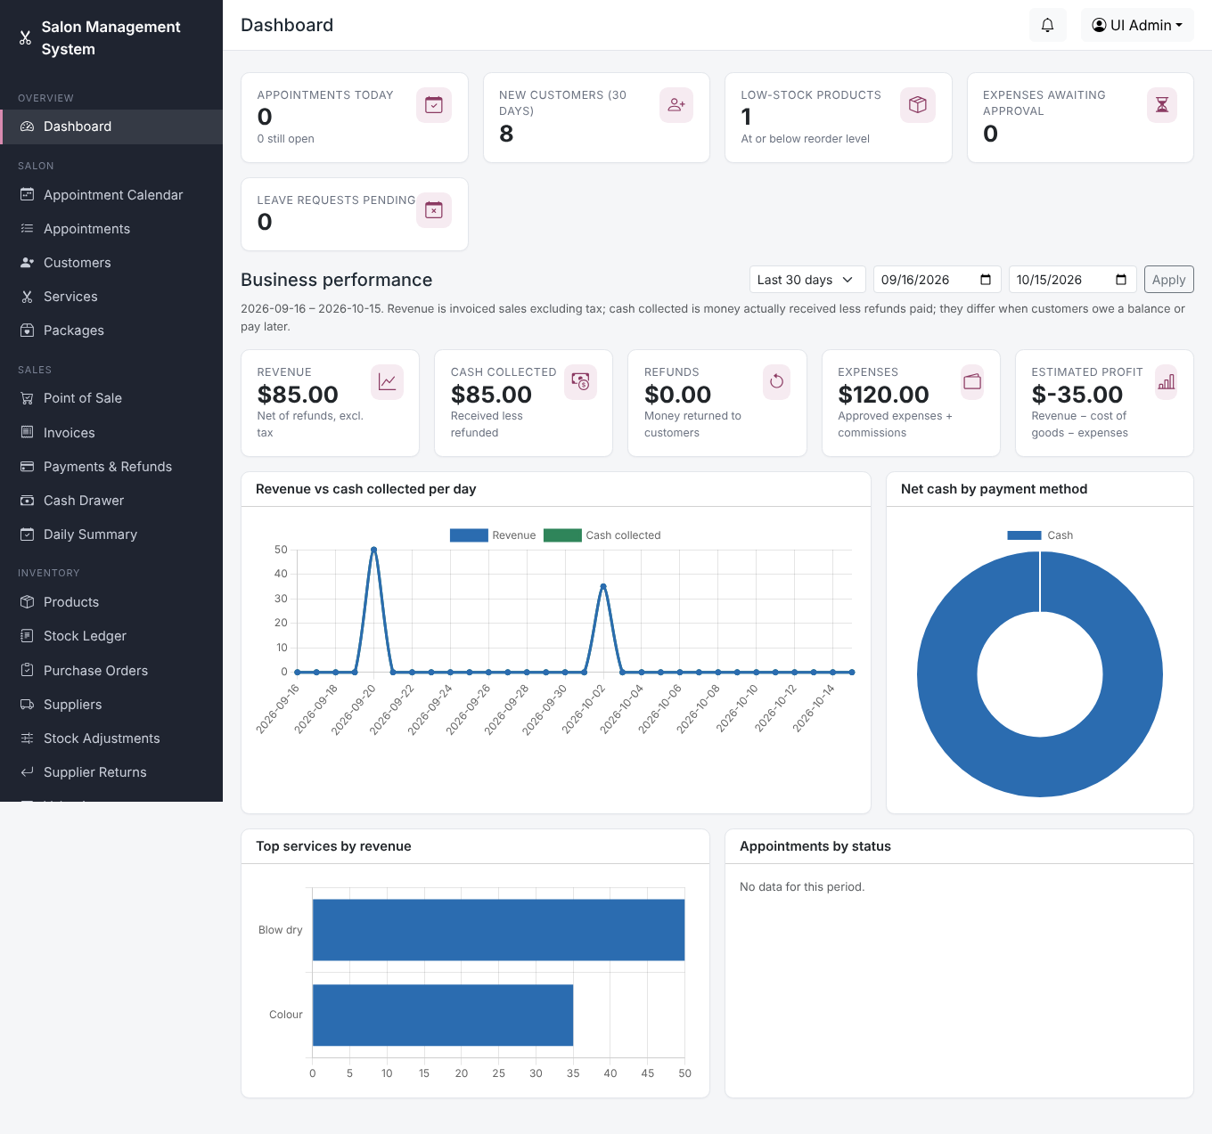
Revenue and cash shown separately
Revenue, cash collected, refunds, expenses and estimated profit are different numbers and are labelled as such
Date-range filter and four charts
Widgets appear only for users whose role allows them
Checked in a real browser with no console or CSP errors

Slide 6
Verification results
393
2
10
automated tests, all passing on MySQL 8
databases: SQLite and real MySQL
parallel processes in each race test
30,000
0
1
invoices used for the performance run
unprotected routes found by the security sweep
real backup, restore and verify round trip

Slide 7
Fast on a year of data (30,000 invoices)
Slowest remaining report: profitability by month, about 1.8 s for 12 months.

Slide 8
Security review findings and fixes
Access control
Browser hardening
Every route tested; a user with no permissions is refused everywhere except self-service pages.
CSP, frame blocking, nosniff, referrer policy, HSTS over HTTPS on every response.
Files and secrets
Bugs fixed
Receipts private and renamed, SVG logos refused, no default admin, backups never expose passwords.
Timestamp clock mismatch, missing coupon on receipts, N+1 queries, slow customer list.

Slide 9
Run it: scheduler, queue, backups
Scheduler
Queue worker
Backups
One cron or Task Scheduler entry runs reminders, low-stock alerts, birthdays, payment reminders and a weekly integrity check.
Email and SMS go through a supervised worker with retries and a delivery log.
Nightly compressed, checksummed dump; verify restores it into a scratch database. Copy files off the server.

Slide 10
What still depends on you
Real SMTP email: only log and test mailers were used
SMS: only a log driver exists; messages show as not delivered
Online payment gateways are not implemented
Web server, HTTPS and Windows XAMPP steps are documented but not run here
Supervised queue worker and off-site backup storage are yours to set up

Slide 11
Go-live checklist
1
Deploy with HTTPS and production settings
2
Create real accounts and enable two-factor for admins
3
Configure SMTP and decide on SMS
4
Start scheduler and queue worker
5
Schedule backups and test one restore
6
Run a day of parallel operation before switching over

