Slide 1
Your new salon system
What it does, whether it is safe, and what to arrange before opening day

Slide 2
Everything in one place
Bookings
Sales
Stock
Appointment calendar that will not double-book a stylist
Till, split payments, receipts, refunds, daily cash count
Products, suppliers and orders, with every change logged
Staff
Customers
Money
Attendance, leave and commissions by clear rules
Loyalty points, memberships, coupons, birthday greetings
Expenses with approval, profit summary, 18 reports

Slide 3
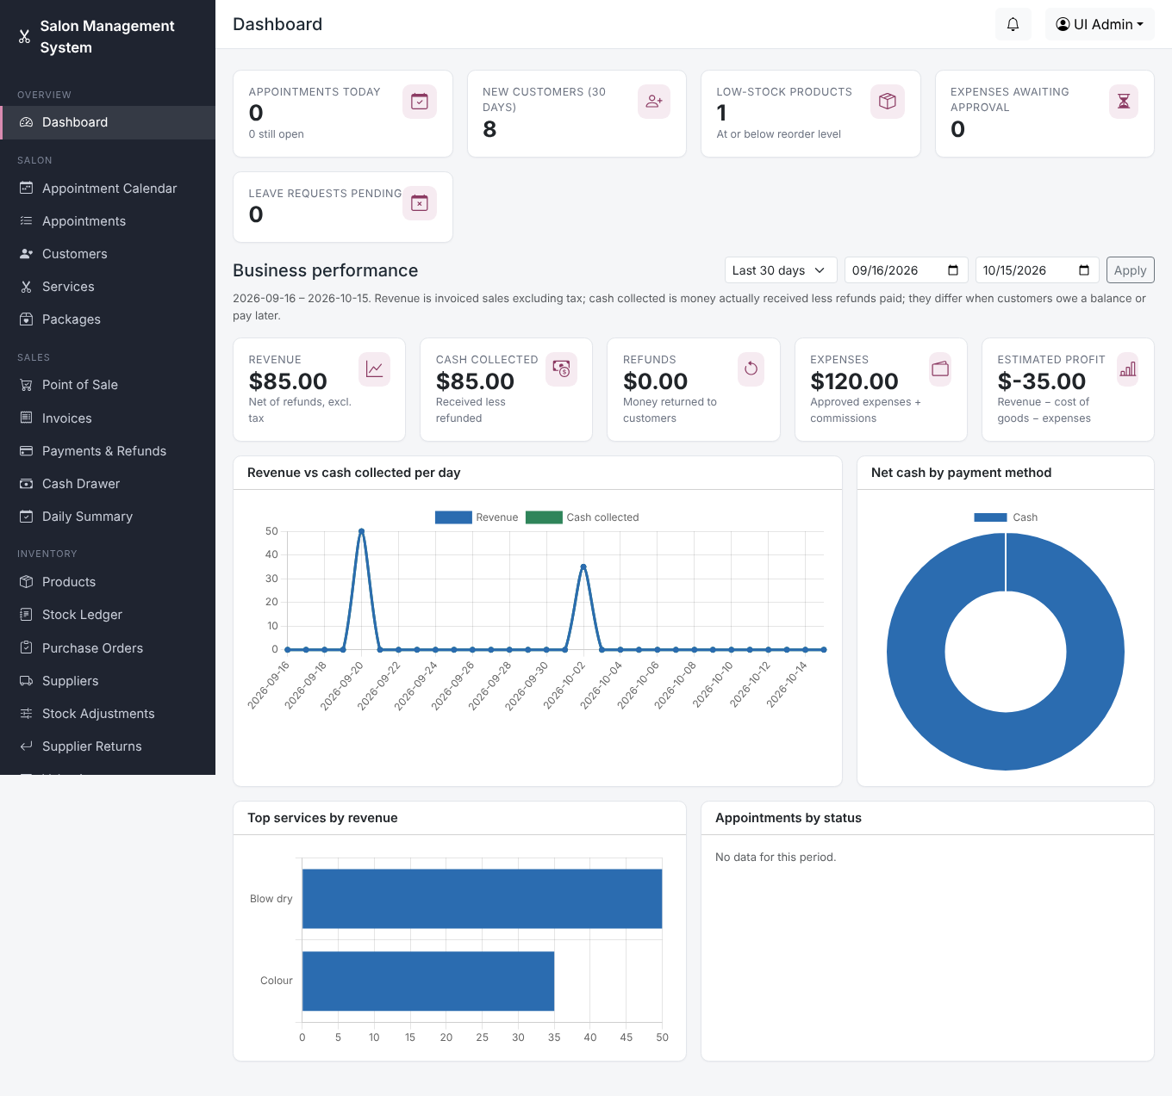
See how the day is going
Sales earned and cash actually collected are shown separately
Expenses and estimated profit for any date range
Staff see only what their role allows

Slide 4
Is it safe to rely on?
393
10
1
automatic checks, all passing
cashiers racing for the last item: only one sale goes through
full backup restored and proven to work
Every money change is recorded and cannot be edited afterwards.

Slide 5
Before opening day
A server with HTTPS
Email and SMS
Your IT person sets this up; the steps are written down
Email needs your mail account; text messages are not delivered yet
Daily backups
A trial week
Copy them to a second place, and test one restore
Run it alongside your paper system before switching

