Slide 1


ONLINE SUPERMARKET MANAGEMENT SYSTEM

Slide 2
NAME(S) OF STUDENTS AND ID
1 | Abdimajid haji adan nor | 13463
2 | Ilhaan Aden Mohamed | 15643
3 | Ikraan Abdullahi Ali | 12680
4 | Mohamed Abshir | 12857
5 | Mohamed Abdikadir | 11940
6 | Ayan Ismail Ahmed | 13068
7 | Hamdi Abdinor Osman | 13285
8 | Abdi rahman Abdshir Awale | 12537
9 | Mohamed Said Mohamed | 16162
10 | Faduma Ali Musa | 10378
11 | Abdi Salaan Ali Osman | 12954
12 | Abdi Risaaq Geesey Cariif | 18095
13 | Suleiman Abdulle Mohamed | 13199

Slide 3
CHAPTER ONE
INTRODUCTION
Background of study
Problem Statement
Research question
Scope of project

Slide 4
BACKGROUND OF STUDY
Yongchang and Mengyao (2015) argue that computer technology has become essential across industries, especially with internet growth. Small and medium supermarkets lag behind in informatization, showing a need for efficient digital systems. A supermarket management system automates operations like sales, stock, staff, and billing. It reduces manual work, saves time, and allows better monitoring. Customers can easily purchase and get bills, and the system notifies when to reorder. Admins assign login credentials to staff for daily tasks.

Slide 5
PROBLEM STATEMENT
Manual management of the supermarket encounter countless problem which varies from time consumption, poor communication, problem of physical count, daily purchase problem and ordering of supplies. Manual management of a supermarket slow down the updating of daily activities, also it can cause a misunderstanding in a supermarket operation process i.e., poor communication. The use of manual management system will always require either the presence either the supermarket owner or the employee to carry out stock taking which is always time consuming, operating with manual management system may cause an injury for the supermarket if transaction record is lost or misinterpret.

Slide 6
RESEARCH QUESTION
Here are clear research questions for a Supermarket Management System thesis:
How can a supermarket management system improve the efficiency of inventory tracking and management?
What are the key functionalities required in a supermarket management system to streamline sales and billing processes?
How can customer data management in a supermarket system enhance customer satisfaction and loyalty?
What role does a supermarket management system play in optimizing supplier and stock management

Slide 7
SCOPE OF PROJECT
The scope of the project is to develop online Supermarket management system which will service the client.
There are three types of dimension scope which mentioned below
1. Time scope of project should be Aprill 30th up to May 20-30th 2024
2. Geography scope will be Hodan district, is one main district at Banadir region
3. Content of scope. The content scope will be Supermarket management system
is to design and develop by using PHP as front end and MySQL (xampp) as back end

Slide 8
CHAPTER TWO
LITEATURE REVIEW
Concept of the project
Existing system

Slide 9
CONCEPTS OF BLOOD BANK MANAGEMENT SYSTEM
Supermarket is a large form of the traditional grocery store, it is a self-service shop offering a wide variety of food and household products, organized into aisles. It is larger in size and has a wider selection than a traditional grocery store, but is smaller and more limited in the range of merchandise than a hypermarket or big-box market (Wikipedia).
Patton (1990) noted that in the 1950s, supermarkets used trading stamps as customer incentives, while today they use loyalty or membership cards for discounts and data generation.
Pagh and Cooper (1998) stated that the first true U.S. supermarket was King Kullen, opened by Michael J. Cullen in 1930, offering low prices, large volume sales, and parking.
Rietze (2006) discussed the debate over the first supermarket, with King Kullen and Ralphs as top contenders. The Food Marketing Institute defined a supermarket by self-service, separate departments, discount pricing, marketing, and volume selling.

Slide 10
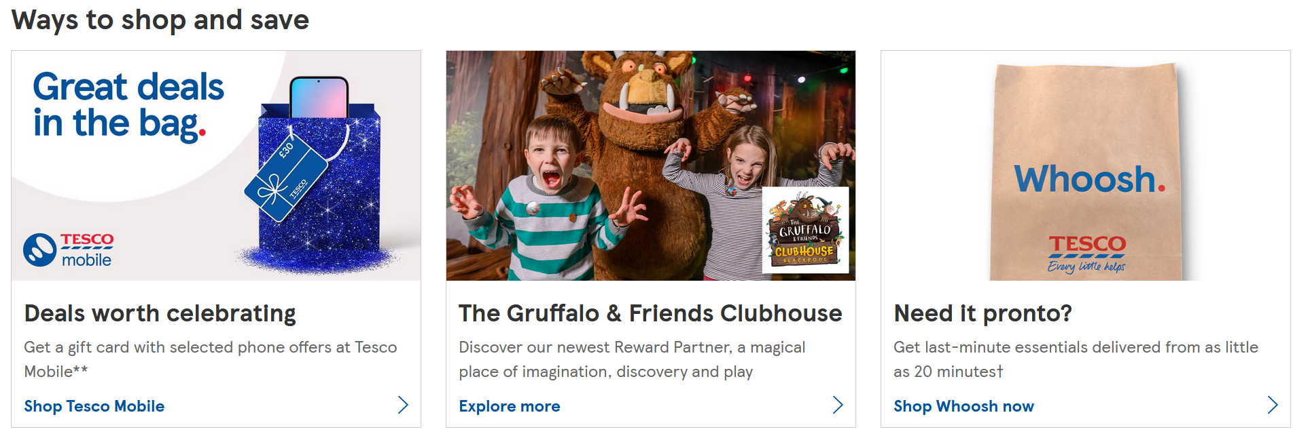
EXISTING SYSTEM
The purpose of this research is to find a way implementation that will provide a Solution not only to tourism hospitality as well as resort since it may be study a number of researches in this field by gathering enough information that will enhance the knowledge by comparing relevance research case studies of relating this article entitled ―Online Supermarket management system Management System for web based technology computerized system.
Tesco Supermarket
Figure 2.1. Website link: https://www.tesco.com

Slide 11
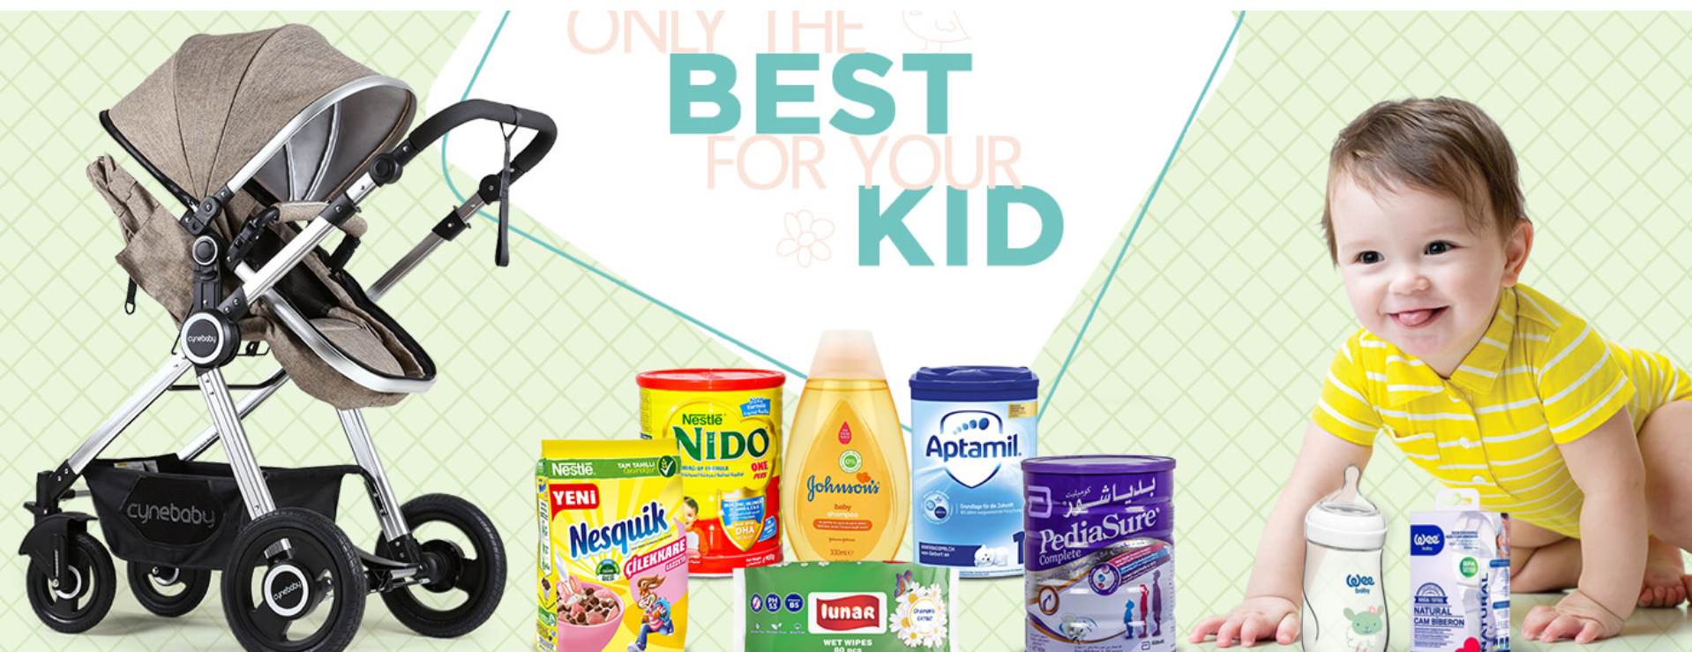
Continue….
2. Hayaat Supermarket website
Figure https://nbtskenya.or.ke/
3.Hayaat supermarket management system

Slide 12
Data Gathering
Data flow Diagram
Feasibility Study
New proposed system
Solution Strategy
CHAPTER THREE
REQUIREMENT ANALYSIS

Slide 13
DATA GATHERING
Data gathering was conducted using multiple methodologies to understand the needs and pain points of users. These methods ensured comprehensive coverage of functional and non-functional requirements.
a. Interviews: Conducted with store managers and cashiers to gather insights on daily operations and system expectations.
b. Observations / Surveys: Observed workflows and surveyed customers to understand service delivery gaps.
c. Questionnaires and Other Documents: Collected feedback from stakeholders using structured questionnaires and reviewed existing documentation.

Slide 14
Uniftied Modelling Language
Unified Modeling Language, (UML) is a standardized modeling language consisting of an integrated set of diagrams, developed to help system and software developers for specifying, visualizing, constructing, and documenting the artifacts of software systems, as well as for business modeling and other non-software systems. The UML represents a collection of best engineering practices that have proven successful in the modeling of large and complex systems.
The UML is a very important part of developing object oriented software and the software development process. The UML uses mostly graphical notations to express the design of software projects. Using the UML helps project teams communicate, explore potential designs, and validate the architectural design of the software which mostly summarized its features in usability used commonly are use case diagram , activity diagram, class diagram and as well as sequence diagram

Slide 15
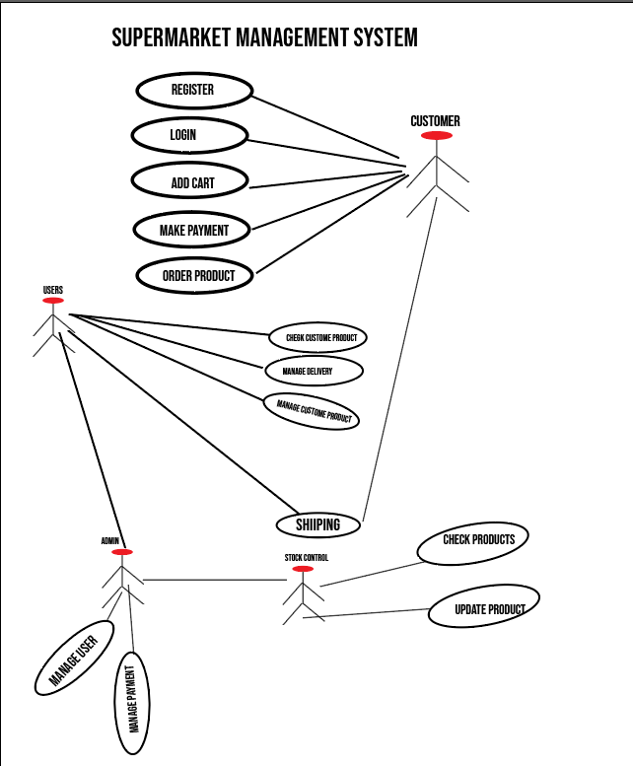
UML –Uniftied Modelling Language

Slide 16
FEASIBILITY STUDY
With the continuous growth and development of society, computer technologies and Informational systems are becoming increasingly prominent resources in many aspects of life relating the decision to implement any new project or program must be based on a thorough analysis of current operation system.
Technical feasibility study
Operational feasibility study
Economic feasibility study
Report feasibility study
Schedule feasibility study.

Slide 17
New Proposed System
Our observation case studies were found that mostly was one of the barriers to online shopping adoption has historically been the level of comfort (or should that be discomfort offline system) with technology that causes many consumers’ fears of technology were challenged unexpectedly during the pandemic and, since then, we have witnessed increased ease and adoption.
The new proposed online supermarket management system can be platform of bushiness transaction throughout web portal technology which discover and be influenced to purchase products attribute or services based on market place recommendations from friends, peers and trusted sources (like influencers) on social networks like Facebook, Instagram and Twitter which many social media platforms e-online system features, such as in-app checkout, stoppable posts and “ view and Buy Now” buttons that take users directly to a brand’s product page.
The new proposed system is visible and later, will have its usage of online supermarket management system that is able to shop transaction and records of payment method banks or EVC-Plus payment of every transaction that entrance has been it registered and. Also, this system will be implemented using PHP as front end and MySQL(Xampp) as back end

Slide 18
Solution Strategy
After we had discovered the current system’s problems, we decided to develop a new system, which meets the needs of the (Hayat Online Supermarket) This solution is associated with implementing sufficient reliable wedding management system, and wiping out the current existing problems; therefore, we considered the solutions and strategies proposed by experts to reach these goals with qualified programmed system.
No | Programming Criteria implementation | Selected choice
Option 1 | JAVA with ANDROID and PHP with MYSQL | Best option
Option 2 | ASP.net with Oracle | Second option
Option 3. | PHP with Mysql | Third option

Slide 19
Chapter IV- System Design
1.Database design
2.Entity relationship Diagram (ERD)
3.Table design

Slide 20
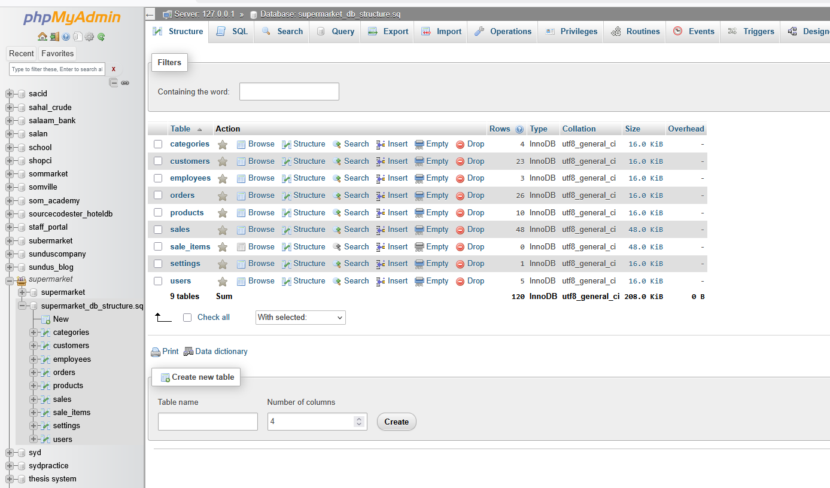
Database design

Slide 21
ENTITY RELATIONSHIP DIAGRAM (ERD)

Slide 22
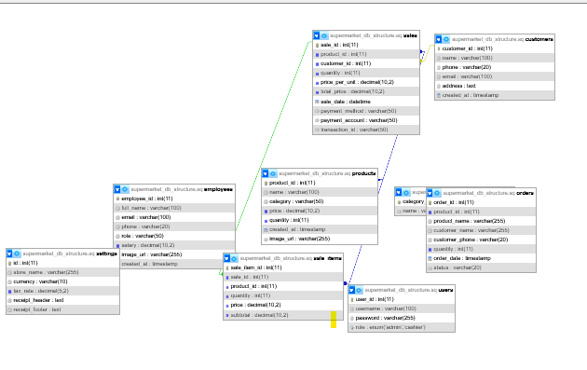
Table design

Slide 23
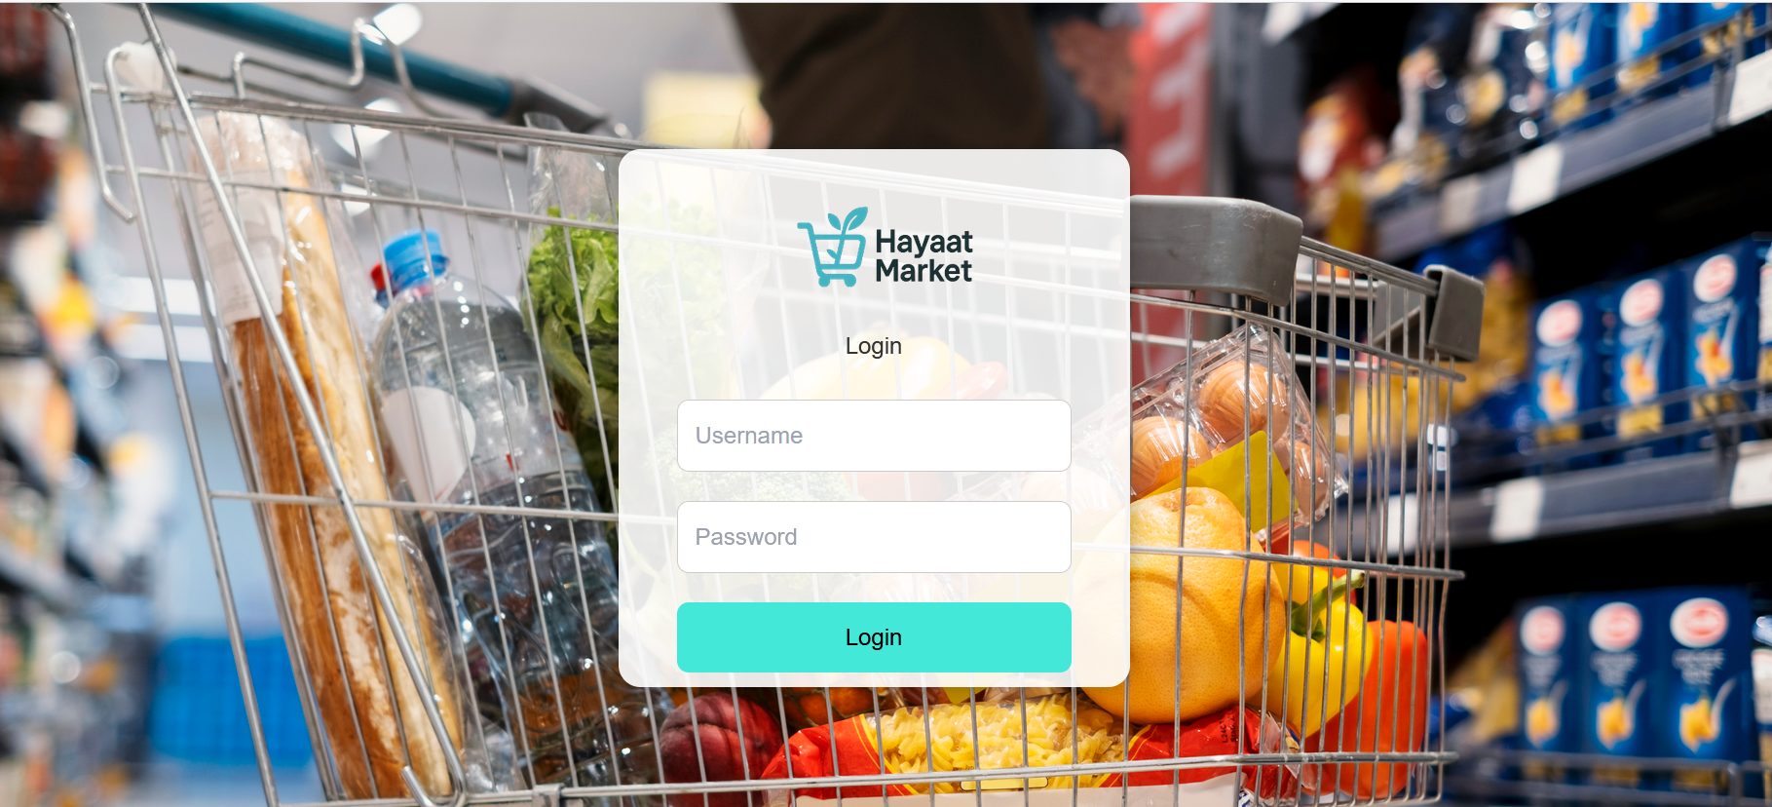
Chapter 5
Login

Slide 24
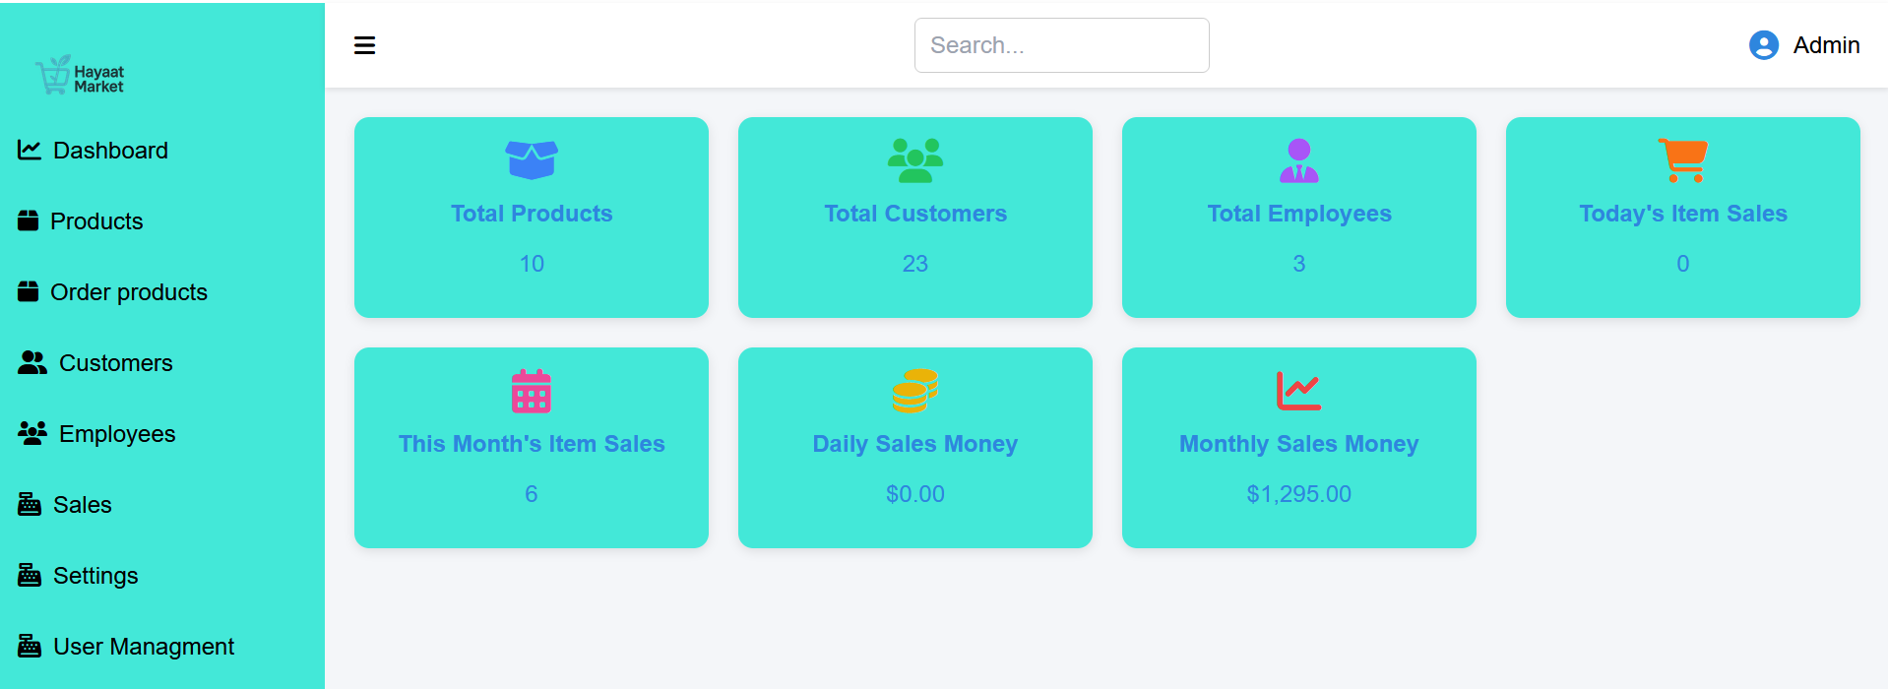
Home Page of Admin

Slide 25
Chapter VI- Conclusion & Recommendation
Conclusion
1.Achievements:
The Supermarket Management System (SMS) is a sophisticated solution that automates the process of managing orders, reservations, and inventory. By digitizing the traditional ordering process, SMS not only makes the operations more efficient but also provides customers with a streamlined and modern experience. It improves overall supermarket operations, reduces errors, enhances customer satisfaction, and saves time for both customers and staff.
SMS offers a web-based platform that gives supermarket owners a comprehensive tool to manage inventory, track sales, and interact with customers. The easy-to-use interface and automated functions reduce wait times, optimize stock availability, and ensure customers can quickly find and purchase what they need.

Slide 26
Contunue………
While the Supermarket Management System provides numerous benefits, there are certain limitations that need to be considered:
Dependency on Technology: The system relies on internet connectivity and software functionality, meaning technical issues (such as server downtime or connectivity problems) could disrupt operations.
Cost Considerations: For small or independent supermarkets, the initial setup and ongoing maintenance costs of implementing such a system could be a concern.
Limited Customization: Off-the-shelf solutions may not always cater to specific needs or branding preferences of every supermarket, limiting flexibility.
Integration Challenges: Compatibility issues may arise when trying to integrate SMS with existing point-of-sale (POS) systems or other software tools used by the supermarket, which could affect operational efficiency.

Slide 27
Concluded marks
Technology has advanced significantly, especially in the field of supermarket automation. The Supermarket Management System (SMS) brings a revolutionary impact to the way supermarkets operate by streamlining order processing, inventory management, and customer interactions. The system's automation features not only save time but also ensure a more effective and seamless operation, which greatly reduces the need for manual intervention

Slide 28
REFERENCE
1: R.H. Ballou, (1999): Business Logistics Management: Planning, Organizing and Controlling the Supply Chain, 4th ed., Prentice-Hall International, London.
2: B. Yang, and N.D. Burns, (2003). "Implications of postponement for the supply chain", International Journal of Production Research, Vol. 41 No.9.
3: M.Q. Patton, (1990). Qualitative Evaluation and Research Methods, 2nd edition, New Bury Park, CA.
4: J.D. Pagh, and M.C. Cooper, (1998). "Supply chain postponement and speculation strategies: how to choose the right strategy", Journal of Business Logistics, Vol. 19
5: W3C, (2015). An analysis of implementing web in the class room. Information System
Educational Journa
6: Wikipedia (https://en.m.wikipedia.org)
7: S. Rietze, (2008). “Examination of supply response”, WA 98237, Vol 7
8: C. Bowersox, (2009). “Inventory Speculation: Cause and Effect”, Ohio, United States 89511
9: “Grocery” (https://www.oxfordlearnersdictionaries.com/us/definition/english/grocery_1?
=grocery+store). Oxford Learner's Dictionary. Retrieved 13 July 2020.
10. Meyer, Zlati (5 April 2017). "Why 'Grocerants' are the new trend, taking bite out of
restaurants"(https://www.usatoday.com/story/money/business/2017/04/05/grocer
nts-take-bite-out-restaurants/99723098/). USA Today. Retrieved 6 April 2017.
"The phenomenon is growing fast enough both in prevalence and sophistication
that the food industry has coined a name for these combination grocery stores and
eateries – the 'grocerant.'"

Slide 29
END

