Slide 1

Admissions Process
Automation
using Microsoft Power Platform
Plymouth Marjon University Interview Presentation
Kingsley Anike
Notes:
Good afternoon and thank you for the opportunity. For this exercise, I designed an end-to-end admissions process automation solution using Microsoft Power Platform and Microsoft 365. The goal was to reduce manual administration, improve operational visibility, standardise communication, and introduce SLA governance into the admissions process.

Slide 2
Current Process Challenges
Current state creates delay, duplication and limited visibility
Operational pain points
Applications and documents are handled manually through the inbox, making ownership, completeness checks and progress tracking harder to control.
Applications arrive via email inbox
Documents arrive separately
Manual completeness checks
Manual academic review routing
Inconsistent applicant tracking
No SLA visibility
Admissions Process Automation | Microsoft Power Platform
2
Notes:
The current process relies heavily on manual handling. Applications arrive via email, documents arrive separately, completeness checks are manual, academic review routing is manual, and tracking is inconsistent. This creates delays, operational inefficiency, and limited visibility. My objective was to design a future-state automated process to streamline those activities.

Slide 3
Solution Architecture
How Power Automate and Microsoft 365 are used
Microsoft Forms
Power Automate
SharePoint List
Applicant intake
Workflow orchestration
Application tracking
Standardised application capture
Triggers, conditions, approvals and updates
Single source of truth and status history
SharePoint Library
Outlook
Scheduled Flow
Document repository
Notifications and approvals
SLA monitoring
Centralised applicant document storage
Applicant updates and reviewer decisions
Overdue checks and escalation alerts
Design reasoning
Microsoft-native tools reduce integration complexity and keep the process familiar for admissions teams while still providing automation, tracking, permissions and auditability.
Admissions Process Automation | Microsoft Power Platform
3
Notes:
I used Microsoft-native tooling throughout the solution. Microsoft Forms handles applicant intake. I chose Forms because it provides a simple, standardised way to collect applicant information and integrates directly with Microsoft 365. Power Automate manages workflow orchestration. SharePoint acts as the tracking and document management layer. I chose SharePoint because it provides a central repository for tracking, document storage and auditability. Outlook handles notifications and approvals. I also created a separate scheduled SLA monitoring flow for governance.

Slide 4
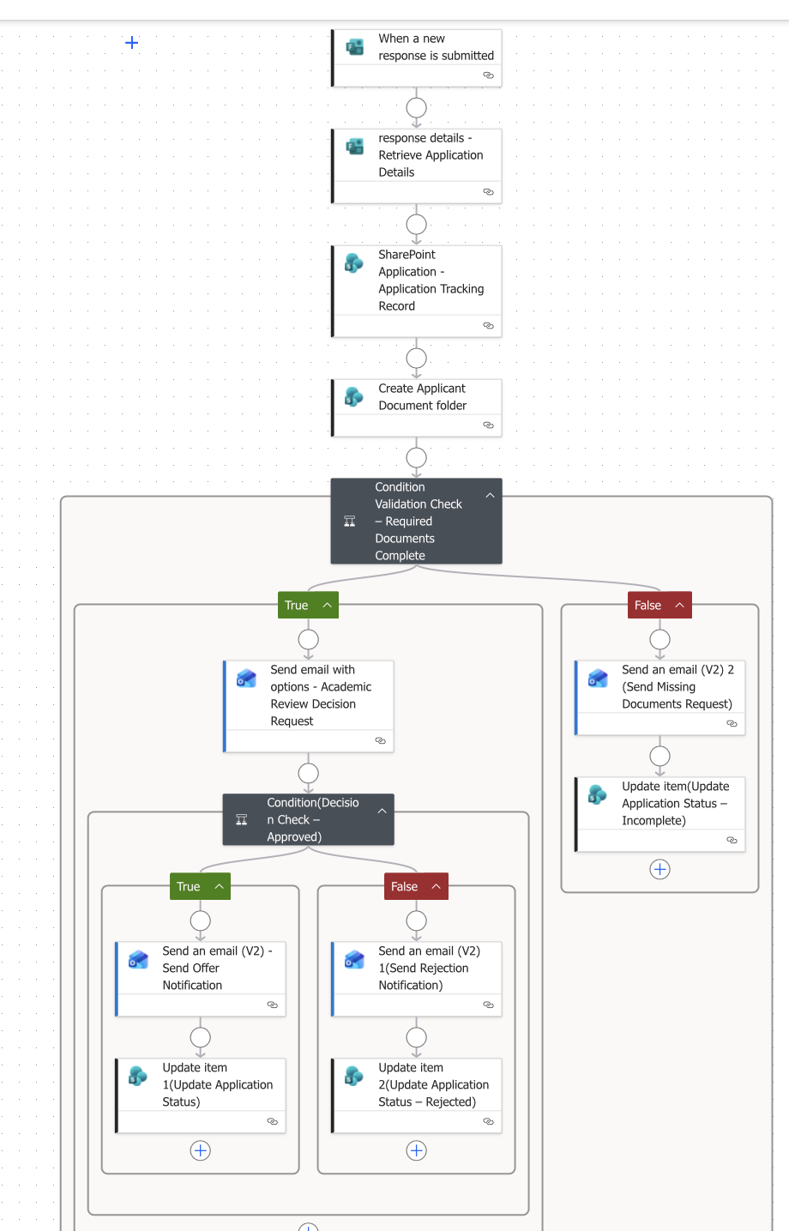
End-to-End Workflow
From applicant submission to decision outcome
What this flow demonstrates
• Forms trigger and response capture
• SharePoint record and folder creation
• Required document validation
• Academic review routing
• Offer / rejection / missing document branches
• Automatic status updates
Reasoning
The flow removes manual inbox handling and creates a single source of truth for admissions staff.
Admissions Process Automation | Microsoft Power Platform
4
Notes:
The process begins when a prospective student submits an application through Microsoft Forms. Power Automate retrieves the submitted details and automatically creates a SharePoint application record. This removes manual data entry and provides a single source of truth for admissions staff. A dedicated SharePoint folder is also created for document storage and organisation. The workflow then validates whether required documents have been submitted. If documents are incomplete, the applicant automatically receives a missing documents notification and the case is marked incomplete. If documents are complete, the application is routed for academic review. The reviewer receives an approval request email with Approve or Reject options. Based on the reviewer’s decision, the applicant receives either an offer communication or rejection notification. SharePoint is then updated automatically to maintain operational visibility and status tracking.

Slide 5
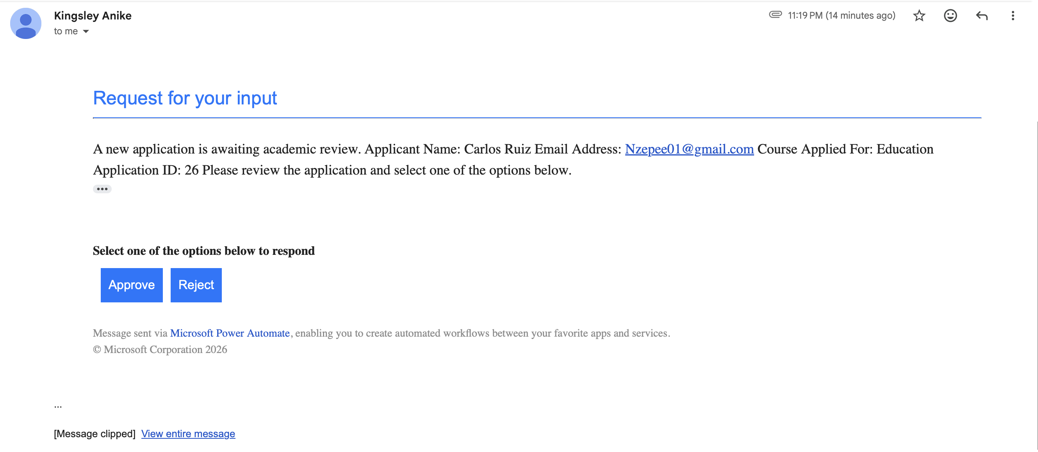
Academic Review Approval Workflow
Internal reviewer decision before applicant outcome is sent
Key point: applicant communications are separate from internal approvals — decisions are controlled through a reviewer mailbox.
Admissions Process Automation | Microsoft Power Platform
5
Notes:
I deliberately separated applicant communications from internal approvals. Approval requests are sent to a reviewer mailbox rather than the applicant. This ensures decisions remain controlled through an internal approval process. This creates a more realistic governance model and standardises academic decision handling.

Slide 6
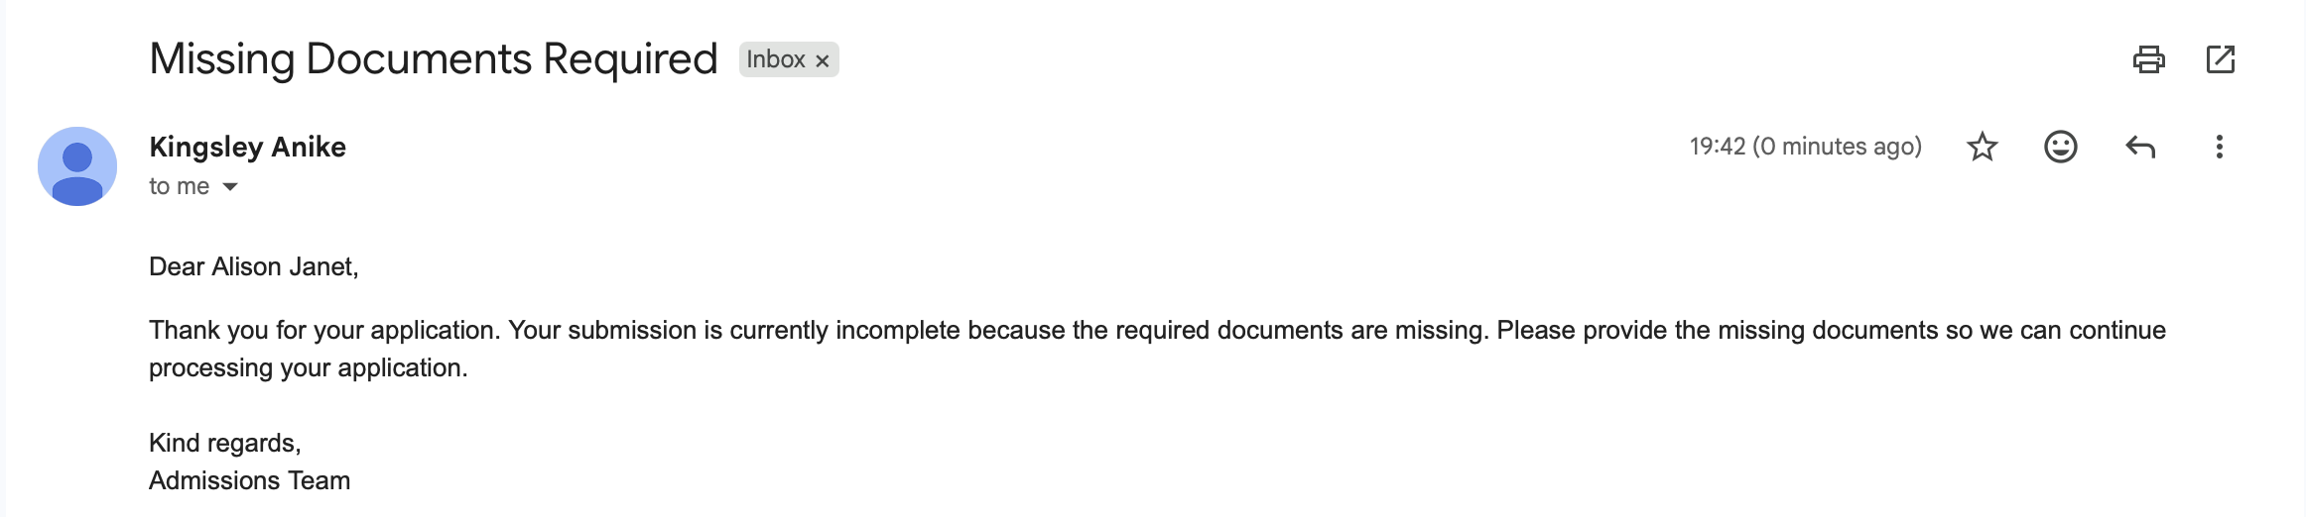
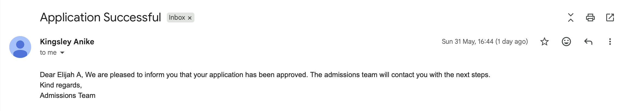
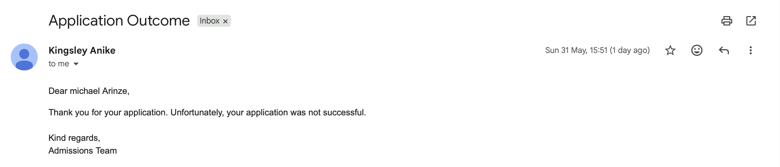
Applicant Communications
Standardised messages based on workflow outcome
Missing Documents Request
Application Successful
Application Rejected
Admissions Process Automation | Microsoft Power Platform
6
Notes:
The solution also standardises applicant communications. Applicants automatically receive the appropriate communication based on workflow outcomes, including missing document requests, approval outcomes, and rejection notifications. This reduces manual drafting and improves consistency.

Slide 7
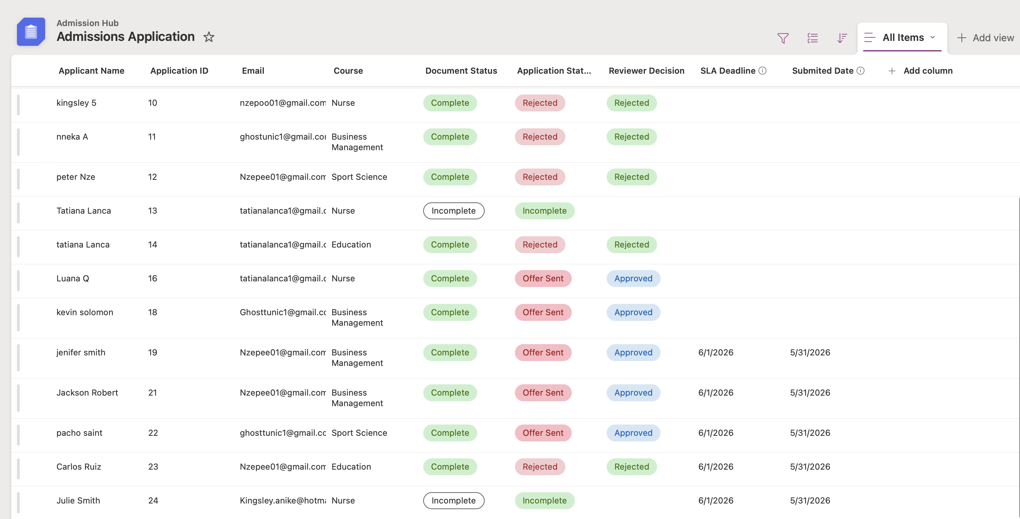
Application Tracking & Case Management
SharePoint list used as an operational tracking layer
Central view of application status, document status and reviewer decisions
Admissions Process Automation | Microsoft Power Platform
7
Notes:
SharePoint acts as a lightweight operational tracking and case management layer. Admissions staff can immediately view application status, document completeness, reviewer decisions, and workflow progress in one central location. This improves visibility and reduces dependency on inbox tracking.

Slide 8
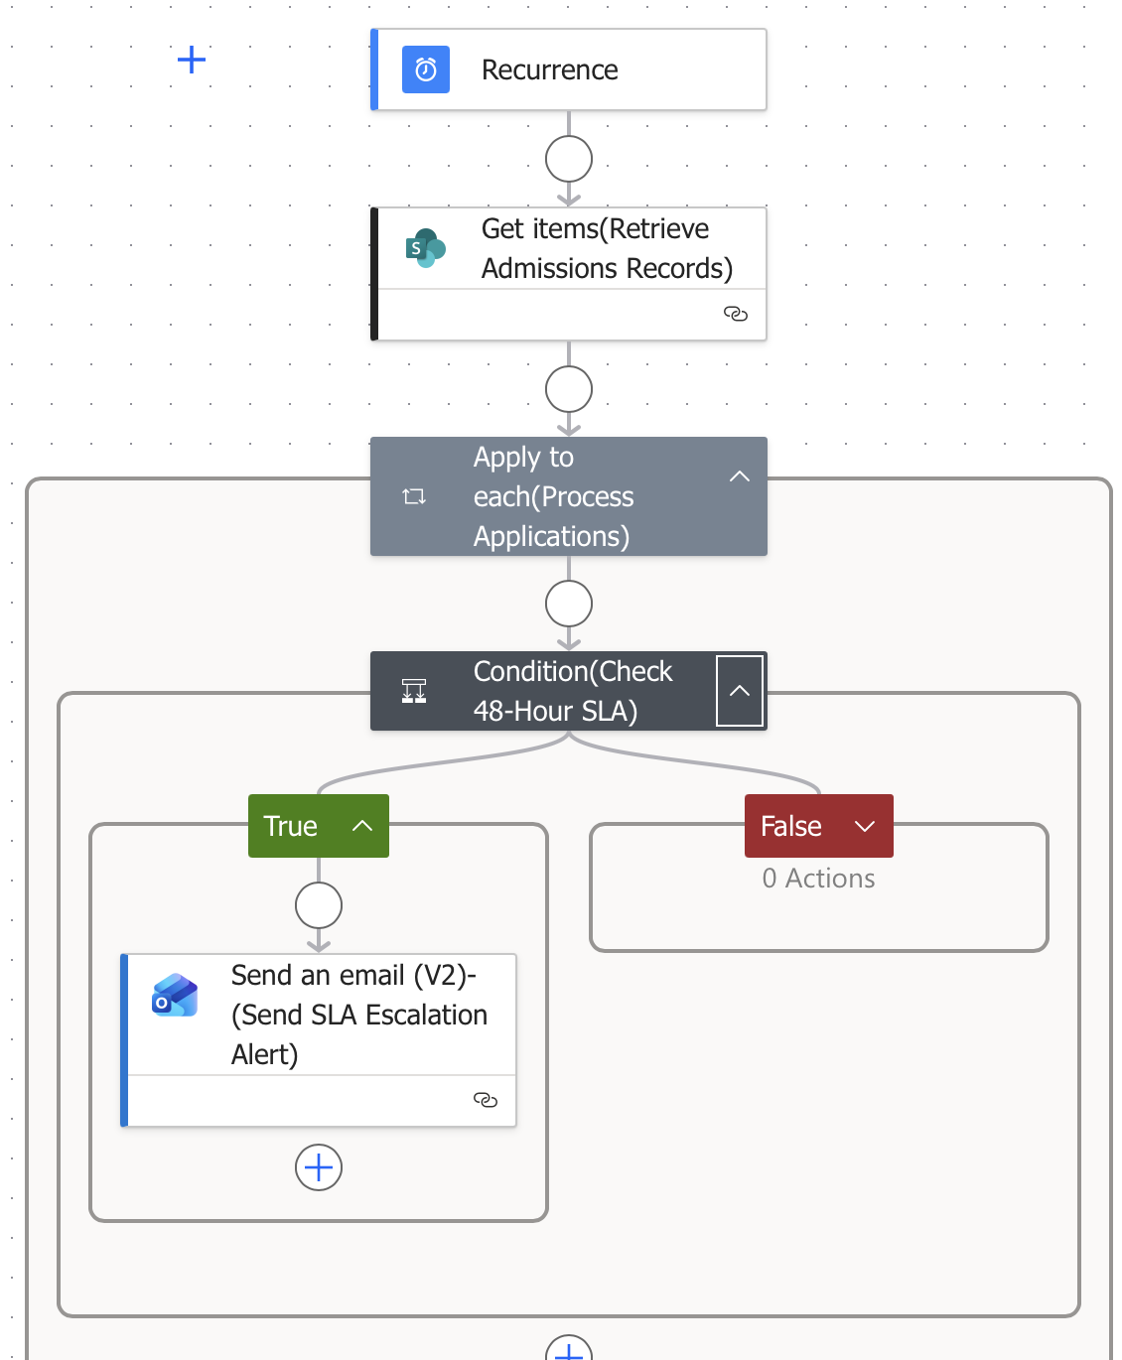
SLA Monitoring & Governance
Scheduled operational monitoring for overdue applications
Why a separate SLA flow?
The main flow processes applications. The SLA flow monitors operational performance. Separating responsibilities makes the solution easier to manage and maintain.
How it works
Runs on a schedule, checks SharePoint for overdue cases and sends escalation alerts when action is required.
Governance value
Reduces the risk of applications being missed or delayed.
Admissions Process Automation | Microsoft Power Platform
8
Notes:
I also created a separate SLA monitoring flow. The main workflow handles application processing, while the SLA flow handles operational monitoring. I separated these responsibilities to make the solution easier to manage and maintain. The SLA flow runs on a schedule, checks for overdue applications still awaiting action, and sends escalation alerts. This introduces governance and reduces the risk of applications being missed or delayed.

Slide 9
Benefits & Business Impact
What the future-state process improves
Reduced admin effort
Faster turnaround
Improved applicant experience
Less manual inbox handling and manual email drafting
Applications move automatically to the next stage
Consistent and timely communication
Better governance
SLA visibility
Scalable design
Review decisions and statuses are visible in SharePoint
Overdue applications can be escalated
Built using Microsoft 365-native tools
The process also provides a foundation for future reporting and analytics.
Admissions Process Automation | Microsoft Power Platform
9
Notes:
The main business benefits are reduced manual administration, faster turnaround times, improved applicant experience, stronger operational visibility, and more consistent communication. The process is also scalable and fully integrated within the Microsoft 365 ecosystem. It also provides a foundation for future reporting and analytics.

Slide 10
Future Enhancements
How the prototype could be taken further in production
Teams approvals
Route review decisions into Teams for easier reviewer action
Power BI dashboard
Report on volumes, conversion, overdue cases and bottlenecks
Automated document validation
Check document completeness and naming standards automatically
Role-based access controls
Limit document and decision access by team role
Dataverse at enterprise scale
Use Dataverse if data model complexity or scale increases
Admissions Process Automation | Microsoft Power Platform
10
Notes:
If developed further, I would extend the solution with Power BI operational reporting, Teams-based approvals, stronger role-based access controls, automated document verification, and potentially Dataverse for enterprise-scale requirements.

Slide 11
Q&A
Thank you for listening. I’m happy to answer any questions.
Notes:
Thank you for listening. I’m happy to answer any questions.

