Slide 1

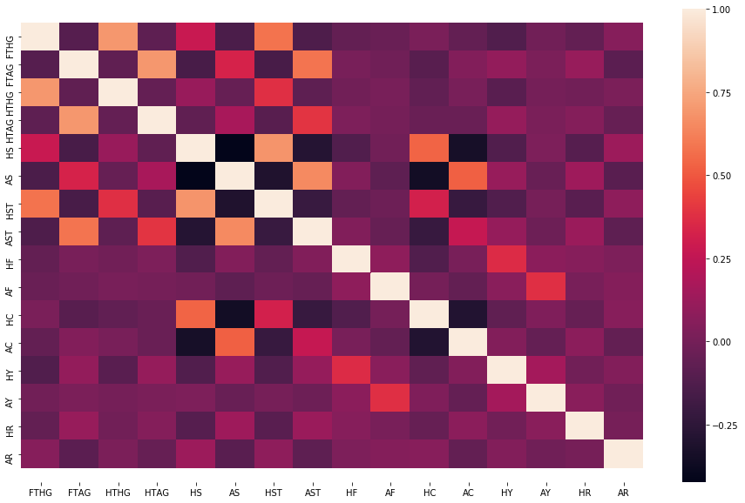
PREMIER LEAGUE PREDICTIONS AND CORRELATIONS
Markus Mikko, Del Remi Liik
Introduction
Training the model
MINGI lambiiiiiiiiiiiiiiiiiiiiiiiiiiiiiiiiiiiiiiiiiiiiiiiiiiiiiiiiiiiiiiiiiiiiiiiiiiiiiiiiiiiiiiiiiiiiiiiiiiiiiiiiiiiiiii tekst
ssssssssssssssssss
MINGI lambiiiiiiiiiiiiiiiiiiiiiiiiiiiiiiiiiiiiiiiiiiiiiiiiiiiiiiiiiiiiiiiiiiiiiiiiiiiiiiiiiiiiiiiiiiiiiiiiiiiiiiiiiiiiiii tekst
ssssssssssssssss
Data
Motivation/Problem
MINGI lambiiiiiiiiiiiiiiiiiiiiiiiiiiiiiiiiiiiiiiiiiiiiiiiiiiiiiiiiiiiiiiiiiiiiiiiiiiiiiiiiiiiiiiiiiiiiiiiiiiiiiiiiiiiiiii tekst
aaaaa
MINGI lambiiiiiiiiiiiiiiiiiiiiiiiiiiiiiiiiiiiiiiiiiiiiiiiiiiiiiiiiiiiiiiiiiiiiiiiiiiiiiiiiiiiiiiiiiiiiiiiiiiiiiiiiiiiiiii tekst
aaaaa
Results
Ssssssssssssssssssss
Ssssssssssssssssss
sssssssssssssssssssssssssssssssssssssssssssssss
Sssssssssssssssssssssss
ssssss
What to bet on | Referee 1 | Referee 2 | Referee 3
Home team yellow cards | S. Attwell | K. Friend | J. Moss
Away team yellow cards | S. Attwell | C. Kavanagh | C. Pawson
Home team red cards | M. Jones | R. Madley | K. Friend
Away team red cards | P. Dowd | H. Webb | L. Probert
Team | Most certain outcome against | Most difficult to predict outcome against
Arsenal | Aston villa | Tottenham
Liverpool | Huddersfield | Hull
Norwich | Tottenham | Newcastle
Sunderland | Man United | Burnley
Swansea | Man United | Crystal Palace
West Brom | Man City | Aston Villa
West Ham | Fulham | Sunderland
Chelsea | Cardiff | Norwich
Crystal Palace | Huddersfield | Swansea
Man City | West Brom | Man United
Aston Villa | Arsenal | Leicester
Everton | Huddersfield | Watford
Fulham | Tottenham | Cardiff
Hull | Arsenal | Liverpool
Newacastle | Huddersfield | Norwich
Southampton | Sunderland | Brighton
Stoke | Tottenham | Southampton
Cardiff | Chelsea | Fulham
Tottenham | Fulham | Arsenal
Man United | Fulham | Brighton
Leicester | Brighton | Aston Villa
Burnley | Bournemouth | Huddersfield
Bournemouth | Brighton | Leicester
Watford | Man City | Everton
Brighton | Chelsea | Man United
Huddersfield | Everton | Burnley
Conclusion
Ssssssssssssssssssssssssssssssssssssssssssssss
S
s

