Slide 1
CS-1002-OOP-Lab-Project
Presented By Abdul Malik-cs201003
Team Members CS-1002-Lab
S.NO | NAME OF TEAM MEMBERS | ROLL NUMBERS
01 | Abdul Malik(Lead) | cs201003
02 | Aftab Ahmed | cs201010
03 | Aamir Saleem | cs201002
04 | Abdul Waleed Kalwar | cs201006

Slide 2
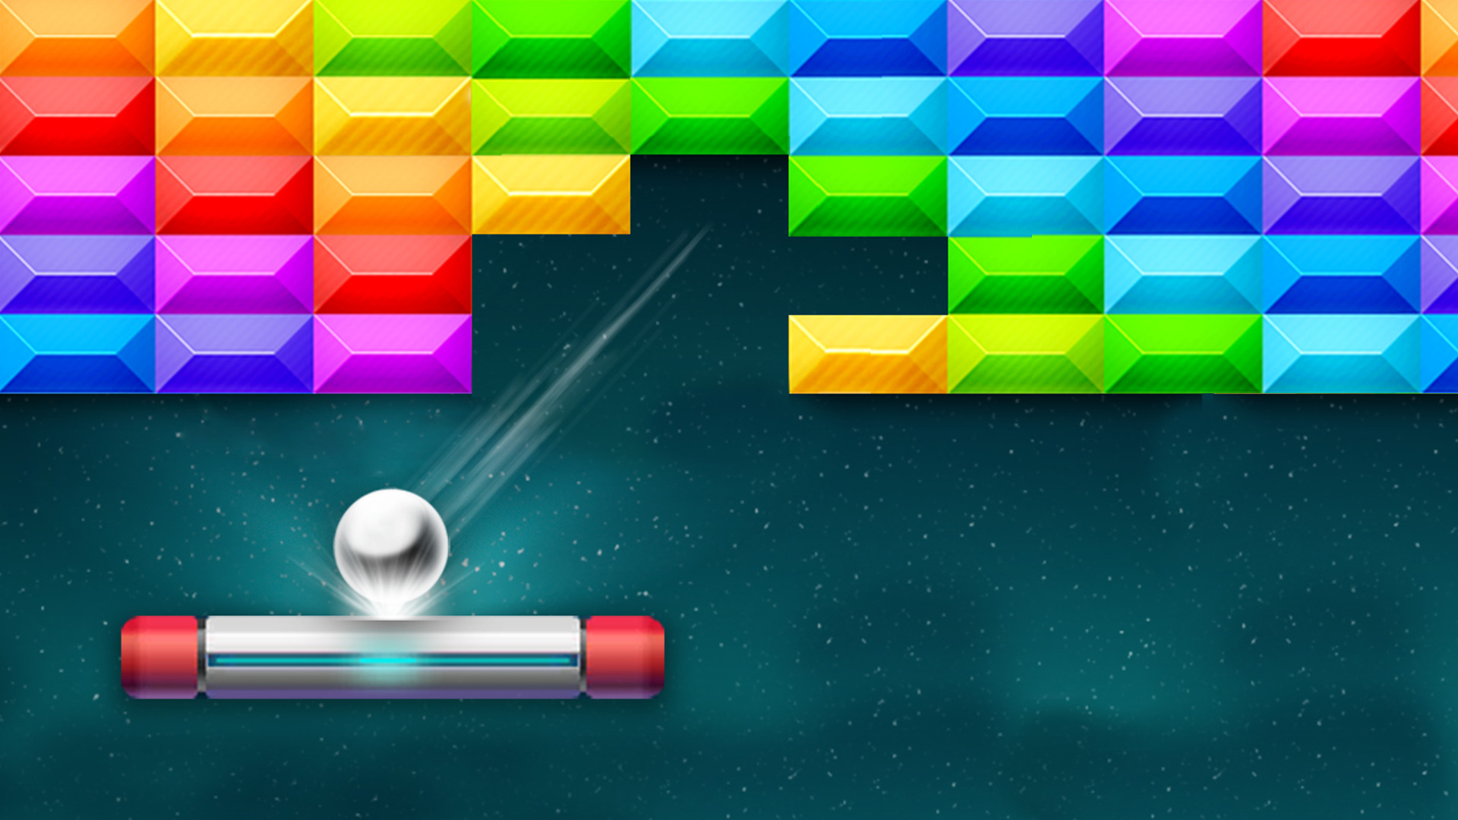
PROJECT ABOUT BRICK BREAKER GAME IN JAVA Language

Slide 3
INTRODUCTION
The Project is Consist of Game which is Known as Brick Breaker Game
Objectives that we need to create this Game
Window(JFRAME)
Bricks
Ball
Paddle
The objective of the game is to break all of the bricks that are on the top of the screen by deflecting the ball with the bottom bar. As the game progresses it becomes more challenging as asteroid objects come onto the screen and can also deflect the ball.

Slide 4
TECHNICAL DETAIL
We have used the following Topics using Java Language to build the Game.
GUI
BUILT_IN FUNCTIONS
ASSOCIATION
INHERITANCE
ENCAPSULATION
POLYMORPHISM
Method Overriding
Private, Instance and Public VARIABLES
Imported Packages
JFrame
JPanel
Color
ImageIcon
Graphics and Graphics2D
Rectangle
ActionEvent
ActionListener
KeyEvent
KeyListener
Timer
Font
BasicStroke

Slide 5
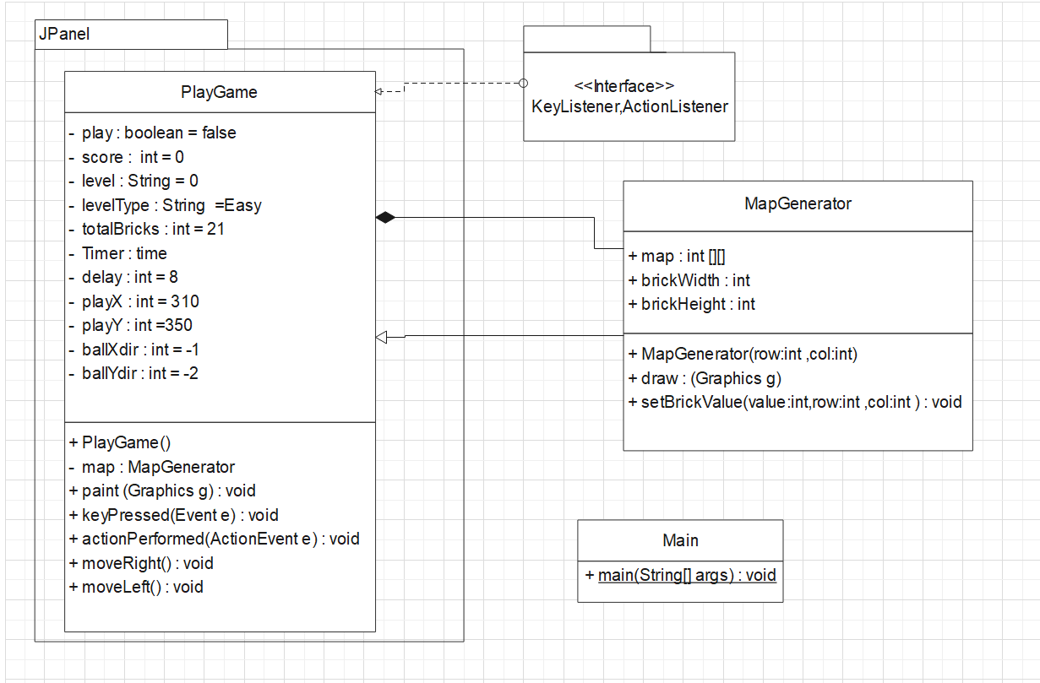
UML CLASS DIAGRAM

Slide 6
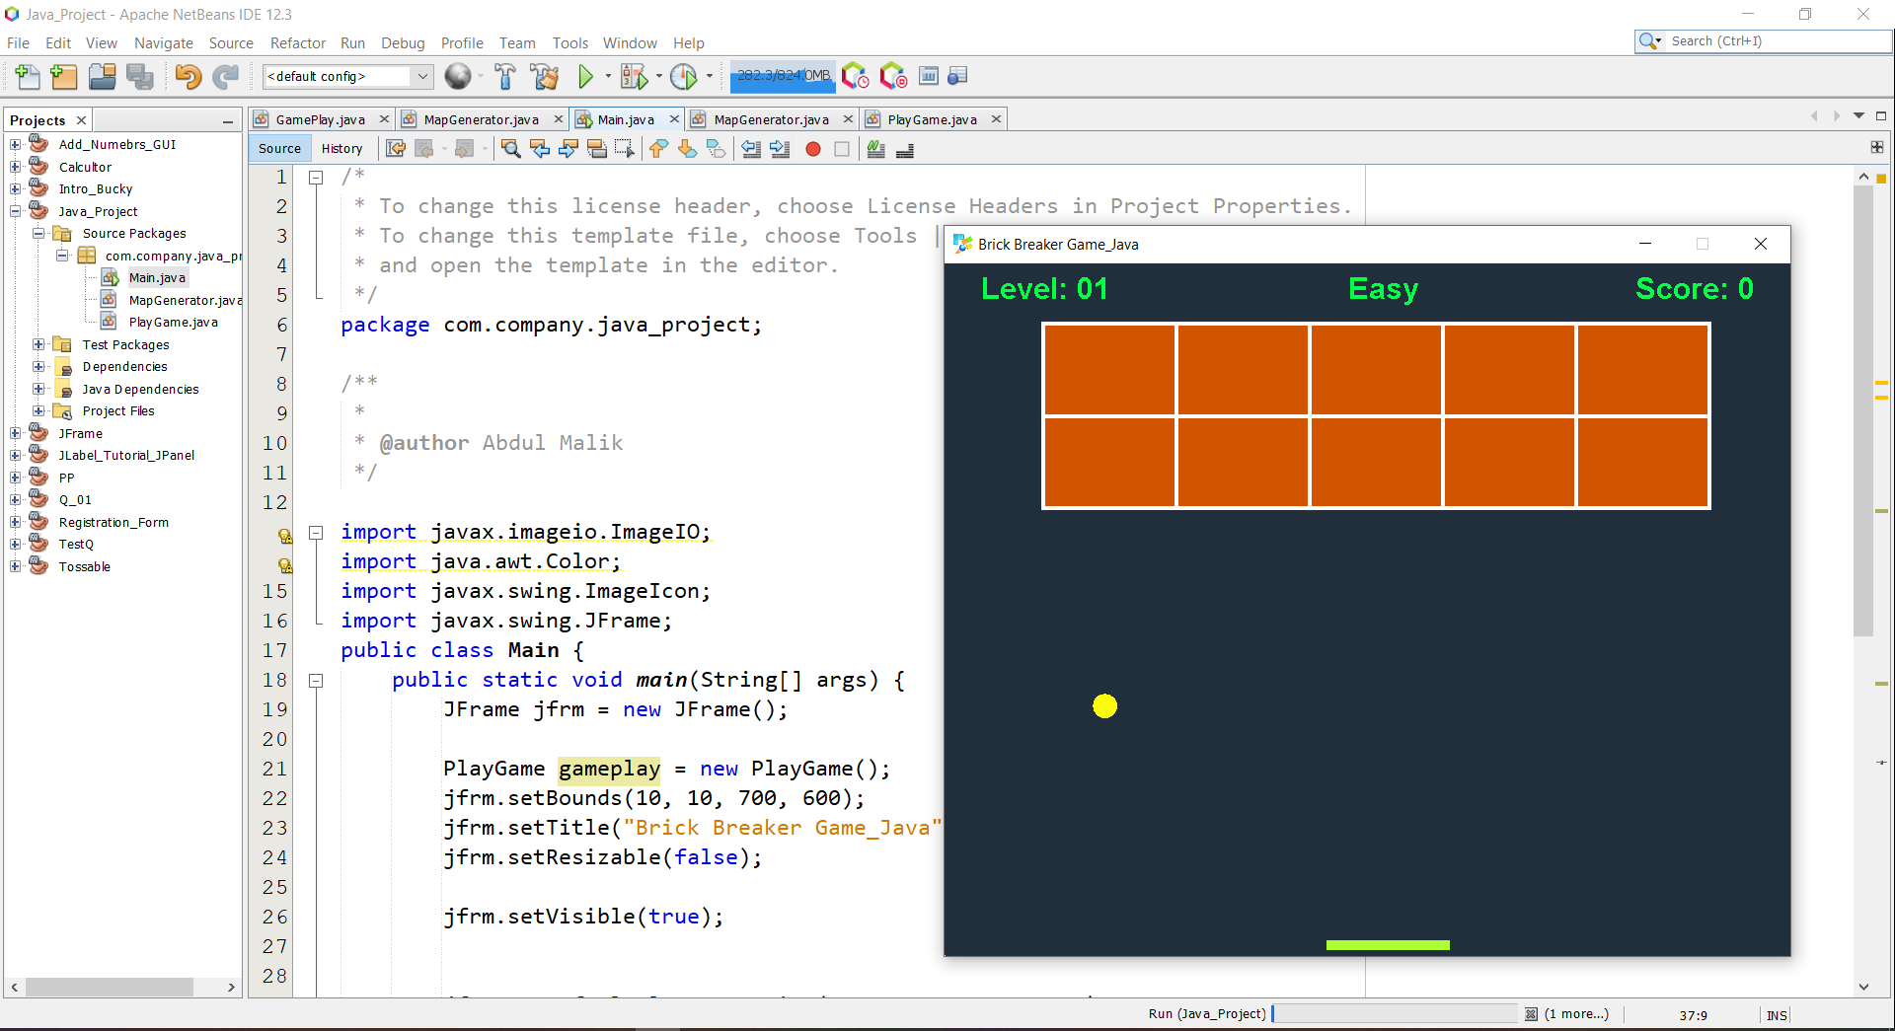
GAME DEVELOPMENT SCREENSHOTS/OUTPUTS

Slide 7
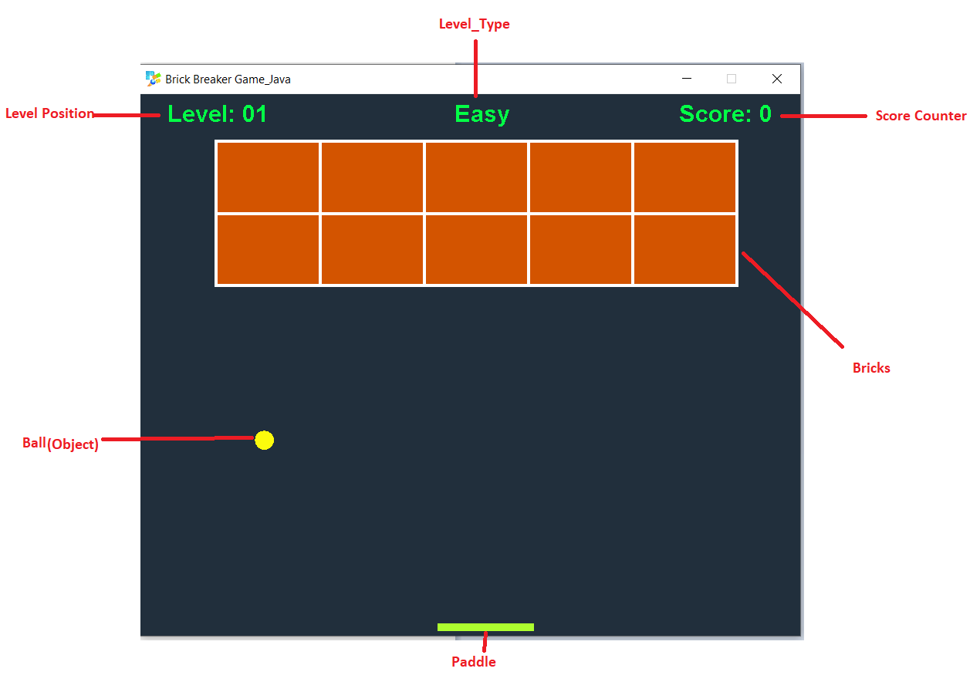
GAME DEVELOPMENT SCREENSHOTS/OUTPUTS

Slide 8
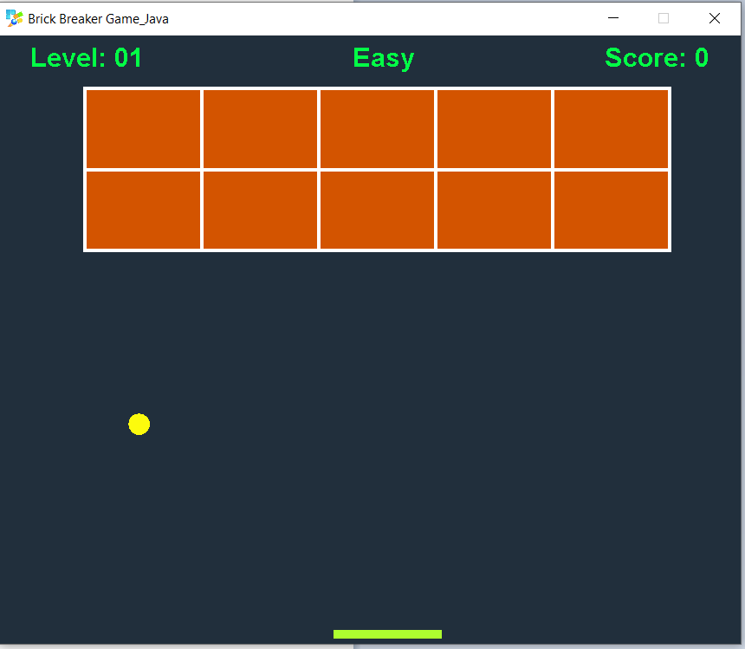
GAME DEVELOPMENT SCREENSHOTS/OUTPUTS

Slide 9
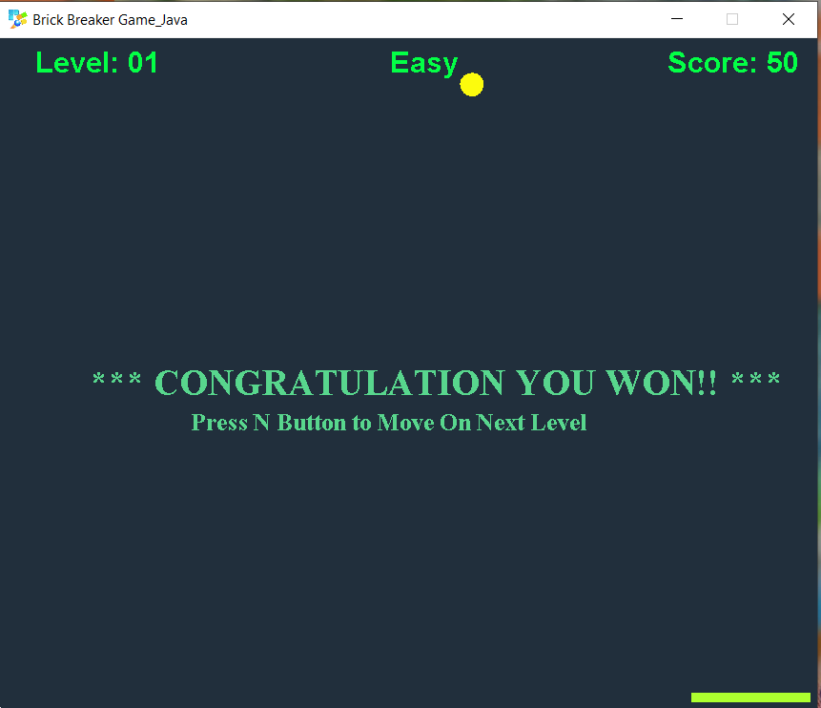
GAME DEVELOPMENT SCREENSHOTS/OUTPUTS
Whenever Level completes it show a message and ask For Press Key to Move on Next Level

Slide 10
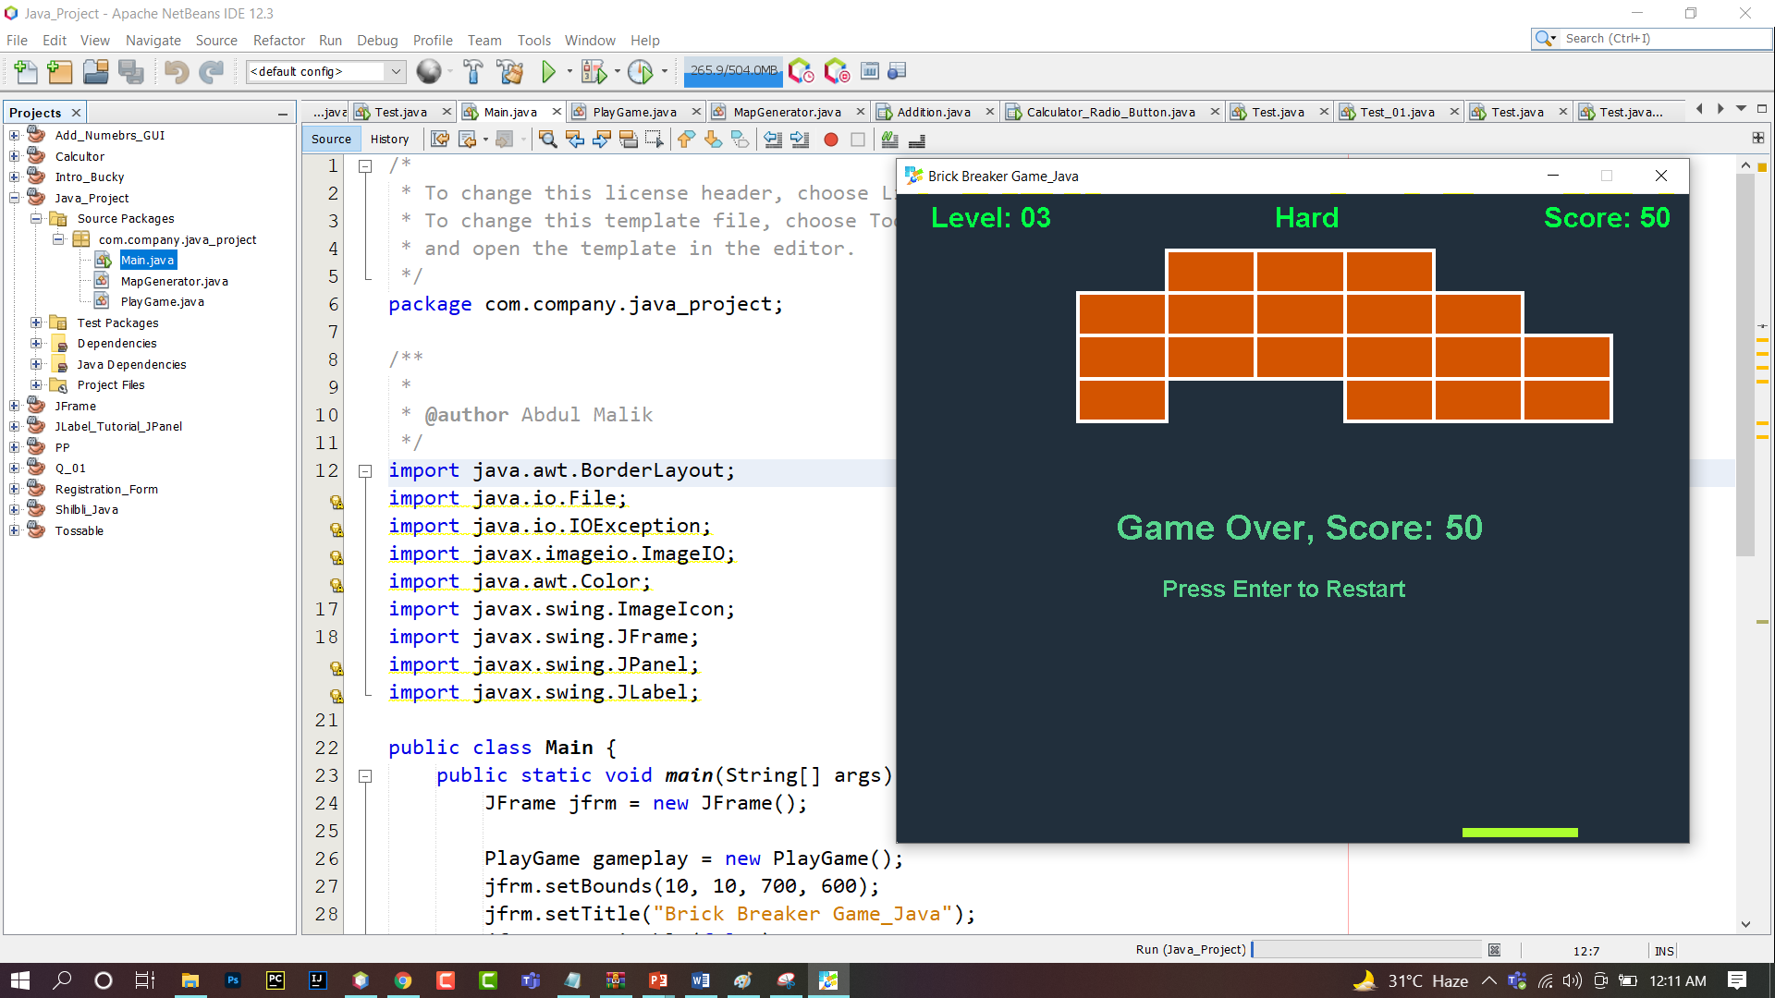
GAME DEVELOPMENT SCREENSHOTS/OUTPUTS
Whenever Player Out at Any Level it Shows message and Ask for to Press Enter key to Start again

