Slide 1
CS-2001L DSA-LAB
PRESENTED BY ABDUL MALIK-CS201003
TEAM MEMBERS
1. SANJAY KUMAR cs201125
2. AYUSH KUMAR cs201029

Slide 2
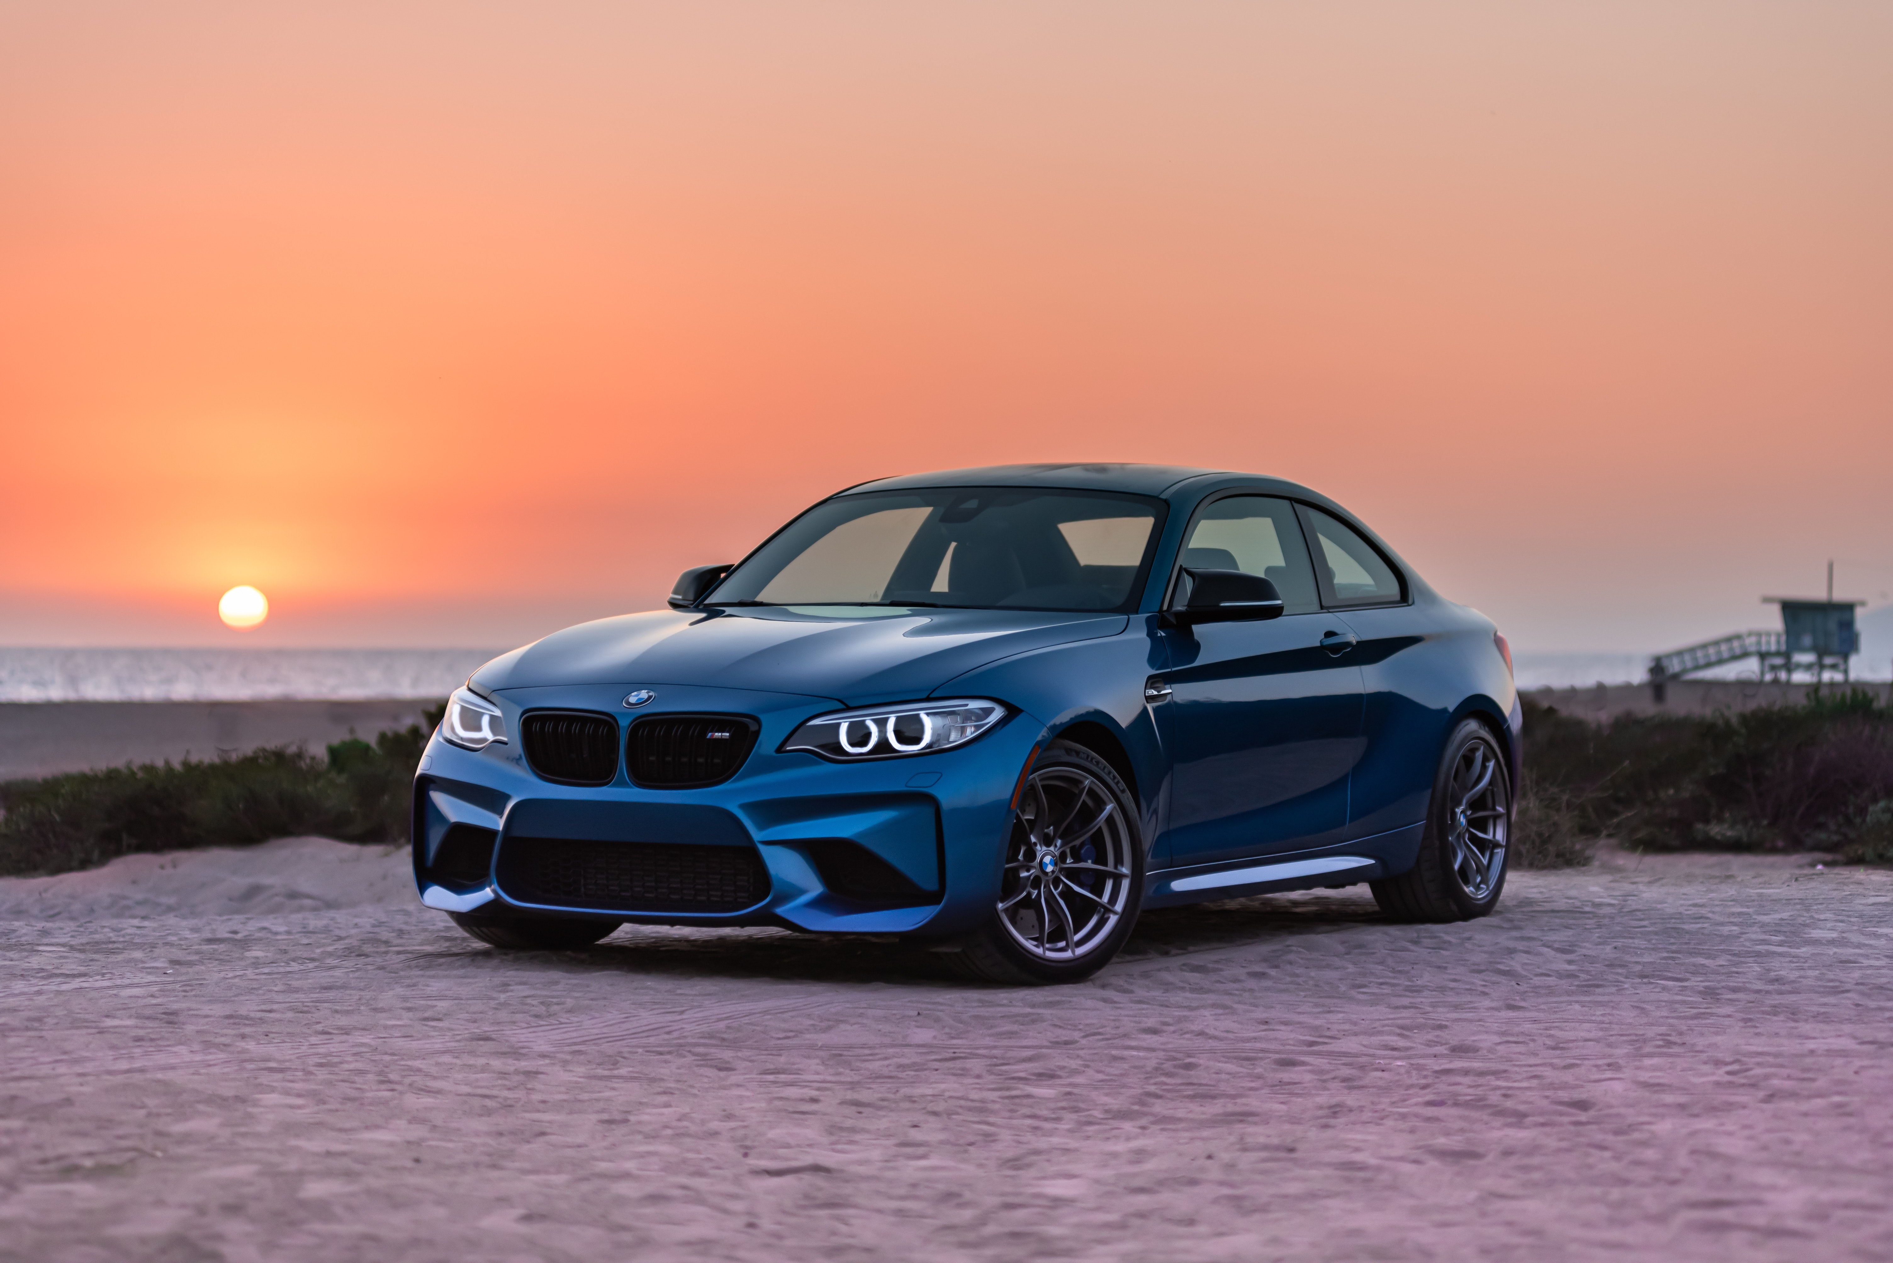
PROJECT ABOUT CAR RENTAL SYSTEM

Slide 3
INTRODUCTION
This Project is Consist of System Application which is known CAR RENTAL SYSTEM
Objectives that we need to create this Application
User Info Needed(Creation of Account)
List of cars with different Prices will be present for rent
List of all rented cars then user will check which car has to rent or not
Payment Method then Invoice will be print at the end
Car Rental System is based on a concept to rent cars and generate rental invoice of a rental company. Before stepping into the main system a user has to pass through a login system to get access, then only the user can select cars with a different model and rent for certain days.

Slide 4
TECHNICAL DETAIL
Data Structure and Algorithm Topic Used
Arrays
Sorting Alogs
Linked List
Recursion
Stack
Queue(Enqueue and Dequeue)
Additional Concepts Used
Concepts of Class and Objects
File Handling
Inheritance
Set width
Loops
Sleep function
System CLS function

Slide 5
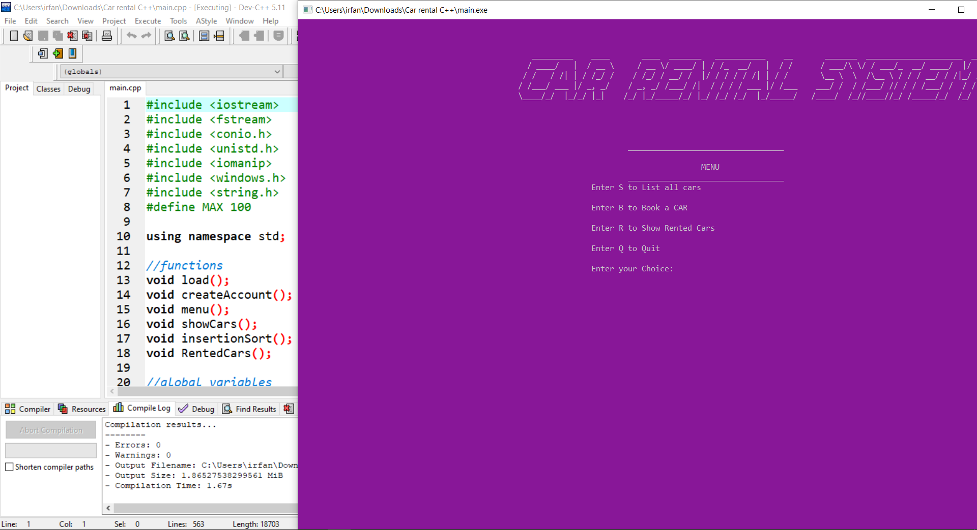
SYSTEM DEVELOPMENT SCREENSHOTS/OUTPUTS

Slide 6
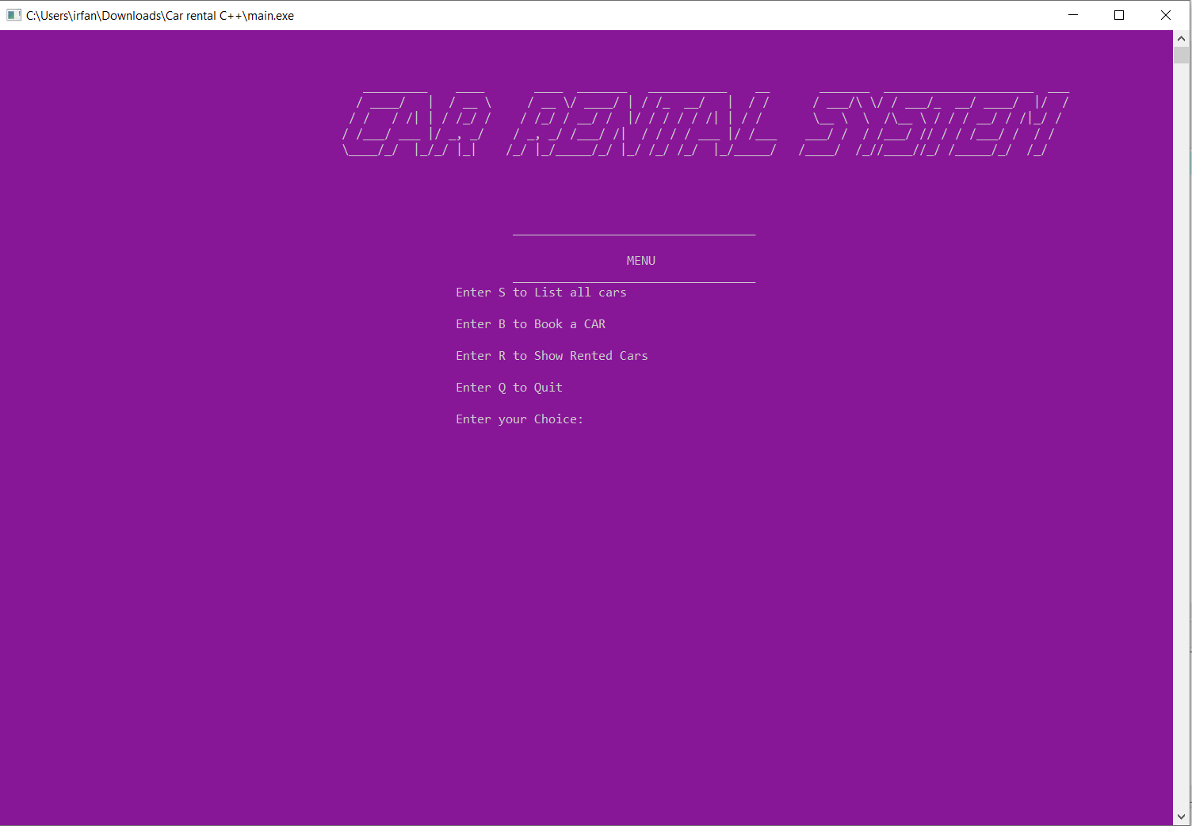
SYSTEM DEVELOPMENT SCREENSHOTS/OUTPUTS
MENU PAGE
At First Menu Page will be Shown you can check and go back same menu page

Slide 7
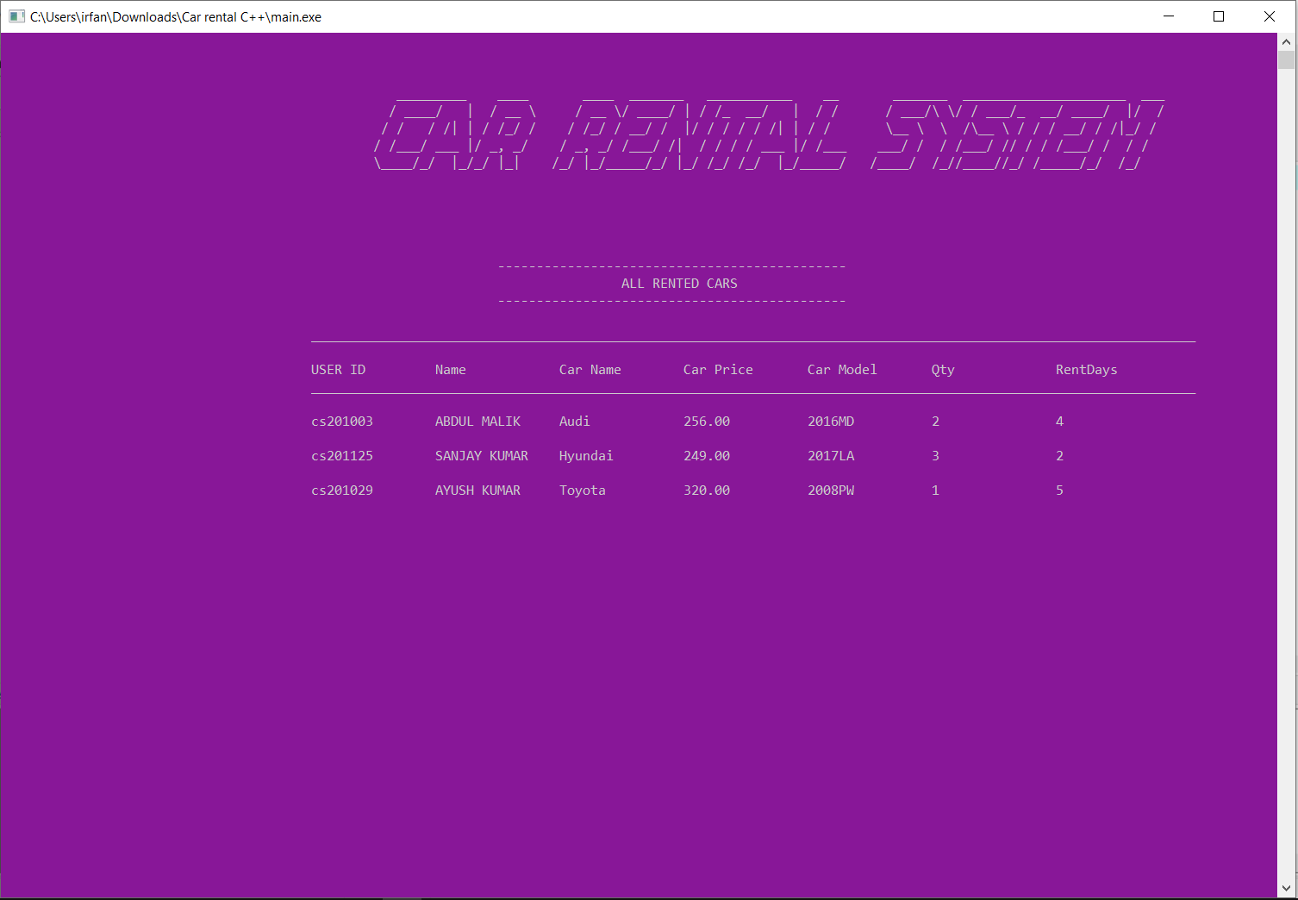
SYSTEM DEVELOPMENT SCREENSHOTS/OUTPUTS
MENU PAGE
At First Menu Page if you click on select any option it will be like and then you will go back.

Slide 8
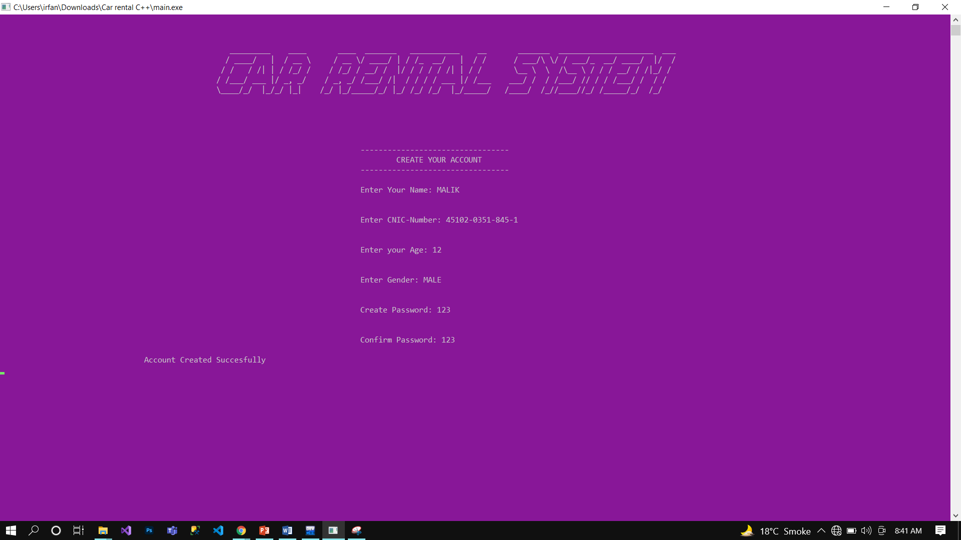
SYSTEM DEVELOPMENT SCREENSHOTS/OUTPUTS
Create Account
After selecting book a car you will be asked to create Account

Slide 9
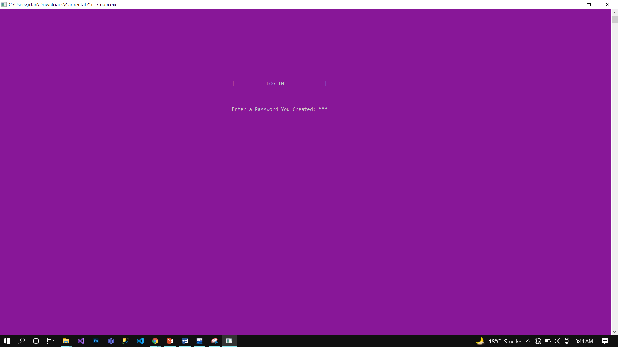
SYSTEM DEVELOPMENT SCREENSHOTS/OUTPUTS
Log IN
After creating Account you will be asked to enter log in password

Slide 10
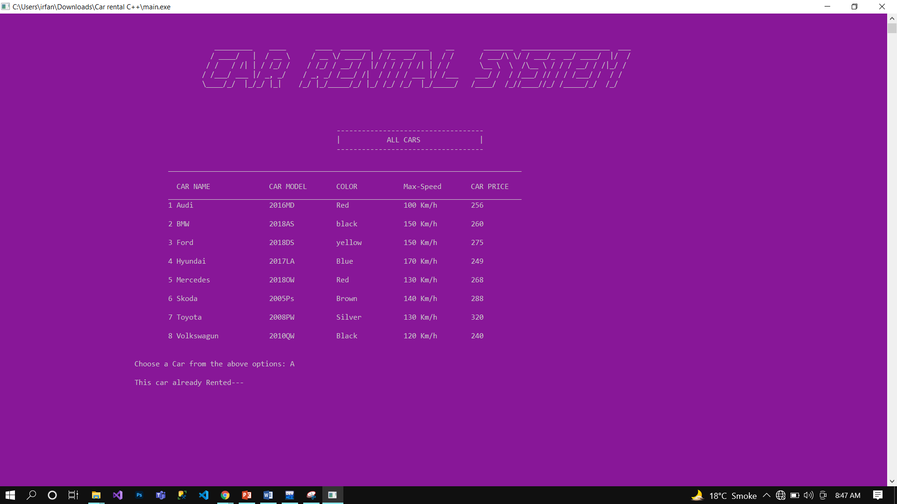
SYSTEM DEVELOPMENT SCREENSHOTS/OUTPUTS

Slide 11
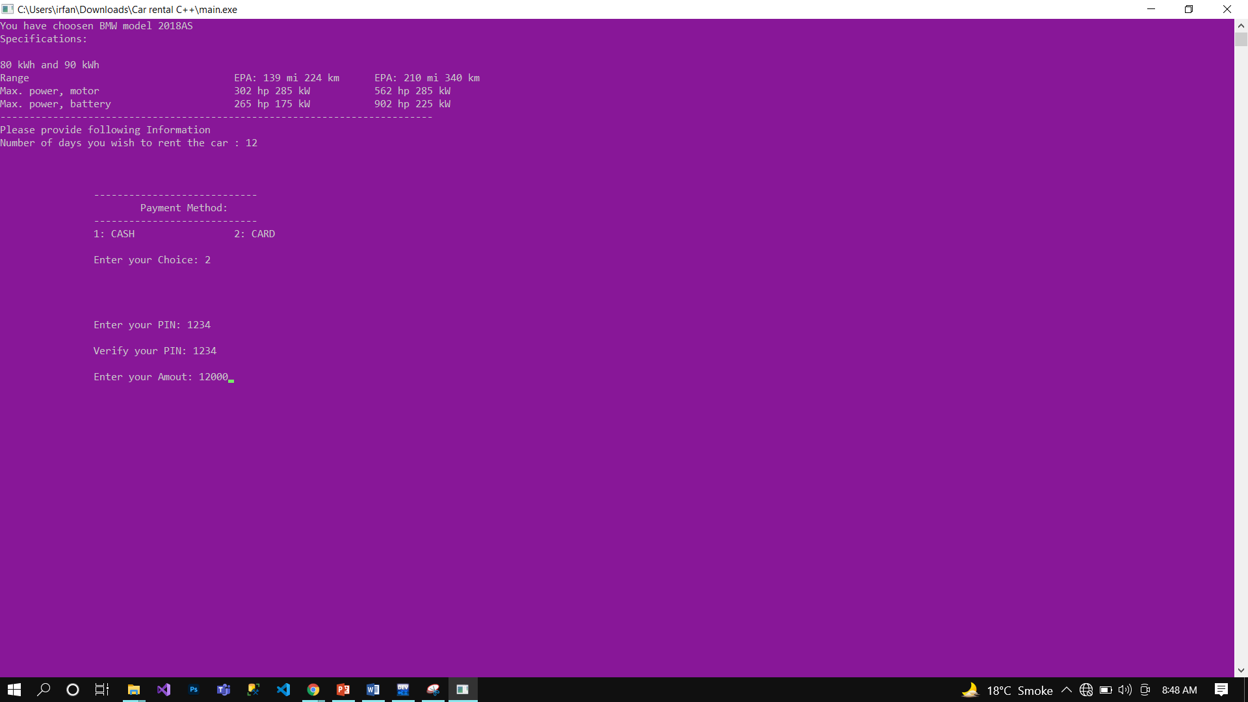
SYSTEM DEVELOPMENT SCREENSHOTS/OUTPUTS

Slide 12
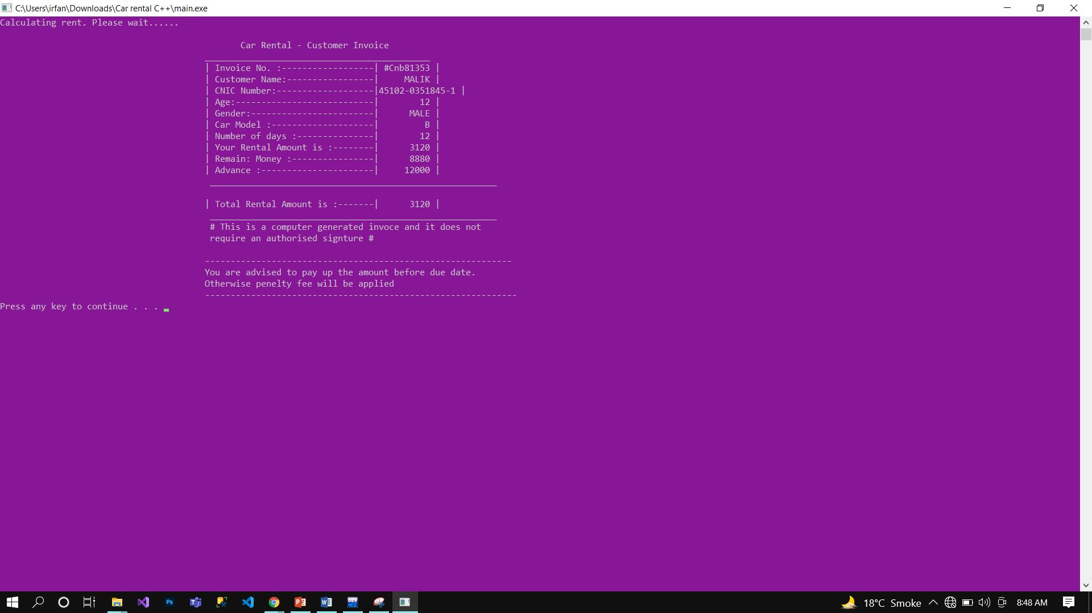
SYSTEM DEVELOPMENT SCREENSHOTS/OUTPUTS

Slide 13
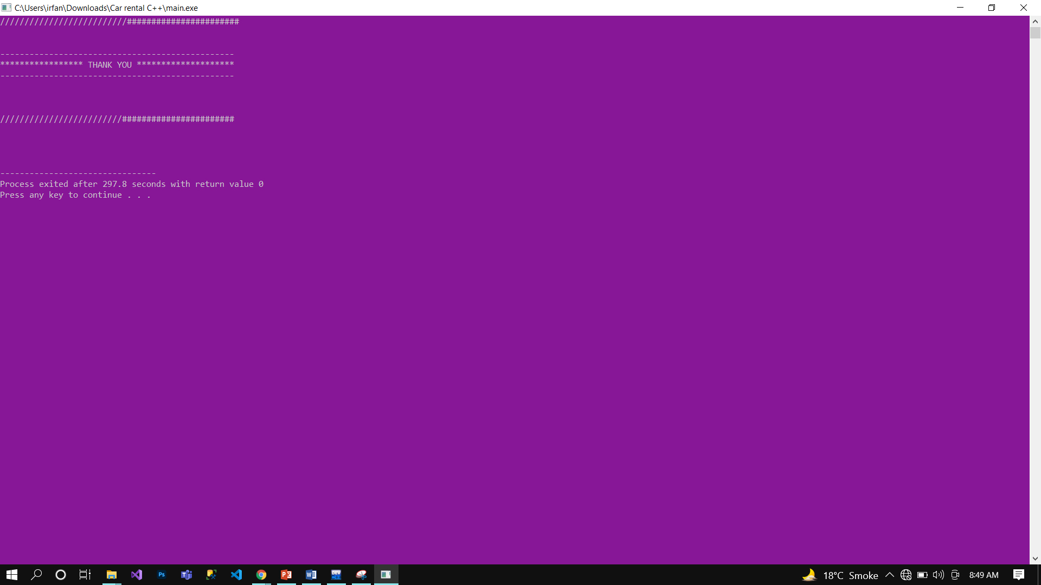
SYSTEM DEVELOPMENT SCREENSHOTS/OUTPUTS

