Slide 1
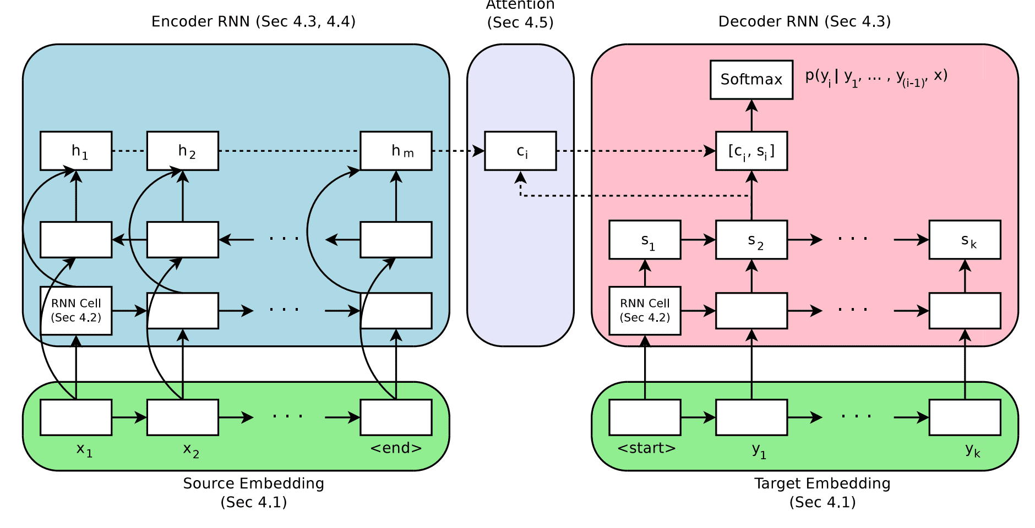

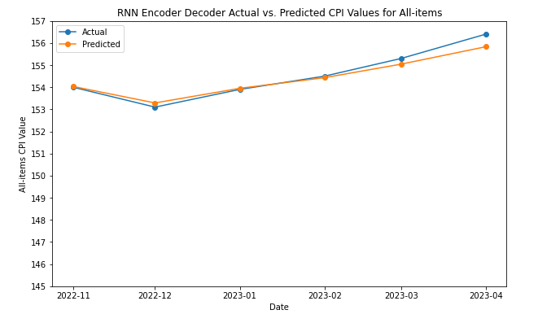
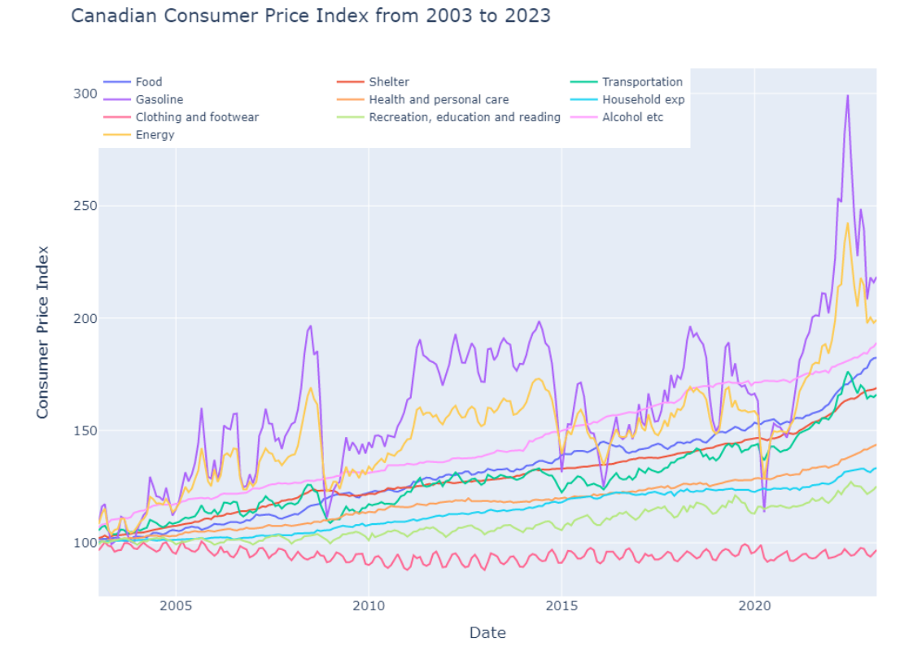
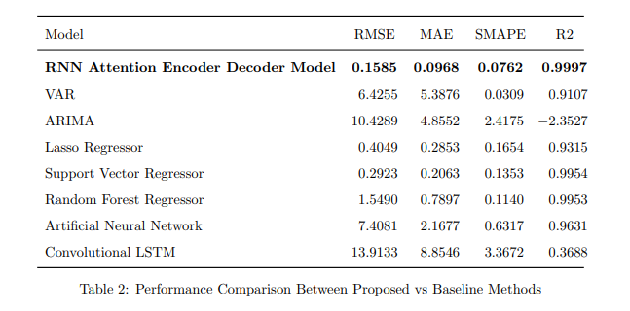
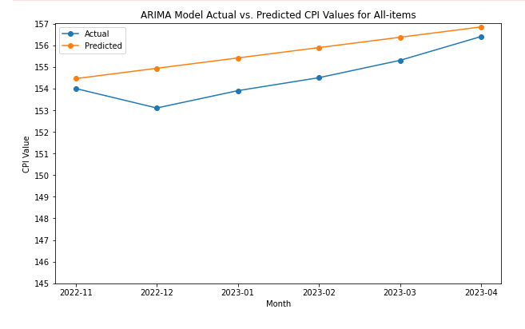
By leveraging advanced techniques, this study contributes to addressing the challenge of accurate CPI prediction, aiding various sectors.
A Deep Learning Approach to Forecast the Canadian Consumer Price Index (CPI) Using Encoder-Decoder Attention Mechanisms with Teacher Forcing Techniques
Author: Maame Cobbinah Supervisor: Dr. Aliaa Alnaggar
Abstract
Methodology
General Findings
This project proposes a novel deep learning approach that utilizes a RNN encoder-decoder Attention model with Teacher-Force technique to forecast the Canadian Consumer Price Index (CPI). Although this method is quite complex in its implementation, it performs well with macroeconomic data, such as the CPI, due to its ability to model long-term dependencies in inflationary variables and reduce forecasting errors. The experimental part of this paper focuses on evaluating the performance of the proposed method, along with traditional methods, supervised learning techniques, and other deep learning approaches. The results show that the RNN Encoder-Decoder Attention Model with Teacher Force Technique outperforms existing methodologies in the literature, generating lower errors and improving R-squared values across all CPI indicators.
The RNN Encoder-Decoder model with Attention Mechanisms employs a two-step process. The encoder processes historical data to capture temporal pattern by encoding input sequence to fixed length vectors, which is then decoded by the model with attention to generate output sequence and predict future datapoints. Teacher forcing techniques guide training by using actual data to improve the model's sequential forecasting capabilities.
The proposed model generates more robust predictions compared to baselines in the current literature.
The model can be quite complex and backward engineering can be quite tricky.
The model forecast suggest that CPI is indicated to go up for all categories except clothing in particular, food, gasoline and energy are more likely to see significant increases warranting the need for appropriate fiscal policies
Data & Description
Conclusion
The dataset used for this research provides monthly Consumer Price Index (CPI) values for different categories of goods and services. The dataset contains not seasonally adjusted CPI values for all-items, as well as categories such as food, shelter, clothing, transportation, and healthcare
Deep learning forecasting for macro economic forecasting in particular CPI is quite new in the sphere of machine learning. This project has shown the capability of the RNN Encoder Decoder Attention mechanism in generating much more accurate forecast for CPI data. The model was able to bridge the gap between capturing long-term dependencies in CPI data and effectively handling the non-linearity commonly present in such datasets. Additionally, the application of the Teacher Forcing technique served enabled the model to stabilize and accelerate the model training process while mitigating issues related to error propagation. This project is important because it opens avenues for future research on economic forecasting, including exploring other transformer methods, attention mechanisms, and hyperparameter tuning techniques that can improve the forecasting capabilities of macro economic data.
Results
Proposed Model achieved the lowest RMSE, MAE, and SMAPE values, indicating smaller prediction errors and more balanced performance.. In contrast, the other models showed higher errors and lower R2 scores, indicating weaker predictive capabilities.

