Slide 1
TME ATLAS
An evidence coverage map of the tumor microenvironment,
with Indian cohort representation tracked explicitly
Scoping phase review · September 2026
Prepared for Prof. Amit Das · Biotechnology & Biochemical Engineering, IIT Delhi
8 factors × 5 tumor types
78% of cells have no data

Slide 2
BACKGROUND
Everything in a tumor that is not a cancer cell
Two categories, measured by completely different instruments — and they are not independent.
STRUCTURAL
CHEMICAL / SOLUBLE
The physical scaffold
The fluid filling it
Collagens · fibronectin · laminins · proteoglycans
MMPs, LOX and other remodelling enzymes
Bulk stiffness · fibre alignment · pore size
Extracellular pH · oxygen tension
Lactate, glucose and other metabolites
TGF-β, VEGF, IL-6 · hormones · fluid pressure
Measured by AFM · rheometry · picrosirius · mass spec
Measured by microelectrode · CEST-MRI · IHC · ELISA
The two are coupled: the matrix sequesters growth factors and releases them on degradation, while acidity activates the enzymes that degrade it.

Slide 3
FRAMING
This phase was scoping, not analysis
Three findings came out of it that I want to check with you before building further.
01
The reference papers do not contain composition data
Four papers, not five — one link was duplicated. Concepts and taxonomy, no per-tumor-type numbers.
02
Indian TME data is strongly asymmetric
Hypoxia in oral cancer is covered. ECM characterisation is close to absent.
03
Coverage can be audited — and auditing changes the answer
Six cells failed the source check. Empty cells went from 62% to 78%.

Slide 4
FINDING 01
The starting papers are concepts, not numbers
The five supplied links resolve to four papers. One was duplicated.
Dzobo & Dandara 2023
Kamal et al. 2026
Byrne et al. 2021
iScience, unidentified
Broad ECM review
ECM–epigenetics crosstalk
The only bench study
PII does not resolve
NO DATA
NO DATA
HAS DATA
UNKNOWN
The one substantive result worth stating aloud
Collagen I was higher in ER+/PGR+ breast tumors than in triple-negative — the opposite of the naive expectation. Matrix composition changed drug sensitivity without changing proliferation.
Per-tumor-type numbers have to come from TCGA, CPTAC, MatrisomeDB and primary measurement papers. Confirm that is the intended direction.

Slide 5
FINDING 02
Indian TME data is strongly asymmetric
Systematic search across tumor types and factor categories, September 2026.
Hypoxia / HIF-1α
PRESENT
Several OSCC IHC studies, incl. Northeast India; HIF1 in gallbladder proteomics
ECM / matrisome
NEAR-ABSENT
Essentially one gallbladder proteomics study (ICMR-NIP Delhi)
pH · lactate · stiffness · IFP
NONE FOUND
No Indian measurement study identified for any of the four
“Indian data” is not one category.
The Northeast India OSCC study notes that population is genetically closer to East Asian groups than to other Indian regions. Regional structure within India may matter.

Slide 6
FINDING 03
The grid got emptier under scrutiny
Every non-empty cell was checked against the source list of its own factor entry.
62%
78%
→
THE RULE
A cell may only be coded above “none” if a source has been read and recorded in that factor entry.
before audit
of cells have no data
Not deletions. Each cell is restored the moment a source is read and added. The audit trail is in the repository, cell by cell, with reasons.
Six cells were coded as having evidence with no source recorded in the entry. They were reset to none. One cell had an Indian source recorded but was not flagged; corrected.
A number that went up under scrutiny is worth more than one that was never scrutinised.

Slide 7
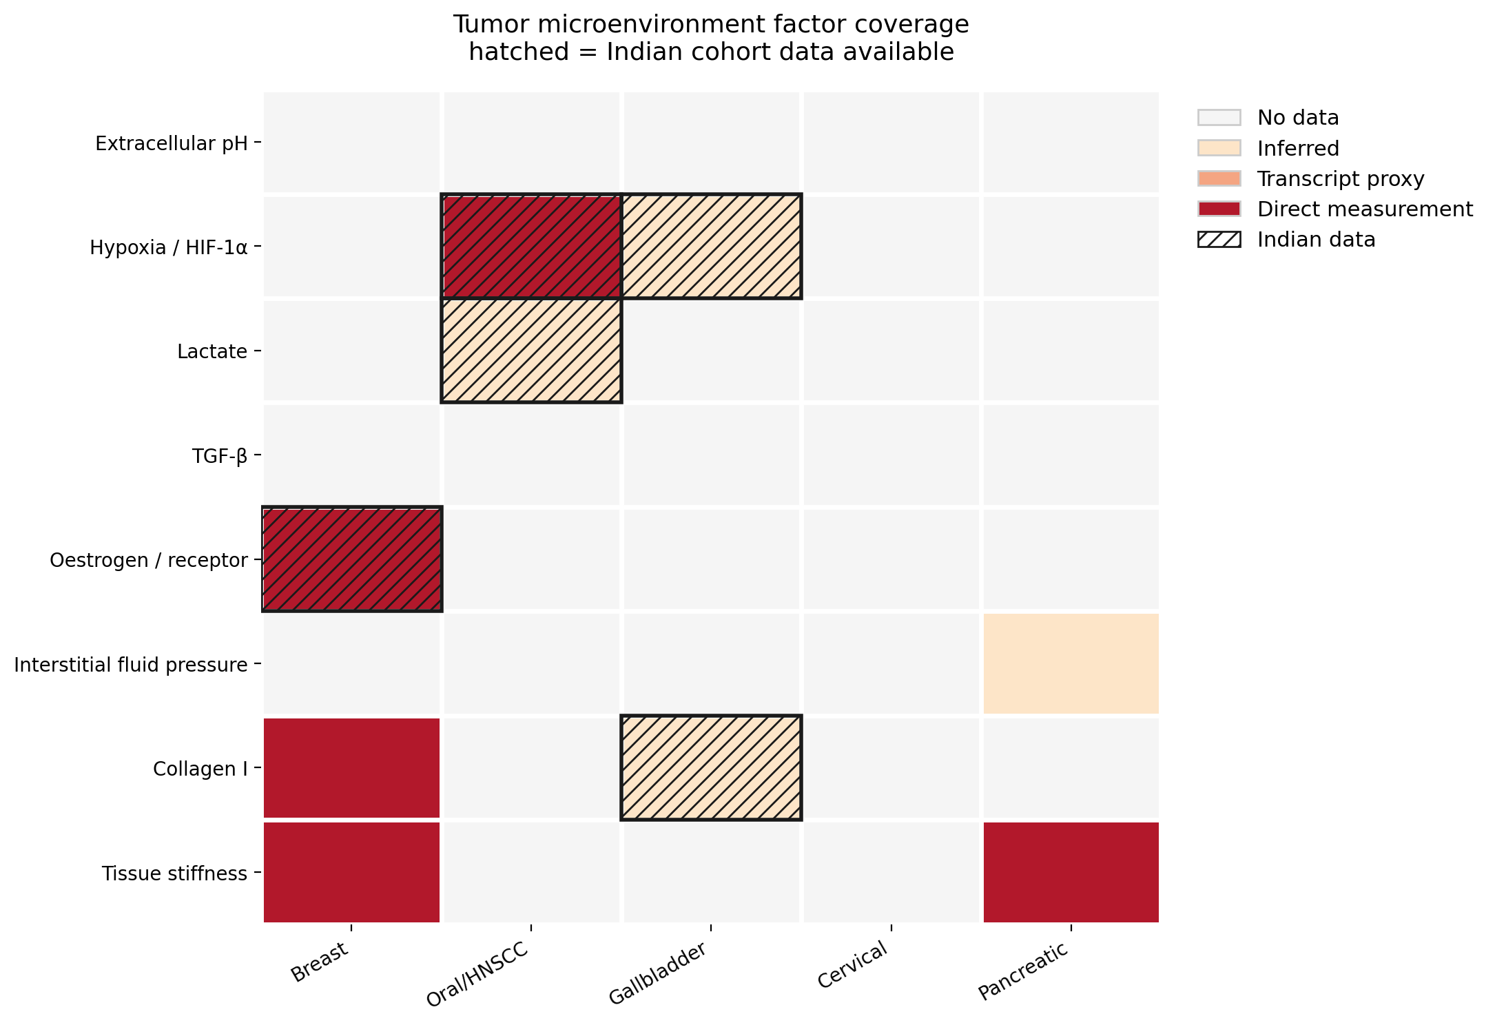
THE MAP
No published map of this kind exists
No TME evidence coverage map is published, and none tracking Indian representation.
78%
of cells empty
12%
have Indian data
0
cells for cervical
The missing data is itself the result.

Slide 8
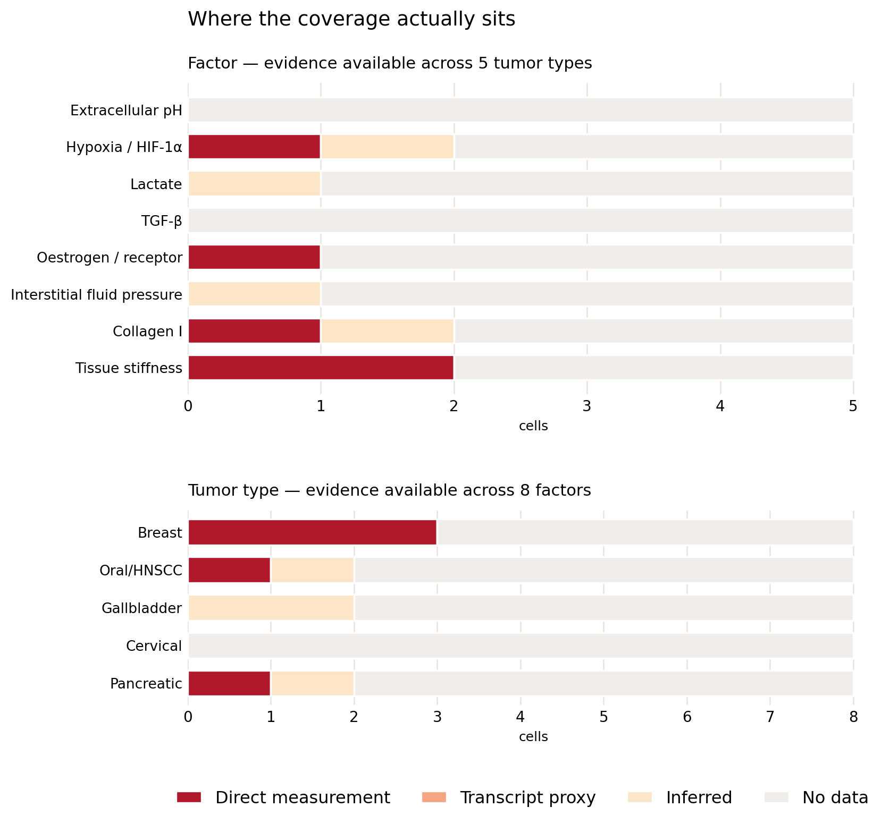
DERIVED ANALYSIS
Two factors are at zero everywhere
Same grid, broken down by factor and by tumor type.
Extracellular pH and TGF-β
No sourced evidence in any tumor type. Both have large literatures — the gap is reading, not biology.
No transcript-level evidence survives
Every remaining cell is direct or inferred. The tier cheapest to fill from public data is the emptiest.
Coverage index: 16%
Scoring cells 0–3 by evidence strength, the grid holds one sixth of what full characterisation would give.

Slide 9
THE LARGEST MISMATCH
Highest burden, zero coverage
Cervical cancer is the second most common cancer among Indian women — and has no characterised factor in this atlas.
127,526
79,906
17.7
0 of 8
new cases in India, 2022
deaths
per 100,000, age-standardised
factors characterised here
Singh, Grover & Dhanasekaran 2025, Global Epidemiology 10:100233, PMID 41399754 · GLOBOCAN 2022 derived
And it is the cheapest column to fill
Two Indian cervical datasets are already inventoried — stage-wise expression profiling with documented purity screening (PMC3892388) and whole-exome sequencing from ACTREC/Tata Memorial (PMC5102491). The transcript-level cells in this column are fillable from existing data, without new experiments.

Slide 10
NEXT STEPS
Two experiments a lab could run now
Both surfaced by the coverage gap, and both within reach of a biochemical engineering lab.
01
02
Measure stiffness on Indian tumor tissue
Test the Byrne finding in an Indian cohort
No AFM, rheometry or elastography characterisation of Indian tumor tissue exists — anywhere, for any cancer type. This is not a gap in the atlas; it is a gap in the literature.
Byrne et al. found collagen I higher in ER+/PGR+ than triple-negative breast tumors. ICGA holds an ER+/PR+ Indian cohort with proteomics.
Standard biomaterials-lab equipment. Genuinely novel data rather than a literature fill.
Indian breast cancer presents at younger age — a different hormonal microenvironment. Whether the finding replicates is a well-posed question.
Scope proposal: 15 factors across 8 tumor types, written to full schema depth — rather than everything shallowly.

Slide 11
WHAT I NEED FROM YOU
Questions
BLOCKING
What is the title of the iScience paper? The PII does not resolve through search or Crossref.
Who is the downstream user — your lab’s modelling and experimental work, or a standalone resource?
Which tumor types should I prioritise?
SCOPING
Izzi et al. 2019 did pan-cancer matrisome across 32 TCGA tumor types. What is our contribution beyond it?
Given Indian ECM data is nearly absent, should Indian cohorts be validation and gap analysis rather than a data source?
Is this the right depth per entry?
Logistics: institutional access for ICGA data requests and paywalled journals. Requests take weeks.
github.com/maan-iitd2/tme-atlas

