Slide 1
CourseConnector
By: Hemil Patel, Mann Patel, Harsh Vasoya, Darsh Parikh, Dvij Parikh

Slide 2
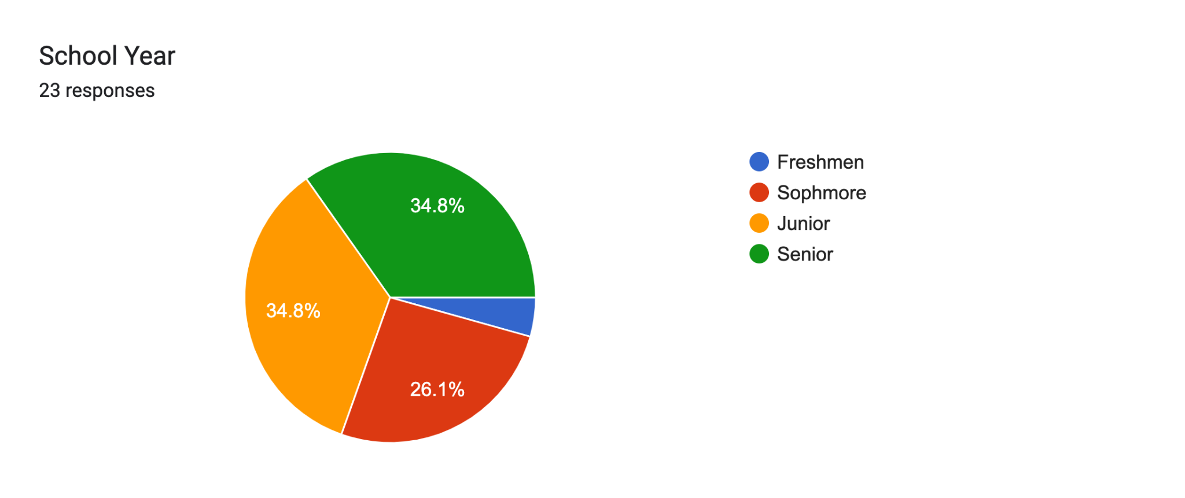
Data Collection from the Survey(Based on School year)

Slide 3
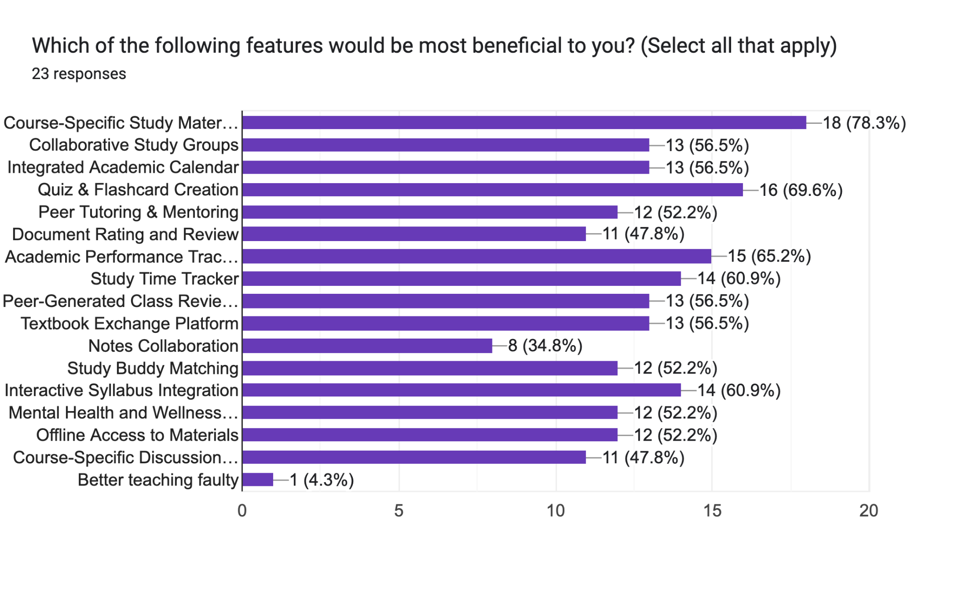
Features

Slide 4
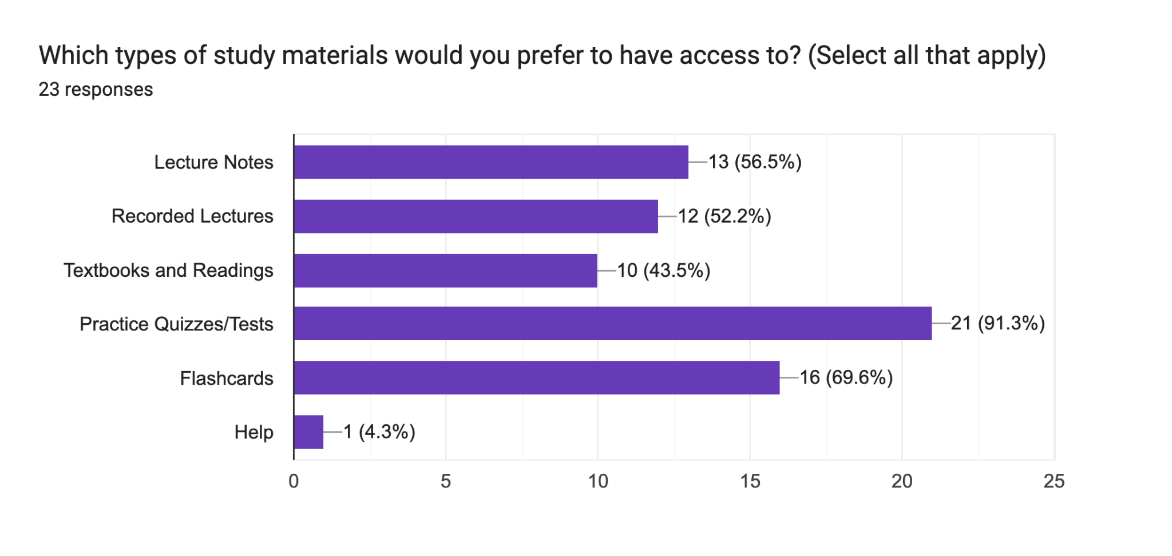
Study Material

Slide 5
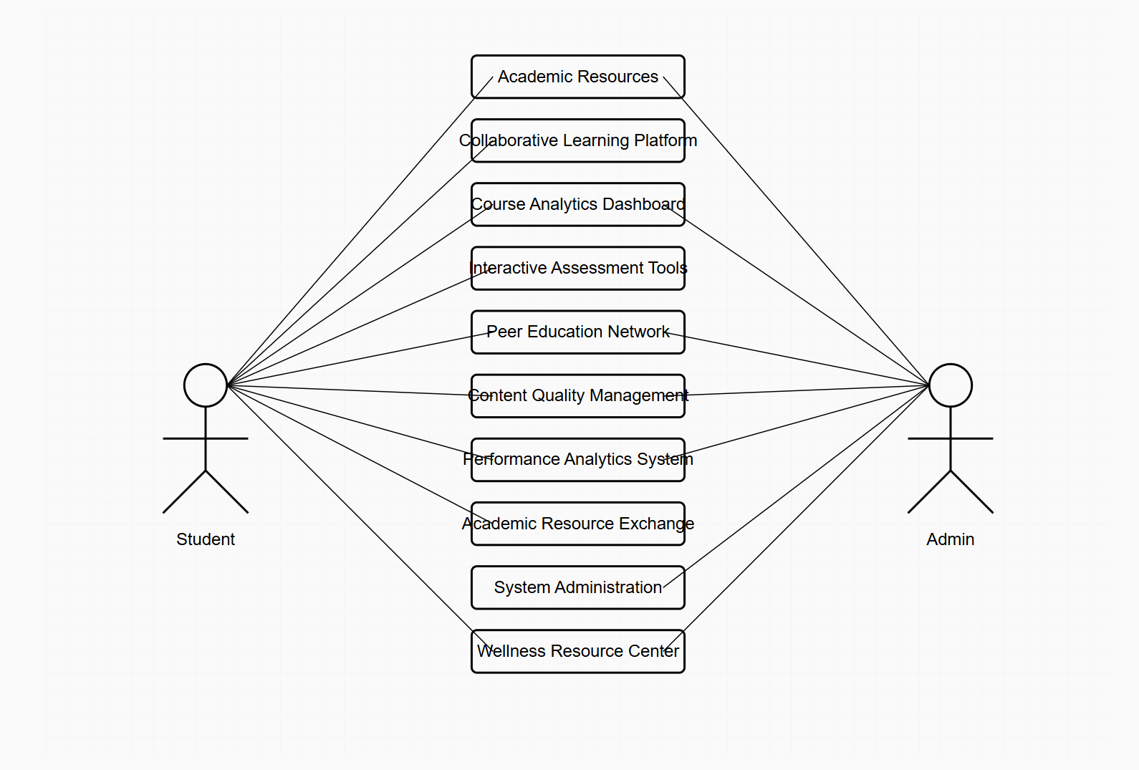
Usecase Diagram
Use Case Diagram

Slide 6
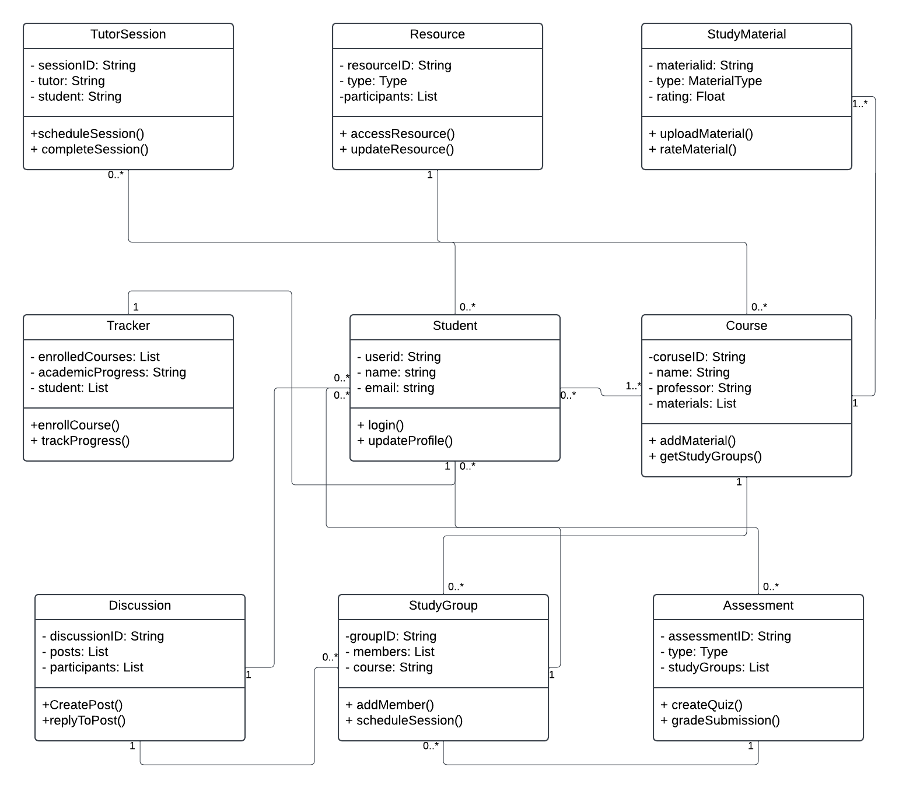

Slide 7
Future Plans
Data Flow diagram
Sequence Diagram

