Slide 1
Status Update
Lambda Server and Lambda Assistant both have Julia
Workspaces for
  GATs – Theory, Type, Term, Axiom, Alias, …
  CatML – Theory, Syntax, Program, Diagram, Instance, …
  Theories
    Category
      Derived: Monoidal, Symmetric Monoidal, Monoidal with Diagonals, Cartesian, Monoidal with Bidiagonals, Biproduct, Closed Monoidal, Markov, Cartesian Closed, Compact Closed, Dagger, Dagger Symmetric Monoidal, Dagger Compact, Traced Monoidal, Schema, Hypergraph
      Instances: Matrix Category, Graph Schema, Property Graph Schema
    Monoid
Intro to Category Theory (informal)
Marketecture
CatML Assistant
  Cloned from GOAP
  Logical flows/maps
  JavaScript to convert Catlab.jl theory into GAT Theory

Slide 2
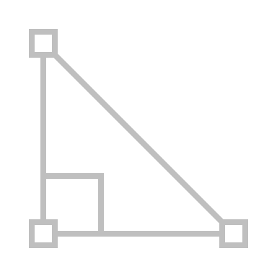





Maana Q
Model-Specific Tools for SMEs
Design
Experiment
Analyze
Validate
Compare
Optimize
Diagrams
Theory
Formulas
Programs
Execution

Slide 3
Maana Q
Operational Domain Models
Algebraic Computing
MBSE
CatML
GATs
Syntaxes
Implementation
Lambdas
Notations
Diagrams
EDSLs
Notebooks
Function Graphs
Services
Theories
Meta
Models
Models

Slide 4
Concept Hierarchy
Theory
  Types, Terms, Axioms, Aliases
  Theories can include other theories
    Simply adds to Types, Terms, …
    Can’t contradict
  Generates a free workspace
  e.g., Monoid, Category, Schema (incl. Category theory)
Metamodels
  Instances of Theory (i.e., Types, Terms, …)
  Models can include other models
  e.g., Category -> Matrix, Schema -> Graph, Graph -> Property Graph (incl. Graph metamodel)
  Generates a free workspace
    includes Theory workspace
Models
  Instances of a Metamodel
  e.g., a matrix, a graph, a property graph
Theory
Workspace
Implementation
include
clone
instance of
Metamodel
Workspace
Implementation
include
instance of
Model

Slide 5
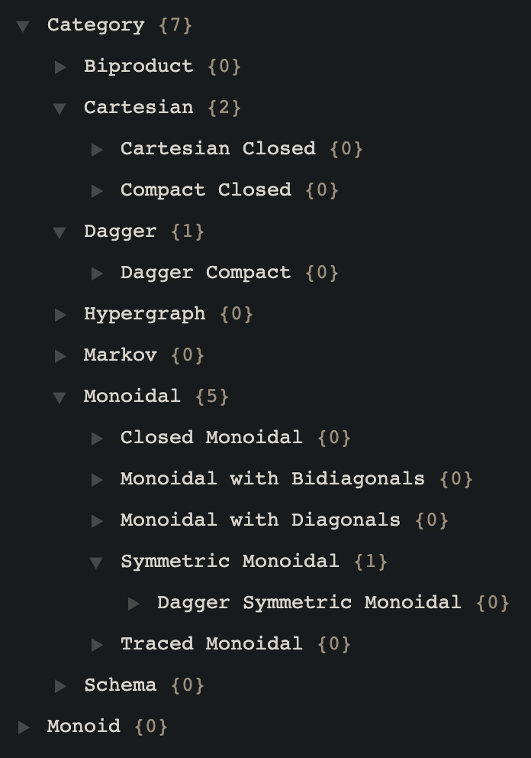
CatML Assistant: UX/UI
Theories
  Browse, Filter, Search
  Add, Edit, Delete
  Extend
Syntax
  Add, Edit, Delete
Meta Models
  Add, Edit, Delete
  Extend
Models
  Add, Edit, Delete
  Clone
Theory
Syntax
Meta Models
Models

Slide 6
Working Functorially
Model in one context Src
Model in another context Tgt to map from Src
Define the two maps:
  Ob(Src) ↦ Ob(Tgt)
  Hom(Src) ↦ Hom(Tgt)

Slide 7
Functors in Q
A functor is completely determined by its action on the generators
There are several ways to specify this mapping:
  Specify a Q Kind for each Ob
  Explicitly map each generator term to a Kind instance value
  For each GAT type (e.g., object and morphism), specify a function mapping generator terms of that to an instance value, using the `terms` dictionary

Slide 8
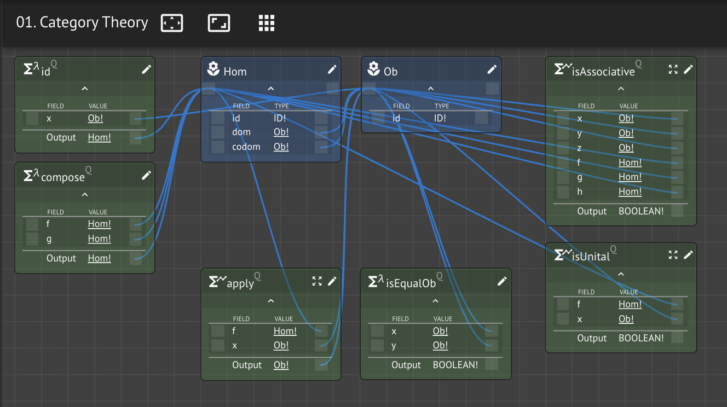
Flow
@theory Category {
types: {Ob, Hom},
terms: {id, compose},
axioms: {assoc, unital},
aliases: {→, •}
} = Service { Kind, Function }
addTheory(Category)
CategoryWS = createWorkspace(Category)

Slide 9
GAT→QSvc
@theory Category {
types: {Ob, Hom},
terms: {id, compose},
axioms: {assoc, unital},
aliases: {→, •}
}
@service Category {
kinds: {Ob, Hom},
fns: {id, compose,
assoc, unital,
→, •}
}

Slide 10
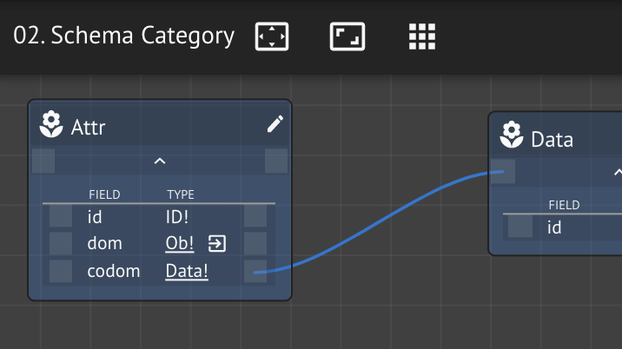
Flow
@theory Schema <: Category {
types: {Data, Attr},
terms: {scompose},
axioms: {sassoc, sunital},
}
addTheory(Schema, Category)
SchemaWS = cloneWorkspace(Category)
addKindsAndFns(SchemaWS, Schema)
addKG(SchemaWS, Schema)

Slide 11
GAT→QSvc
@service Schema {
kinds: {…Category.kinds,
Data, Attr},
fns: {…Category.fns,
id, compose,
assoc, unital,
→, •}
}
@theory Schema <: Category {
types: {Data, Attr},
terms: {scompose},
axioms: {sassoc, sunital},
}
@functor GATToQSvc {
Ob: {{types, kinds}}
Hom: {{terms, fns},
{axioms, fns},
{aliases, fns}}
}

Slide 12
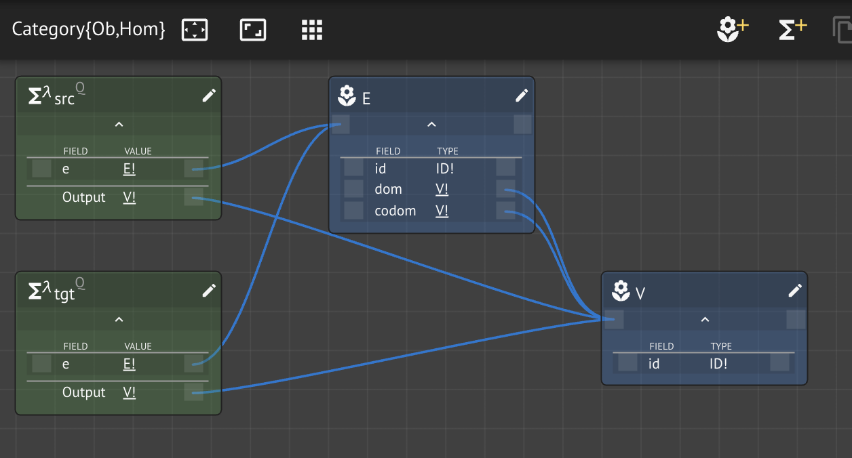
Flow
@present GraphSchema(Schema) {
V::Ob
E::Ob
src::Hom(E,V)
tgt::Hom(E,V)
}
addSchema(GraphSchema)
GraphSchemaWS = cloneWorkspace(Schema)
addKindsAndFns(GraphSchemaWS, GraphSchema)
addKG(GraphSchemaWS, GraphSchema)

Slide 13
GAT→QSvc
@service Schema {
kinds: {…Category.kinds,
Data, Attr},
fns: {…Category.fns,
id, compose,
assoc, unital,
→, •}
}
@theory Schema <: Category {
types: {Data, Attr},
terms: {scompose},
axioms: {sassoc, sunital},
}
@functor GATToQSvc {
Ob: {{types, kinds}}
Hom: {{terms, fns},
{axioms, fns},
{aliases, fns}}
}

Slide 14
Flow
@present PropertyGraph <: GraphSchema {
Props::Data
vprops::Attr(V,Props)
eprops::Attr(E,Props)
}
addSchema(PropertyGraph)
PropertyGraphWS = cloneWorkspace(GraphSchema)
addKindsAndFns(PropertyGraphWS, PropertÿGraph)
addKG(PropertyGraphSchemaWS, PropertÿGraph)

Slide 15
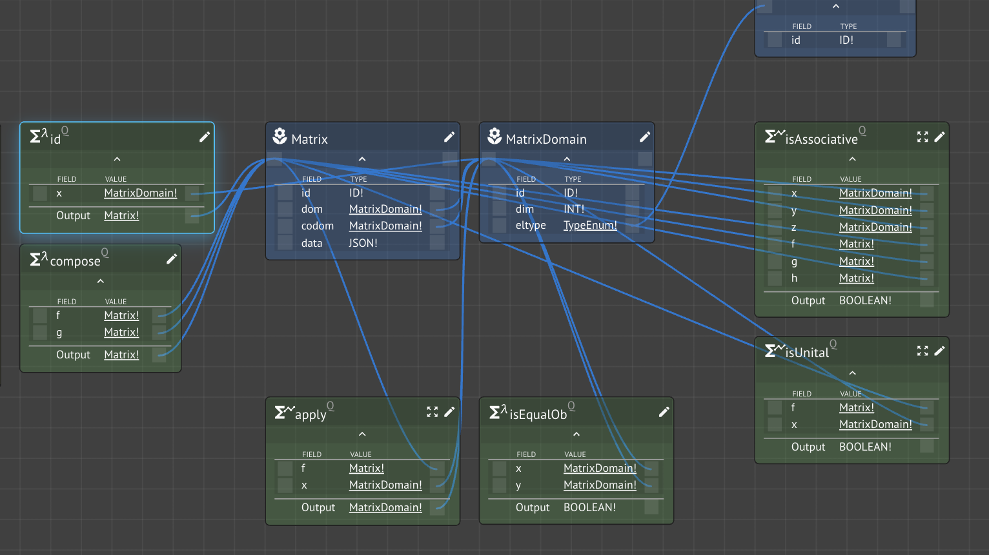
Flow
@instance Matrix <: Category {
MatrixDomain::Ob
Matrix::Hom
id::Matrix
compose::Matrix
}
addCategory(Matrix)
MatrixWS = cloneWorkspace(Category)
renameKinds(MatrixWS, Matrix)

Slide 16
Flow
@program TestMatrix <: Matrix {
m::Matrix = [[0,1][-1,0]]
@test size(m, 1) == 2
@test eltype(m) == num
@test dom(m) == MatDom(num,2)
}

Slide 17
Flow
@present TrigFunctions <: FreeCartesianCategory {
R::Ob
sin::Hom(R,R)
cos::Hom(R,R)
(+)::Hom(otimes(R,R),R)
(*)::Hom(otimes(R,R),R)
}

Slide 18
Wiring Diagram to Function Graph
All wiring diagrams are an instance of a SymmetricMonoidalCategory
WiringDiagram = FunctionGraph
  Box = Function
  Wire = Input/Output link
compose

Slide 19
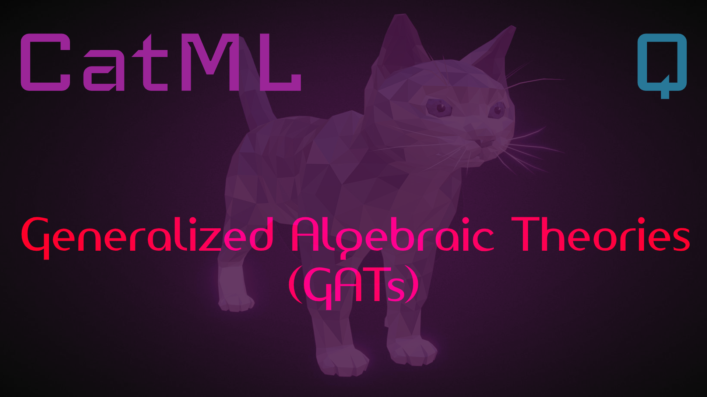
informal

Slide 20
Monoid
Monoid A
  A = (A, *, e)
  set A
  multiplication operation *
  unit e
Category A with one object •
  A = A(•, •)
  The homs A are from • to •
  unit e is identity
  composition is multiplication *

Slide 21
Functor T: A → Set
The one object • of A will be some set:
s := T(•)∈ Set

Slide 22
∀a∈ A, T(a):T(•) → T(•)
Each a of A is a morphism:
a := • → •

Slide 23
∀a∈ A, T(a):T(•) → T(•)
And because each T(•)∈ Set:
T(•) → T(•) = Set → Set

Slide 24
This functor is like choice
It can only pick one object and one arrow.

Slide 25
This functor is like pair
It can only pick two objects and two arrows.

Slide 26
Sameness is isomorphism
id
1
2
Pair
1
2
Bool and Pair aren’t the same, but they share an essential meaning and are interchangeable.
F
G
T
F
Bool
T
F
id

Slide 27
Match the pattern
id_{A}
Disc(1)
F
f
id_{A}
id_{B}
Arrow

Slide 28
Match the pattern
id_{A}
id_{B}
Disc(2)
G
f
id_{A}
id_{B}
Arrow

Slide 29
Match the pattern
1
2
Pair
F
T
F
Bool

